Slide 1
The Circumference Champion!
by Shamak K

Slide 2
Question
Does a big wheel complete a certain distance faster than a smaller wheel?

Slide 3
Hypothesis
The big wheel will complete the certain distance faster than the small wheel, due to the larger circumference and the distance completed in one rotation.

Slide 4
Background Research
I was finding a way to prove my project, because I needed a car and track to test on, when I realized that I could build a LEGO car with a motor and battery pack and test the experiment on a 1-metre black thermocol road. I went online and searched for LEGO Technic parts and went to Dollarama to get the thermocol board. I went to work and finished making a prototype car for the experiment and a bendable board for less space. I completed the experiment and wrote the results down.

Slide 5
Variables
Independent Variable: Different wheels (2 sizes)
Dependent Variable: Time to cross the track with both wheels
Controlled Variables: Length of track (1 metre) and Rotations per Minute (RPM)
Formula used to find the time taken to cover a specified distance:
Time taken = (Distance/Wheel Circumference)/Rotations per minute

Slide 6
Materials
1 remote-controlled LEGO Technic car
2 sets of LEGO wheels (small=9.5 cm, big=13.5 cm (diameter))
A stopwatch
1 metre length track made of thermocol
Equipment | Details | Comments
Wheel (small) | 9.5 cm (circumference)
Wheel (large) | 13.5 cm (circumference)
Track | 1 metre = 100 cm
Variable speed motor | 160 rpm/200 rpm* | *Rotations per minute

Slide 7
Procedure
Unfold and lay out the ramp
Put the car (in small wheels) in the front of the track
Turn on the motor and let it run until it has reached the end of the track
Measure the time taken
Run once more with a faster speed
Switch wheels
Repeat St. 2-5 again
Record observations on a piece of ‘loose leaf‘ paper

Slide 8
My Observations
My observations that I recorded confirms that my hypothesis was correct, as the bigger wheels had a faster point-to-point time on both speeds (160 and 200 RPM) than the smaller wheel’s.

Slide 9
The below results were recorded with the experiment equipments:
Experiment 1: Motor speed set to 160 rpm
Wheel size (cm) | Time taken (sec)
9.5 | 3.95
13.5 | 2.78
Experiment 2: Motor speed set to 200 rpm
Wheel size (cm) | Time taken (sec)
9.5 | 3.16
13.5 | 2.22

Slide 10
Conclusion
Over all, my hypothesis is correct, as my big wheel(s) covered the 1-metre track in 2.78 and 2.22 seconds, while the smaller wheel(s) completed it in 3.95 and 3.16 seconds.

Slide 11
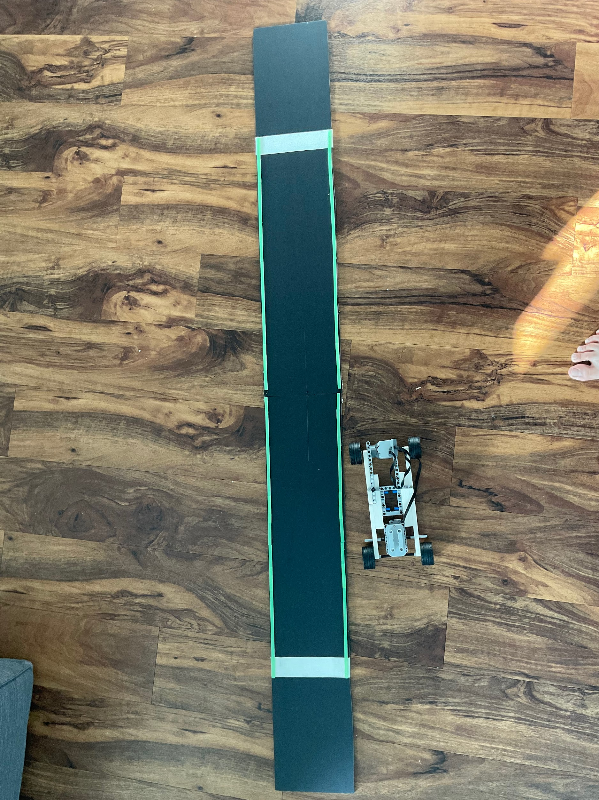
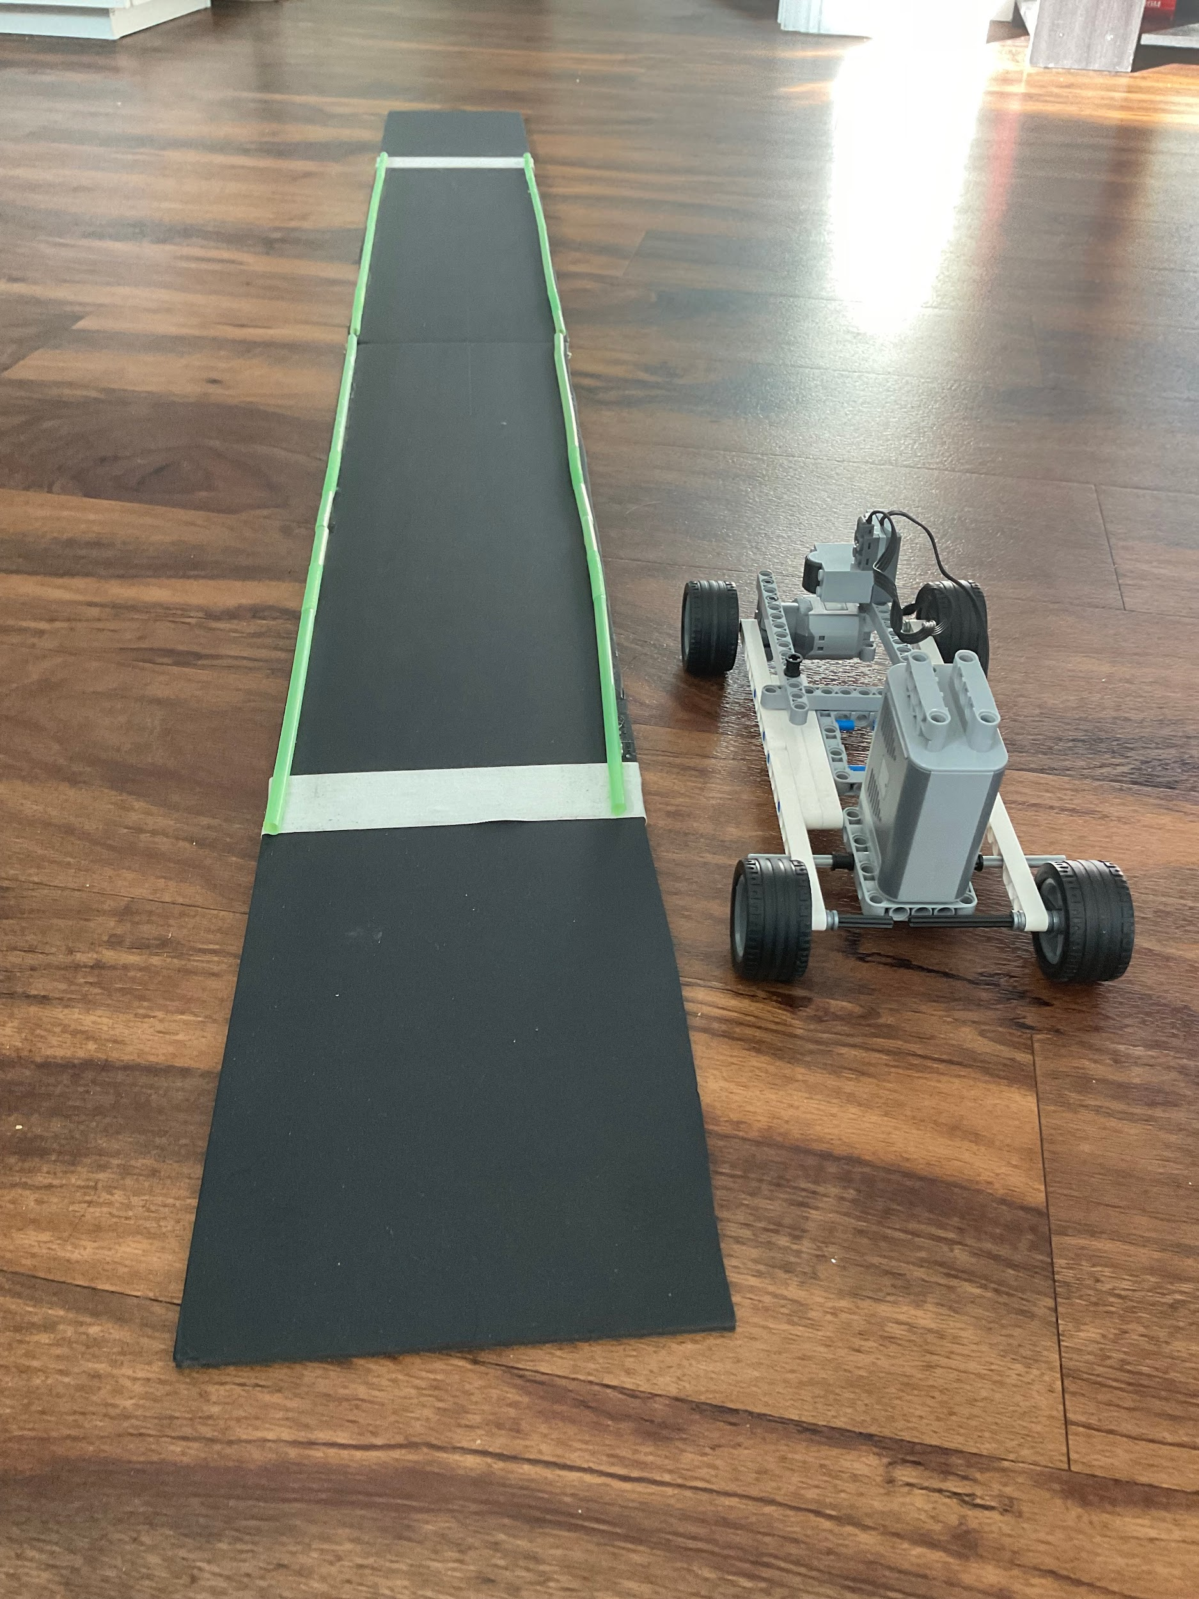
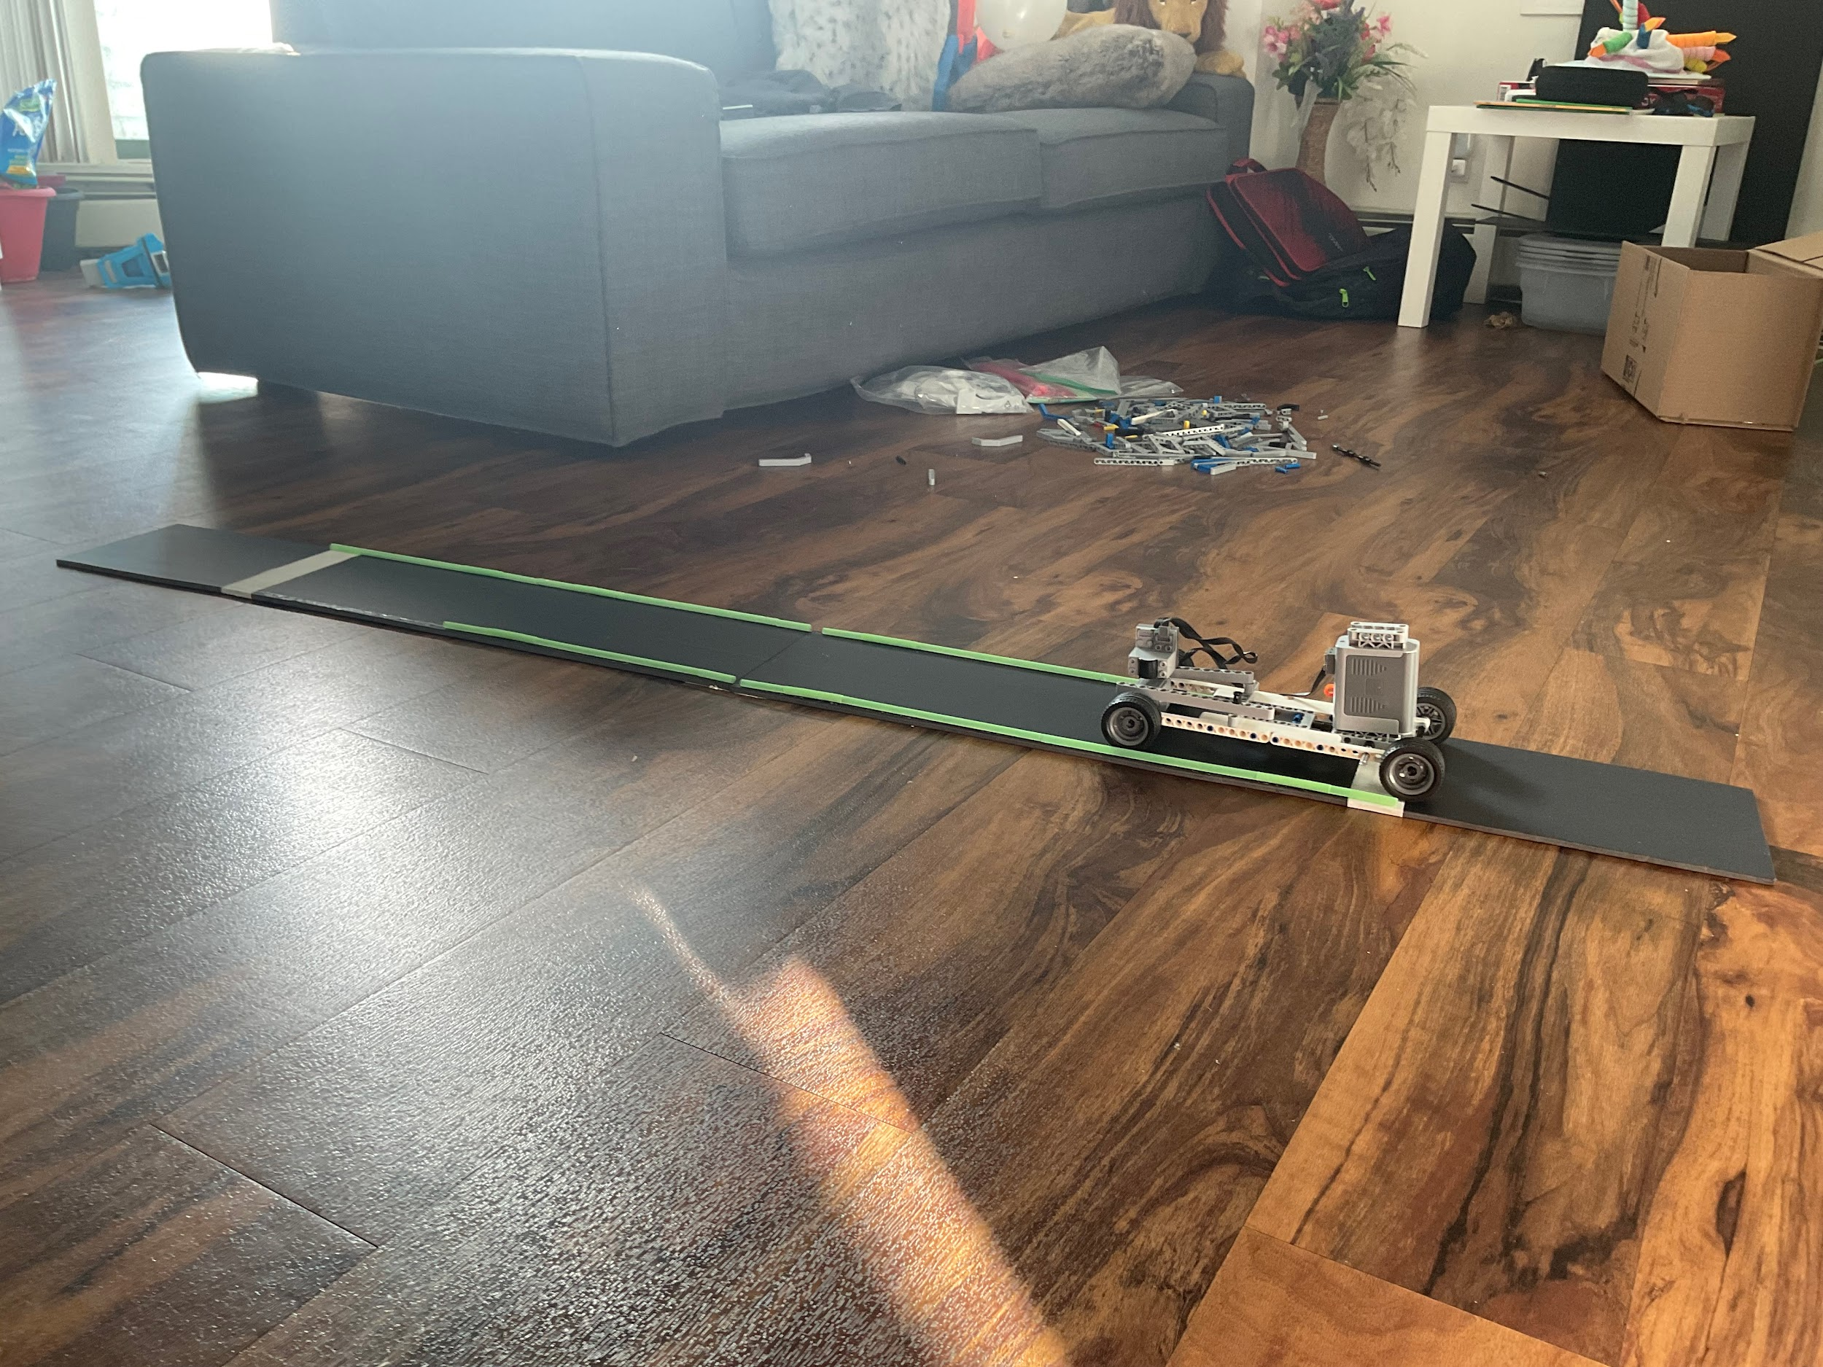
References:
My project guides
The Internet (or the World Wide Web)
THE END
Pictures of car and track

