Slide 1
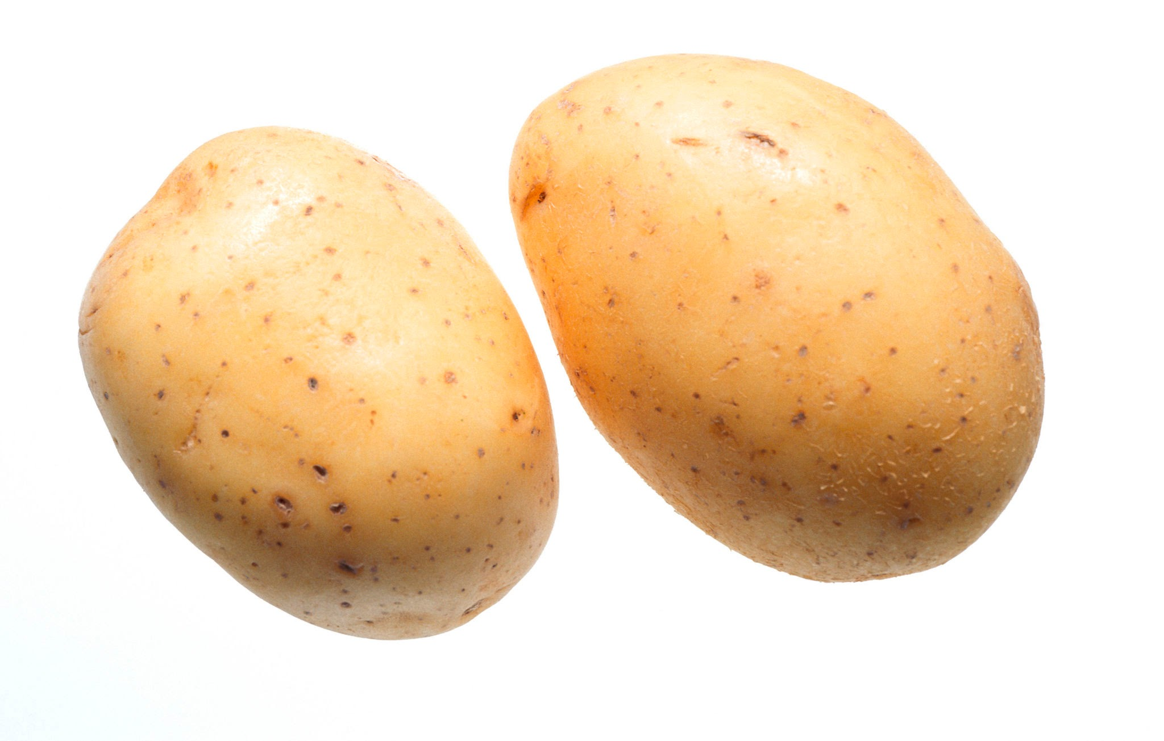
Unusual Electricity
By Blakely And Nina

Slide 2
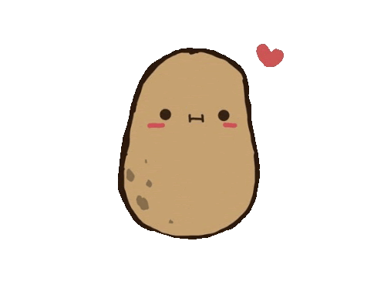
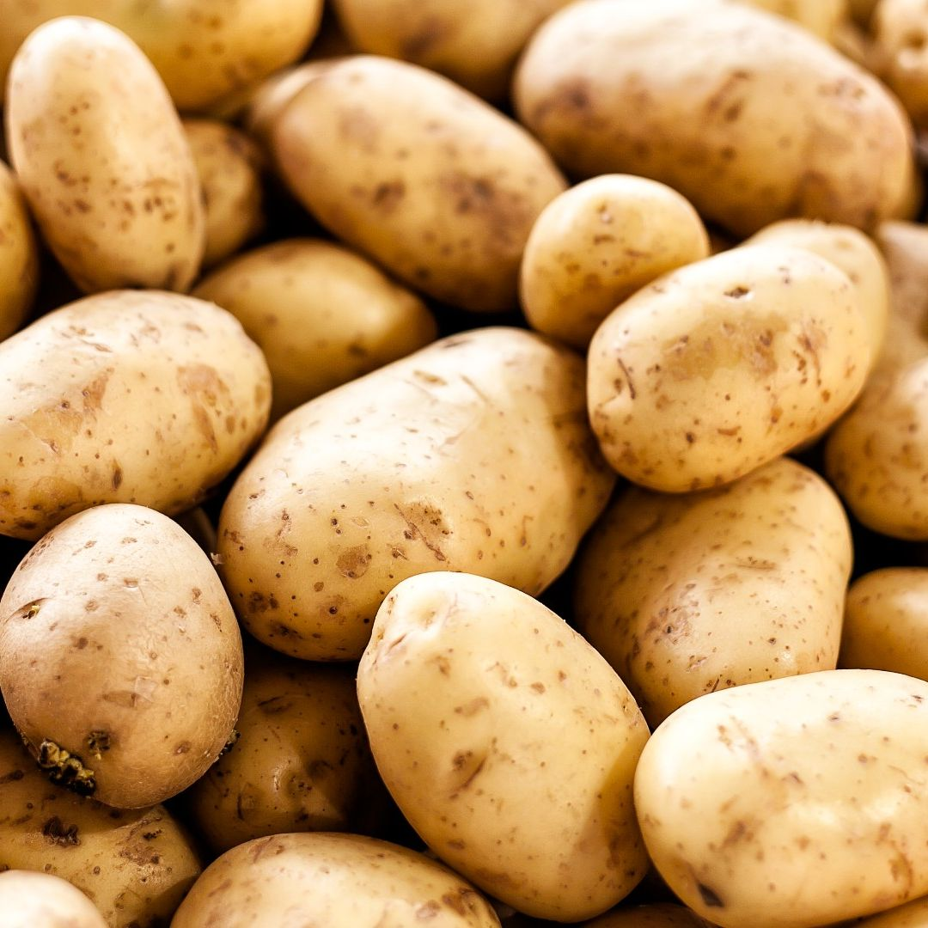
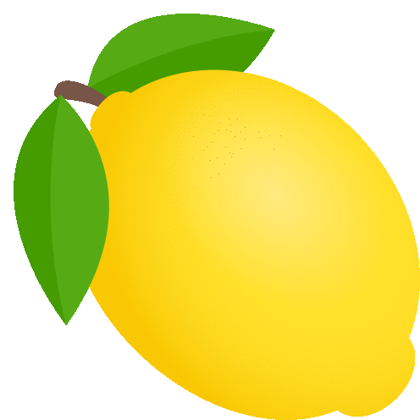
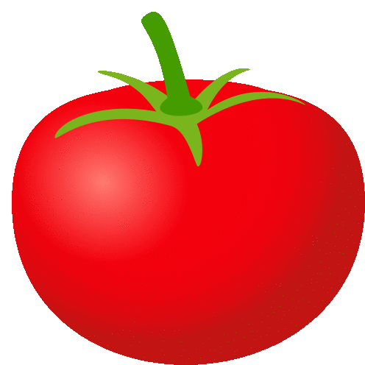
What are we doing
We are measuring the amount of voltage a fruit and or vegetable can conduct. Then we compare every single fruit and vegetable and calculate the average voltage for each fruit.
It will use a simple contraption including a voltage meter penny (copper) nail (zinc) and the fruit or vegetable of choice.

Slide 3
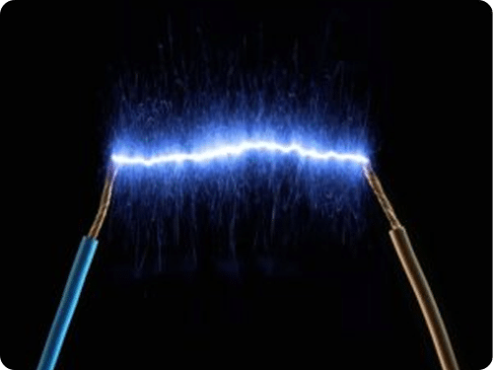
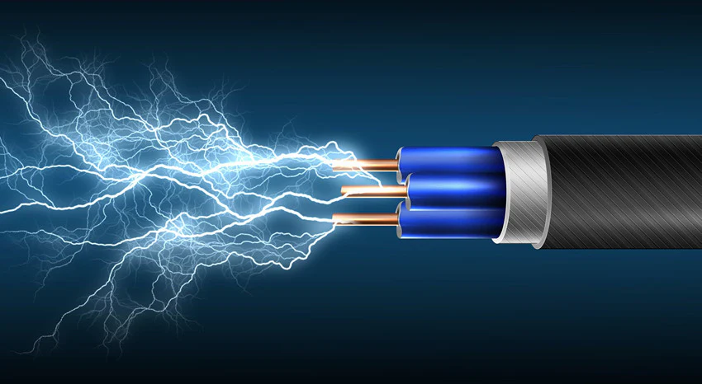
What is current?
Current is the flow electricity through the wires. If the voltage is the water pressure, then current would be the flow of water. It's basically just like if the water from the hose only flowed a little every second, it would have low current.

Slide 4
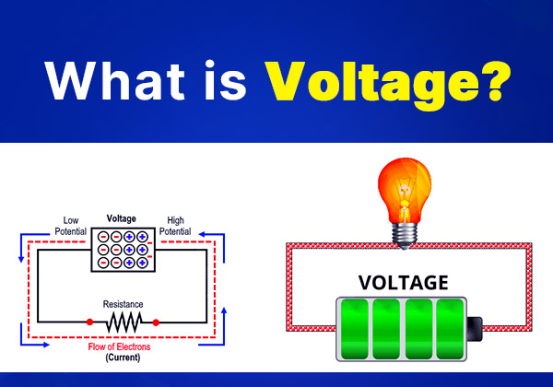
What is voltage?
Voltage is basically the thing that pushes the electricity forward. If a wire is a hose and the electricity is the water, the voltage is what pushes the water out of the hose, so if our hypothesis is correct and the lime produces the most electricity, it has the most voltage pushing the electricity out. There could be a bunch of electricity there, but with no voltage it will not come.

Slide 5
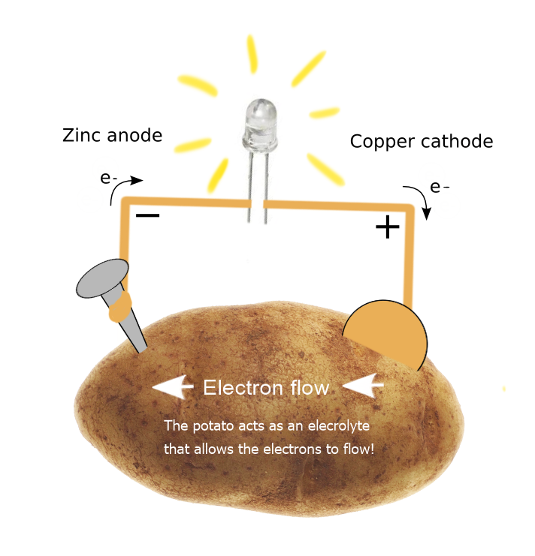
Research
Our hypothesis was based on two main things: citric acid and size. The more citric acid the fruit has, the more voltage is produced. Size is also a big factor, because the bigger fruits are more likely to have more voltage stored in them. This is why it was surprising to have the lemon only produce 1.3 volts, when it has the most citric acid. Also surprising was that the mini potato only had 0.1 volts less than the normal potato, despite the big size difference.

Slide 6
Research continued
The potato itself doesn't actually produce the voltage, it just helps the metal create the voltage because it has chemicals inside it that allow the the electricity to move between the two metals ( galvanized nail, penny). Inside of the potato there is little particles called ions, and ions help move the electricity move between the metals like a bridge. The zinc, ( galvanized nail ) creates electrons, and the copper moves the electrons around, and the moving electrons creates electricity! The potatoes juice or citric acid helps move the electrons around, and the bigger the fruit, the more electrons there is. So if we added more potatoes, there would be more voltage! Basically, all the potatoes are like batteries, and the more batteries we have, the more electricity we have!

Slide 7
Research continued
Think of it like a hill, the zinc is at the top of this hill and the copper (penny) is at the bottom, and the electrons want to go down the hill. Then the voltage would be how steep the hill is. The potato ( or whatever fruit were using ) is like a slide that makes it easier for the electrons to travel down the hill. It would be very hard without the potato. Also, just know that the potato doesn't get used up, because it just helps the electrons.

Slide 8
Hypothesis
For our hypothesis were going to use our knowledge so far to guess 2 things: which fruit will produce the most voltage, and which one will produce the the least. We think the lemon will produce the most electricity, because it has lots of citric acid and maybe it will have a bigger reaction. We think our mini potato will produce the very least voltage out of all of them because it is the smallest and has gone through the least.
We think the mini potato will produce the least
We think the lemon will produce the most

Slide 9
Why do we think they all have different voltage?
We think the fruits would all have a varying amount of voltage produced because they all have different amounts of acidity and physical properties, which can affect how much voltage is produced. The ones with more acidity has more charged particles, so it produces the most voltage. Also, size is a big asset, because it gives the electrons more room to move, affecting the current, not the voltage. We based our hypothesis off of these factors.

Slide 10
What are we changing? ( Manipulated)
Each time we will be changing the fruits and vegetables we use, but when were measuring the same fruit multiple times we are sure to use the same brand, type, and size of that fruit. Other than that , we are using the same copper, zinc, volt meter, and basically everything else is the same each time.

Slide 11
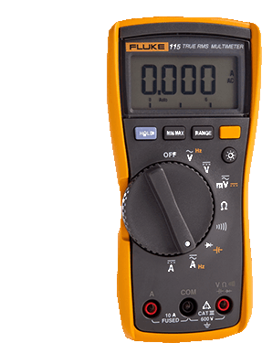
What are we measuring? ( Responding control)
We will be measuring the electricity and voltage that each fruit produces during our tests and experiments, and then will be ranking them from most voltage to least. We are measuring the electricity using a simple gadget called a voltage meter, that will tell us how much electricity each fruit produces.
We are using a simple machine called a volt meter to measure the voltage each fruit produces!

Slide 12
What are we keeping the same? ( Controls)
Same volt meter each time
Same zinc nails
Same pennys
Exact same procedure
Same wire
The only thing we changed was the fruit each time!

Slide 13
Materials
Fruits:
2 tomato
2 Potato
2 Mini potato
2 Lemon
Mechanical:
2 copper coin ( penny)
2 galvanized nail
1 Voltage meter

Slide 14
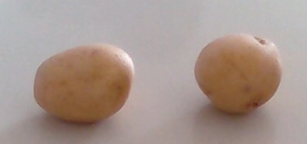
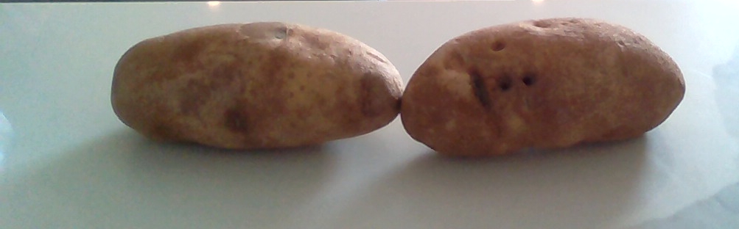
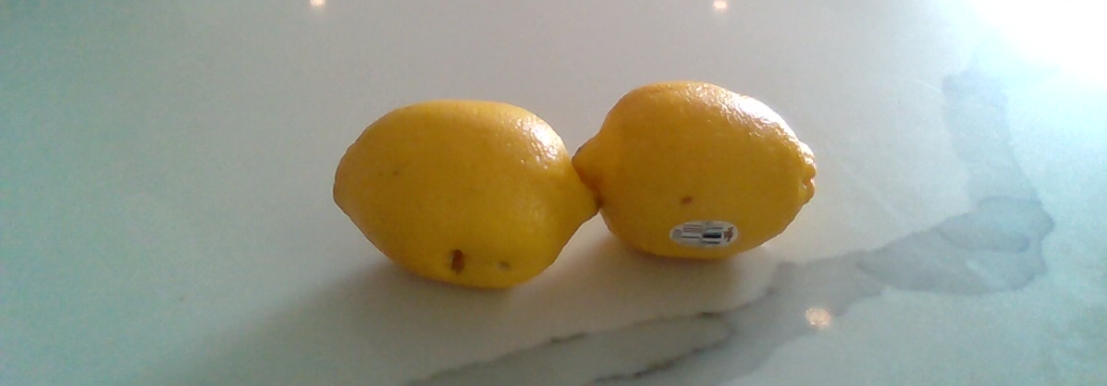
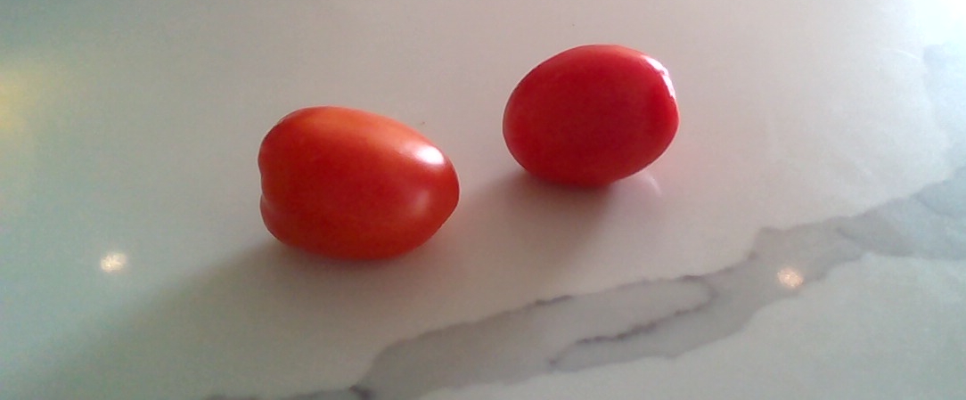
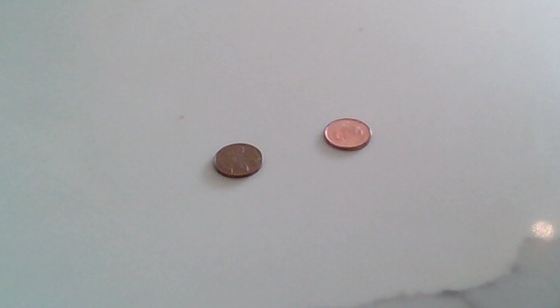
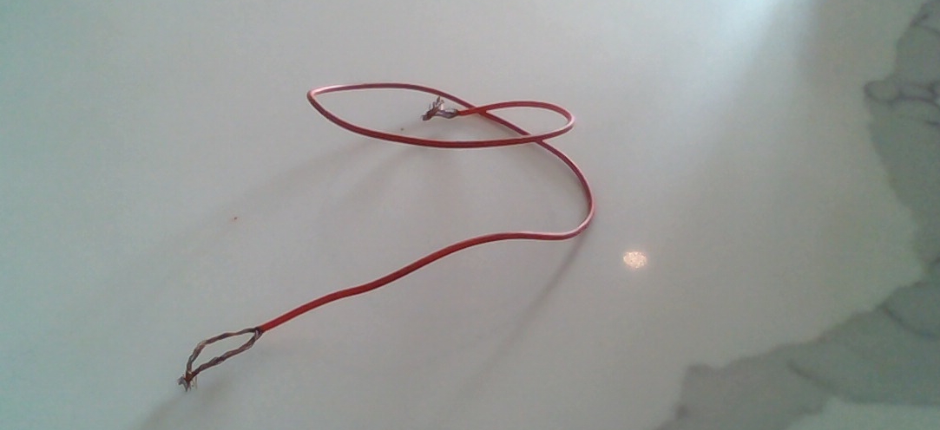
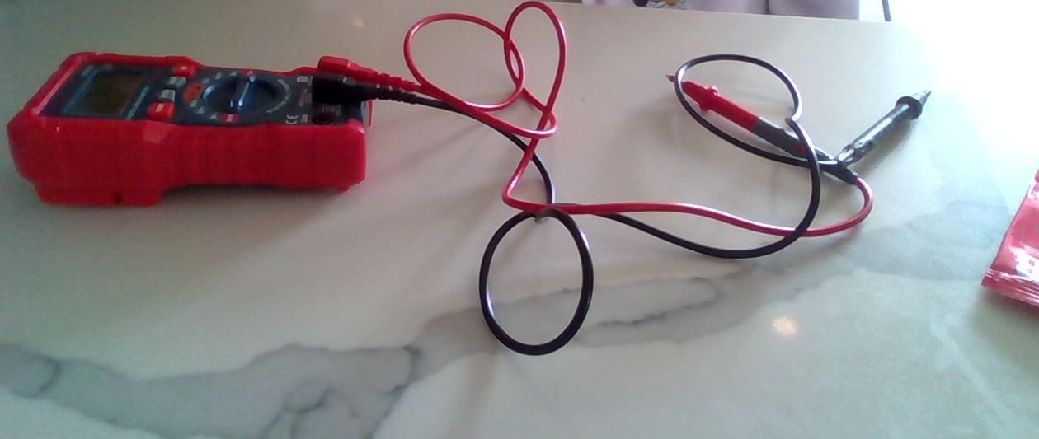
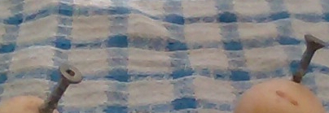
Mini potato
potato
lemon
tomato
wire
penny
Zinc nail
Voltage meter

Slide 15
Procedure
First we set up our experiment by making a hole for the galvanized nail and putting it on both of our fruits. then we put our penny in the fruits. Next we tie our wire around the penny on one of them, and the nail on the other. After that we bring the probes to the nail one of of them and the penny on the other but on the ones that DON'T have to wire, then our voltage meter shows us how much voltage it made!
We make a hole in both of the fruits
We insert our galvanized nails in each of the holes
Now we put our pennies in our fruits ( be careful not to push them in too far! )
next we wrap our wires around the penny on one of the fruits and the nail on the other
We bring the probes to the nail and penny that do not have wire wrapped around them.
Our voltmeter shows us how much voltage the fruit produced!

Slide 16
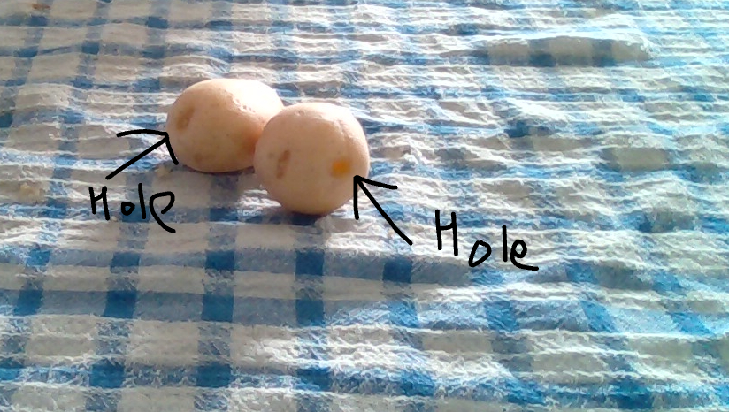
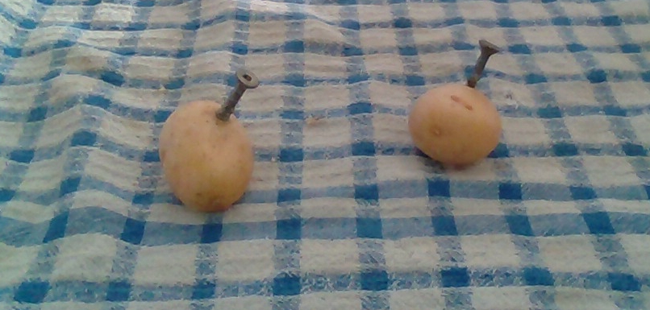
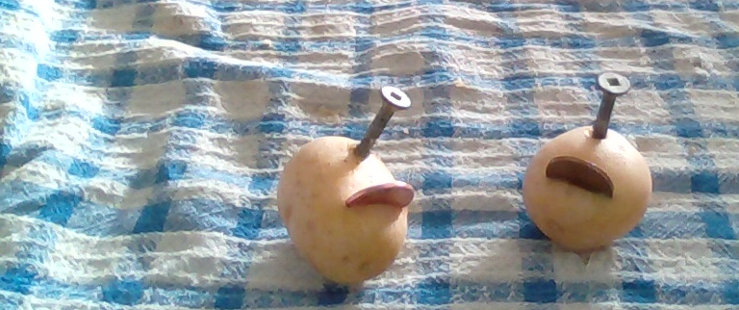
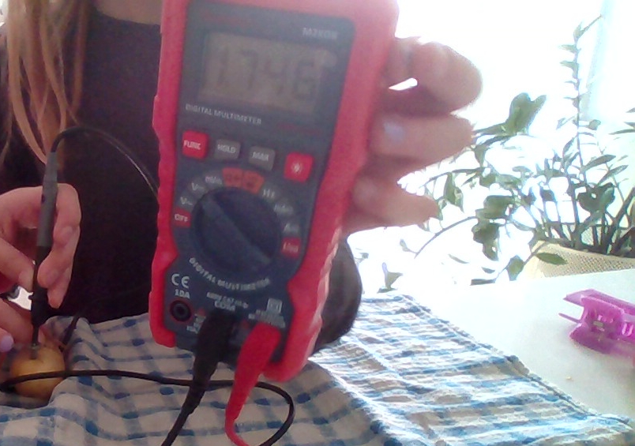
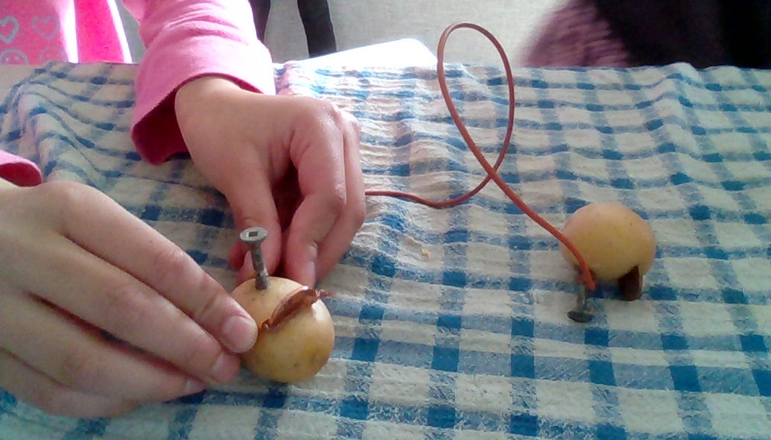
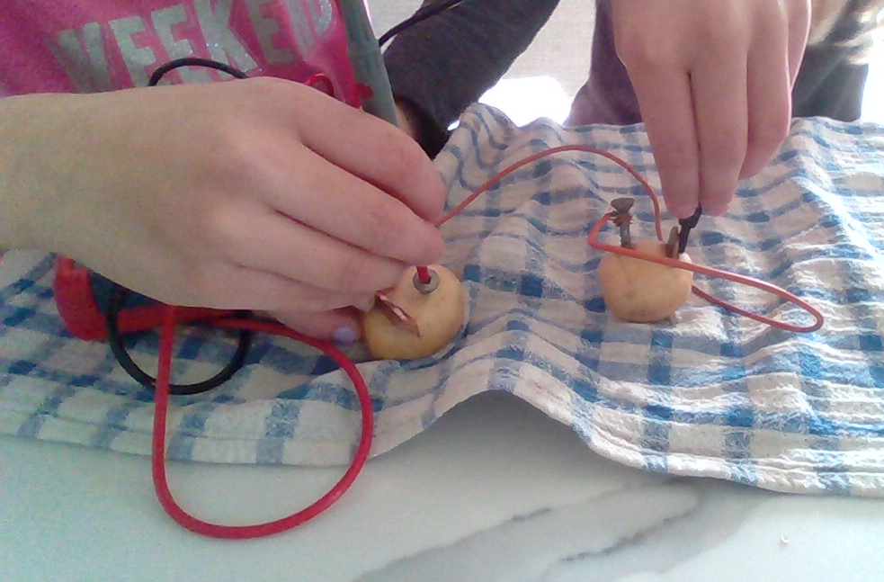
Photos
Step 1
Step 2
Step 3
Step 4
Step 5
Step 6

Slide 17
Results
We tested the tomato, potato, mini potato, lemon, and here are the results.
The mini potato - 1.8 volts
Normal potato - 1.9 volts
Tomato - 1.6 volts
Lemon- 1.3 volts

Slide 18
2nd results
Mini potato 1.7 volts
Potato 1.8 volts
Lemon 1.4 volts
Tomato 1.6 volts

Slide 19
3rd results
Potato 1.6 volts
Lemon 1.4 volts
Tomato 1.3 volts
mini potato 1.5 volts

Slide 20
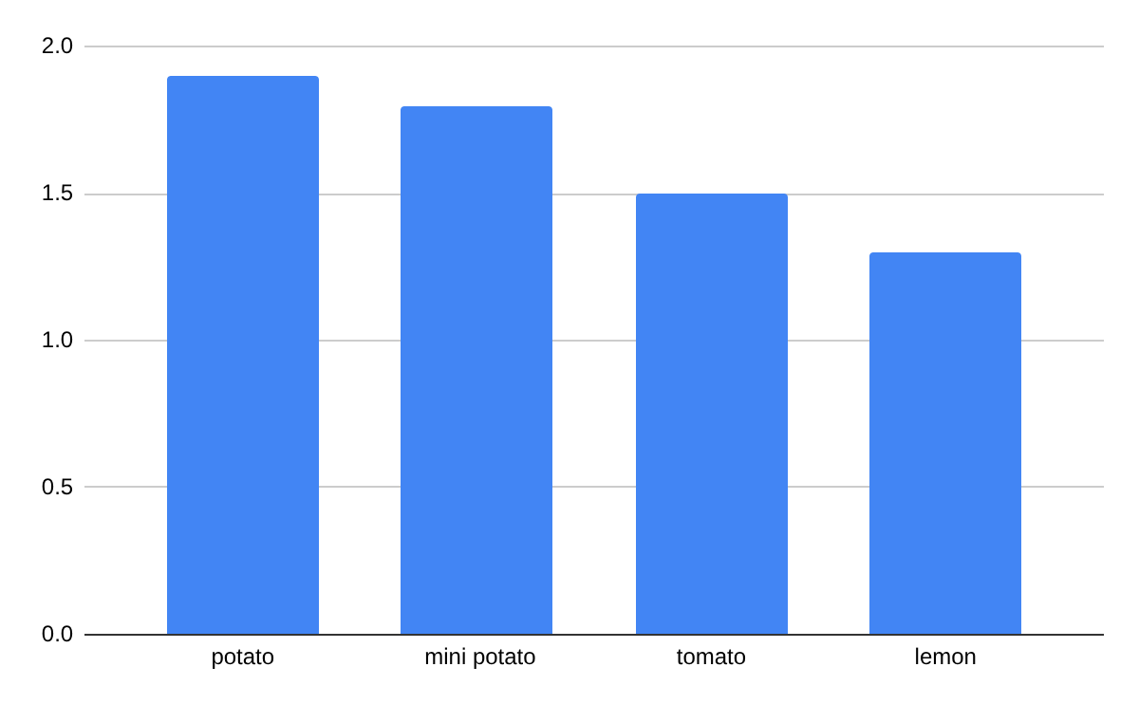
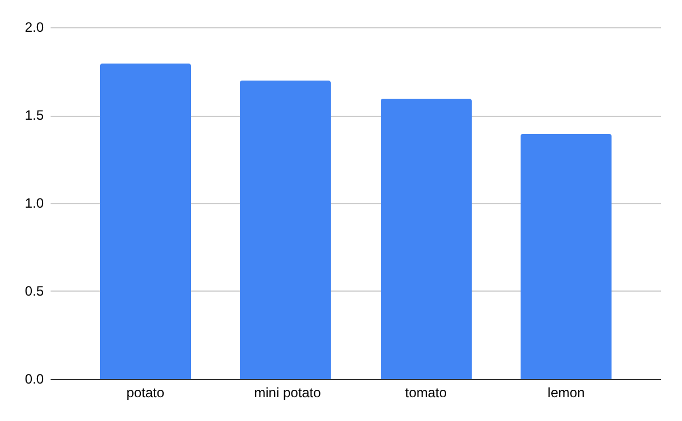
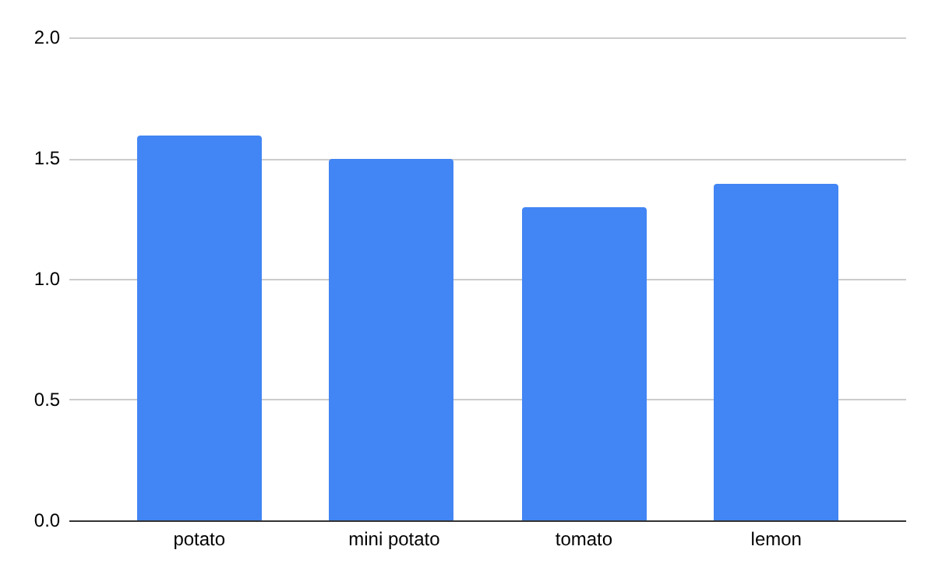
Results ( charts )
First results
Second results
Third results

Slide 21
Analysis
Our hypothesis was incorrect. Our original hypothesis was that the lemon would produce the most because it has the most citric acid. We also thought the mini potato would produce the least because it's the smallest. The actual results showed the lemon with the least amount of voltage, and the mini potato with the second most! The actual fruit that produced the most voltage was the normal potato, only 0.1 volts ahead of the mini potato! The lowest scorer was the lemon, which was surprising because we thought it would have the highest voltage!

Slide 22
Observations
Our results were that the normal potato had the most voltage with 1.9 volts, almost 2.0 volts! The lemon had the least amount of voltage with 1.3 volts. This was surprising to us because our hypothesis was that the lemon would have the most voltage because it has the most citric acid! One surprising thing we observed during our tests was that our mini potato produced only 0.1 volts less than the normal potato, despite the fact that there's a big size difference!

Slide 23
Conclusion
Our hypothesis was proven incorrect, given how during our tests the mini potato always came in second place and the lime almost always came in last. The overall highest voltage producer was the normal potato, coming in first every test. The lemon produced the least amount of voltage in the first and second tests, though the tomato got less in the last ( third) test. So overall, the potato produced the most voltage, and the lemon produced the least voltage.

Slide 24
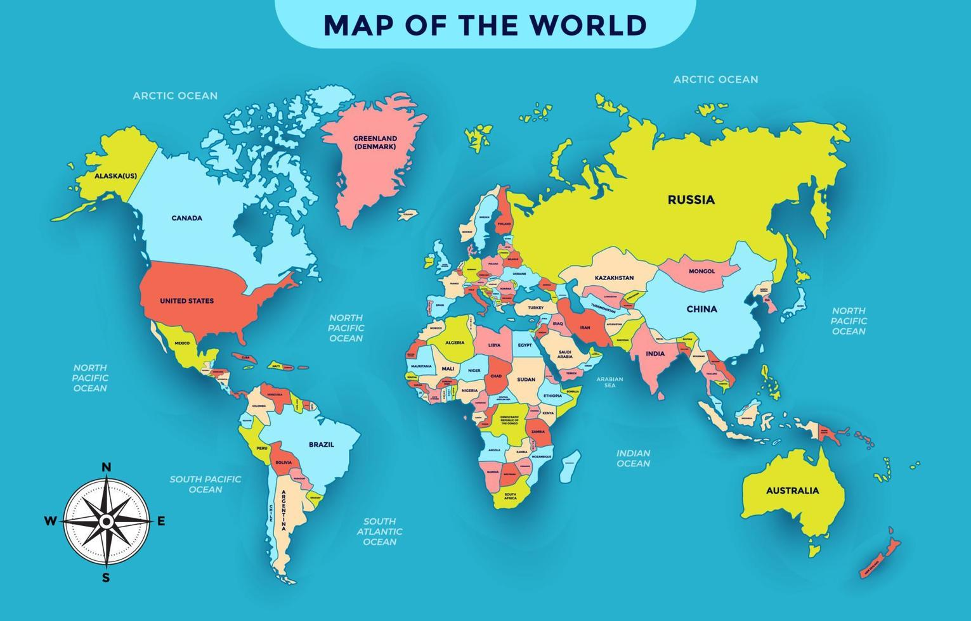
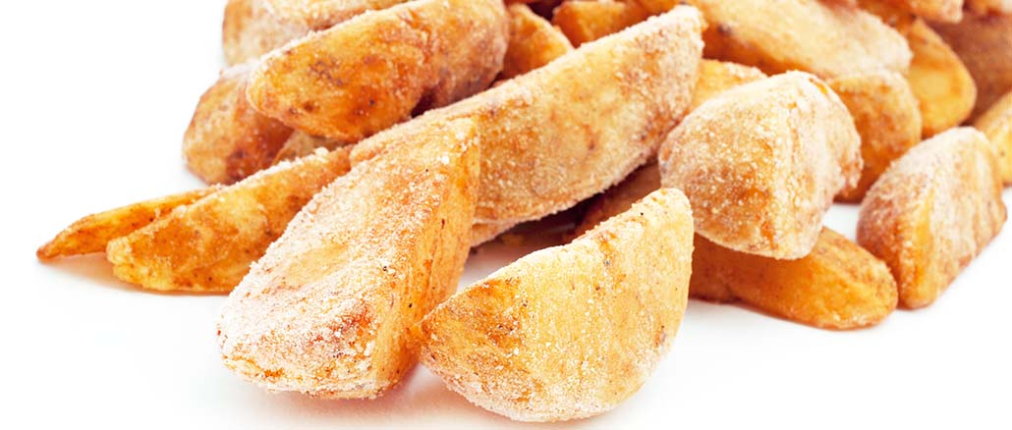
What could we do differently next time?
If we choose to do the same project or a similar one a different year, we would probably use different fruits and vegetables, and maybe even things outside of those categories? We could also test the same fruits, but with different conditions. for example, we could test a potato from one place, then test the same type of potato but from another place! Or we could take 2 potatoes, but freeze one?
?

Slide 25
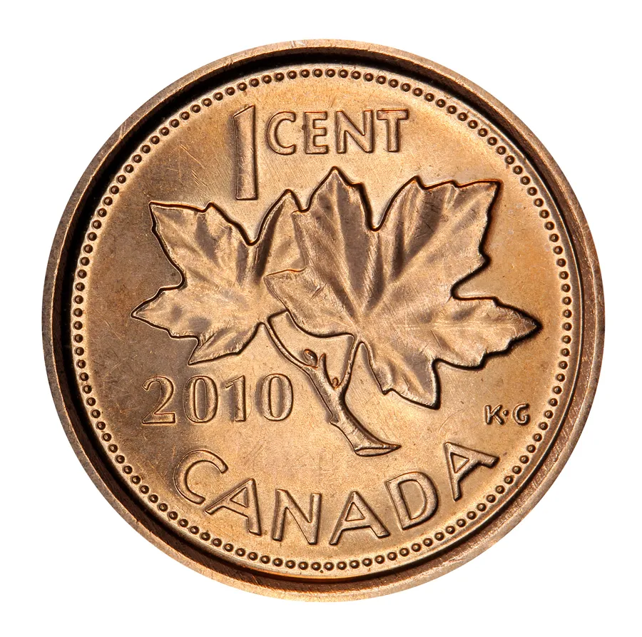
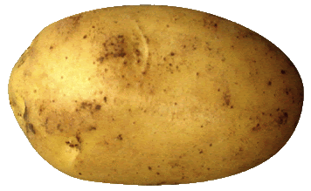
Source of Error
During our tests we actually had most things go pretty smoothly, but a few thing that went wrong like when we first started our experiments things were a bit confusing, but then we did a bunch of research and by now we know a bunch about electricity and voltage! Also, during our experiments we accidentally pushed the penny in too much a few times, and then we had to learn how to put them in at the perfect balance of how much the penny should go in.
Penny is in to deep

Slide 26
Acknowledgements
Thank you to my dad ( Blakelys dad ) who helped us with a few experiments, and also helped us understand what we were doing!
Thank you to Nina's dad, who got us a lot of materials and even let us use his volt meter.

Slide 27
Sources
https://www.etsy.com/ca/listing/1507726937/potato-battery-experiment-pdf-download?dd_referrer=https%3A%2F%2Fwww.google.com%2F
Potato Battery Experiment | PDF Download | Chemistry for ...
Images may be subject to copyright. Learn More
https://www.livescience.com/62570-potato-battery-conduct-electricity.html
https://chatgpt.com/?utm_source=google&utm_medium=paid_search&utm_campaign=GOOG_C_SEM_GBR_Core_CHT_BAU_ACQ_PER_MIX_ALL_NAMER_CA_EN_032525&c_id=22376911868&c_agid=175413814965&c_crid=741707849649&c_kwid={keywordid}&c_ims=&c_pms=9198479&c_nw=g&c_dvc=c&gad_source=1&gad_campaignid=22376911868&gbraid=0AAAAA-I0E5eWqF8xKvOtgtCANBlO7cflK&gclid=Cj0KCQiA1czLBhDhARIsAIEc7uixqt742yp9fAX9-tdfuWquc0vFePH2XMyxDomVqesSJqLvZbbYHwEaAn1hEALw_wcB
https://www.google.com/search?q=potato+electricity&rlz=1C5FPAB_enCA1198&oq=potato+electricity&gs_lcrp=EgZjaHJvbWUyCQgAEEUYORiABDIHCAEQABiABDIHCAIQABiABDIHCAMQABiABDIHCAQQABiABDIHCAUQABiABDIHCAYQABiABDIHCAcQABiABDIHCAgQABiABDIHCAkQABiABNIBCjE1ODgzajBqMTWoAgiwAgHxBWGetLrK9Gde8QVhnrS6yvRnXg&sourceid=chrome&ie=UTF-8&safe=active&ssui=on
What is Current? - PowerSight Blog
What Is Electric Current? – Enjoybot Official Store
What is Voltage? - Definition, Uses, and Effects
Potato Battery: Understanding Chemical and Electrical Energy : 13 Steps (with Pictures) - Instructables

