Slide 1
Science Fair Logbook
Name: samar
Notes:
Make a copy of this logbook (File - Make a Copy) and save in your Google Drive.
Share it with your Science Fair teachers: mmolfert@educbe.ca amduncan@educbe.ca kknanji@educbe.ca

Slide 2
Topic:
Write about the topic you chose. Why did you choose this topic? What do you hope to find out?
I chose a highway crash detection system using an arduino uno r3 starter kit
I chose this project because lots of car crashes in the summer and winter happen and i want to fix that by making a crash detection system with an arduino uno r3 starter kit
I hope to find that this project does not crash and i hope to find that it actually works.

Slide 3
Testable Question
How does _________ affect _________?
What is the effect of _______ on __________?
Which __________ is/does/makes/etc _______________?
How does changing the speed limit on a highway affect the cars crashing
Notes:
See D2L - Content - Getting Started - Planning Page 2

Slide 4
Background Information
What questions/information do you need to find out about your topic? What is some important vocabulary?
My background info came from me doing lots of research while building other projects like a dino game a lock and many others and now im using my knowledge for coding kits in this project

Slide 5
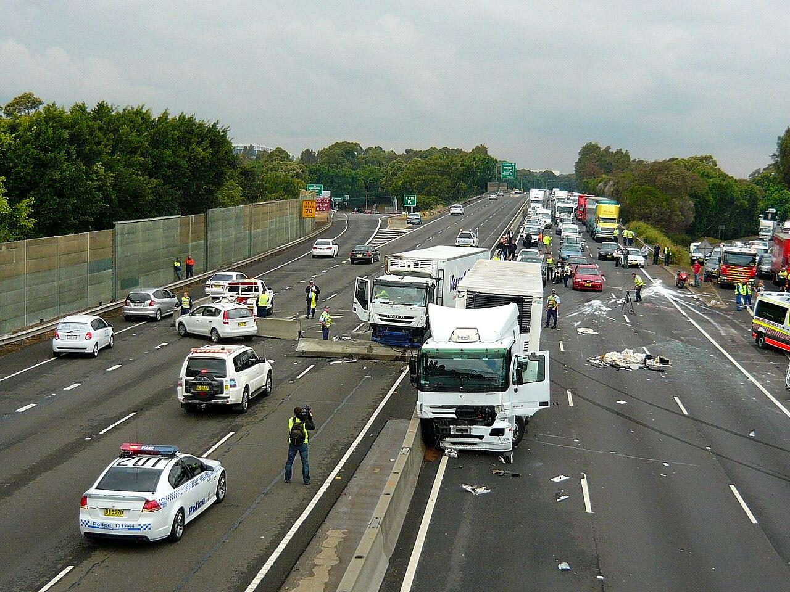
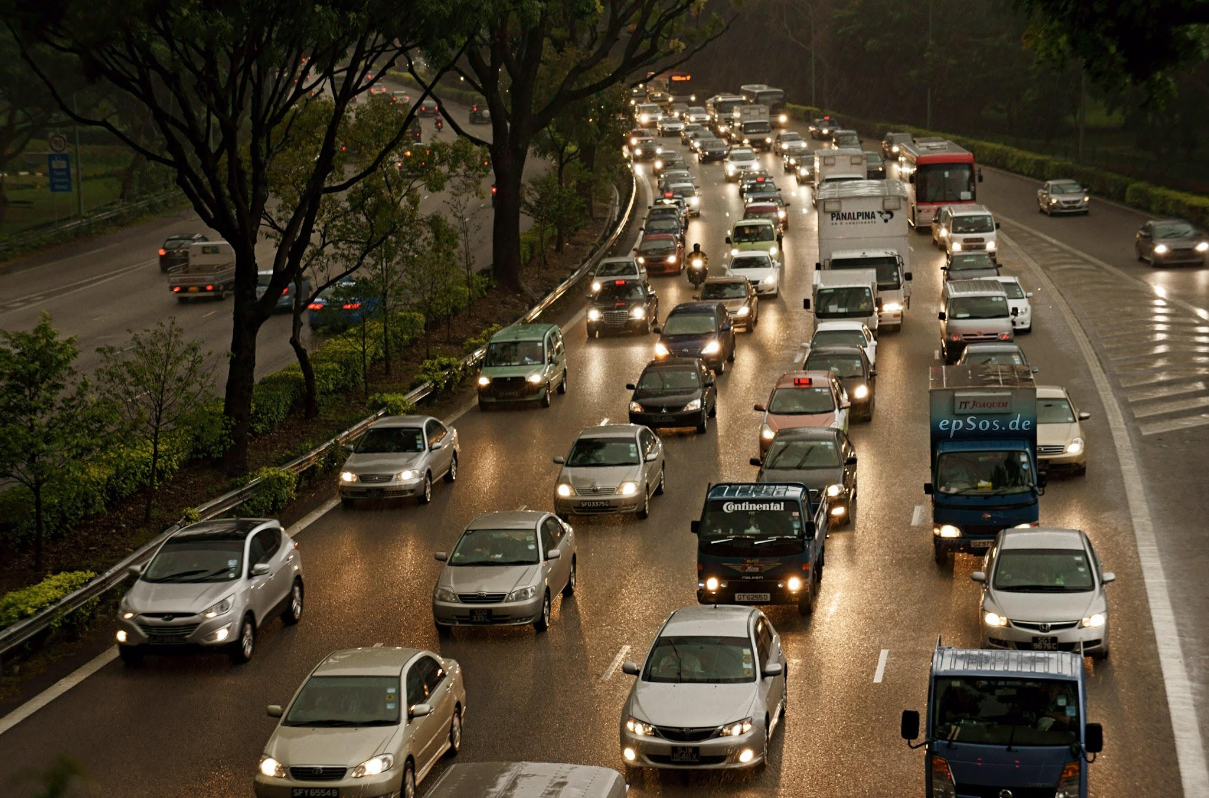
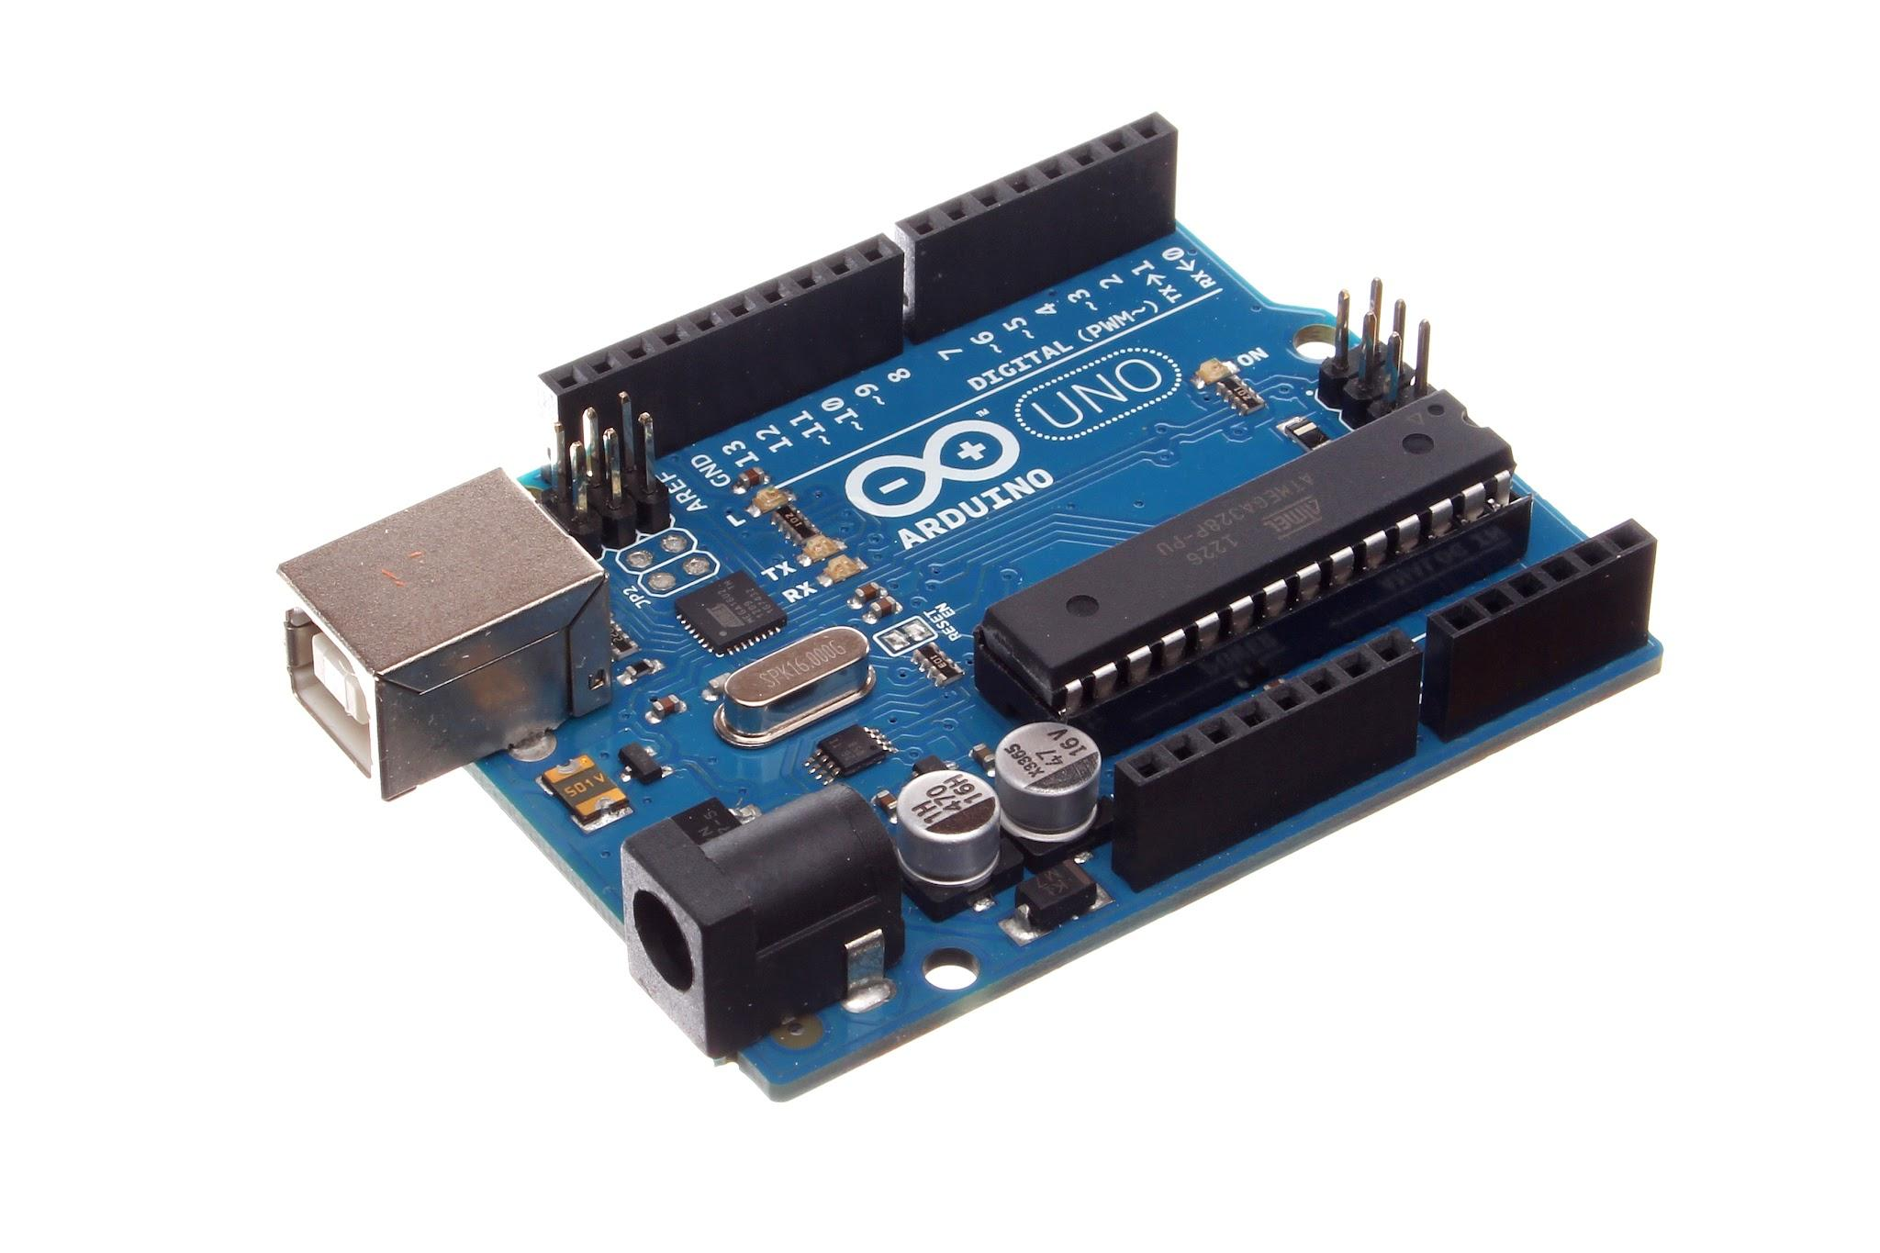
Background Information
Research your topic and write about what you find out IN YOUR OWN WORDS. Add slides as necessary. Make sure to note your sources of information on the Sources page.
I researched how Smart Highways work and how technology can make roads safer. I wanted to understand how sensors, signals, and automatic systems can detect hazards and warn drivers before accidents happen. I also looked at how engineers use electronics, like the Arduino, to build small‑scale versions of these systems.
Notes:
Photos from Google Stock Images

Slide 6
Sources of Information
Note all sources used - websites, books, experts, etc. ( *Google is not a website, follow links to find the page information.) Add slides as needed.
Title | Author | Information (web link, publisher, etc) | Year
How Do LCDs Work? #LCDs #electronics #arduino | robonyx | https://www.youtube.com/hashtag/lcds/shorts | 2026
You NEED to Know How Ultrasonic Sensors Work! #electronics #robotics #STEM #arduino | robonyx |  | 2026
Notes:
See D2L - Content - Referencing Your Sources

Slide 7
Variables
Manipulated / Independent Variable
ONE thing that you will test/change:
I will test how far away the cars it can sense
Responding / Dependent Variable
The thing I think will change or be affected:
The speed limit will reduce depending on the harshness on the crash
How will you measure it? :
It will display it on the lcd
Notes:
See D2L - Content - Hypothesis - Variables and Hypothesis

Slide 8
Variables
Controlled Variables
Things we have to be very careful to keep the same every time we test so that they do not affect the results/outcome of the experiment:
I will be using the same arduino uno r3 starter kit the wires , power source, lcd (a screen), sensors , water sensor and potentiometer (to adjust brightness on lcd).
Notes:
See D2L - Content - Hypothesis - Variables and Hypothesis

Slide 9
Hypothesis
Your prediction, or what you think will happen:
If the crash sensor detects a sudden impact or force change
then the system will activate the alert the lcd to lower speed limit
because __________________.
(I do/change this…) (I think this will happen) (Why? )
*use info from your research or background knowledge to help explain)
the sensor is designed to recognize rapid changes in acceleration that indicate a collision.
I think if i move my toy cars closer and further away the sensor will react to it and send a signal to the LCD to lower or increase the speed limit
Notes:
See D2L - Content - Hypothesis

Slide 10
Materials
What materials will you use for your experiment? Be specific about amounts whenever possible.
Aurduino uno r3 starter kit
Wires (about 18)
Sensors
Notes:
See D2L - Content - Designing Your Experiment

Slide 11
Procedure
List the step-by-step procedure you will follow to conduct your experiment. Be as specific as possible and include exact measurements, quantities, times, etc.
First i will make the project
Then i will code the project
Then i will debug the code
Then i will make my model with cardboard
Then i will do my 3 trials
Notes:
See D2L - Content - Designing Your Experiment

Slide 12
Experiment: Trial 1
Date:
Data: (measurements)
Observations:/Notes
During the first test, the Smart Highway system detected the hazard normally and responded exactly as expected. The LCD displayed the proper alert message without delays.
distance | Speed (k/mh)
5 cm | 100 k/mh
20 cm | 75 k/mh
33 cm | 40 k/mh
Notes:
See D2L - Content - Designing Your Experiment

Slide 13
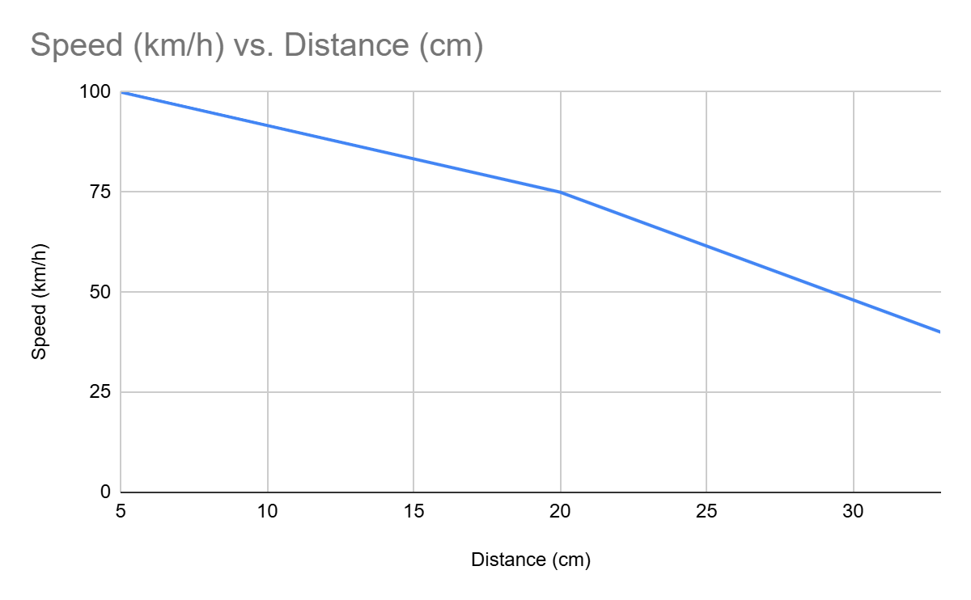
Trial 1

Slide 14
Experiment: Trial 1
Photos:
Notes:
See D2L - Content - Designing Your Experiment

Slide 15
Experiment: Trial 2
Date:
Data: (measurements)
Observations/Notes:
In the second trial, the system still reacted to the hazard, but the sensor took a moment longer to trigger. The LCD updated with the warning message, showing that the system can still function even with small timing differences.
distance | Speed (k/mh)
10 cm | 95 k/mh
30 cm | 83 k/mh
50 cm | 30 k/mh
Notes:
See D2L - Content - Designing Your Experiment

Slide 16
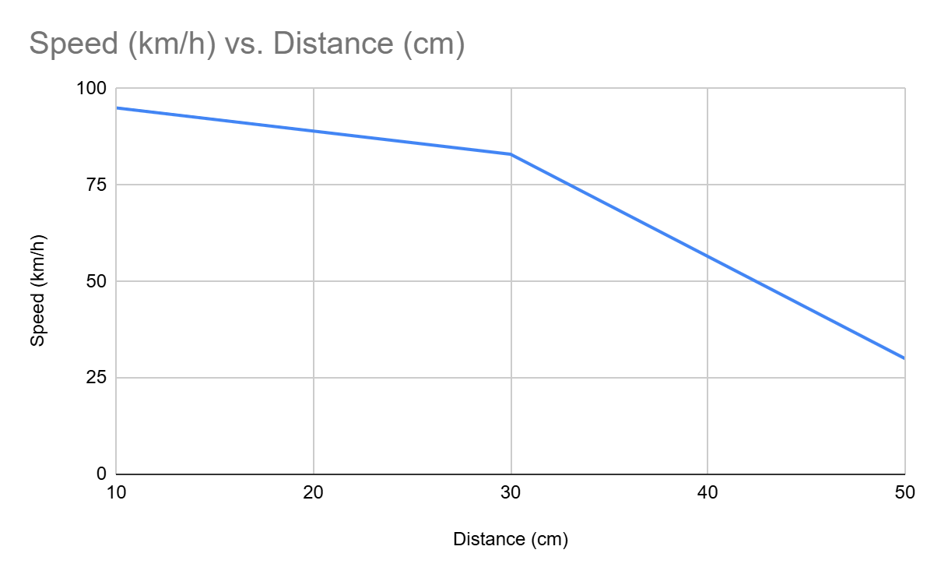
Trial 2

Slide 17
Experiment: Trial 2
Photos:
Notes:
See D2L - Content - Designing Your Experiment

Slide 18
Experiment: Trial 3
Date:
Data: (measurements)
Observations/Notes:
During the final trial, the system responded quickly again, almost identical to Trial 1. LCD activated in the right order, confirming that the Smart Highway setup is consistent and reliable across multiple tests.
distance | Speed (k/mh)
20 cm | 75 km h
60 cm | 40 km h
80 cm | 60 km h
Notes:
See D2L - Content - Designing Your Experiment

Slide 19
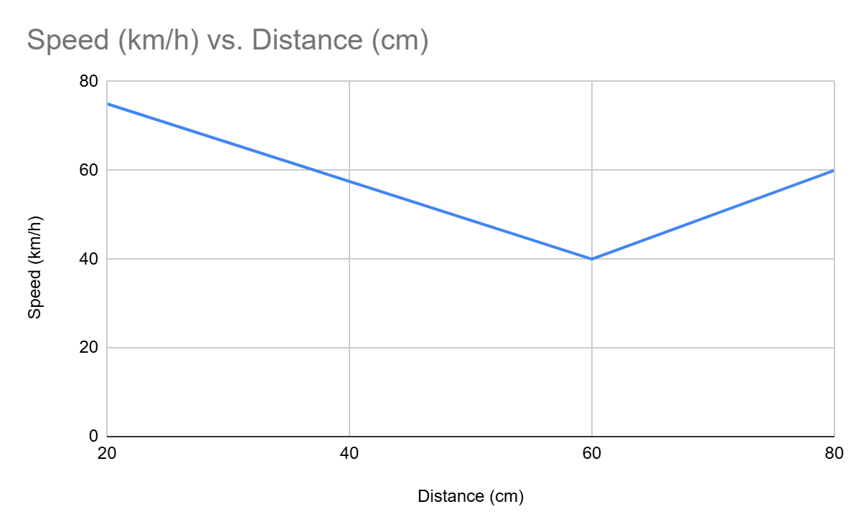
Trial 3

Slide 20
Experiment: Trial 3
Photos:
Notes:
See D2L - Content - Designing Your Experiment

Slide 21
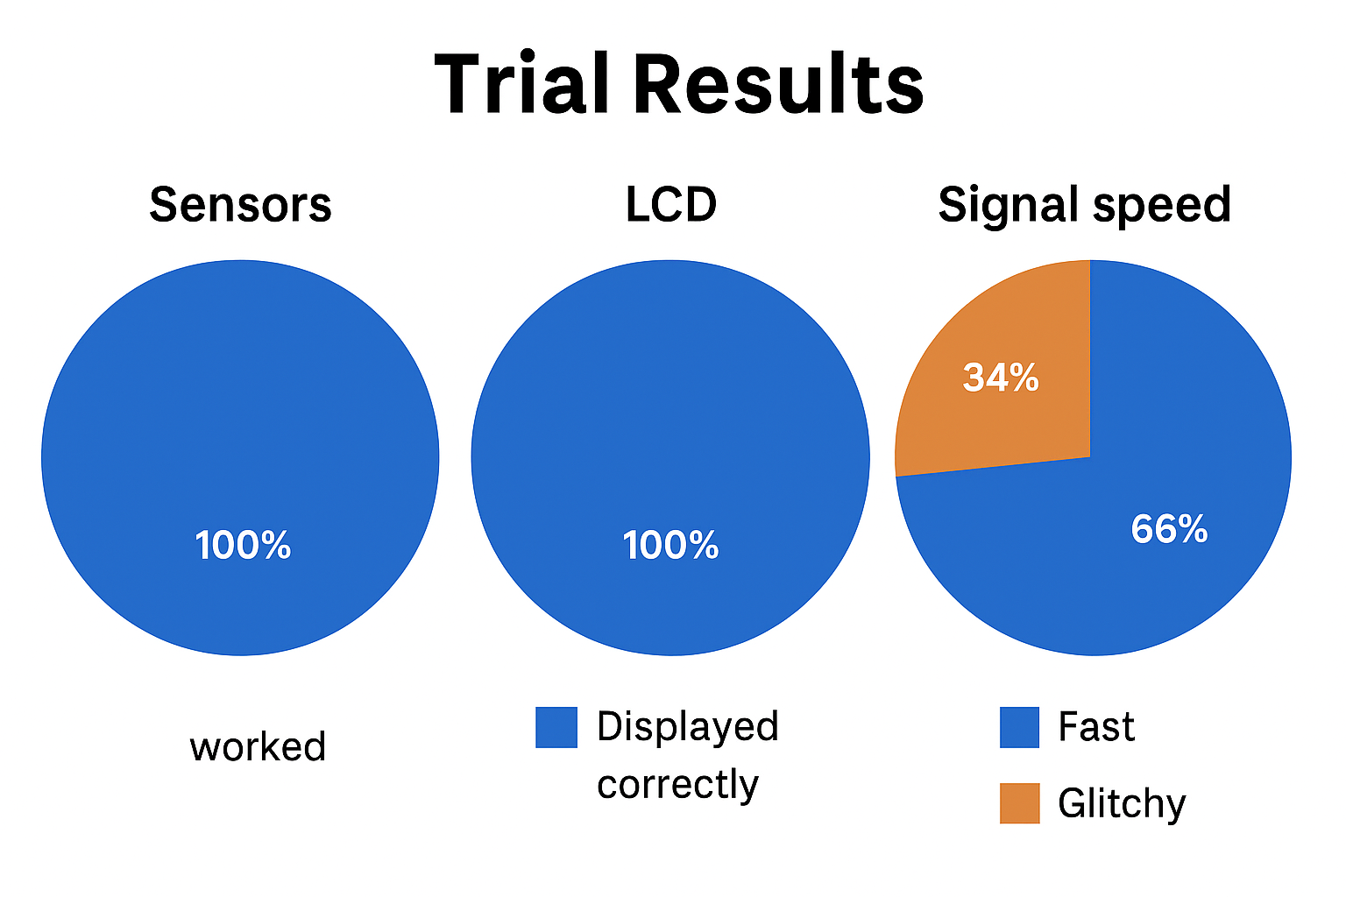
Put your data together into a chart.
Example: (you can change the chart)
 | sensors | LCD | Signal speed
Trial 1 | worked | Displayed corectly | fast
Trial 2 | Worked | Displayed correctly | Kind of glitchy
Trial 3 | worked | Displayed corectly | fast
Notes:
See D2L - Content - Designing Your Experiment
See D2L - Content - Conclusion, Application, and Extensions

Slide 22
Results: Analyze
Look at your data and observations. Look for patterns and trends. Explain what happened in your experiment and what you found out:
The Smart Highway system successfully detected the hazard and responded correctly, showing a clear warning on the display each time, with only a small delay during one of the tests but still functioning as intended.
Notes:
See D2L - Content - Designing Your Experiment
See D2L - Content - Conclusion, Application, and Extensions

Slide 23
Results: Graph
Graph your data for a visual display of your results.
Use Google Sheets or another website and copy the graph onto this slide, or draw by hand and upload a photo.
Ask your Science Fair teachers for help if you need it!
Notes:
See D2L - Content - Designing Your Experiment
See D2L - Content - Conclusion, Application, and Extensions

Slide 24
Conclusion
My question was:
How does changing the speed limit on a highway affect the cars crashing
The answer to my question is:
Changing the speed limit on a highway affects car crashes by influencing how much time drivers have to react, how much control they have, and how severe a crash becomes. Higher speeds less reaction time and more crash force, while lower speeds give drivers more time to avoid accidents.
My hypothesis was correct because: changing the speed limit does affect how likely cars are to crash. When the speed is higher, drivers have less time to react to hazards, which increases the chance of an accident. Lower speeds give drivers more control and more time to respond, making crashes less likely. This matches both real‑world traffic behavior and the results shown in my Smart Highway experiment.
Notes:
See D2L - Content - Conclusion, Application, and Extensions

Slide 25
Applications
In what ways are your findings useful?
Who could benefit from your results and how?
My findings are useful because i show how a highway system can react to dangers on its own using sensors. The results help explain how changing speed limits or giving warnings can make driving safer. People like drivers, road workers, and engineers could benefit this because this idea could reduce accidents and help roads respond faster to hazards.
Notes:
See D2L - Content - Conclusion, Application, and Extensions

Slide 26
Sources of Error
Do you think your results were reliable? Were there any other factors or conditions that could have affected the results of your experiment in unexpected ways?
What could have affected your results, that would need to be controlled differently if you were to repeat the experiment?
During my experiment, a few things could have affected my results. The sensors almost always reacted the exact same way just little differences , and even small changes in how I placed objects could make the readings different. Some wires on the breadboard might have moved a little, which can change how well the system works. The Arduino can also have tiny delays when checking each sensor, which can make the timing slightly different in each trial. These small errors mean my results were mostly reliable, but repeating the experiment with everything set up the same way each time would make the results even better.
Notes:
See D2L - Content - Conclusion, Application, and Extensions

Slide 27
Extensions
If you were to conduct this experiment again, what would you do differently?
If i did this experiment again, i could try a few simple changes to make it even better. i could test more “speed limits” to see how the system reacts at different levels, not just one or two. I could also move the sensor to a new spot to check if it still picks up the hazard the same way. Another thing i could do is run more trials so you have more results to compare. These changes would help me learn more about how your Smart Highway works and how i can make it safer and stronger.
Notes:
See D2L - Content - Conclusion, Application, and Extensions

Slide 28
Extensions
Because of the results of this experiment, I wonder…
Describe further experiments that could be conducted to further investigate and understand your topic:
I wonder if there are any better ultrasonic sensors in the world to detect further distances
Notes:
See D2L - Content - Conclusion, Application, and Extensions

Slide 29

CONGRATULATIONS!!
You have completed your experiment!
Make sure that you enter information from this logbook into the CYSF Digital platform.
You are now ready to create your trifold display and practice your presentation.

