Slide 1
Medicine Flavours Preferred by Gender & Age
Zack Rajesky
Halpern Akiva Academy
Grade 6

Slide 2
Abstract
My project is to figure out if boys or girls like different flavours for their medications, and if there is a difference between adults and kids
We are using 5 flavours and then people rate them
This will help ensure that everyone takes their medicine

Slide 3
Testable Question
Which medicine flavour tastes the best depending on gender and age?

Slide 4
Background Research
Researchers have studied (in 2013) that 90% of children that don’t take their medications is due to them not tasting good
The study also showed children are more sensitive than adults when it comes in flavours
FlavoRx is a company that sells medicine flavours to many pharmacies worldwide. They have 13 different flavours
FlavoRx flavours have been used over 150 million times
40% of adults have trouble swallowing pills
Children have 10,000 taste buds, but adults have only 5,000. That’s why food taste different to kids

Slide 5
Hypothesis
Kids and adults are going to like different flavors because their taste buds are different. Kids are going to like chocolate the best because it’s the sweetest. Adults are going to like lemon the best because it isn’t sweet.
Males and females will like the same thing in each age group because there was no research that I could find showing that they would have different taste buds

Slide 6
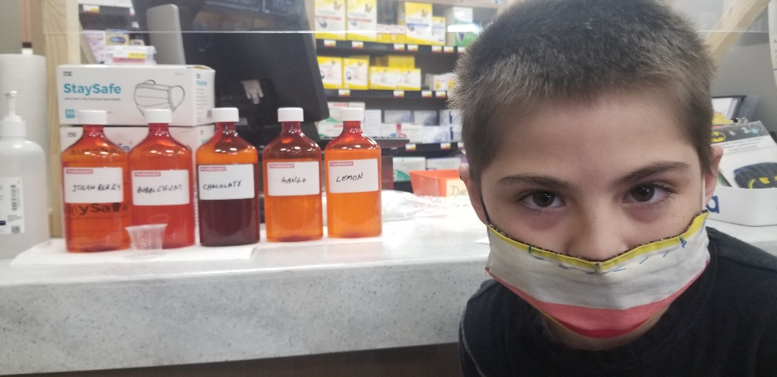
Procedure
Measure 30ml of each medicine flavour (lemon, chocolate, bubblegum, strawberry, and mango) and put them in 400ml of water
Mix together in a plastic bottle
Ask a person if they would like to participate in the experiment, and if they say yes then tell them to try each flavoured water
Pour a small amount of each water in a medicine cup for them to try
Ask the person if they are 18 or older or under 18, and record if they are male of female
Then tell they person to rate the flavours from 1 to 10, 1 being horrible and 10 being the best. Record each answer

Slide 7
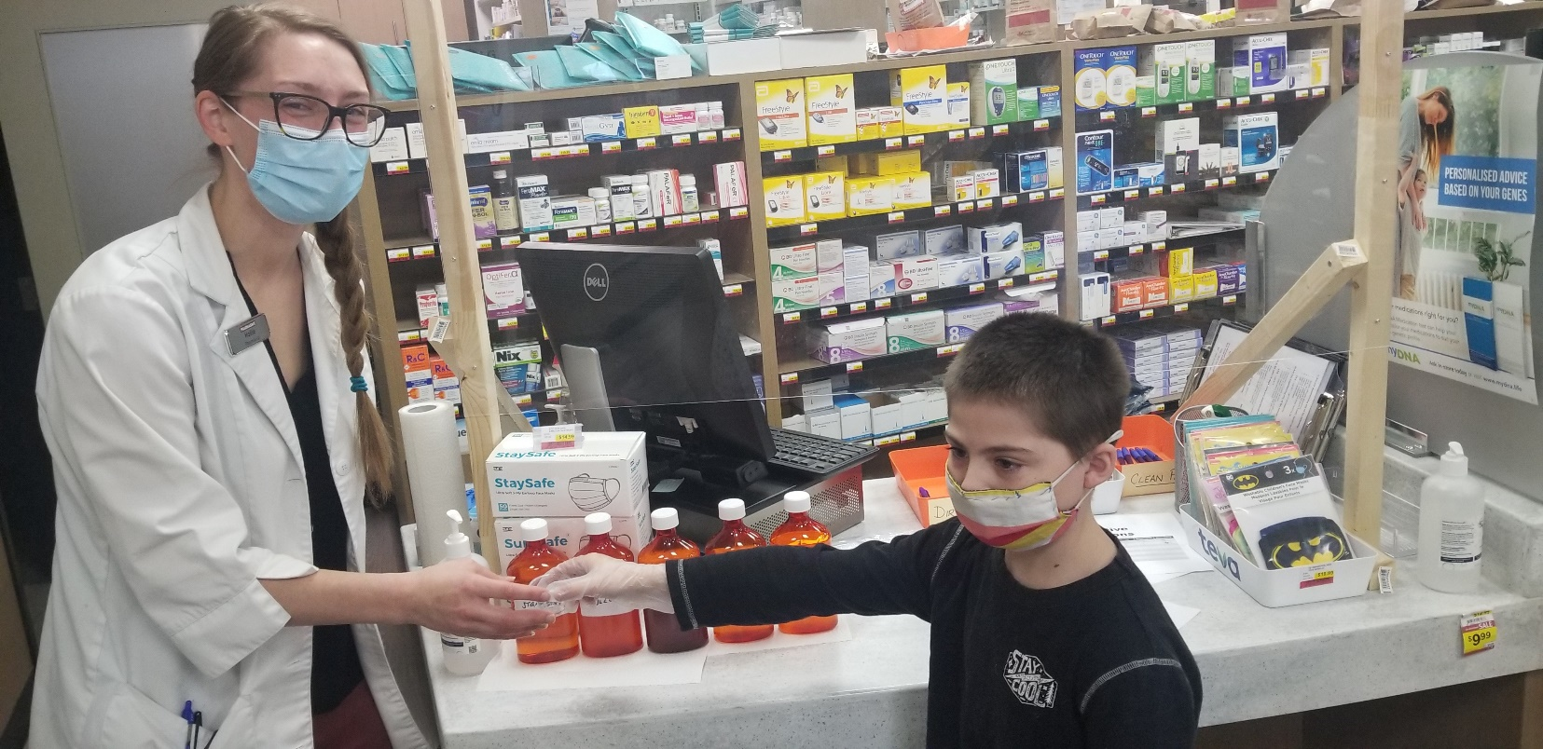
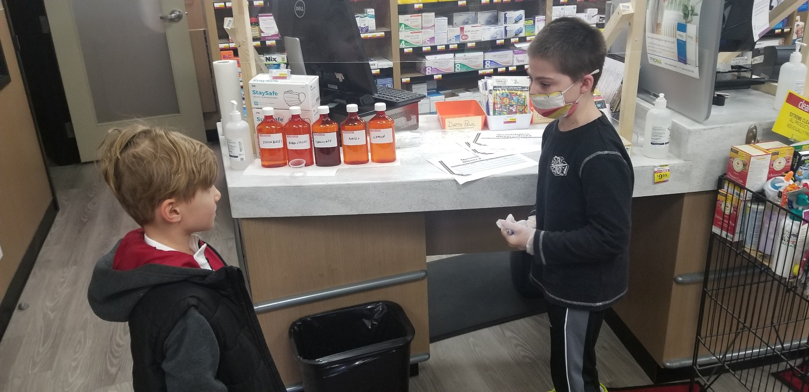

Slide 8
Variables
Manipulated Variables:
Flavour used
Gender & Age of tester
Responding Variable:
The taste rating of the tester
Controlled Variables:
The same proportion flavour to water
Same container for each type of water
Explain the rating system to everyone

Slide 9
Materials / Apparatus
Water
5 Flavours (Chocolate, Strawberry, Lemon, Bubblegum, Mango)
5 plastic bottles
Beaker to measure water
Medicine cups
Syringe to measure flavours
Masks and gloves (COVID safety)

Slide 10
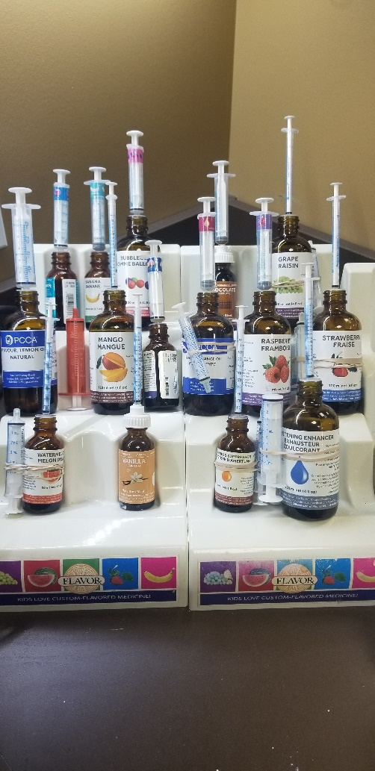
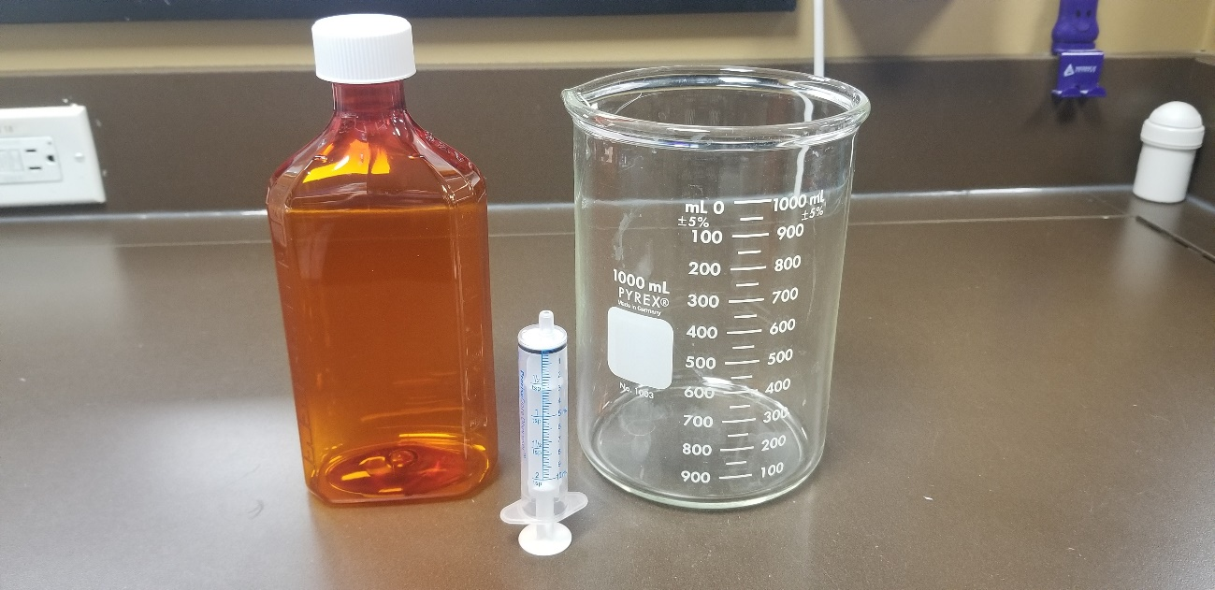
Materials / Apparatus

Slide 11
Qualitative Observations
Some flavours are darker than others
All flavours smell different
Everyone that tried the flavours had a different reaction

Slide 12
Raw Data
Person # | Adult / Child | Gender | Lemon | Chocolate | Mango | Bubblegum | Strawberry
1 | A | M | 1 | 7 | 6 | 7 | 2
2 | C | F | 3 | 2 | 1 | 9 | 7
3 | A | F | 6 | 8 | 3 | 1 | 4
4 | A | M | 8 | 6 | 5 | 2 | 7
5 | C | M | 10 | 9 | 1 | 6 | 1
6 | A | F | 8 | 9 | 4 | 4 | 8
7 | A | F | 7 | 7 | 2 | 9 | 3
8 | A | F | 9 | 6 | 6 | 1 | 2
9 | A | F | 6 | 3 | 1 | 1 | 4
10 | A | F | 7 | 3 | 2 | 3 | 4
11 | A | F | 1 | 1 | 1 | 1 | 1
12 | A | M | 10 | 7 | 1 | 1 | 6

Slide 13
Raw Data
Person # | Adult / Child | Gender | Lemon | Chocolate | Mango | Bubblegum | Strawberry
13 | C | M | 10 | 10 | 8 | 1 | 10
14 | C | F | 2 | 8 | 2 | 1 | 4
15 | A | M | 9 | 10 | 2 | 6 | 5
16 | C | M | 10 | 7 | 1 | 1 | 1
17 | A | F | 1 | 2 | 1 | 2 | 1
18 | A | F | 4 | 5 | 1 | 2 | 6
19 | C | M | 10 | 10 | 10 | 1 | 10
20 | A | F | 5 | 8 | 4 | 5 | 7
21 | A | M | 7 | 7 | 6 | 5 | 6
22 | A | F | 6 | 7 | 1 | 1 | 6
23 | C | M | 1 | 6 | 8 | 1 | 6
24 | A | F | 1 | 6 | 2 | 2 | 6

Slide 14
Quantitative Observations

Slide 15
Quantitative Observations

Slide 16
Results
There was no difference in adult and children on their favorite flavour
There was no difference in a male or female on their favorite flavour
Chocolate was the favorite flavour for adults, children, male, and female
There is a difference for adults least favorite flavor than a child. Adults least favorite is mango and child it is bubblegum
There is a difference for gender least favorite flavor. Female least favorite is mango and male it is bubblegum

Slide 17
Sources of Error
Flavours were tested in different orders for each person
We mixed the flavours in water instead of usual liquids for medicine
We didn’t use actual medicine
Some flavours are stronger than others

Slide 18
Improvements
Use what we would usually use for liquids for medicines
Test the flavours in actual medicines
For the stronger flavours use less of them
Test more people

Slide 19
Extensions / Future Research
Test the flavours in more age groups
Test the flavours in different liquids (oral mix, simple syrup)
Test the flavours in different real medicines
Test other flavours

Slide 20
Practical Applications
When people ask which medicine flavour we recommend we will know from this experiment based on their age and gender
We will increase the number of people that take their medicines

Slide 21
Conclusion
Part of my hypothesis is correct because adults and children both liked chocolate the best, and there is no difference between males and females favorite flavour

Slide 22
Letter of Authority
“Medicine Flavours Preferred by Gender and Age" is a well-developed and methodical experiment that has a relevant application in retail pharmacy practice today. The data collected and conclusions derived could be a useful tool to help improve liquid medication compliance, especially in children who may otherwise refuse therapy.”
Hollie Gamble B.Sc. (Pharm) Copperfield Pharmasave

Slide 23
Bibliography
https://www.breakthroughs.com/advancing-medical-research/why-flavor-matters-drug-design-especially-kids
https://www.flavorx.com/
https://howtoadult.com/difference-between-taste-buds-adults-kids-27362.html

