Slide 1


Cardia
Femme
Perpetuated myocardial infarction diagnosis in women

Slide 2



Problem
8.94 million women in North America contribute to the mortality rates of myocardial infarction deaths every singular year . And 35 % female mortalities are due to myocardial infarctions.Half of those women aren’t aware they are experiencing a myocardial infarctions. This is due to the misconception of the usage of male myocardial infarction symptoms which are transmitted for female diagnoses. The sex bias is ever evolving and research is not being perpetuated on female myocardial infarctions. The constriction of the arteries and plaque build up is a main cause of myocardial infarction and yes both men and women share such characteristics during a myocardial infarction but this does not mean that there are no differential components of exertion of heart attack symptoms with in men and women. Women suffering from a myocardial infarction often appear asymptomatic or with atypical symptoms however this is due to the symptoms not mirroring the prevalent referenced symptoms that have been exhibited by men. It is a necessity for atypical symptoms to become typical within myocardial infarctions . But to help perpetuate the act of efficient hospital intervention feasible efficient detection is a requirement.
06

Slide 3


Question
Can a respiratory biosensor designed for premature signs of a women’s myocardial infarction through measuring Adenosine Triphophosphate levels, and lactic acid biomarkers using Exhaled Breath Condensate detection enable efficient hospital intervention and reduce mortality rates among women?
Myocardial Infarction
A condition caused by the decreased or complete cessation of blood flow to a portion of the myocardium; commonly referred to as a heart attack.

Slide 4
Hypothesis
I hypothesize that the identification of the bio markers Adenosine Triphosphate and lactate acid within Exhaled Breath Condensate will provide a efficient , non-invasive diagnostic tool for the identification of myocardial infarction in women exhibiting atypical symptoms during a myocardial event.

Slide 5
Instructions
Follow the instructions exhibited above to design, and test my breath-analysis mechanism and all necessary components. This includes ensuring the functionality of your version of the mechanism is feasible and non detrimental to participants.
Once recruiting individuals it is a necessity that bias is not implicated( no contortion of test due to the fact you are aware of prior medical conditions which are not prevalent).The tests should be conducted ethically, ensuring that participation is entirely voluntary and free from pressure or coercion.
Clearly convey to potential participants any foreseeable impediments, inconveniences, or minimal risks associated with the study. Emphasize the simplicity of the tests and any possible minimal impediments.
Curate a consent and information form that explicitly outlines what participants are required to do, as well as what they are not obligated to do. Also note in your consent form of how extortion of information will not occur and how anonymity will be
curate an email that specifies in the perpetuation for future diagnoses and the premise of the project and how it correlates with myocardial infarction diagnoses and efficient hospital intervention. As well implements the scientific aspect of it and what components are involved.
When a participant arrives at the designated testing location, ensure the space is clean, quiet, and sufficiently spacious. This is particularly important to help alleviate any anxiety or discomfort participants may experience before or during the procedure.
. Before beginning the test, clearly explain each step of the process. Inform the participant that they will be asked to breathe into a tube, describe how long the procedure will take, and explain when results are expected to appear. Reiterate that the test is experimental and that results are not guaranteed to be fully accurate or diagnostic.
Instruct the participant to exhale into the tube as directed in order to collect the exhaled breath condensate.
After the breath sample has been collected, inform the participant that results will take approximately 15 minutes to process. During the duration of time allow the participant to remain seated . Once the process is complete, test results will be shared explicitly.

Slide 6
Women’s myocardial infarction bio markers
ATP is compromised during a woman’s myocardial infarction due to the rapid decline in cellular energy. The depletion of oxygen during the infarction causes a rapid decline in the production of ATP. High lactic acid is a critical sign of insufficient oxygen supply to the tissues and can cause tissue hypoxia. Tissue hypoxia is caused by inadequate blood flow and hypo-perfusion. This forces cells into inefficient anaerobic metabolism to produce energy. The ischemic heart muscle, as well as other organs under stress produce excess lactic acid. Due to the fact that liver and kidneys are the primary clearing organ of lactic acid. The kidneys and liver are impaired due to severe stress which causes excess lactate. EBC has bio markers such as oxidative stress markers, NT pro BNPL and inflammatory markers, which help exhibit signs of myocardial infarction diagnosis immediately. As tissue is damaged, oxidative stress is developed during the myocardial infarction in women. Byproducts of the process contain ethane, and eight–isoprostane will increase shortly after a tissue injury and can be detected in EBC.

Slide 7
Research
When suffering
from myocardial infarction women are less likely to undergo extensive evaluation of cardiac symptoms due to sex bias that correlates with the fact that women appear asymptomatic when measured by male standard frame of reference. This appeases the myth of sex neutral potential symptoms.electrocardiogram stress testing has lowered specificity in comparison to men. Due to the fact that women usually are less likely to have optimal heart rate responses and in the words of the article cited “they are susceptible to repolarization abnormalities“. (Percutaneous trans luminal coronary angioplasty of coronary bypass surgery.) odds of undergoing angiography were 28% and 15% higher for men in Massachusetts and Maryland.(95% confidence interval for the ratios, 1.22 -- 1.35 and 1.08 to 1.22).
Women’s myocardial infarction is influenced by biological factors most prevalent after menopause, which can contribute to the likelihood of coronary vascular disease . As well preeclampsia from pregnancy complications induce heart attacks later in life.
When suffering from myocardial infarction are less likely to undergo extensive evaluation of cardiac symptoms due to sex bias that correlates with the fact that women appear asymptomatic when measured by male standard frame of reference. This appeases the myth of sex neutral potential symptoms.electrocardiogram stress testing has lowered specificity in comparison to men. Due to the fact that women usually are less likely to have optimal heart rate responses and in the words of the article cited “they are susceptible to repolarization abnormalities“. (Percutaneous transluminal coronary angioplasty of coronary bypass surgery.) odds of undergoing angiography were 28% and 15% higher for men in Massachusetts and Maryland.(95% confidence interval for the ratios, 1.22 -- 1.35 and 1.08 to 1.22).
Women’s myocardial infarction is influenced by biological factors most prevalent after menopause, which can contribute to the likelihood of coronary vascular disease . As well preeclampsia from pregnancy complications induce heart attacks later in life

Slide 8
Efficiency of EBC versus other detection
In comparison to ECG and blood test, EBC is a non-invasive method that could potentially be feasible for future diagnostics. Currently, blood tests and ECGs are the validated clinically used methods. Blood tests, such as troponin blood tests, offer the highest specificity for confirming cardiac damage. ECGs record the immediate electrical events that take place in the heart. Research suggests that EBC analysis could identify a wide array of markers that are associated with heart disease and inflammation. Some reflected systemic changes in cardiac disease in women, and others are specific to the heart. Through volatile organic compounds and lipid biomarker analysis, it is possible to identify processes like lipid peroxidation and oxidative stress associated with cardiovascular disease. Inflammatory markers tend to have higher levels of inflammatory markers like high sensitivity C-reactive protein (hsCRP) and lipoprotein-associated phospholipase A2 (Lp-PLA2) in comparison to men. Some of the most unique markers that are potential EBC biomarkers include interleukins, tumor necrosis factor, cardiac damage markers, and atherosclerosis. These provide specific markers such as oxidative stress (F2-isoprostanes), Lp-PLA2, and hsCRP. 8-iso prostaglandin F2α (8-iso PGF2α) is another biomarker used in EBC. Another quintessential fat metabolism metabolic biomarker. When changes can lead to the cardiac distress. Thus, biomarker production levels in EBC in women are strongly correlated with body composition such as BMI , waist circumference and body fat. This appeases to the sex specific differences and metabolic Biomarkers. As well, there are cardiac stress markers that can be measured through natriuretic peptides which are markers of cardiac stretch. These are generally higher at baseline in women than in men while markers of myocyte injuries are lower.

Slide 9

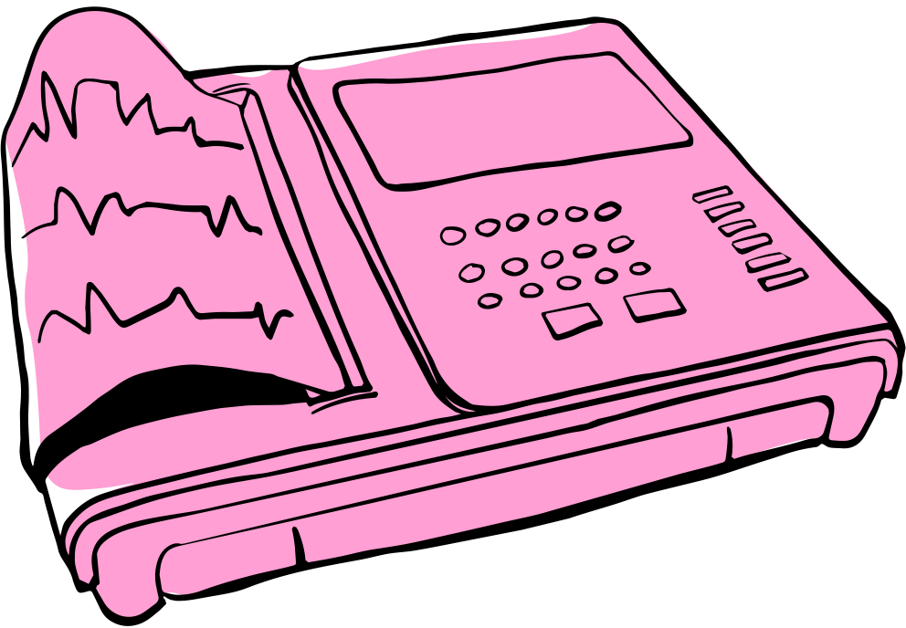
Materials
Oxidase/hexokinase electrode
Vishal dale 3W wire wound metal resistors Hifi
Micro fluidic flow channel
Graphite counter electrode
Hydrophobic coating
R tube EBC collection device
ID resistor
Custom 3D printed exhaled breath condensate sampler inlet
Output connectors for handheld meter
Small glassy carbon rod electrode
EBC condensate collection tube
Polydimethylsiloxane

Slide 10
Instructions
Step 1: Buy all materials listed from page fifteen to sixteen it will be exhibited with diagrams with in those pages
Step 2:
Next design the micro channel structure that could be exhibited through the usage of autoCAD software. ( materials for this includes microfluidic flow channel , R tube and 3D printed sampler inlet).
Dimensions are a key aspect so refer to these dimensions while using autoCAD. (Microfluidic channel width: 17mm , microfluidic channel height : 1.45 microns. R tube 0.3 microns for filter, 0.8 mm tubing diameter. EBC sampler inlet 0.8mm inner diameter).
Step 3
Create the PDMS device layer
Prepare the polydimethylsiloxane mixture by combining the base curing agent within a bowl with a 10 : 1 ratio. Pour the PDMS into the 3D printed mold and put it into the oven at an elevated temperature of 115 degrees Celsius for an hour. Remove the PDMS layer from the mold this will act as the channel structure layer.
Step 4
Lactic acid and Adenosine Triphosphate electrode pre treatment
Rinse the bare electrode with deionized water and then absolute ethanol to remove impurities . Dry the electrodes by implementing them into the oven at a low heat (60 degrees Celsius). Due to this project requiring a glassy carbon electrode, polishing is necessary, by polishing it using alumina slurries of varying grades ( 1.0 , 0.3 and 0.05 microns ) before rinsing and drying.
Step 5
Embed the conductive materials with the inclusion of the PLA polymer with a high weight percentage (e.g., 20-40% or more) of a conductive filler like graphite powder ( this is used to to create functional interfaces for electrokinetic manipulation and sensing ).
Step 6
Integrate connection through ID resistor
Locate the two terminals or pads on the id resistor and connect one terminal of the ID resistor to the working electrode input.( counter electrode to reference electrode ). The second ID resistor terminal gets connected to the reference electrode. This is used as the reference electrodes working electrode.
10

Slide 11

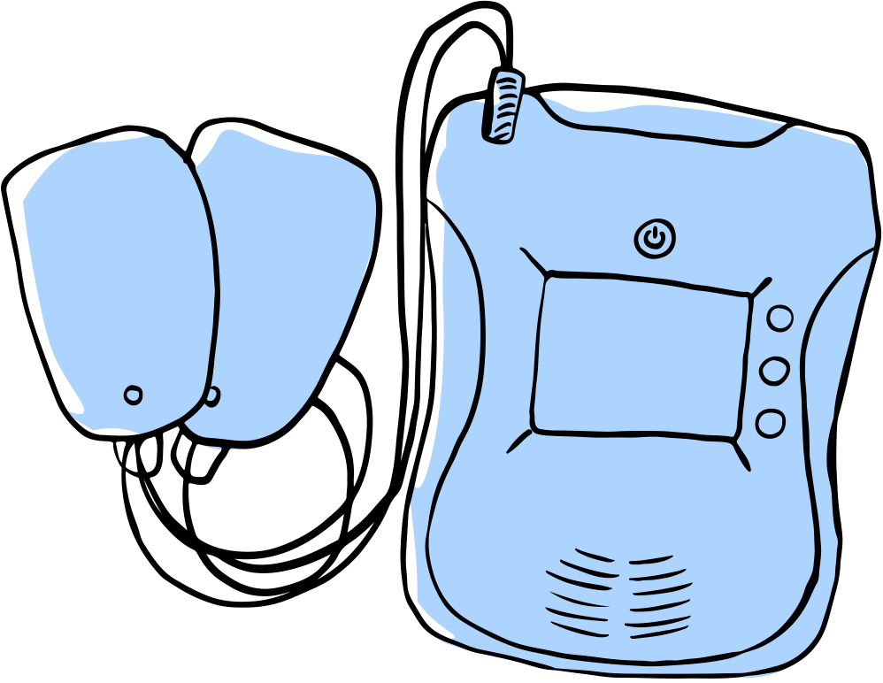
Method
I will be addressing these implications that correlate with female myocardial infarctions by the creation of a breathalyzer which relies on the detection of biomarkers with the usage of exhaled breath condensate. For specificity the bio markers that are detected are adenosine triphosphate and lactic acid. This system is predicated on the theory that the metabolic disturbances that occurs when a female experiences cardiac events that can be quantified through the detection of exhaled biomarkers, through a measurable decrease in ATP levels and a corresponding elevation in lactate concentrations serve as early-stage physiological indicators of myocardial infarctions. This is due to them being prominent biomarkers in myocardial infarctions in women.
The mechanism works through the usage of Adenosine triphosphate and lactic acid working electrodes which . The ATP electrodes combine high specificity biological recognition elements (aptamers or enzymes) with electrochemical transduction methods (such as voltammetery or impedance spectroscopy) to generate a measurable electrical signal. I am also using lactic acid electrodes which proceeds by using electrochemical techniques to detect the concentration of lactate in biological fluids . I am using Exhaled breath condensate. My sensors operate by the conversion of lactate into a differentiated chemical species, which then undergoes an oxidation or reduction reaction at the electrode surface to generate a measurable electrical current. The ID resistors for lactic acid electrodes identify the specific electrode type or batch to the analyzer, ensuring the device applies the correct calibration settings. Simultaneously, the colour component refers to a chemical reaction often involving lactate oxidase where the sensor physically changes color (such as green to blue) based on the lactic acid concentration, allowing an efficient result for Myocardial infarction detection in women when women experience elevated lactic acid. The ATP detection through an ID resistor works through the usage of integrated ID (identification) resistors to detect ATP by converting biological binding events into measurable electrical signals (voltage or current changes)This ensures the ID resistor identify the specific type and calibration of of the electrode, while the electrode itself changes its electrical characteristics in proportion to the concentration of ATP in a sample. ​

Slide 12

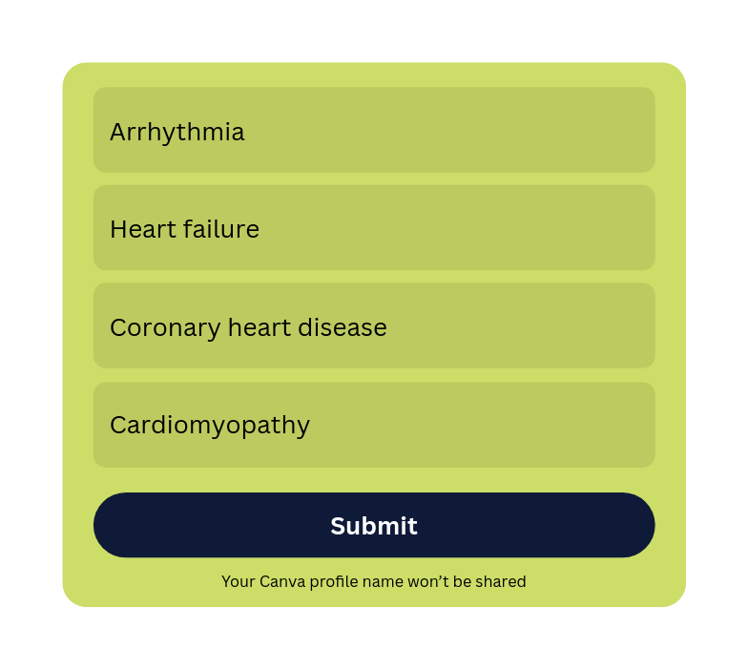
Symptom check
Fatigue
Pain in the left arm
Sleep disturbance
Chest discomfort (angina)
Anxiety
Shortness of breath and cold sweats
Abdominal Pressure
Nausea and vomiting
“ATYPICAL” SYMPTOMS
“TYPICAL” SYMPTOMS
12

Slide 13



Conversing with an expert
Recently I conversed with Dr. Di Martino, who is currently
situated at the University of Calgary and is a civil engineer
specializing in cardiac research and possess extensive
knowledge in this field. During our discussion, she shared a
multitude of ideas that aided me with in my project. She
emphasized that prior to attempting to design a solution, it is a necessity
to clearly define the problem being addressed. In other words, before selecting materials or components for my mechanism, I need to identify its prominent purpose and determine how it differentiates from existing solutions. She also mentioned the potentially using gel, which I found intriguing, and encouraged me to think critically about how the materials I choose for example my usage of ATP and lactic acid electrodes. I was fixated on achieving the correct minuscule size. But then she advised me that at this stage my goal is to curate a functional model. . She told me that the initial design should be as simplistic as possible to allow for effective testing of the mechanism, and that finer details and refinements are a later on problem.
13

Slide 14
Application to world
I believe that the application of this mechanism to the real world is significant due to the prevalence of what are called atypical symptoms in women with myocardial infarctions. This could be profoundly helpful to those who have no prior knowledge of myocardial infarction and may help save the 50% who aren’t aware that they are having a myocardial infarctions. As priorly mentioned, women are less likely to go under extensive observation when when exerting signs of myocardial infarction they are often told by medical professionals that their potential coagulation or clotting of there blood with in there circulatory system or evident symptoms are just a sign of menopause or that they’re just exasperated, and if it was me, I would also believe my Medical professional. But by implementing this into their house, the simplistic mechanism could be a life or death saver. This mechanism is innovative, due to it redefining myocardial infarction testing through exhaled breath condensate instead of a High-Sensitivity Cardiac Troponin Blood Test.
In an actual setting, this mechanism could be implemented as a modular system adaptable for home use, community health distribution,

Slide 15
Electrodes
Researchers have developed integrated systems
and specific electrodes which are used to
measure ATP in lactic levels often
simultaneously. They typically use an
enzyme based electrometric method.
Enzymatic reactions to specific enzymes
are integrated within the electrode surface.
For lactate an enzyme called lactate
oxidase is commonly used. This enzyme
breaks down lactate and produces hydrogen
peroxide. For ATP a Multiplex enzyme system
involving adenylate kinase, pyruvate kinase and pyruvate oxidase
Is often employed which also produces H₂O₂ .

Slide 16
Others doing similar things and how they differentiate from my mechanism
A proposed sensor for sequentially detecting ATP and lactic levels in blood. This is performed through a continuation of an chemical reactions. The ATP and lactate are converted to hydrogen peroxide displayed as H₂O₂. The breakdown of H₂O₂ to water causes the sensor chip to generate a signal that is detected by the sensor. The Way my mechanism differentiates from this is due to the blood usage, and the simplicity of it is not evident as well. I use a electrodes well within this one they aren’t using a electrode they’re using a chemical reaction that needs to be controlled and contained within a specialized environment. Well, mine is based off efficiency and detection there’s is based off of an amount of tests that need to be put into a situation that requires freezing that may not be able to be implicated within the time of a females myocardial infarction.
ATP-MPI is a ATP-MPI requires hospital intervention to stress the heart, or blood based aptasensors that wait for late-stage protein leaks,
Unlike my device which provides an efficient readout of ATP depletion and lactic acid elevation. This is more efficient for women because it identifies the specific metabolic shifts of female-pattern ischemia within a sufficient amount o f time to receive hospital intervention . By using ID-resistor calibration and a colorimetric interface, my sensor offers a efficient diagnoses ,while the ATP-MPI using doctor facilitation for the usage of blood based aptasensors my relies on it simplicity and efficient result

Slide 17
Citations
https://pmc.ncbi.nlm.nih.gov/articles/PMC12237364/#:~:text=Global%20burden%20of%20total%20cardiovascular,com/MD/P340
https://pmc.ncbi.nlm.nih.gov/articles/PMC11121322/#B1-healthcare-12-00972
https://www.goldbio.com
Sciencedirect.com/science/articlelabslp:/500362010001
Pmc.ncbi.nlm.nih.gov/article/PMC6107466
Https://pubmed.ncbi.nlm.nih.gov/3743392/
Https://pmc.ncbi.nlm.nih.gov/PMC6107466
Https://www.ottawahearts.ca>thebest>news>nownewresearch-protectinghearts amidshiftingclimate
Researchgatenet/figure/EBCfromairwaylining
Https://www.abcam.com/en-us/products/assay-kits/ab83355
https://www.sigmaaldrich.com/deepweb/assets/productdocumnent/262/439/mak/90bul.polf
Researchgate.net/figure/TOP-micronit-FLC503-flow-channel-microfluidic-chip-with-1-32inch-0.8mm-outside-fig2-351971310

