Slide 1
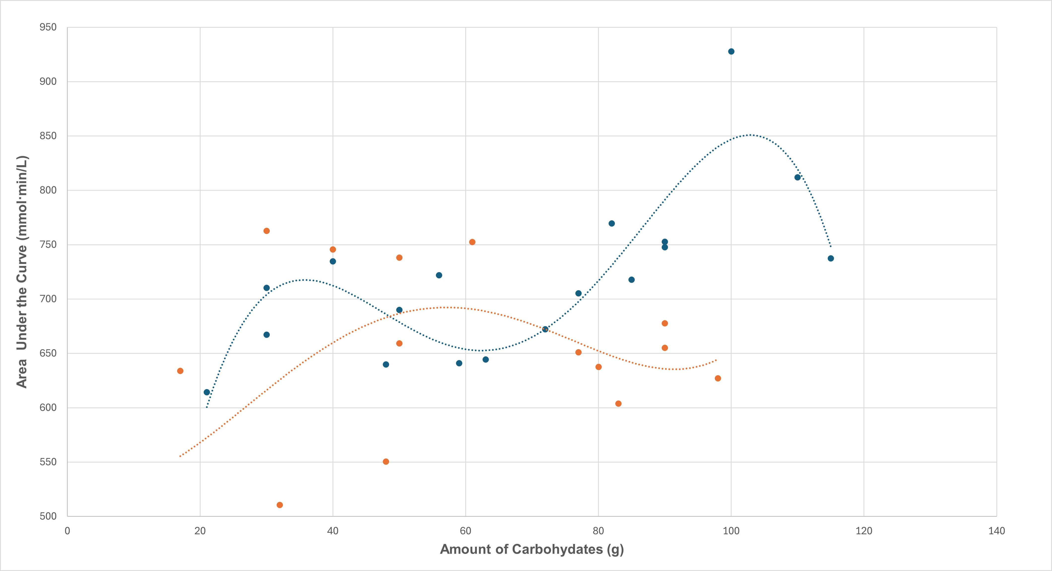
Graph 1. Baseline and Experimental Data for User 1

Slide 2
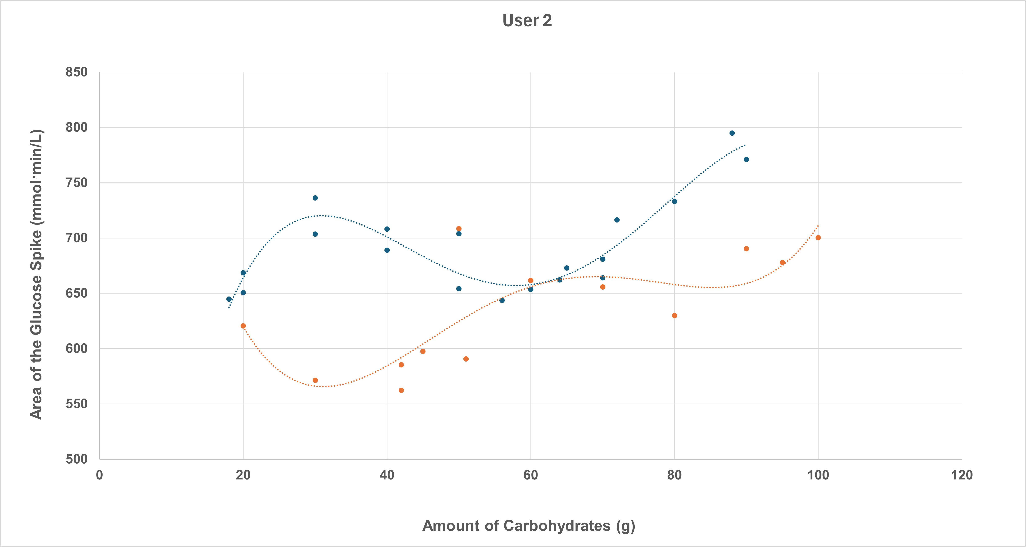
Graph 2. Baseline and Experimental Data for User 2

Slide 3
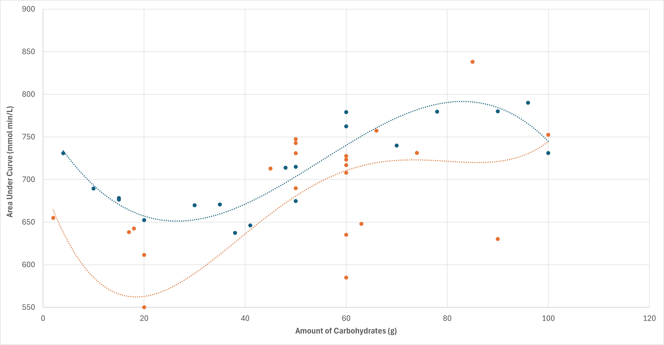
Graph 3. Baseline and Experimental Data for User 3

Slide 4
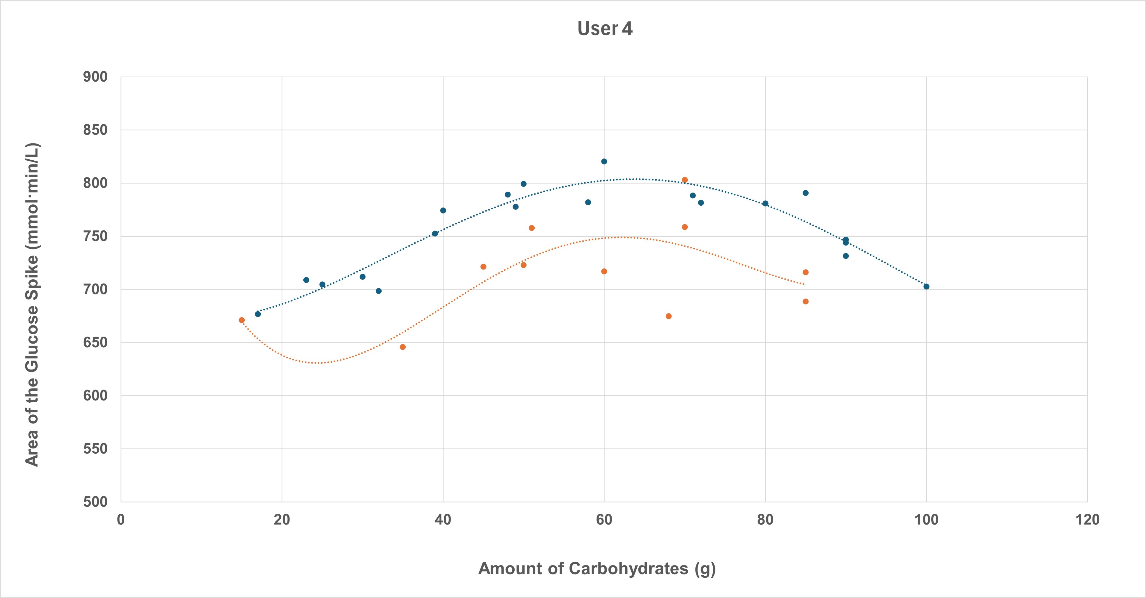
Graph 4. Baseline and Experimental Data for User 4

Slide 5
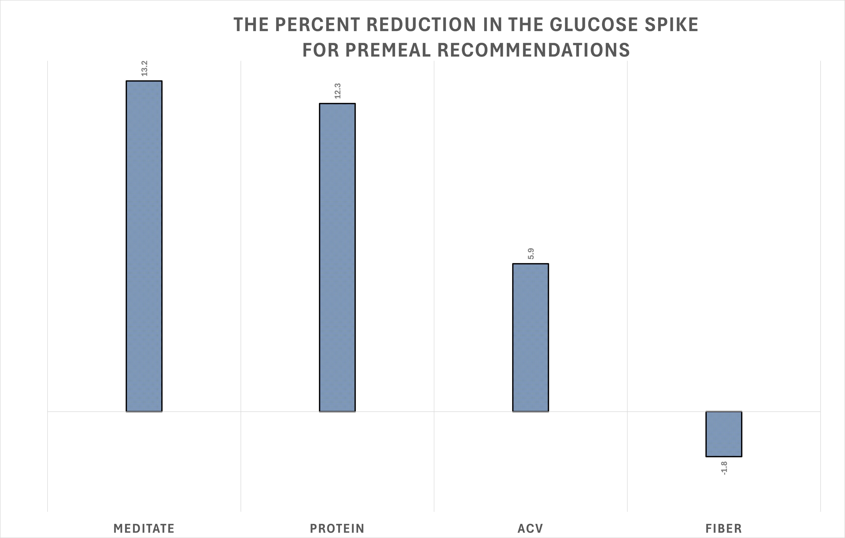
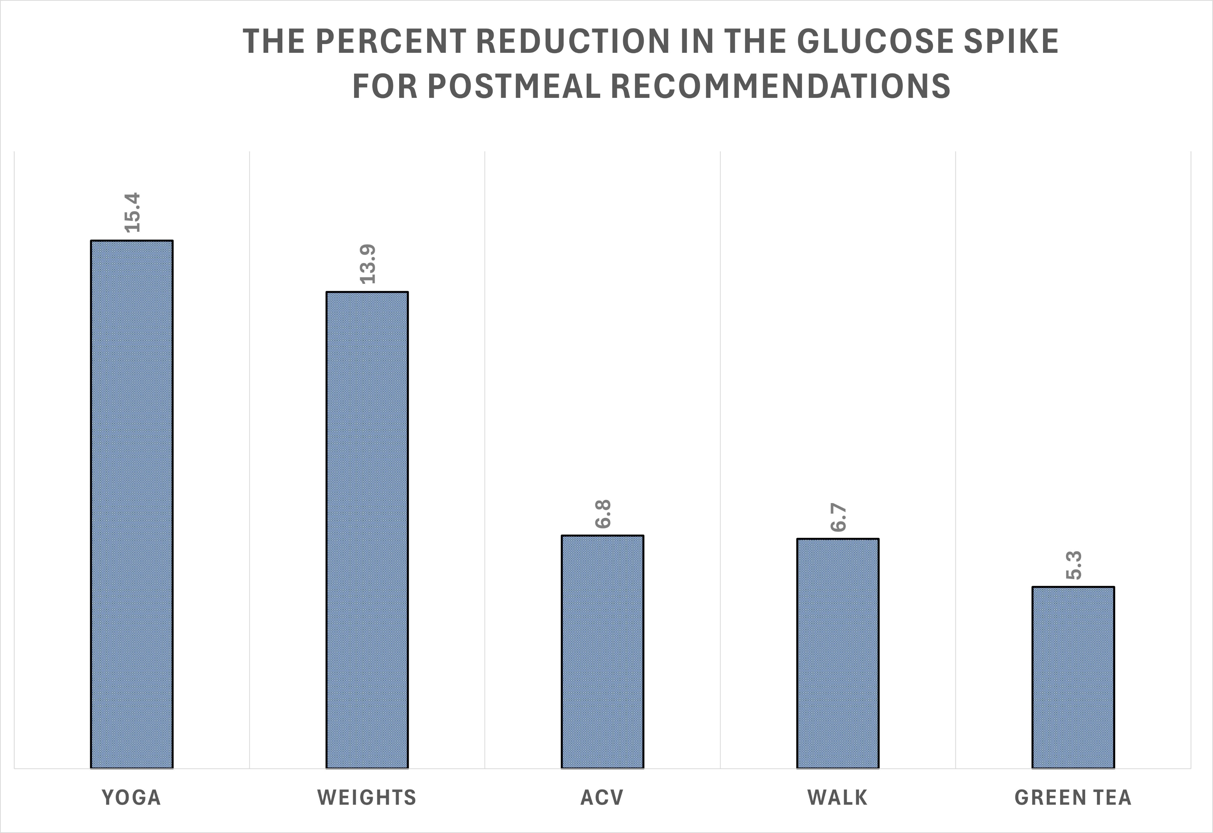
Graphs 5 and 6. The Percent Reduction in Glucose Spike for Premeal and Postmeal Recommendations

