Slide 1
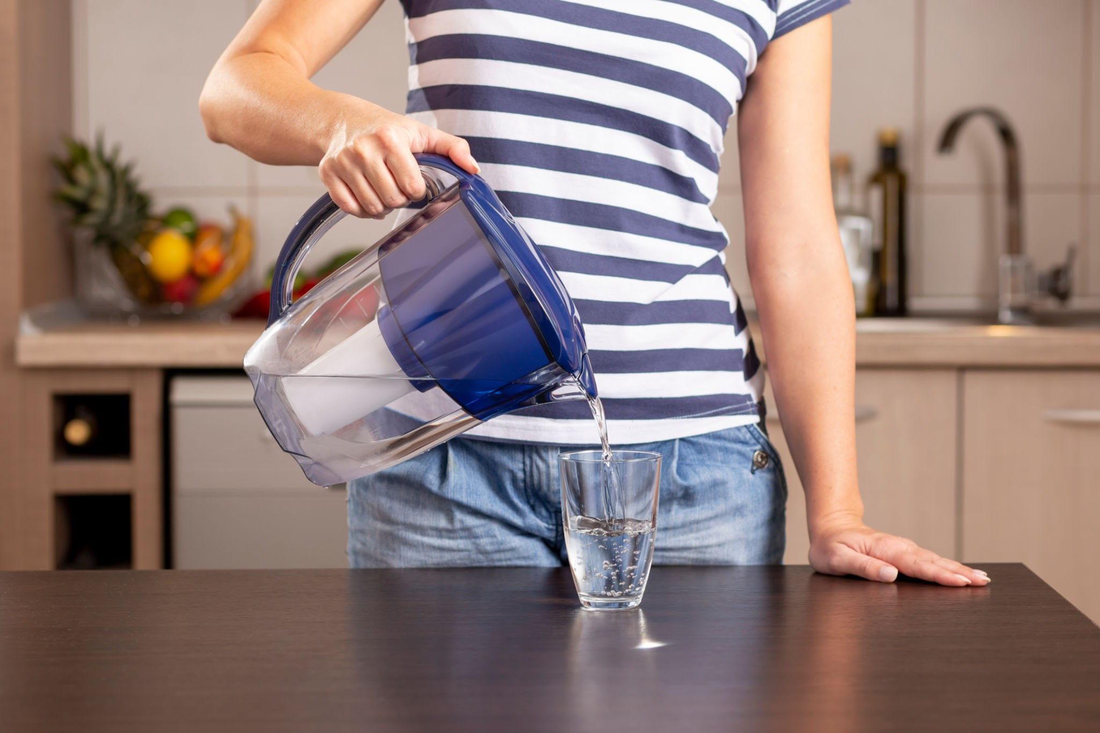
Which Filter is Better? (Solar or Gravel Filter)
By Abi and Piper

Slide 2
The Problem
Access to clean drinking water is one of the most important challenges for people. Different methods are used to make water safer, ranging from simple physical filters to advanced purification systems. Two low-cost approaches are gravel filtration and solar purification.
Gravel filtration works by passing water through layers of gravel and sand, which trap dirt, debris, and suspended particles. This method improves clarity but may not remove harmful microorganisms.
Solar purification uses the power of sunlight—either through heat or ultraviolet rays—to disinfect water. This method can reduce bacteria and viruses but depends on weather and exposure time.
By comparing these two methods, this project explores which technique is more effective at improving water quality.

Slide 3
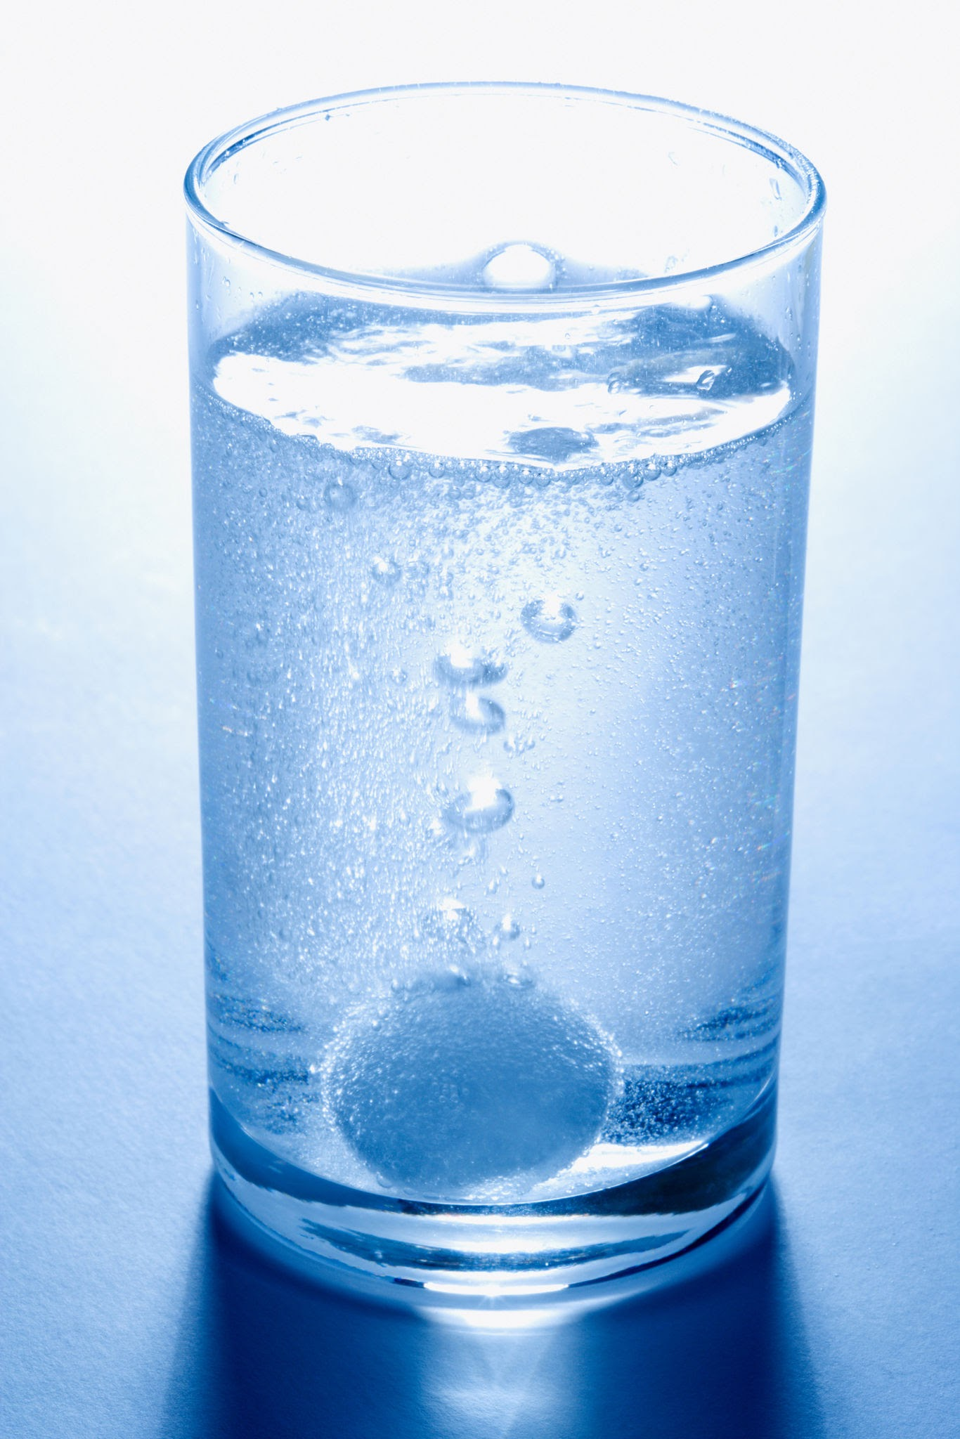
Hypothesis
We think that the solar filter would work better because it's more reliable than the gravel filter. With the gravel filter when water is passing through the layers there’s not a 100% chance it will get everything but the solar filter it's guaranteed to work if you set it up right.

Slide 4
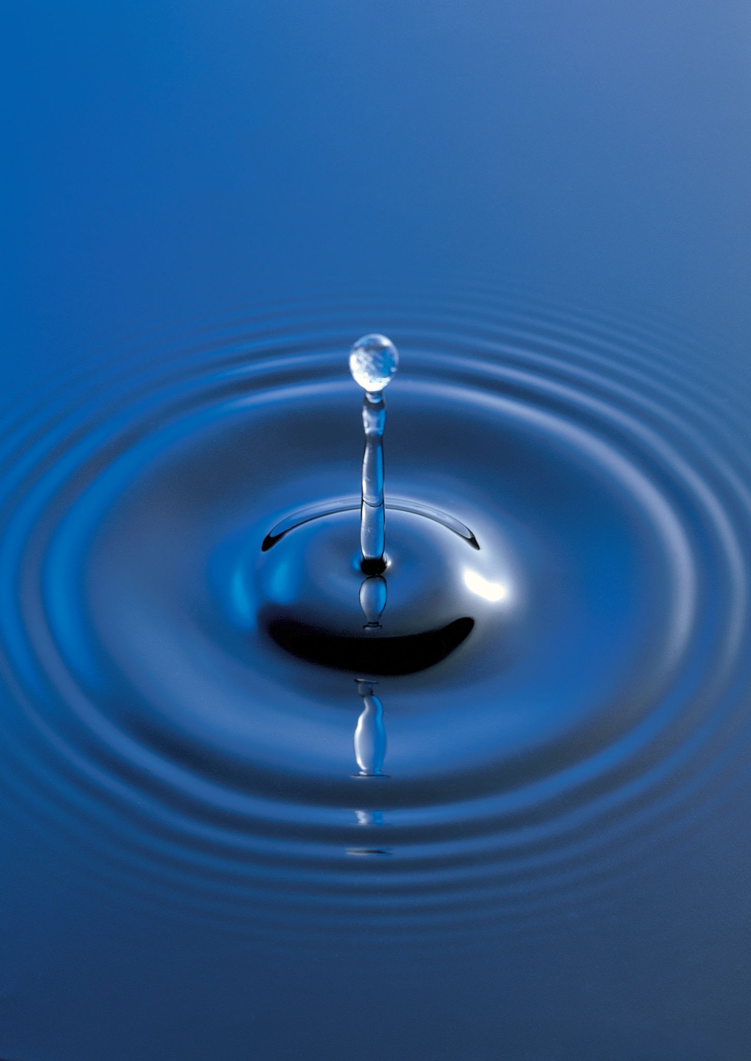
Making Observations
During the experiment, we observed that the gravel acted like a big stuff snatcher because the rocks are large and have wide spaces between them, the water or light moved through this layer very quickly. We saw that it could trap large items like twigs or leaves, but it let all the tiny, cloudy dirt particles slip right through the gaps. This is where the sand comes in. It trapped the bad, cloudy water!

Slide 5
Making Observations 2
Even though it only came out in tiny droplets, it was MUCH cleaner than when it was pond water. In contrast, we observed that the solar or fine filter acted like a "tiny stuff" shield. The water moved much more slowly through this filter. By the time it finished passing through this filter, the result looked much clearer and cleaner than before because the tiny particles were trapped. (finally!)

Slide 6
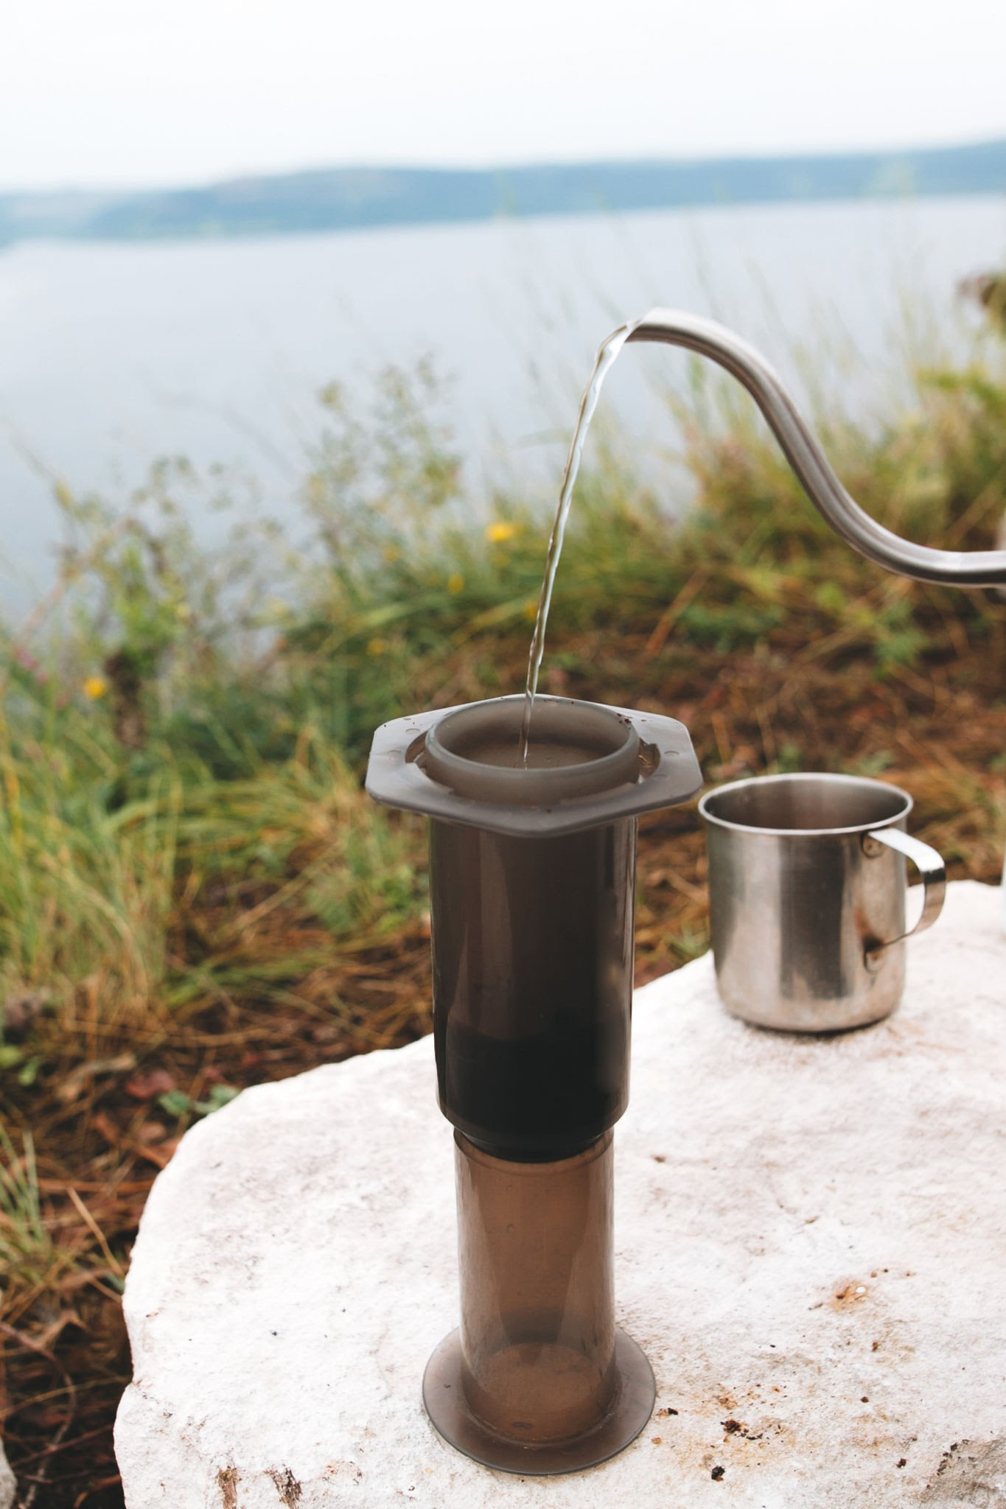
Conclusion
Neither method works best all the time—it really just depends on where you are! For example, if you were in a sunny, sandy desert, it would be much easier to use a solar filter to clean your water. But, if you were hiking near a cool body of water shaded by trees, a gravel filter would probably work better. It’s all about using what is around you!

