Slide 1
Propelling into the future!
By Phoenix Chen

Slide 2
Hypothesis

Slide 3
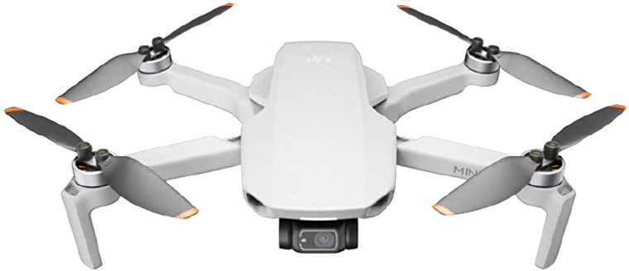
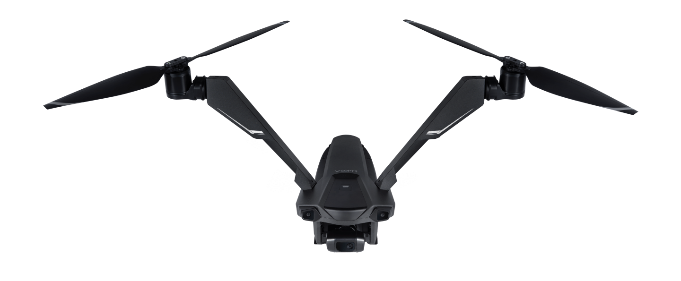
If I use a drone with 2 rotors instead of 3 or 4, then the drone should be more agile because 2 rotor drones usually have a high center of lift which means that the frame will be more stable.
V.S

Slide 4
Background Research

Slide 5
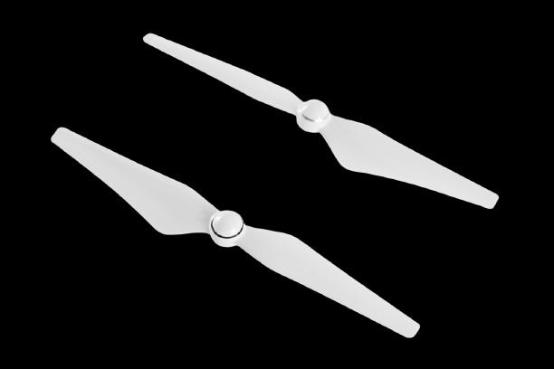
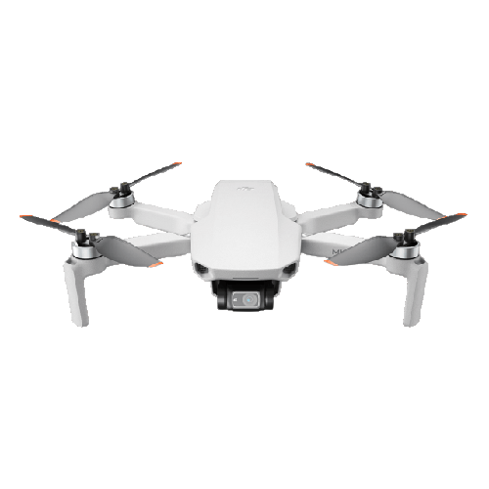
What Is a rotor?
Rotors spin with a motor attached to the bottom of the centre.
Rotor

Slide 6
What is a rotor?
What is a rotor? Rotors are used for propulsion and control. You can think of a rotor as a fan, because they work very similarly. Spinning blades push air down. All forces come in pairs, which means that as the rotor pushes down on the air, the air pushes up on the rotor (Airfoil). Propulsion is the action of driving or pushing forward.

Slide 7
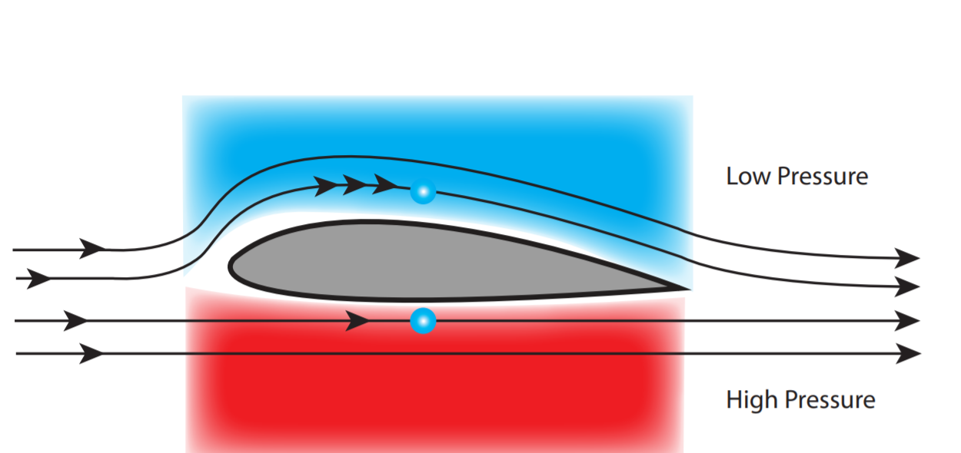
What Is AIRFOIL?
Air goes faster to keep up

Slide 8
What is airfoil?
What is airfoil? The air above the wing needs to travel and has a special shape, so it makes the air above it go faster. Faster air exerts less pressure, so the wing is lifted upwards. According to the Bernoulli Principle, this pressure differential pushes the flying object upward, giving it an upwards lift.

Slide 9
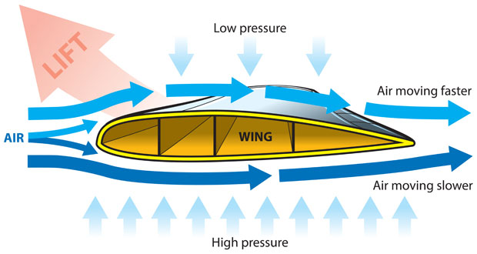
What is Bernoulli's principle?

Slide 10
What is Bernoulli's principle?
Bernoulli's principle is an increase in the speed of the air that occurs simultaneously with a decrease in static pressure or a decrease in the fluid's potential energy.

Slide 11
Variables

Slide 12
Controlled:
drone
Fully charged batteries
toy train track length
living room
Timer
Controller
Size/type of rotor
Size/type of motor
Manipulated: 2 motors and rotors, 4 motors and rotors and 3 motors and rotors.
Responding: The agility of drone.

Slide 13
Materials

Slide 14
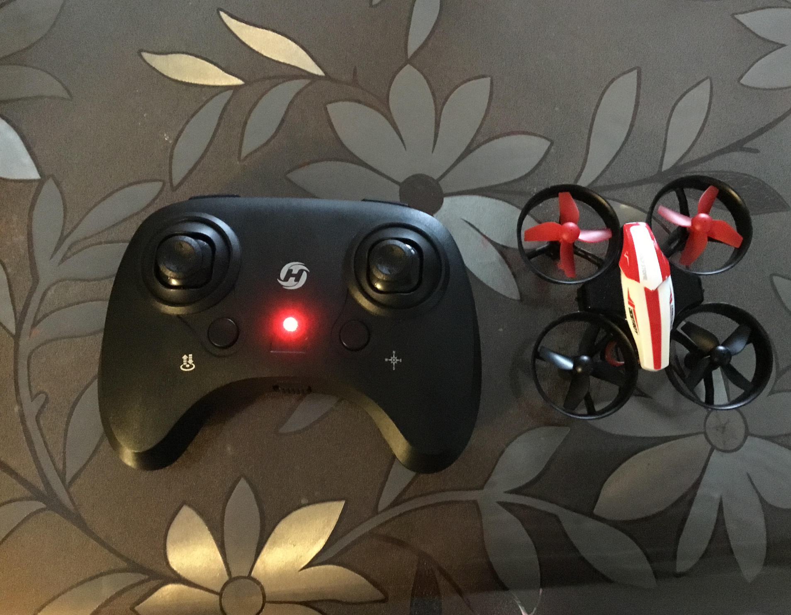
Drone
3 rechargeable batteries that go with the drone
Remote controls
Toy train tracks
A computer to charge the batteries
A cleared space to fly drone in
4 rotors
4 motors

Slide 15
Procedure

Slide 16
Gather materials
Charge drone batteries
Place toy train tracks in a straight line
Use controller to lift drone into air
Fly drone low above the line you made (4 rotors)
Record
Flip the drone
Record
Record how much time the drone can fly in the air
Repeat steps 3-9 with 2 rotors
Repeat steps 3-9 with 3 rotors
Clean up

Slide 17
Observations

Slide 18
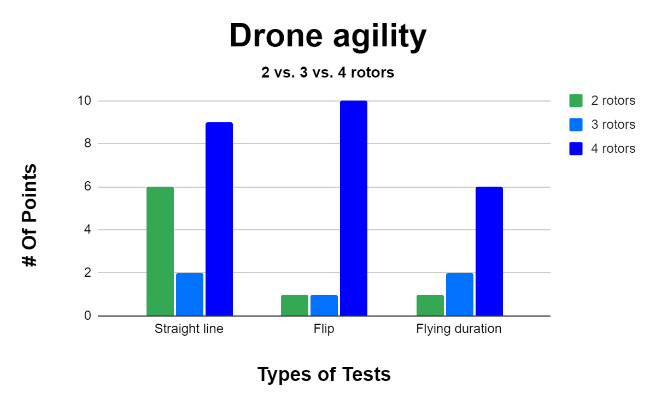

Slide 19
Observations (4 rotors)
The 4 rotored drone works well and is very sensitive with the drone controls.
When I flew it in a straight line right above some toy train tracks it would be pretty hard to keep it in a straight line thanks to the sensitivity. The drone can flip very easily without any observable jagged movements at all.

Slide 20
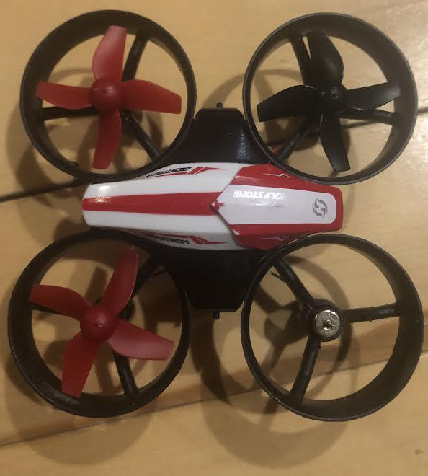
Observations (3 rotors)
The drone did not really fly up but looked more like someone getting dragged up the stairs. The drone was always tipped over and going in crazy directions and crashing into the walls. There was no control over the drone.
No rotor

Slide 21
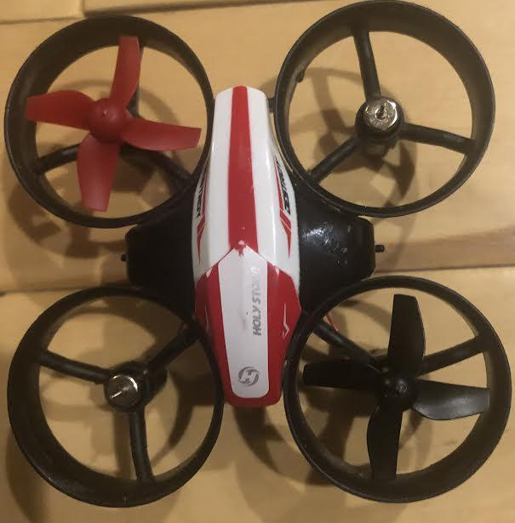
Observations (2 rotors)
No rotor
The drone did not rise at all and just stayed on the ground spinning in circles. Sometimes, it moved around and went into walls, but was mostly just trying to make me dizzy.
No rotor
Notes:
Tada

Slide 22
Analysis

Slide 23
4 rotors: The drone worked perfectly.
Why did it work so well?
Reason 1: The drone was made for 4 rotors.
Reason 2: The drone was equally balanced so it could move around easily.
3 Rotors: Did not fly up but ¾ of it did get lifted into the air.
Reason 1: It was still too heavy.
Reason 2: ¾ of a drone will be lifted up because of the low pressure but with 1 of the rotors not working the drone will tip and drag the drone the direction the missing rotor is pointing towards. That sounds okay, but just like 2 rotors, you have almost no control over where the drone goes because the pressure will want to go to the spinning rotor and then the drone will spin which will lead to the drone traveling in lots of different directions without you even touching the controller.
2 Rotors: The drone did not fly up.
Why did the drone not fly with 2 rotors?
Reason 1: The drone was too heavy
Reason 2: Because of the 2 rotors that were working, the pressure was lower than the pressure of the rotors that were not working. The air molecules will then want to travel to the area with less pressure so the rotor and motor, instead of moving up and down, the rotor will shift the drone left and right.

Slide 24
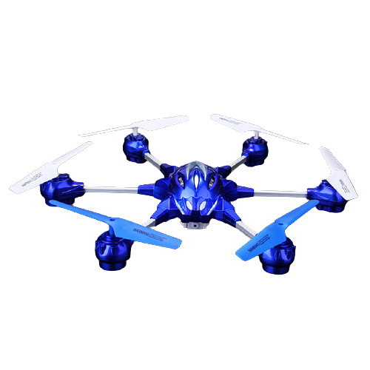
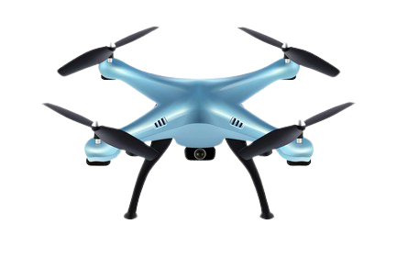
Analysis: Extension
Next time if I choose this project again, I would like to test out 6 rotors and see the difference between 4 rotors and 6. Is 6 going to be more agile? Can a drone like that still do flips? How long can a 6 rotor drone stay in the air?
Pic source:
https://image.shutterstock.com/image-vector/realistic-3d-blue-drone-quadcopter-260nw-1406190089.jpg
https://img.gkbcdn.com/s3/p/2015-05-15/w609-10-pathfinder-2-4-5channel-rc-6-rotor-copter-drone-3d-eversion-auto-return-aircraft-with-2-0mp-camera---blue-1571981307951.jpg

Slide 25
Conclusion

Slide 26
My hypothesis was incorrect. 2 rotors are too heavy and cannot stay in the air for more than a second. 4 rotors flies around with agility but runs out of battery fairly quickly. My hypothesis was incorrect because of the 2 rotors that were working, the pressure was lower than the pressure of the rotors that were not working. The air will then want to travel to the area with less pressure so the rotors and motors, instead of moving up and down, the rotor will shift the drone left and right.

Slide 27
Sources of error

Slide 28
I believe that some of the errors that could have affected the outcomes of this project are:
When I pulled off the rotor for the 2 and 3 rotor test, it might have affected the other rotors and motors.
The drone I used might have already had some balance issues.
The 4 rotors might have been made differently which would mean if a specific one wasn’t there, then the drone wouldn’t work the same.

Slide 29
Bibliography

Slide 30
last edited on 4 September 2021 last viewed Nov 20 2021 https://en.wikipedia.org/wiki/Aerodynamic_force
last edited on 29 November 2021 Unmanned aerial vehicle last viewed Nov 25 2021 https://en.wikipedia.org/wiki/Unmanned_aerial_vehicle
Is there a benefit to having the motors for a multi-rotor copter on the top vs the bottom of the frame? last viewed Nov 7
https://aviation.stackexchange.com/questions/9787/is-there-a-benefit-to-having-the-motors-for-a-multi-rotor-copter-on-the-top-vs-t/9792
Lesics Drones | How do they work? last viewed Nov 2 https://www.youtube.com/watch?v=N_XneaFmOm
M.HassanalianA. Abdelkefi ; Classifications, applications, and design challenges of drones: A review May 2017, last viewed Nov 4 https://www.sciencedirect.com/science/article/abs/pii/S0376042116301348
NDA Hack: How to make Quadcopter at Home - Make a Drone, last viewed Nov 30 https://www.youtube.com/watch?v=XvMdL1PncEQ
Bibliography: 2002-2021, last viewed Nov 30 https://www.sciencebuddies.org/science-fair-projects/science-fair/writing-a-bibliography-examples-of-apa-mla-styles#howtowriteabibliographyPrinciples of flight; Foam wing last viewed Dec 1
https://www.nasa.gov/sites/default/files/atoms/files/foam_wing_k-12.pdf
https://www.teachpe.com/biomechanics/fluid-mechanics/bernoulli-principle
https://d346xxcyottdqx.cloudfront.net/wp-content/uploads/2020/08/ContributionRenewable-magazine-e1612945820532.jpg
https://www.lifewire.com/how-to-add-bullet-points-to-google-slides-presentations-4584364#:~:text=Open%20a%20Google%20Slides%20presentation,bullet%20list%20in%20Google%20Slides.

Slide 31
Acknowledgements
I want to thank all the authors that wrote the amazing articles I used to help with my background research.
Mrs. Secord because she explained all of the guidelines and made sure I was on the right track.
Dr. M. Hassanalian A. Abdelkefi because he helped me with quite a lot of questions that I didn't have the answers to.
My mom, dad, and little brother for not bothering me and for being encouraging.
Klaire (friend) for encouraging me and helping me on deciding on my title.
And all the other people who have helped me to make this project possible. (Which is a lot)

Slide 32
Application

Slide 33
I think my experiment will really benefit everyone in this world in the future because I believe that in the future drone delivery, military use, healthcare, agriculture, wildlife monitoring, search and rescue, and a lot more will be a huge investment. I wanted to test out if we could cut out the battery use to make drones more efficient to produce.

