Slide 1
Science Fair Logbook
Name: Ahmad Omari
Notes:
Make a copy of this logbook (File - Make a Copy) and save in your Google Drive.
Share it with your Science Fair teachers: mmolfert@educbe.ca amduncan@educbe.ca kknanji@educbe.ca

Slide 2
Topic:
My topic is about volcano eruptions. The reason I chose this topic is because i want to learn how chemical reactions make carbon dioxide gas and looks like a volcano eruption

Slide 3
Testable Question
How does the amount of vinegar affect the eruption height ?
What is the effect of acid on base(baking soda)?
Which vinegar amount is/does/makes/etc has the strongest reaction?
Notes:
See D2L - Content - Getting Started - Planning Page 2

Slide 4
Background Information
The information I gathered for this topic was that baking soda is a base. Vinegar is an acid. When you mix them, they react together and create carbon dioxide gas (CO₂). It’s called an acid‑base reaction.
The chemical reaction creates:
carbon dioxide gas
water
sodium acetate
The CO₂ gas is what makes the eruption happen. This experiment is fun and safe as it looks like real lava. It reacts quickly and is easy to control

Slide 5
Background Information
Research your topic and write about what you find out IN YOUR OWN WORDS. Add slides as necessary. Make sure to note your sources of information on the Sources page.
since my topic is volcano eruption, here is the purpose of my experiment and what it shows this experiment show how acid + base react. Baking soda is the base and vinegar is the acid when mixed, it creates a chemical reaction plus it creates carbon dioxide gas, this gase pushes liquids up creating an eruption. I found this using AI but i wrote it my own words.

Slide 6
Sources of Information
Note all sources used - websites, books, experts, etc. ( *Google is not a website, follow links to find the page information.) Add slides as needed.
Title | Author | Information (web link, publisher, etc) | Year
Equation for the Reaction Between Baking Soda and Vinegar |  | https://www.thoughtco.com/equation-for-the-reaction-of-baking-soda-and-vinegar-604043 | 2026
Volcano eruption |  | Youtube
Notes:
See D2L - Content - Referencing Your Sources

Slide 7
Variables
Manipulated / Independent Variable
ONE thing that you will test/change:
Amount of vinegar
Responding / Dependent Variable
The height of eruption
Notes:
See D2L - Content - Hypothesis - Variables and Hypothesis

Slide 8
Variables
Things we have to be very careful to keep the same every time we test so that they do not affect the results/outcome of the experiment:
Amount of baking soda
type / size of container
Location of experiment
Time of the reaction
Notes:
See D2L - Content - Hypothesis - Variables and Hypothesis

Slide 9
Hypothesis
If a add more vinegar then explosion will be higher cause more gas this gas is called carbon dioxide which causes the vinegar to raise causing an eruption.
Notes:
See D2L - Content - Hypothesis

Slide 10
Materials
Materials I will use are as below:
1 small plastic bottle (500 mL size, for the volcano chamber)
1/4 cup baking soda (sodium bicarbonate, for the eruption reaction)
1 cup vinegar (white vinegar, acidic reactant)
Red food coloring (5–10 drops, for lava effect)
Dish soap (2 tablespoons, to make the eruption foamy)
Construction paper or clay (to build the volcano shape around the bottle)
Tray or large plate (to catch overflow and keep the area clean)
Spoon or funnel (to help pour ingredients safely)
Notebook or digital logbook (for recording observations and results)
Notes:
See D2L - Content - Designing Your Experiment

Slide 11
Procedure
Place the plastic bottle in the center of a tray or large plate.
Build the volcano structure around the bottle using construction paper or clay, leaving the top open
Put on safety goggles to protect your eyes.
Add 1 cup of baking soda into the bottle using a spoon or funnel.
Add 2 tablespoons of dish soap to the bottle.
Add 5–10 drops of red food coloring for lava effect.
Prepare 1 cup of vinegar in a separate container
Pour the vinegar into the bottle quickly and step back.
Observe the chemical reaction and record what happens in my logbook.
Clean up the area and safely dispose of the materials.
Notes:
See D2L - Content - Designing Your Experiment

Slide 12
Experiment: Trial 1
Date:
Data: (measurements)
Observations:/Notes
During Trial 1, the volcano took about a minute to start erupting after I added the vinegar. As the amount was too little the eruption was not high at all. It actually didnt look like a volcano. Almost no noticeable eruption !
Material | Measurement
Baking soda | 1 ⅕ tablespoons
vinegar | ¼ cup
Dish soap | A small squeeze
Food coloring | A few drops
Notes:
See D2L - Content - Designing Your Experiment

Slide 13
Experiment: Trial 2
Date:
Data: (measurements)
Observations:/Notes
During Trial 1, the volcano took about a minute to start erupting after I added the vinegar. I accidentally spilled a little extra vinegar because I panicked when it didn’t react right away, but the eruption still worked well. Overall, the experiment went smoothly and the reaction happened like I expected without any mess.
Material | Measurement
Baking soda | 2 tablespoons
vinegar | ½ cup
Dish soap | A small squeeze
Food coloring | A few drops
Notes:
See D2L - Content - Designing Your Experiment

Slide 14
Experiment: Trial 3
Date:
Data: (measurements)
Observations/Notes:
In my last trial I exceeded the amount of both baking soda and vinegar which resulted in a very high eruption causing alot of mess!
Material | Measurement
Baking soda | ¼ Cup
Vinegar | 1 cup
Vinegar | A small squeeze
Food coloring | A few drops
Notes:
See D2L - Content - Designing Your Experiment

Slide 15
Results: Chart
Trial 1 | Small eruption | ¼ cup vinegar 1 tbsp baking soda | Approx. 2-6 cm
Trial 2 | Medium eruption | ⅕ cup vinegar + 2 tbsp baking soda | Approx 5 -15 cm
Trial 3 | Big eruption | 1 Cup vinegar + ¼ cup baking soda | Approx. 10 -25 cm
Notes:
See D2L - Content - Designing Your Experiment
See D2L - Content - Conclusion, Application, and Extensions

Slide 16
Results: Analyze
When I did my volcano experiment, I noticed that the amount of vinegar I used made a big difference in how strong the reaction was. When I added small amounts of vinegar, the reaction was pretty weak and didn’t make much foam. It fizzed a little, but it didn’t rise very high.
When I used medium amounts, the reaction got stronger. The bubbles formed faster, and the foam came up higher. It looked more like a real volcano.
When I used the biggest amounts of vinegar, the reaction was the strongest. The foam shot up the most and lasted the longest. It also overflowed the container more than the smaller amounts did.
From this, I can tell that more vinegar makes a bigger reaction, because there’s more liquid to react with the baking soda. But I also noticed that once the baking soda was all used up, the reaction stopped, even if I added extra vinegar. That means the reaction only works as long as both ingredients are still there.
Overall, the results matched what I expected: the more vinegar I added, the bigger the “lava” reaction became.
Notes:
See D2L - Content - Designing Your Experiment
See D2L - Content - Conclusion, Application, and Extensions

Slide 17
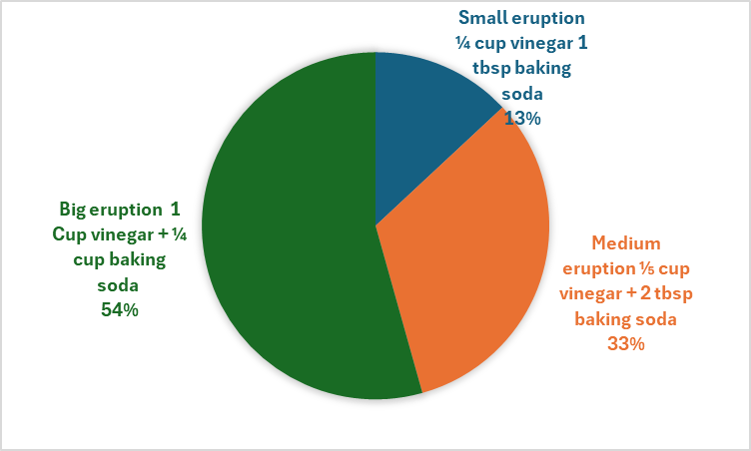
Results: Graph
Notes:
See D2L - Content - Designing Your Experiment
See D2L - Content - Conclusion, Application, and Extensions

Slide 18
Conclusion
My question was:
What happens if i change the amount of vinegar in my experiment?
The answer to my question is:
The volcano erupts because the baking soda and vinegar react and make gas, which pushes everything out and causes the eruption. More baking soda + vinegar results in higher eruption.
My hypothesis was correct because:
the volcano did erupt when I mixed baking soda and vinegar, just like I predicted. The reaction created gas and pressure, which caused the eruption to happen the way I expected.
Notes:
See D2L - Content - Conclusion, Application, and Extensions

Slide 19
Applications
This experiment helps show how chemical reactions work in everyday life. The reaction between baking soda and vinegar is similar to real reactions that produce gas, pressure, or foam. For example, this type of reaction is used in things like fire extinguishers, cleaning products, and even some science‑based toys. It also helps explain how real volcanoes build up pressure underground before they erupt, even though real volcanoes use heat and magma instead of baking soda and vinegar.
Doing this experiment also teaches how changing the amount of one ingredient can change the strength of a reaction. This idea is important in cooking, chemistry, and many science fields where the right amounts of materials matter. Overall, this experiment helps me understand chemical reactions better and how they can be controlled by adjusting the ingredients.
Notes:
See D2L - Content - Conclusion, Application, and Extensions

Slide 20
Sources of Error
There were a few things in my experiment that could have affected my results. One possible source of error was that the amounts of vinegar or baking soda might not have been measured perfectly every time. Even small differences could change how strong the reaction was. Another source of error is that the volcano container might not have been cleaned the exact same way between trials, which could leave leftover baking soda or vinegar and affect the next reaction.
The temperature of the room or the ingredients could also have changed the reaction slightly. Pouring the vinegar at different speeds might have made some eruptions look stronger or weaker. Finally, some of my observations were based on what I saw, which means they could be a little subjective. These small errors could have made the results slightly different each time.
Notes:
See D2L - Content - Conclusion, Application, and Extensions

Slide 21
Extensions
If i did this experiment again, i would change…hmm let's see i would i add another type of vinegar to see what happens.
Notes:
See D2L - Content - Conclusion, Application, and Extensions

Slide 22
Extensions
To learn more about this topic, I could try doing the volcano experiment again but change one thing at a time. For example, I could test different types of vinegar, different amounts of baking soda, or even try adding dish soap or food coloring to see how it affects the eruption. I could also try using a different volcano shape or container to see if that changes how the eruption comes out. Doing more experiments like this would help me understand what makes the reaction stronger or weaker.
Notes:
See D2L - Content - Conclusion, Application, and Extensions

Slide 23

CONGRATULATIONS!!
You have completed your experiment!
Make sure that you enter information from this logbook into the CYSF Digital platform.
You are now ready to create your tri fold display and practice your presentation.

