Slide 1
Science Fair Logbook
Name: Ersheen Kaur
Notes:
Make a copy of this logbook (File - Make a Copy) and save in your Google Drive.
Share it with your Science Fair teachers: mmolfert@educbe.ca amduncan@educbe.ca kknanji@educbe.ca

Slide 2
Topic:
Write about the topic you chose. Why did you choose this topic? What do you hope to find out?
The topic that I choose is “ Tooth Damage Caused By Different Drinks” because my elder sister suffered from dental issues and I want to know the details why it happened. Many drinks that we enjoyed can weaken or damage tooth enamel because of acids and sugar. This experiment helps students understand which drinks are healthiest for their teeth and how everyday choices affect dental health. And Dental treatment is very costly and painful too so I want that everybody has a good teeth and health.

Slide 3
Testable Question
How does ___soda______ affect ___teeth______?
What is the effect of ___juice____ on ____teeth______?
Which ___drinks_______makes _____teeth healthier__________?
In this project I use eggshells as tooth enamel as both are made of calcium , compounds and now a days children and adults both enjoy drinking different varieties so I want to experiment which drinks are healthiest for our teeth.
Notes:
See D2L - Content - Getting Started - Planning Page 2

Slide 4
Background Information
What questions/information do you need to find out about your topic? What is some important vocabulary?
Some questions I need to find out is :
1) how does acid in drinks affect tooth enamel?
2) Are sugary drinks more harmful than non sugary drinks?
3) What can people do to protect their teeth from damage caused by drinks
Some vocabulary words are
Enamel- the hard layer outside of teeth to protect the teeth
Acid- a substance in some drinks that can damage tooth enamel
Cavity- a hole in tooth caused by decay

Slide 5
Background Information
Research your topic and write about what you find out IN YOUR OWN WORDS. Add slides as necessary. Make sure to note your sources of information on the Sources page.
Soda:
Soda uses lots of sugar contents with carbonation (means dissolving carbon dioxide gas into liquid) which makes tooth decay happen very easily also soda (cola specifically) has lots of high acid in their drinks leading to soft enamel too.
Milk:
Soda is bad but milk on the other hand is the opposite. Next to water, milk is the healthiest drinks for our teeth. Milk protects our enamel, containing vitamins and calcium makin it reduce tooth decay.
Water:
Now water makes you hydrated which help increasing the flow of saliva and the flow of protective minerals which stay in the saliva that protect our teeth from decaying.

Slide 6
Sources of Information
Note all sources used - websites, books, experts, etc. ( *Google is not a website, follow links to find the page information.) Add slides as needed.
Title | Author | Information (web link, publisher, etc) | Year
Soda | Colgate-Palmolive Company | Colgate® | Toothpaste, Toothbrushes & Oral Care Resources | 2026
milk | Colgate-Palmolive Company | Colgate® | Toothpaste, Toothbrushes & Oral Care Resources | 2026
water | James norman | Healthline: Medical information and health advice you can trust. | 2026
Notes:
See D2L - Content - Referencing Your Sources

Slide 7
Variables
Manipulated / Independent Variable
ONE thing that you will test/change:
Type of drink used ( cola,juice,energy drinks,milk, and water).
Responding / Dependent Variable
The thing I think will change or be affected:
How will you measure it? :
Amount of damage to eggshells (colour change, softness, surface damage).
Notes:
See D2L - Content - Hypothesis - Variables and Hypothesis

Slide 8
Variables
Controlled Variables
Things we have to be very careful to keep the same every time we test so that they do not affect the results/outcome of the experiment:
Things kept the same for a fair test
Same size eggshells
Same soaking time
Same type of container
Same amount of liquid in each cup
Same room temperature
Notes:
See D2L - Content - Hypothesis - Variables and Hypothesis

Slide 9
Hypothesis
Your prediction, or what you think will happen:
If _________________ then _____________ because __________________.
(I do/change this…) (I think this will happen) (Why? )
*use info from your research or background knowledge to help explain)
My hypothesis is that energy drinks is going to be the most amount of damage to the eggshells because it has a high caffeine which causes fast heartbeat, headaches and more. It also has lots of sugar that can give cavities and make you gain weight. I think that water is going to be the least amount of damage to the eggshells because we drink water everyday and we never have any cavities or other teeth problems to our teeth.
Notes:
See D2L - Content - Hypothesis

Slide 10
Materials
What materials will you use for your experiment? Be specific about amounts whenever possible.
Clean eggshells
Cola
Juice
Sport drinks
Milk
Water
15 clear cups
Permanent marker (labelling cups)
Paper towels ( spills)
These materials will be at home and grocery stores
Notes:
See D2L - Content - Designing Your Experiment

Slide 11
Procedure
List the step-by-step procedure you will follow to conduct your experiment. Be as specific as possible and include exact measurements, quantities, times, etc.
Get clean dry eggshells
Place eggshells in each cups
Pour drink(soda, water,energy drink,milk, juice) into the cups
Leave cups at room temperature for 3 days
Observe eggshells and write down notes
after a 3 days remove eggshells from cups
Compare results and decide which drink gave the most amount of damage and the least
Notes:
See D2L - Content - Designing Your Experiment

Slide 12
Experiment: Trial 1
Date: 21 jan 2026 12:37
Data: (measurements)
Observations:/Notes
Some notes that I observed was that milk and water no matter how much I soaked them they had no damages .Juice , energy drink ,soda changed their colour and soda was the worst one of them all. Energy drink had turned grey and it started to be a little soft. For pepsi the colour changed into this dark brown colour in two days. Juice turned this light pink also in just two days. Overall monster,pepsi, and guava juice will give you tooth decay and cavities.
drinks | temp | damage | time | started
milk | 22 | none | 3 days | sunday
water | 22 | none | 3 days | sunday
pepsi | 22 | Colour change | 3 days | sunday
monster | 22 | Colour change softness | 3 days | sunday
Guava juice | 22 | Colour change | 3 days | sunday
Notes:
See D2L - Content - Designing Your Experiment

Slide 13
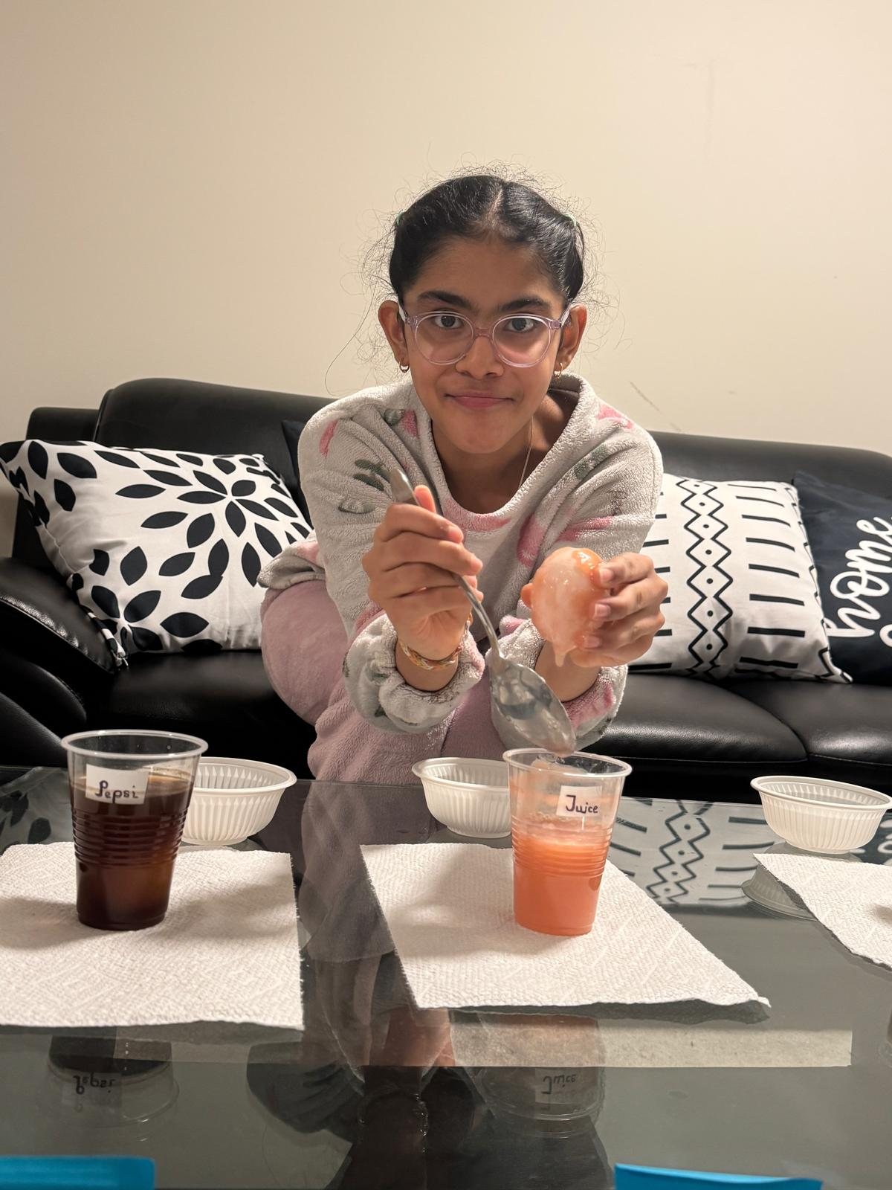
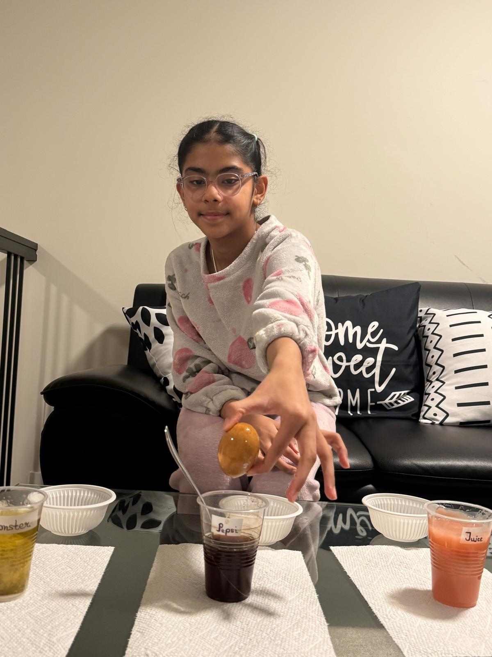
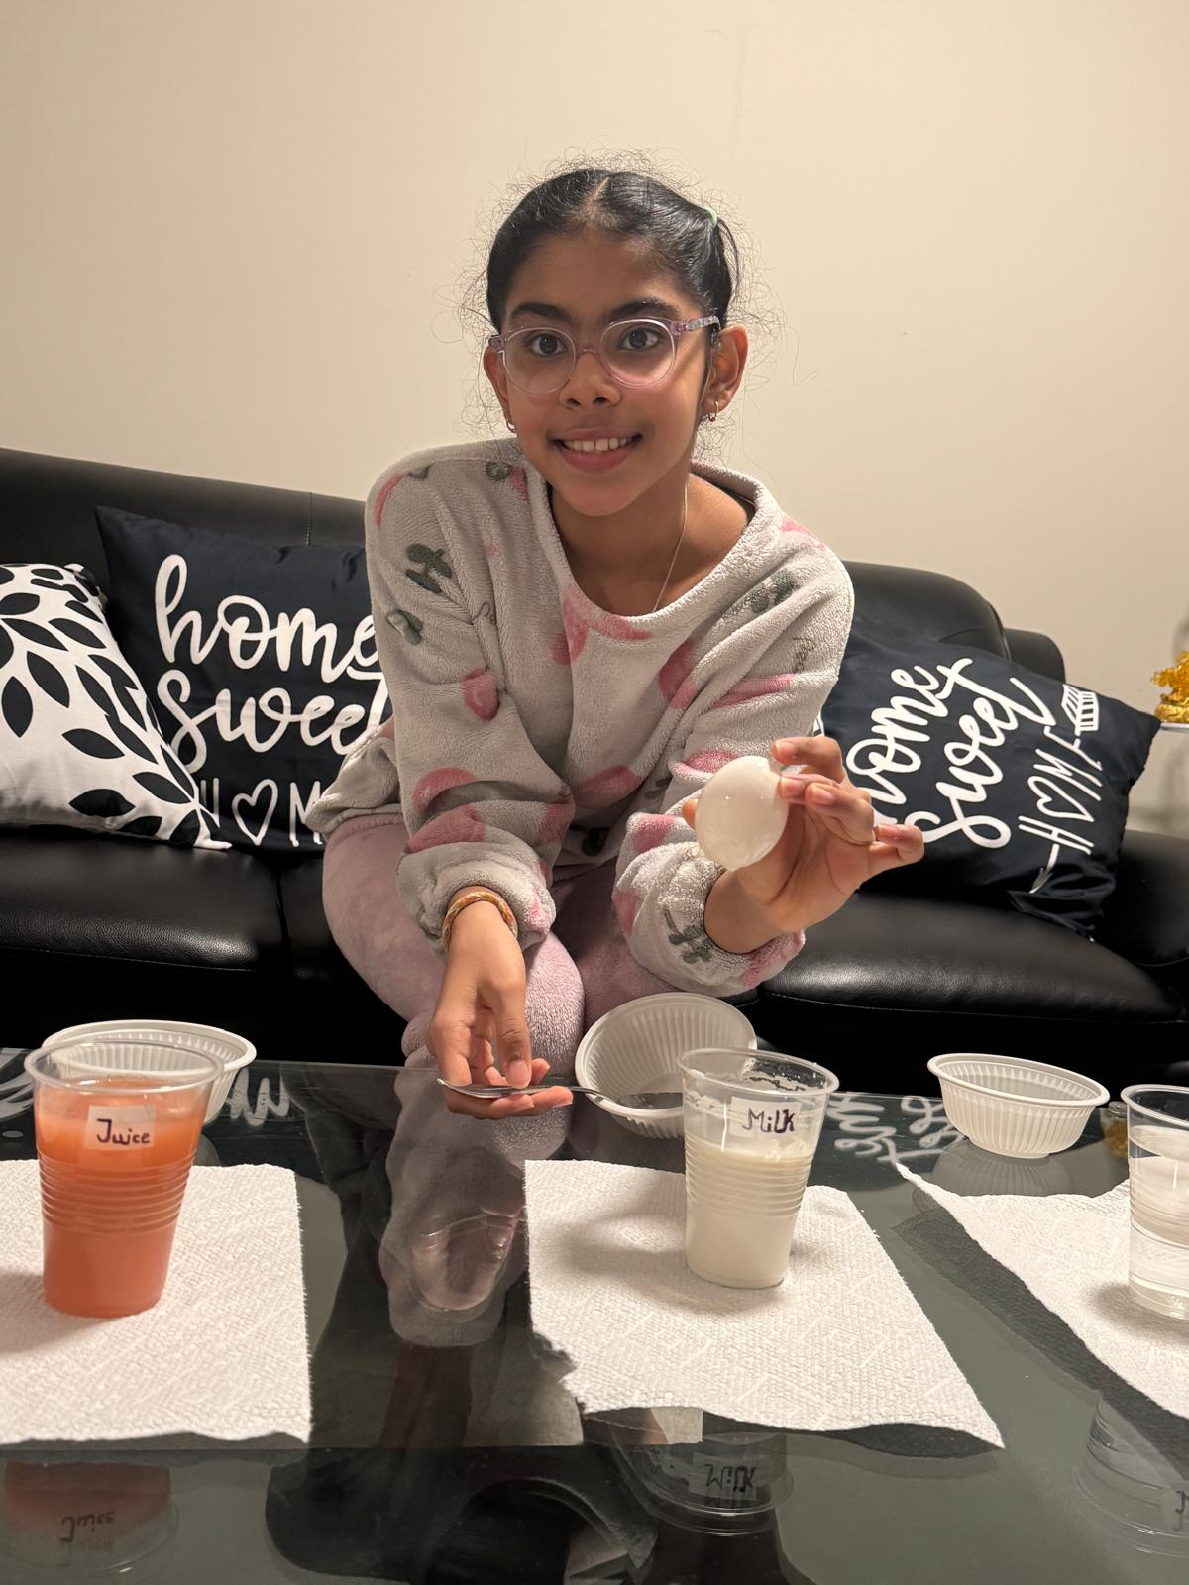
Photos of 1st trial

Slide 14
Experiment: Trial 2
Data: (measurements)
Date:
drinks | temp | started | How long | damage
soda | 22 | sunday | 3 days | Colour change
Energy drink | 22 | sunday | 3 days | Colour change
juice | 22 | sunday | 3 days | Colour change
milk | 22 | sunday | 3 days | Colour change
water | 22 | sunday | 3 days | Colour change
Observations/Notes: some observations I had noticed is that water and milk do no damage like the 1st trial . Pepsi was also the worst with a dark brown shade with some spots a tiny bit darker than the other spots on the egg. Juice was pink colour. The egg for energy drinks was yellow lighter than the other colours.
Notes:
See D2L - Content - Designing Your Experiment

Slide 15
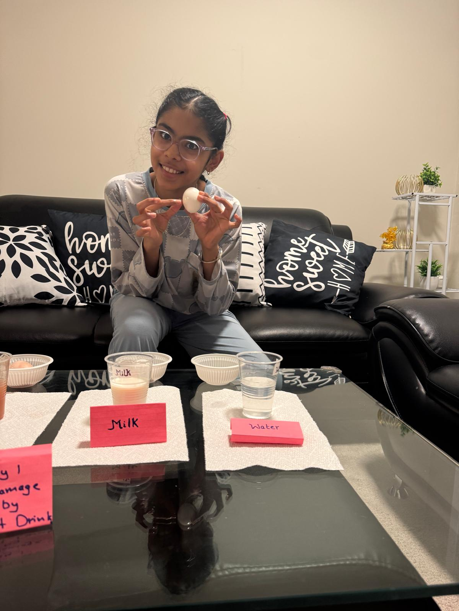
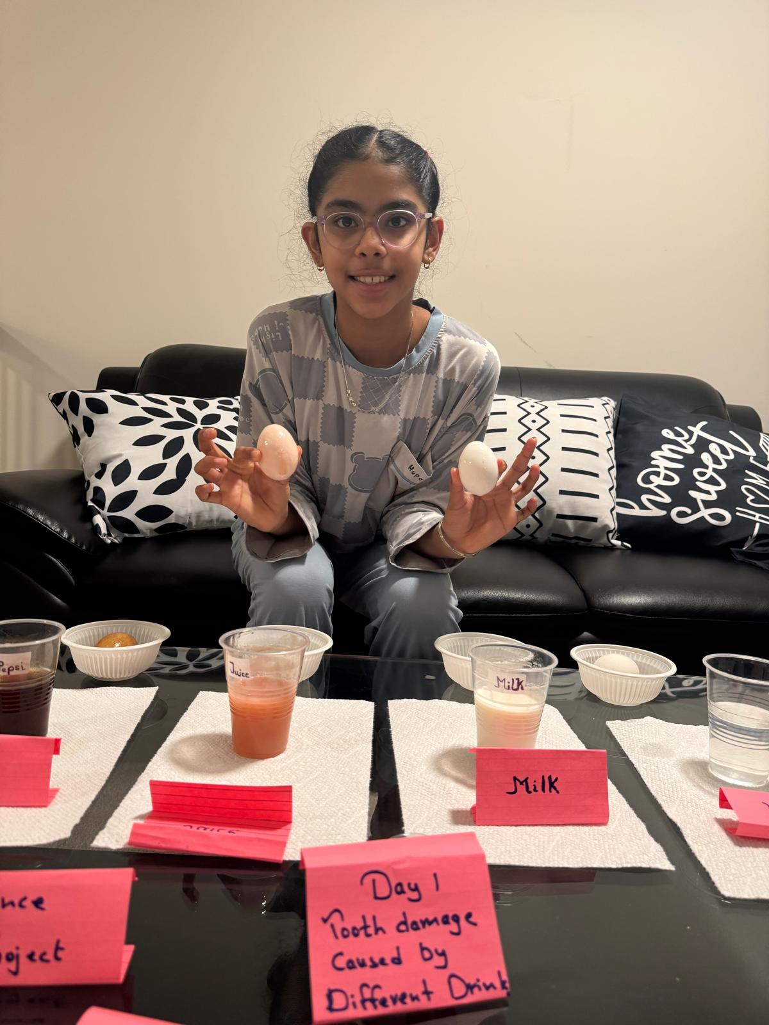
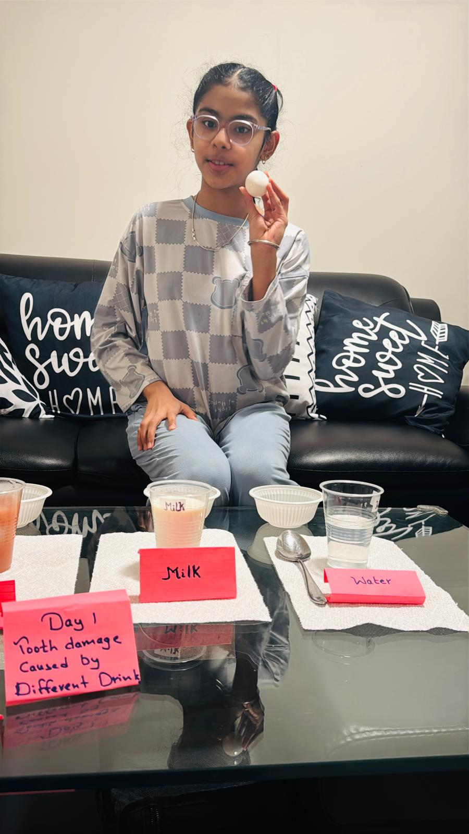
Experiment: Trial 2
Photos:
Notes:
See D2L - Content - Designing Your Experiment

Slide 16
Experiment: Trial 3
Data: (measurements)
Date:
drinks | temp | started | How long | damage
soda | 22 | sunday | 3 days | Colour change
Energy drink | 22 | sunday | 3 days | Colour change
juice | 22 | sunday | 3 days | Colour change
milk | 22 | sunday | 3 days | Colour change
water | 22 | sunday | 3 days | Colour change
Observations/Notes: same for all of the trial 2 and 1 we have the same result . pepsi was the worst and water is the best. Pepsi was brown. Energy drink was slightly yellow. Juice was pink. Milk was white. Water was white.
Notes:
See D2L - Content - Designing Your Experiment

Slide 17
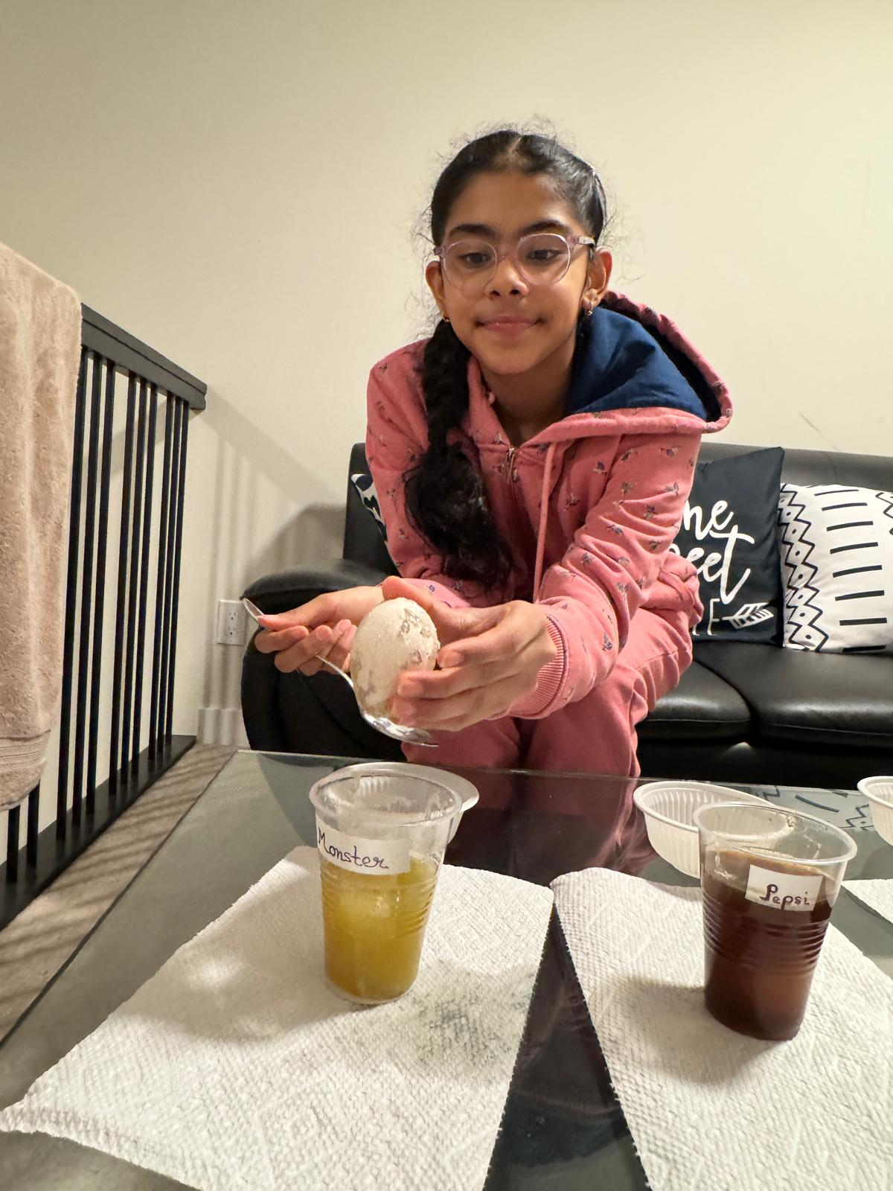
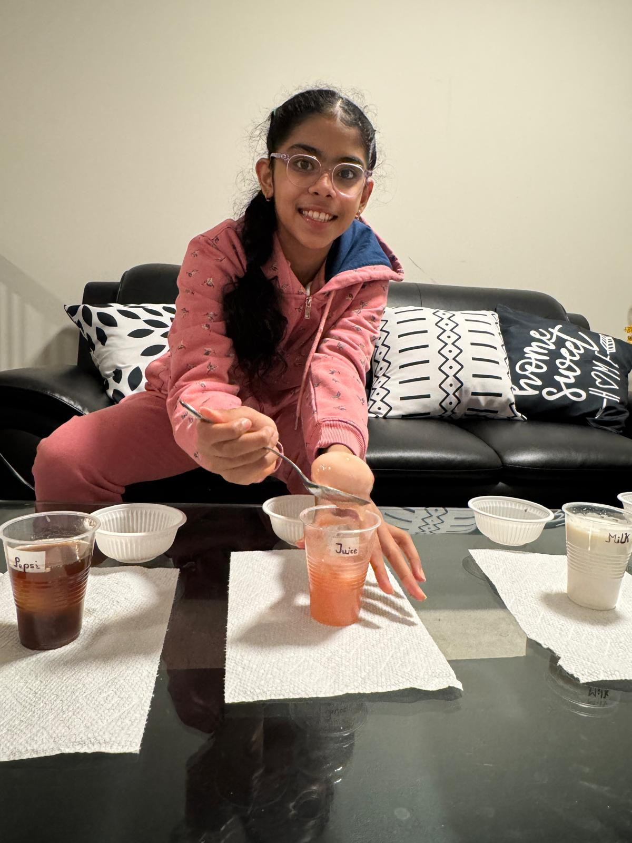
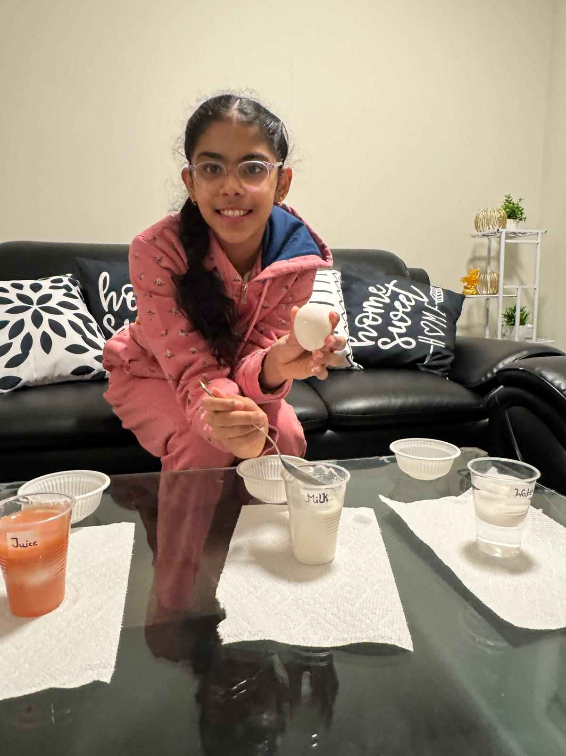
Experiment: Trial 3
Photos:
Notes:
See D2L - Content - Designing Your Experiment

Slide 18
Results: Chart
Put your data together into a chart.
Example: (you can change the chart)
trials | Most damage | Least damage | Egg colour
Trial 1 | pepsi | water | white
Trial 2 | pepsi | water | white
Trial 3 | pepsi | water | white
Notes:
See D2L - Content - Designing Your Experiment
See D2L - Content - Conclusion, Application, and Extensions

Slide 19
Results: Analyze
Look at your data and observations. Look for patterns and trends. Explain what happened in your experiment and what you found out:
As the 3 trial were going on milk and water had no damage showing no cavities and tooth decay. Which means milk and water were the best for your teeth. For juice since I used guava juice the egg was pink making it bad for your teeth.soda and monster had the same damages to the teeth. Soda was dark brown but monster was a lighter brown making soda bad. There were no changes to how soft the egg is.
Notes:
See D2L - Content - Designing Your Experiment
See D2L - Content - Conclusion, Application, and Extensions

Slide 20
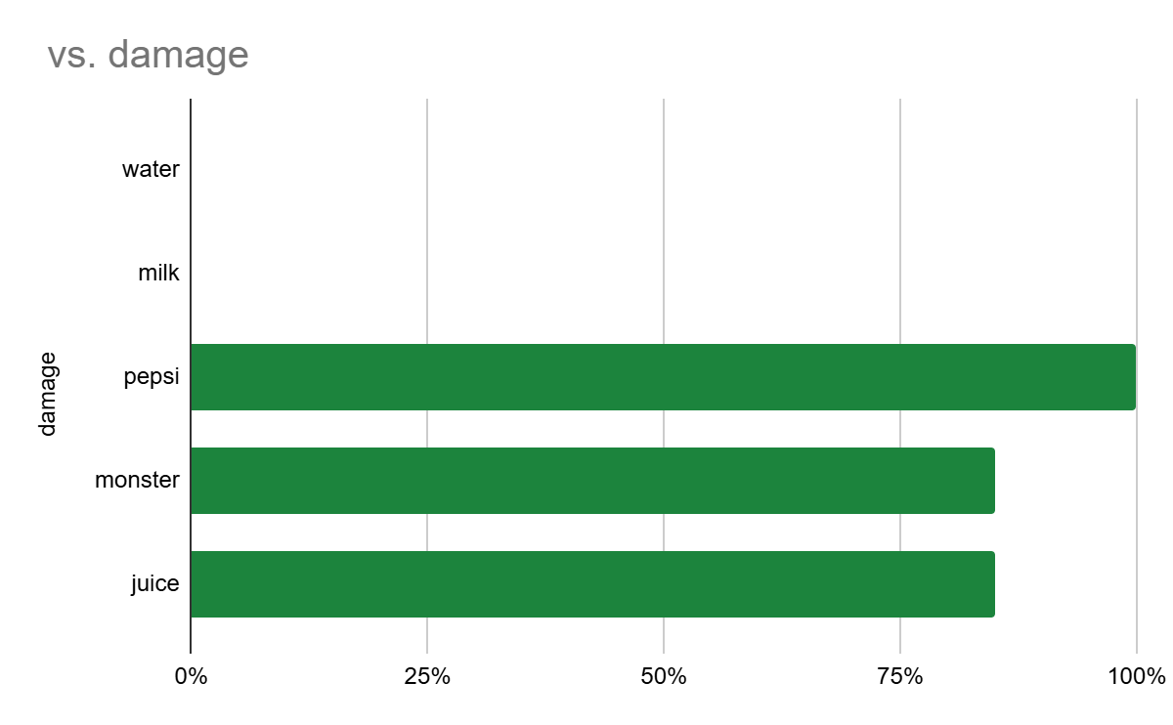
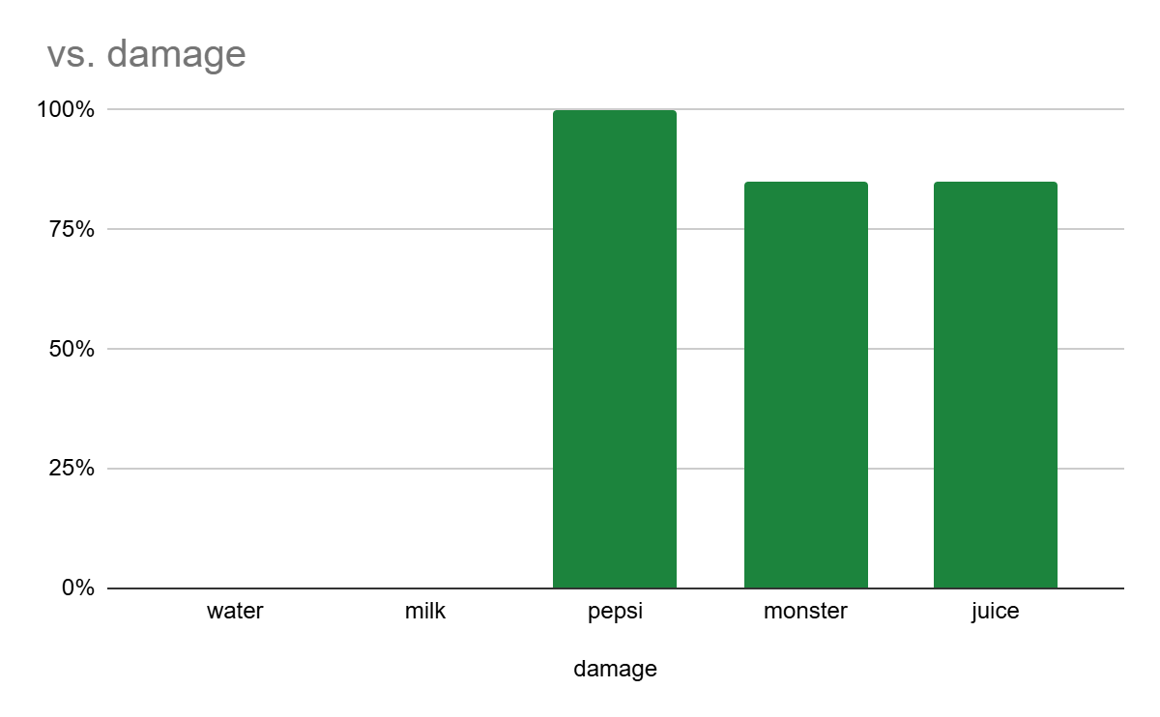
Results: Graph
Graph your data for a visual display of your results.
Use Google Sheets or another website and copy the graph onto this slide, or draw by hand and upload a photo.
Ask your Science Fair teachers for help if you need it!
Notes:
See D2L - Content - Designing Your Experiment
See D2L - Content - Conclusion, Application, and Extensions

Slide 21
Conclusion
My question was: which drink has the most damage to our teeth?
The answer to my question is: The drink with the most damage to our teeth is pepsi
My hypothesis was correct because:
OR
My hypothesis was incorrect because: I thought it was energy drink that would be the worst because how much caffeine it has in it but apparently I was wrong. Pepsi had a brown colour on the egg because of the acid in it leading to cavities and tooth decay.
Notes:
See D2L - Content - Conclusion, Application, and Extensions

Slide 22
Applications
In what ways are your findings useful?
Who could it benefit from your results and how?
This is useful because the dentist is very expensive and can hurt a lot compared to starting to take care of your delicate tooth from the start to save money from the dentist. It can be beneficial from my results to help keep your teeth safe from acid reflux and decay. Our sweet teeth have 4 layers enamel,dentin,pulp, and roots. The enamel is the first layer that protect the teeth from bacteria. The dentin supports the teeth under the enamel. Pulp store all the flood vessels and roots hold the teeth. These layers are important to our teeth and destroy would be the worst so we need to take care of our teeth.
Notes:
See D2L - Content - Conclusion, Application, and Extensions

Slide 23
Sources of Error
Do you think your results were reliable? Were there any other factors or conditions that could have affected the results of your experiment in unexpected ways?
What could have affected your results, that would need to be controlled differently if you were to repeat the experiment?
some sources of error can be
the amount of drink in each cup could be more or lesser than others .
the temperature has to be the same which if it changed a bit and you didn't notice it could put a impact on the drink.
some eggs can also be soaked a tiny bit longer than others like being taken out for observations
Notes:
See D2L - Content - Conclusion, Application, and Extensions

Slide 24
Extensions
If you were to conduct this experiment again, what would you do differently?
What I would do differently is
How long I am doing it (4 days or more)
Actually the measure the amount of drink
Use brown eggs
Film a video
Notes:
See D2L - Content - Conclusion, Application, and Extensions

Slide 25
Extensions
Because of the results of this experiment, I wonder…
Describe further experiments that could be conducted to further investigate and understand your topic:
Which drinks can dye clothes the most darkest colour What drink has the the most acid reflux
Which drink has the least caffeine in it
Notes:
See D2L - Content - Conclusion, Application, and Extensions

Slide 26

CONGRATULATIONS!!
You have completed your experiment!
Make sure that you enter information from this logbook into the CYSF Digital platform.
You are now ready to create your trifold display and practice your presentation.

Slide 27
Science Fair Logbook
Name: Ersheen Kaur
Notes:
Make a copy of this logbook (File - Make a Copy) and save in your Google Drive.
Share it with your Science Fair teachers: mmolfert@educbe.ca amduncan@educbe.ca kknanji@educbe.ca

Slide 28
Topic:
Write about the topic you chose. Why did you choose this topic? What do you hope to find out?
The topic that I choose is “ Tooth Damage Caused By Different Drinks” because my elder sister suffered from dental issues and I want to know the details why it happened. Many drinks that we enjoyed can weaken or damage tooth enamel because of acids and sugar. This experiment helps students understand which drinks are healthiest for their teeth and how everyday choices affect dental health. And Dental treatment is very costly and painful too so I want that everybody has a good teeth and health.

Slide 29
Testable Question
How does ___soda______ affect ___teeth______?
What is the effect of ___juice____ on ____teeth______?
Which ___drinks_______makes _____teeth healthier__________?
In this project I use eggshells as tooth enamel as both are made of calcium , compounds and now a days children and adults both enjoy drinking different varieties so I want to experiment which drinks are healthiest for our teeth.
Notes:
See D2L - Content - Getting Started - Planning Page 2

Slide 30
Background Information
What questions/information do you need to find out about your topic? What is some important vocabulary?
Some questions I need to find out is :
1) how does acid in drinks affect tooth enamel?
2) Are sugary drinks more harmful than non sugary drinks?
3) What can people do to protect their teeth from damage caused by drinks
Some vocabulary words are
Enamel- the hard layer outside of teeth to protect the teeth
Acid- a substance in some drinks that can damage tooth enamel
Cavity- a hole in tooth caused by decay

Slide 31
Background Information
Research your topic and write about what you find out IN YOUR OWN WORDS. Add slides as necessary. Make sure to note your sources of information on the Sources page.
Soda:
Soda uses lots of sugar contents with carbonation (means dissolving carbon dioxide gas into liquid) which makes tooth decay happen very easily also soda (cola specifically) has lots of high acid in their drinks leading to soft enamel too.
Milk:
Soda is bad but milk on the other hand is the opposite. Next to water, milk is the healthiest drinks for our teeth. Milk protects our enamel, containing vitamins and calcium makin it reduce tooth decay.
Water:
Now water makes you hydrated which help increasing the flow of saliva and the flow of protective minerals which stay in the saliva that protect our teeth from decaying.

Slide 32
Sources of Information
Note all sources used - websites, books, experts, etc. ( *Google is not a website, follow links to find the page information.) Add slides as needed.
Title | Author | Information (web link, publisher, etc) | Year
Soda | Colgate-Palmolive Company | Colgate® | Toothpaste, Toothbrushes & Oral Care Resources | 2026
milk | Colgate-Palmolive Company | Colgate® | Toothpaste, Toothbrushes & Oral Care Resources | 2026
water | James norman | Healthline: Medical information and health advice you can trust. | 2026
Notes:
See D2L - Content - Referencing Your Sources

Slide 33
Variables
Manipulated / Independent Variable
ONE thing that you will test/change:
Type of drink used ( cola,juice,energy drinks,milk, and water).
Responding / Dependent Variable
The thing I think will change or be affected:
How will you measure it? :
Amount of damage to eggshells (colour change, softness, surface damage).
Notes:
See D2L - Content - Hypothesis - Variables and Hypothesis

Slide 34
Variables
Controlled Variables
Things we have to be very careful to keep the same every time we test so that they do not affect the results/outcome of the experiment:
Things kept the same for a fair test
Same size eggshells
Same soaking time
Same type of container
Same amount of liquid in each cup
Same room temperature
Notes:
See D2L - Content - Hypothesis - Variables and Hypothesis

Slide 35
Hypothesis
Your prediction, or what you think will happen:
If _________________ then _____________ because __________________.
(I do/change this…) (I think this will happen) (Why? )
*use info from your research or background knowledge to help explain)
My hypothesis is that energy drinks is going to be the most amount of damage to the eggshells because it has a high caffeine which causes fast heartbeat, headaches and more. It also has lots of sugar that can give cavities and make you gain weight. I think that water is going to be the least amount of damage to the eggshells because we drink water everyday and we never have any cavities or other teeth problems to our teeth.
Notes:
See D2L - Content - Hypothesis

Slide 36
Materials
What materials will you use for your experiment? Be specific about amounts whenever possible.
Clean eggshells
Cola
Juice
Sport drinks
Milk
Water
15 clear cups
Permanent marker (labelling cups)
Paper towels ( spills)
These materials will be at home and grocery stores
Notes:
See D2L - Content - Designing Your Experiment

Slide 37
Procedure
List the step-by-step procedure you will follow to conduct your experiment. Be as specific as possible and include exact measurements, quantities, times, etc.
Get clean dry eggshells
Place eggshells in each cups
Pour drink(soda, water,energy drink,milk, juice) into the cups
Leave cups at room temperature for 3 days
Observe eggshells and write down notes
after a 3 days remove eggshells from cups
Compare results and decide which drink gave the most amount of damage and the least
Notes:
See D2L - Content - Designing Your Experiment

Slide 38
Experiment: Trial 1
Date: 21 jan 2026 12:37
Data: (measurements)
Observations:/Notes
Some notes that I observed was that milk and water no matter how much I soaked them they had no damages .Juice , energy drink ,soda changed their colour and soda was the worst one of them all. Energy drink had turned grey and it started to be a little soft. For pepsi the colour changed into this dark brown colour in two days. Juice turned this light pink also in just two days. Overall monster,pepsi, and guava juice will give you tooth decay and cavities.
drinks | temp | damage | time | started
milk | 22 | none | 3 days | sunday
water | 22 | none | 3 days | sunday
pepsi | 22 | Colour change | 3 days | sunday
monster | 22 | Colour change softness | 3 days | sunday
Guava juice | 22 | Colour change | 3 days | sunday
Notes:
See D2L - Content - Designing Your Experiment

Slide 39
Photos of 1st trial

Slide 40
Experiment: Trial 2
Data: (measurements)
Date:
drinks | temp | started | How long | damage
soda | 22 | sunday | 3 days | Colour change
Energy drink | 22 | sunday | 3 days | Colour change
juice | 22 | sunday | 3 days | Colour change
milk | 22 | sunday | 3 days | Colour change
water | 22 | sunday | 3 days | Colour change
Observations/Notes: some observations I had noticed is that water and milk do no damage like the 1st trial . Pepsi was also the worst with a dark brown shade with some spots a tiny bit darker than the other spots on the egg. Juice was pink colour. The egg for energy drinks was yellow lighter than the other colours.
Notes:
See D2L - Content - Designing Your Experiment

Slide 41
Experiment: Trial 2
Photos:
Notes:
See D2L - Content - Designing Your Experiment

Slide 42
Experiment: Trial 3
Data: (measurements)
Date:
drinks | temp | started | How long | damage
soda | 22 | sunday | 3 days | Colour change
Energy drink | 22 | sunday | 3 days | Colour change
juice | 22 | sunday | 3 days | Colour change
milk | 22 | sunday | 3 days | Colour change
water | 22 | sunday | 3 days | Colour change
Observations/Notes: same for all of the trial 2 and 1 we have the same result . pepsi was the worst and water is the best. Pepsi was brown. Energy drink was slightly yellow. Juice was pink. Milk was white. Water was white.
Notes:
See D2L - Content - Designing Your Experiment

Slide 43
Experiment: Trial 3
Photos:
Notes:
See D2L - Content - Designing Your Experiment

Slide 44
Results: Chart
Put your data together into a chart.
Example: (you can change the chart)
trials | Most damage | Least damage | Egg colour
Trial 1 | pepsi | water | white
Trial 2 | pepsi | water | white
Trial 3 | pepsi | water | white
Notes:
See D2L - Content - Designing Your Experiment
See D2L - Content - Conclusion, Application, and Extensions

Slide 45
Results: Analyze
Look at your data and observations. Look for patterns and trends. Explain what happened in your experiment and what you found out:
As the 3 trial were going on milk and water had no damage showing no cavities and tooth decay. Which means milk and water were the best for your teeth. For juice since I used guava juice the egg was pink making it bad for your teeth.soda and monster had the same damages to the teeth. Soda was dark brown but monster was a lighter brown making soda bad. There were no changes to how soft the egg is.
Notes:
See D2L - Content - Designing Your Experiment
See D2L - Content - Conclusion, Application, and Extensions

Slide 46
Results: Graph
Graph your data for a visual display of your results.
Use Google Sheets or another website and copy the graph onto this slide, or draw by hand and upload a photo.
Ask your Science Fair teachers for help if you need it!
Notes:
See D2L - Content - Designing Your Experiment
See D2L - Content - Conclusion, Application, and Extensions

Slide 47
Conclusion
My question was: which drink has the most damage to our teeth?
The answer to my question is: The drink with the most damage to our teeth is pepsi
My hypothesis was correct because:
OR
My hypothesis was incorrect because: I thought it was energy drink that would be the worst because how much caffeine it has in it but apparently I was wrong. Pepsi had a brown colour on the egg because of the acid in it leading to cavities and tooth decay.
Notes:
See D2L - Content - Conclusion, Application, and Extensions

Slide 48
Applications
In what ways are your findings useful?
Who could it benefit from your results and how?
This is useful because the dentist is very expensive and can hurt a lot compared to starting to take care of your delicate tooth from the start to save money from the dentist. It can be beneficial from my results to help keep your teeth safe from acid reflux and decay. Our sweet teeth have 4 layers enamel,dentin,pulp, and roots. The enamel is the first layer that protect the teeth from bacteria. The dentin supports the teeth under the enamel. Pulp store all the flood vessels and roots hold the teeth. These layers are important to our teeth and destroy would be the worst so we need to take care of our teeth.
Notes:
See D2L - Content - Conclusion, Application, and Extensions

Slide 49
Sources of Error
Do you think your results were reliable? Were there any other factors or conditions that could have affected the results of your experiment in unexpected ways?
What could have affected your results, that would need to be controlled differently if you were to repeat the experiment?
some sources of error can be
the amount of drink in each cup could be more or lesser than others .
the temperature has to be the same which if it changed a bit and you didn't notice it could put a impact on the drink.
some eggs can also be soaked a tiny bit longer than others like being taken out for observations
Notes:
See D2L - Content - Conclusion, Application, and Extensions

Slide 50
Extensions
If you were to conduct this experiment again, what would you do differently?
What I would do differently is
How long I am doing it (4 days or more)
Actually the measure the amount of drink
Use brown eggs
Film a video
Notes:
See D2L - Content - Conclusion, Application, and Extensions

Slide 51
Extensions
Because of the results of this experiment, I wonder…
Describe further experiments that could be conducted to further investigate and understand your topic:
Which drinks can dye clothes the most darkest colour What drink has the the most acid reflux
Which drink has the least caffeine in it
Notes:
See D2L - Content - Conclusion, Application, and Extensions

Slide 52
CONGRATULATIONS!!
You have completed your experiment!
Make sure that you enter information from this logbook into the CYSF Digital platform.
You are now ready to create your trifold display and practice your presentation.

