Slide 1
How do Wildfires happen in Alberta
By Zaynab Syeda - Grade 6

Slide 2
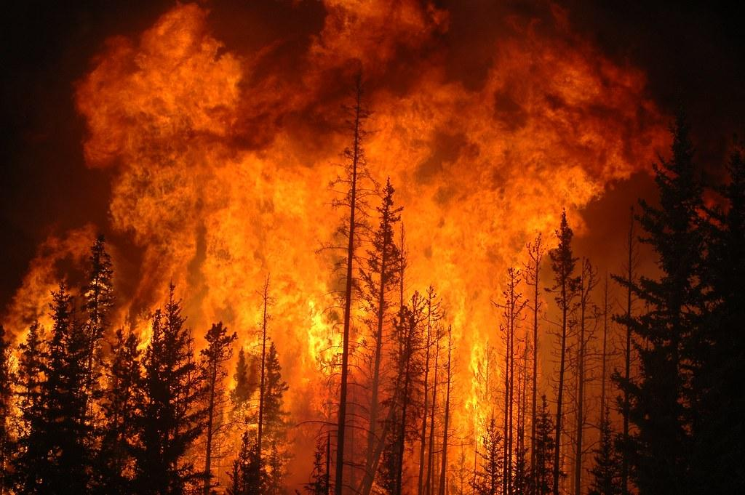
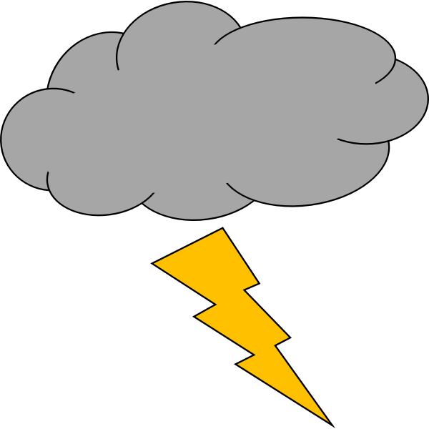
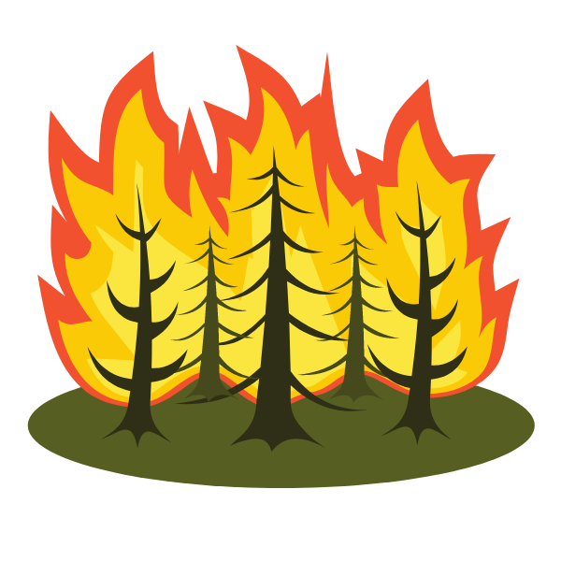
Hypothesis ( what I know)
I think wildfires happen when a fire starts in the forest due to excessive heat, lightning and dry conditions in the environment or when humans cause the fire, allowing it to spread.

Slide 3
What is a Wildfire
A wildfire is an uncontrolled fire that spreads rapidly across vegetation, such as forests, grasslands, or brushlands, often fueled by dry conditions, strong winds, and high temperatures. These fires can start naturally, such as from lightning strikes, or through human activities like unattended campfires or discarded cigarettes. Wildfires can cause significant environmental and economic damage, destroying wildlife habitats, homes, and infrastructure. However, they also play a natural role in some ecosystems by clearing dead vegetation and promoting new plant growth (Government of Canada, 2023).

Slide 4
Background Research ( 1 )
Before diving more into the topic of wildfires, let’s start with some background research. One key concept is the Fire Triangle, which explains how wildfires—or any fires—are created. The three essential elements are oxygen, fuel (like oil or dry vegetation), and heat. When these elements combine, they trigger a chemical reaction that starts a fire.

Slide 5
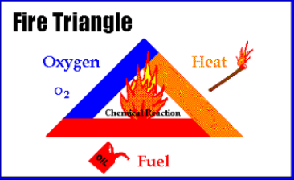

Slide 6
Background Research ( 2 )
Wildfires typically occur in forests, grasslands, and shrublands, and they can spread at speeds of up to 14.27 miles per hour. In Alberta, wildfire season usually runs from April to September, when conditions are driest and fires are most likely to occur.
Fun fact: In Alberta, burning debris from a wildfire can be carried by the wind up to 2 kilometers ahead of the main fire, making it even harder to control.

Slide 7
Types of Wildfire
In Alberta, wildfires are classified into three main types:
Surface fires are the most common, burning through grass, shrubs, and fallen leaves, and are typically easier to control.
Crown fires are more intense, spreading rapidly through treetops and often driven by strong winds, making them highly destructive.
Ground fires burn beneath the surface in organic-rich soils, such as peatlands, and can smolder for long periods, even through winter.

Slide 8
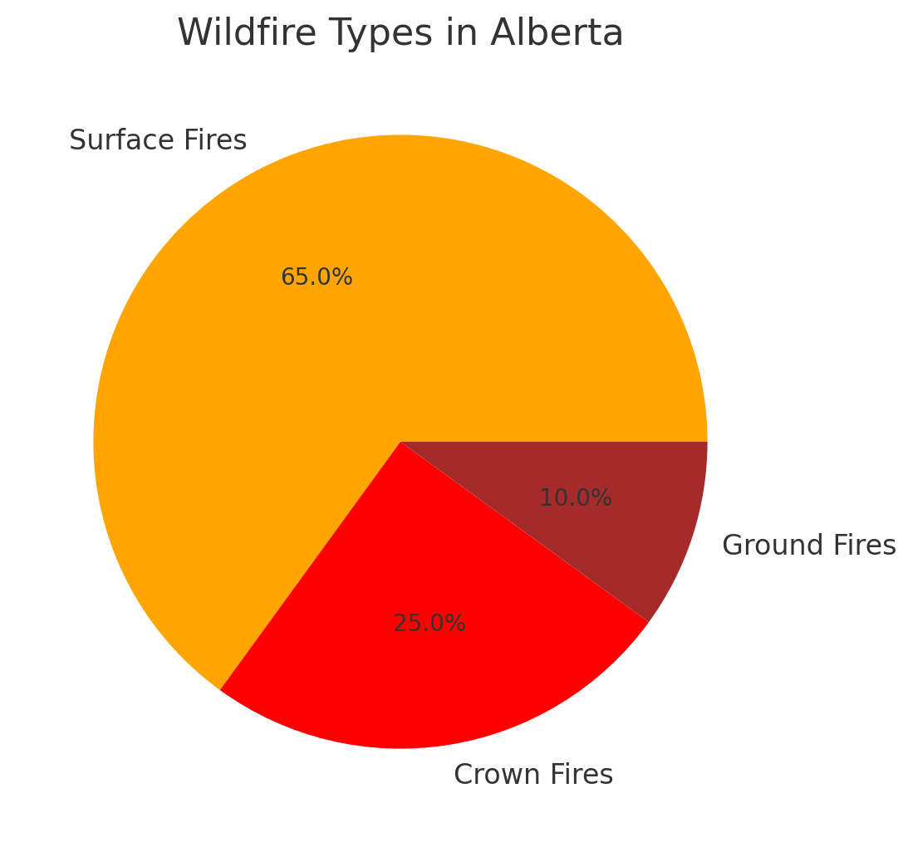

Slide 9
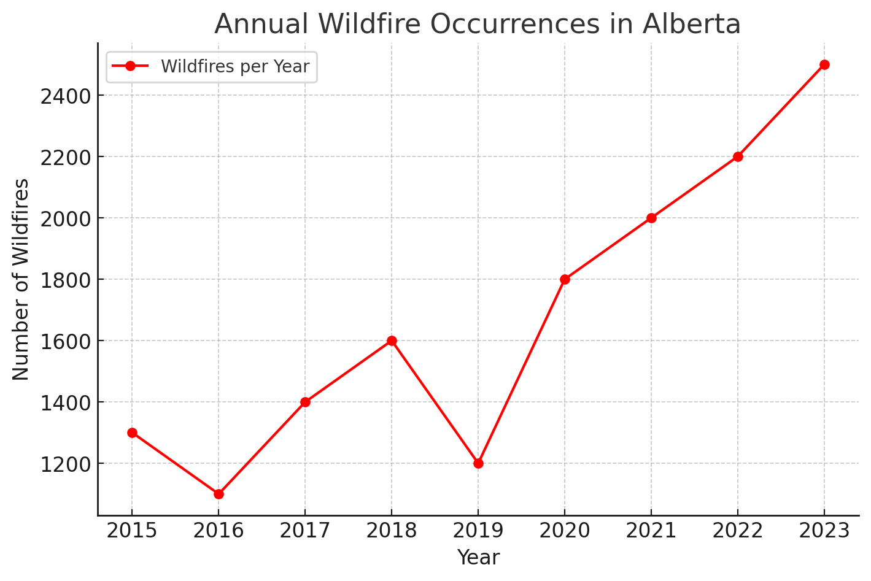

Slide 10
Factors Contributes to Alberta Wildfire
Temperature and dry conditions play a major role, as hot weather combined with low humidity dries out vegetation, turning it into highly flammable fuel.
Wind patterns and droughts further increase wildfire risks by spreading flames rapidly and intensifying fire behavior. Strong winds can carry embers over long distances, igniting new fires, while prolonged droughts reduce moisture levels in forests and grasslands, making fires more difficult to control.

Slide 11
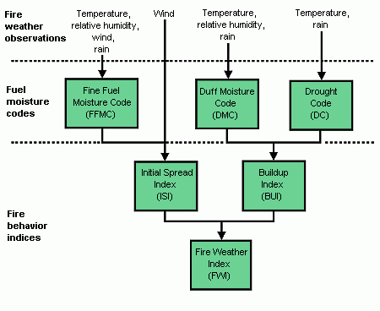
Canadian Forest Fire Weather Index (FWI) System
The Canadian Forest Fire Weather Index (FWI) System consists of six components that account for the effects of fuel moisture and weather conditions on fire behavior.

Slide 12
Problem
Wildfires can spread rapidly and become uncontrollable in a short time. In 2024, most wildfires were caused by human activity. In Alberta, wildfires are historically more frequent during the spring months, after the snow has melted and moisture has evaporated, leaving dry conditions before trees and grass begin to grow or green up. Some wildfires have forced mass evacuations, such as the Jasper wildfire, which became the second most costly in Canadian history, with damages totaling $1.23 billion.

Slide 13
Rational ( Why I am doing it) ( 1 )
Why did I choose to focus on wildfires? In Alberta, we rank second in Canada for the number of wildfires, and they impact humans, animals, and our land in many ways. Most wildfires in 2024 were caused by human activity. However, some, like the Jasper wildfire in 2024, caused major damage and loss of homes but weren’t started by humans. I want to raise awareness about wildfires so people can be more careful and help prevent them.

Slide 14
Rational ( 2 )
While researching, I was surprised to discover that wildfires aren’t entirely negative—they actually have some positive impacts, too. This made me curious to learn more and investigate how wildfires can benefit ecosystems. Personally, I love taking road trips and exploring Alberta’s natural beauty. Places like Lake Louise, Peyto Lake, Johnston Canyon, Elbow Falls, and Cameron Lake all located outside Calgary, are surrounded by nature and are absolutely stunning. I’ve visited these places, and they’re truly wonderful. By raising awareness about wildfires, I hope to help protect these beautiful areas and better understand the balance between their risks and benefits.

Slide 15
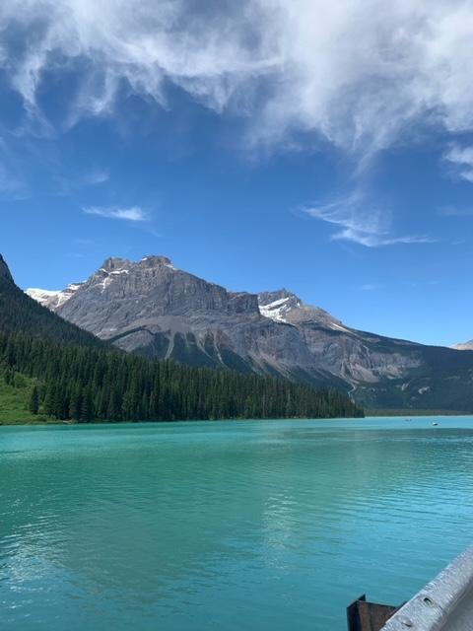
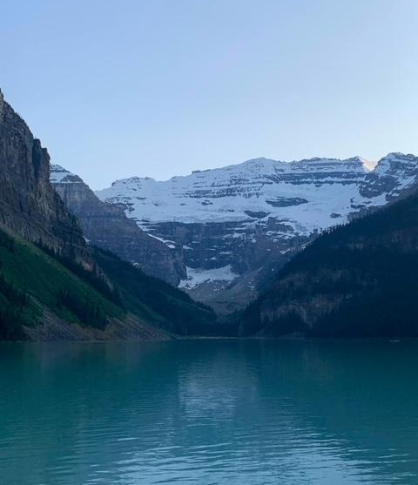
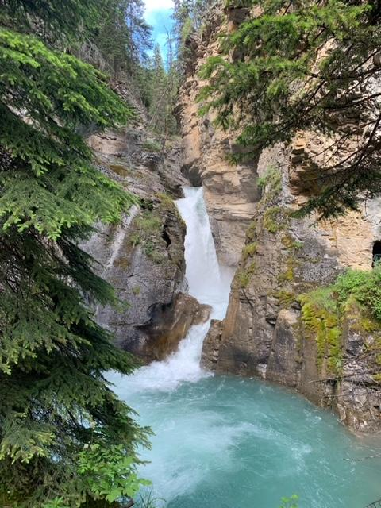
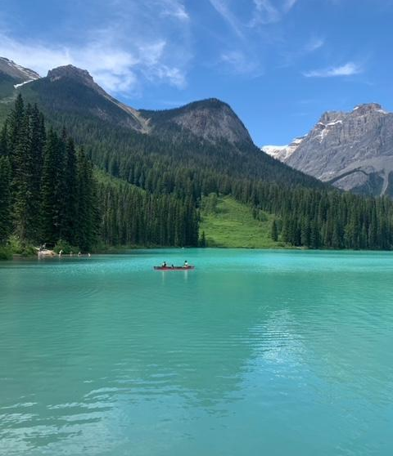
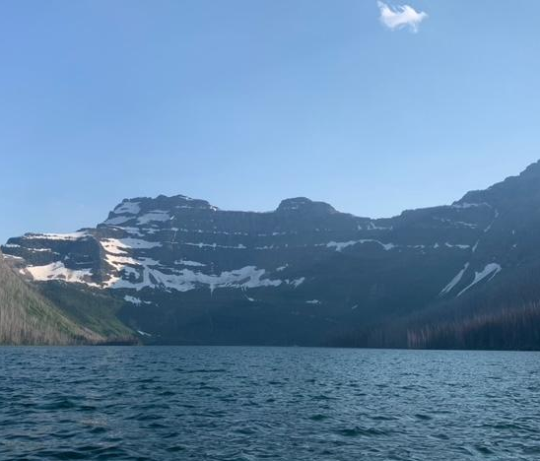
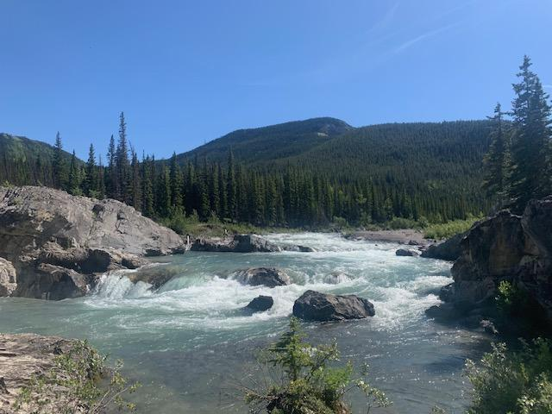
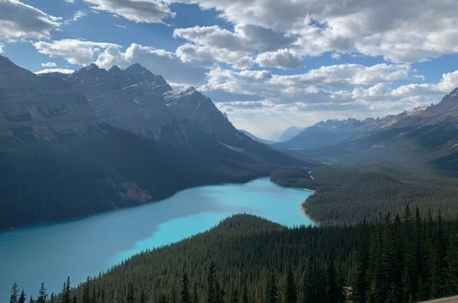

Slide 16
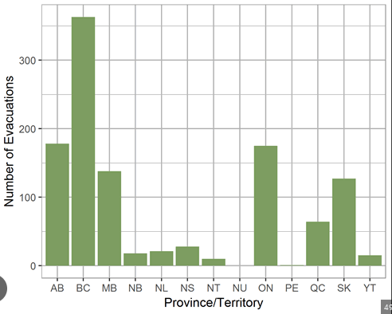
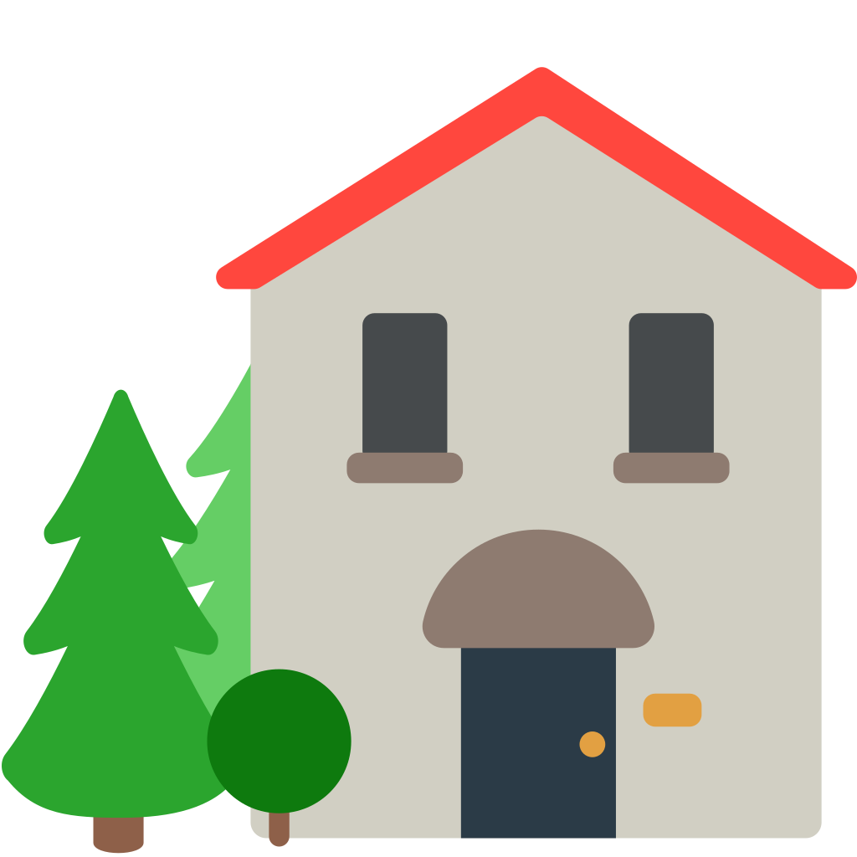

Slide 17
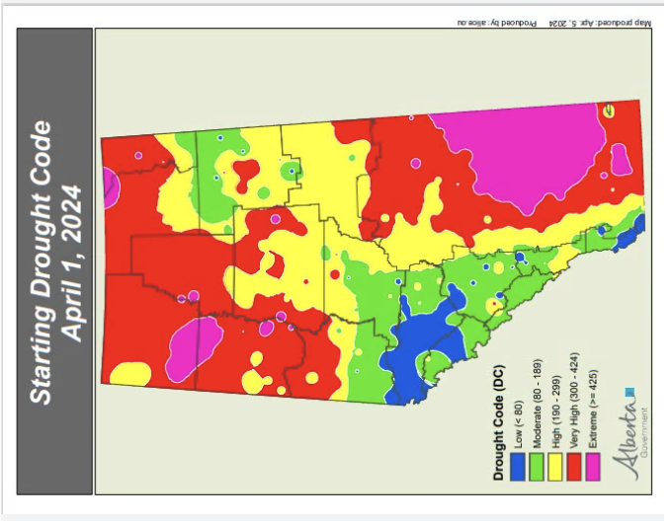

Slide 18
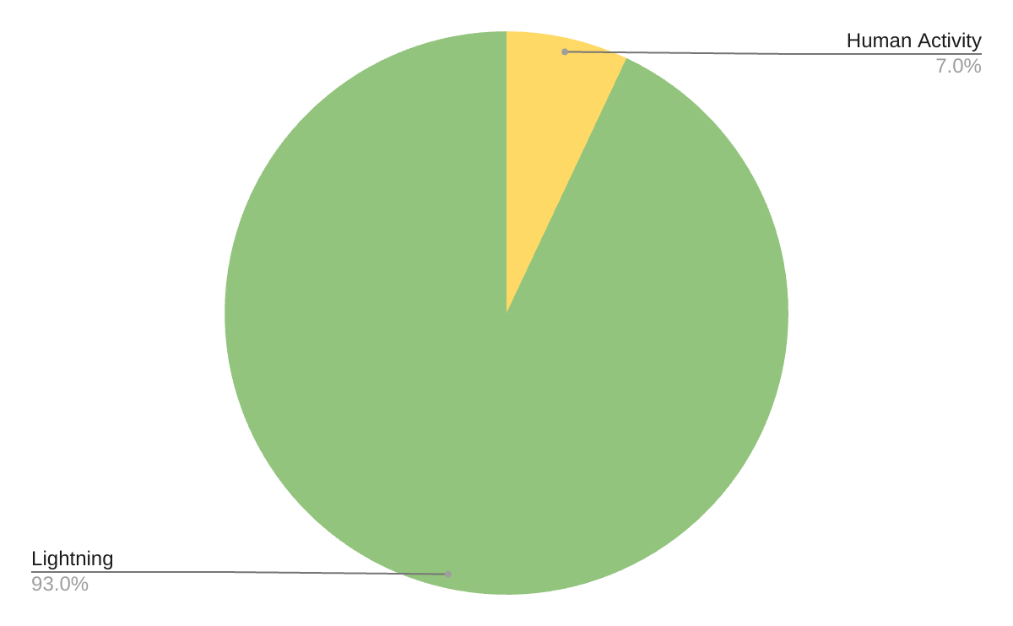

Slide 19
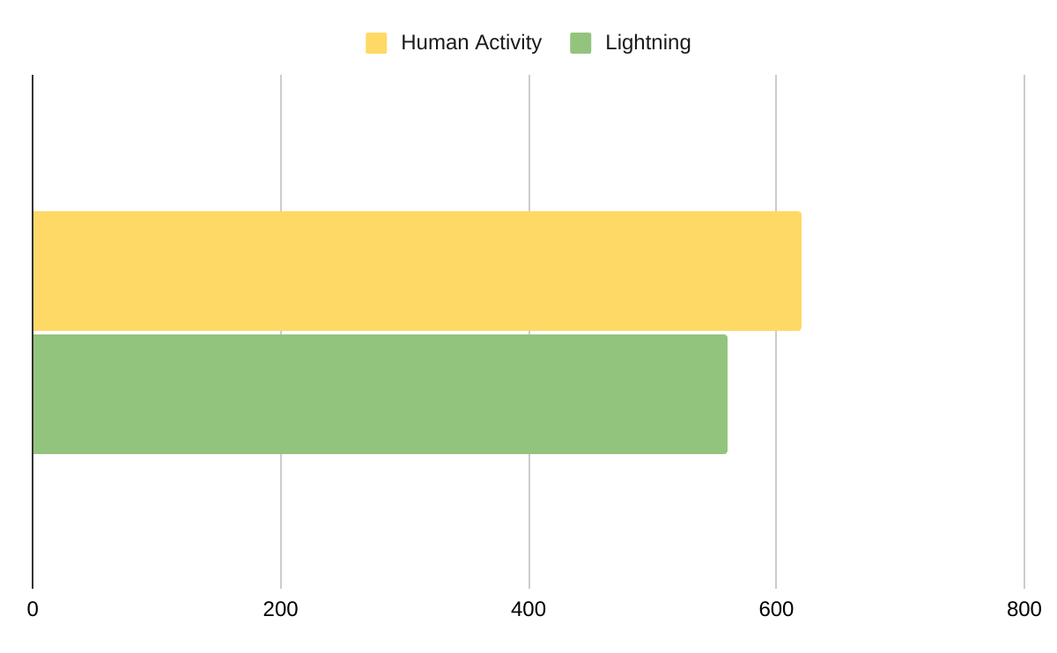

Slide 20
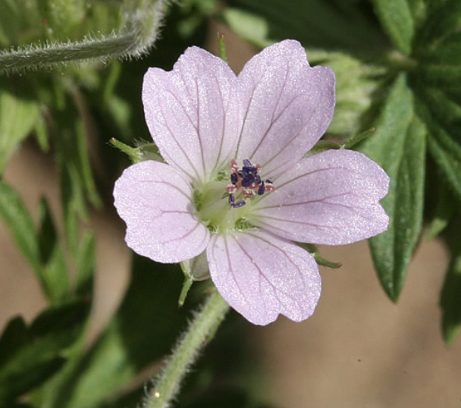
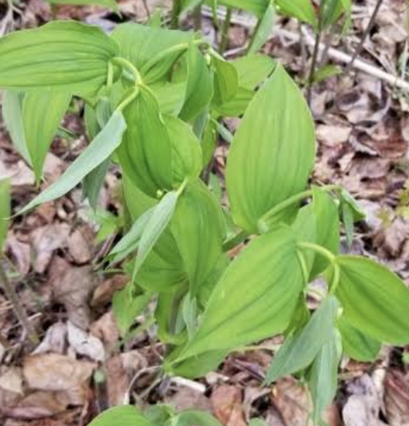
What the Nature causes
In 2023, 93% was cause by lighting. While 560 wildfires were caused by lightning in 2024.

Slide 21
Impact on Nature
Bicknell's Geranium is a beautiful purple-flowered plant that thrives in burned areas. Their seeds are very strong, their seeds last a in soil for decades.They cope really well with the after results of the wildfires. The increase in their plants are 22.2% across the province and 50% more in the northern areas. Then the Clasping Twisted Stalk, this plants produces red berries that makes old forests more motivated to create new plants/etc. Prediction of loss is 5.8% of the habitat gone. 8.9% in the foothills where it is the most abundant.

Slide 22
How human causes Wildfire
In Wildfires there are 2 or more reasons who/what caused them. 1 of them are Human Activity. In 2023 7% of Wildfires were caused by Human Activity. You may wonder what things do us humans cause? Well the Man Made items/stuff is fireworks , campfire, cigarettes , industrial activity , agriculture, powerlines, off-road vehicle, and ammunition. Did you know that in 2024 620 wildfire were caused by us! This is why we should be aware of this.

Slide 23
Animals in Forest/Alberta
In Alberta, there are many animals living in the forests, and when a wildfire starts, they’re put in danger. Some animals manage to escape, but others don’t survive. Some of the less commonly seen animals in Alberta include white-tailed deer, mule deer, elk, bobcats, American bison, bushy-tailed woodrats, boreal woodland caribou, North American river otters, and wood bison—and that’s just a few! More common animals include wolves, grizzly bears, black bears, and mountain lions. Personally, I even saw a black bear in 2024!

Slide 24
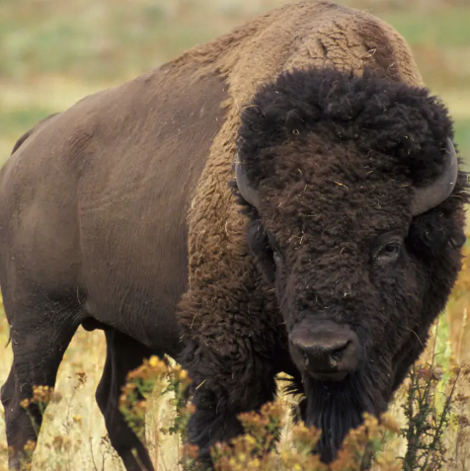
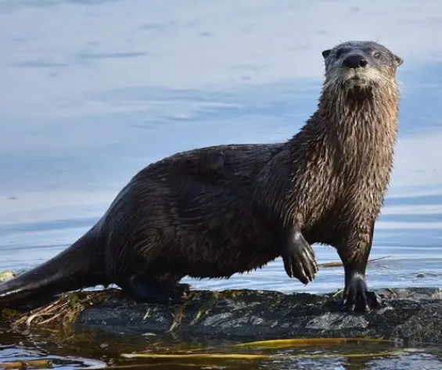
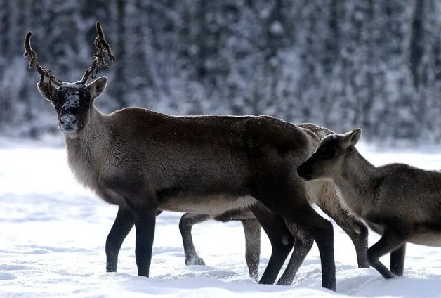
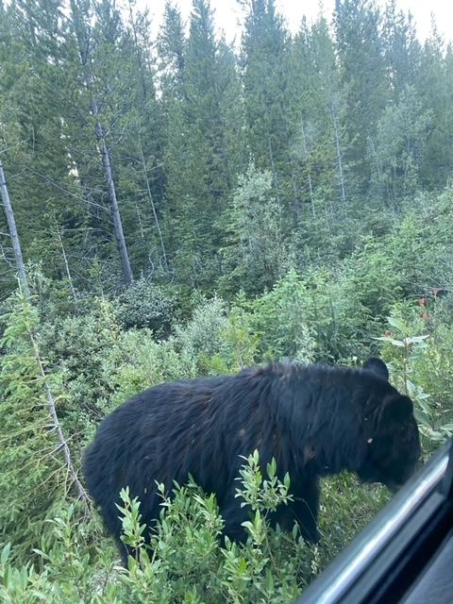
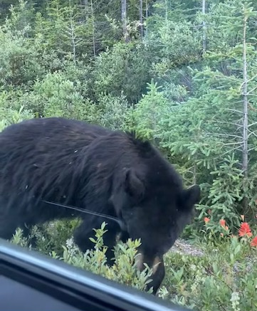
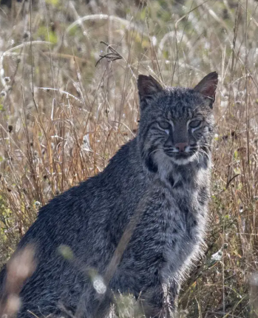
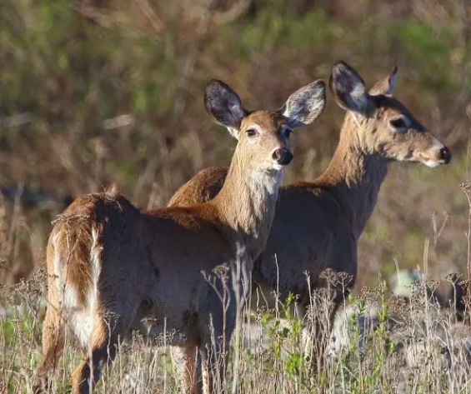

Slide 25
Impact on wildlife ( 1 )
The impact of wildfires on animals is significant, with 1 in 8 species losing their habitats. Many animals in Alberta are now scattered across different areas, and the most affected regions are the Canadian Shield and the Northern Mixwood. One species particularly at risk is the Woodland Caribou, whose habitat has been almost completely destroyed, with a 5.2% loss. In the northern Caribou range, habitat loss is even higher, with 13.7% in the Caribou Mountains and 12.7% in the Bistcho herds.
Notes:
How much animals, plants are affected - area?Animals,Population change, Effect on endangered species.

Slide 26
Impact on Wildlife ( 2 )
The loss of caribou habitat is mainly due to the fact that they live in shrubs, which are vulnerable to wildfires. While shrubs may eventually regrow, they also provide food for deer and moose, which in turn attract predators like wolves, putting the caribou at further risk. On a more positive note, the black-backed woodpecker, which thrives in burned areas, has seen its population grow by 12.9%. In the foothills region, their numbers have increased by an impressive 38.1%.
Unfortunately, many animals, especially the elderly and very young, don’t survive wildfires because they can't escape in time.

Slide 27
Impact on human ( 1 )
Wildfires have a significant impact on humans, causing issues such as school closures and a serious threat to the health of millions. Children, seniors, and individuals with lung or heart diseases are especially vulnerable. Wildfires release dangerous levels of tiny particles into the air, which increase the risk of heart disease, cardiovascular disease, lung cancer, and brain cancer. The heavy smoke from wildfires can have a profound effect on the Canadian healthcare system.
Notes:
Impact on health -> numbers,Impact on migration -Impact on economy - how much damage? Cost of rebuilding?

Slide 28
Impact on Human ( 2 )
For example, during one week in June 2023, it was estimated that the health impact in Ontario alone cost around $1.2 billion, with early deaths, increased hospital visits, and health emergencies. The poor air quality affected those who work outdoors, as well as children, seniors, and pregnant individuals. Wildfire smoke also worsens conditions for people with asthma, particularly in the western parts of Canada.

Slide 29
Impact on human ( 3 )
Beyond health, wildfires can destroy homes, communities, ecosystems, and threaten economic security. These events also contribute to mental health issues such as post-traumatic stress disorder (PTSD), depression, anxiety, and even suicidal thoughts. Physically, they can cause burning eyes, a runny nose, coughing, and difficulty breathing.

Slide 30
The Positive of Wildfires
While wildfires have many negative effects, they also offer some positive benefits. When a wildfire burns through an area, it leaves behind valuable nutrients in the forest floor. The fire also opens up the forest canopy, allowing sunlight to reach the ground, which stimulates new growth and encourages the development of new tree species. Did you know that wildfires actually promote growth by killing invasive plants and species, as well as forest pests? They help recycle nutrients back into the soil and create gaps in the tree stand, providing space for new vegetation to thrive.

Slide 31
Tips and Ways of Preventing Wildfires ( 1 )
In Alberta, during emergencies like wildfires, Alberta Emergency Alerts are issued to keep the public informed. These alerts are broadcasted through various channels, including television, radio, social media, and compatible smartphones. For instance, on a compatible smartphone, an alert will appear as a pop-up message accompanied by an intense sound. Additionally, the Alberta Emergency Alert mobile app provides timely notifications.
Notes:
- observation, alert system?

Slide 32
Tips and Ways of Preventing Wildfires ( 2 )
When camping, it's essential to use designated stoves, fire rings, or fire pits to ensure safety. Here are some tips to minimize fire risks:

Slide 33
Tips and Ways of Preventing Wildfires ( 3 )
Choose Campsites Wisely: Select sites that are free from dry grass, dense bushes, leaves, logs, peat areas, or overhanging branches.
Build Fires Safely: Use existing fire rings or pits. If none are available, dig a pit away from overhanging branches, circle it with rocks, and clear a 10-foot area around the pit down to the dirt, removing anything that could catch fire.
Supervise Fires: Never leave a campfire unattended. Ensure the fire is completely out and no longer smoldering before leaving the campsite or going to bed.

Slide 34
Tips and Ways of Preventing Wildfires ( 4 )
By staying informed through official alerts and practicing responsible fire safety measures, we can help protect ourselves and the environment.

Slide 35
How Alberta Fights Wildfires and What you need
In Alberta, when emergencies like wildfires occur, various organizations issue alerts tailored to the specific situation. Local authorities manage incidents such as floods, fires, and hazardous materials. The province employs a combination of air tankers, helicopters, and other aerial operations to combat wildfires. To prepare for such emergencies, it's essential to have an emergency kit containing supplies like food, water, a battery-powered or crank radio, flashlight, extra batteries, and a Weatheradio. These items are crucial for staying informed and safe during a wildfire.
Notes:
-Who? Organize?What are plans,What techniques,What supplies, equipment used?

Slide 36
Conclusion ( 1 )
Through my research, I've come to understand that wildfires are not merely terrifying events; they also have positive aspects. In Alberta, wildfires are often caused by a combination of natural factors, such as lightning, and human activities. This interplay is explained by the "Fire Triangle," which illustrates the three essential elements for a fire: heat, fuel, and oxygen.

Slide 37
Conclusion ( 2 )
While fire trucks play a crucial role in combating wildfires, there are proactive measures we can take to prevent them. Learning about the impacts on animals and humans has been enlightening, especially considering the significant number of wildfires in 2024. Understanding both the destructive and beneficial aspects of wildfires is essential for developing effective strategies to manage and coexist with these natural events.

Slide 38
Glossary ( definition) ( 1 )
Hectare = a unit of area measurement, 1 Hectare is 10,000 square meters.
Shrubland = it’s a habitat that has the most common plants that are bushes. The bushes are a small to medium never-ending woody plant.
Thrive = it works well in the environment and grows
Decades = 10 years
Increase = more bigger or higher
Abundant = it’s like plentiful
Habitat = it’s a home for a species or animal
Ammunition = it is bullets and/or shell
Industrial Activity = it’s manufacturing or production ( a lot of meanings)
Agricultural = like farming or growing crops
Elderly = something old age
Closure(s) = something closed
Cardiovascular Disease = it’s a general term for conditions/diseases affecting the heart or the red blood vessels
Senior = older or a more experienced person

Slide 39
Glossary ( definition) ( 2 )
Ecosystem = a geographic area where animals, plants and other things including weather and landscapes ,working together to form life
Post-traumatic stress disorder = it’s a mental health condition that is caused by a extremely stressful or terrifying moment/event
Economic = the way that people spend money or the way people make money
Nutrient = provides nourishment items for a growth of a life
Compatible = something able to exist and perform a/in harmonious or an agreeable combination
Fire Pit = a dug out area or a open container outsides that keeps the fire lit
Suicidal = when a person is deeply unhappy or really sad to commit and die
Forest Canopy = it is layer of where most of the branches/leaves (crowns) forest tree meet up and creates a thick layer.
Simulate(s) = it kinda means like reproduce
Species = a distinct group of plants or animals that have a common characteristics and that can breed(mate and then produce something) with each other
Invasive = usually a plant or a disease that tends to spread
Fire Ring = a device/something that contains a campfire to prevent it from spreading creating a prevention from Wildfires

Slide 40
Index ( what page topics are on)
Slide 2 = Problem
Slide 3 = Hypothesis ( what i know )
Slide 4 = Rational ( why I am doing it)
Slide 5 = Background Research
Slide 11 = Impact on Nature an What Nature Causes
Slide 12 = How human causes wildfire
Slide 13= Animals in the forest/albereta
Slide 14 = Impact on Wildlife
Slide 15 = Impact on Human
SLide 16 = The Positive of WIldfires
Slide 17 = Tips and Ways of Preventing Wildfires
Slide 18 = How Alberta Fights Wildfires and What you need
Slide 19 = Conclusion
Side 20-21 = Glossary
Slide 22= Index
Slide 23 = Acknowledgment
Slide 24 - 28 = Resources

Slide 41
Acknowledgement
Thanks to my Mom, Mr.Zhang, Gunreet, Ragvi , Brooklynn and Bryn!
Thanks for helping me!

Slide 42
Resources ( 1 )
1. 2023 Wildfire Percentage
https://climateinstitute.ca/news/fact-sheet-wildfires/#:~:text=Ninety%2Dthree%20per%20cent%20of,of%20control%20much%20more%20easily
2. Jasper Wildfire South and North
https://parks.canada.ca/pn-np/ab/jasper/visit/feu-alert-fire/feudeforet-wildfire
3. What objects Human Activity causes
https://thenarwhal.ca/canada-wildfires-cause/#:~:text=The%20B.C.%20government%20says%20the,years%20it%27s%20not%20even%20close
4. Fire Triangle
https://www.sc.edu/ehs/training/Fire/01_triangle.htm#:~:text=Oxygen%2C%20heat%2C%20and%20fuel%20are,the%20fire%20will%20be%20extinguished
5. Valuable Nutrients stored in the litter and Opens Forest Canopy
https://natural-resources.canada.ca/forest-forestry/insects-disturbances/forests-need-fires-insects-diseases

Slide 43
Resources ( 2 )
6. How fast does Wildfires go
https://wfca.com/wildfire-articles/how-fast-do-wildfires-spread/
7. Where do they happen
https://www.redcross.ca/how-we-help/emergencies-and-disasters-in-canada/types-of-emergencies/wildfires/wildfires-information-facts#:~:text=Most%20wildfires%20occur%20between%20April,a%20fire%20hits%20your%20community
8. Animal effect
https://www.nationalforests.org/blog/what-happens-to-wildlife-during-a-wildfire#:~:text=Some%20animals%20do%20die%20in,sources%20burned%20in%20the%20fire
9. 620 Human Activity and 560 Lightning
https://www.cbc.ca/news/canada/edmonton/alberta-wildfire-2024-season-over-1.7369601#:~:text=The%20agency%20suspects%20620%20fires,than%202.2%20million%20hectares%20combined

Slide 44
Resources ( 3 )
10. When selecting a campground
https://www.alberta.ca/agri-news-albertans-can-do-their-part-to-prevent-wildfires#:~:text=If%20you%20are%20at%20a,peat%20areas%20or%20overhanging%20branches
11. Over 1,210 and Hectare burned
https://globalnews.ca/news/10847595/2024-record-breaking-wildfire-season-alberta/
12. Animals in Alberta
https://animalia.bio/alberta-region?page=1#google_vignette
13. Lightning caused Jasper Wildfire
https://www.cbc.ca/news/canada/edmonton/jasper-wildfire-how-did-it-get-so-out-of-control-1.7282633#:~:text=Officials%20believe%20the%20fire%20that,can%20create%20its%20own%20weather

Slide 45
Resources ( 4 )
14. Kills invasive plants and pest
https://climateatlas.ca/forest-fires-and-climate-change#:~:text=Wildfire%20is%20a%20natural%20part,invasive%20species%20and%20forest%20pests
15. Action Alberta does is uses Air Tankers
https://www.google.com/url?q=https://www.alberta.ca/how-we-fight-wildfires%23:~:text%3DAlberta%2520Wildfire%2520uses%2520a%2520combination,information%252C%2520see%2520the%2520Pilot%2520Handbook&sa=D&source=docs&ust=1739287508119799&usg=AOvVaw2hHQcwMhgUJuYesq5tGWRw
16. The increaser and Decreaser of Plant/Animal in Alberta
https://ftp-public.abmi.ca/home/publications/documents/642_ABMI_2024_EffectsOf2023WildfiresInAlberta_ScienceLetter_Issue8.pdf
17. Cause to human health impact
https://climateinstitute.ca/news/fact-sheet-wildfires/

Slide 46
Resources ( 5 )
18. Alert system and Organization
https://www.alberta.ca/about-emergency-alerts#:~:text=Alerts%20are%20sent%20out%20on,criminal%20events%20including%20AMBER%20Alerts.
19. Supplies you need for a Wildfire
https://www.alberta.ca/wildfire-preparedness#:~:text=Maintain%20an%20emergency%20kit%20stocked,flashlight%2C%20extra%20batteries%20or%20Weatheradio
20. Maybe more common animals
https://animalia.bio/alberta-region?gpp=&gpp_sid=#:~:text=Alberta%20is%20home%20to%20many,%2C%20Canada%20lynx%2C%20and%20bobcats.
21. Jasper WIldfire price Damage
https://www.canada.ca/en/parks-canada/news/2025/02/government-of-canada-funding-for-2024-wildfire-season-in-parks-canada-administered-places-including-jasper-national-park-wildfire-response-recovery.html

Slide 47
Resources ( 6 )
19. Government of Alberta. (2023). Wildfire Types and Behavior in Alberta
https://www.alberta.ca
20. Government of Alberta Wildfire Status
https://www.alberta.ca/wildfire-status
21. Canadian Wildland Fire Information System
https://cwfis.cfs.nrcan.gc.ca
22. Canadian Wildland Fire Information System | Canadian Forest Fire Weather Index (FWI) System

