Slide 1
What would happen if all the mosquitoes went extinct?
By: Aimee

Slide 2
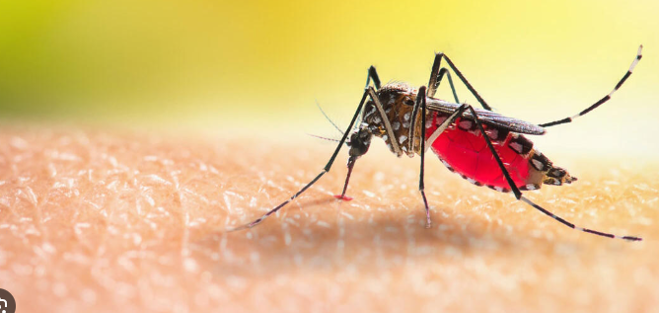
Introduction
Today I am going to present my science fair project to you! This project is about what happens if all the mosquitoes died? I will show the research i have gathered and information i have collected in this experience. So get ready to find out what will happen!

Slide 3
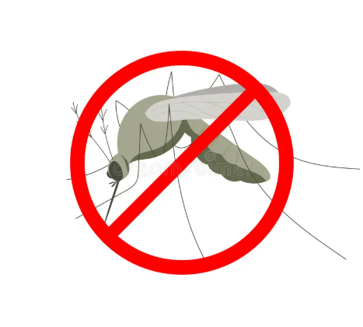
Hypothesis
In my perspective my hypothesis is if all the mosquitoes died it would benefit humans greatly by saving lives from the awful and dangerous threats from these insects. Less diseases like malaria would have been reduced transmitting to others. But food chains and ecosystems would be disturbed from their extinction.

Slide 4
Mosquitoes
Mosquitoes are threatening insects that feed on fruit nectar and animals’ blood. Mosquitoes transmit lethal illnesses like malaria and yellow fever, which kill 1 million or even more people each year making the more dangerous than sharks or lions. There are over 3,500 known species but only a small fraction are a lethal threat to humans. Mosquitoes live in warm climates and live in every continent but antartica. They have an appearance of 6 long slim legs , a thin sort of “sucker” on the end of it’s rounded oval-like head. They have 2 wings and a abdomen that stores blood or nectar and their vital organs.

Slide 5
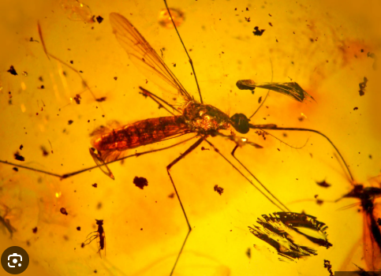
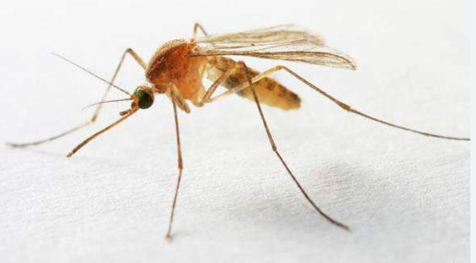
Mosquitoes Evolution
Mosquitoes have a fascinating evolution line. Mosquitoes originated approximately 100 million years ago in the cretaceous period, when dinosaurs still roamed the earth.they are believed to evolved from a family of insects known as the Chaoboridae. Mosquitoes have since spread worldwide and are found in almost every country except for Iceland and Antarctica. They evolved and adapted to various habitats, including freshwater, saltwater, and urban environments. Mosquitoes have evolved very little in the past 100 million years. They almost look identical in the past, meaning that they had no need to adapt and change to different environments, meaning that their original body was perfectly adapted to any different environments.
Today's mosquito
100 million years ago
mosquito

Slide 6

Positive impact for Humans
Diseases:
If the mosquitoes were driven to extinction , this would greatly benefit mankind. The eradication of these insects would prevent as much disease transmitting , saving many vulnerable people.
Daily life:
Our day-to-day lives would be much more bearable, without mosquitoes existence. Vacations to warm weathered areas would be much more pleasurable as well. Less irritating itchy bites and bumps would be eradicated.

Slide 7
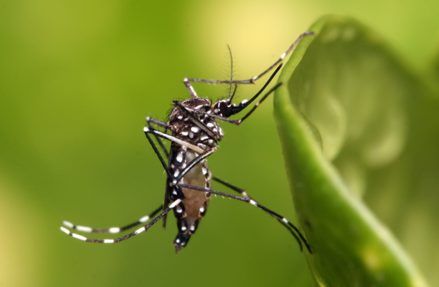
Negative Impacts For Humans
Water Quality changes
Mosquito larvae are filter feeders that consume organic matter in stagnant water, which helps to improve water quality and control algae blooms. Without them, these aquatic environments could see an accumulation of organic debris and increased algae.
Replacement by other species
Other insect species may replace the mosquitoes position, Possibly the species may be even more threatening than the mosquitoes. There is a possibility the new species may be a more aggressive disease transferer.
Unforeseen consequences
The complete eradication of 3,500 species may result in unexpected ways. Complex effects on the natural world that scientists do not fully understand, highlighting the potential dangers of large-scale ecosystem manipulation.

Slide 8
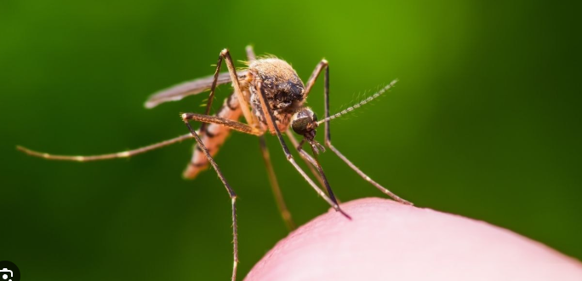
Positive Impacts For The Environment
Surprisingly, there are not as many positive impacts for the environment if the mosquitoes fell in extinction. Instead their eradication would lead to minor changes. If they all died, This would lead to short-term effects to the environment because other insects would likely replace their position in the food web.

Slide 9

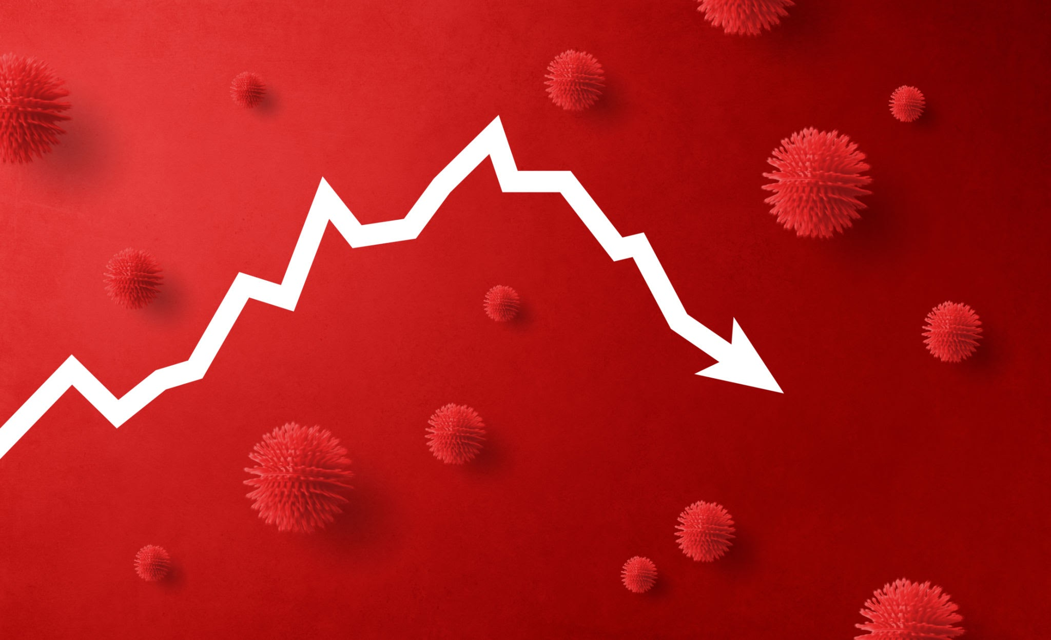
Negative Ecological impacts
The food web:
The extinction of mosquitoes have a great ecological impact. It would greatly disturb the food web animals like fish , frogs, bats,birds , and dragonflies would be affected because there diet heavily relies on the population on the mosquitoes. These animals would have difficulties finding sources of food, potentially impacting their populations as well.
Pollination loss:
Adult male mosquitoes feed on nectar , acting as pollinators to some plants, if they go extinct other insects would have to participate in pollinating.

Slide 10
Negative Ecological Impacts continued…
Microhabitat changes:
Specific communities within pitcher plants that depend on mosquito larvae would be altered.
Adaptation
Other insects (like flies or midges) might increase in population and fill the food/pollination roles, allowing ecosystems to stabilize.
Unpredictable Shifts
The sheer complexity of ecosystems means the full effects are hard to predict, with some speculating catastrophic shifts while others think nature would find a balance.

Slide 11
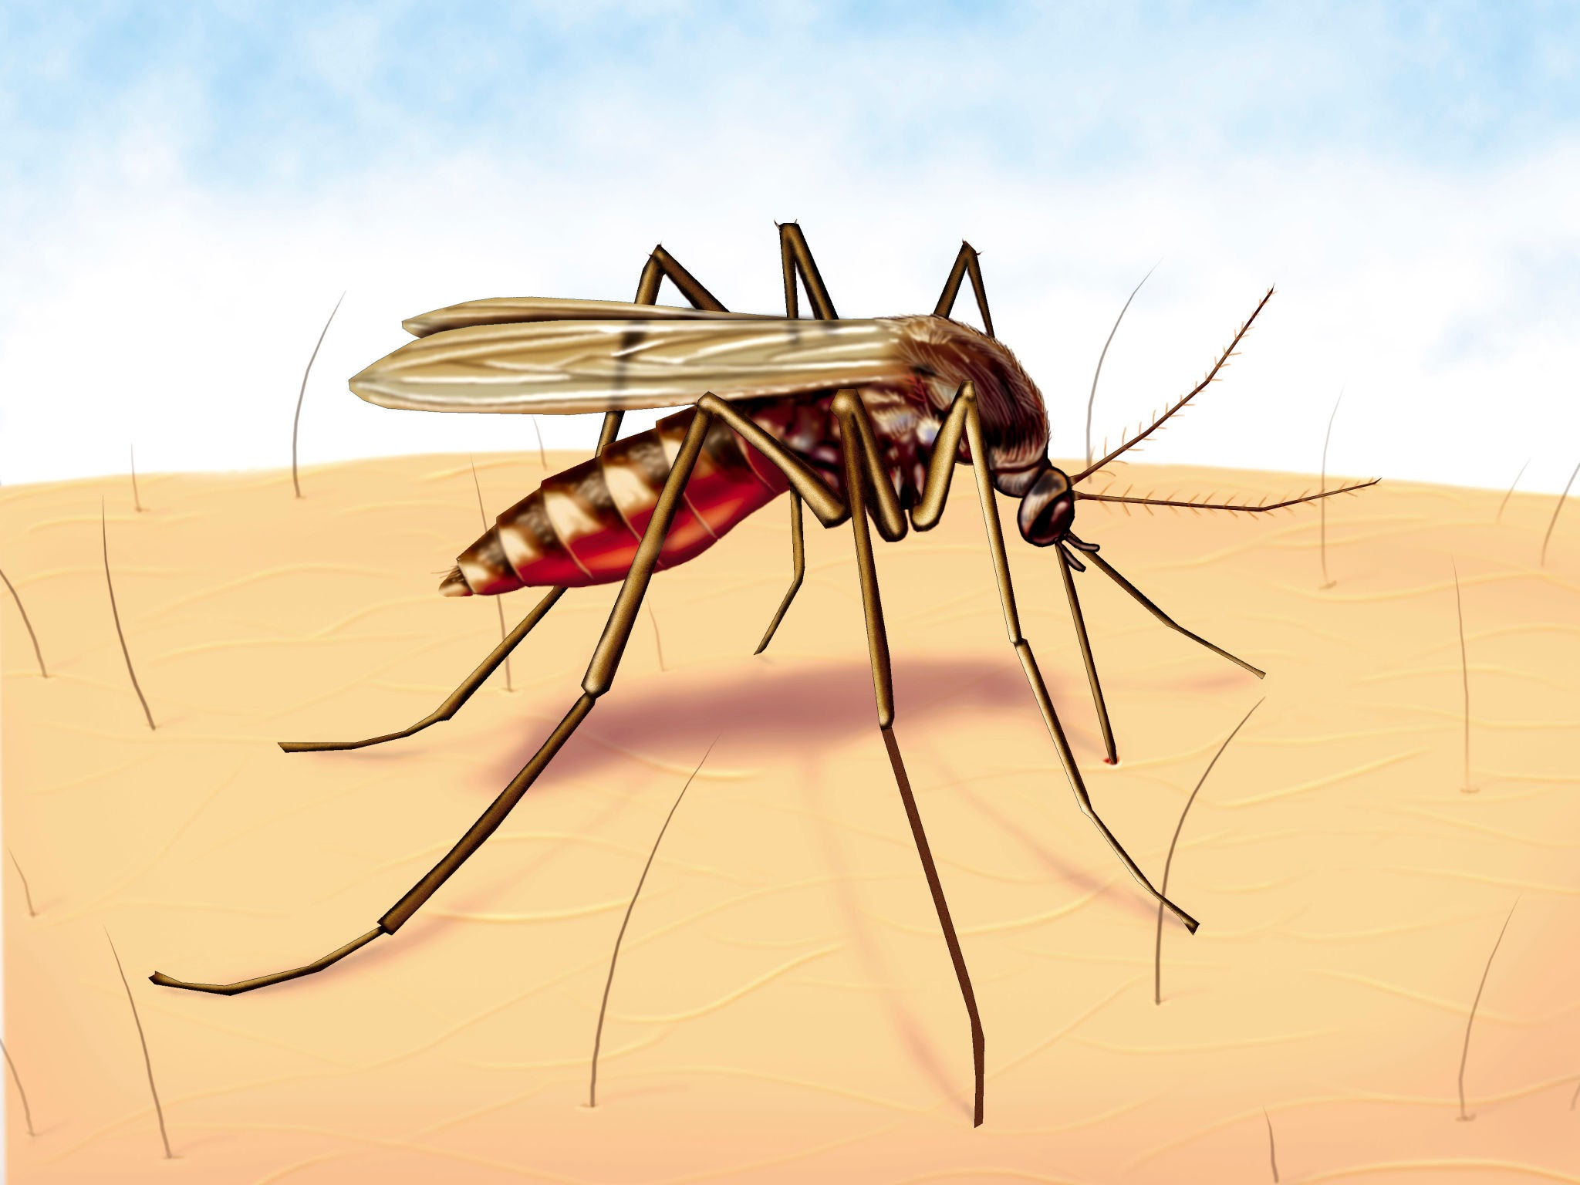
Overall summary
If mosquitoes went extinct, humans would benefit greatly from the elimination of deadly diseases like malaria, but ecosystems would face major disruptions as mosquitoes are a key food source for fish, birds, bats, other insects, and others. Their nectar-feeding adults are pollinators, leading to food web changes and potential population shifts in other insects, though other insects might eventually fill their spot.

Slide 12
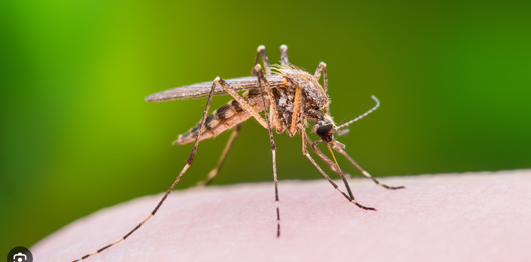
Overall conclusion
While beneficial for human health, a world without mosquitoes would force rapid, significant changes in ecosystems, potentially causing short-term hardship for insectivores, but likely leading to a new equilibrium as other species adapt or new insects fill the void.
Mosquitoes may be a lethal illness transmitter and additionally a nuisance to humans as well, But they do play a essential role in the food web and in pollination.
The extinction of the mosquitoes would actually give short-term effects, due to adaptation of other animals.

Slide 13

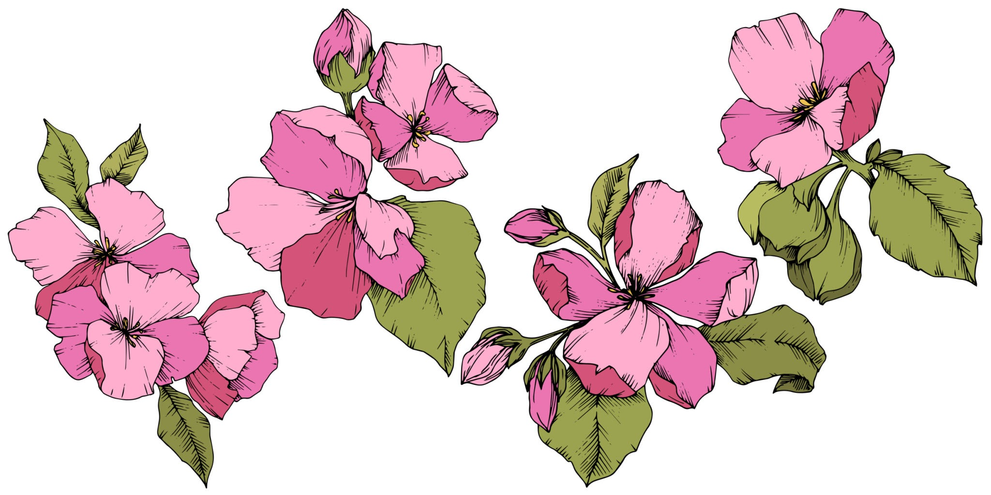
Thank You For Listening!
I hope you enjoyed my presentation, and learned something from it! Have a great rest of your day!!

Slide 14

Credits
Created by
Aimee
Research from
https://en.wikipedia.org/wiki/Mosquito
https://www.ecospark.ca/mosquito
https://www.britannica.com/animal/mosquito-insect

