Slide 1
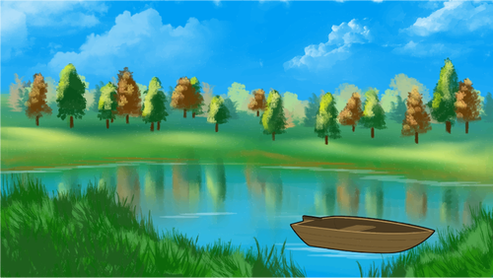
Condensation
Condensation
evaporation
precipitation
Collection

Slide 2
How we did the solar filter is we got a tub and put a smaller container in the middle. Then, we poured a bit of dirty water (enough to fill the big container). After that, we covered the big tub in plastic wrap and put a rock on the saran wrap right above the smaller container. Next, we just let it sit out in the sun and let the water cycle do its thing.

Slide 3
How we did the gravel filter is we got a 13 litre pop bottle and cut the bottom half off. Then, we took off the cap and drilled holes in it so the water could pass through. After that, we got a mason jar and put the top part of the bottle on the jar so it rested on the mouth of the mason jar. Next, we poured some sand into the pop bottle and then we poured some small pebbles (gravel) on top of that and on top of THAT we put some larger pebbles (gravel) and on top of THAT we folded up some cheese cloth and placed it on top of the large pebble (gravel) layer. After, you pour the water in the pop bottle and let the water flow through the layers. The gravel filter catches all the debris and the water gets filtered out cleanly. (-:

Slide 4
SOLAR FILTER
rainwater
pond water
GRAVEL FILTER

