Slide 1
Using Biomimicry to improve structural stability
By Aaryan Praveen

Slide 2
Table of Contents
Project Information
Introduction
What is Biomimicry
Problem and Solution
Solid, Shell and Frame Structures
Rules of Structures
Forces
Structure Design
Incorporating Biomimicry into my Design
Natural Structures
Structure planning
Structural Shapes
Design Idea
Procedure and Materials
Analysis
Real world applications
Conclusion
Bibliography

Slide 3
Project Information
Problem: Can incorporating biomimicry into structures help improve their structural stability?
Hypothesis/Predicted Outcome: If you incorporate natural concepts and ideas into a feasible design, then it will allow the design to achieve greater structural stability because natural structures have proven to have great stability and have been incorporated in infrastructure in the past.
Objective/purpose: To create a structurally stable design based on natural concepts that could be incorporated in the real world.

Slide 4
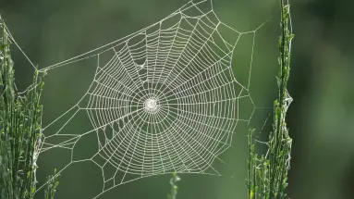
Introduction
Over the course of 2024 and the years before that, many natural disasters have took place. These disasters have taken thousands of lives and left many families broken. Most of the disasters caused great amounts of structural damage, leaving societies and governments incredibly high prices to pay. Though many of these disasters could have been prevented by developing the appropriate structural design for the area it was built in. Well my project has created a solution to preventing our infrastructure from collapsing just by using simple designs created by nature!

Slide 5
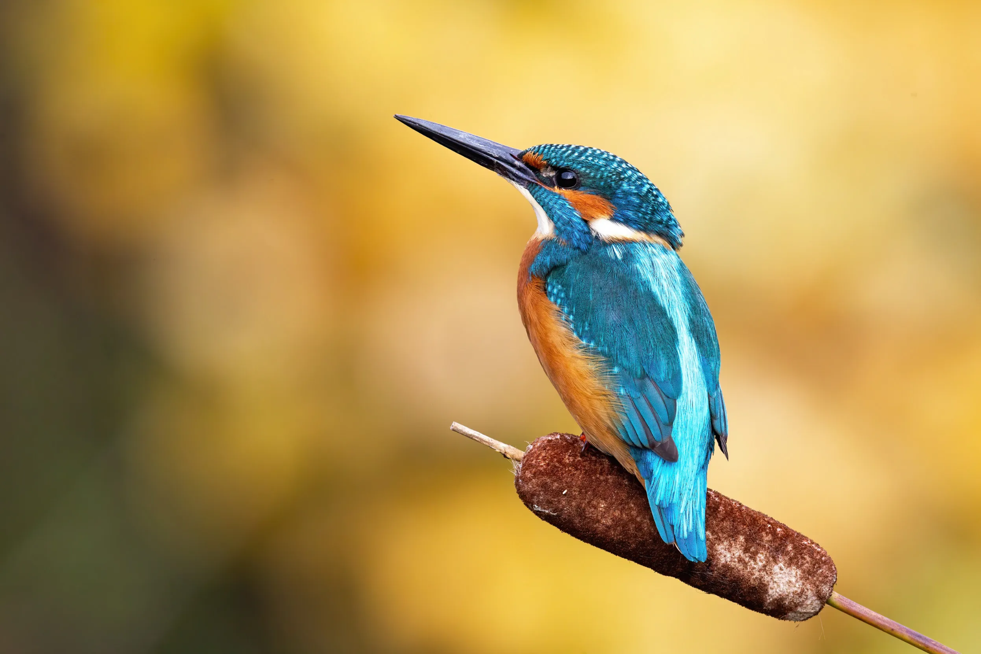
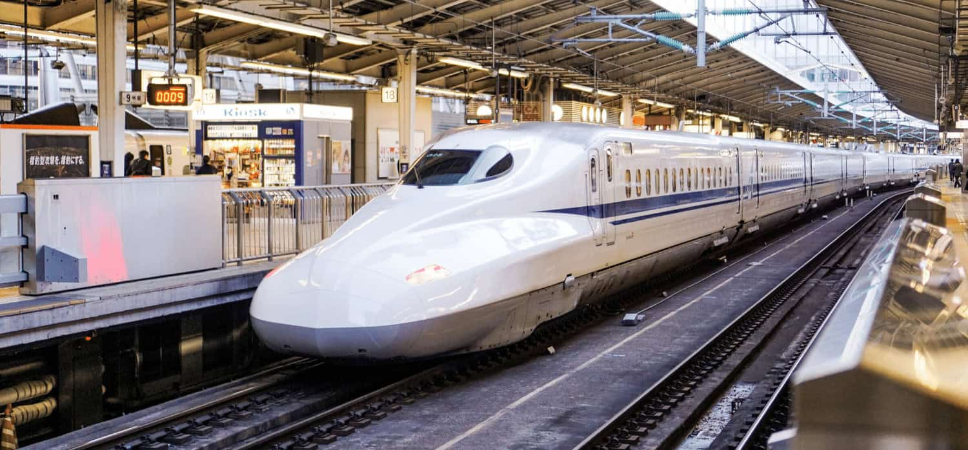
What is Biomimicry?
Biomimicry is the concept of learning and mimicking natural ideas and strategies to incorporate and improve the human society.
Biomimicry involves three basic components to be achieved properly. These components are emulation, ethical framework, and (re)connection.
Emulation: The process of learning or observing natural concepts to allow humanity to build and incorporate more useful design solutions.
Ethical Framework: The responsibility to use knowledge gained from nature to create solutions to conserve nature.
(Re)connection: Acknowledging that human life is not separate from nature which is affected and affects all organisms in Earth’s ecosystems. By reconnecting with nature, your are better able to appreciate how life works and incorporate these natural designs into man-made designs.
The Kingfisher(bird at the top) inspired the design for the Japanese bullet train because when kingfishers dived in the water to hunt for fish, their beaks created low pressure waves, making them quieter and faster. This inspired the bullet train design to be really fast yet quiet.

Slide 6
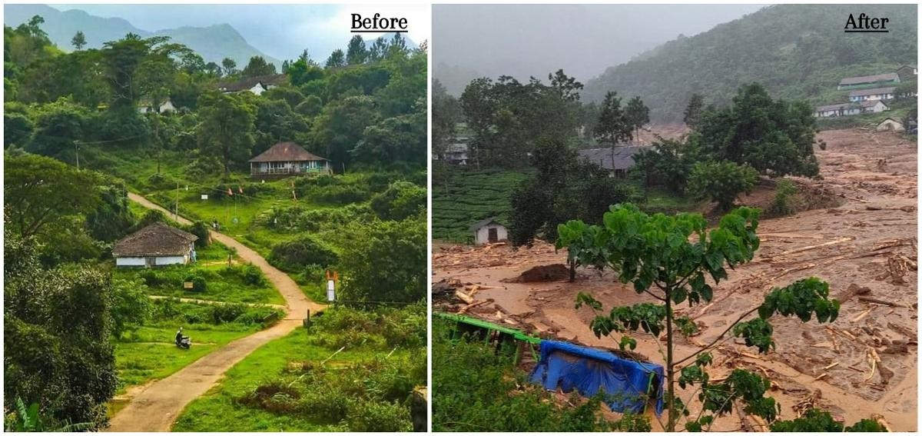
Problem/Inspiration and Solution
Many infrastructure failures have happened in the past and have cost the lives of hundreds. An example of one that I can personally relate to is the Wayanad Landslide that took place on July 30, 2024 in Kerala, India, the state that I was born in. Heavy rainfall triggered multiple giant landslides to occur washing away homes, bridges, an entire town, and taking the lives of many unsuspecting innocent people. As barely any homes were left, it left hundreds of people stranded, waiting for hours to get help. As one of the largest natural disasters to ever occur in Kerala, I began to wonder could we have prevented less damage to the the towns and homes affected by the landslide? My solution was by taking natural ideas on how organisms dealt with such setbacks to their structures and incorporating their methods into building designs that will prevent structural failure.
This picture shows the area before and after the landslide took place.
By using Biomimicry, I’m going to create multiple designs and test which ones works best through a couple of factors. Based on the information, I will determine which biomimicry design should be used for infrastructure.

Slide 7
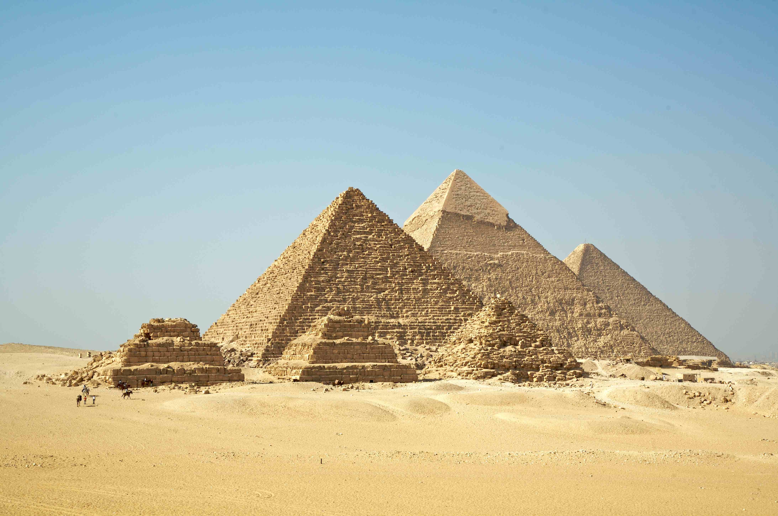
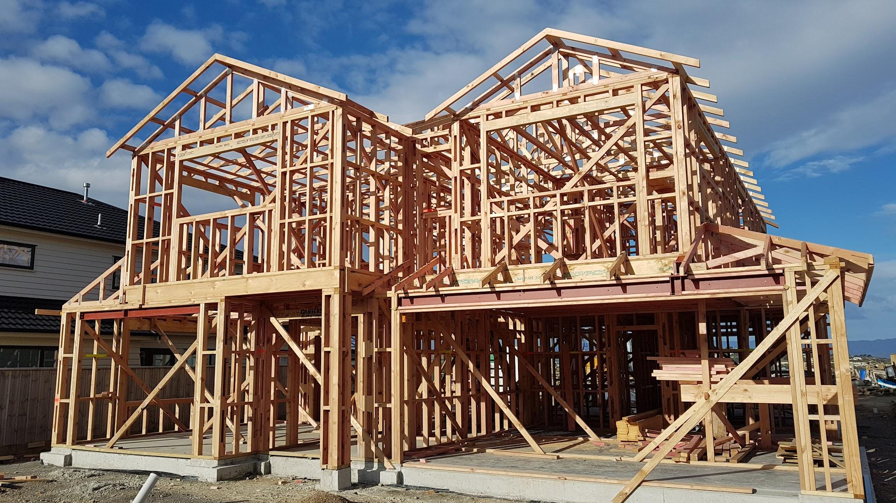
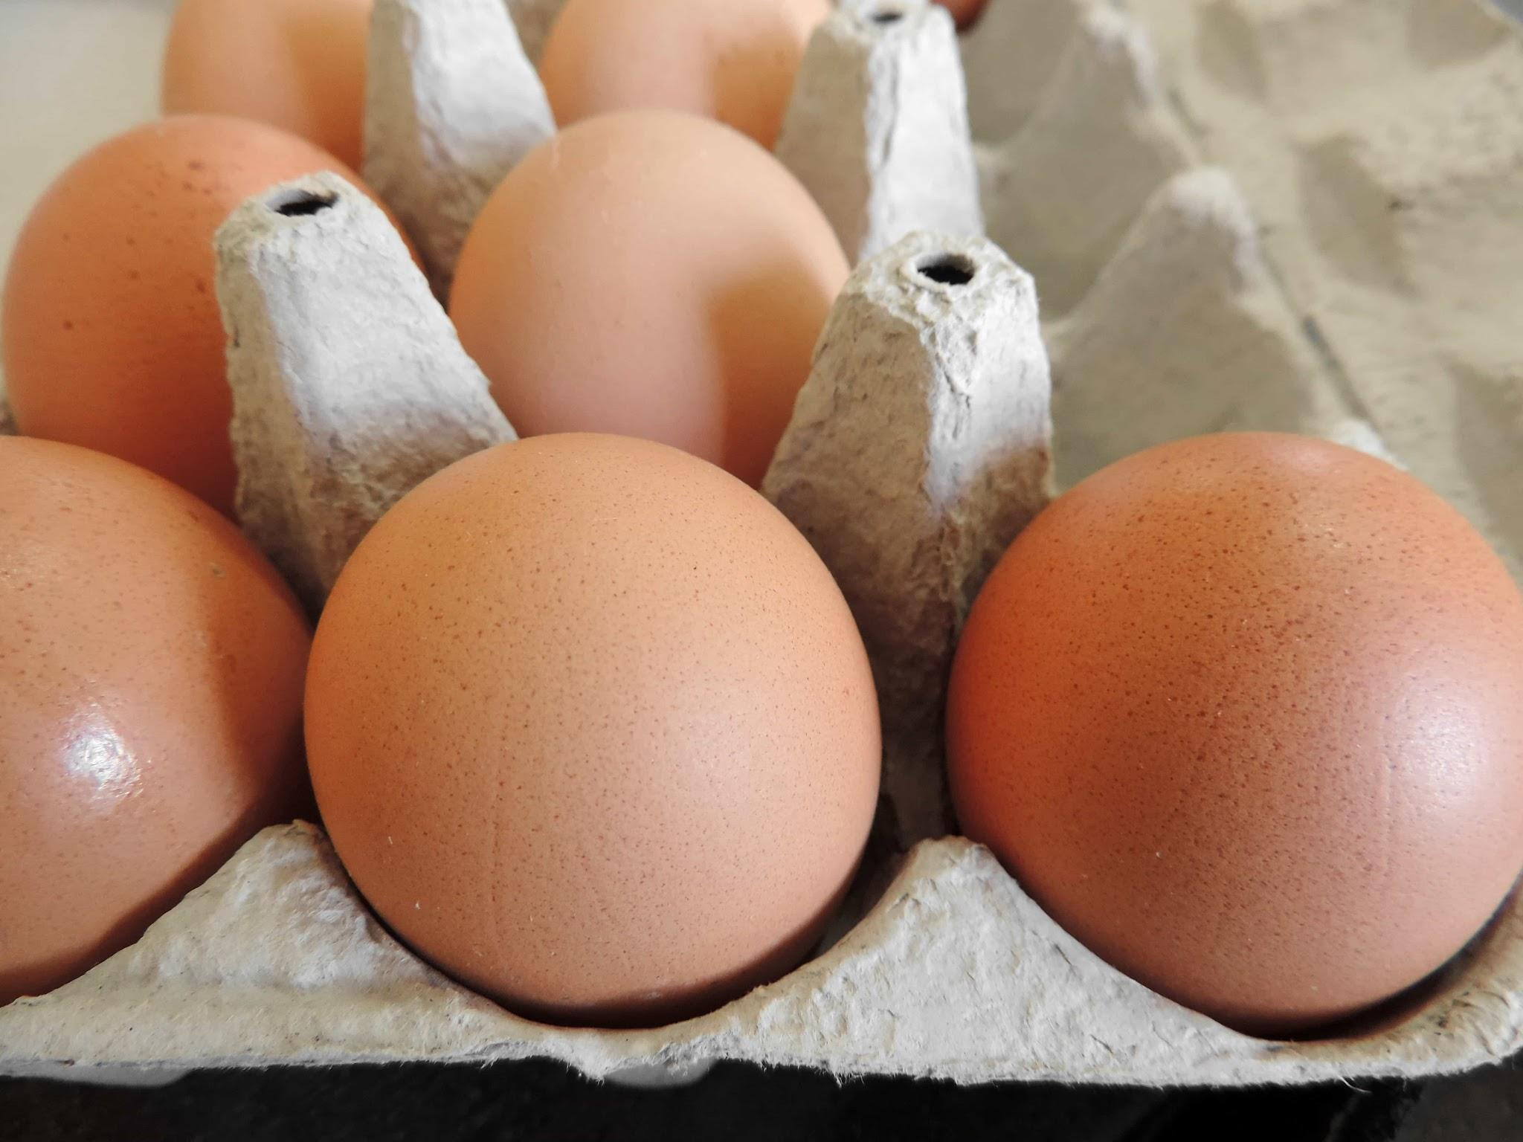
Solid, Shell and Frame Structures
Through my research I found the 3 basic types of structures. These include:
Solid Structures- Structures built off the same material that’s strong and sturdy throughout and are placed in a repeated pattern to ensure stability. An example of this are the pyramids or concrete dams.
Frame Structures- Structures built through multiple different components/pieces placed together to ensure stability and strength. These pieces are joined together to almost create a “skeleton” or framework for the structure. An example of this is a bicycle or the internal frames in a building.
Shell Structures- Structure made out of a thin and often curved material but have great strength and rigidity. Though they are better to hold the weight of masses with a higher surface area, having a heavy weight placed at a single point in a shell structure can crack a shell structure. An example of this are eggshells or a bicycle helmet.

Slide 8
Rules that ensure a structure fulfills its purpose
To ensure the stability and efficiency of a structure, many things have to come in play. These can be separated into 4 different categories which include:
Forces- How a structure reacts to magnitude, direction, the point of application and the plane of application.
Structure design- How the structure is designed to ensure stability. These include symmetry, external forces, material use, and design and construction
Materials- This category determines what materials need to be used to ensure that the structure does its intended purpose. Factors that come into consideration are strength, flexibility, and durability of the materials used.
Extra Factors- This includes the cost of building the structure, what steps have to be taken to make sure no errors occur, the environmental impact of the structure which could be based on the impact of the materials used or how the structure reacts to external factors such as weather.

Slide 9
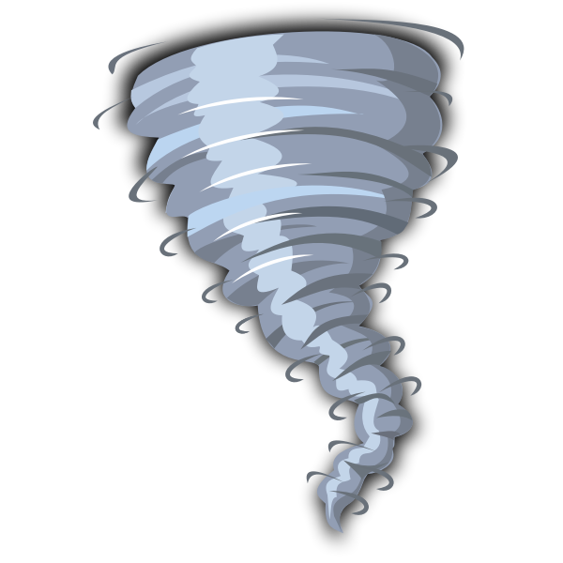
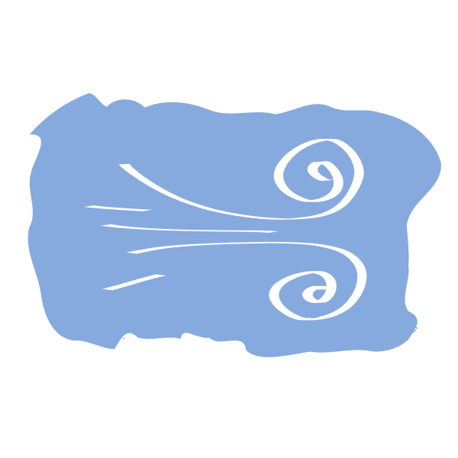
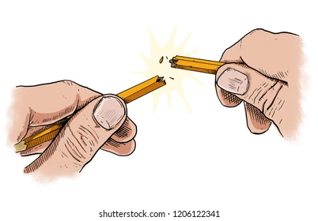
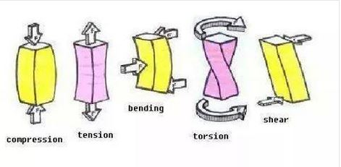
Forces
Magnitude- When talking about structures, this refers to the amount/ strength of the force being applied on a structure. For example, small gust of wind exerts a small magnitude of force onto a structure while something like a tornado may exert a large magnitude of force onto a structure.
Direction- This represents where the force is being applied from. This means depending on where the force is applied, the object that its being applied to will react in the opposite direction. For example, if you were to kick a ball, you are applying force from behind the ball to move it forward.
Point and Plane of application- The point of application refers to the direct location of the force applied onto the object. For example if you were to try to snap a pencil, it's a lot easier to snap it through the middle then for one side. The plane of application refers to the invisible surface within the object that corresponds to where the force was applied. The point refers more to exterior forces while the plane refers more to interior forces.
High magnitude vs low magnitude
Force is applied here
It moves forward
Point of application/force
Depending on the type of structure, these are other forces that could affect it to.

Slide 10
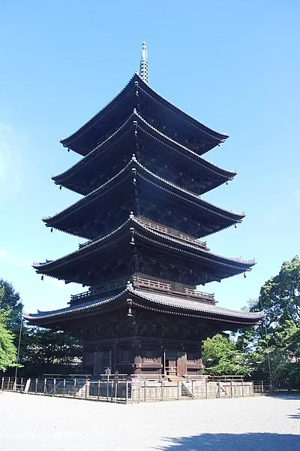
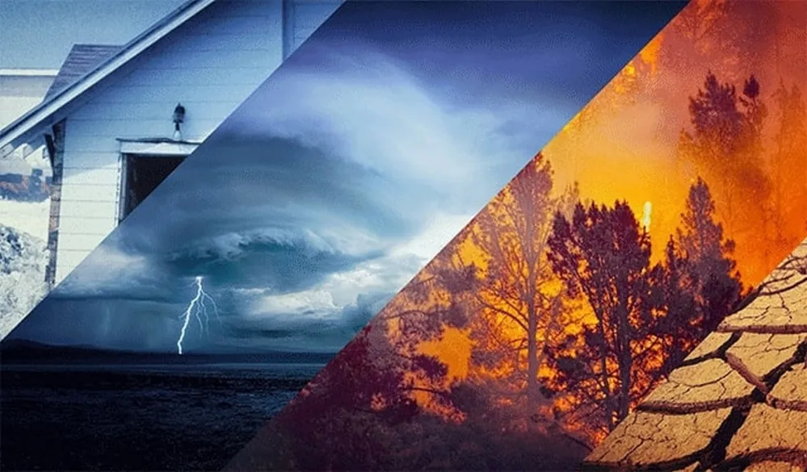
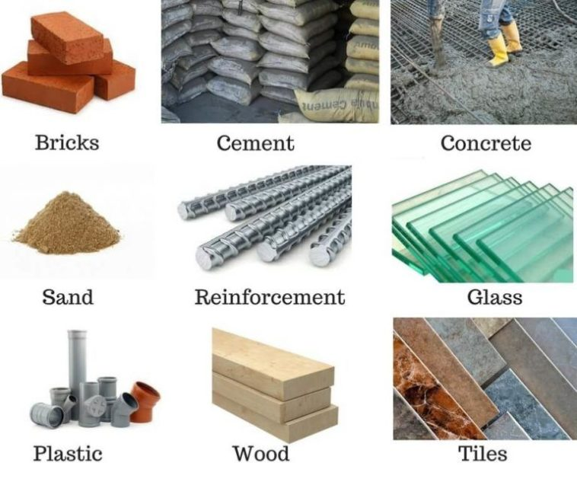
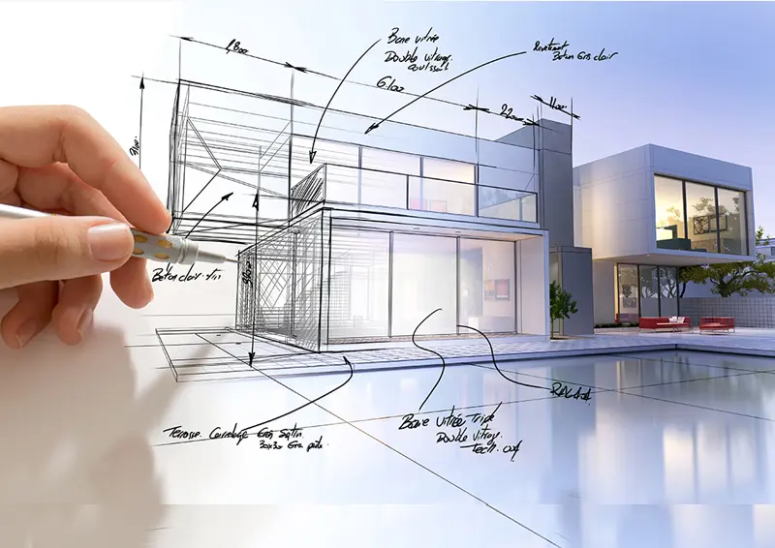
Structure design
Symmetry- It is often recommended when building a structure, to keep it symmetrical. Other than the aesthetic benefit it has on the structure, it helps provide equal balance distribution around the structure so that a certain part of the structure does not become weak.
External Forces- These include factors that the structure has to withstand and stand through. This can can be wind, earthquakes, water damage, erosion, snow etc. It doesn’t always have to be weather but things that may hinder the performance/stability of a structure.
Material Use- This is talking about the types of materials used. This could relate to the feasibility of the materials, its availability, it efficiency, how well it works against external factors and its impact on the environment. For example, if you are building a structure where it often hails, you don’t want to use a material for roofing that's very vulnerable to hail. This is the reason why you want to have your structure built out of materials that have the correct amount of strength, flexibility, and durability.
Design and Construction- Finally this category is a mix of all the things that need to be considered when trying to achieve a perfect structure. Your design and construction should be able to use appropriate materials for your structure, have a stable design, be able to serve its purpose, withstand forces that will hinder its performance, and maintain its center of gravity without collapsing.

Slide 11
Incorporating Biomimicry into my Design
By mimicking natural concepts, I should be able to create a proper design that can withstand external and internal forces while also following the basic structure design needed to be accomplished to ensures structural stability.
Before deciding what biological concept I am mimicking, I have to determine what type of structure should I use, shell, solid, or frame? Most man-made structures are either frame or solid. Bridges and walls are solid structures as it use strong materials such as concrete to hold weight and maintain shape. Buildings are often frame structures as they require multiple floors and need extra supports to hold the weight of the structure and the the people inside it. In addition to that, most home are also frame structure as they have a main framework inside before adding exterior and interior over the frame.
Though shell structures are strong, it's really dependant on the material used and the force that is being applied to it to determine that its efficient. Solid structures have the most strength but often have very little flexibility which can pose as a threat during earthquakes. Frame structures are right in between as they have good flexibility and based on its design, can support or withstand multiple factors. To further ensure its success, the frame structure should have solid materials around it to maintain its strength while still being flexible. For this reason, I decided to mimic natural concepts involving frame structures specifically.
Through my project I will test 3 different nature inspired design which will include a beehive, a spider web, and a cell wall as well as an average residential building design to see if my design achieves greater structural stability when compared to a normal residential building.

Slide 12
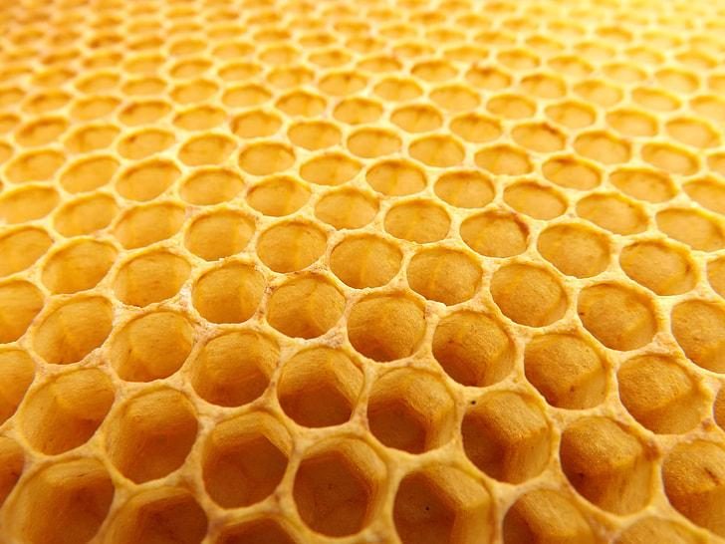
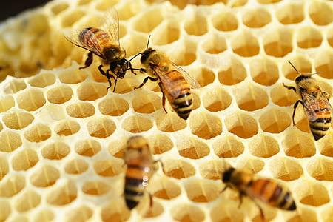
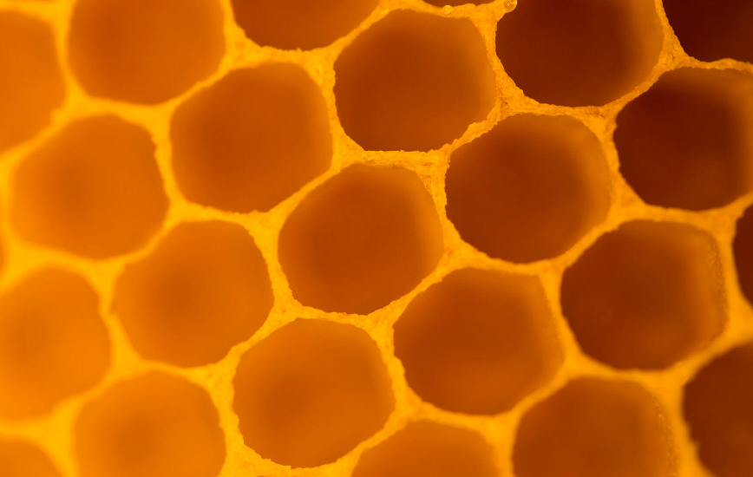
Natural Structures(Beehives)
Beehives- Beehives are built when bees produce wax and mold them into circle shaped holes. This wax is melted using the bee’s body heat which stretches out due to surface tension and creates the unique stable hexagonal pattern. This design is so great as the honeycombs provide space for the bee’s, supports holding things such as honey, while the hexagons equally distribute weight, holds its shape and doesn’t waste any space.
By combining these hexagonal cells into a full scale structure, a beehive is formed. By developing a structure made up of a hexagonal cells, bees are able to maintain a stable structure, use minimum materials, not waste any space and create a stable structure that can withstand many external forces and the wax act as supports to the structure.
The reason why the hexagonal shape is so structurally stable and can hold weight is because the the junctions of 120 degrees(the angle per side of a hexagon) is the most mechanically stable as the pull of surface tension and force are in balance when they are placed in a hexagonal arrangement. This makes extremely difficult to any side of the hexagon to collapse unless of extreme force because of the surface tension that's supporting it.
The arrows show the surface tension that are being applied to each side of the hexagon, therefore balancing out the external force that's being applied to it. This maintains its shape and structure as its not only being held in place but also supported by other hexagons around it.

Slide 13
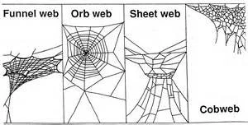
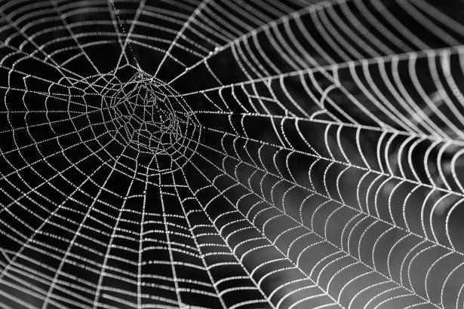
Natural Structures(Spiderwebs)
Spiderwebs- Spiderwebs are well known to maintain its shape due to its extreme ductile and tensile strength of the webs. But on top of this spiders create different webs for different purposes, which could be for catching prey, shelter, mating etc. The 4 main types of webs are the funnel web, orb web, sheet web, and cob/tangle web.
The Sheet web is designed to almost mimic a hammock as whenever potential prey fall or fly into the net, the prey get captured to the spider’s web because stickly silk that is wrapped around the web. The sheet web is very thin and is often created by criss-crossing the webs and building them within tall blades of grass or vegetation. As the design is very ununiformed, the web acts as a net and maze for prey that gets captured, making it almost impossible to escape.
Funnel webs are built by making large, flat horizontal webs that have openings on both ends. When a spider feels vibrations of potential prey, it pounces outside the funnel and drags the prey into the funnel.
Tangle webs or cobwebs are webs created by spider that don’t have any specific structure and are just bunched together with other webs. Tangle webs are often attached to a support system like the corner of a seiling. This provides extra support for the web and allows the spider to store multiple prey onto the web without the fear that the weight of the prey may collapse the web. An abandoned tangle web is a cobweb.
Orb webs are the most common type of spider web made by creating a spiral of silk and then creates almost a net by adding vertical pieces of silk the stretch for the center to the outside of the spiral. The web is reinforced by adding arches and layer of webbing outside the spiral.
The picture above is the spiral orb web and the web that is going to used for my structure design.

Slide 14
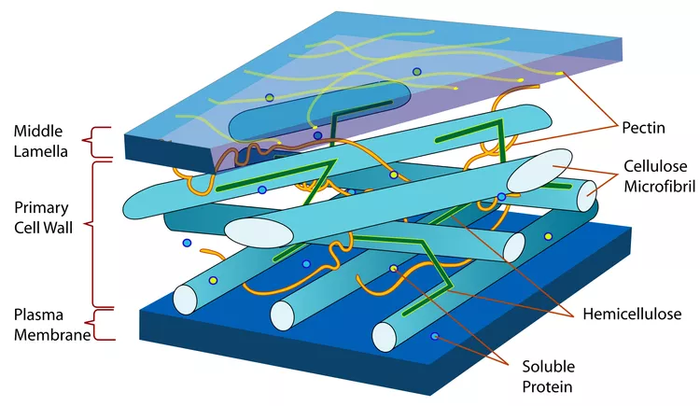
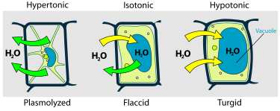
Natural Structures(Cell wall)
Cell wall- The Cell wall is the exterior barrier or wall found in a plant cell that protects the interior and other components of the cell. A plant cell usually has a primary and a secondary cell wall. In addition to protection, these walls also act as support and maintain the structure of the cell.
The cell wall is made up of interlocking fibers called Cellulose Microfibril which act as the support/internal framework to maintain the cells shape and hold everything in place. The cell wall becomes stronger, if the plant cell contains more water as it makes the cell wall rigid. The reason the cell wall needs to be strong is to deal with hydrostatic pressure which is the internal force that is applied to the cell when water pressure is greater outside the cell than inside. As water is collected into the cell, the cell wall makes sure it doesn’t escape so the cell wall has to be mechanically strong to stop water from escaping.
The image above shows how the cell wall will adjust based on what type of solution the cell is in and the level of water that is contained in the cell.

Slide 15
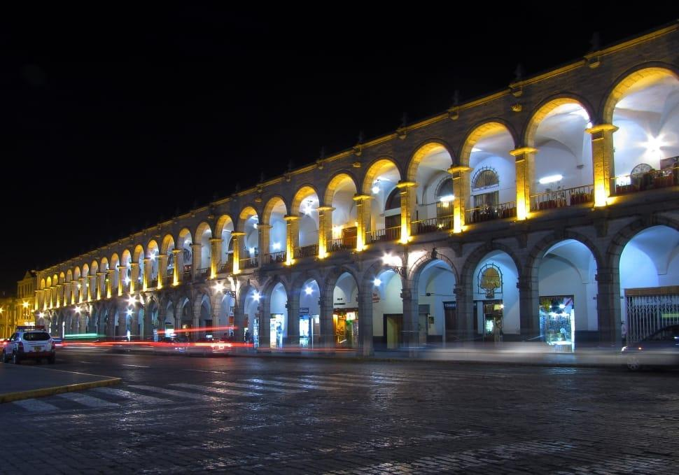
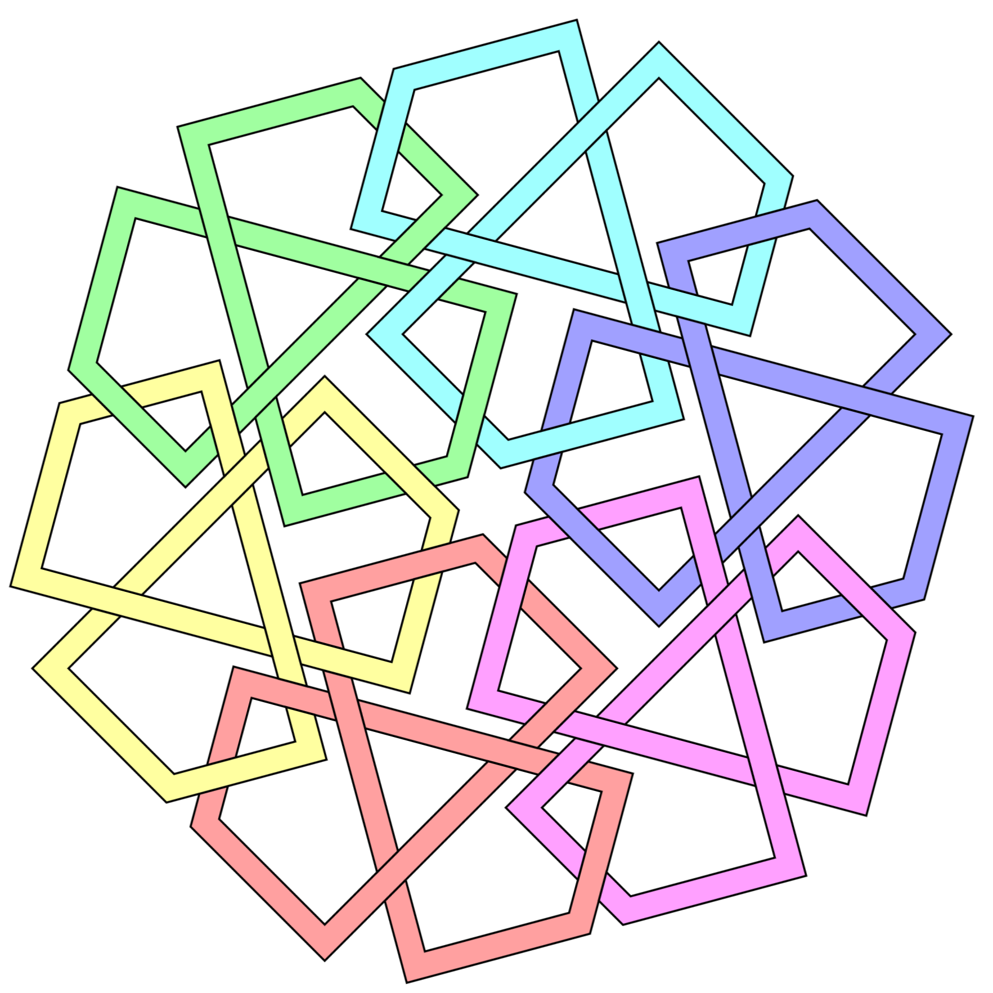
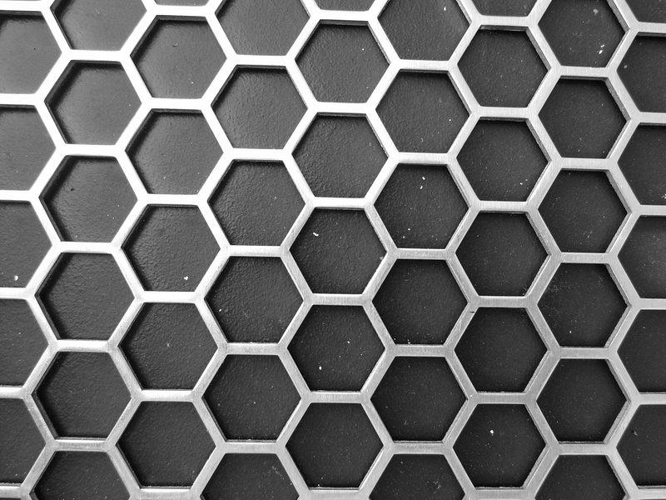
Structural shapes
The Arch
Interlocking Shapes
Hexagon and Triangle
The triangle is one of the strongest shapes because of the fact that no amount of stress can change the angle and shape its placed in. This makes it very hard for a structure using triangles to collapse. Hexagons are even stronger because it is a shape that is made up of 6 different triangles which in addition to being structurally stable, it can support even more weight than triangles as there are other hexagons or more groups of triangles that can support it. Both beehives and spider webs use triangles while beehives also have the addition of using hexagons.
The arch is a structurally stable shape due to the shape being able to equally distribute stress while also maintaining its shape. This is done by placing 2 arches together and filling up the space between them with a solid material which stops any movement or collapse from taking place. Spider webs contain this shape.
Interlocking shapes are great to maintain structural stability as they help close and cover up gaps and weaknesses the a certain shape might have, while increasing its overall surface area, and structural stability. The cell wall uses interlocking shapes to increase strength and stability to the cell wall.

Slide 16
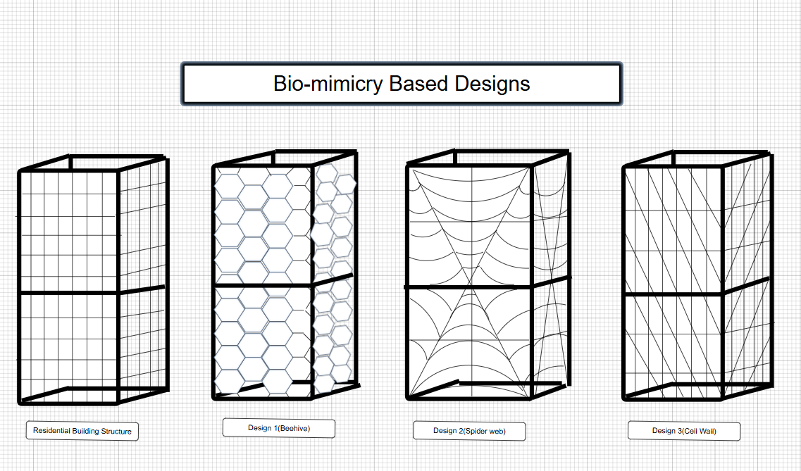
Structure Planning
Using Smartdraw, I created 3 different structural designs in addition to the residential building design.
Design 1: I took the aspect of making my framework be based on the 120 degree junctions found in beehives to create a framework that uses space effectively while maintaining support and stability.
Design 2: I based this design on the spiral orb web in which all the stress is diverted to the center but surface tension and arches are placed to equalize the stress applied and maintain the structures strength and stability.
Design 3: This design is based on the cellulose fibers found in the cell wall that have interlocking, chains of cellulose to help maintain the cell wall’s shape and structure.
When building these designs in real life, the materials could be concrete or steel depending on the availability and location it is built. As wood also works and has good availability, it may not be the strongest and most efficient material when up against external forces like natural disasters.

Slide 17
Procedure
For my designs, I decided to build all of my designs out of toothpicks. To ensure a controlled experiment, I will use the same number of toothpicks for all my designs and make sure the weight of each structure are equal as well. In addition to this, 2 copies of each design will be built in case one of the structures receives any damage during testing.
After building all my designs, I will run 3 different tests that will be repeated 4 times to ensure the most accurate of results.
One of the tests includes a load test, in which the structures will have loads added upon them until the structure reaches a point where it's no longer capable of holding any more weight. The only materials required are weights or loads that have significant weight.
The second test is the earthquake test in which I will attach a piece of plywood or a platform to a linear motion track that will move side to side to mimic an earthquake. The speed in which the track moves will increase until the structure falls over. The results will be concluded based on the average speed and time taken for each structure to collapse.
The third test is a stress test which mimics the force of magnitude a building may receive during a landslide. This will be done by attaching a platform/piece of plywood to a linear actuator or a linear reciprocating motor that will continue to push my structures until they fall down.

Slide 18
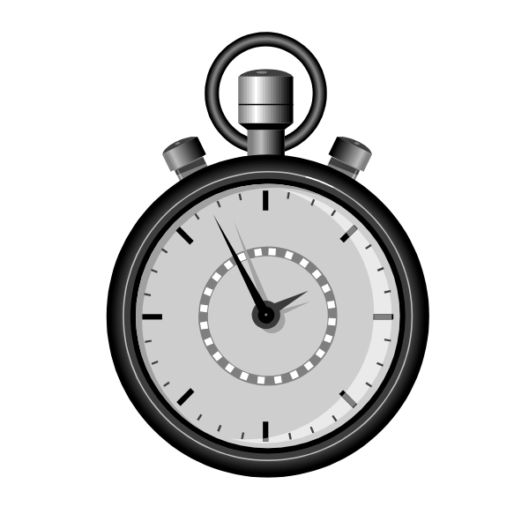
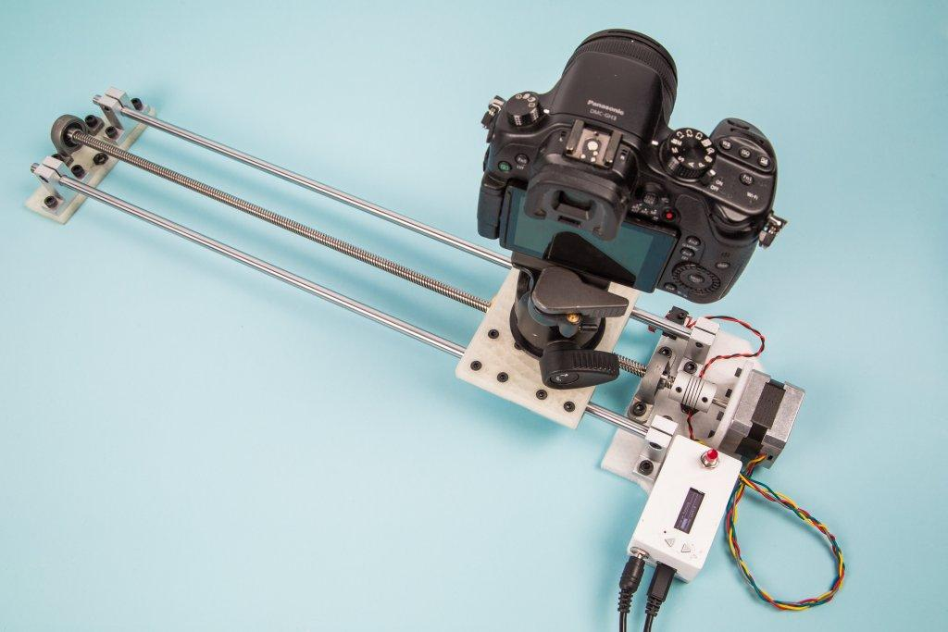
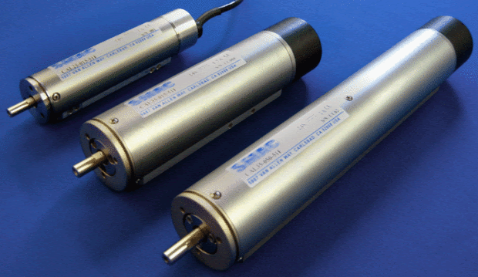
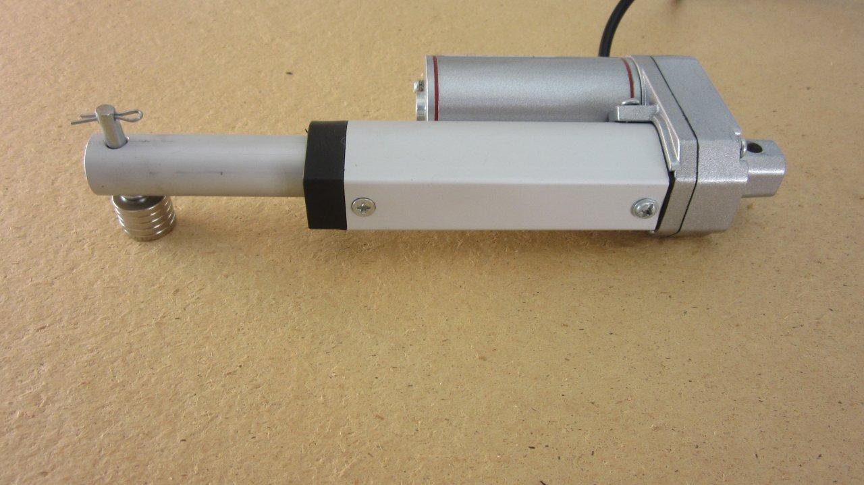
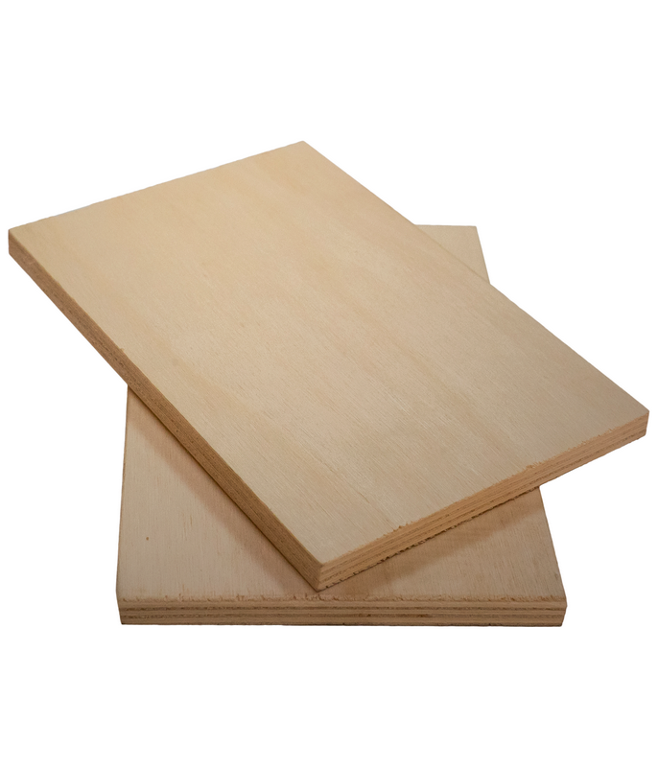
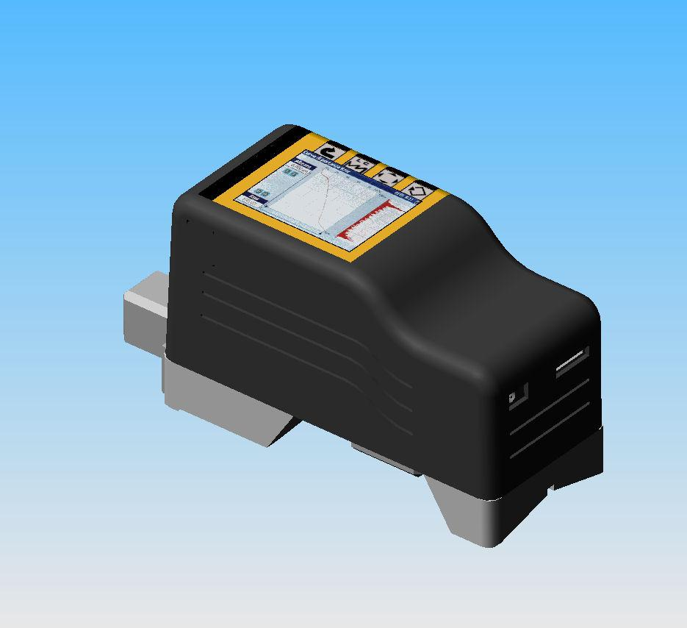
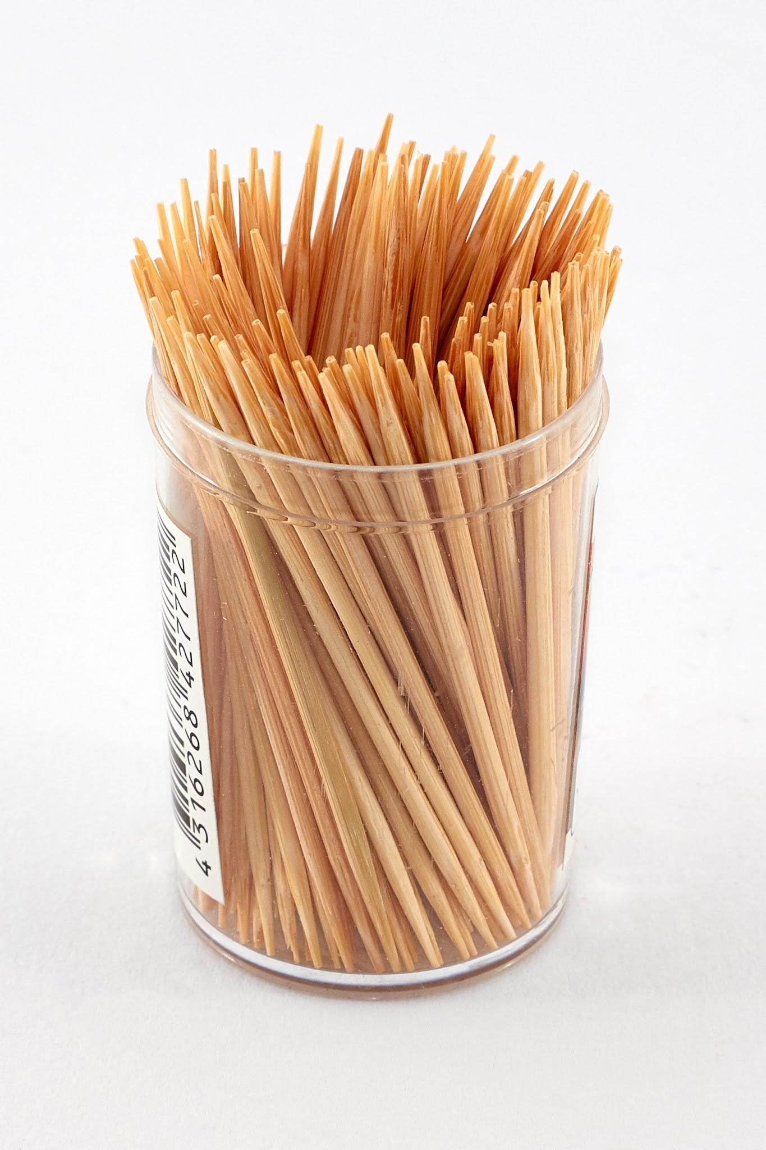
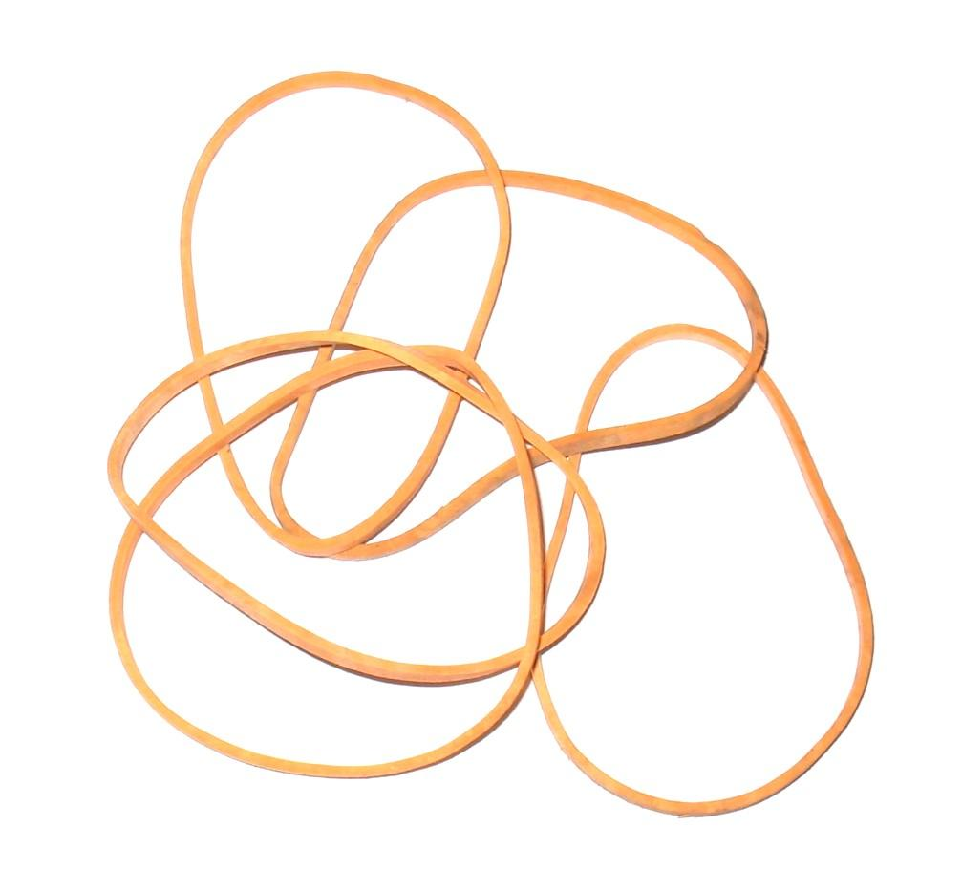
Materials Required
Linear reciprocating motor(Left) or Linear actuator(Right)
Timer
Linear Motion Track
Vibration Meter
Plywood
Rubber Bands(To hold plywood in place)
Toothpicks

Slide 19
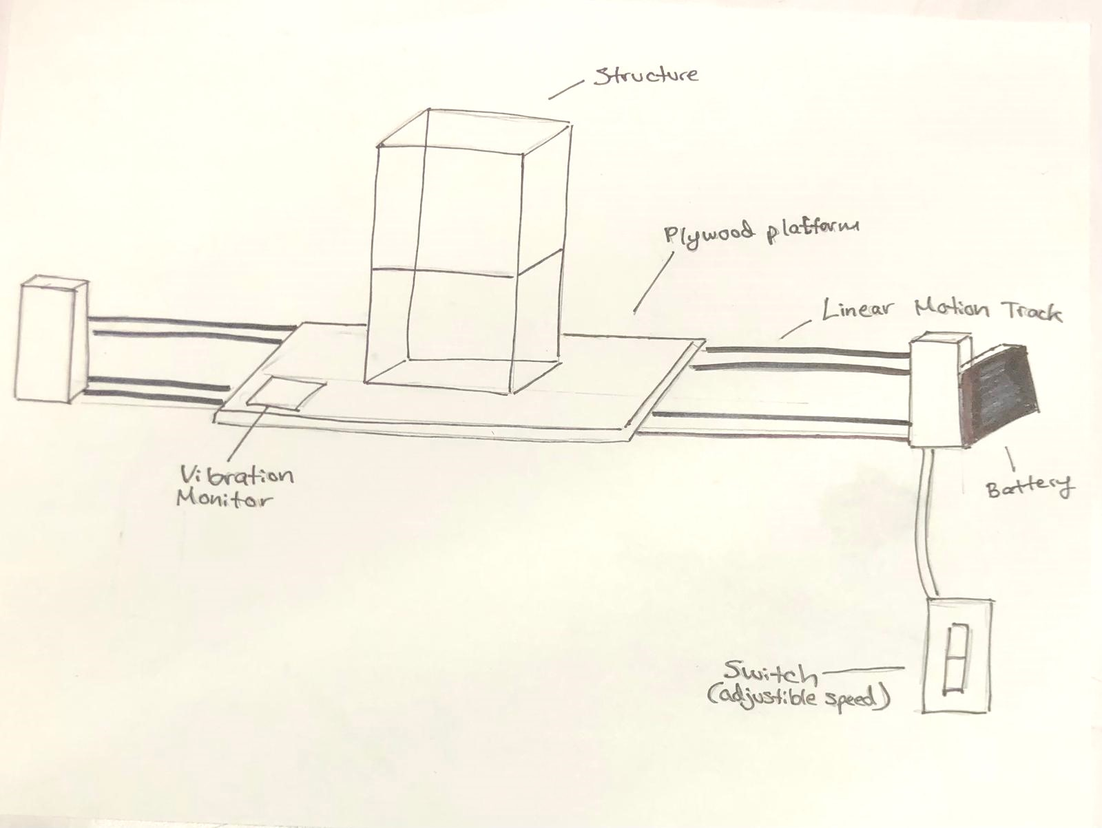
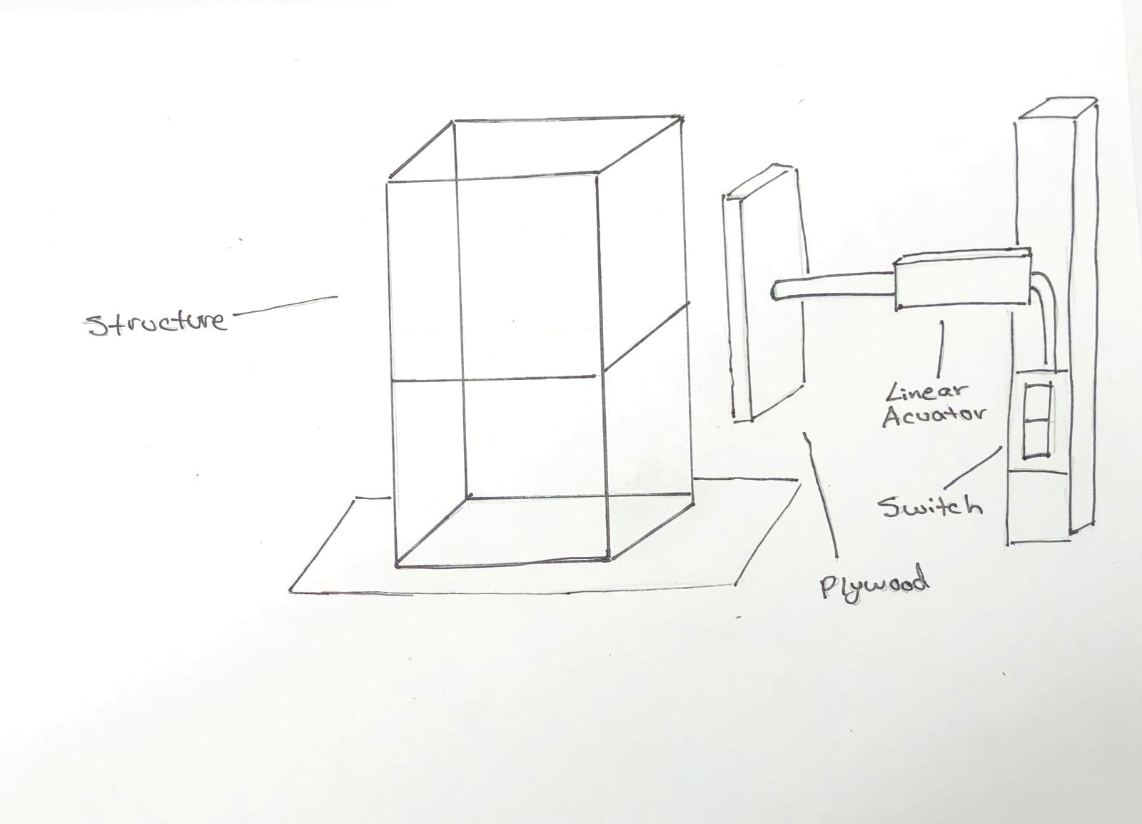
Functions of Tests
The first picture show the earthquake test. The structure will be placed on the platform and the linear motion track will start moving side to side to mimic an earthquake. To minimize side to side motion and create more vibrational motion, the settings will be adjusted show that we can increase the speed using a switch, without the platform moving that much of a distance. The Linear motion track will be powered by the battery that is located on the side. Based on the outcome, weights can also be added to the structures.
The second picture shows the stress test where a piece of plywood will be attached to a linear actuator. Using a switch, the linear actuator will horizontally, move forward and push the structure. To ensure that the structure doesn’t move away from the actuator, the structure will be secured to the based with rubber bands so that it can be seen how much force the structure can withstand before it breaks. Based on the outcome, weights can also be added to the structures. The linear actuator is being powered by a 60 w adapter.
The load test will include adding weight to the top of the structure until they collapse.

Slide 20
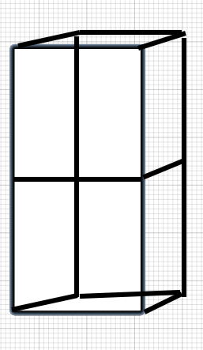
Dimensions and Further Info
Each structure has a height of 12 cm and a width of 6 cm. The total volume of the outer frame is 432 ㎤.
The platform of plywood will be cut into 10cm x 18 cm with the linear motion track being around 30 cm long.
Currently the linear actuator exerts 150 Newtons of force and is 8 cm long.
The plywood segment that is attached to the linear actuator in the stress test will have the dimensions of 10 cm x 6 cm.
Outer Frame

Slide 21
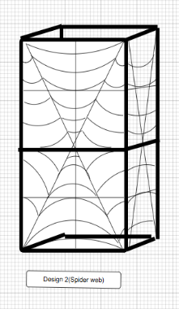
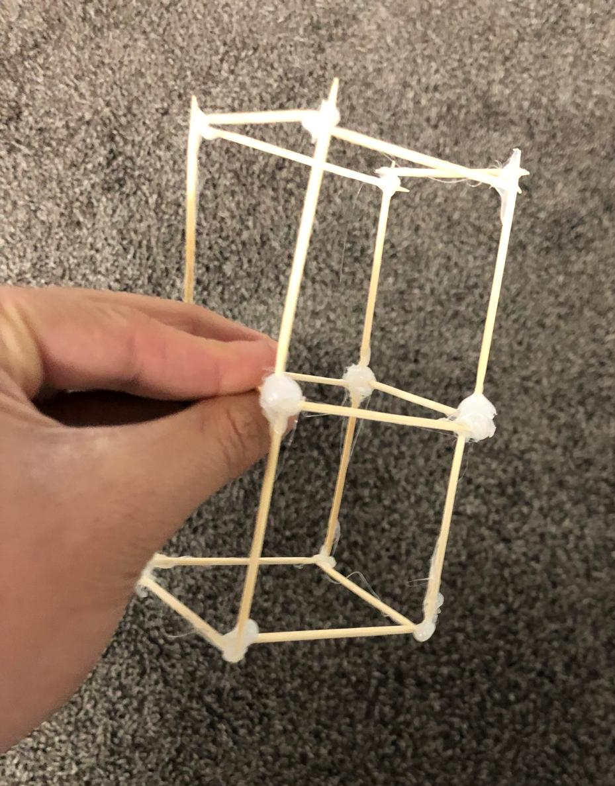
Analysis(Sources Of Error and Setbacks)
As I was very unfamiliar with designing structures and platforms to do so, it took me a very long time to find a proper platform in which I could use for designing. In addition to that, because of my prior lack of knowledge in designing, I had redesign all my designs multiple times to create a nature inspired design that was still structurally stable. The design that I had to re-do the most was the spider web design. As I wanted to create a design based on the spiral orb web, it took me multiple tries until I reached a basic understanding of a design that was like the spiral orb web, could be structurally stable and met the number of materials to do so.
When I was first building the exterior frame of all the designs(bolded black parts), there was a lot of inconsistency in my design. As I used a toothpick for each segment of my design, the pillars were not straight and was often disoriented. Also when making of this some segments got glued on top of another as shown in the bottom circle which created imbalance. Finally since I used hot glue to connect all the parts together, the amount of glue I used was different for each structure which made the weights unequal. To solve the inconsistency in the pillars, I changed my design so that for the pillars, I use one long toothpick instead of two smaller ones so that bending doesn’t occur. I also made sure when attaching two toothpicks together, I didn’t attach one over the other. To equalize the weight of all my designs, I tried to use the same amount of glue as well as make sure I used the same amount of toothpicks for each design.
Pillar

Slide 22
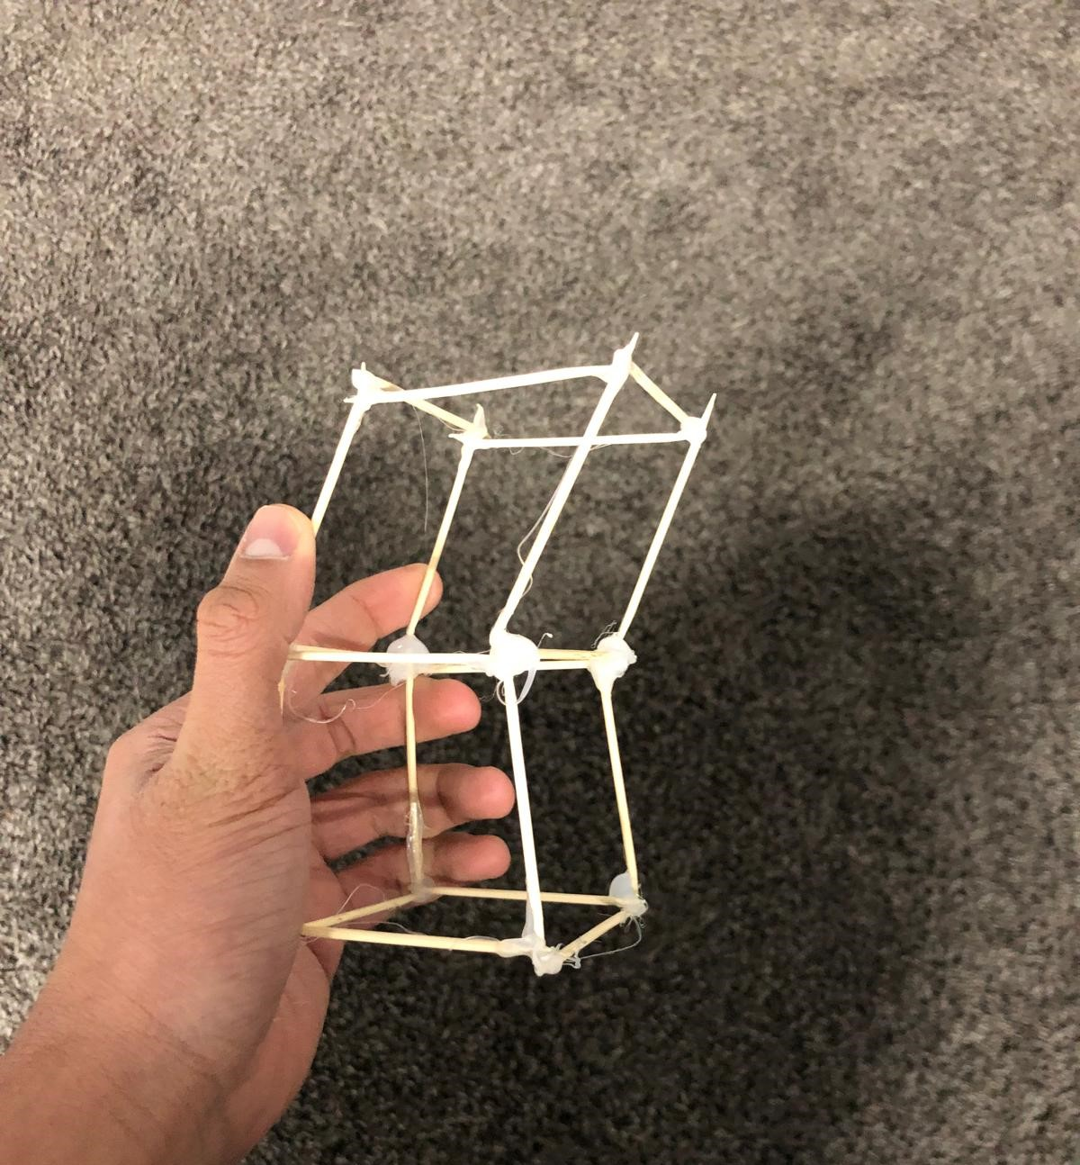
Analysis(Sources Of Error and Setbacks)
Before redesigning the pillars of my structure, I decided to see how much force the outer frame itself could withstand. Though it held up for a while, it eventually snapped in half due to shear and bending forces that were applied to the top of the structure. I later realized that the solidified glue used to hold the outer frame together was actually working against the structure. When force was being applied to the structure, the toothpick was being pressed against the ball of glue, causing the toothpick to bend. To fix this, instead of wrapping the toothpick with glue, I only applied glue to the end of the toothpicks so the only a minimal amount was being applied. To further enhance the toothpicks strength, I used thicker toothpicks
I also had to setback of when I began putting together all my designs as it was very difficult to maintain the same number of toothpicks and ensure the same wight. In addition to this, when cutting toothpicks, it created a lot of mess and some pieces became too small which caused me to restart. To fix this, instead of making everything made out of toothpicks, I decided to only use toothpick for the outer frame while using silver beading wire to build the interior framework. The reason I made this decision was because it created less of a mess, the wire was both strong and flexible, and was a lot easier to ensure the same amount of wire was used. To add, beading wire was much better and easier when making the arches for the spider web design.
Perhaps the biggest setback, I was able to get the linear actuator and all the other materials, but because of availability, I wasn’t able to get the linear motion track, plywood, or a vibration meter. Due to this, I wasn’t able to complete all my tests and the results of the stress test became insignificant as without plywood, the linear actuator didn’t have much surface area to create accurate results. Though my structures were able to hold loads of 1kg, I wasn’t able to create a controlled load increase because of the lack of 1kg loads. This made the experiment inaccurate as well and has to be re-done in the future. This could be overcome, given more time to ensure that all materials were collected.

Slide 23
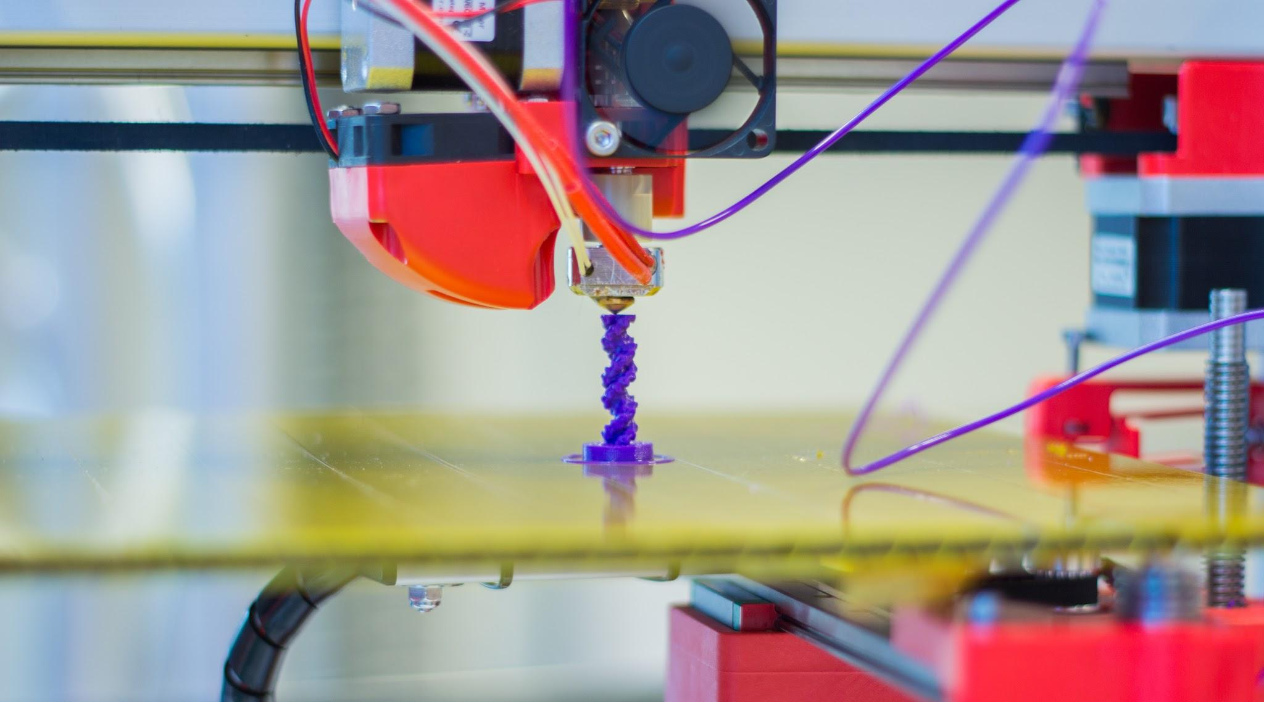
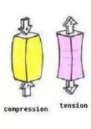
Progression to the project
In the future, the project can further progress by 3D printing all of my designs. By doing this, I can create multiple designs that are more exact to each other while also using a material that is stronger, provides more flexibility when designing, and won’t break that easily.
In addition to 3D printing the design, the designs and experiment could be made at a larger scale to be more accurate to real life structures. By doing so, the experiments could achieve better accuracy and be more relevant to current structural issues that we have in our society.
When repeating this project in the future, another test could be done that applies internal forces within the structures. All of my current experiments are external forces the a structure can receive so by adding a new experiment, we can see more accurately which design has the best efficiency considering the materials used and its size.

Slide 24
Successes
I was able to create multiple different designs that were inspired by nature that were all structurally stable and in theory, had better efficiency than an average residential building structure.
Develop a new solution to natural disasters by creating an effective design that if implemented, could achieve better protection against events such as a landslide when compared to our current housing designs.
I was able to create an experiment that very well mimicked the forced that could be applied to a structure during a landslide but could still be further improved to receive accurate results.
Was able to create an experiment that was able to collect the direction of force, point of application, and magnitude of force in a controlled manner.

Slide 25
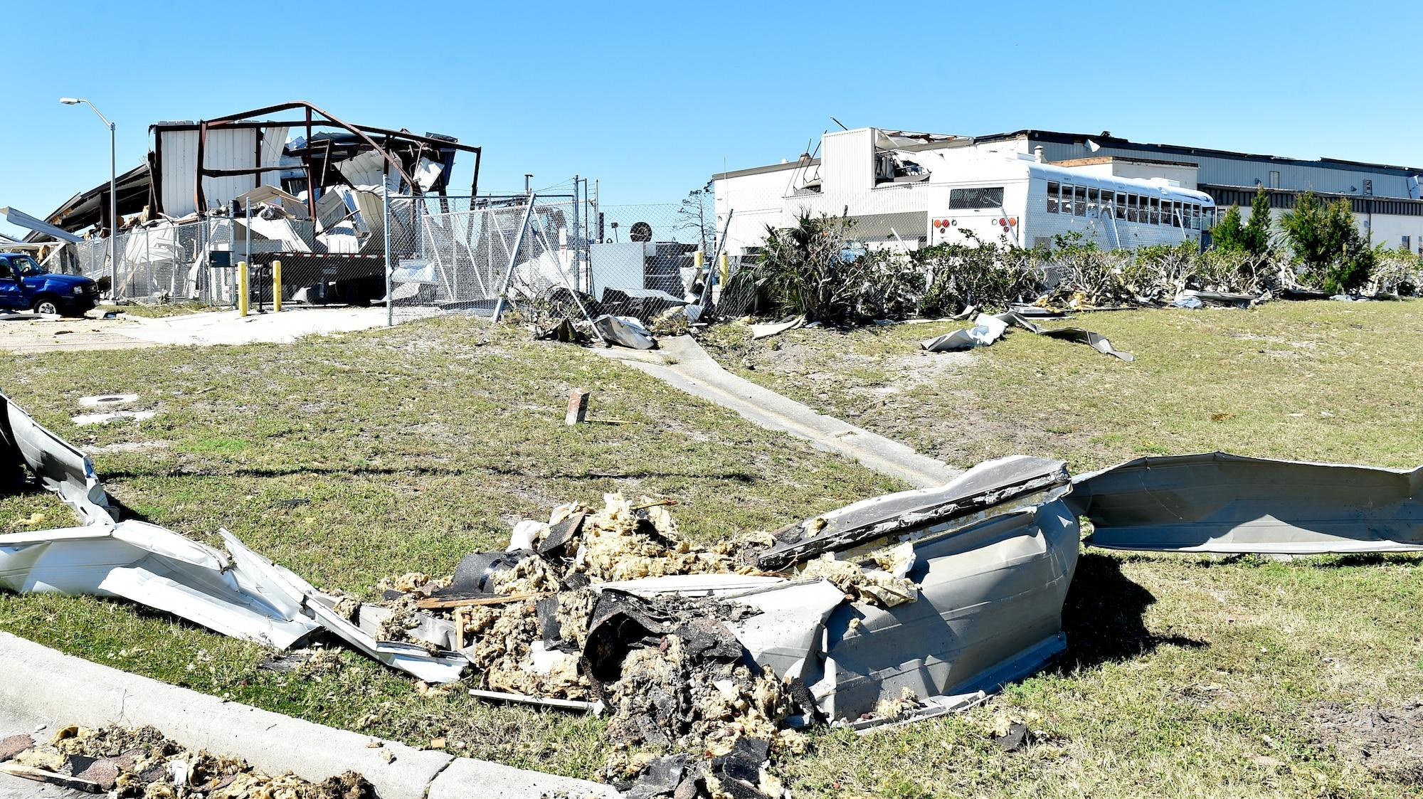
Real World Applications
Even though significant experimentation was not able to be accomplished due to the current circumstances, the designs itself are definitely structurally stable. As natural concepts are already being implemented to structures today to enhance its performance, my designs could be used to improve the structural stability of structures in our world. In addition to this, my structures have an effective design that organisms have used to not only maintain its structure, but to protect itself against external factors. This can be greatly valuable during times of natural disasters, where a great amount of force is applied to structures in the area the disaster took place in. By developing such solutions, construction workers, city planners, architects and people involved with infrastructure can create better strategies to prepare their community for untimely events that could cause havoc to their city.

Slide 26
Conclusion
As mentioned throughout this project, natural disasters can occur at any place at any time. Being unprepared for such events can result to being catastrophic where homes are destroyed, people are killed, families are broken, and lives are ruined.
With my proposed solution, communities can receive a better advantage to facing these problems. By implementing my designs, all communities, including lesser developed communities can develop feasible strategies that do not require an extreme amount of work to achieve a good result.
Though further experimentation is required, the designs I have developed will provide greater structural stability to all communities through an efficient way my using the same amount of space, materials, and effort to achieve greater efficiency to current structures.

Slide 27
Bibliography(APA)
(n.d.). Introduction to Structures: Types, Stability, Centre of Gravity, Forces, and More! https://www.youtube.com/watch?v=2e_7Pn_xKZo
(n.d.). https://mrdenney.weebly.com/uploads/1/3/7/6/13767597/lesson_10.3_classifying_figures.pdf
(n.d.). https://aidanross7.wordpress.com/2010/10/10/s14-design-and-analyse-basic-structures/
(n.d.). https://www.shutterstock.com/image-illustration/hands-breaking-pencil-half-1206122341
(n.d.). https://prezi.com/udhbr_n4vxlh/forces-acting-on-structures/#:~:text=Magnitude%20is%20the%20strength%20of,which%20occur%20on%20the%20exterior.
(n.d.). https://slallison.weebly.com/unit-d---structures--forces.html
(n.d.). https://www.ice.org.uk/news-views-insights/inside-infrastructure/re-evaluating-the-design-life-of-buildings
(n.d.). https://spiritualmusclehead.wordpress.com/2014/04/28/walking-into-spiderwebs/
(n.d.). https://www.planetbee.org/post/buzz-worthy-architecture-how-honey-bees-build-their-hives#:~:text=But%20why%20hexagons%3F,food%20stores%2C%20and%20their%20young.
(n.d.). https://geekswipe.net/science/physics/why-honeycomb-cells-are-built-hexagonally/
(n.d.). https://www.youtube.com/watch?v=faoqUN4c4cw
(n.d.). https://en.wikipedia.org/wiki/Turgor_pressure
Bailey, R. (2024, July 29). Cell Wall Structure and Function. ThoughtCo. https://www.thoughtco.com/cell-wall-373613
Dhali, S. (n.d.). Symmetry In Design And Its Importance. The Archspace. https://thearchspace.com/importance-of-symmetry-in-design/#google_vignette
Dhali, S. (n.d.). Symmetry In Design And Its Importance. The Archspace. https://thearchspace.com/importance-of-symmetry-in-design/#google_vignette
Gaware, D. (n.d.). How Do Extreme Weather Conditions Affect the Durability of Buildings? Rethinking The Future. https://www.re-thinkingthefuture.com/architectural-community/a7259-how-do-extreme-weather-conditions-affect-the-durability-of-buildings/
Hexagonal shapes in nature and architecture - Prefabricados de Hormigón SAS 1900. (2023, June 7). SAS Prefabricados de Hormigón. https://sas1900.com/en/hexagonal-shapes-in-nature-and-architecture/
Illustrative Mathematics. (n.d.). Illustrative Math Tasks. https://tasks.illustrativemathematics.org/content-standards/tasks/1123
Japanese bullet trains to carry freight in response to COVID-19. (2020, April 8). Springwise. https://springwise.com/coronavirus/japanese-bullet-trains-to-carry-freight-in-response-to-covid-19/
The Kingfisher and the bullet train – In the news. (n.d.). GTAC. https://gtac.edu.au/the-kingfisher-and-the-bullet-train-in-the-news/
Kingfisher Bird Facts | Alcedo Atthis. (n.d.). RSPB. https://www.rspb.org.uk/birds-and-wildlife/kingfisher
Materials Used in Building Construction. (2019, March 27). Construction Tuts. https://www.constructiontuts.com/materials-used-in-building-construction/
Petley, D. (2024, October 17). A first analysis of the 30 July 2024 Wayanad landslide in India. Eos.org. https://eos.org/thelandslideblog/wayanad-4
Spiders and their Webs – Acreage Life – Nebraska. (2018, October 1). Acreage Life - Nebraska. https://acreagenebraska.org/2018/10/01/125/
Sullivan, K. D. (2017, August 13). Ever wonder why there are so many hexagons in nature? | Videos. Labroots. https://www.labroots.com/trending/videos/10939/ever-wonder-why-there-are-so-many-hexagons-in-nature
The Wayanad Landslide: Catastrophic Event and Its Aftermath. (n.d.). https://www.linkedin.com/pulse/wayanad-landslide-catastrophic-event-its-aftermath-abishek-arokiasamy-l0roc
What is Biomimicry. (n.d.). https://biomimicry.org/inspiration/what-is-biomimicry/.
(n.d.). https://buffaloarchitecture.org/wp-content/uploads/2015/08/AEPresentation-ArchitecturalElements.pdf

Slide 28
Thank You!

