Slide 1
How does temperature affect how long a battery lasts
By Tariq Al-Ssalmani

Slide 2
Hypothesis
If i use the same kind of batteries at different temperatures freezing,cold,room temperature, and hot the freezing and batteries will not last as long as the ones in cold,room temperature or warm because freezing temperatures will slow down the chemical reactions inside the battery.

Slide 3
Background Research
We will ‘test’ How long a fresh battery can power the flashlight at different temperatures.
Independent variable [the things changes]
Temperatures [freezing,cold,room temperature,hot]
Dependant variable [the things we measure]
Voltage
How long the flashlight stays bright om [battery life in minutes/hours
temperature
Controlled variables(you keep these the same)
same brand
same type of device
same starting point [fresh batteries
same way of deciding if batteries are dead [for example light is off

Slide 4
Materials
A digital multimeter
AAA batteries
Test device (flashlight)
Notebook
Pen/Pencil
Different temperature places temperature
measurement recorder
stopwatch.

Slide 5
Experiment
We will do separate tests for each temperature and repeat it 2,3 times to settle the data :
1. chill or warmth battery and device until it reaches that temperature
2.turn the device on and leave it on in the freezer while it runs.
3.Measure volume every 15 minutes and measure time with flashlight
For example:
1.take a fresh battery and label it the temp it's going to .
2.put the battery and flashlight in the freezer for 1 hour exactly.
3.After hour,Take voltage,Take Battery into flashlight and turn on
4.Measure voltage every 15 minutes
5.Repeat.

Slide 6
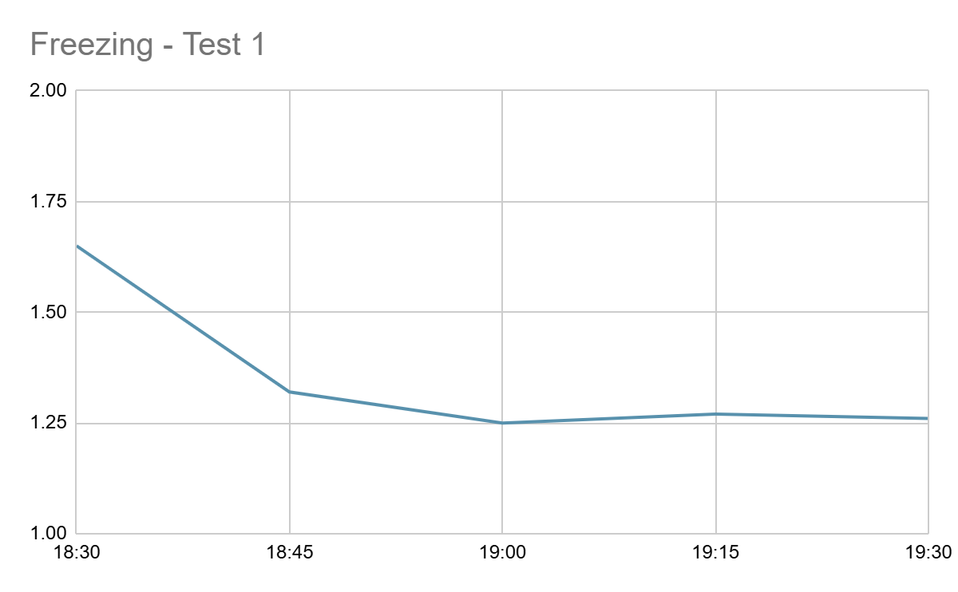
Results - Freezing Test 1
Start up Voltage before 1 hour inside the freezer = 1.67 Volt
Time | Duration (min) | Voltage
18:30 | 0 | 1.65
18:45 | 15 | 1.32
19:00 | 30 | 1.25
19:15 | 45 | 1.27
19:30 | 60 | 1.26

Slide 7
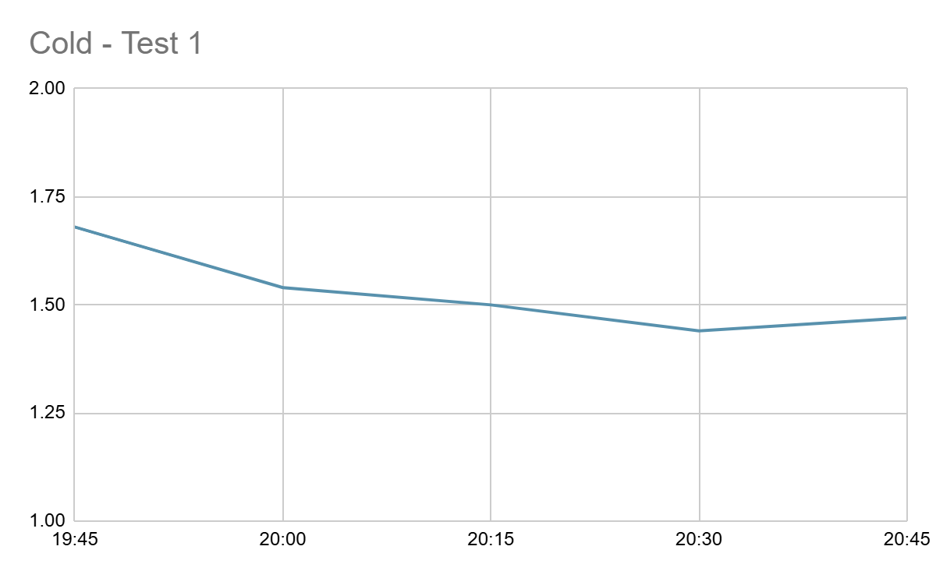
Results - Cold Test 1
Start up Voltage before 1 hour inside the cold = 1.67 Volt
Time | Duration (min) | Voltage
19:45 | 0 | 1.68
20:00 | 15 | 1.54
20:15 | 30 | 1.50
20:30 | 45 | 1.44
20:45 | 60 | 1.47

Slide 8
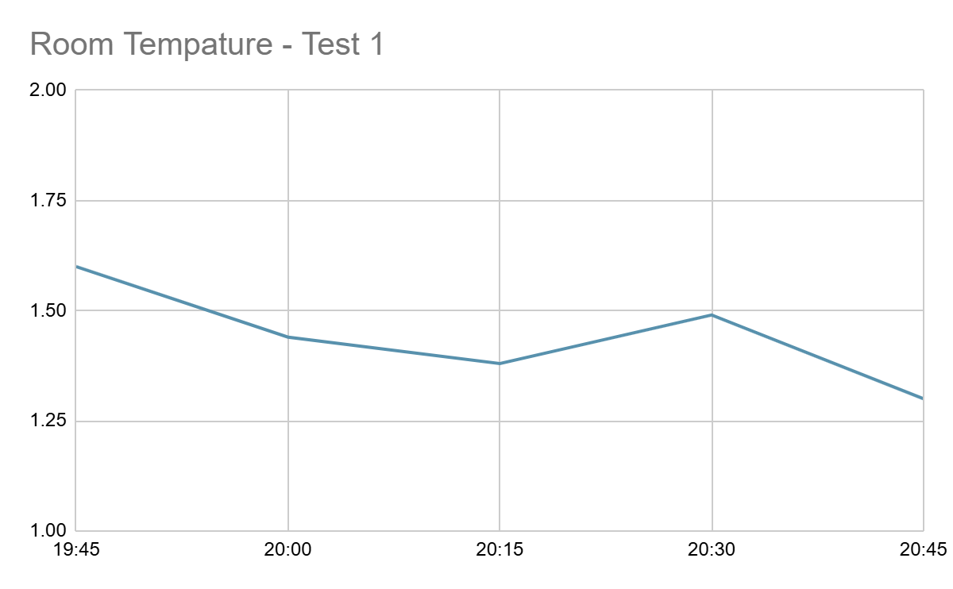
Results - Room Temperature Test 1
Start up Voltage before 1 hour inside the room temperature = 1.67 Volt
Time | Duration (min) | Voltage
19:45 | 0 | 1.60
20:00 | 15 | 1.44
20:15 | 30 | 1.38
20:30 | 45 | 1.49
20:45 | 60 | 1.30

Slide 9
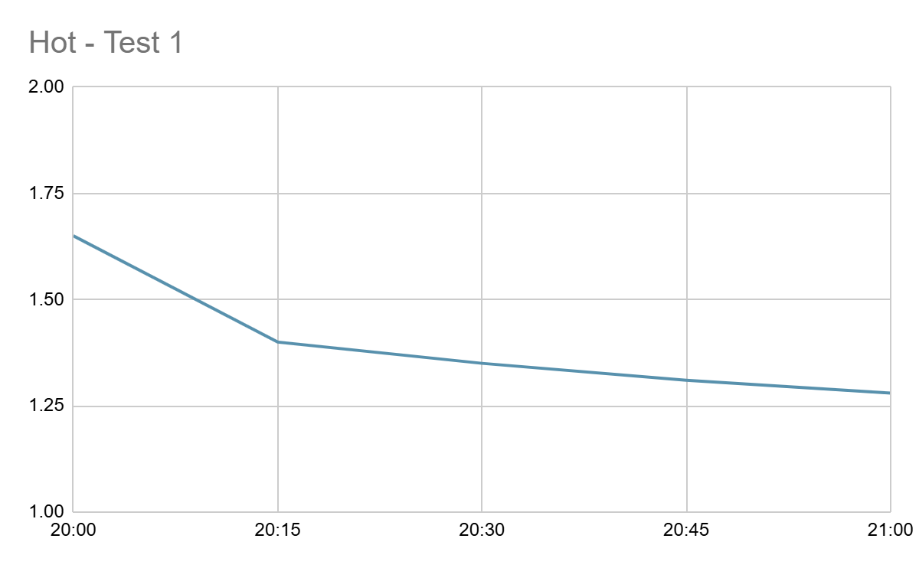
Results - Hot Test 1
Start up Voltage before 1 hour inside the Hot Temperature = 1.65 Volt
Time | Duration (min) | Voltage
20:00 | 0 | 1.65
20:15 | 15 | 1.40
20:30 | 30 | 1.35
20::45 | 45 | 1.31
21:00 | 60 | 1.28

Slide 10
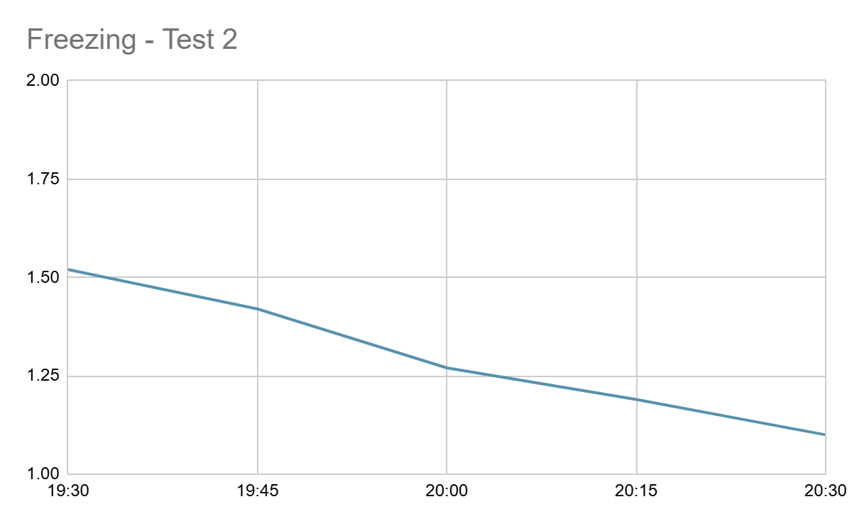
Results - Freezing Test 2
Start up Voltage before 1 hour inside the freezer = 1.52 Volt
Time | Duration (min) | Voltage
19:30 | 0 | 1.52
19:45 | 15 | 1.42
20:00 | 30 | 1.27
20:15 | 45 | 1.19
20:30 | 60 | 1.10

Slide 11
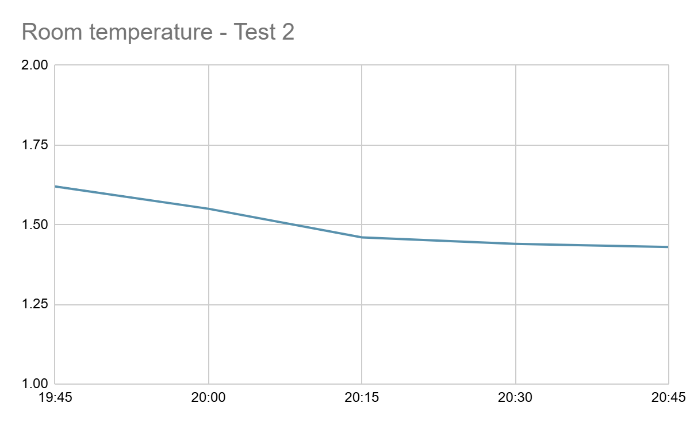
Results - Cold Test 2
Start up Voltage before 1 hour inside the cold = 1.62 Volt
Time | Duration (min) | Voltage
19:45 | 0 | 1.62
20:00 | 15 | 1.55
20:15 | 30 | 1.46
20:30 | 45 | 1.44
20:45 | 60 | 1.43

Slide 12
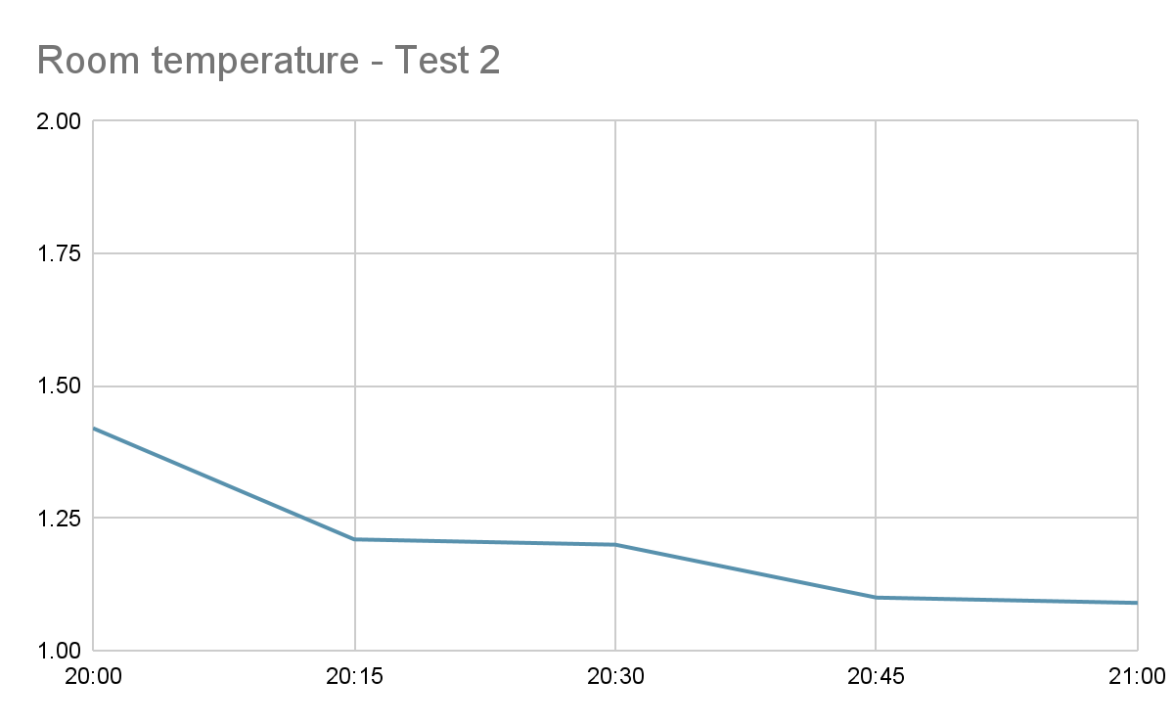
Results - Room Temperature Test 2
Start up Voltage before 1 hour inside the room temperature = 1.58 Volt
Time | Duration (min) | Voltage
20:00 | 0 | 1.42
20:15 | 15 | 1.21
20:30 | 30 | 1.20
20:45 | 45 | 1.10
21:00 | 60 | 1.09

Slide 13
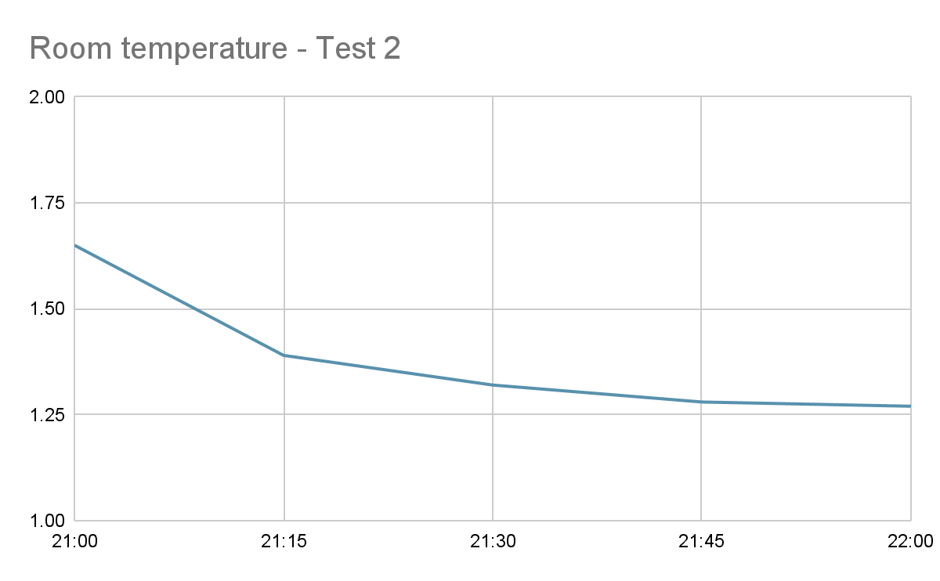
Results - Hot Test 2
Start up Voltage before 1 hour inside the Hot temperature = 1.65 Volt
Time | Duration (min) | Voltage
21:00 | 0 | 1.65
21:15 | 15 | 1.39
21:30 | 30 | 1.32
21:45 | 45 | 1.28
22:00 | 60 | 1.27

Slide 14
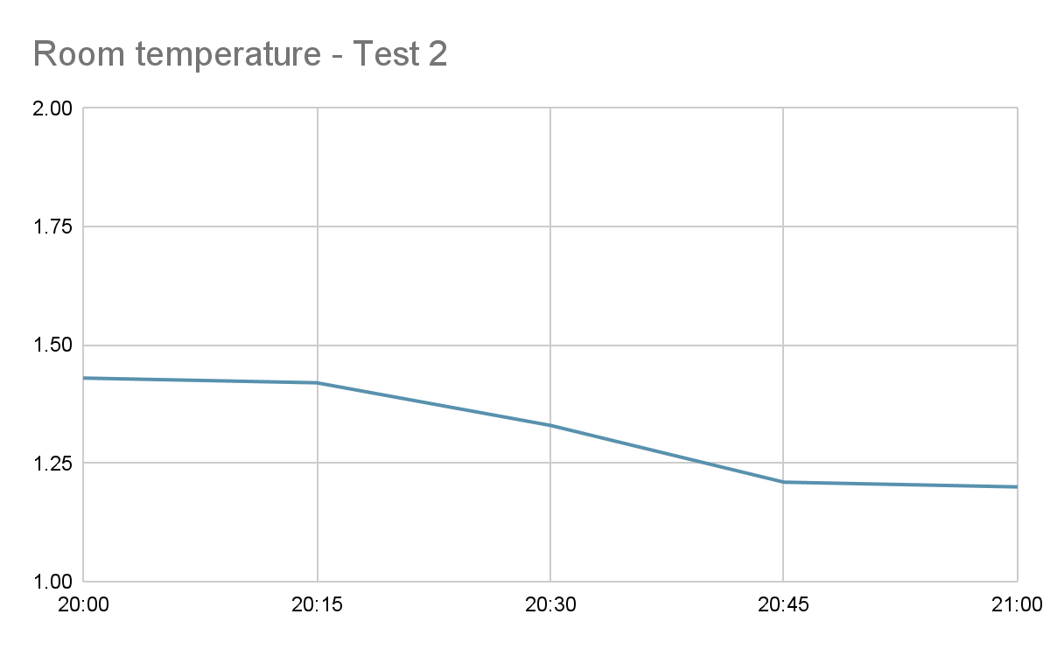
Results - Freezing Test 3
Start up Voltage before 1 hour inside the freezer = 1.54 Volt
Time | Duration (min) | Voltage
20:00 | 0 | 1.43
20:15 | 15 | 1.42
20:30 | 30 | 1.33
20:45 | 45 | 1.21
21:00 | 60 | 1.20

Slide 15
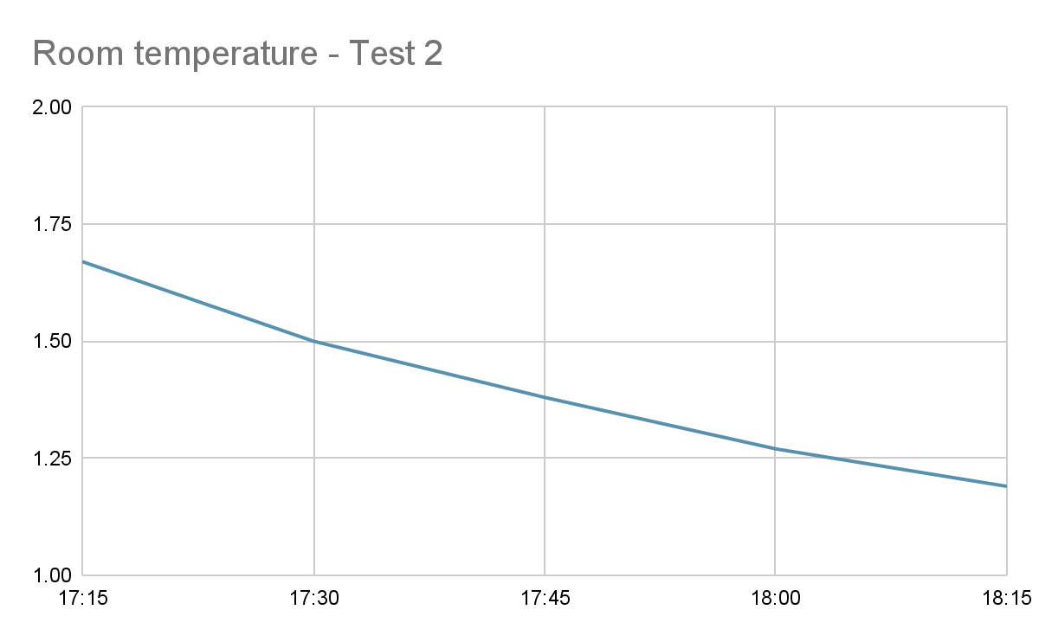
Results - Cold Test 3
Start up Voltage before 1 hour inside the cold = 1.67 Volt
Time | Duration (min) | Voltage
17:15 | 0 | 1.67
17:30 | 15 | 1.50
17:45 | 30 | 1.38
18:00 | 45 | 1.27
18:15 | 60 | 1.19

Slide 16
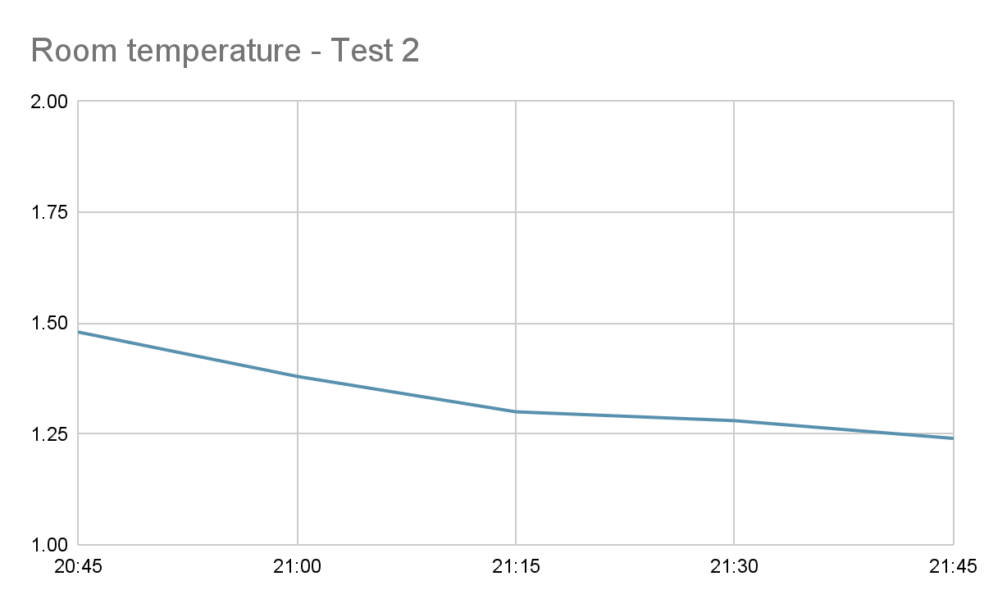
Results - Room Temperature Test 3
Start up Voltage before 1 hour inside the room temperature = 1.50 Volt
Time | Duration (min) | Voltage
20:45 | 0 | 1.48
21:00 | 15 | 1.38
21:15 | 30 | 1.30
21:30 | 45 | 1.28
21:45 | 60 | 1.24

Slide 17
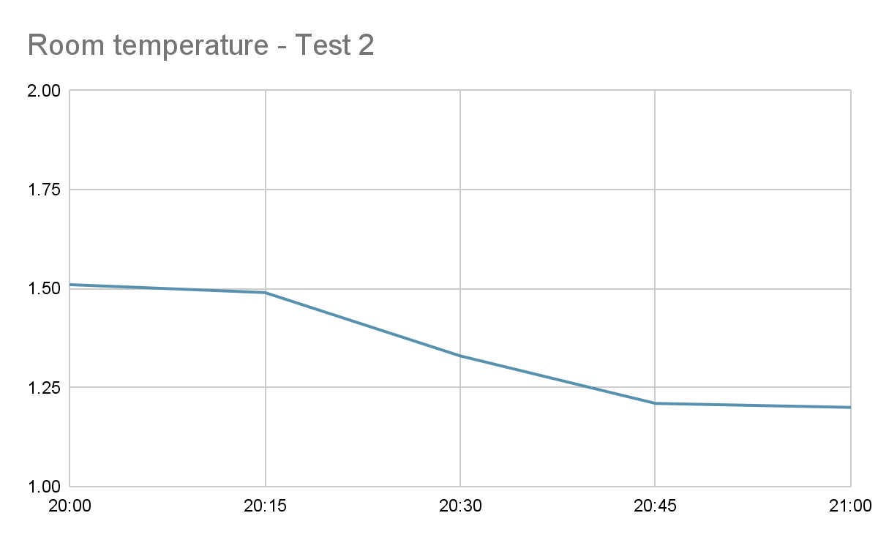
Results - Hot Test 3
Start up Voltage before 1 hour inside the Hot temperature = 1.51 Volt
Time | Duration (min) | Voltage
20:00 | 0 | 1.51
20:15 | 15 | 1.49
20:30 | 30 | 1.33
20::45 | 45 | 1.21
21:00 | 60 | 1.20

Slide 18
Conclusion
Test 1
Test 2
Test 3
 | Start | Finish | % | Start | Finish | % | Start | Finish | % | AVG %
Freezing | 1.65 | 1.26 | 0.39 | 1.52 | 1.10 | 0.42 | 1.43 | 1.20 | 0.23 | 0.34
Cold | 1.68 | 1.47 | 0.21 | 1.62 | 1.43 | 0.19 | 1.68 | 1.32 | 0.36 | 0.25
Room T | 1.60 | 1.30 | 0.30 | 1.42 | 1.09 | 0.33 | 1.48 | 1.24 | 0.24 | 0.29
Warm | 1.65 | 1.28 | 0.37 | 1.65 | 1.27 | 0.33 | 1.51 | 1.20 | 0.31 | 0.33
My conclusion shows that my hypothesis was right as you can see from this table freezing went down the most. What was interesting and i did not expect is that warm temperature drained the battery life similar to freezing.

