Slide 1
Treat or Beat
By: Mahi Budihal and Elaine Qu

Slide 2
Scientific Question
Will a person get a better mark if they are told they will get a punishment or a reward?

Slide 3
Manipulated Variables
Controlled Variables
Responding Variable
Variables
-The age of participants - Everyone has an equal chance -Which side- punishment or reward,
- The test (No cheating, favouritism, studying) will get the better results/marks
( Based on the person’s age) - What the test is out of ( /25 )
-What the test is )multiple choice
-Background sound- quiet

Slide 4
Connection and History
What was the history of punishment and reward? Well an experiment like ours, about the motivation of reward and punishment, was first conducted long ago and still to this day with one exception. It was conducted on a donkey. The experiment was known as the carrot and stick approach. In the carrot and stick approach, people would see if a carrot, a treat for the donkey or a stick which is used to hit it works better. If the donkey doesn’t move, they get hit by a stick while if they go towards the right side, they get a carrot as a treat. In this experiment they are testing whether punishment or reward will make the donkey move forward as well as do more tasks. Although this experiment is done world wide, the results are not definitive since both approaches lead to the same result. Thus, my partner and I came up with an idea if punishment or reward pushes a human to perform better and work harder.

Slide 5
Background Research Part 1
Punishment teaches the brain to avoid bad behaviors, making us remember to do things differently next time. The hippocampus makes us remember about the punishment by storing the memory of it in our brain. Our brain uses this information to try to avoid more punishments. After a punishment, we might feel guilt and shame which helps us change our future behavior. Rewards motivate us by releasing a chemical called dopamine that boosts our confidence in the daily activities we do. The hippocampus, this time works the opposite way, and makes us remember about the reward and the feeling of earning something instead of getting it painfully. Earning rewards make us feel happy and proud of ourselves since we achieved our goal and earned something at the same time.

Slide 6
Background Research Part 2
The answer for elementary students is reward, because as well as reinforcing good habits, boosting motivation and confidence, it also boosts problem solving. Punishment is not the way to go for elementary students because it causes the fear of failure, learning from mistakes and even short-term focus because punishments causes a fear of punishment. Punishments causes the brain to always be distracted and worried of getting a punishment instead of focusing on what is happening right in front of them. Lastly, if a punishment is too hard or consistent, it causes resistance rather than cooperation.
For adolescents, rewards are still the better choice because it can make them feel like their action was appreciated and recognized for what they did potentially causing them to try to repeat it, and rewards cause stronger and better relationship with their authority figure. Instead of a bad connection and fear towards their authority figures with punishments, rewards build good relationships.

Slide 7
Background Research Part 3
In fact, the answer is also the same for adults and seniors because it boosts their morale, encourages goal achievement and reinforces positive behavior. All of this is because rewards are what they want and like, which motivates them to try harder. Rewards make seniors and adults feel good about themselves, encourages them to participate positively. They have a goal to achieve and earn a reward. Incentivizing a senior and adult with a reward is more effective than punishments because earning rewards preserves dignity and encourages participation. As well as punishment discourages them and can lead to frustration, resentment and exhaustion. They would try to avoid the consequences without finding better solutions. Punishment for adults and seniors also leads to short term effectiveness defining it would not work well and long enough. Punishments, also damages their self esteem which can be negative for learning and their behaviour.

Slide 8
Hypothesis
If you tell a elementary student, adolescent, adult, and senior they will get a reward if they get 100% each on a test, then all of them will get a better mark than if they were told they will get a punishment if they don’t get 100%.
For a elementary student, adolescent, adult, and senior, telling them they will get an reward works better than telling them they will get a punishment if they don’t get 100% because using the reward method for an overall of all the ages boosts the motivation to earn something in a person to try to achieve that goal of 100% again while if you use the punishment method, for all the ages, causes a major drop in their self esteem and confidence in themself while doing the test, making them possibly doubt and rethink some of the answers they put whether they are wrong or right as all they are thinking about is to not get a punishment.

Slide 9
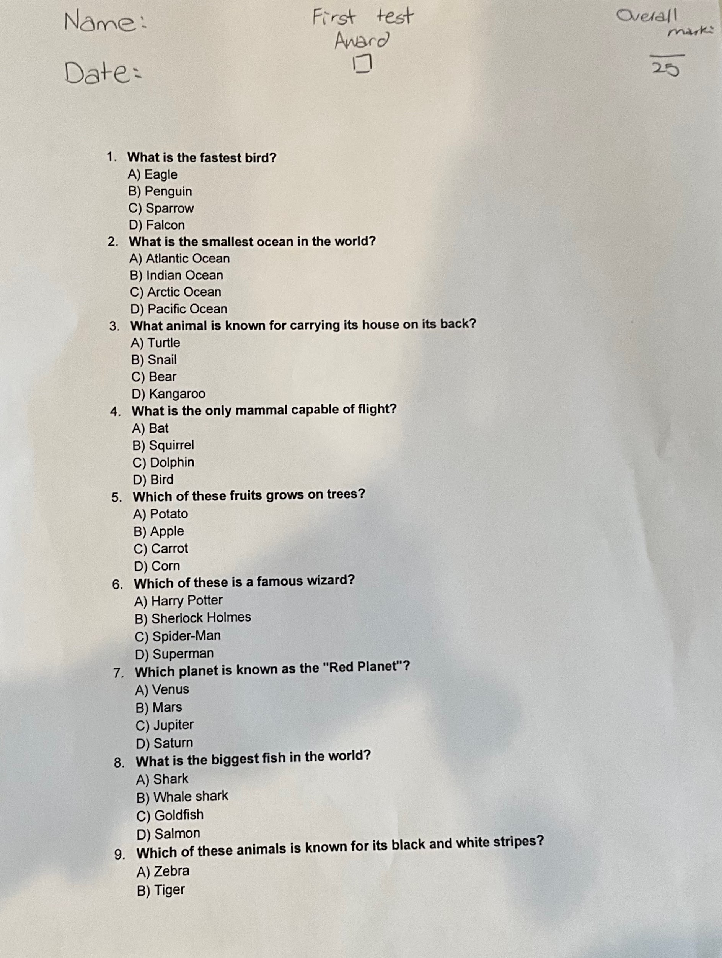
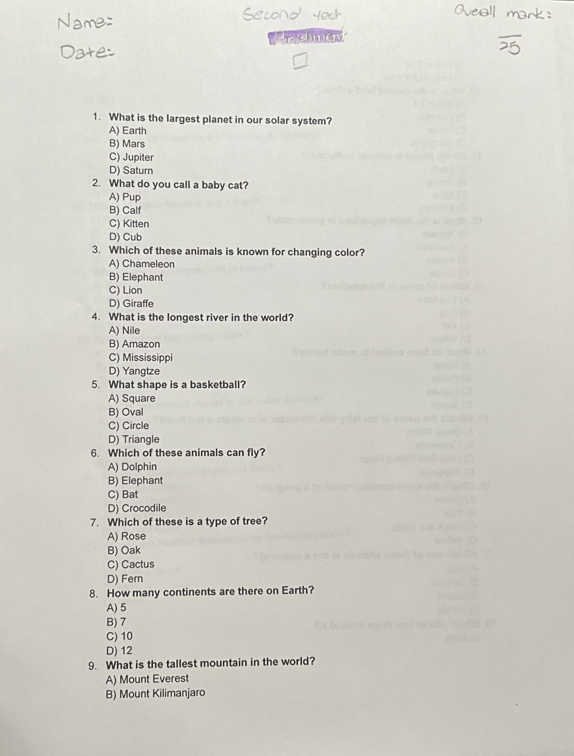
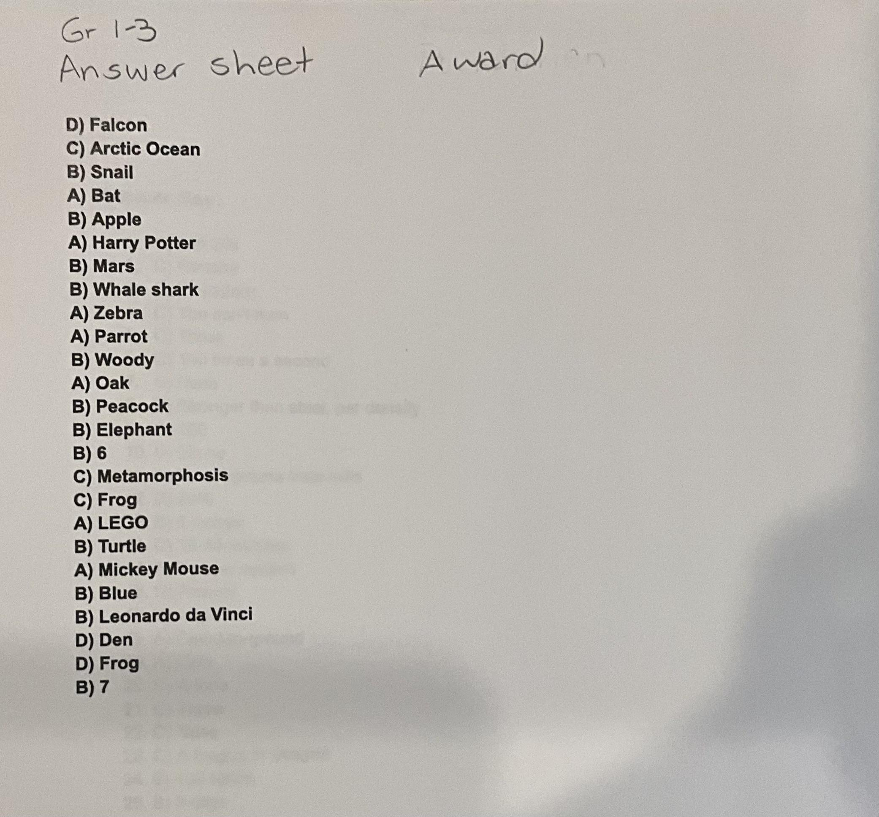
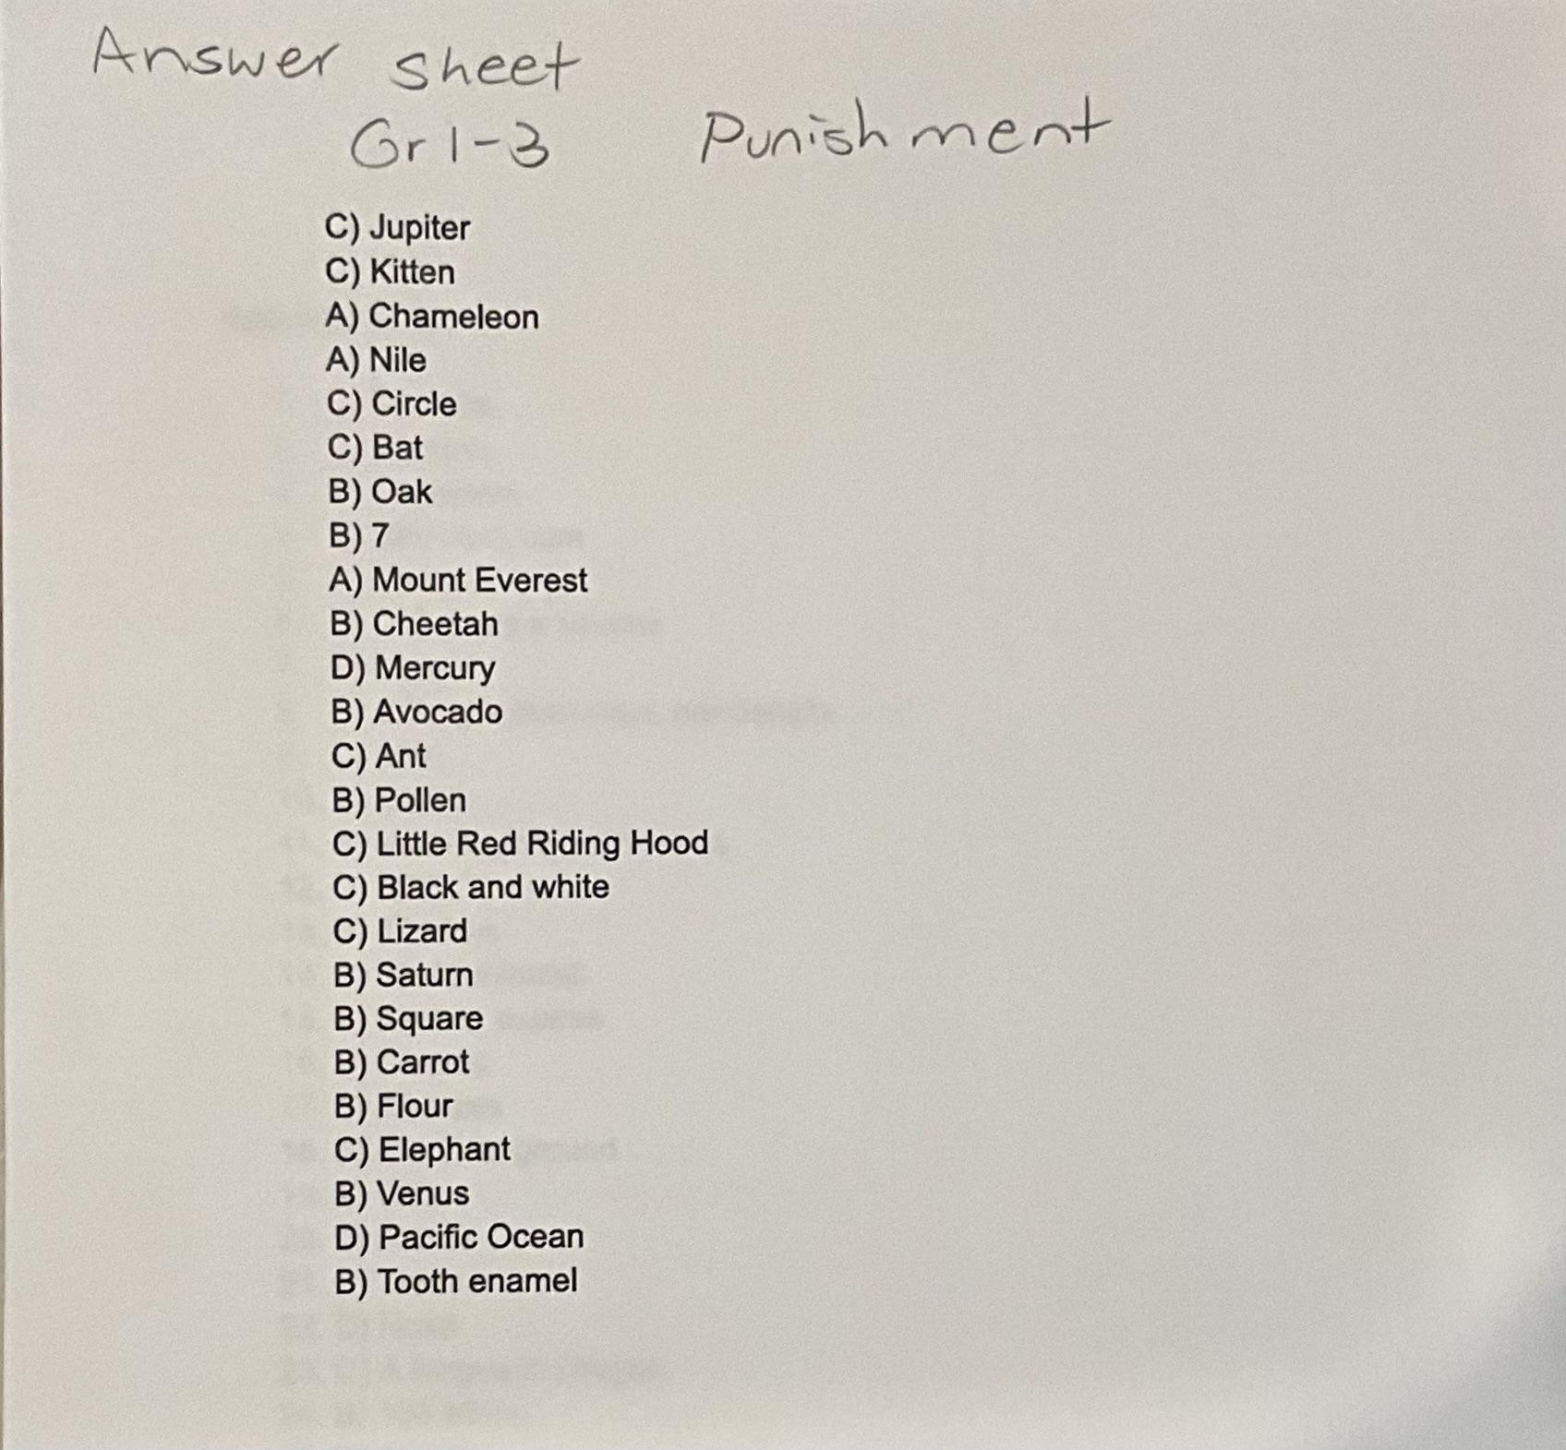
Experimental design-Tests Grades 1-3
These were the tests that were given to the Grades 1-3 individuals.
These were the answer sheets to each of the questions.

Slide 10
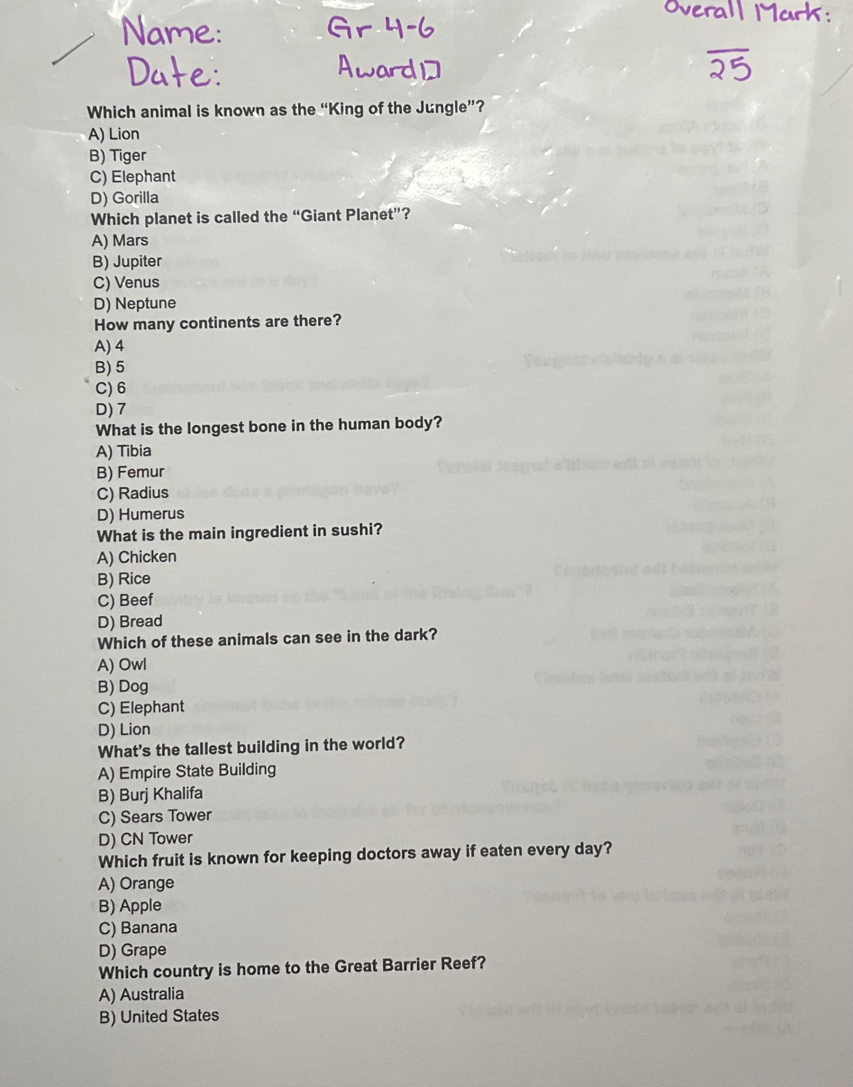
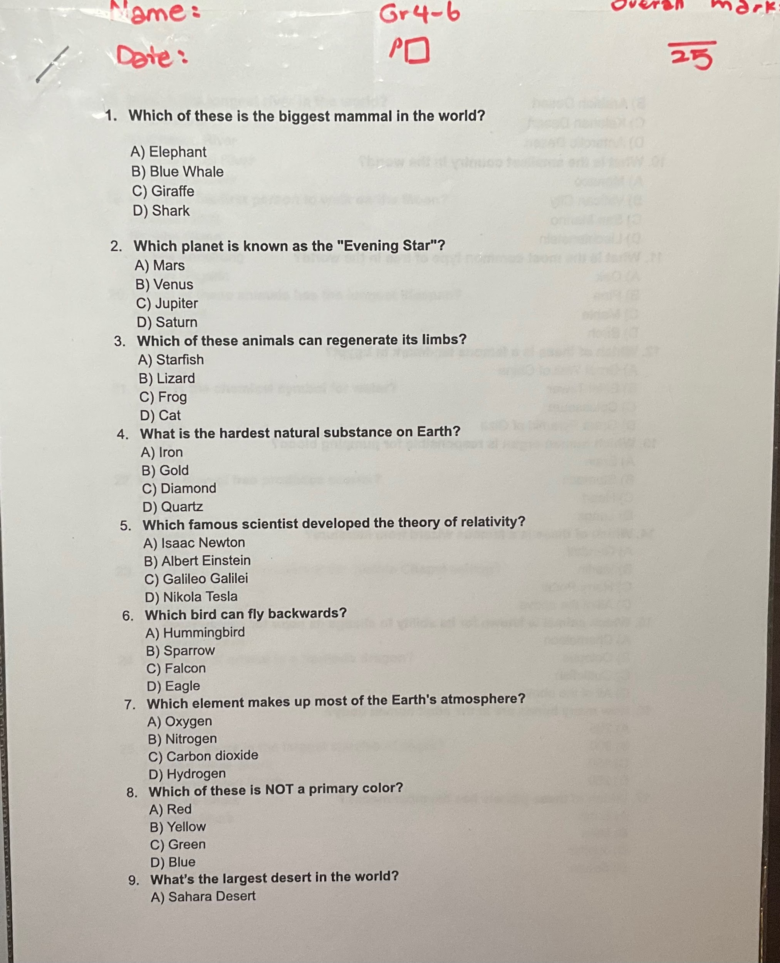
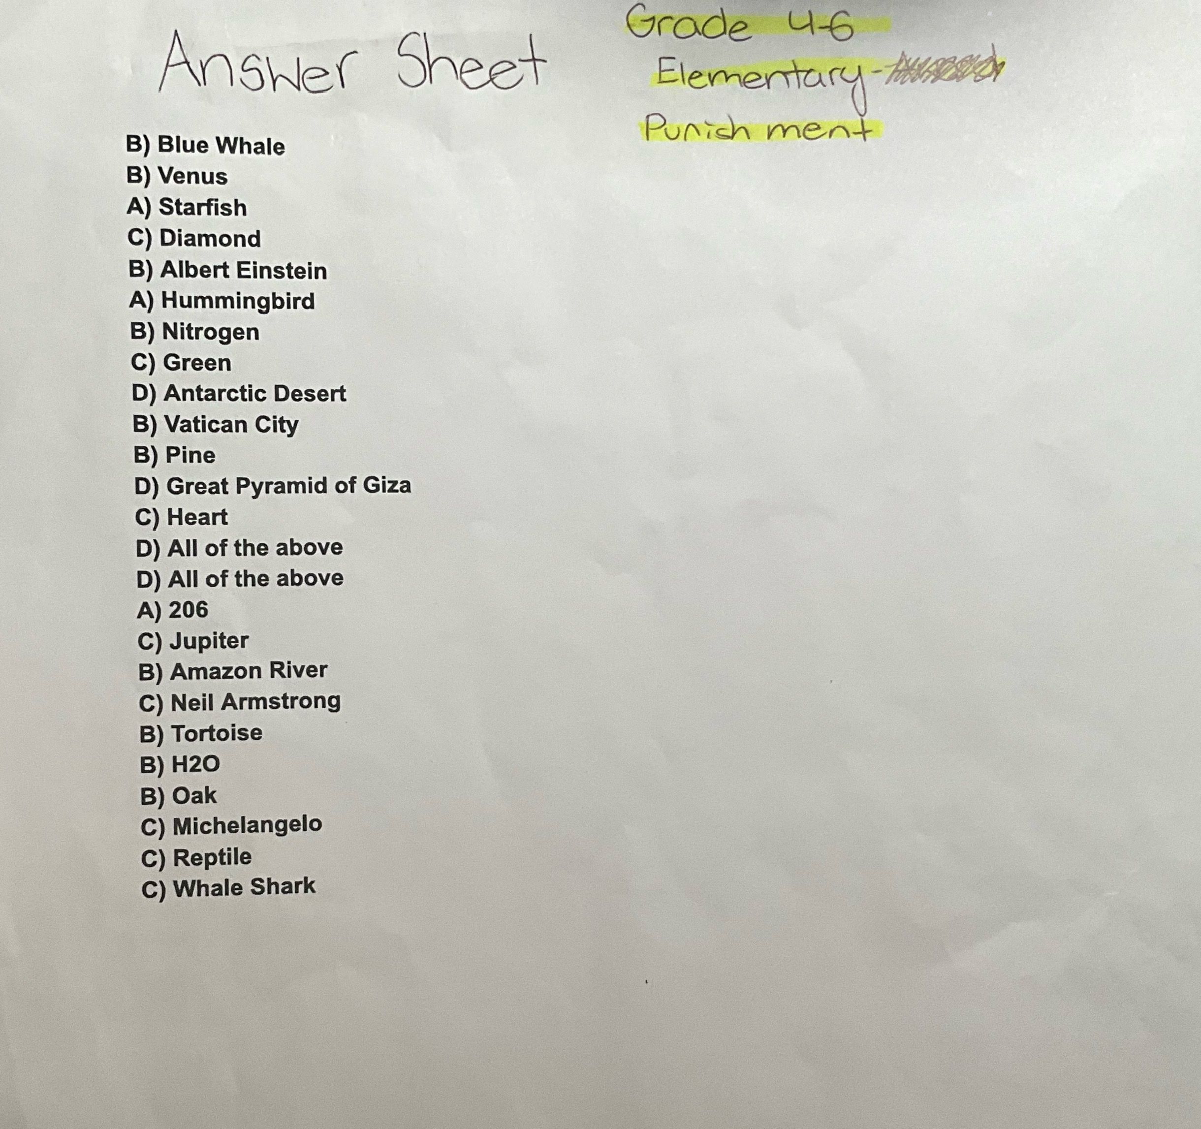
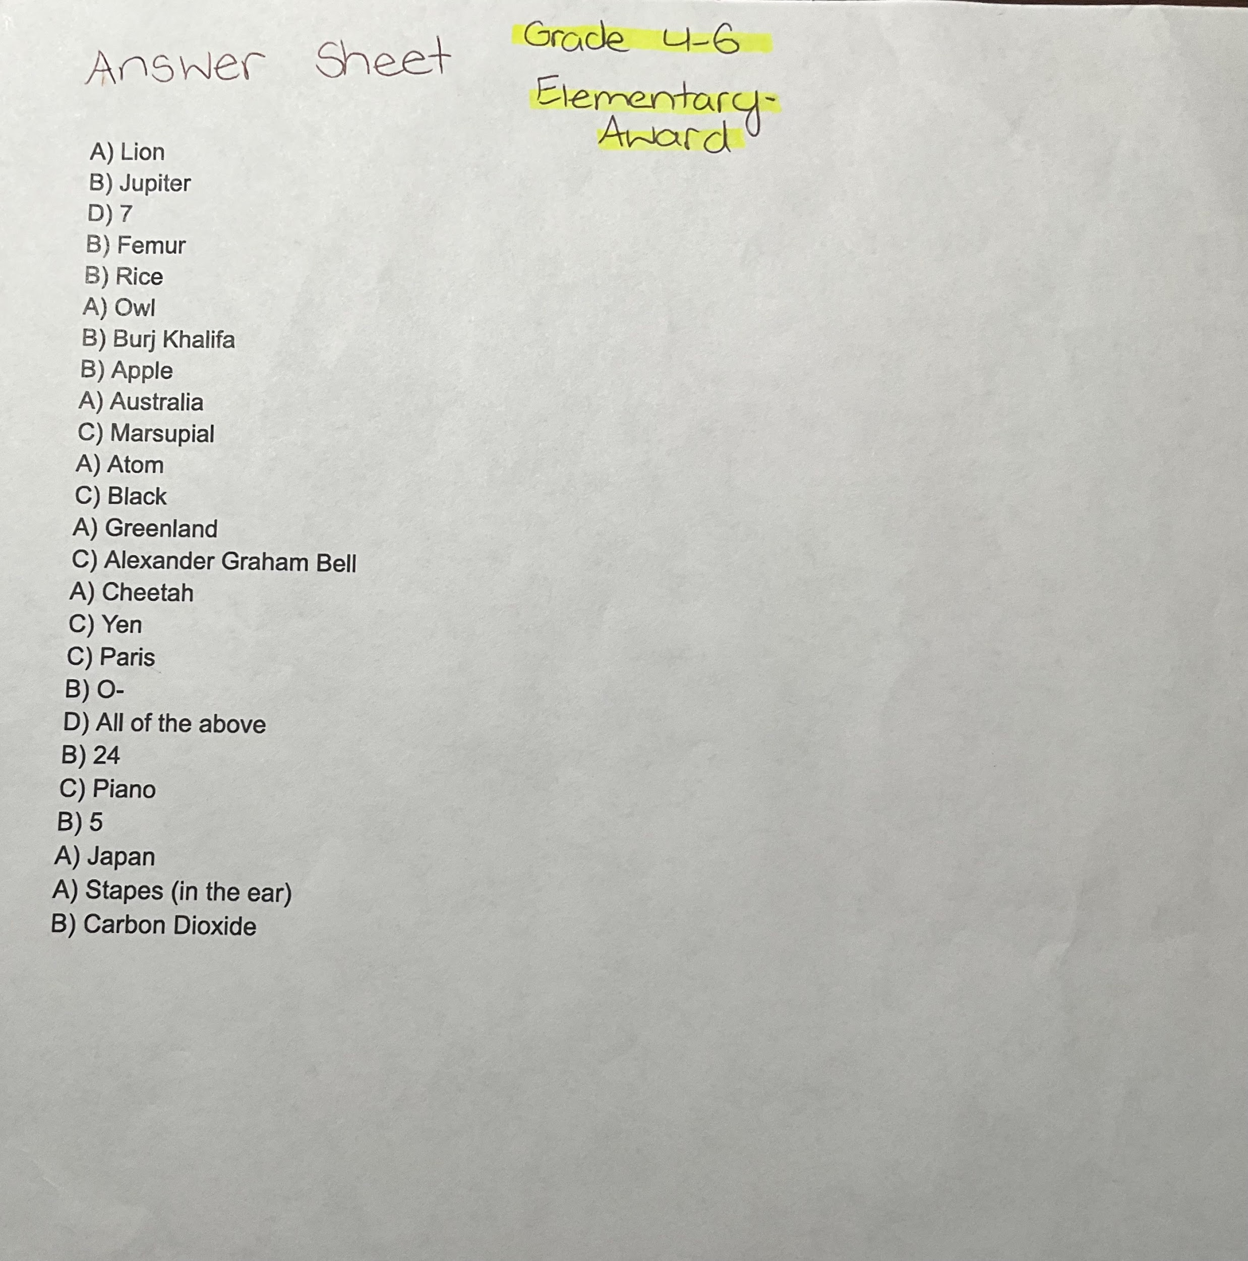
Experimental Design-
Tests Grades 4-6
These were the tests that were given to the Grades 4-6 individuals.
These were the answer sheets to each of the questions.

Slide 11
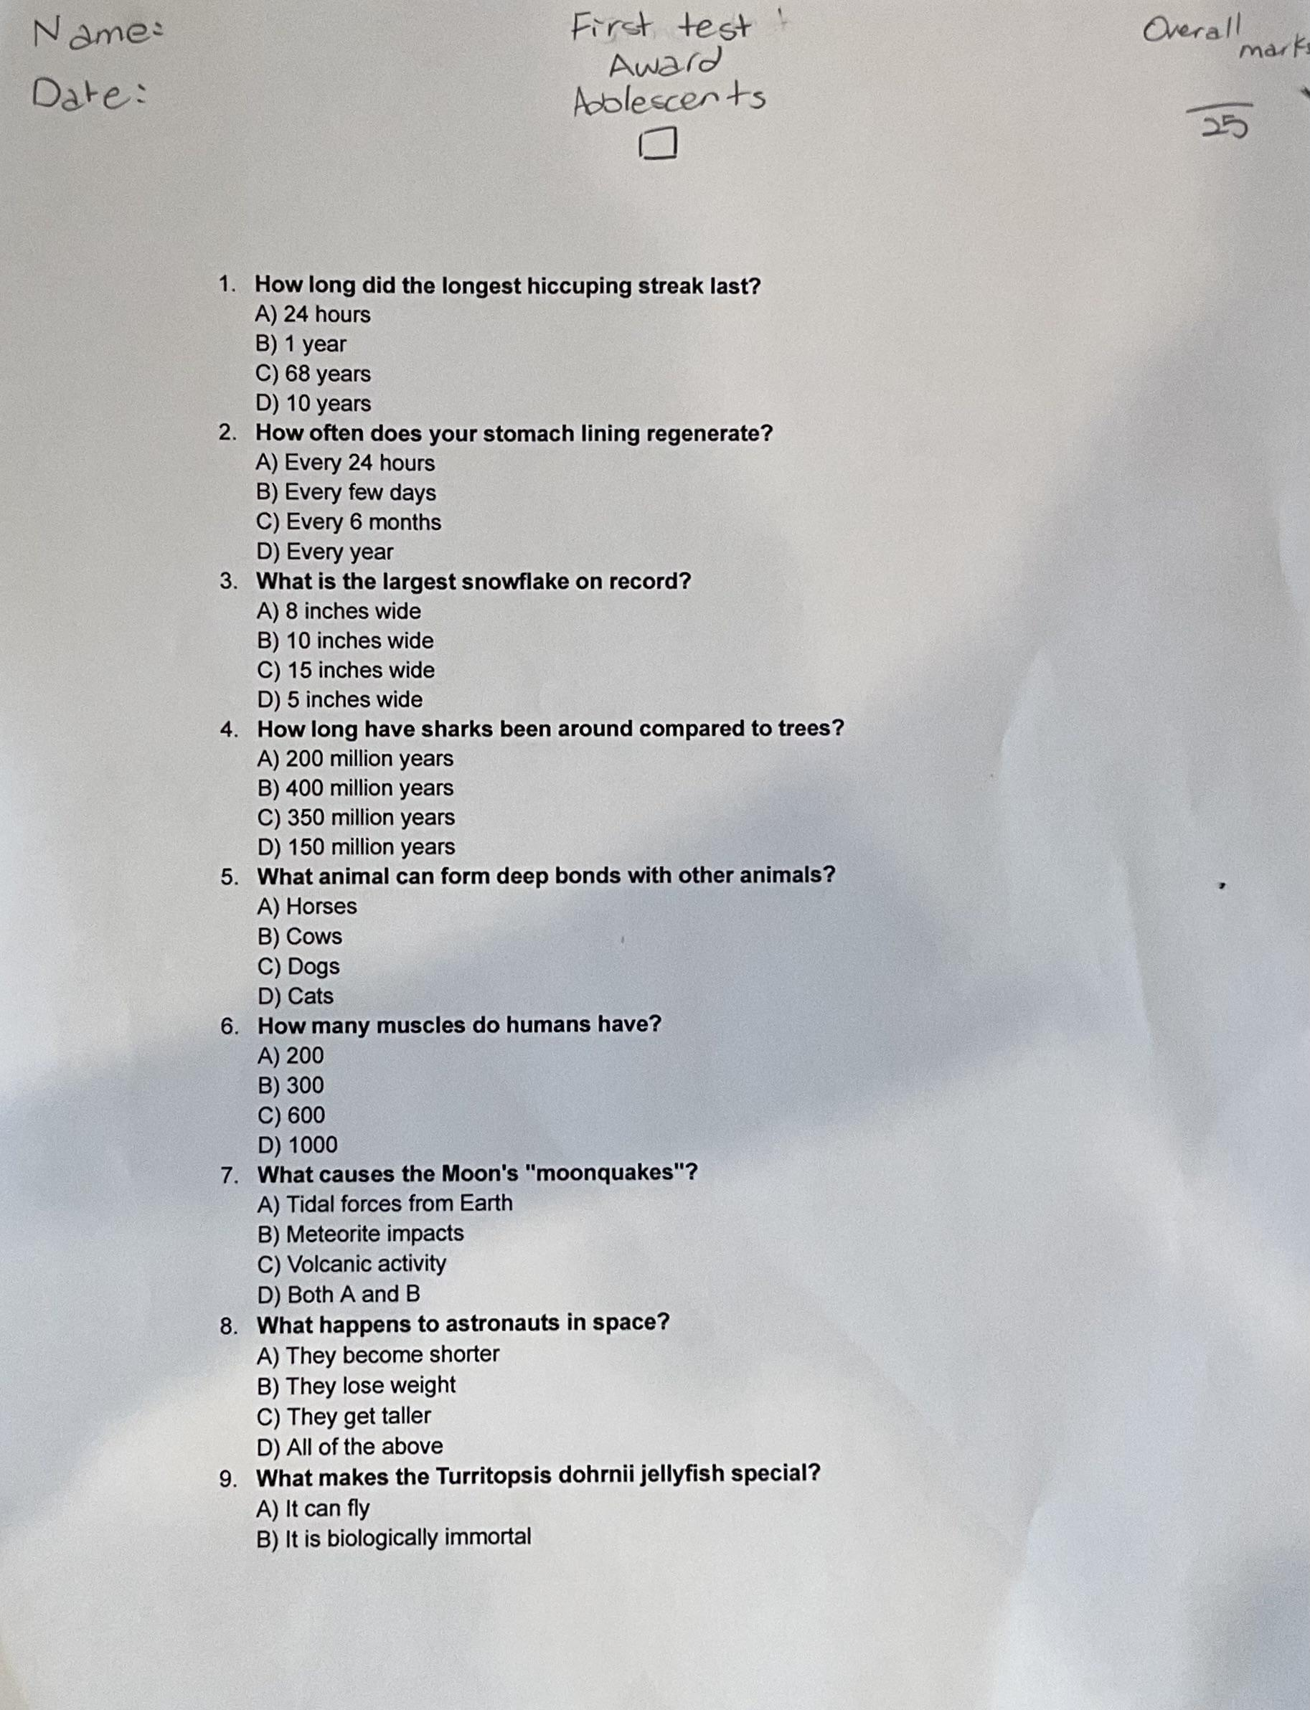
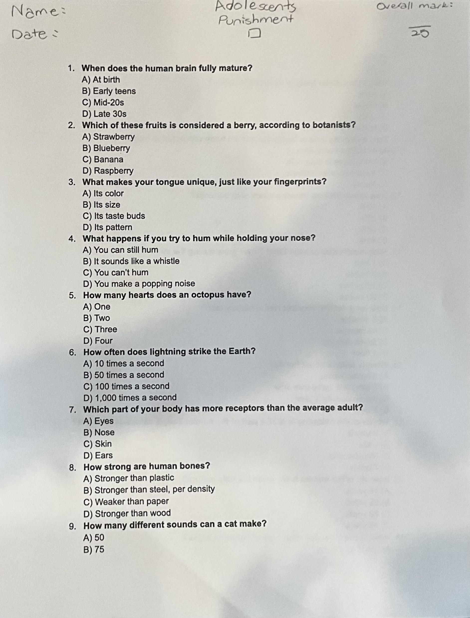
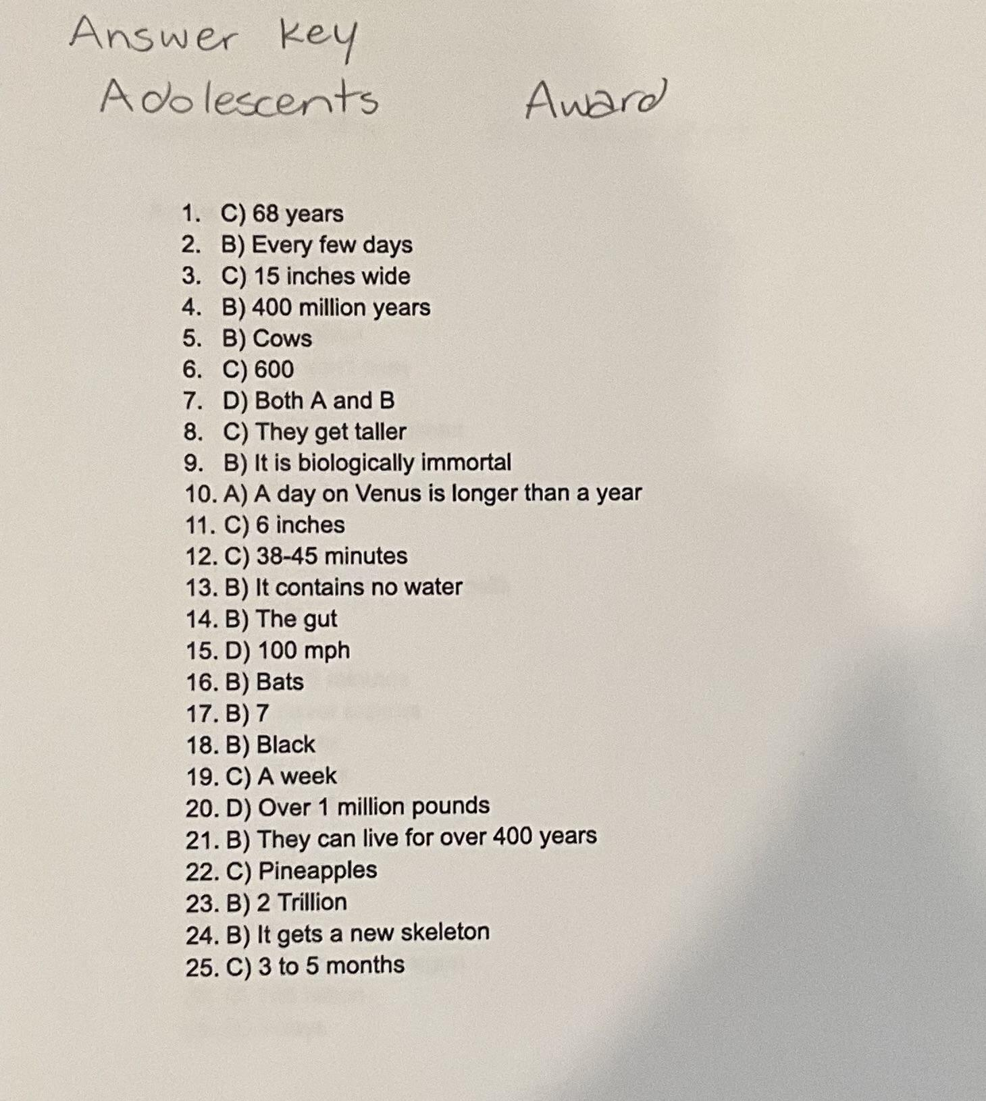
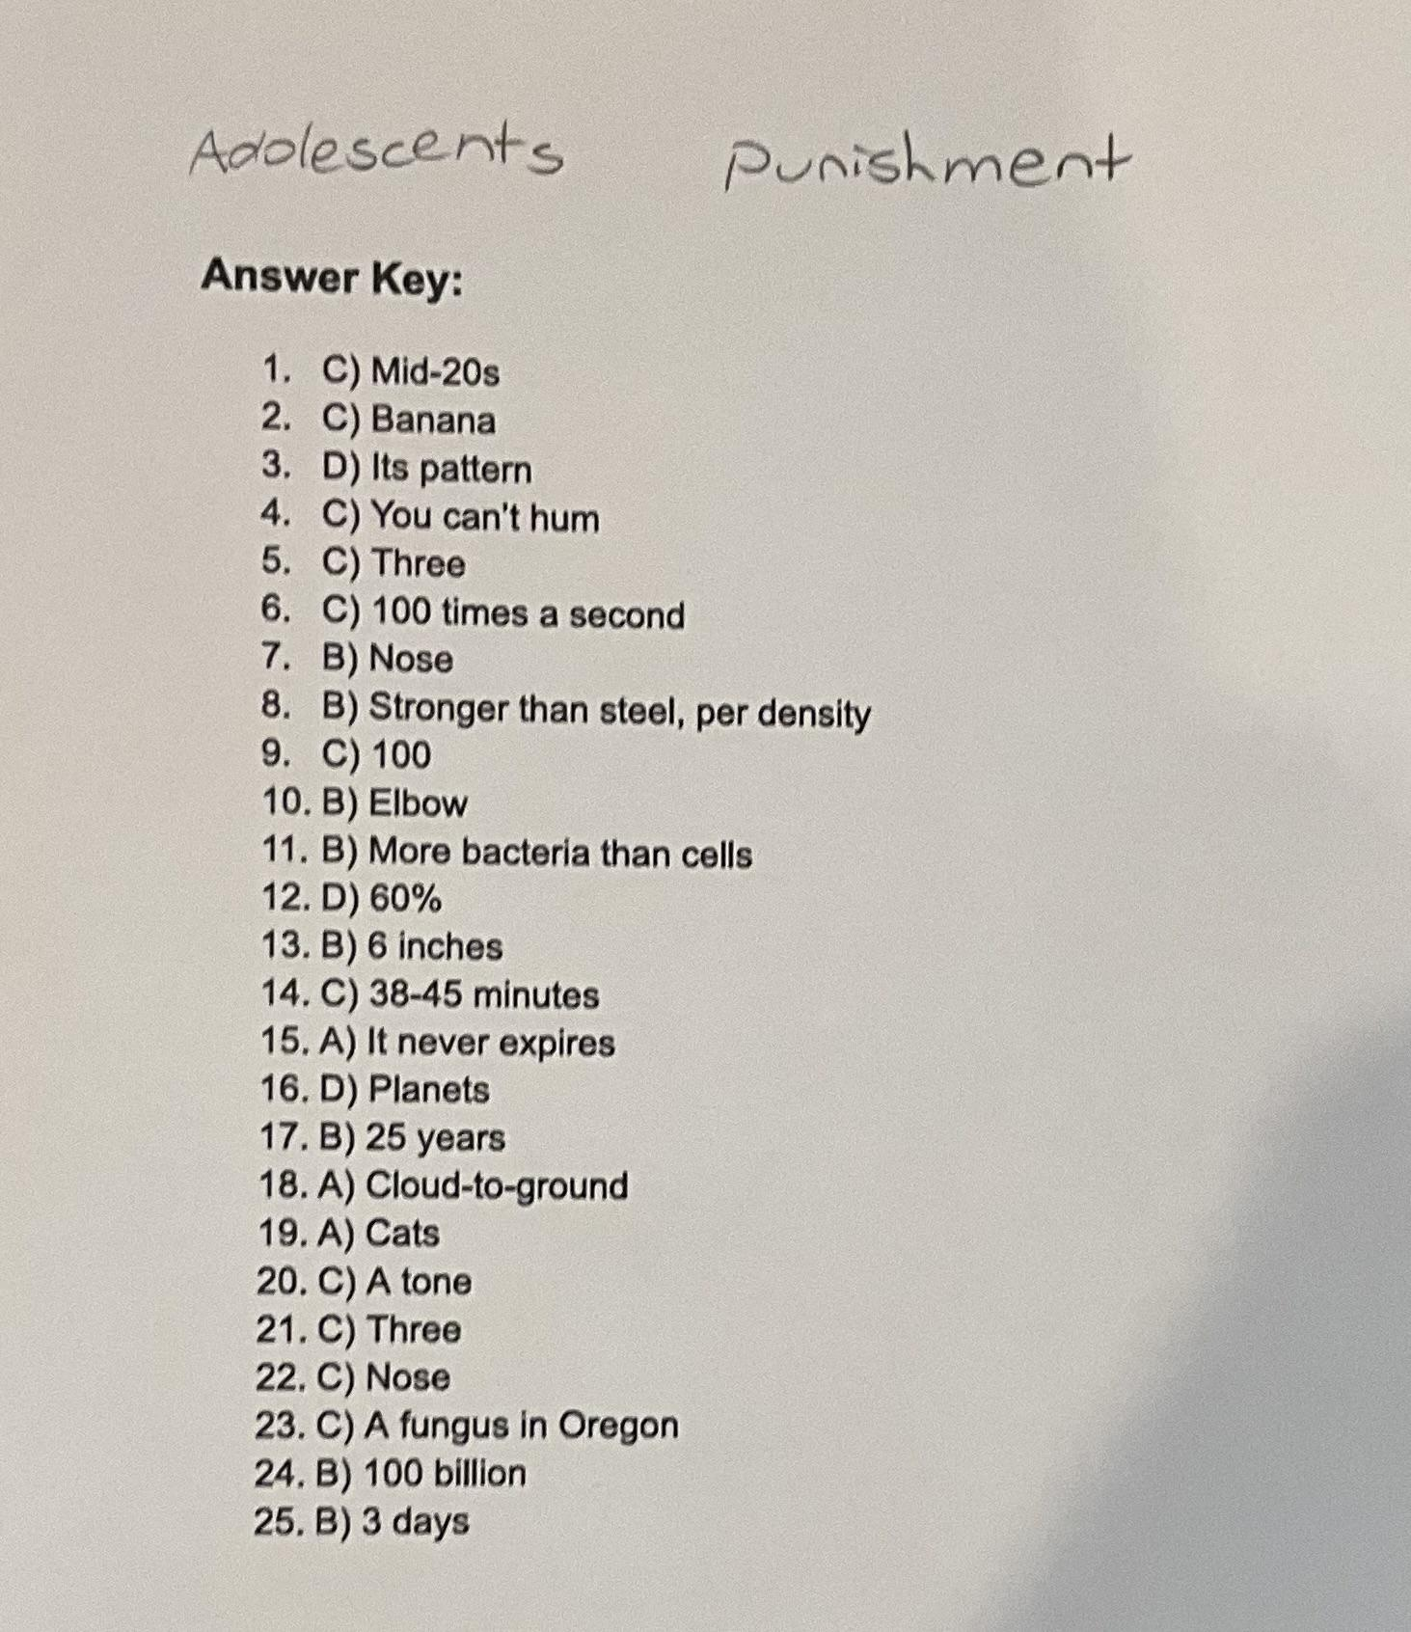
Experimental Design-Adolescents
These were the answer sheets to each of the questions.
These were the tests that were given to the adolescents.

Slide 12
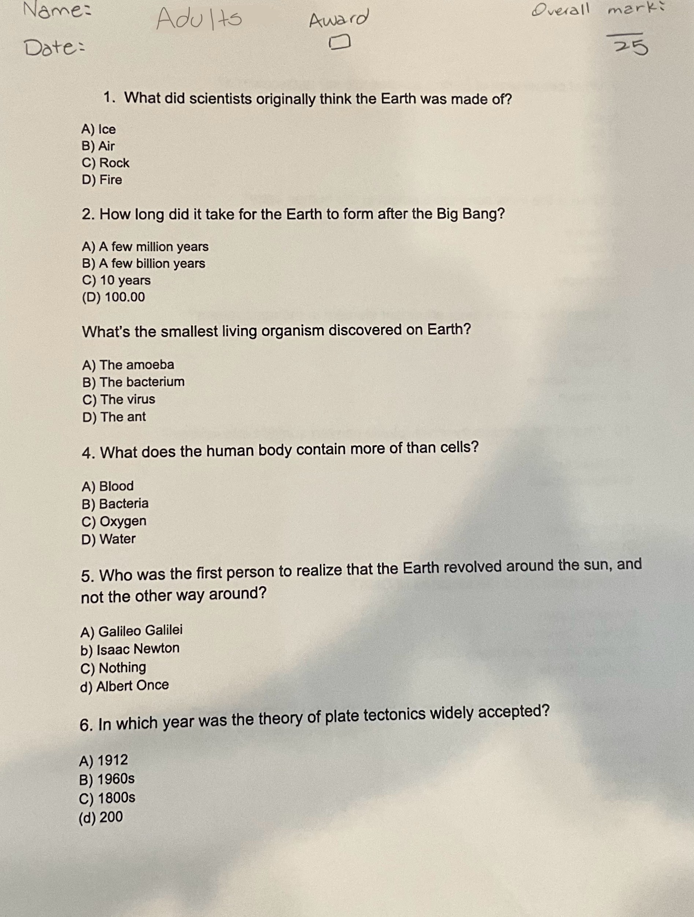
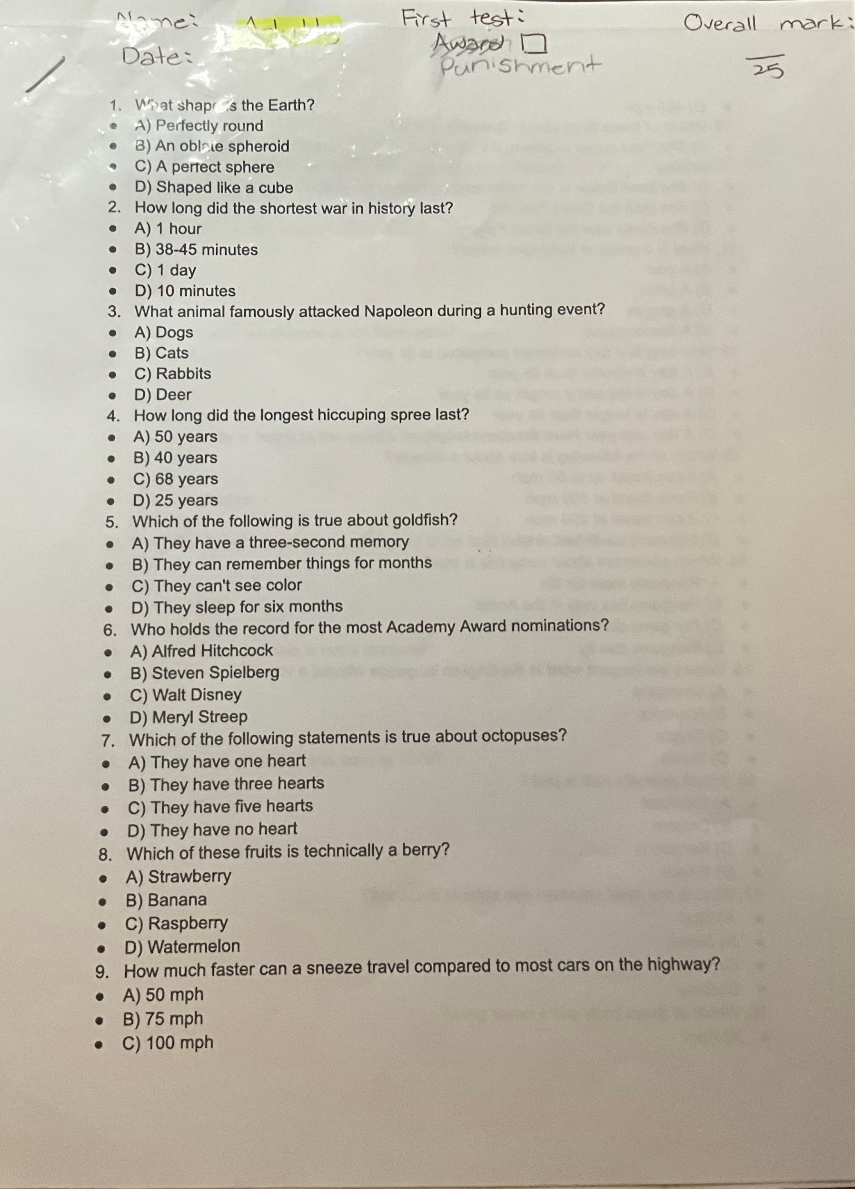
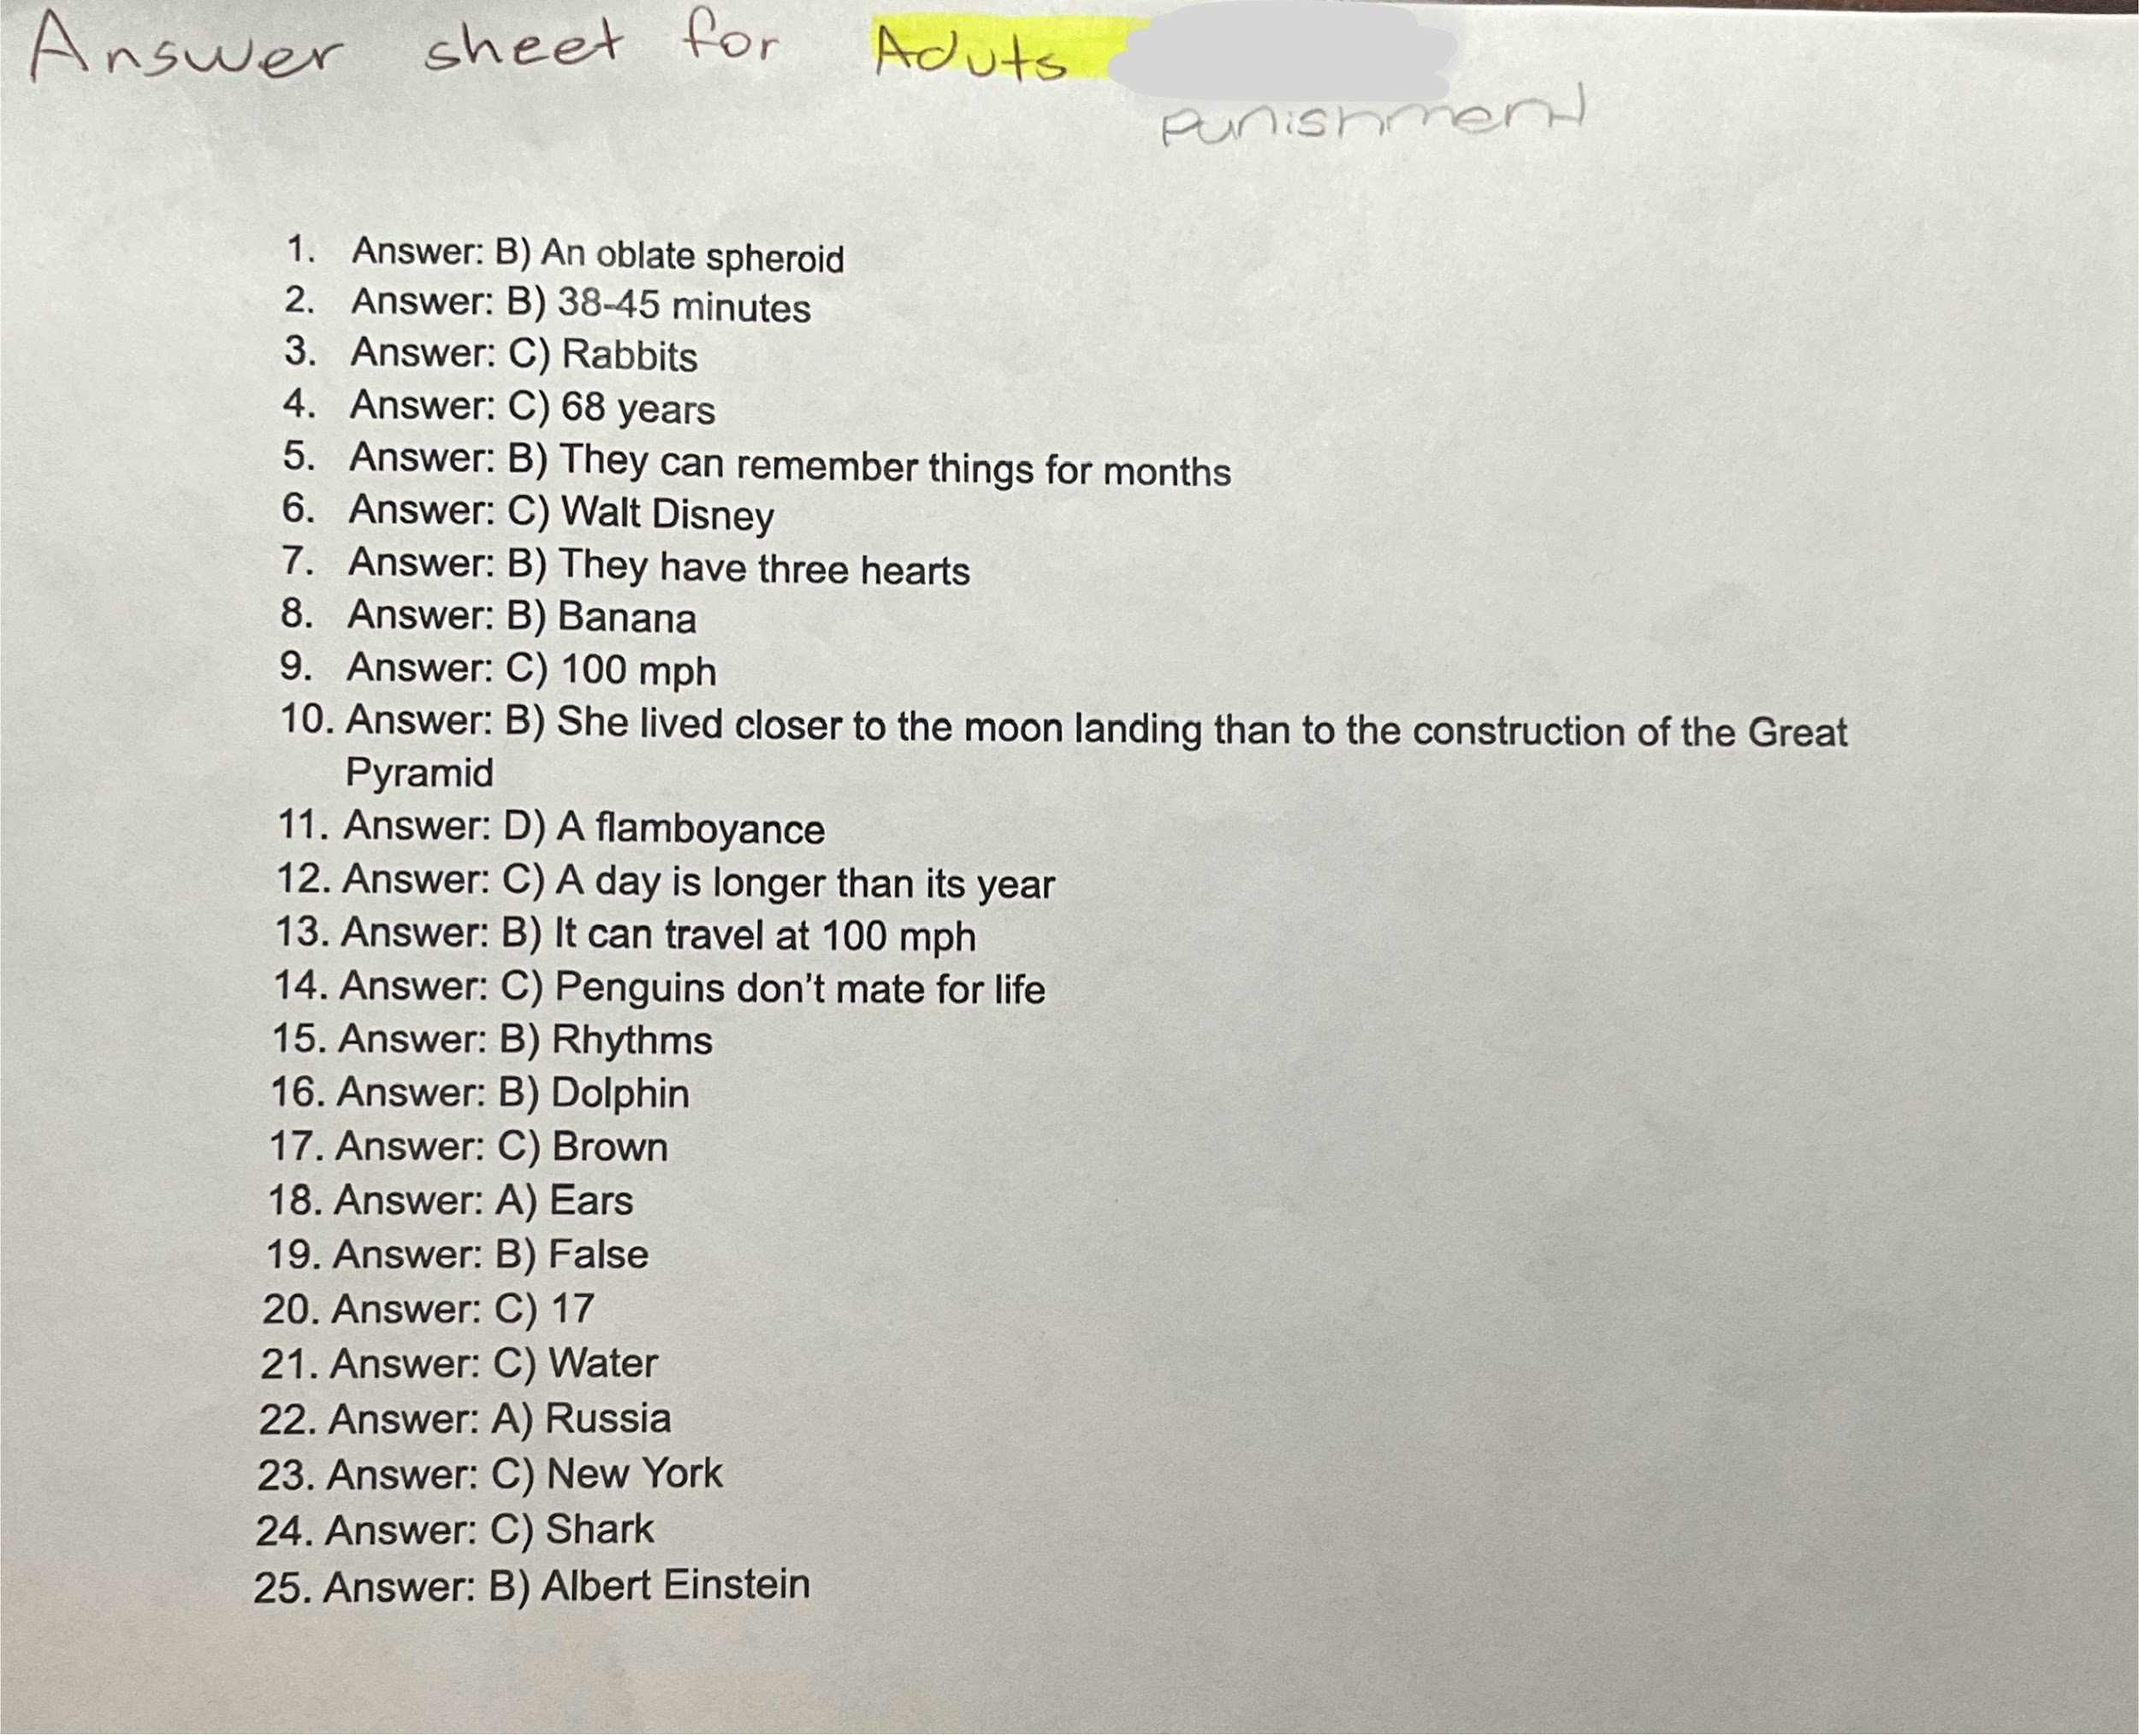
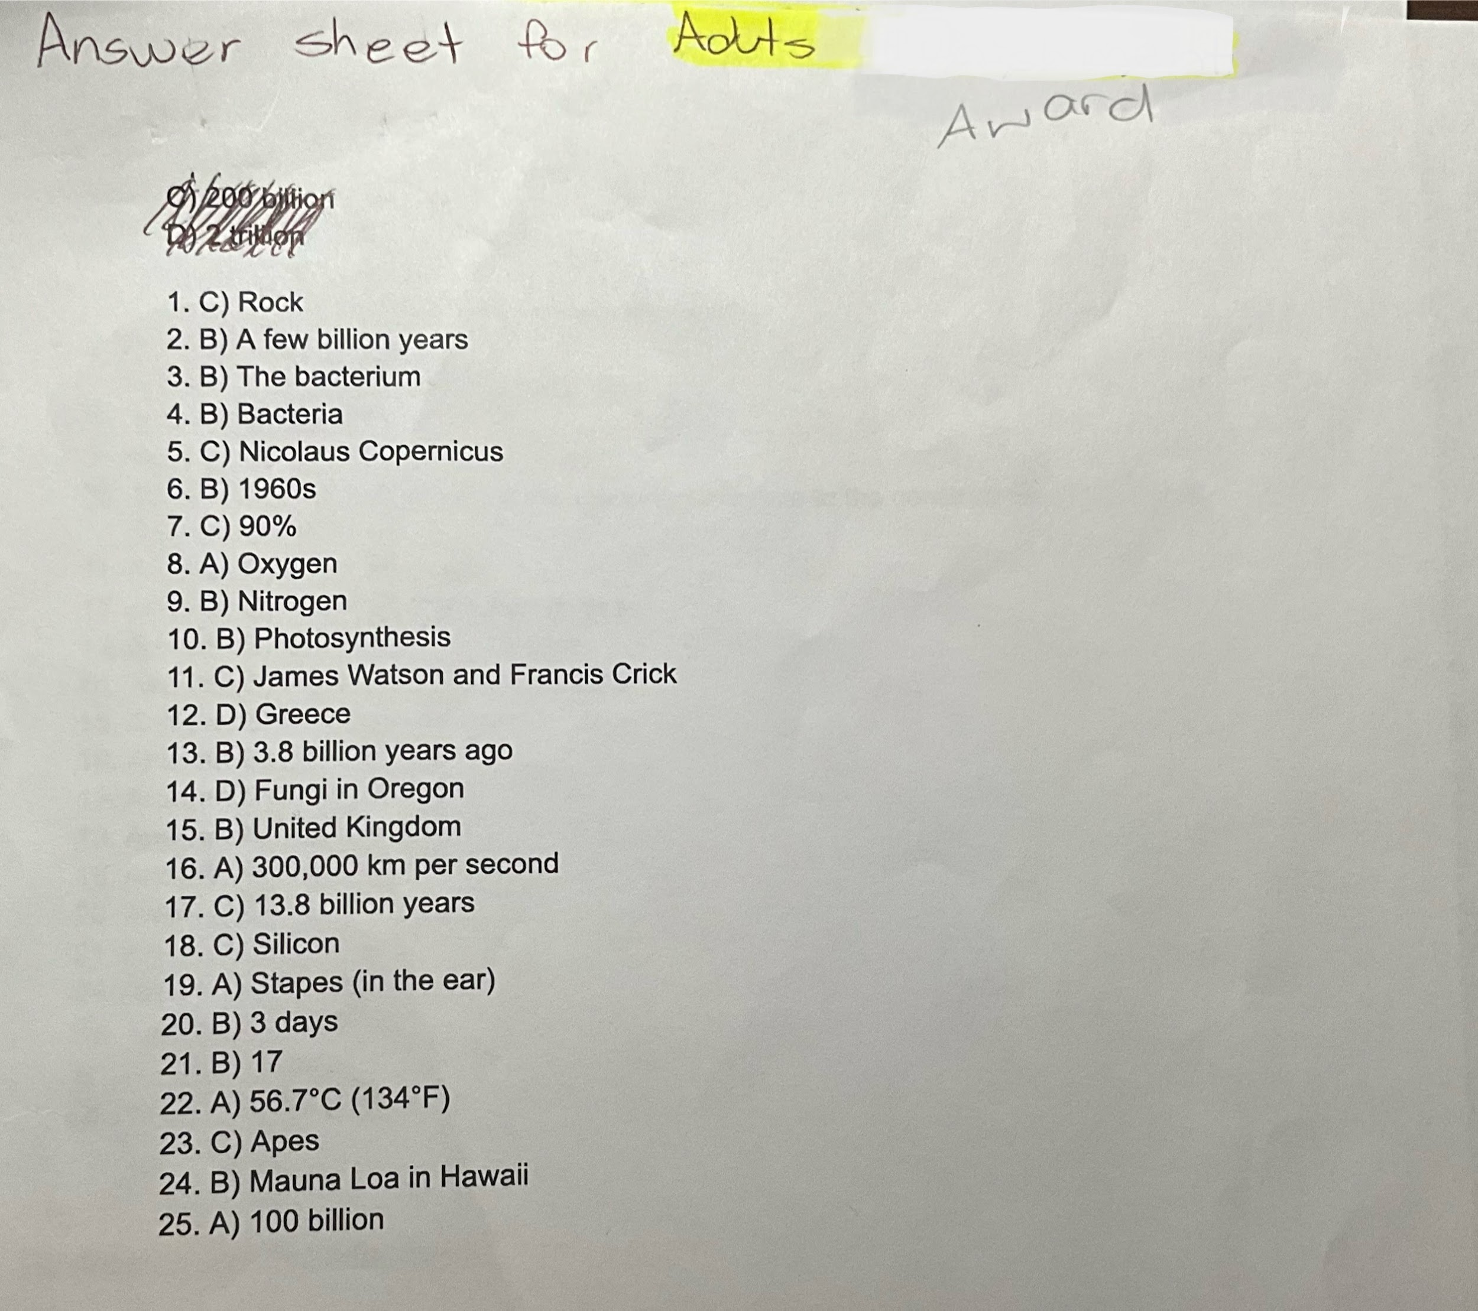
Experimental Design-
Tests- Adults/Seniors
These were the tests that were given to the Adults and Seniors individuals.
These were the answer sheets to each of the questions.

Slide 13
Experimental Design
Number of Participants:
Elementary Students-32
Adolescents-22
Adults/Seniors-38
TOTAL NUMBER OF PARTICIPANTS:

Slide 14
Material:
Get test sheets- depending on the participants age based on fun facts in a multiple choice test format
pencil, eraser, sharpener
Participants-elementary, adolescents, adults, and seniors
Coffee, tea, hot chocolate (Espresso, Mocha, Americano, Latte)
Candy (Jolly Ranchers, SourPatch, Menards) and soda (Sparkling Ice)
Calculator, Answer sheet or any Electronic Devices

Slide 15
Procedure:
Get test sheets based on random fun facts online that are appropriate for that age group
Gather up participants elementary students - Grades 4-6, adolescents, adults and seniors- you can get participants to do it on different days
Give a short class of explaining the separate topics in the test for example, food, planets, human body etc and what will happen if they get 100% and will happen if they don’t
Get a pencil, eraser and sharpener for each participant
Get all the participants to do the test- make sure that nothing is biased and that there is a quiet background for everyone and no one is cheating
Get someone to check answers with a calculator or answer sheet
If the participants get 100%-award will be given depending on their age.
Record marks onto a piece of paper and label that side AWARD.
Repeat steps 1-7 except using punishment and labeling the paper with PUNISHMENT and if the participants don’t get 100% they will be given a punishment depending on their age.

Slide 16
Collection of Data and Observations- Elementary
Some observations me and my partner made was that before tests were handed in more students double checked for the punishment test than the reward test, showing signs of taking the test more seriously. A big difference me and my partner noticed between the two tests was the time it took to finish the two tests. For the punishment test, it had taken a longer period of time for grades 1-6 to finish ranging from 5-10 minutes with an accuracy level of getting 0-3 wrong. The accuracy level was about the same and some even higher for the reward tests, except the tests were finished and handed in with higher efficiency of time.

Slide 17
Collection of Data and Observations-Adolescents
What we noticed for adolescents is that for the punishment test they were more worried about losing their electronic playtime than getting a reward causing them to take a longer period of time on the punishment. Once a few of the tests were getting handed in me and my partner noticed a pattern of where although it took a longer period of time to finish the punishment tests than the reward tests, the reward test results were higher.

Slide 18
Collection of Data and Observations- Adults and Seniors
For Adults, me and my partner noticed that for adults when telling them about their punishment of having to meet us somewhere and write a word 100 times, this motivated the adults more as a lot of their responses were things like, “ That’s the only time I get to relax.” This told me and partner that punishment motivated the adults more because adults don’t like wasting their time. For those adults who did better on the award test, majority of them were asking a bunch of questions about what they would get as a reward. Reward motivated them because the award would be beneficial and good for them if they were to get 100%. Same with the Elementary students and Adolescents the punishment tests took a longer period of time yet got worse results.

Slide 19
Data and Results Table
DATE | AGE GROUP | TEST | AVERAGE GRADE | OBSERVATIONS
February 12th-27th 2025 | Elementary | Reward | 97% | Took a faster Period of time than the punishment test
February 12th-27th 2025 | Elementary | Punishment | 99% | Took a slower period of time and got better results than reward
March 5th- 9th 2025 | Adolescents | Reward | 90% | Took a faster period of time than the punishment test
March 5th-9th 2025 | Adolescents | Punishment | 74% | Took a slower period of time, but still got a lower average than Reward
February 16th- March 9th 2025 | Adults and Seniors | Reward | 90% | Took a faster period of time than the punishment test
February 16th- March 9th 2025 | Adults and Seniors | Punishment | 81% | Took a slower period of time, but still got a lower average than Reward

Slide 20
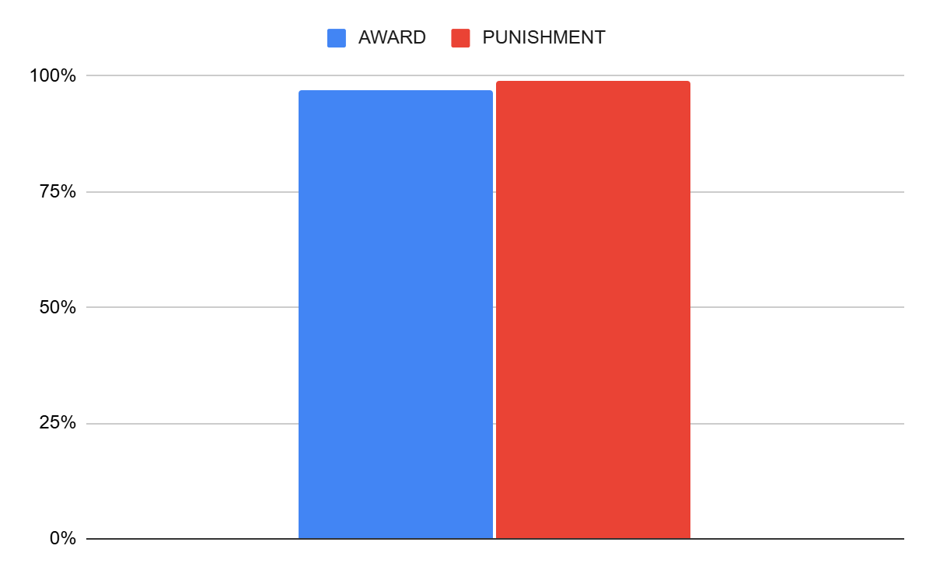
Data and Results Table
Elementary
AVERAGES:
REWARD- 97%
PUNISHMENT-99%

Slide 21
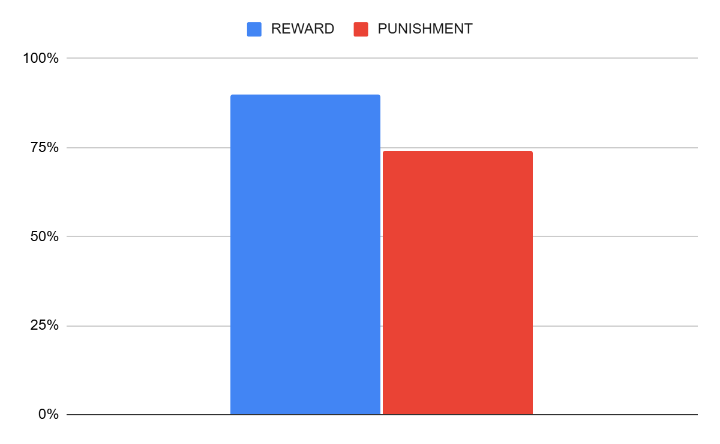
Data and Results Table
Adolescents
AVERAGES:
REWARD- 90%
PUNISHMENT-74%

Slide 22
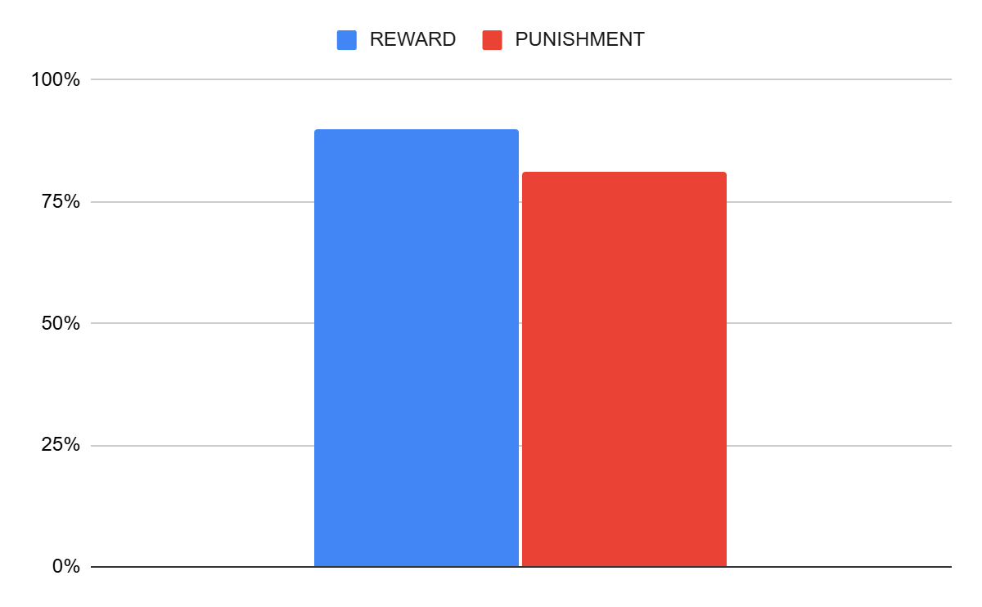
Data and Results Table
Adults/Seniors
AVERAGES:
REWARD- 90%
PUNISHMENT-81%

Slide 23
Analysis
Overall with all the results and data, to tell an elementary student they use the punishment or reward method as they both work equally because there was only a difference of 2%, meaning that 2% difference could have been caused by 1 person’s test. As for adolescents, the average for reward was better than punishment because rewards encourages them while punishments make them question their ability and feel insecure. For adults and seniors, reward also had a better effect than punishment because rewards motivate them to do well and is a positive way to learn something new rather than having pressure to do well which has a impact on their actions and thoughts.

Slide 24
Conclusion
In conclusion, my partner and I wanted to test out whether telling an elementary student, adolescent, adult, and senior they will receive a punishment if the don’t get 100% works better than incentivizing them with a reward if they get 100%. In the end, our result showed that Elementary students respond to punishment and reward equally while for seniors, adults, and adolescents respond better to rewards. Based on our background research, we hypothesized that for all age groups, reward will work better for them on the test rather than telling them they will have to receive a punishment if they didn’t get 100%. Our hypothesis was correct for ⅔ of the age groups- adults/seniors and adolescents. The other ⅓ we were incorrect for elementary students as in our data and results, the punishment test got a higher average than the award test. This was because we didn’t realize the impact of our punishment which was for them to miss a recess or electronic time. The main difference was that adolescents prioritize getting full marks to get a reward. In the end, my partner and I compared our results to another experiment like ours. The results were that incentivizing someone with a reward worked better as well. Like us, they noticed that although it took a longer period for the majority participants to finish the punishment test, more people scored a higher mark on the reward test.

Slide 25
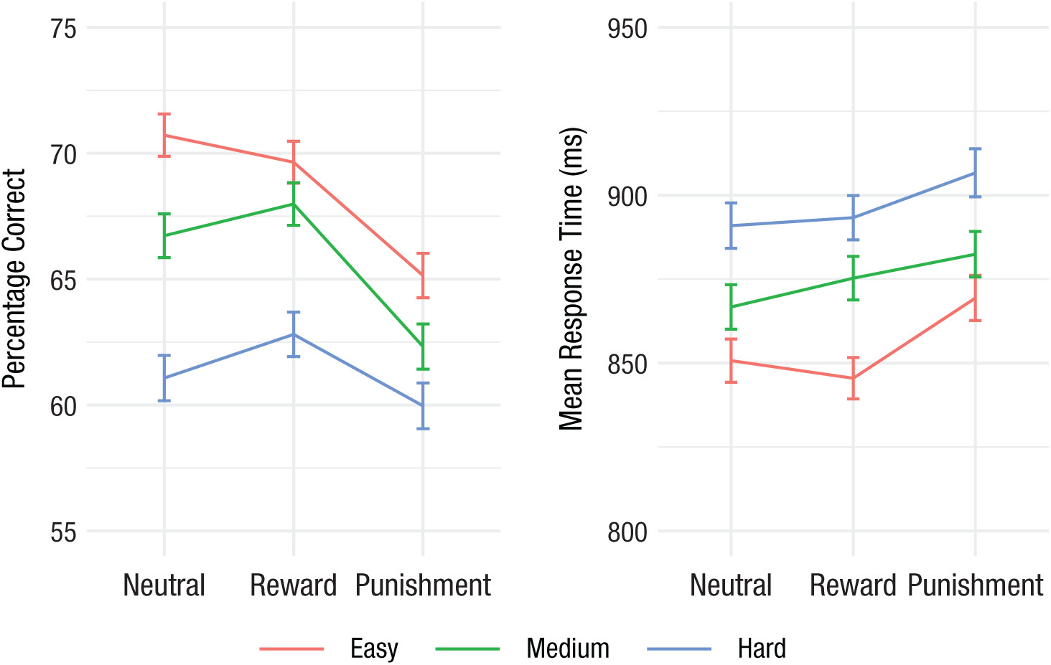
Other Experiment’s Results

Slide 26
Real life applications
This experiment is very useful for parents who are teaching their children at home since they know what will encourage them more and make them try their best if they are homeschooling an elementary student. As well as for their child even if they don’t homeschool they can set up study habits like for their child if their child is an elementary student they can set limits like if you don’t get 100% on this test you get no electronics for a week or they can use the reward method as well, while if their child is an adolescent they can tell them if they get 100% they will get a reward. The results of our experiment can also help with teachers in motivating their class to get better marks which can higher the amount and probability of applications for scholarships. For Adolescents, it can help as I said for their probability of getting an application for scholarships, and for the adolescents who are applying for universities or colleges they know they should push themself by creating a reward at the end if they make it into that college or school. Lastly, for elementary students it can help for study habits and preparation for Junior High and tests because they now know that they should set up a punishment for themself like no electronic if they don’t ace the test.

Slide 27
Further Projects/Questions
Why does the human brain react and think time flies by when you are having fun?
What do the human brain prefer, rewards or punishment and why?
How do human brain store memories and how well does it work?

Slide 28
Errors
I think we could have improved on our observations by adding more by showing cause and effect. We could have given them classes individually because the classes with many people don’t really pay attention. We noticed that the people who got better marks are people who we taught with smaller classes instead of people who were taught with many other people which could have impacted our results. As for our Tri-Fold I think we could have made it more neater and tied up as well as tried to make the sheets of paper less squished together.

Slide 29
Bibliography- Tests
Resource- Book of Useless Information
Does the 'Carrot-and-Stick' Approach Come From Donkeys?
meaning and origin of the phrase ‘carrot and stick’ – word histories
https://www.quora.com/Is-punishment-and-rewards-the-most-effective-training-method
https://pmc.ncbi.nlm.nih.gov/articles/PMC6006171/#:~:text=Punishment%20causes%20greater%20response%20suppression,the%20punishment%20contingency%20is%20suspended.
What Happens in Your Brain When You're Angry
The Psychology Behind Award Recognition: A Deep Dive
Understanding the stress response in exams – what happens in your brain? | Oxford AQA International Qualifications
Your 5 Biggest Fears: How to Overcome Them, According to Psychologists
The Fascinating History and Evolution Of Awards | Modern Awards | All Time Awards
https://manhattancbt.com/how-to-deal-with-disappointment/#:~:text=We%20all%20have%20many%20expectations,is%20a%20near%2Duniversal%20experience.
https://www.bbc.co.uk/bitesize/guides/z3w3vwx/revision/1#:~:text=Typical%20medieval%20punishments&text=Under%20the%20Forest%20Laws%2C%20illegal,of%20their%20fingers%20cut%20off.&text=For%20the%20most%20serious%20crimes,punished%20by%20being%20burned%20alive.
https://guides.ll.georgetown.edu/c.php?g=261307&p=1753681#:~:text=The%20history%20of%20crime%20and,drowning%20and%20other%20violent%20acts.

