Slide 1
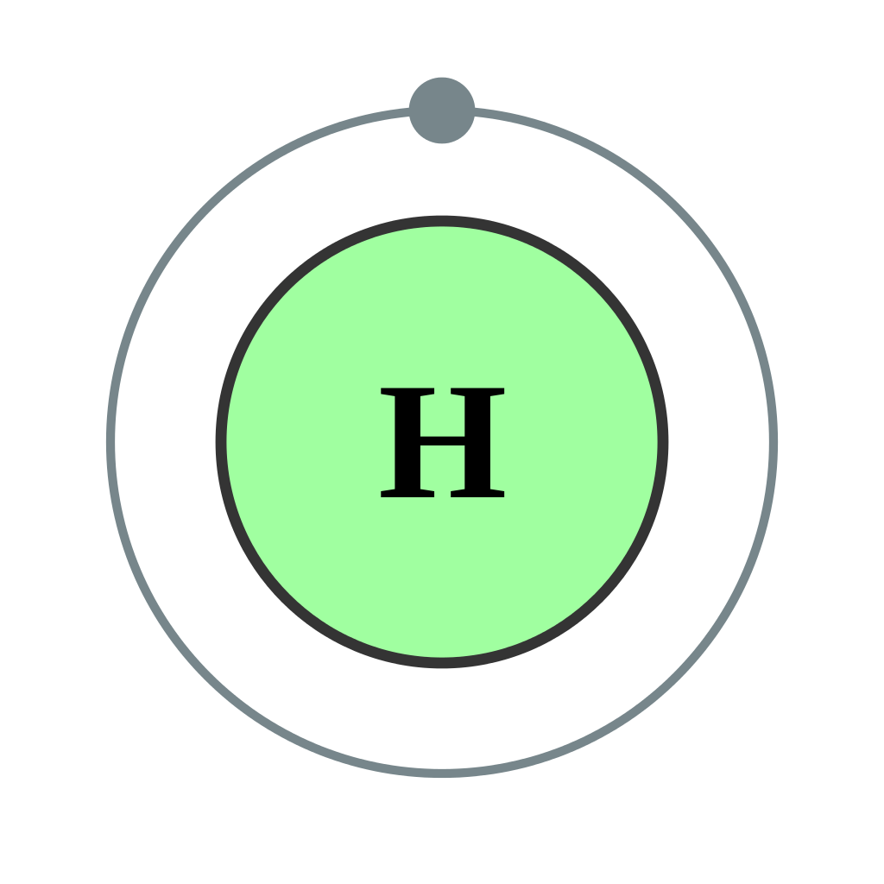
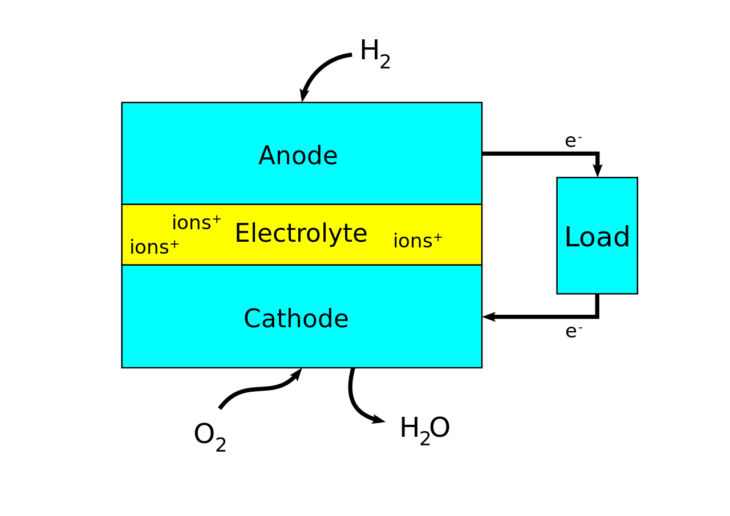
The effects of the multicell
By: Kenneth Onekpe

Slide 2
Scientific Question
Can You Make A Hydrogen Parallel/Series Cell?
Can You Stop It From Discharging?

Slide 3
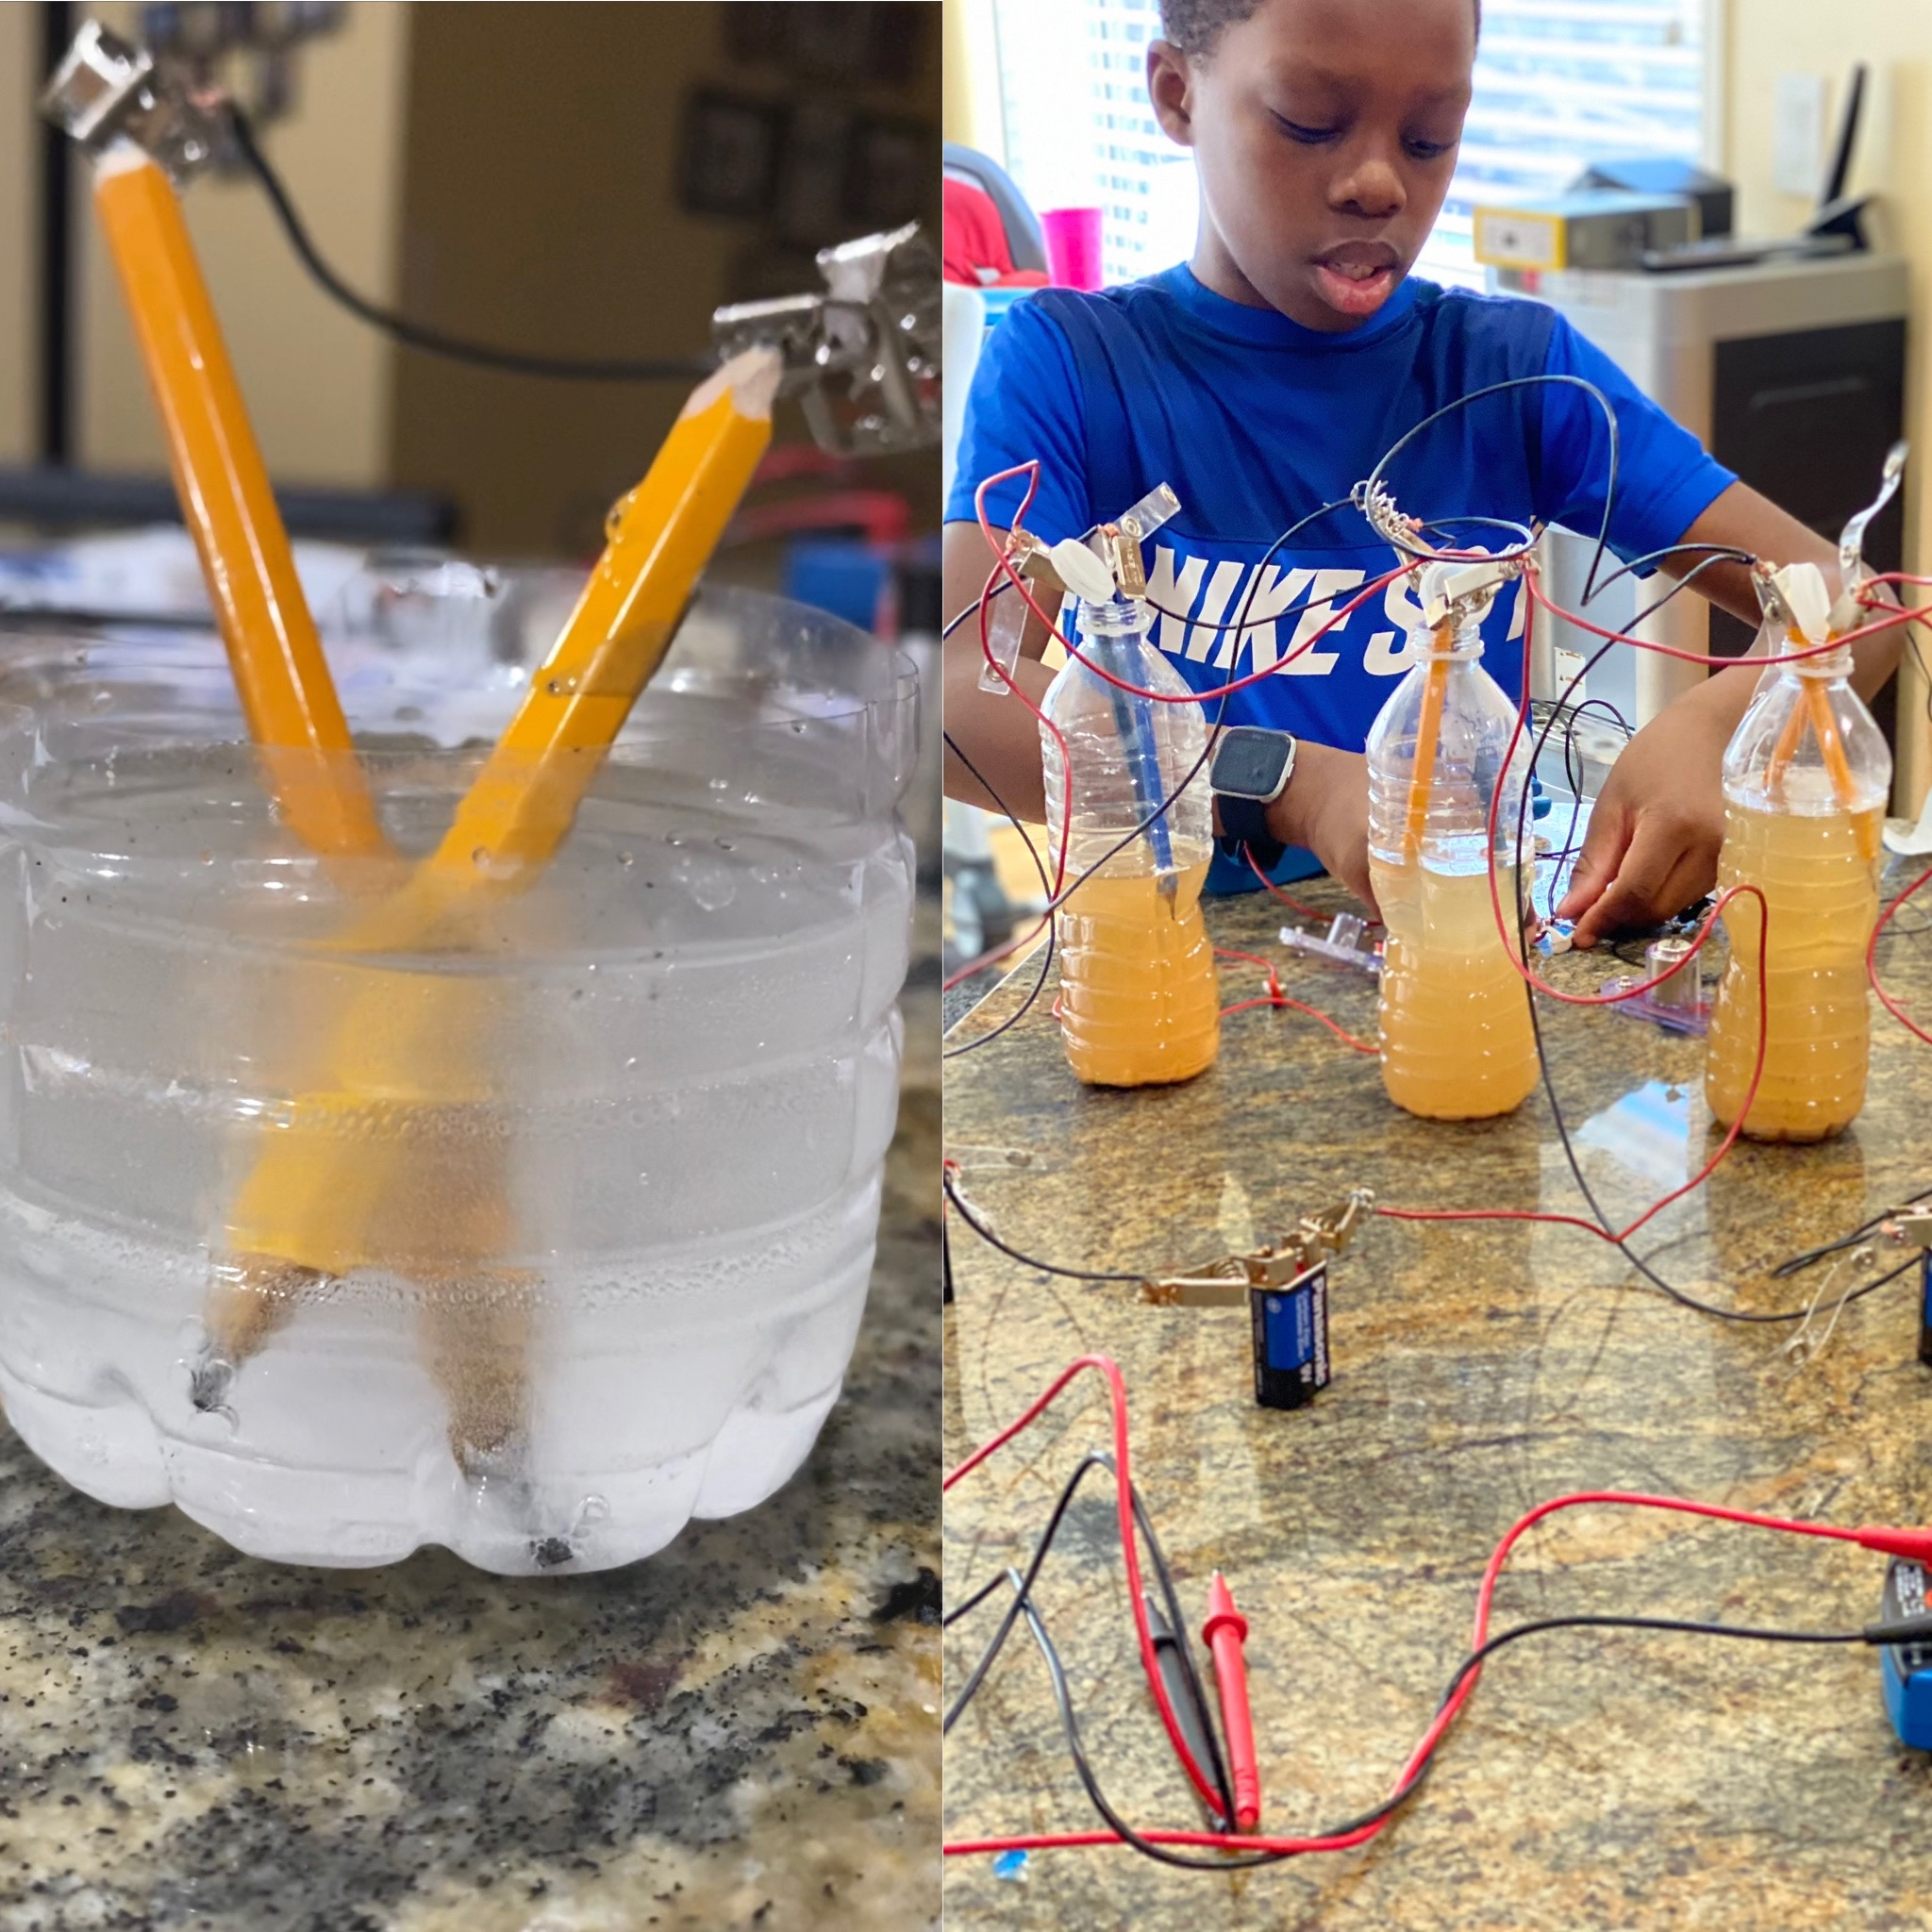
Project Purpose
I want to do this project because of my previous project.
I want to see if you can make the power of the cell larger and stop it from discharging so there is a steady production of electricity.
If I can make this and it works, then this will be another way to produce electricity from hydrogen without the use of fossil fuel

Slide 4
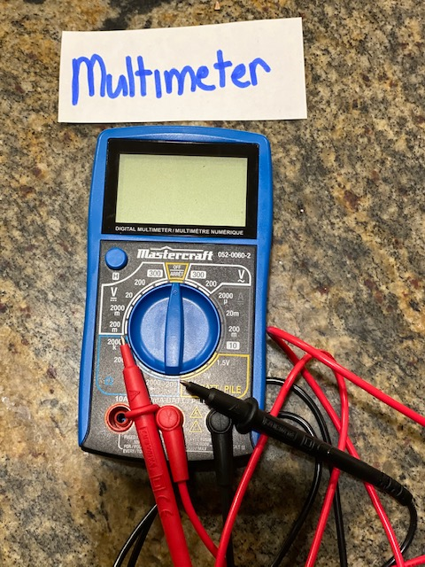
Variables
In this experiment the manipulated variable will be the amount of fuel cells taking power from the battery.
The responding variable will be the current voltage and power measured
There will be many controlled variables. Some of them include: The same type of water and salt, the same type wire, the same battery ,the same multimeter ,the same aluminum wire ,the same surface and the same house, the same materials .

Slide 5
Background Research

Slide 6
Background Research Water
The type of water being used greatly affects the results of this experiment. Salt affects the conductivity of water, so there will be a difference in the conductivity between saltwater and freshwater.
When salt goes into water, the particles break into tiny electrically charged particles called ions. Ions increase the water’s ability to conduct electricity.
Saltwater is about a million times more conductive than normal water. For my experiment I will be using saltwater.

Slide 7
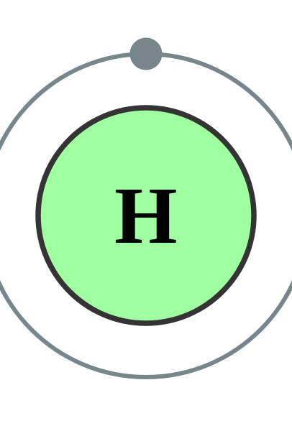
Background Research Hydrogen
Hydrogen is an essential element for life. It is present in water and in almost all the molecules in living things.
Hydrogen is easily the most abundant element in the universe. It is found in the sun and most of the stars, and the planet Jupiter is composed mostly of hydrogen.
On Earth, hydrogen is found in the greatest quantities as water. It is present as a gas in the atmosphere only in tiny amounts – less than 1 part per million by volume.
Any hydrogen that does enter the atmosphere quickly escapes the Earth’s gravity into outer space.

Slide 8
Background Research
The Multicell
A hydrogen fuel cell is an improvement to modern technology
Single fuel cell does not hold a lot of power needed, only around 2 volts. When you connect a motor or light bulb, it only produces 0.6-0.8 volts! Not a lot.
Fuel cell stack produce more energy.
The battery is used to separate the hydrogen from the oxygen. You just cannot just find hydrogen because it is a light gas most of it is in the atmosphere.

Slide 9
Ways to make hydrogen
Electrolysis: An electric current splits water into hydrogen and oxygen using a cathode, anode, electrolytes(salt) and catalyst(graphite).
Natural Gas Reforming/Gasification: Synthesis gas, a mixture of hydrogen, carbon monoxide, and a small amount of carbon dioxide, is created by reacting natural gas with high-temperature steam.

Slide 10
How does the hydrogen fuel cell work?
Fuel cells work like batteries, but they do not run down or need recharging.
In a hydrogen fuel cell, a catalyst at the anode separates hydrogen molecules into protons and electrons, which take different paths to the cathode.
The electrons go through an external circuit, creating a flow of electricity.

Slide 11
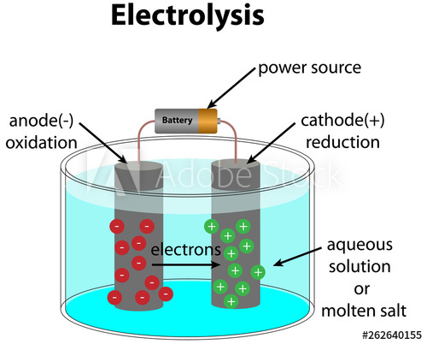
Electrolysis of Water

Slide 12
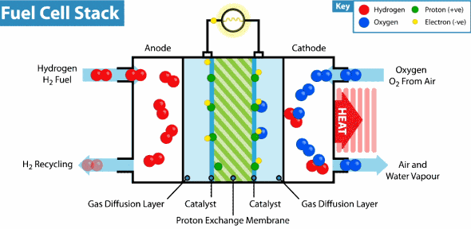

Slide 13
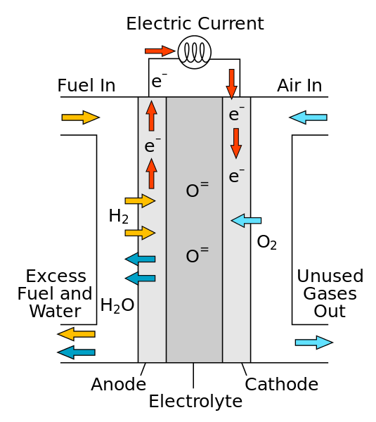
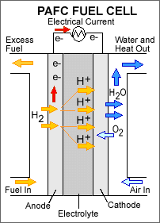
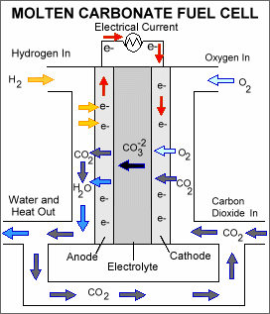
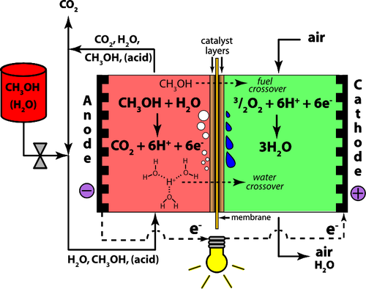
Types of Fuel Cells
Polymer electrolyte membrane fuel cells
Direct methanol fuel cells,
Alkaline fuel cells,
Phosphoric acid fuel cells,
Molten carbonate fuel cells,
Solid oxide fuel cells

Slide 14
Hypothesis

Slide 15
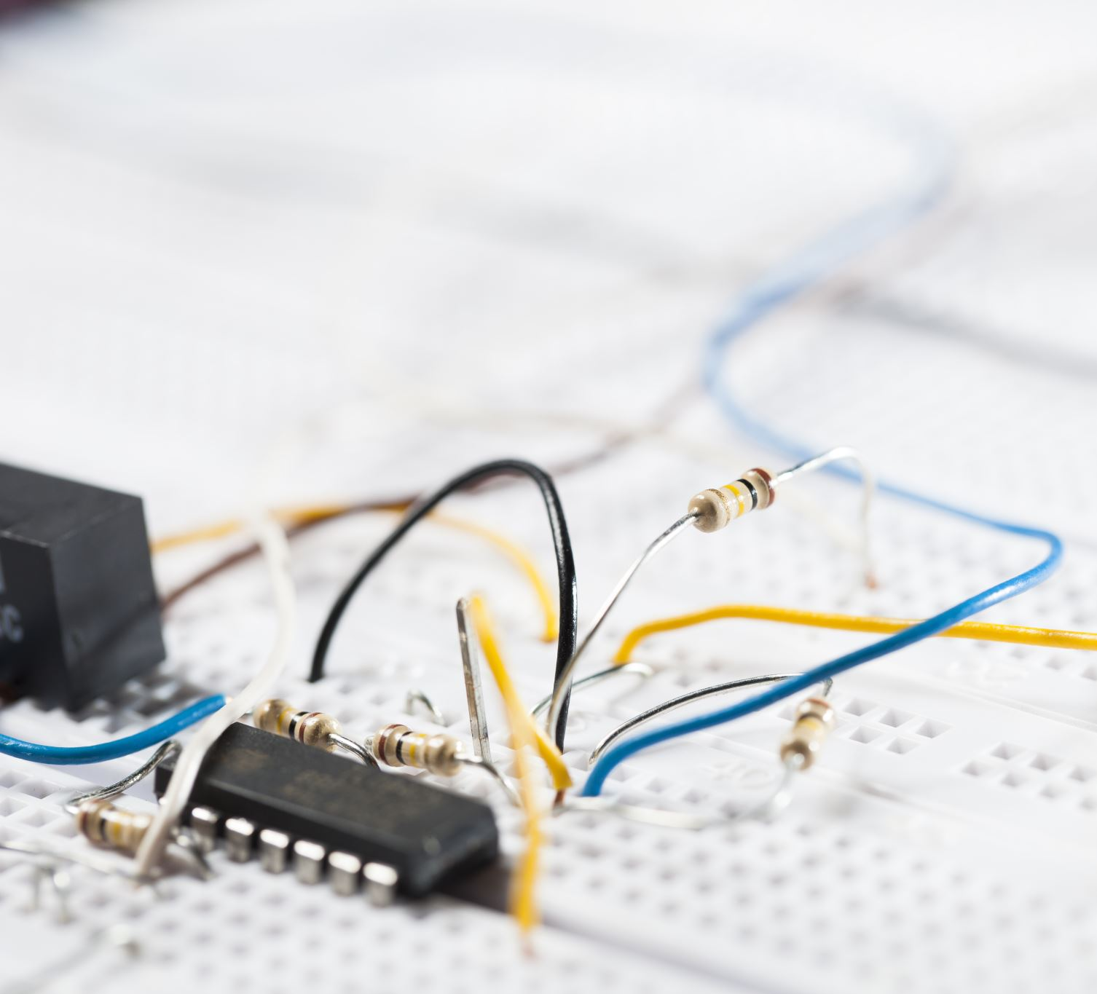
If you add more fuel cells to a circuit, then the voltage would be higher

Slide 16
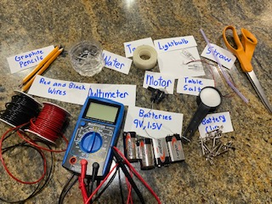
Materials
You will need:
An empty plastic bottle
Cutter
Scissors
3 150ml of Water
3 ⅛ Table salt
6 lead pencils
Scotch tape
3 9V battery
10 battery clips
Multimeter
Red and Black wire
Aluminum Wire

Slide 17
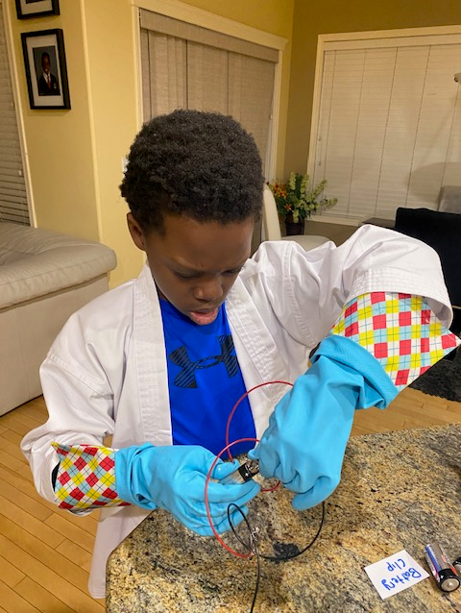
Procedure
Make a beaker by cutting the plastic bottle
Sharpen both ends of 2 pencils using a cutter
Join the 2 pencils using the scotch tape
Fill half of the beaker with water, add ⅛ of a cup of salt and stir well
Put pencils in salt solution
Connect a pencil lead to the negative terminal of the battery with black connecting wire
Connect the other pencil lead to the positive terminal of the battery with the read connecting wire
Leave it for 2 to 3 minutes
When you smell the hydrogen, ( it smell really weird)take out the pencils and measure the voltage. Do this 3 times
Get 2 more balck wires and two more red wires.
Connect the 3 individual fuel cells together black to black to black, red to red to red
Observe

Slide 18
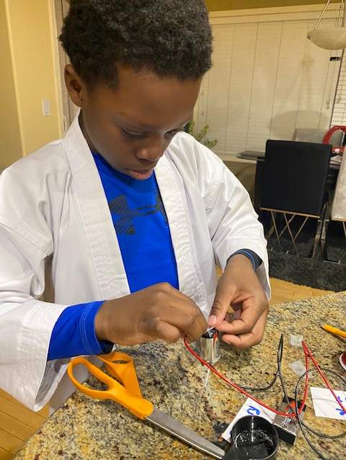
Observation and Data Analysis
For my quantitative data I will be observing the voltage and the amps of the water so I can know the power. With this data I will find out if hydrogen multicell actually provides more power than a normal cell .
For my qualitative data I will observe what is happening in the water if the water is bubbling. I will observe the voltage and amps of the water by using a multimeter.

Slide 19
Results-Average of 6 trials
Measured Voltage | Current(amp) | Resistance | Calculated Voltage | Power (W)
6.51 | 0.33 | 17.91 | 5.9103 | 2.1483
6.72 | 0.33 | 17.91 | 5.9103 | 2.2176
6.62 | 0.33 | 17.91 | 5.9103 | 2.1846
19.85 | 0.33 |  |  | 6.5505

Slide 20
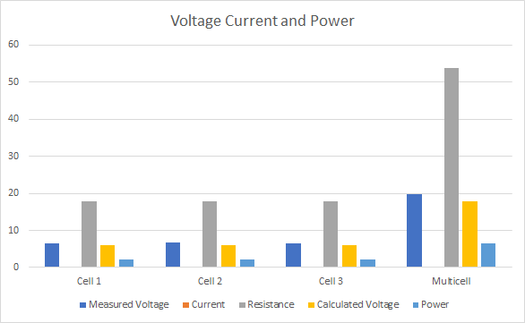
Results

Slide 21
Results and conclusions
With this experiment I can conclude that you can make a hydrogen multicell and it will work. But I also learned from this project that the hydrogen fuel cell does not discharge. It just needs a constant supply of hydrogen which you cannot get naturally. So you have to continually use the battery to work the fuel cell and provide power.
Now, you may be wondering, won’t the power just be from the battery? Actually no. If you measured the battery’s voltage beforehand it won’t be the same, It would be a lot less than what is being produced.
Also, as my voltage is high, why is the current low? That is because there is a lot of electrical components involved in the circuit. So, cutting the resistance by half and leaving the voltage unchanged will double the amperage across the circuit. This just means removing the number of electrical components.
More cells = More power.

Slide 22
Improvement
You can increase the voltage of the fuel cell by expanding its surface area
Adding more water and salt- This does not increase the amperage so much, but it increases it a little bit
Increase the number of cells.
Series connection had more power than parallel connection
Measure the voltage immediately
Use something besides plastic to stop a short circuit

Slide 23
Extension and Questions
What other fuel cells can I make?
Why do bubbles form in the water?
Why does graphite work as a catalyst?
Can I make my fuel cell smaller and have a compact cell
How do I use solar energy to separate the hydrogen from water instead of using battery?

Slide 24
Real world applications
My project has a lot of real-life application. Hyrogen can be used as a fuel. It can be used in vehicles and power plant
The hydrogen fuel cell will help technology prosper and stop the effect of Global climate change.
Hydrogen is a clean fuel that, when consumed in a fuel cell, produces only water.
Hydrogen can be produced from a variety of resources, such as natural gas, nuclear power, biomass, and renewable power like solar and wind.
Today, 95% of the hydrogen produced in the United States is made by natural gas reforming in large central plants.

Slide 25
The End

