Slide 1
Testing the for the best algorithm for teaching Artificial Intelligence
By Viacheslav, 6-23 in Tom Baines

Slide 2
What even is my project
Basically, it is like a child, a teacher shows it a handwritten number, the child guesses,and the teacher says how wrong they are, and repeats, eventually the child learns how to distinguish numbers, and that is it, the child, is the ai, and the teacher, is the loss function, and the child learns because of 2 other functions, that help it improve, and the incredible part, it is just math, and mostly simple, if you can understand every function, you can grab a pencil and a piece of paper, and calculate it!

Slide 3
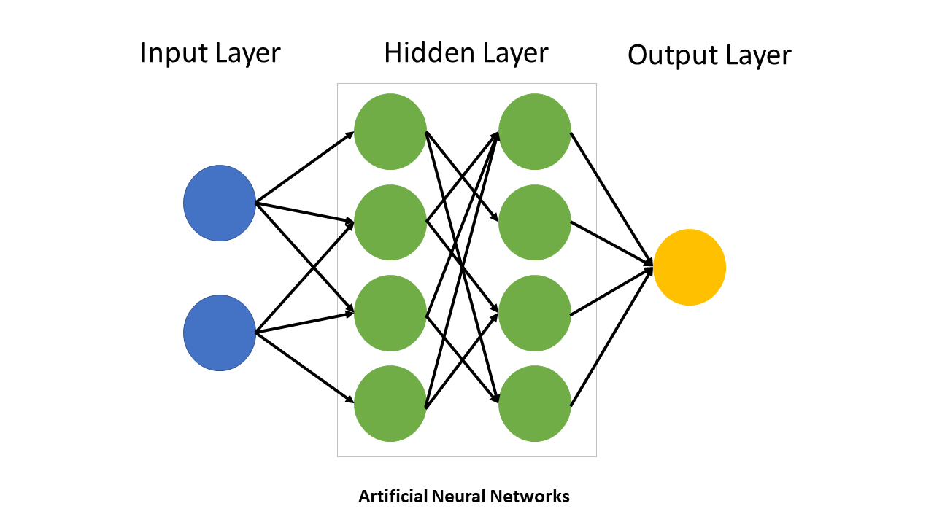
How does it work
This is how it looks, the lines are the weights, and circles are biases, but the inputs aren't biases
I’ll quickly and simply explain how my homemade AI works, and it is the same for every other AI. so first, i take a 28x28 image, and turn it into 784 inputs, which then go through weights, they just multiply, then goes through 16 biases, which sum up all of their inputs into them, and add some bias, which then goes through an activation function, and goes through another sets of weights, 16 biases, set of weights, 10 biases, which are the outputs, then we take each of the 10 outputs and compare them to the target, by feeding through a loss function, after that, the math just explodes in complexity, I took many days to understand the last part. Note that, three are different activation functions and loss functions, and that you can make a network with 50 layers, and a 1000 inputs and 100 biases, it will work anyway.

Slide 4
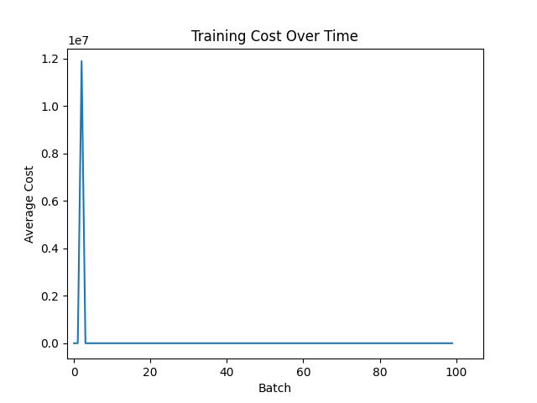
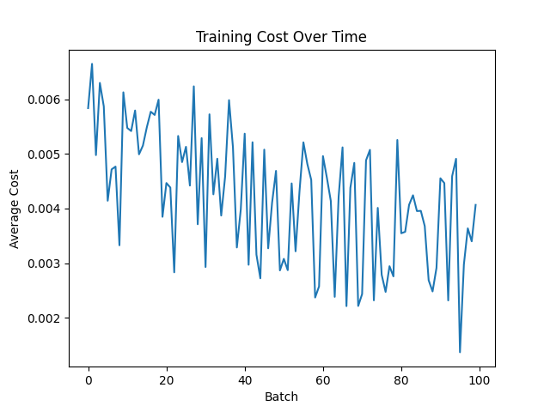
Results
of ReLU with MSE
Of Sigmoid with MSE

Slide 5
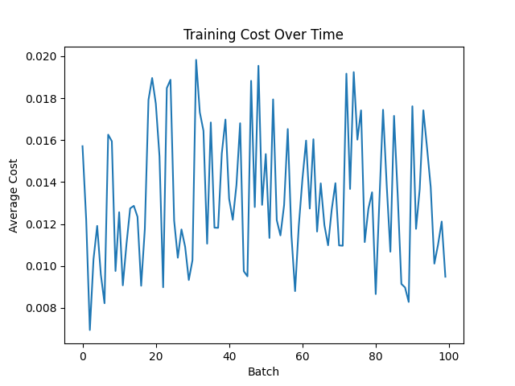
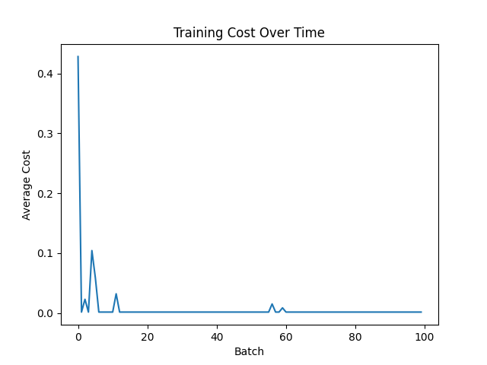
Results
of tahn with MSE
of ReLu with MAE

Slide 6
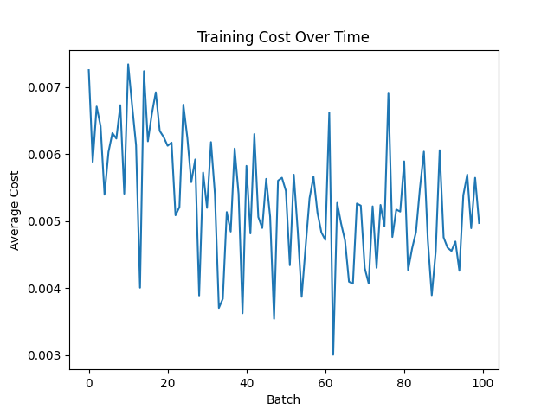
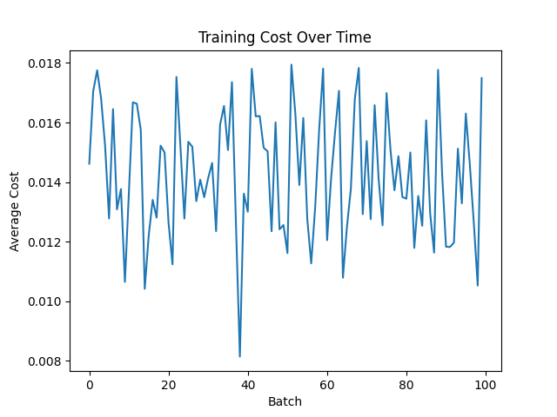
Results
of Sigmoid with MAE
of tahn with MAE

Slide 7
The code
For anyone who wants to extend one this, here is the whole code, i only used 3 libraries, so to replicate this, you have to install python and run in your command line “pip install tensorflow”, “pip install numpy” and “pip install matplotlib”, anyway, here is the link to the code
https://drive.google.com/file/d/1Xqu22fPtoPm1X9BVm-_8s4RfyoEoRqqZ/view?usp=sharing

Slide 8
Thank You For Listening!
I appreciate your attention, and I am grateful for the chance to participate in this science fair!

