Slide 1
Face Recognition Patterns in Cross-Race Effect Why They All Look Alike?! Tarana Sharma Gr. 12

Slide 2
Abstract
Face Recognition is a form of natural biometric authentication integral to social dynamics as people often engage in face-to-face communications, which require an ability to ascertain identities through quick and reliable recall techniques. Cross-Race Effect is a psychological phenomenon which suggests that people recognize faces belonging to their own race more effectively than faces from another race. Common belief claims the effect results from innate racial preconception. To dispute that idea, this project questioned Cross-Race Effect through the lens of Pattern Recognition. It was hypothesized that Face Recognition intuitively relies on systematic pattern recognition processes. Literature survey investigated foundational research on challenges encountered in recognizing faces. As research on this interconnection is sparse, landmark publications in cognitive psychology, cognitive neuroscience and machine learning were analyzed for relevant inputs. Collated findings revealed that Face Recognition categorically relies on a pattern recognition processes to code patterns based on common structures of facial geometry. The hypothesis was strongly supported with clear indication that our ability to recognize and differentiate between faces draws heavily from mental datasets gathered from visual experiences. Future implications point at experimental research for improved substantiation of the mechanics of face recognition through behavioral and neural responses.

Slide 3
Project Framework
Problem
Common belief claims that Cross-Race Effect is an outcome of innate racial preconceptions
Objective
Is our cognitive ability to recognize and differentiate between faces related to intelligence?
Is Cross-Race Effect an outcome of innate racial preconception?
Why is in-between category differentiation better than within-category differentiation?
Hypothesis
Face Recognition intuitively relies on systematic pattern recognition processes

Slide 4
Methodology & Findings
Initially, the project design intended to investigate foundational research in cognitive psychology and cognitive neuropsychology exploring intuitive reliance on patterns during face recognition through simplistic behavioural experiments. Critical analysis revealed that the investigation was eye-opening but minimal in scope, which led to an inclusion of other landmark studies and popular literature in machine learning to ensure a robust body of research evidence.
Through extensive reading and detailed analysis, a systematic understanding was developed which elucidated the basis of Face Recognition patterns in Cross-Race Effect through processes mainly including:
Face Inversion Effect
Composite Effect
Whole-Part Effect
Norm-Based Coding

Slide 5
Face Recognition ≠ Object Recognition
Face Inversion Effect: Robert Yin demonstrated that Face Recognition is different from object recognition by asking subjects to recognize inverted faces
His experiments showed that there was a significantly greater decrease in memory and recall when people viewed faces in inverted position compared to when they viewed non-human objects in inverted manner
I think perhaps this happens because the brain stores a more complex representation of faces than non-human objects causing less flexibility in pattern recognition
Fig 1. Inversion Effect

Slide 6
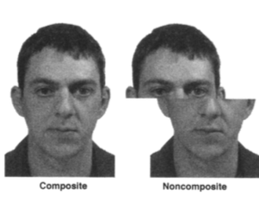
Face Recognition is Holistic
Composite Effect: Andrew Young and his team’s research proposed that Face Recognition is holistic and not decomposed into individual parts!
Experiments showed that people find it difficult to distinguish pictures of faces if they are made by combining halves of two separate faces unless there is some misalignment in the two halves
Fig 2. Example of Composite Effect

Slide 7
Face Recognition ≠ Decomposable
Whole-Part Effect: Tanaka and Farah’s studies highlighted a whole-part effect indicating that any part of a face – nose/eyes/mouth is more easily recognized on the whole face than by itself as an isolated item
Subjects did not show any advantage for part identification in whole object recognition for scrambled faces, inverted faces and houses
Fig 3. Example of Whole-Part Effect

Slide 8
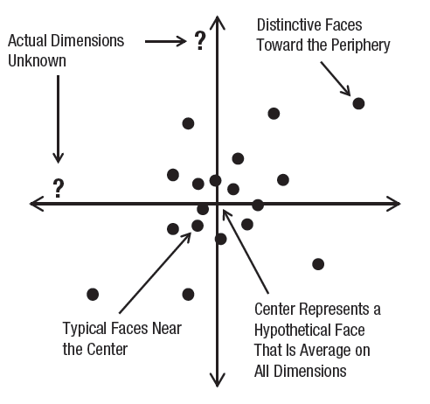
Norm-Based Face Space Coding
Face-Space Coding of Face Identity: Face recognition is based on a norm-based coding system in multi-dimensional face spaces
Each individual face is coded as a point in a multi-dimensional perceptual space that has dimensions corresponding to attributes that vary across faces and that has average face at the center.
Face after-effects are commonly interpreted as arising from a shift in the location of this average which is caused by persistent varying exposure to external stimuli
This framework is analogous to a lookup table or a data map which can be updated based on neural perception
Fig 4. Example of 2D Face Space

Slide 9
Main Findings
I think that these concepts imply that our brains memorize faces like a map where encoding involves the relative positioning of facial features combined with contextual or background information
Essentially, lessons from these foundational experiments and studies in cognitive neuropsychology, neuroscience and other subsequent applied research indicate three aspects about our ability to recognize and differentiate between faces:
Face Recognition is different from object recognition
Face Recognition takes into account holistic face representation
Face Recognition uses norm-based coding systems

Slide 10
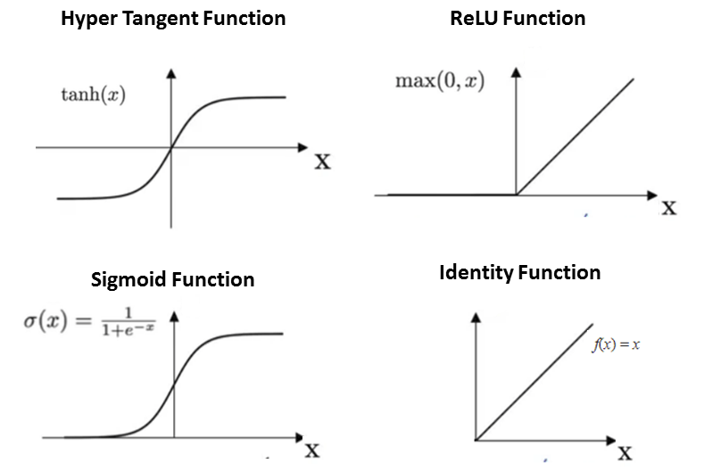
Neural Response Mechanism
Face space coding is based on two types of neural responses:
Broadband opponent coding is set up such that one set of neurons respond to the maximal value of an attribute while another group of neurons respond to the minimal value of the same attribute
The linear opponent coding function is a physiologically confirmed phenomenon which involves face selective neurons that have linear ramp functions to respond to several face attributes
Fig 5. Mathematical functions approximate neural response behaviors including mean/norm shift, bias, linear ramp

Slide 11
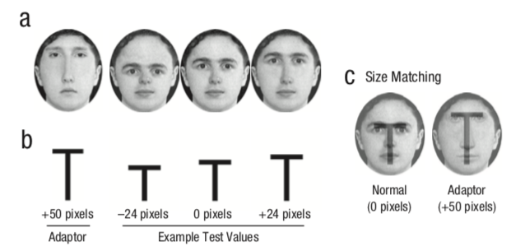
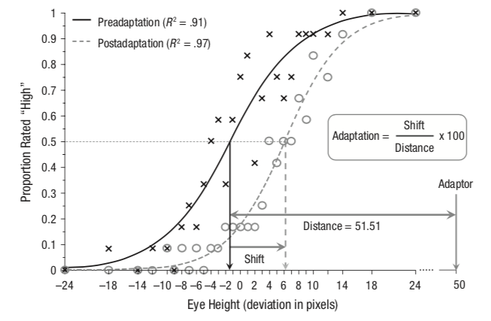
Memory & Recall
Machine Intelligence expert, Jeff Hawkins theorizes that the neocortex:
Stores sequences of patterns
Recalls patterns auto associatively
Stores patterns in an invariant form
Stores patterns in a hierarchy
The maps are conditioned based on norms or averages created in response to external stimuli the brain is exposed to over time
This was experimentally validated by Mckone et al. using the distance between the eyes and the mouth of faces as a facial attribute used to recognize faces
Fig 6 a, b, c: Experiment setup for eye-height variations
Fig 6 d: Detection of changes in facial attributes by subjects with and without pre-conditioning

Slide 12
Analysis & Conclusions
The human brain uses patterns to memorize and identify faces
Facial recognition differentiates people by spontaneously yet systematically capturing, analyzing, and comparing patterns based on facial details
The face detection process detects and locates human faces
The face capture process transforms analog information (a face) into a set of digital information (data) detailing the person's facial features
The face analysis process analyses the recorded facial geometry
The face match process verifies if two faces belong to the same person
Neural conditioning uses a range of external stimuli for a flexible and non-linear face recognition mechanism spanning multi-dimensional face spaces. People have difficulty recognizing faces accurately when presented with facial features outside the pre-conditioned range, which forms the basis for Cross-Race Effect

Slide 13
Revisiting Framework
Objectives Answered
Face Recognition is not an exclusive outcome of intelligence.
Evidence of norm-based coding of faces contradicts innate racial bias as the reason underlying an inability to differentiate between faces
In-between category differentiation tends to be better than within-category differentiation because of limited range of exposure or what I’d like to call unfamiliarity quotient
Hypothesis Supported
Findings clearly supported the hypothesis through evidence that our intuitive ability to encode and decode faces draws on systematic pattern recognition

Slide 14
Implications & Limitations
Findings of this study have direct implications for Face Recognition technologies.
In fact, high level results from NISTIR 8280 - a landmark US Federal study released in December of 2019 showed that Facial Recognition systems misidentified people of color more often than white people. In a press release, Patrick Grother – primary author of the report was quoted “While it is usually incorrect to make statements across algorithms, we found empirical evidence for the existence of demographic differentials in the majority of the face recognition algorithms, we studied.” The shocking finding demands intensified focus on mitigation of inherent racial bias in surveillance tools.
Systems can be improved by training algorithms on a larger and more diverse set of faces and by using additional facial parameters which are independent of skin color to compensate for the limitations of the human brain. Minimizing and eventually eliminating systemic bias in surveillance and security systems is crucial for equitable law enforcement.

Slide 15
Implications & Limitations
Comprehension of neural mechanisms for facial recognition can enable an alternate pathway to induce or enhance vision in visually impaired people
The fascinating findings from this research review demonstrate that individual differences can be investigated to understand aspects of cognitive neuroscience because we can learn about the cognitive ability of face recognition using simple measurements of behavioral responses based on accuracy and time
Interesting and pertinent questions identified for further exploration include:
What is the role of experience in Face Recognition?
Are there any age-effects that influence Face Recognition?
What are the neural responses of challenges on Face Recognition tasks?
Although the research review methodology of this project limited the scope of exploration, the distinct findings are encouraging for experimental studies using sizeable sample sets and multiple trials

Slide 16
Primary References
Deen, B., Richardson, H., Dilks, D. et al. (2017). Organization of high-level visual cortex in human infants. Nat Commun 8, 13995. https://doi.org/10.1038/ncomms13995
Deen, B., Saxe, R & Kanwisher, N. (2020) Processing communicative facial and vocal cues in the superior temporal sulcus. NeuroImage, Volume 221, 117191, https://doi.org/10.1016/j.neuroimage.2020.117191
Kanwisher, Nancy. 2020. Nancysbraintalks. MIT. http://nancysbraintalks.mit.edu
Lebrecht S, Pierce LJ, Tarr MJ, Tanaka JW (2009) Perceptual Other-Race Training Reduces Implicit Racial Bias. PLoS ONE 4(1): e4215. https://doi.org/10.1371/journal.pone.0004215
McKone E, Crookes K, Jeffery L & Dilks D D. (2012) A critical review of the development of face recognition: Experience is less important than previously believed, Cognitive Neuropsychology, 29:1-2, 174-212, DOI: 10.1080/02643294.2012.660138
Tanaka, J. W., & Farah, M. J. (1993). Parts and wholes in face recognition. The Quarterly Journal of Experimental Psychology A: Human Experimental Psychology, 46A(2), 225–245. https://doi.org/10.1080/14640749308401045
Taylor, John. (2005). On Intelligence, Jeff Hawkins, Sandra Blakeslee Times Books (2004). Artificial Intelligence. 169. 192-195. 10.1016/j.artint.2005.10.011
Yin, R. K. (1969). Looking at upside-down faces. Journal of Experimental Psychology, 81(1), 141–145. https://doi.org/10.1037/h0027474
Young AW, Hellawell D, Hay DC. Configurational information in face perception. Perception. 1987;16(6):747-59. doi: 10.1068/p160747. PMID: 3454432

