Slide 1
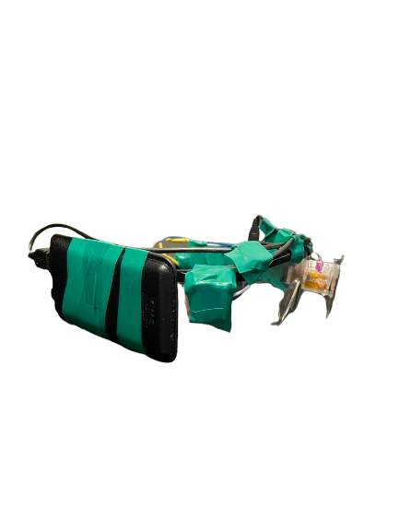
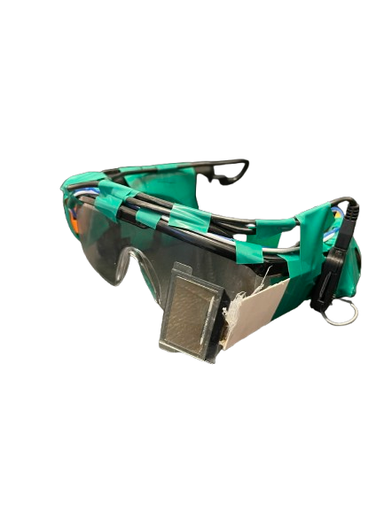
SpektraLens
A D.I.Y Smart Glasses
Mohtad Abdullah Qutab – Grade 7
Notes:
This project is called SpektraLens. It is a pair of DIY smart glasses designed to reduce unnecessary phone pick‑ups by showing important notifications directly in the user’s field of view.

Slide 2
The Problem
50–80 notifications per day
Over half of pick‑ups start with a notification
89% turn into unintentional scrolling
Adds 30–50 minutes of extra screen time
Causes eye strain and loss of focus
Notes:
Research shows that people receive between fifty and eighty notifications every day. More than half of all phone pick‑ups start because of a notification, and almost ninety percent turn into unintentional scrolling. This adds thirty to fifty minutes of extra screen time daily and contributes to eye strain and reduced focus.

Slide 3
Purpose of SpektraLens
Show
Show essential notifications
Reduce
Reduce curiosity‑based phone checks
Improve
Improve focus and reduce screen time
Notes:
The purpose of SpektraLens is to reduce curiosity‑based phone pick‑ups. By showing only essential notifications on a small transparent display, the user does not need to unlock their phone.

Slide 4
Engineering Workflow
Frame construction
Electronics and power
Android setup
Python notification filtering
Testing and evaluation
Notes:
For this project, I followed an engineering workflow with five main stages. First, I built the physical frame for the glasses and figured out how to mount the transparent OLED in the correct position. Second, I worked on the electronics and power system, including an attempt at a custom battery circuit before switching to a powerbank. Third, I set up the Android phone to send notifications to an ntfy server, since iOS was too restricted for what I needed. Fourth, I wrote a Python program that receives the notifications, filters the message text, and displays it on the OLED. Finally, I tested the prototype with different users to evaluate readability, comfort, and how much it reduced unnecessary phone pick‑ups.

Slide 5
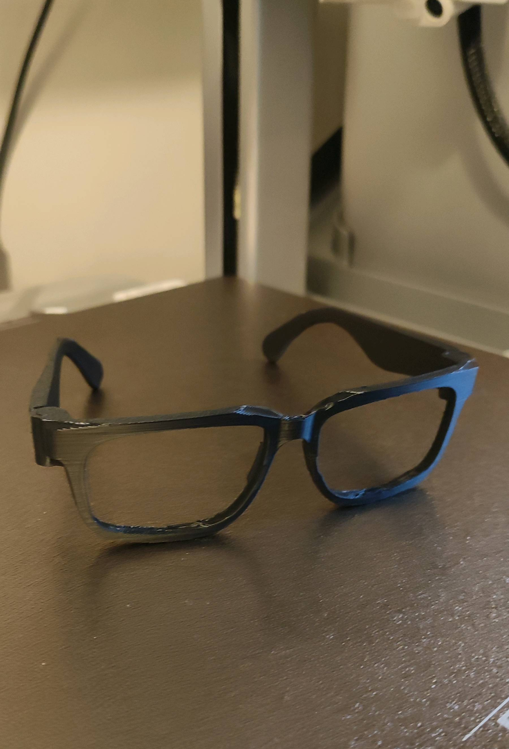
Frame Construction
3D‑printed frame was too flexible
Switched to safety glasses
Mounted OLED with cardboard shims
Electrical tape for stability
Drop‑tested: no damage
Notes:
My original 3D‑printed frame was not strong enough to hold the transparent OLED. I replaced it with safety glasses, which were already rigid and shaped correctly. I mounted the OLED using cardboard shims and electrical tape. The structure was stable and survived multiple drop tests from one foot.

Slide 6
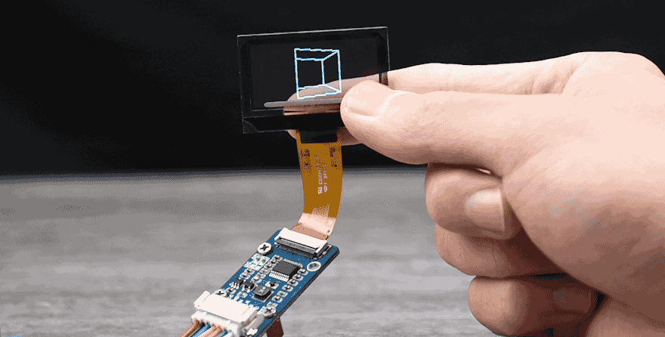
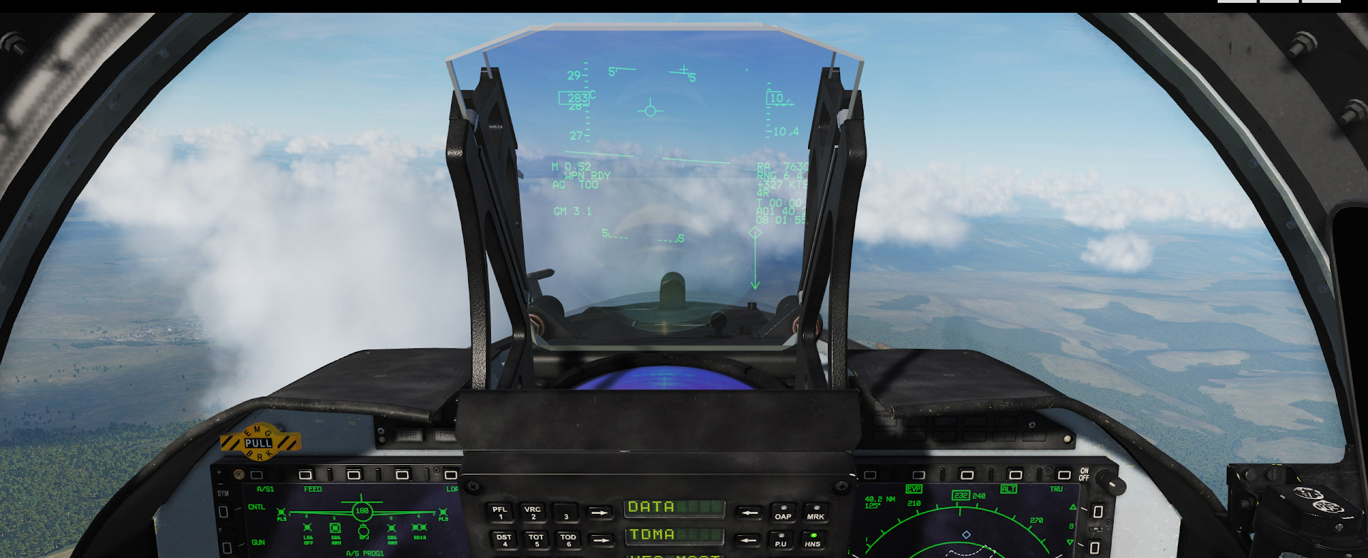
The Transparent OLED Screen
The transparent OLED is the main display of SpektraLens.
It shows notifications directly in front of the user’s eye.
The screen is see‑through, so you can still look forward normally.
The Raspberry Pi sends text to the OLED instantly using SPI.
This acts like a mini HUD (Heads‑Up Display).
HUDs are used in real fighter jets like the F‑16, JF‑17, and J‑10C.
SpektraLens is a small DIY version of this same HUD concept.
Notes:
The transparent OLED screen is the core of SpektraLens. This is the part that actually shows the notifications right in front of your eye. Since the screen is transparent, you can still look forward normally while reading the text. The Raspberry Pi sends the messages to the OLED instantly using SPI, so the updates appear in real time.
This screen works just like a HUD, which stands for Heads‑Up Display. A HUD is a special type of display used in fighter jets to show important information directly in front of the pilot’s eyes. Jets like the F‑16, the JF‑17, and the J‑10C all use HUDs for flight and targeting data. SpektraLens is basically a small, DIY version of that same technology, but designed for everyday notifications.

Slide 7
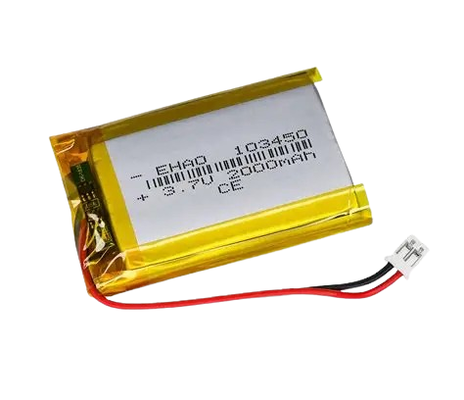
Power System
Attempted custom Li‑ion battery system
Charger board + boost converter failed
Switched to a powerbank
Reliable but caused weight imbalance
Notes:
I attempted to build a custom rechargeable power system using a lithium‑ion battery, a charger board, and a boost converter. The circuit failed, and with limited time remaining, I replaced it with a powerbank. The powerbank worked reliably but added noticeable weight to one side of the glasses.

Slide 8
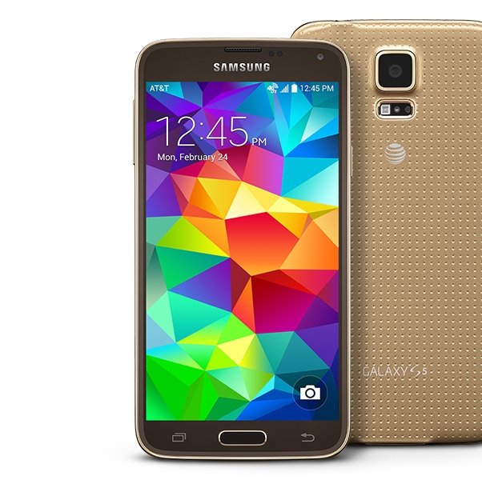
Android Setup
iOS too restricted
Switched to Android
Used old Samsung S5 Duo
Installed apps manually via SD card
Sends notifications to ntfy server
Notes:
I originally planned to use iOS, but it was too restricted for the features I needed. I switched to Android and used an old Samsung S5 Duo, the newest android phone I have. I installed the required apps manually using an SD card and configured the phone to send notifications to an ntfy server

Slide 9
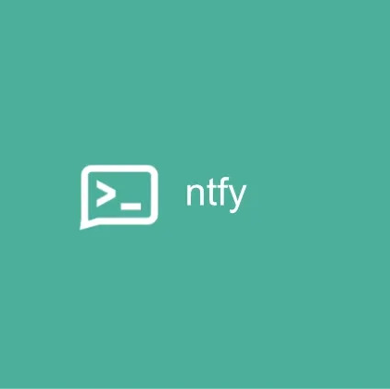
Python Program
Connects to ntfy
Filters message text
Sends text to OLED
Auto‑runs on startup
Around 5‑minute boot time
Notes:
I wrote a Python script that connects to the ntfy server, filters out metadata, and sends only the message text to the transparent OLED. The script auto‑runs on startup, but due to hardware limitations, the system takes about five minutes to fully boot.

Slide 10
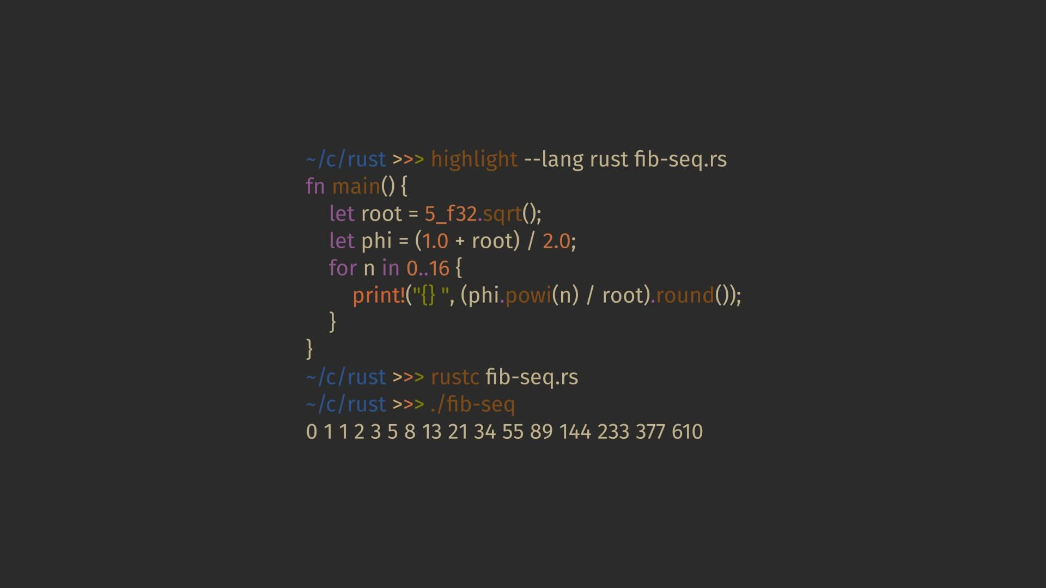
First Test - Successful!
Set up the Raspberry Pi Zero 2W with the OLED display.
Connected the OLED using SPI and ran the display test script.
Installed and configured ntfy for real‑time notifications.
Sent a test message from my phone to the Pi’s ntfy topic.
The OLED successfully displayed the message instantly.
Confirmed that the system worked end‑to‑end:
Phone → ntfy → Raspberry Pi → OLED screen.
This proved the core concept of SpektraLens.
Notes:
For my first test, I wanted to check if the entire system could work from start to finish. I started by setting up the Raspberry Pi Zero 2W and connecting the transparent OLED using the SPI pins. After that, I ran a simple display test script to make sure the OLED was working.
Then I installed and configured ntfy, which is the notification service that sends messages to the Pi. Once everything was ready, I sent a test message from my phone to the ntfy topic that the Pi was subscribed to. The message appeared instantly on the transparent OLED screen.
This confirmed that the whole workflow was working: the phone sends the message, ntfy delivers it, the Raspberry Pi receives it, and the OLED displays it. That first successful test proved that the core idea behind SpektraLens was possible.

Slide 11
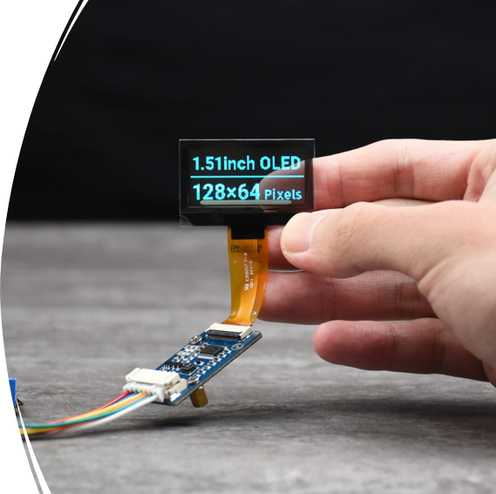
Optical Challenges
OLED needs exact distance and angle
Cardboard shims used for alignment
Adults struggled to focus
Caused by near‑point vision differences

Slide 12
Wiring and Electronics
Wires originally messy
Mostly routed across top of frame
Secured with electrical tape
Improved stability and usability
Notes:
The wiring was originally exposed and unstable. I improved this by routing the wires neatly across the top of the glasses and securing them with electrical tape. This made the device more durable and easier to handle.

Slide 13
Usability Testing
Tested readability with different users
Checked comfort & balance
My own observations
Not fully accurate (I was excited)
Issues: clarity, comfort, weight
Notes:
I tested the glasses by having different people try them on to see if the text was readable and if the device felt comfortable and balanced. I also paid attention to my own experience while using them, but my results weren’t completely accurate because I was excited to use the prototype. From this testing, I noticed issues with display clarity for adults, weight imbalance, and overall comfort.

Slide 14

Parent Feedback (Users)
Dad:
Found the system useful in many cases
Notifications worked perfectly
Temples not sitting on ears
Mom:
Notifications worked reliably
Weight imbalance
Hard to focus quickly
Notes:
My dad found the system very useful for many different use cases, as expected – The notifications worked perfectly, but he did feel discomfort while wearing. Mostly because the temple was blocked by the powerbank. My mom confirmed that the notification system worked reliably, but she noticed the weight imbalance and had somewhat trouble seeing the text clearly. Their feedback highlighted the need for better ergonomics and improved optical clarity.

Slide 15
Conclusion
Concept worked
Reduced unnecessary phone pick‑ups
Prototype had mechanical and optical limits
Clear direction for future improvements
Notes:
In conclusion, SpektraLens successfully reduced unnecessary phone pick‑ups by placing essential information in the user’s field of view. The prototype revealed important mechanical, electrical, and optical limitations, but it also provided a clear direction for future improvements

Slide 16
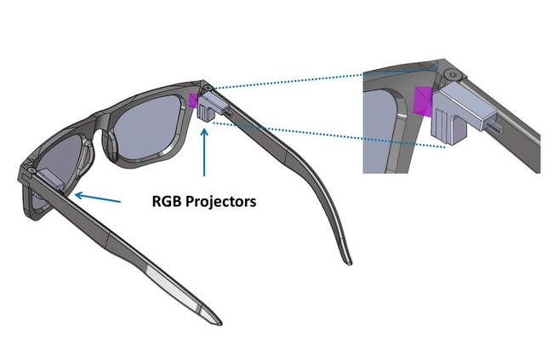
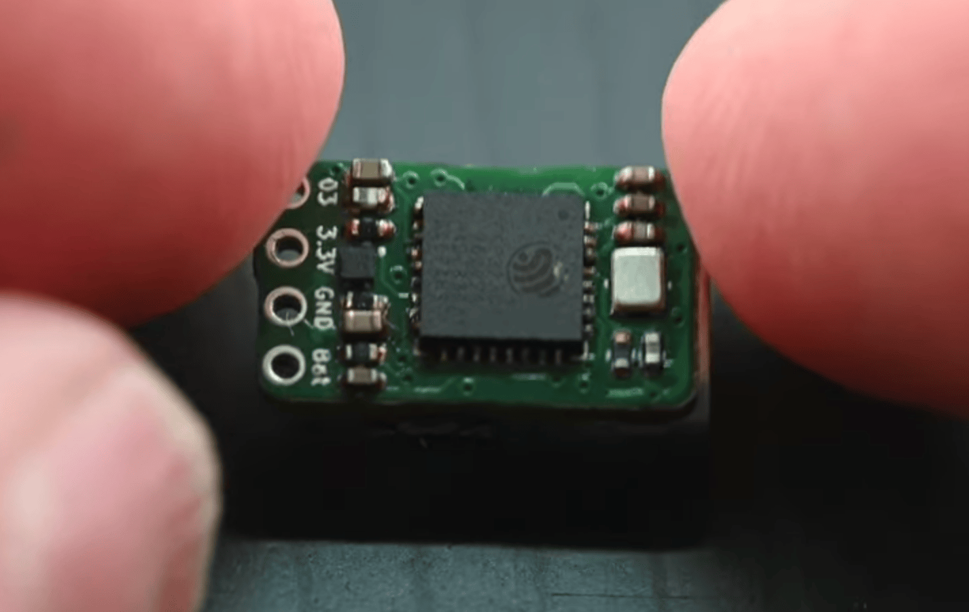
Future Improvements
Custom lightweight frame
Proper lens system
Smaller power module
Faster device or microcontroller
Improved display technology
Notes:
Future improvements include designing a lightweight custom frame, adding a proper lens system, using a smaller power module, upgrading to faster hardware, and exploring better display technologies.

Slide 17
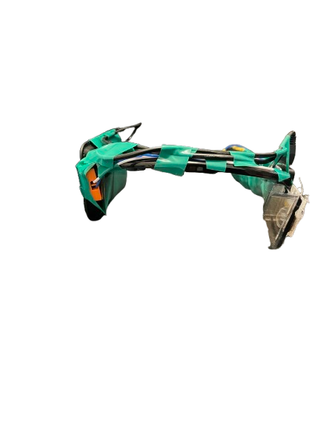

Thank You For Your Time

