Slide 1
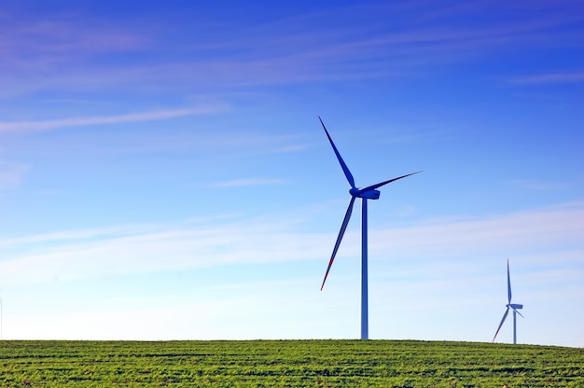
Project Title
Speed bump electric generator
Prepared by
Param Panchal (Grade 5)
‘Speed bump electric generator’ by Param Panchal (Feb 2025)
School
Glamorgan School,
Calgary
School Coordinator
Mr. Jason Rip
Supporter
Mother, Father
Prerana Archit

Slide 2
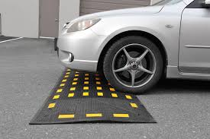
Question, Hypothesis, Prediction
Question:
Can we generate electricity from the movable Speed Bump (which can move up and down little bit) by installing gears and wind turbine motors under the Speed Bump?
How can we recover a moving vehicle’s energy (kinetic energy) and convert it into electrical energy?
‘Speed bump electric generator’ by Param Panchal (Feb 2025)
Photo Sources:
https://www.reliance-foundry.com/blog/speed-humps-vs-speed-bumps

Slide 3
Question, Hypothesis, Prediction ..(Cont.)
Hypothesis:
I think, the DC motor (wind turbine motor) under the movable Speed Bump (which can move up and down little bit) will generate electricity, because the vehicles pass over the speed bump will push the speed bump and the small gears - Rack and Pinion gears (‘Press and Go’ Toy Cars) under the movable Speed Bump will rotate the DC motor (wind turbine motor).
‘Speed bump electric generator’ by Param Panchal (Feb 2025)

Slide 4
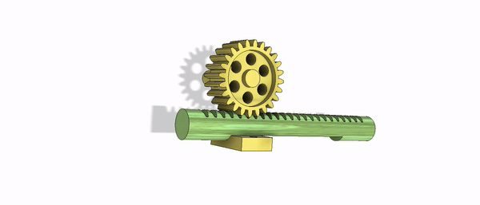
Question, Hypothesis, Prediction ..(Cont.)
Prediction:
If I modify one movable Speed Bump (which can move up and down little bit) by installing gears and wind turbine motors under the Speed Bump, but not others, then the motor will generate electricity when a vehicle passes over the modified movable Speed bump than the non-modified Speed bump.
‘Speed bump electric generator’ by Param Panchal (Feb 2025)
Photo Sources:
https://grabcad.com/library/animated-round-rack-and-pinion-gear-1

Slide 5
Background Research
Big Topic: Energy
Why is this important for society:
Energy is very important in our daily life.
Electrical energy powers many electronic daily items. (Smartphones and Computers etc.)
Electrical energy is also essential for our home. (Heating and Cooling, Refrigerators, Washers etc.)
Transportation completely depends on energy (electricity or gas).
What do we already know about the topic:
Alternative Energy is the energy from renewable sources or natural sources:
Wind, Solar, Water, Soil
Alternative Energy is non-polluting and clean energy
Examples of Alternative Energy: Wind energy, Solar energy, Hydraulic energy, Geothermal energy, Tidal energy
‘Speed bump electric generator’ by Param Panchal (Feb 2025)

Slide 6
Background Research ..(Cont.)
What are we missing?
How do we produce clean energy (electricity) from the Speed Bump with the help of gears and wind turbine motors under the Speed Bump?
How my topic solves a problem
We can generate energy (electricity) by modifying the movable speed bump (which can move up and down little bit)
(Install gears and wind turbine motors under the Speed Bump)
When a vehicle passes over the movable Speed bump, the motor will generate electricity.
We can use kinetic energy (motion of vehicle) and convert it into electrical energy.
We can recover a moving vehicle’s energy (kinetic energy) and convert it into electrical energy.
‘Speed bump electric generator’ by Param Panchal (Feb 2025)

Slide 7
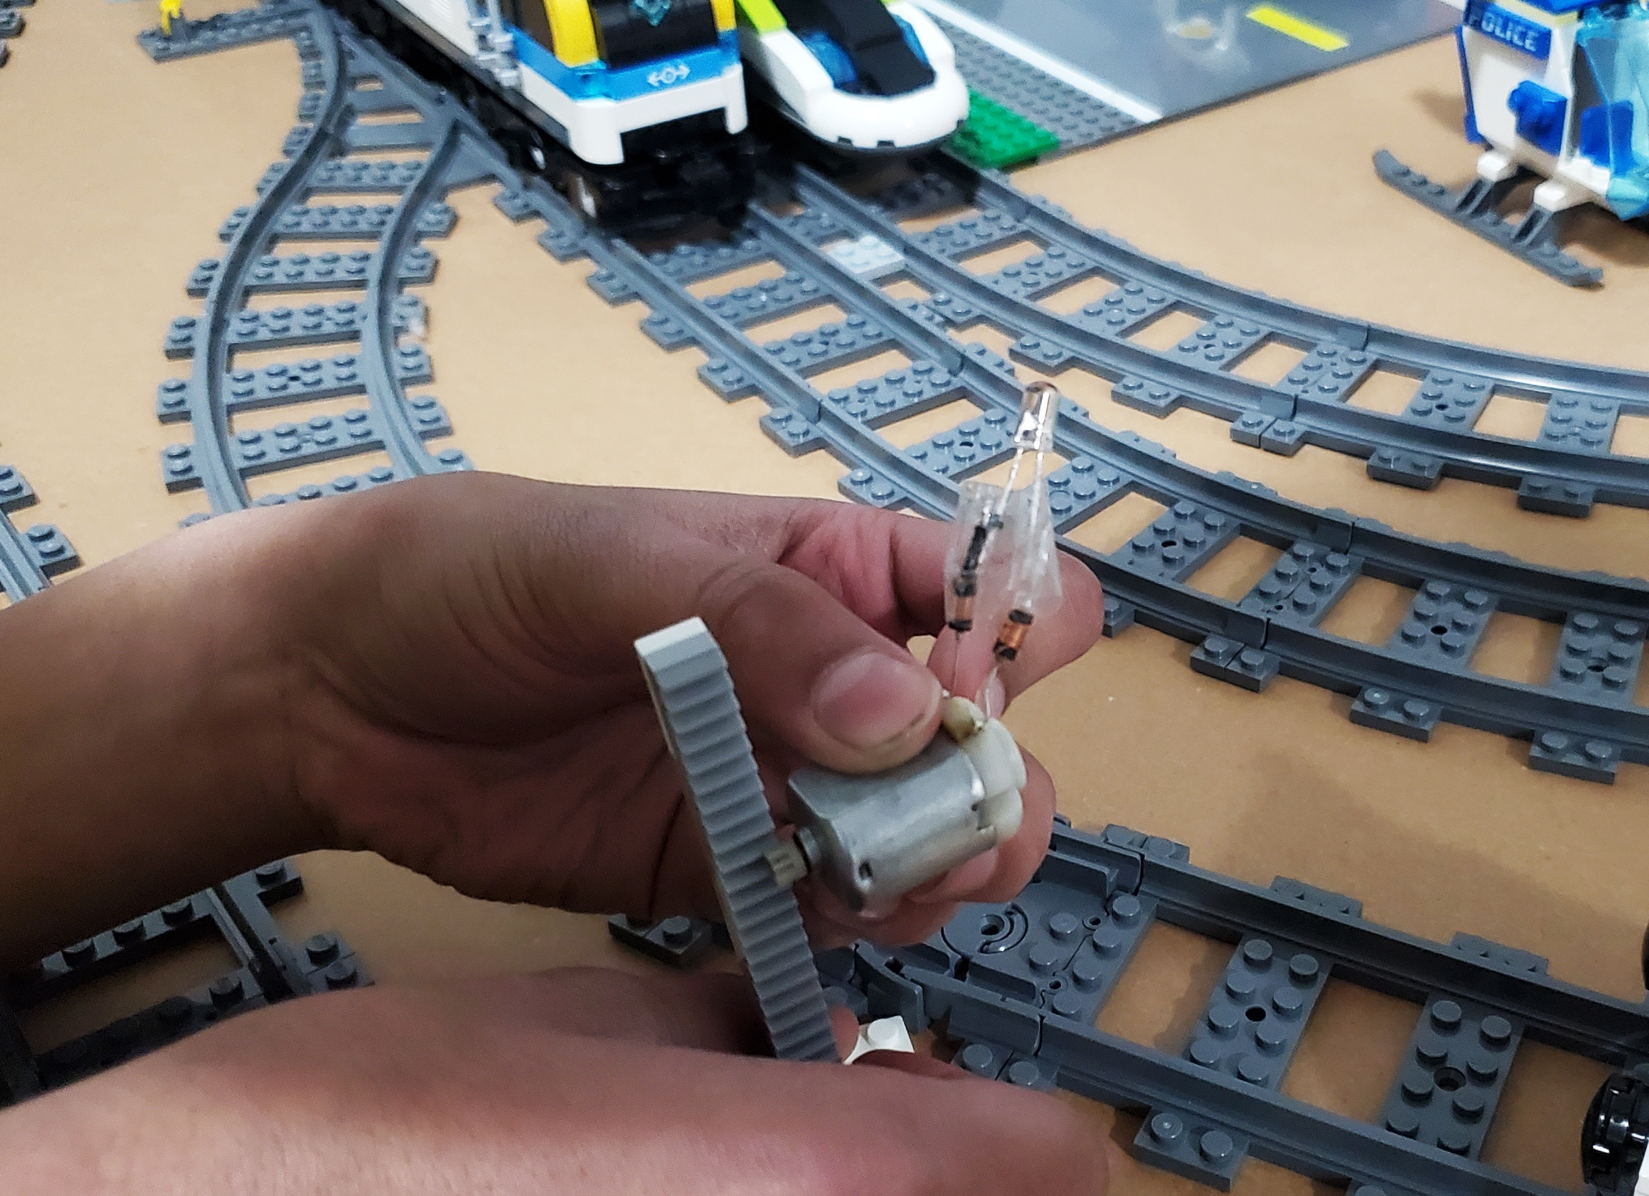
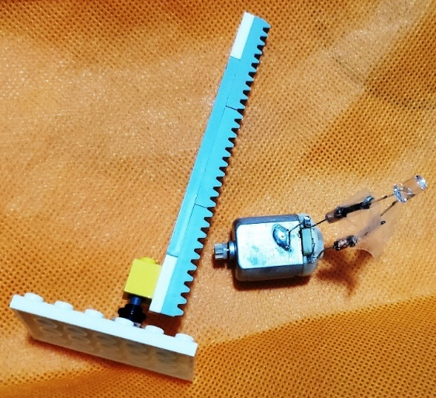
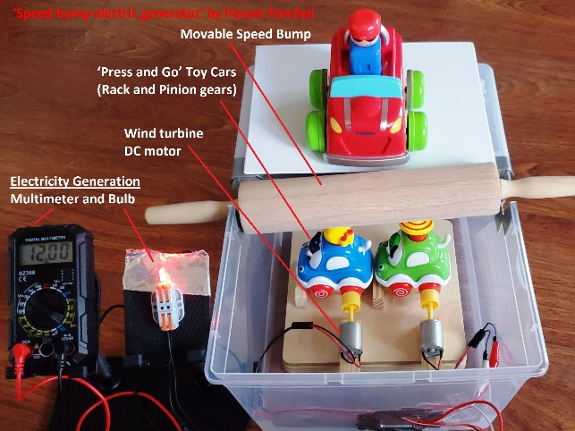
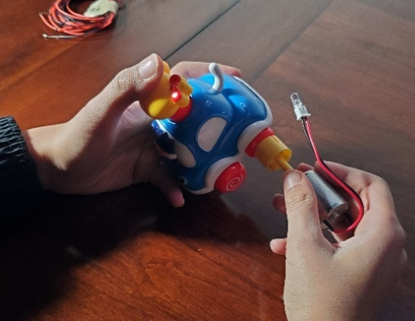
My Science Project Ideas
‘Speed bump electric generator’ by Param Panchal (Feb 2025)

Slide 8
Variables
Independent Variable (What I change) | Dependent Variables (What I observe) | Controlled Variables (What I keep the same)
- Movable Speed Bump (which can move up and down little bit) with small gears - Rack and Pinion gears (‘Press and Go’ Toy Cars), and generator (DC motor) under the Speed Bump, Measured in numbers of gears and number of generators | - Electricity Generation, Measured in Voltage with a multimeter - Electricity Generation, Measured by the number of light bulbs | - Same vehicles or cars - Same type of road - Same type of road sign for the speed bump - Same size of the speed bump - Same height of the speed bump
‘Speed bump electric generator’ by Param Panchal (Feb 2025)

Slide 9
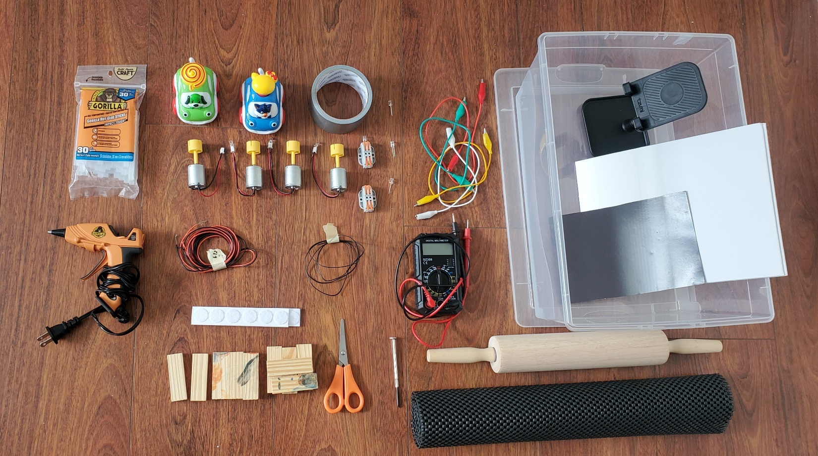
Material used for Working Model
‘Speed bump electric generator’ by Param Panchal (Feb 2025)

Slide 10
Material used for Working Model ..(Cont.)
4 Small wind turbine DC motor (5 Volts)
Gears ‘Press and Go’ Toy Cars (4 quantities)
2 LED light bulbs (5mm), & 1 Multimeter
Electrical Wires (approx. 1 meter), & Wire Connectors
Plastic storage box, Cardboard
1 Toy Car for an experiment on a Speed bump
Small Wooden pieces or Wooden box
Wooden rolling pin, Wooden chopping board
Hot Glue Gun and Sticks, & Glue (1 small bottle 150ml)
Electrical Tape (1 roll), Clear Tape (1 roll)
Scissors, Other Craft items
‘Speed bump electric generator’ by Param Panchal (Feb 2025)

Slide 11
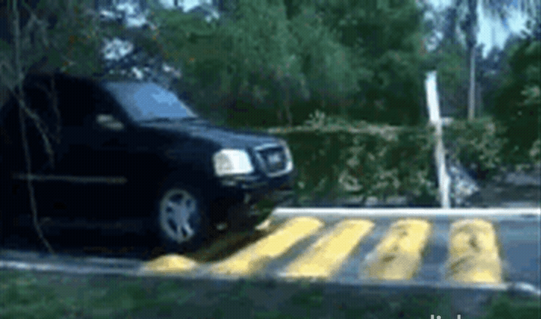
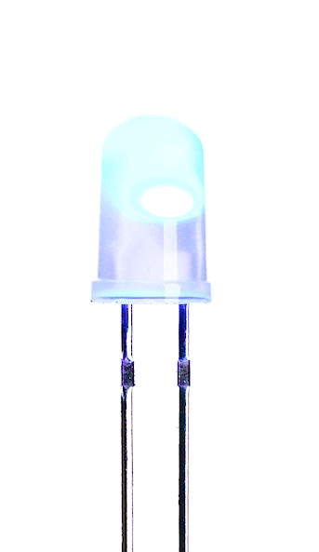
Procedures (Experiment - Working Model)
Movable Speed Bump
Electricity Generation
Rack
Pinion
‘Speed bump electric generator’ by Param Panchal (Feb 2025)
Photo Sources:
https://grabcad.com/library/animated-round-rack-and-pinion-gear-1
https://cad.grabcad.com/library/dc-motor--11
https://shop.pimoroni.com/products/5mm-rainbow-led-pack-of-10?variant=2833384833034
https://tenor.com/view/bounce-bumpy-ride-bouncy-ride-gif-3550911
https://giphy.com/gifs/desktoppaints-jump-spring-xT0xeGxcmzPAdn9mzC
https://www.amazon.ca/
Rack and Pinion gears

Slide 12
Procedures (Experiment - Working Model) ..(Cont.)
First, I made a road with a movable speed bump (which can move up and down little bit) on the storage box.
Gears - Rack and Pinion gears (‘Press and Go’ toy cars) are installed under the movable speed bump.
Then, two wind turbine DC motors (generator) are connected to the wheels of the toy car.
Next, two motors are connected to an LED light bulb (5mm) and a multimeter by using an electrical wire.
Now, we can test our working model. And we can check that when a vehicle pushes the speed bump, the gears under the speed bump rotate and generate electricity. The generated electricity can be seen on an LED light bulb and a multimeter.
‘Speed bump electric generator’ by Param Panchal (Feb 2025)

Slide 13
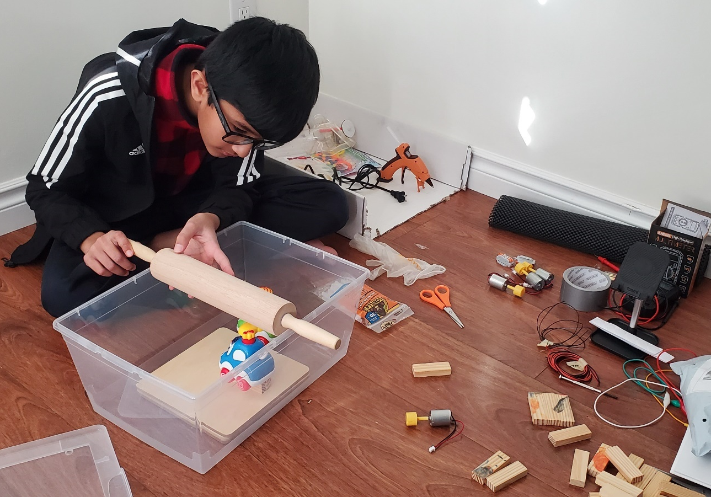
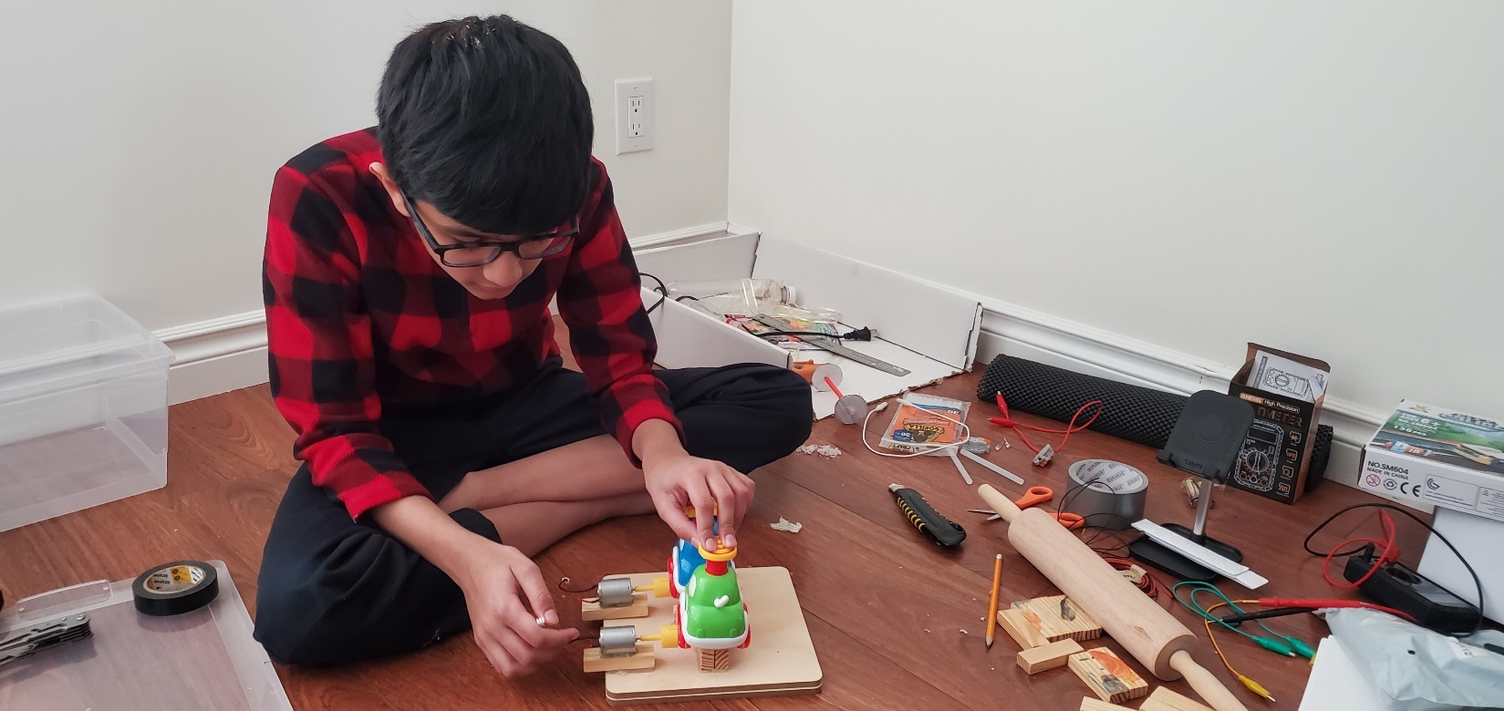
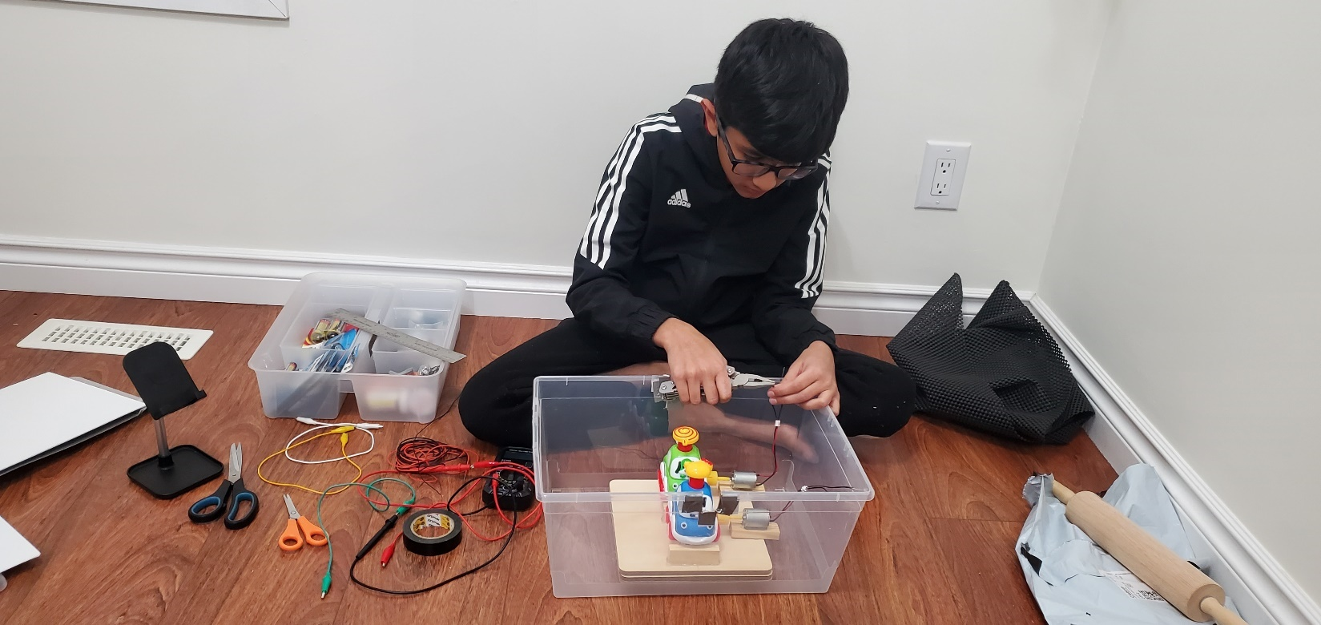
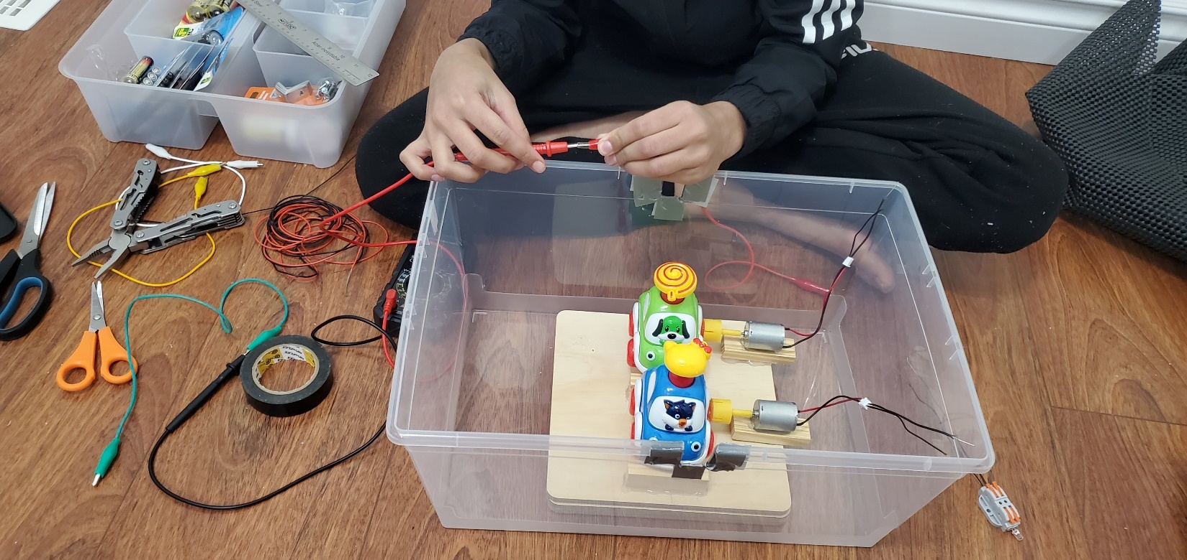
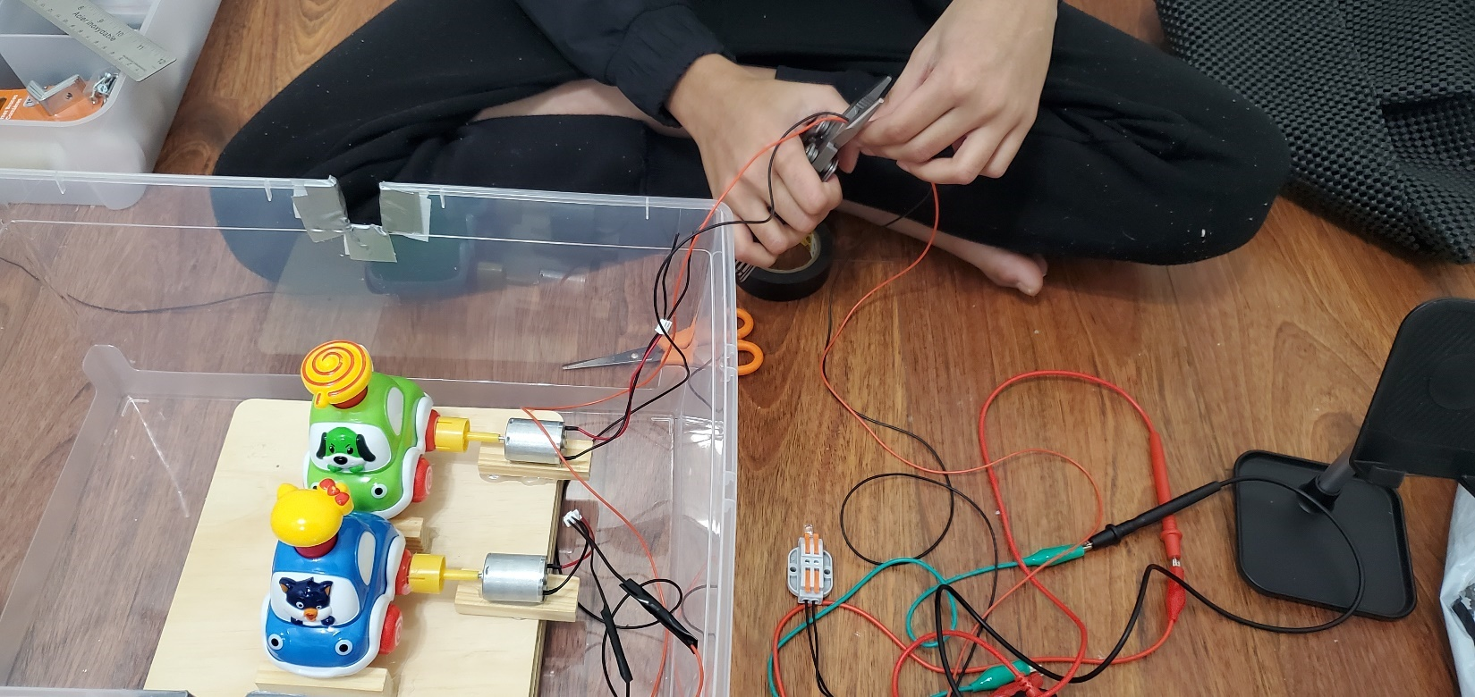
Procedures (Experiment - Working Model) ..(Cont.)
‘Speed bump electric generator’ by Param Panchal (Feb 2025)

Slide 14
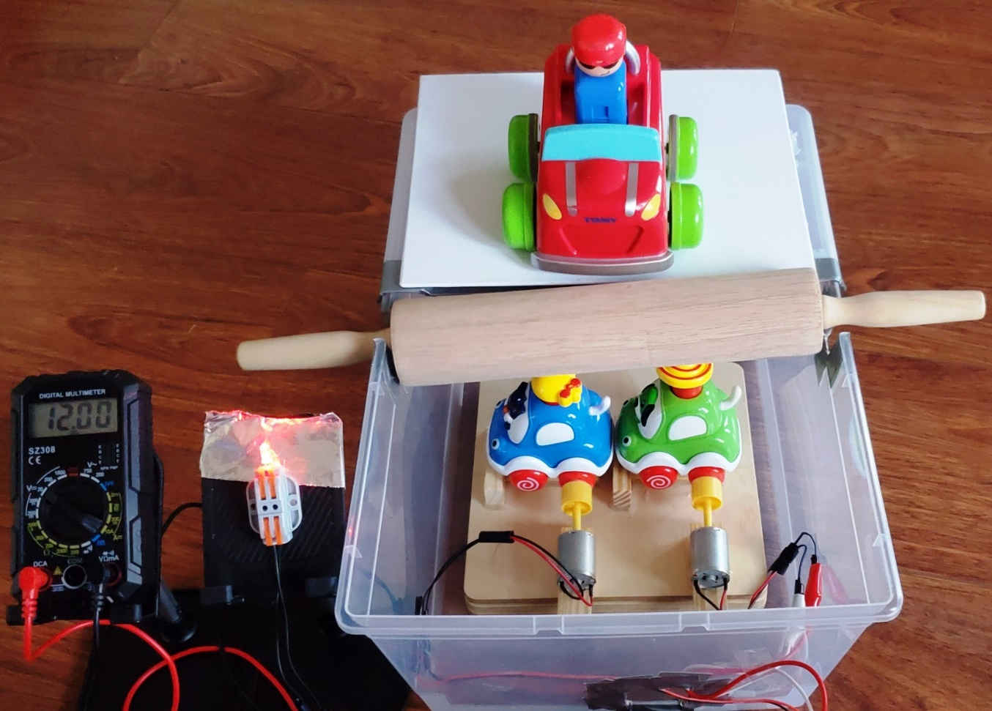
Procedures (Experiment - Working Model) ..(Cont.)
‘Press and Go’ Toy Cars (Rack and Pinion gears)
Movable Speed Bump
Electricity Generation
Multimeter and Bulb
Wind turbine DC motor
‘Speed bump electric generator’ by Param Panchal (Feb 2025)

Slide 15
Results
I drove a small toy car a few times on the road with the movable speed bump (which can move up and down little bit).
When a car passed over the speed bump, it pushed the speed bump.
Small gears - Rack and Pinion gears (‘Press and Go’ Toy Cars) under the Speed Bump rotated.
The DC motor connected with the gears generated electricity.
The generated electricity could be seen on an LED light bulb and a multimeter.
I measured the generated electricity in Voltage with a multimeter and the number of LED light bulbs.
We can generate electricity from the movable Speed Bump with the help of the wind turbine concept.
All my observations/counts (in a table form) are noted when the electricity was generated after pushing the movable Speed Bump.
‘Speed bump electric generator’ by Param Panchal (Feb 2025)

Slide 16
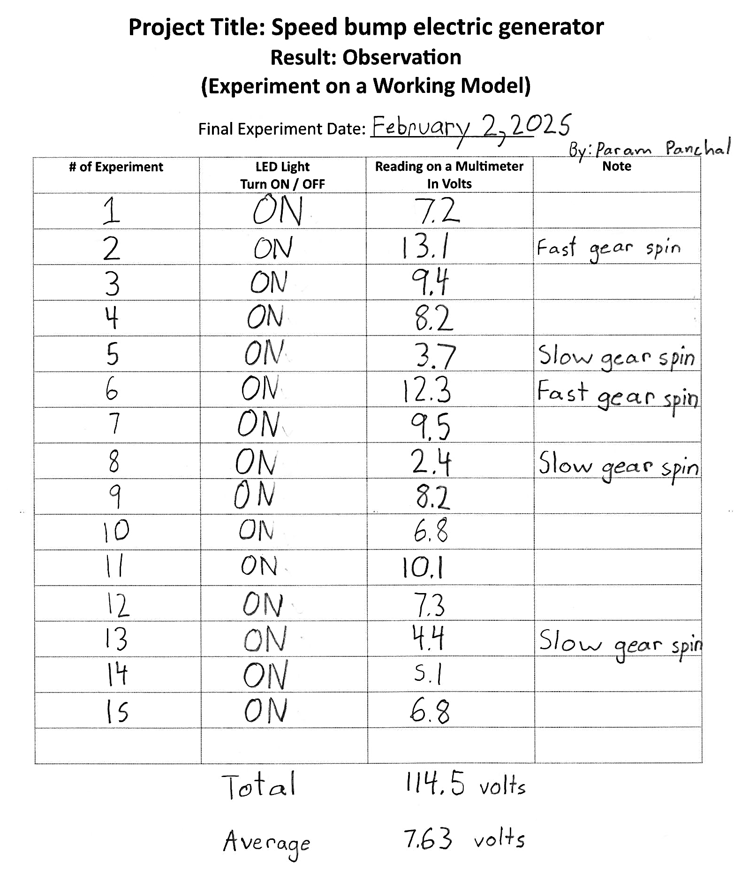
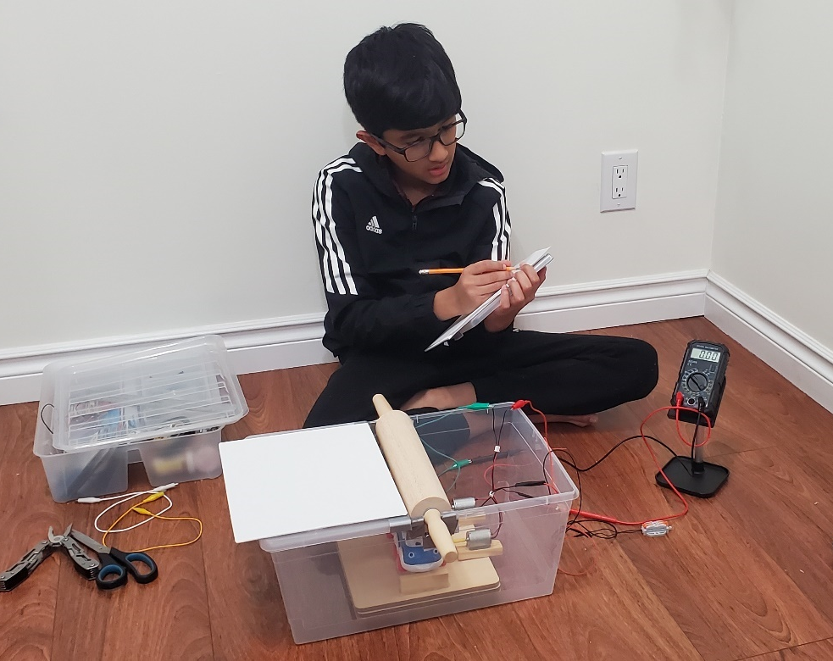
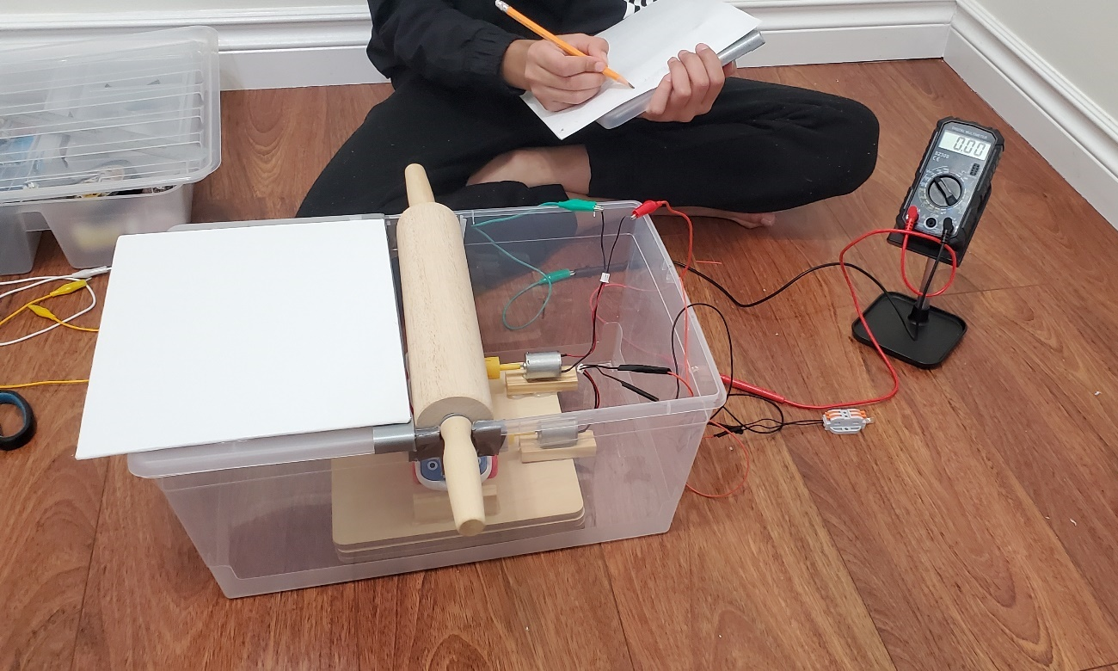
Results 1 ..(Cont.)
‘Speed bump electric generator’ by Param Panchal (Feb 2025)

Slide 17
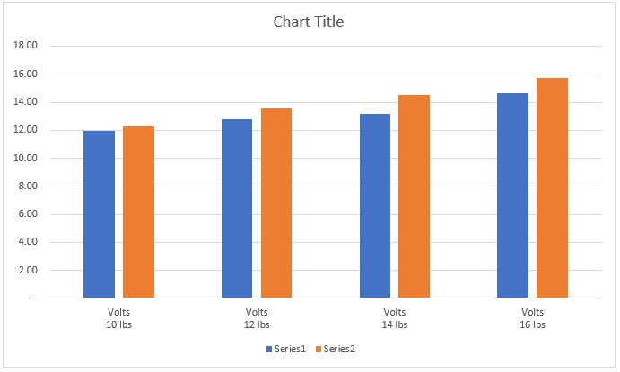
Results 2 ..(Cont.)
‘Speed bump electric generator’ by Param Panchal (Feb 2025)

Slide 18
Conclusion
My hypothesis is true:
We can generate electricity (Dependent Variables) by modifying the movable speed bump (Independent Variables) by installing gears and wind turbine motors (Independent Variables) under the Speed Bump.
My experiment answers the missing piece of my background research:
We can use kinetic energy (motion of vehicle) and convert it into electrical energy.
In other words, we can recover a moving vehicle’s energy (kinetic energy) and convert it into electrical energy.
Importance of energy to the world:
We found another way to generate energy (electricity) in addition of Wind energy, Solar energy, Hydraulic energy, Geothermal energy, and Tidal energy.
‘Speed bump electric generator’ by Param Panchal (Feb 2025)

Slide 19
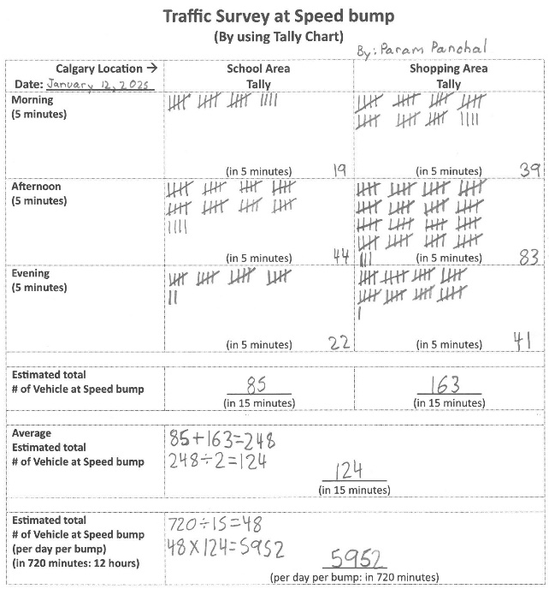
Next Steps
In Calgary: (Based on Traffic Survey at a Speed bump)
About 124 Vehicles passes over one Speed Bump in 15 minutes
About 5,952 Vehicles pass over one Speed Bump per day (in 720 minutes: 7 am to 7 pm).
‘Speed bump electric generator’ by Param Panchal (Feb 2025)

Slide 20
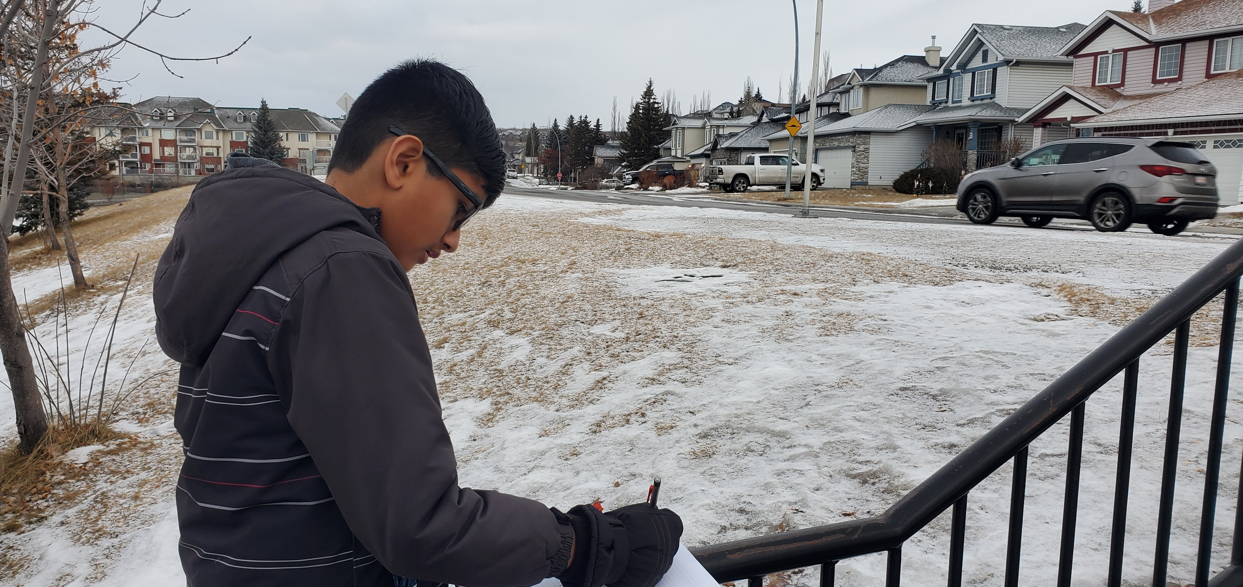
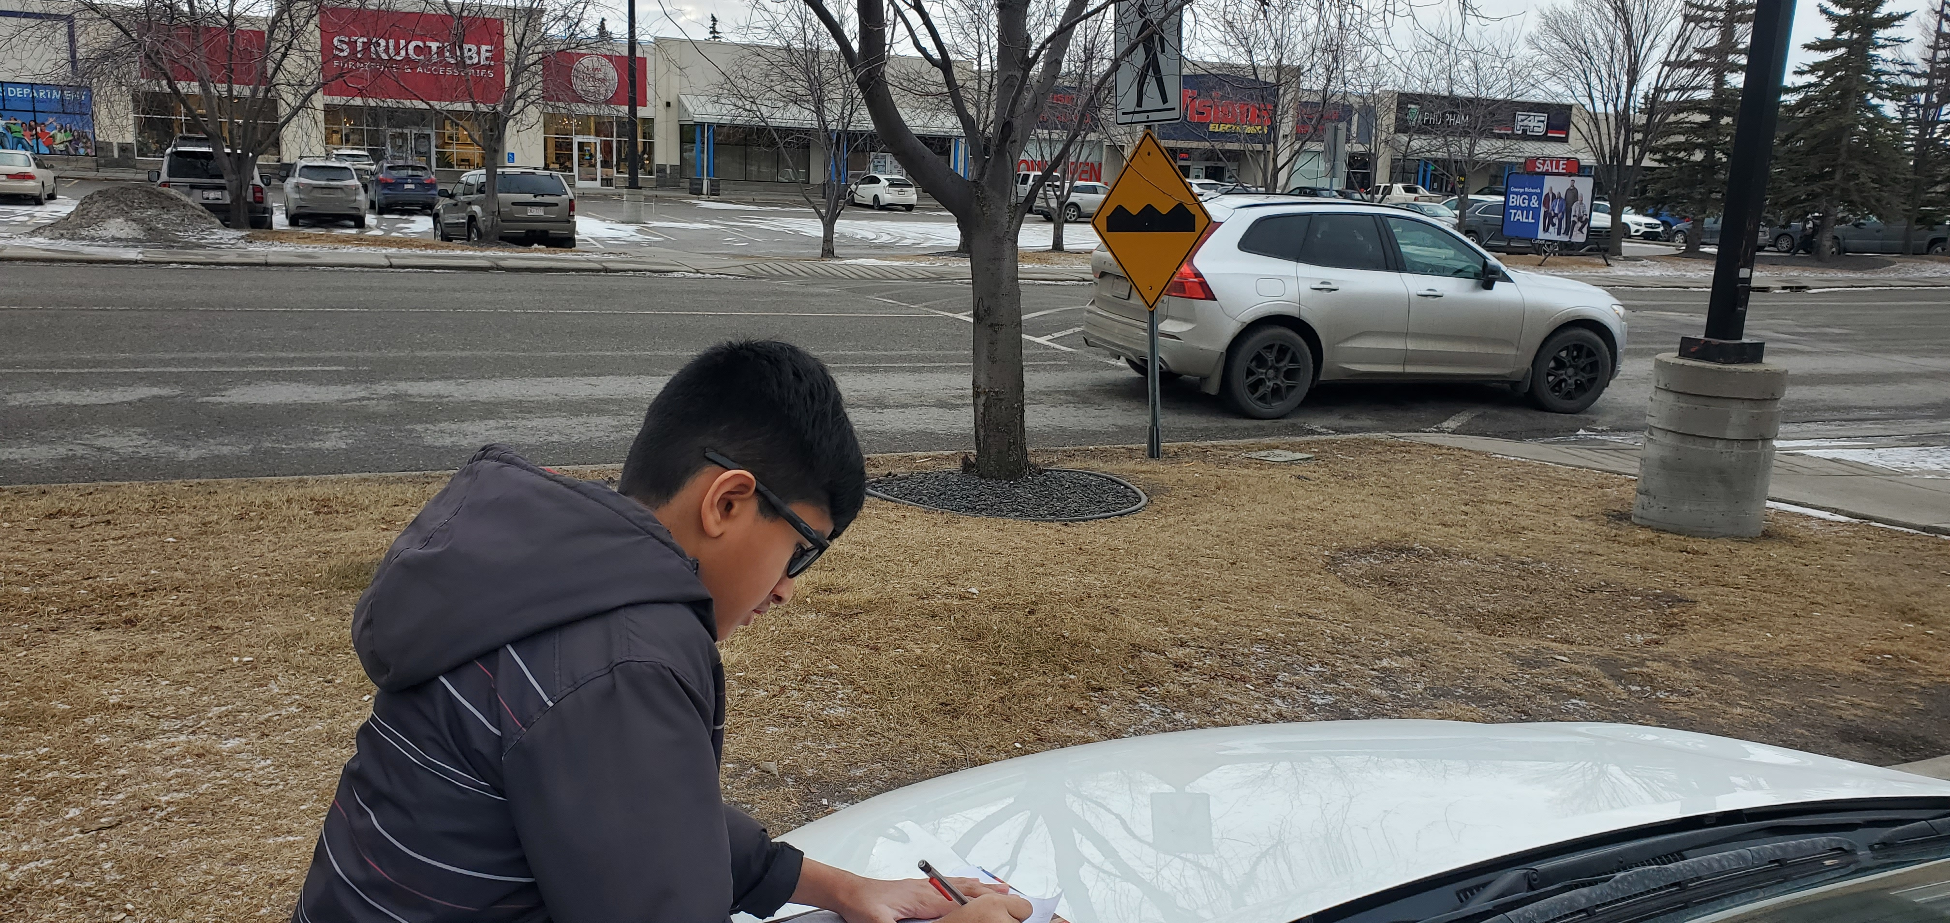
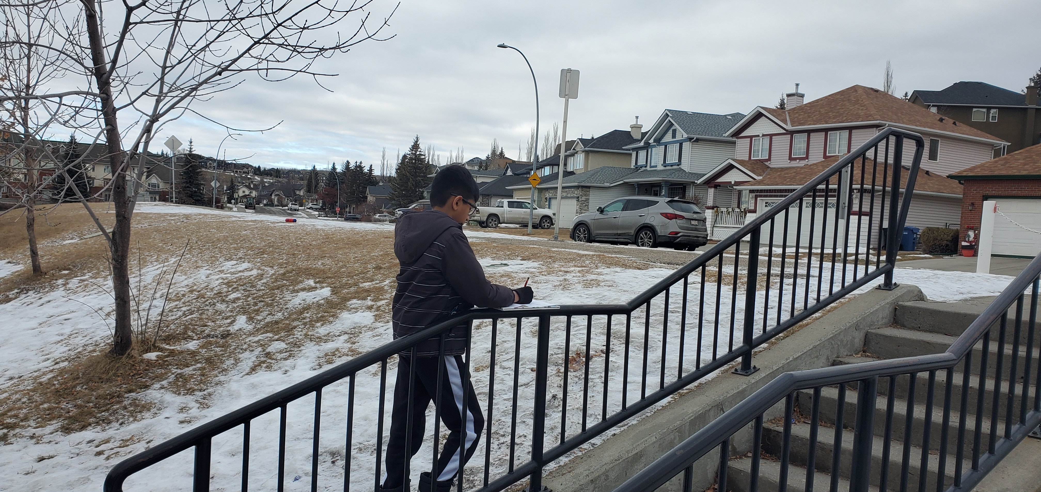
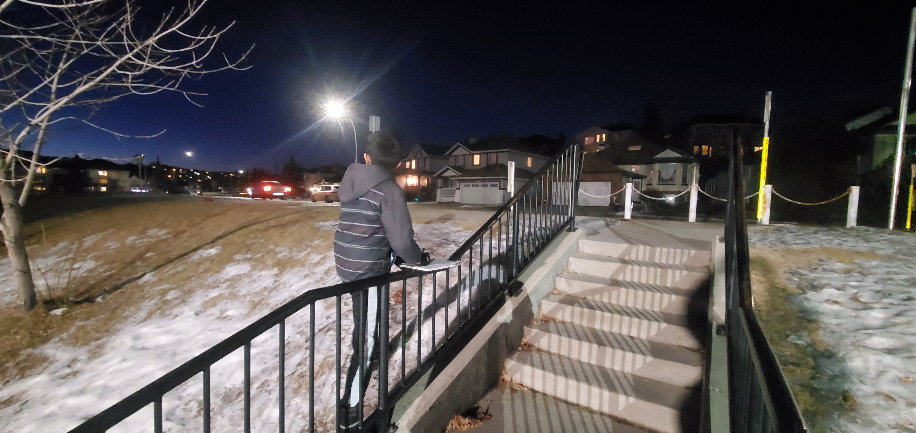
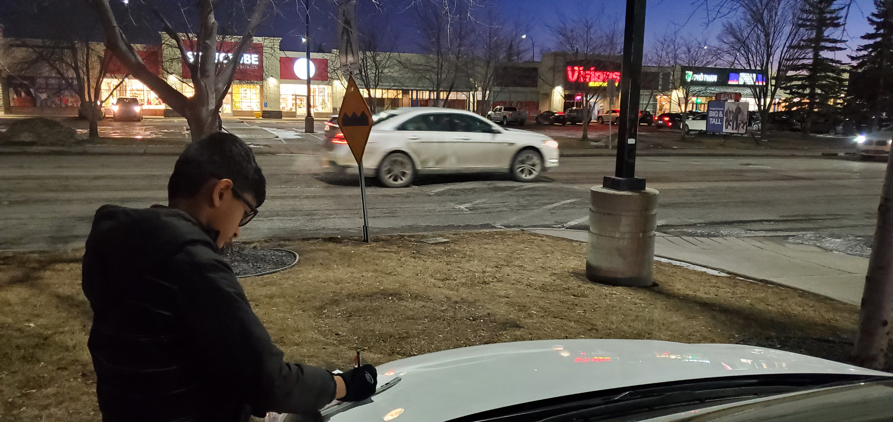
Next Steps ..(Cont.)
‘Speed bump electric generator’ by Param Panchal (Feb 2025)

Slide 21
Next Steps ..(Cont.)
In Calgary: Total 206 communities (as per City of Calgary)
About 8 Speed Bumps in one Community on a busy/main road (Counted in one Community)
About 1,400 Speed Bumps in Calgary
In Calgary: (approximation)
About 8.3 million Vehicles pass over the speed Bumps per day (5,952 x 1,400 = 8.3 Million)
(1,061,681 Vehicles registered for Calgary as of March 31, 2024: as per Alberta Govt.)
(https://open.alberta.ca/dataset/number-of-motorized-vehicles-registered-in-alberta-as-of-march-31-years)
The Speed bump generator may rotate 8.3 million per day, and generate electricity for the City of Calgary.
The city can use the electricity for street lights or transmit it for household use.
I would like to request the city of Calgary to consider my project and check with the expert engineers for the practicability of my project.
The city of Calgary can be the first city to generate electricity with a ‘Speed bump electric generator.’
‘Speed bump electric generator’ by Param Panchal (Feb 2025)

Slide 22
Sources: Citations
Websites: For Project Research
Renewable Energy
https://www.alliantenergykids.com/renewableenergy/renewableenergyhome
https://www.alliantenergykids.com/renewableenergy/windenergy
https://www.alliantenergykids.com/renewableenergy/solarenergy
https://www.alliantenergykids.com/renewableenergy/hydroenergy
https://www.alliantenergykids.com/renewableenergy/biomassenergy
Renewable Energy in Canada
https://natural-resources.canada.ca/our-natural-resources/energy-sources-distribution/renewable-energy/about-renewable-energy-canada/7295
https://www.canadaaction.ca/canadian-renewable-energy-facts
Canadian Centre for Energy Information
Energy Fact Book, 2024-2025
https://energy-information.canada.ca/en/energy-facts
‘Speed bump electric generator’ by Param Panchal (Feb 2025)

Slide 23
Sources: Citations ..(Cont.)
Calgary’s community information
https://newsroom.calgary.ca/the-city-of-calgary-releases-community-and-ward-profiles/
Rack and Pinion gear information
https://www.developingexperts.com/glossary/rack-and-pinion?info=secondary#:~:text=The%20rack%20is%20a%20straight,of%20rotation%20of%20the%20pinion.
https://kids.kiddle.co/Gear
https://academickids.com/encyclopedia/index.php/Rack_and_pinion
Websites: For Image (including gif file) for ppt slides
https://www.freepik.com/
https://pngtree.com/free-backgrounds-photos/saving-energy
https://www.reliance-foundry.com/blog/speed-humps-vs-speed-bumps
https://grabcad.com/library/animated-round-rack-and-pinion-gear-1
https://cad.grabcad.com/library/dc-motor--11
‘Speed bump electric generator’ by Param Panchal (Feb 2025)

Slide 24
Sources: Citations ..(Cont.)
Websites: For Image (including gif file) for ppt slides
https://shop.pimoroni.com/products/5mm-rainbow-led-pack-of-10?variant=2833384833034
https://tenor.com/view/bounce-bumpy-ride-bouncy-ride-gif-3550911
https://giphy.com/gifs/desktoppaints-jump-spring-xT0xeGxcmzPAdn9mzC
https://www.amazon.ca/
Grade 5: Study material on Energy
Renewable vs Non-Renewable Energy
Solar Energy, Wind Energy, Hydro Energy, Biomass and Tidal Energy, Geothermal Energy
Nuclear Energy
Alberta’s Energy Usage
Conserving Energy, Energy Efficiency
‘Speed bump electric generator’ by Param Panchal (Feb 2025)

Slide 25
Sources: Citations ..(Cont.)
Books from Calgary Public Library: For Project Research
Brick Science
STEM Tips and Tricks for Experimenting With your LEGO Bricks
by Fisher, Jacquie
Book - 2021
The Lego Ideas Book
Unlock your Imagination
by Lipkowitz, Daniel
Book – 2011
Tech Lab
Brilliant Builds for Super Makers
by Challoner, Jack
Book - 2019 | First American edition
‘Speed bump electric generator’ by Param Panchal (Feb 2025)

Slide 26
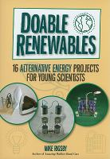
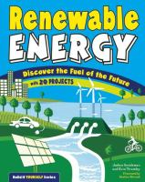
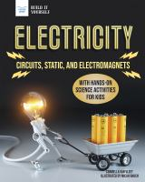
Sources: Citations ..(Cont.)
Books from Calgary Public Library: For Project Research
Doable Renewables
16 Alternative Energy Projects for Young Scientists
by Rigsby, Mike
Book - 2010
Wind Energy
by Grady, Colin
Book – 2017
Renewable Energy
Discover the Fuel of the Future : With 20 Projects
by Sneideman, Joshua
Book - 2016
Electricity
Circuits, Static, and Electromagnets With Hands-on Science Activities for Kids
by Van Vleet, Carmella
Book - 2022
‘Speed bump electric generator’ by Param Panchal (Feb 2025)

Slide 27
Thank you
‘Speed bump electric generator’ by Param Panchal (Feb 2025)

