Slide 1
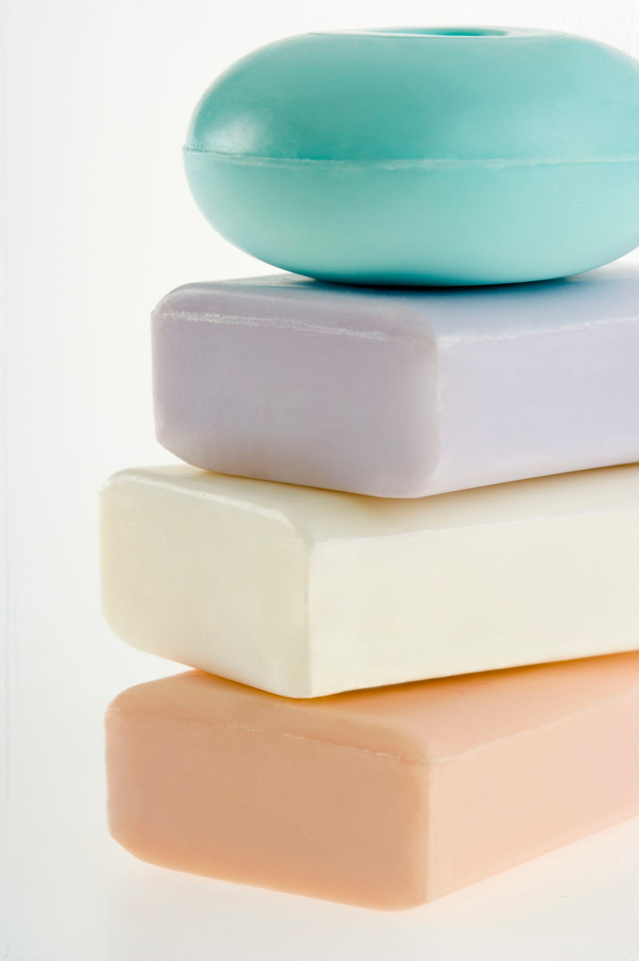
Which soap cleans the best?
By : Abdullah Ammar & Eiyas Ghazali - 5B

Slide 2
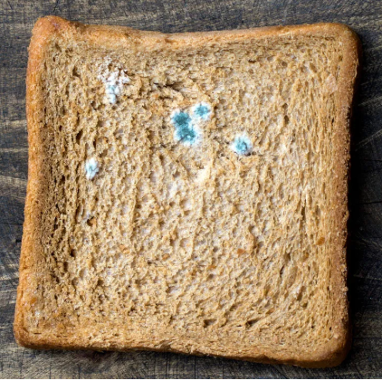
Background Research
Mold: Mold is a type of fungus and usually grows as tiny threads called hyphae. These threads form a fuzzy patch that you might see on old food or damp surfaces. Molds are usually made out of cells.
Molds are a big group of fungi. When their hyphae grows, they can make things look discolored and fuzzy. This network of branching threads is called a mycelium.Each mycelium is like a single living thing.
Mold grows from tiny seeds called spores. They are so tiny that they float all around us. When spores land on a damp surface with food, then they can start to grow.

Slide 3
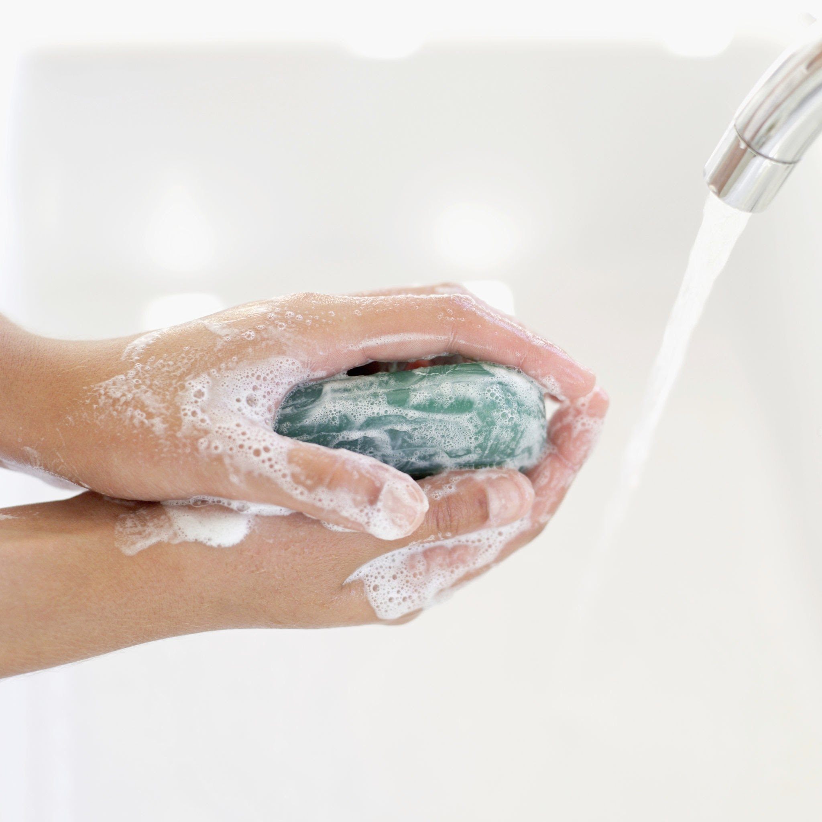
Background Research
Soap: Soap is a cleaning product that helps us get rid of dirt, oil, and germs. It comes in many forms, like solid bars, liquid, or even foam.
How soap works : Each soap molecule has two ends:
One end LOVES water
One end LOVES oil and dirt
When we wash hands the oil-loving end sticks to the dirt, oil, and germs on your hands. The water-loving end sticks to the water.
When you rub your hands together, the soap surrounds the germs and dirt and forms little bubbles called micelles.
Now the dirt, oil, and germs are trapped inside these bubbles.
When you rinse with water, the bubbles get washed away — taking the dirt and germs with them!

Slide 4
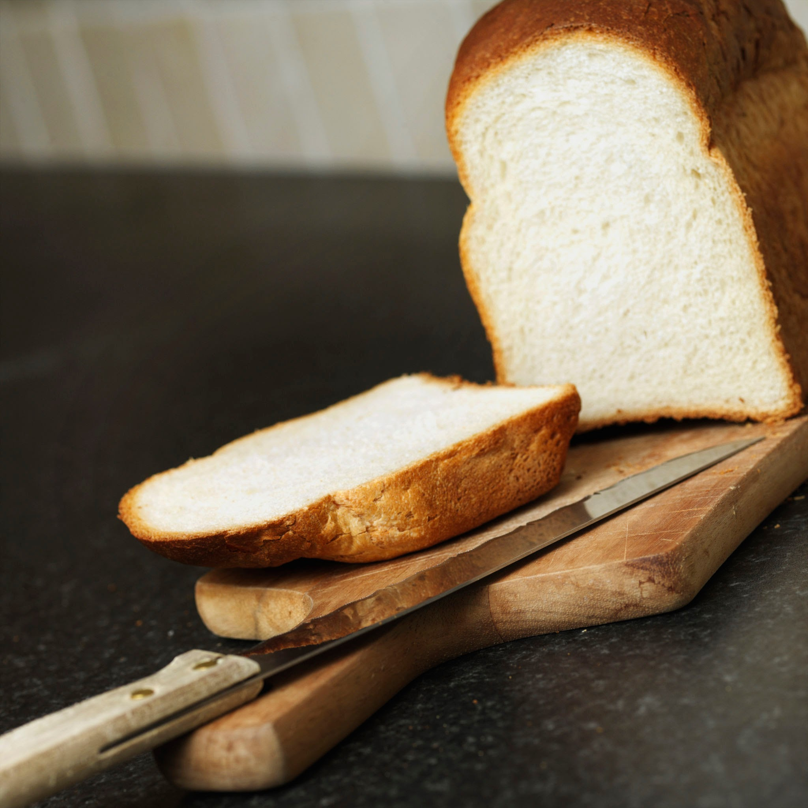
Background Research
Bread: Bread is a common food which is usually baked. It is basically made out of dough, which is a mix of flour and water. Most bread also has salt and yeast. It is usually cooked in a oven.
There are many kinds of bread. You can toast bread or you can use it in a sandwich. You can also use it to make yummy pizza. There are two main types of bread, leavened bread and unleavened bread.

Slide 5

Hypothesis
More bacteria means more mold.
A soap or any other washing mechanism removes bacteria and dirt from our hands. Some will do a better job than others.
We expect the following results:
Bread which is touched with dirty hands not washed will have the most mold
Bread which was not touched at all will have the least mold
The other samples will fall between these two
We expect the “Water only (wash hands with water)” sample to have more mold than the other samples
From the soap samples (antibacterial, dishwashing, and regular), we expect the antibacterial soap to have the least mold and the dishwashing soap to have the most mold

Slide 6
Materials
7 slices of bread (to test for mold)
A sink (to wash your hands)
An antibacterial soap (for washing)
A regular soap (for washing)
A hand sanitizer (for cleaning)
A dishwashing soap (for washing)
Grass outside (to get bacteria)
A Tong (to avoid unwanted touch)
7 ziplocks (to store bread pieces)
A warm, moist, and dark place (for mold to grow)
A marker (to label samples)

Slide 7
Procedure
Touch hands on the grass outside to collect bacteria
Touch hands on a bread. Use tongs to hand the bread.
Put the bread in a ziplock and seal it
Label the ziplock “dirty hands”
Do step 1 and wash your hands with water only
Do step 2 and 3, also label the ziplock “Water only”
Do step 1 and wash your hands with a regular soap
Do step 2 and 3, also label the ziplock “Regular soap”
Do step 1 and wash your hands with an antibacterial soap
Do step 2 and 3, also label the ziplock “Antibacterial soap”

Slide 8
Procedure
Do step 1 and wash your hands with a dishwashing soap
Do step 2 and 3, also label the ziplock “Dishwashing soap”
Do step 1 and clean hands with a hand sanitizer
Do step 2 and 3, also label the ziplock “Hand sanitizer”
Pick up a bread with a tong.
Do step 3 and label the ziplock “Control slice”
Put all 7 samples in a dark, moist, and warm place
Observe the change and look for mold growth in the samples daily.

Slide 9
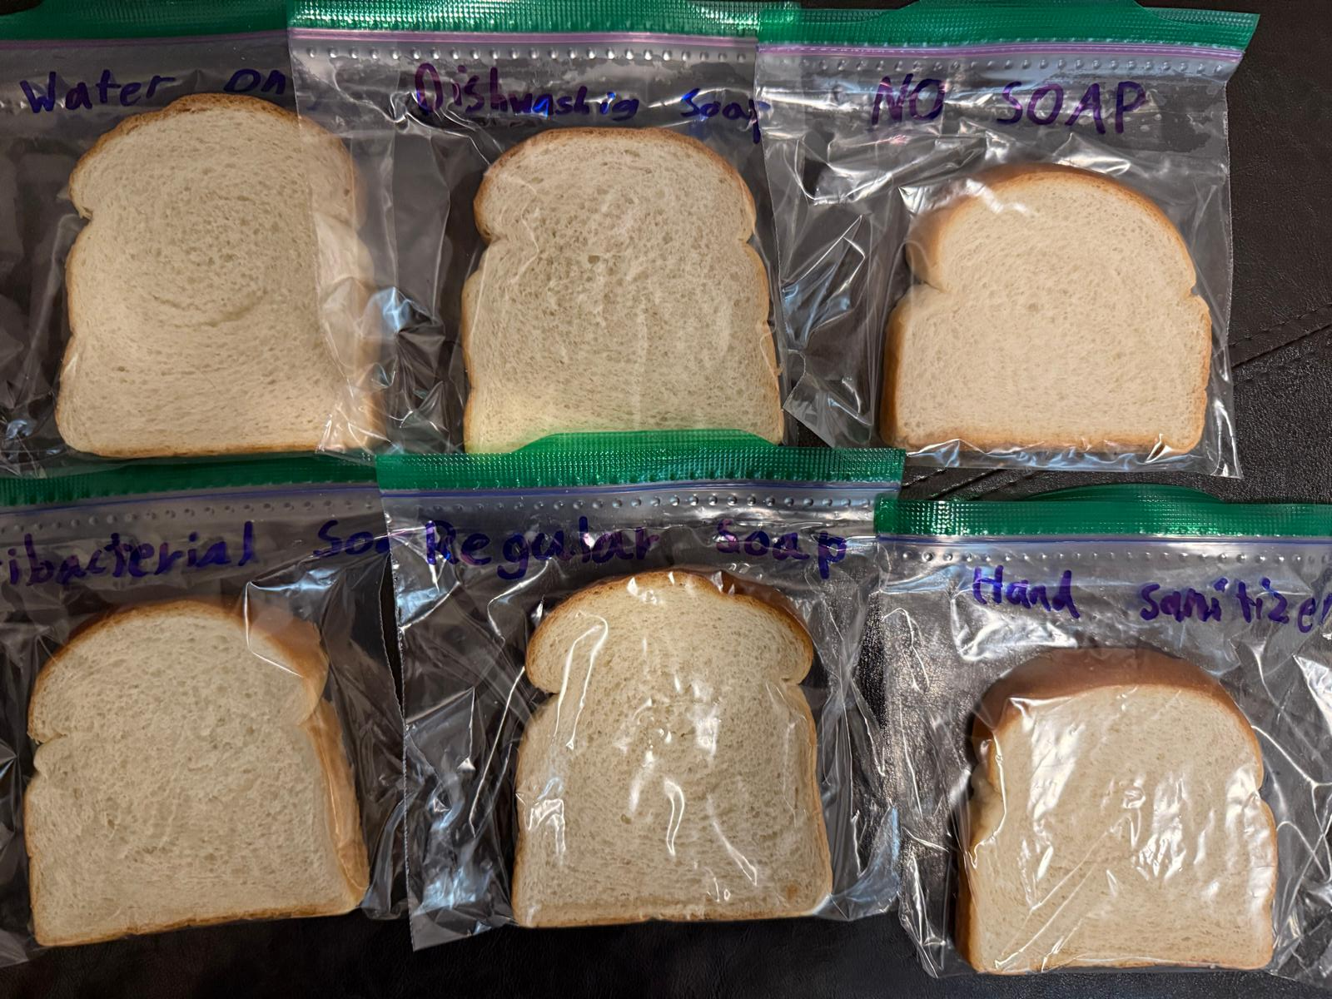
Observation
No change/ Mold was observed in any of the samples over the 3 weeks period.
The bread was checked daily

Slide 10
Analyze Data
Why No Mold was observed ?
We used the bread bought from the big chain store. This bread has preservatives (Calcium Propionate) which prevents mold growth.
The outdoor bacteria do not survive well indoors and we need to find bacteria inside the house for our test.
To help mold growth we did the following steps after 1 week
We added extra moisture by spraying an equal amount of water to all bread loafs
We put the samples in a warmer location with a humidifier to increase the amount of moisture and heat. We know mold grows faster in moist and warm places.
No improvement was seen after the above steps

Slide 11
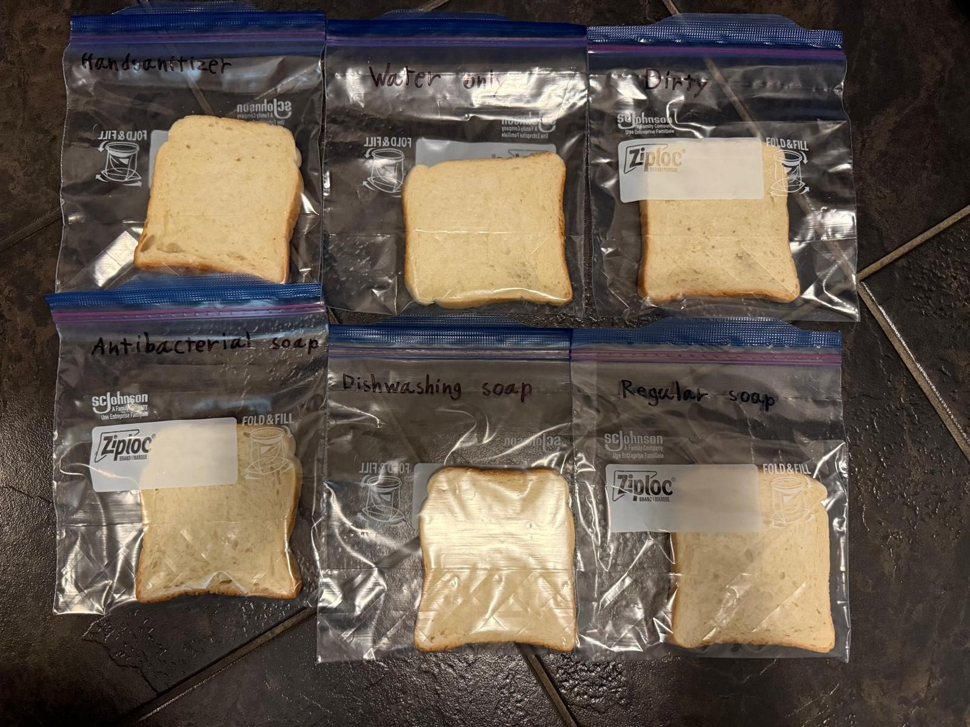
Analyze Data - Experiment redo
We repeated the experiment with the following:
Bought fresh bread from a bakery (without preservatives)
Used indoor places where mold spores may already exist for the test
Under the kitchen sink
Under kitchen cabinets
Door knobs, light switches etc.
Places which typically do not get a wipe/cleaning.

Slide 12
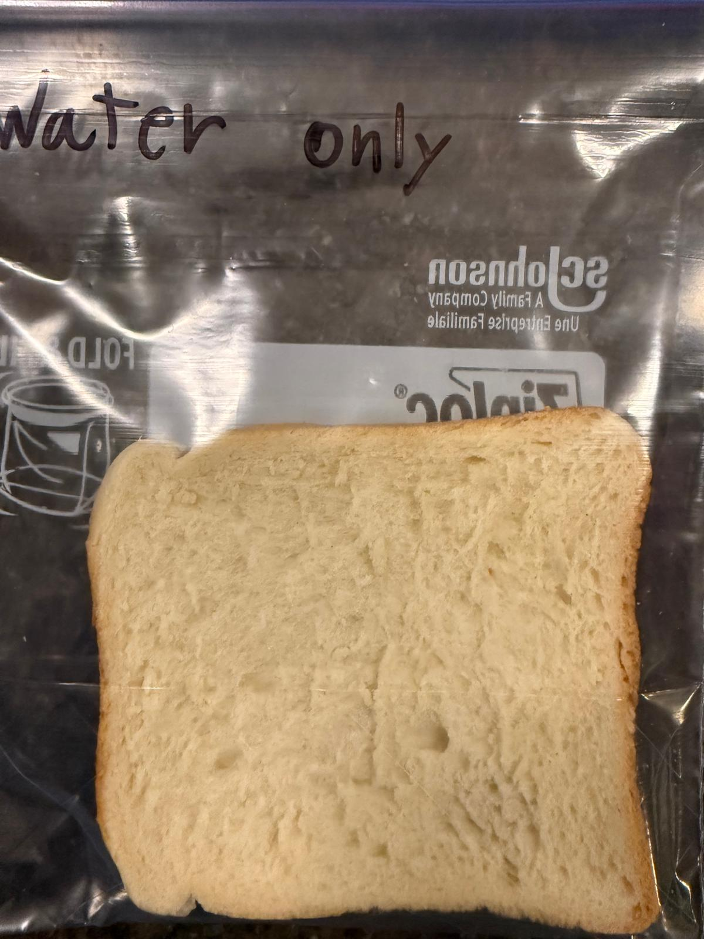
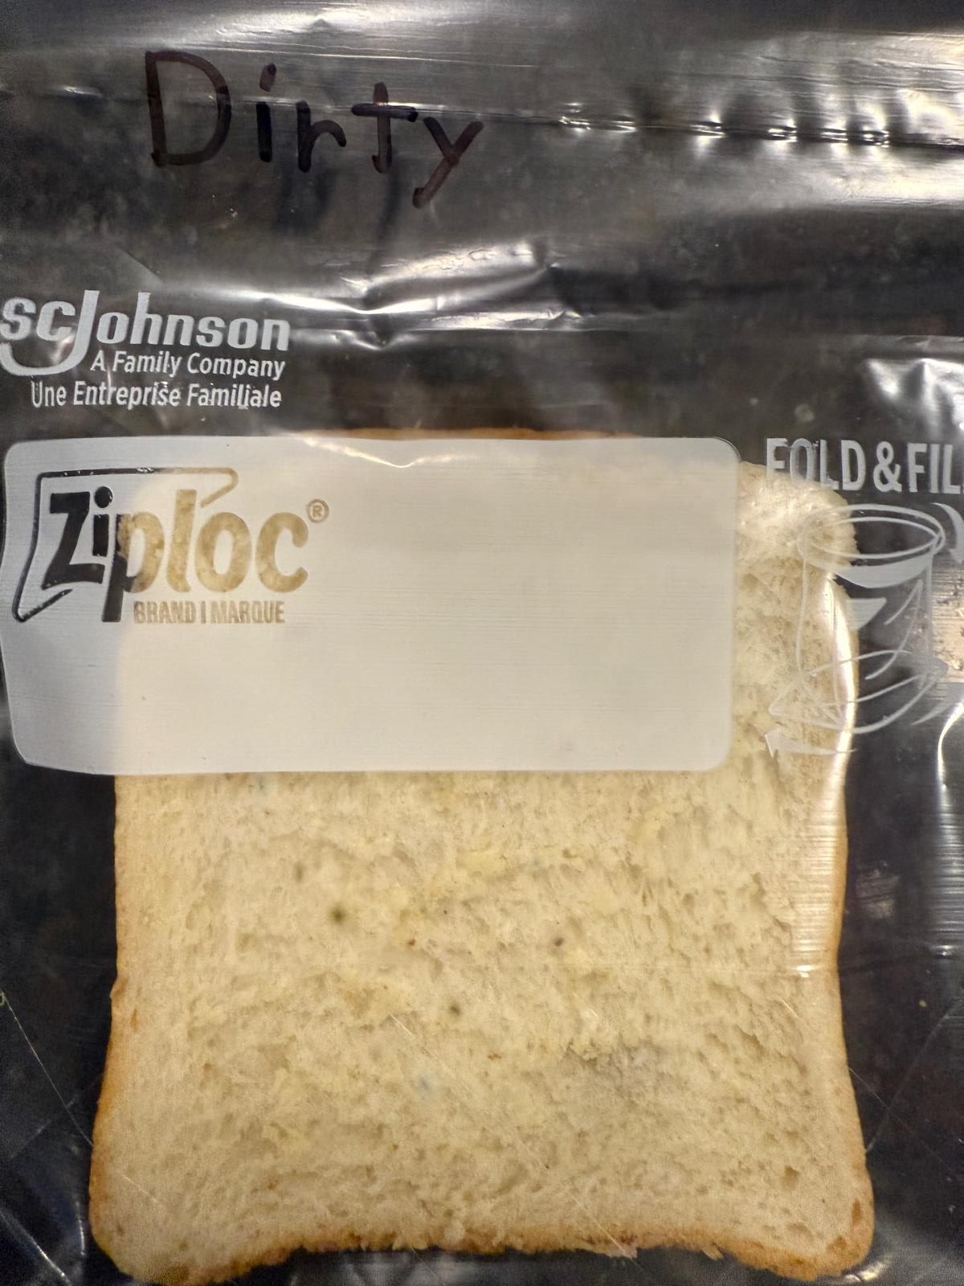
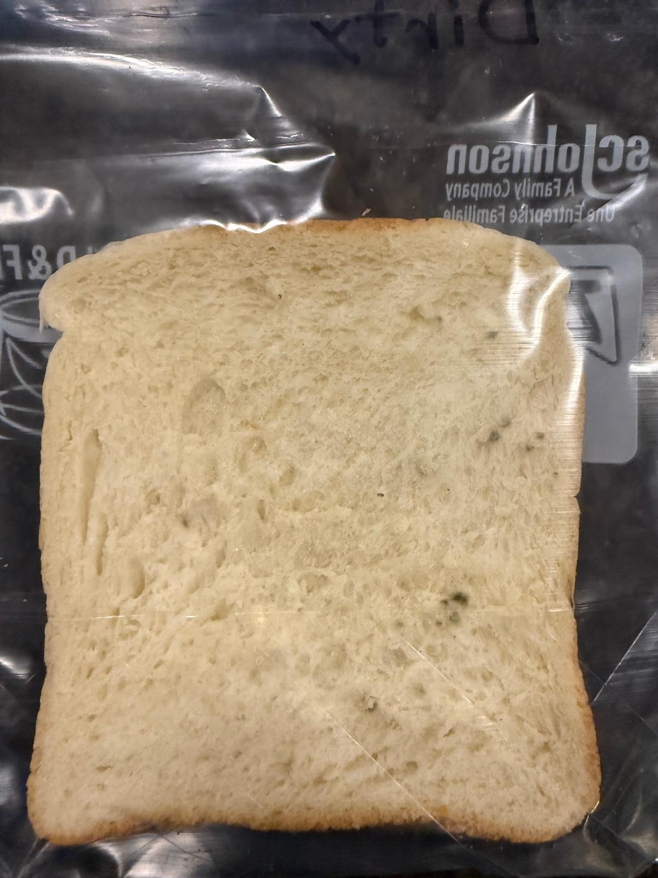
Observation
We are in day 7 of the revised experiment and starting to see mold on “dirty hands” sample and “water only” sample
No change on other samples yet.

Slide 13
Analyze Data - Experiment redo
2 worst samples (“water only” and “Dirty hands” have already started to catch mold
Dirty hands sample has the most mold.
We expect the remaining samples to catch mold in 1 week.

Slide 14
Results
The revised experiment is successful
All soaps remove germs and washing with soap removes more germs compared to not washing hands or washing with water only.
We learnt the following through research and experiment
Store breads / food have preservatives to increase the shelf life of products and to reduce mold growth
Outdoor bacteria is different from the indoor bacteria
Mold does not grow easily in winter conditions.

Slide 15
Conclusion
The results prove the hypothesis
The experiment is important to know how much bacteria is removed by using a good soap and washing hands properly.
If we wait longer, we would see the mold on all samples

