Slide 1
Why is some smoke black while others grey or white
______________________________________
By Kadilo Cally-Ntete and Jessica Rajapandian
Grade 6

Slide 2
Our hypothesis
When things get burned differently, it would affect the colour of smoke.

Slide 3
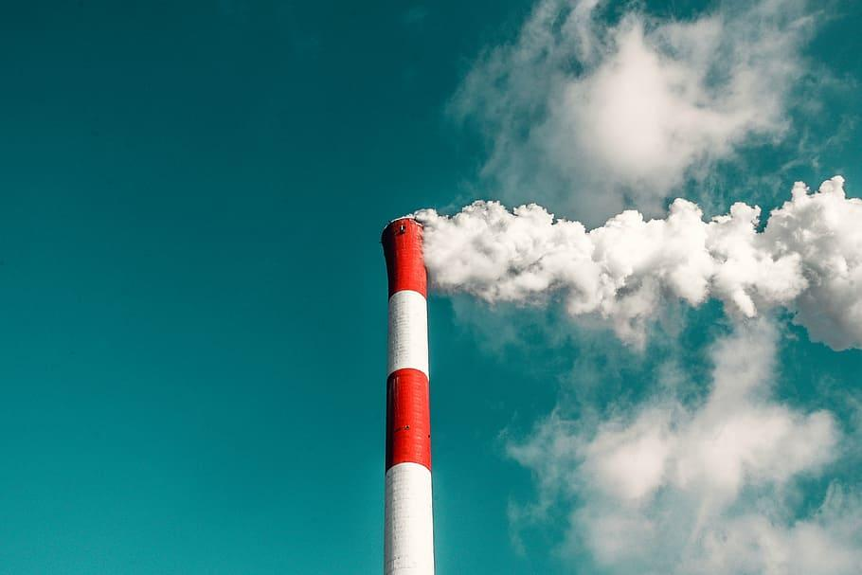
What is smoke?
Smoke is the visible vapor and gases given off by a burning substance, especially the gray, brown, or blackish mixture of gases and suspended carbon particles resulting from the combustion of wood, peat, coal, or other organic matter.

Slide 4
Black smoke
Black smoke can be a sign that a man made material is burning tires, vehicles or a structure. It could also mean that some heavy fuels are not consumed fully. The darker the smoke, the more fierce the fire is.

Slide 5
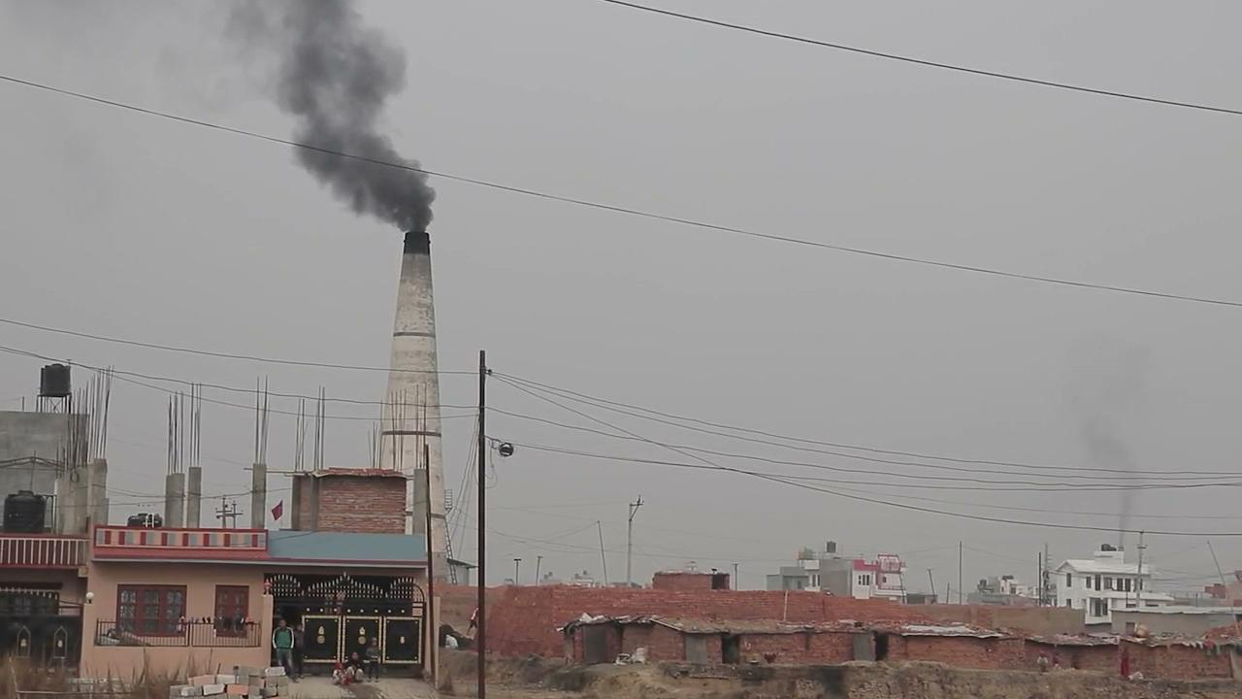

Slide 6
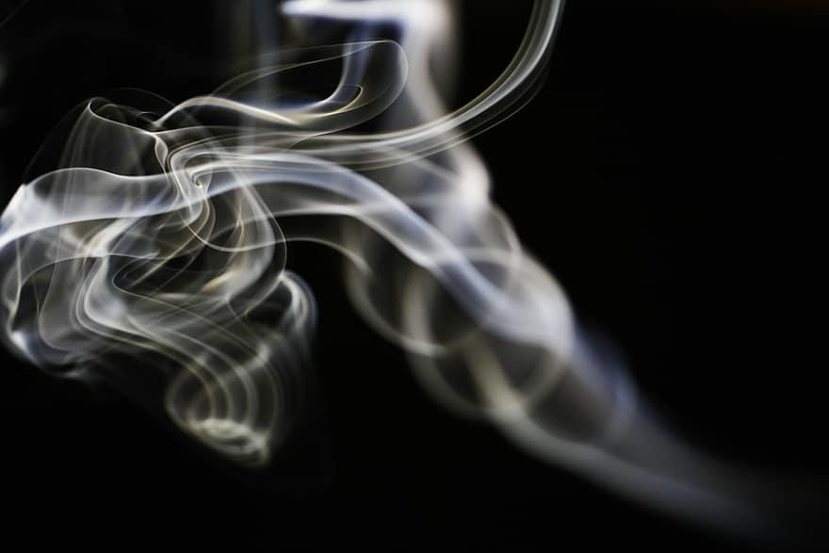
Grey smoke
Grey smoke is when the fire starts settling down and has little left to burn.

Slide 7
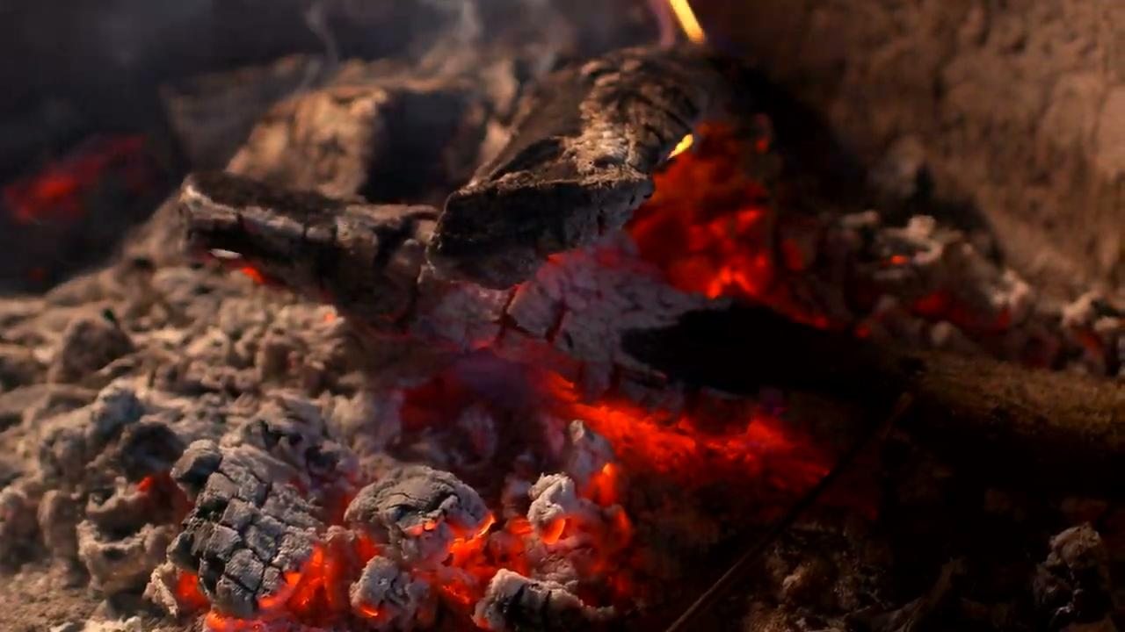

Slide 8
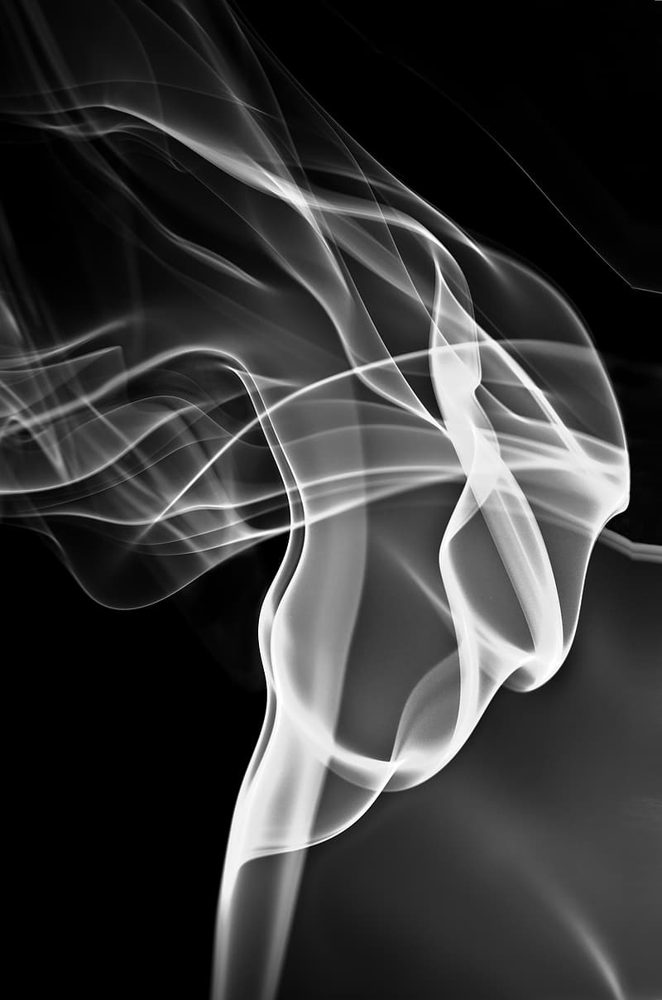
White smoke
White smoke usually happens at the start of a fire. It could also mean light fuels such as grass and twigs are being burned.

Slide 9
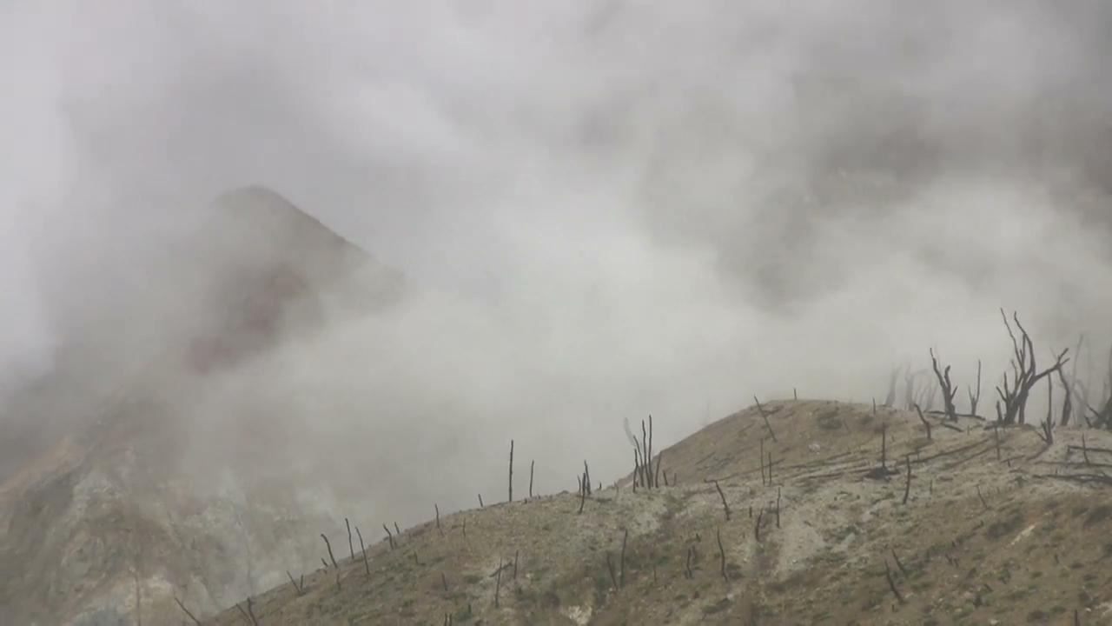

Slide 10
Conclusion
There are several factors that affect the color of the smoke. When things get burnt differently, their color is affected. It depends on the raw materials being burnt, fuel and also the stage of the fire.
Hence our hypothesis is right.

Slide 11
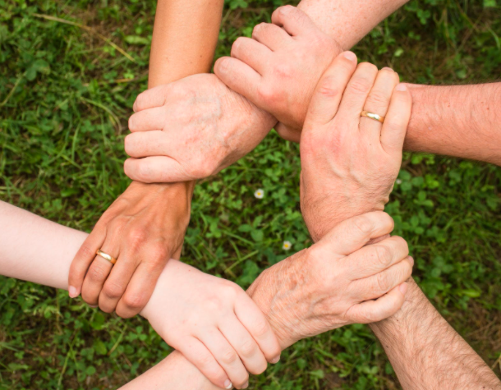
How can this help society?
This could help society by finding out what caused a fire to happen and for how long it has lasted for. It also helps in various investigations This can also

