Slide 1

Heart in Motion: How to Exercise Efficiently and Recover Properly
Made by:
Samraj Bhattacharya

Slide 2
Introduction
I am Samraj Bhattacharya, a student at Glamorgan School. I have direct experience playing sports, and I also care about maintaining fitness.
I wanted to learn how fast the heart slows down after exercise. So, I did a study to see how heart rate changes during and after exercise. I also looked at how this is different for people of different ages, genders, and fitness levels.
This study can help give simple ideas on how to plan breaks during exercise. When we understand our limits, we can work within them and stay motivated.

Slide 3
About the heart, and why does it beat
Our body uses oxygen to oxidize nutrients such as glucose, producing ATP that powers muscle contraction, neural activity, and organ function. To deliver oxygen and metabolic substrates efficiently, the cardiovascular system maintains a continuous, regulated flow of blood. The heart is a muscular pump with four chambers two atria and two ventricles that work in a precisely coordinated sequence.
The heart is a muscular pump with four chambers two atria and two ventricles that work in a precisely coordinated sequence. : two upper ones called atria and two lower ones called ventricles. It pumps blood throughout the body to deliver oxygen and nutrients while removing wastes like carbon dioxide. Deoxygenated blood enters the right atrium, moves into the right ventricle, and is sent to the lungs to pick up oxygen. The Oxygenated blood returns to the left atrium, flows into the left ventricle, and is pumped out to the rest of the body. The heartbeat is controlled by electrical signals from the SA node, which pass through the AV node and the His-Purkinje system, making the ventricles contract together. The AV node delays the signal slightly to allow the atria to finish contracting before the ventricles contract. This coordination ensures blood flows efficiently through the heart and to the body. The Purkinje fibers rapidly carry electrical signals through the ventricles, making the muscle cells contract almost simultaneously. By distributing the signal quickly from the inner walls to the outer walls, they ensure the ventricles squeeze from the bottom up, efficiently pushing blood out of the heart.
The heart beats faster or slower depending on how much oxygen the body needs. When we exercise, breathing gets faster and the heart pumps quicker to deliver more oxygen. When we rest, breathing and heart rate slow down because the body needs less oxygen. The more active we are, the more oxygen we need, and the faster the heart beats.
In short:
The heart pumps blood to deliver oxygen needed for normal body functions.
Oxygen needs change based on activity level.
Different people need different amounts of oxygen depending on age, sex, and fitness level.

Slide 4
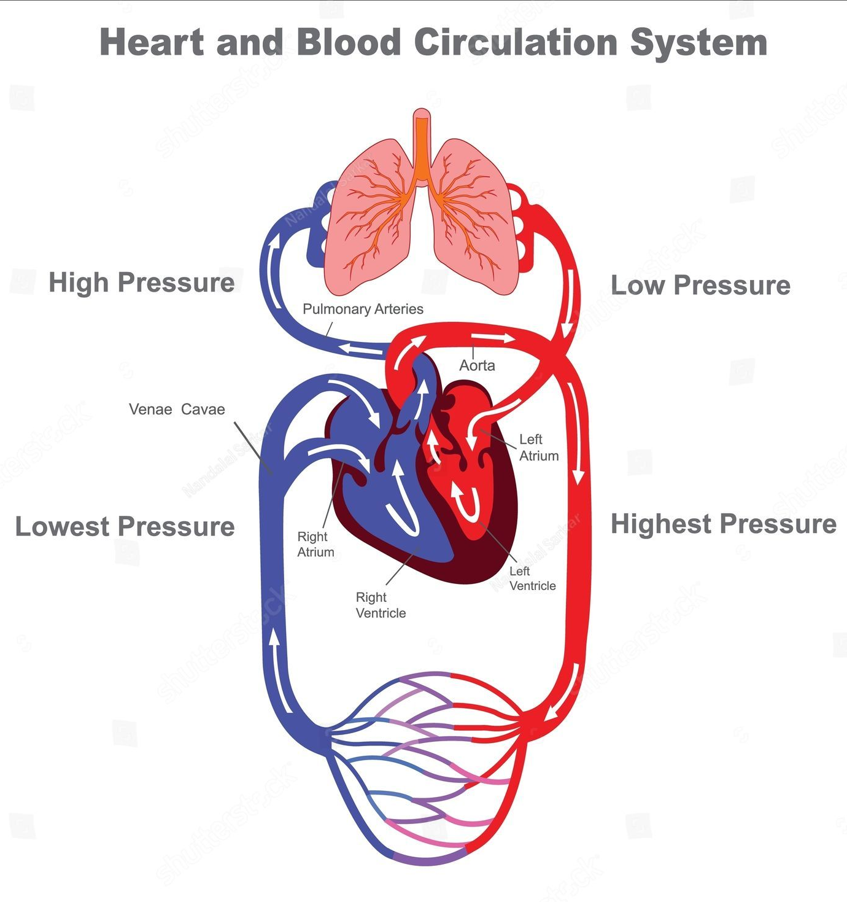
Diagram of the heart and circulatory system

Slide 5
About my study
Independent Variable: The type and intensity of exercise the volunteers do.
Dependent Variable: How long it takes for their heart rate to return to resting levels and the rate at which it drops after exercise.
Controlled Variables: The rest time before measuring heart rate, the equipment used to measure it, the exercise method, How we prepare (like environment, no caffeine etc.)
Equipment & Subjects:
Heart rate monitor or smart watch
Stopwatch or timer
Exercise equipment (e.g., treadmill or stationary bike)
Volunteers from different age group and gender with various fitness levels
Method:
Pre-Exercise Measurement: Measure and record the resting heart rate (HR) of each volunteer after they have been at rest for at least 30 minutes.
Exercise: Have each volunteer perform a 10-minute exercise at moderate intensity (e.g. Running on a treadmill at 5 MPH speed). Record the peak heart rate immediately after the exercise.
Post-Exercise Recovery: After exercise, monitor the volunteer’s heart rate every 3 minutes until it returns to the resting heart rate.
Data Collection: For each volunteer, record: Resting HR, Exercise HR, Recovery time
Recovery Time: Time taken for HR to return to resting levels.
Heart Rate recovery (Drop rate) = (Peak HR – Resting HR) / (Recovery time)
Analysis: Analyze how different volunteers recover (i.e., faster or slower recovery times).
Discuss the relationship between exercise intensity and recovery rate.

Slide 6
Hypothesis
I think people with lower fitness levels will take longer to recover because their bodies are not as used to exercise and may need more oxygen.
I think younger people will recover faster because their bodies are smaller and need less blood and oxygen.
Males might recover faster because they may be more hydrated, but they might also need more oxygen during exercise since they usually have more muscle mass.
I compared many different and similar pairs of people on the factors and all the variables, I also did some background research to support my ideas.

Slide 7
Data Analysis
I made this chart of many average rates of all the subjects, Each subject did this a few times
Observations
Fit people, who lead an active & healthy lifestyle have higher Heart Rate Recovery (HRR). This means their heart rate comes back to normal faster after exercising.
Unfit people, who are overweight and/or lead a less active lifestyle, have lo HRR. This means their heart rate takes longer to come back to normal after exercising.
Younger people tend to have higher HRR, though kids can sometimes show inconsistent HRR.
Females have slightly higher HRR as compared to males.
Fitness level was determined with endurance observations, weight and age.

Slide 8
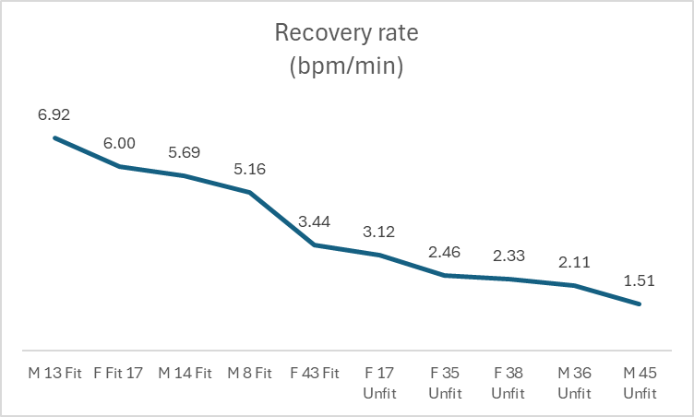
Some charts I made based of the data for more insight
Since my sample size wasn’t too big, I used controlled comparisons to eliminate differences in people and focused on manipulating one variable at a time.

Slide 9
Corelating my study with factual data (Results)
My hypothesis was mostly accurate. The data confirmed that fitter individuals recovered faster, younger participants generally had quicker recovery, but I was wrong about males recovering faster than females.
Fitness level strongly affects heart rate recovery. Fit individuals’ hearts return to resting rates much faster than unfit people, even older adults can recover quicker than younger, less fit individuals.
Gender also plays a role in recovery speed. Females tend to recover slightly faster than males, though young, fit males can still achieve very quick recovery despite needing more oxygen during exercise.
Very young children recover efficiently because their hearts and lungs respond quickly, though their naturally higher heart rates can make recovery take slightly longer in minutes. Older adults recover more slowly as heart and lung efficiency declines with age, so it takes longer for the body to return to baseline after exercise.
** Reference: 411 heart guide, by Marc Gillinov

Slide 10
What caused these results
According to developmental statistics (and trends found in my data):
Fitness Level: Individuals with higher fitness levels tend to perform better in physical exercise and recover more quickly than those with lower fitness. This is because fitter people have stronger cardiovascular systems, more efficient oxygen transport, and greater muscular endurance, which reduces physiological strain and allows the body to return to resting conditions faster. Fitness reflects exercise capacity and systemic conditioning, not body fat, since muscles break down and strengthen with training.
Sex: Males generally perform slightly better in strength-based activities and recover more slowly than females on average (Females recover faster), due to higher muscle mass, greater hemoglobin levels, and testosterone. However, females often exhibit strong endurance and recovery. My trends and these same statistics also say you can be a strong athlete regardless of gender
Age: Age also significantly affects performance. Young adults (20–30) typically achieve peak exercise capacity with fully matured cardiovascular and respiratory systems. Adolescents often recover the fastest due to lower metabolic demand and rapid autonomic regulation, despite still-developing pulmonary and aerobic systems. Children, whose resting and exercise heart rates are elevated by ongoing growth, can recover moderately quickly, though lower stroke volume and cardiopulmonary efficiency make recovery less effective than in teens.
When you tired: Focusing on one small, immediate goal like finishing the next 30 seconds or the next few reps—can make the effort feel manageable instead of overwhelming. Steady breathing and controlled pacing help you regain rhythm, which often gives you just enough energy to keep going. Reminding yourself why you’re training and picturing the payoff can give you a mental boost that carries you through the fatigue.

Slide 11
Planning your activity level
By fitness:
People with low fitness should focus on less intense exercise and longer breaks, as intense heavy activity isn’t possible unless you are already active and used to it.
Start slow and work your way up, you should also eat healthy so that those foods can build up a healthy body.
By Gender:
Males have greater muscle mass and short-term power than females. Males benefit from shorter, high intensity workouts with longer rest.
Females have greater endurance so they do better with longer duration, moderate intensity exercise and shorter breaks (Both men and women can be strong fit athletes)
By Age and Body Size:
Children should have short bursts of safe, low intense activity and play and be given longer breaks.
Teens should be given longer, more moderate exercises with shorter breaks.
Young adults should be given the most intense exercise and shortest breaks as that is peak captivity
Older adults should be given less intense workouts and longer breaks.

Slide 12

Life advice
True progress comes not from force alone, but from mindful effort, proper rest, and steady practice.
By honoring your limits and caring for yourself, you can grow stronger, recover wisely, and be inspired to reach your goals.

Slide 13
Conclusion
My study showed the heart recovers faster in fit, younger, and female individuals, while less fit, older, and some males take longer to return to resting heart rate.
Understanding these factors helps you exercise safely, work within your limits, and stay motivated, so you can enjoy long-term, consistent progress. By respecting your limits and persisting, you can build fitness, strengthen your heart, and achieve your goals without overexertion.

Slide 14

Questions?

