Slide 1
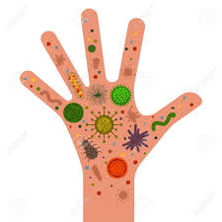
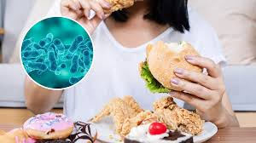
Are You Eating Bacteria?
Jack Sheng

Slide 2
Scientific Question
Hand Hygiene is considered as a critic intervention to stop communicable diseases
How does different hand wash regimens (5s-hand wash, 20s-hand wash) reduce bacterial transmission from hand to food?

Slide 3
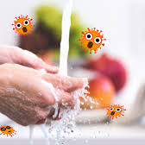
Hypothesis
Only adequate hand wash time (20s) can effectively reduce bacterial transmission from hands to food.

Slide 4
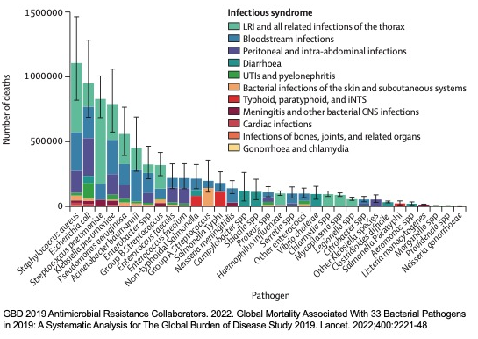
Research Background
Bacterial infection disease Research in 2019:
Analyzed 343 million individual records from 204 countries and territories
7.7 million deaths occurred as a result of bacterial infection
Involved 13.6% of global death
Second leading cause of death globally

Slide 5
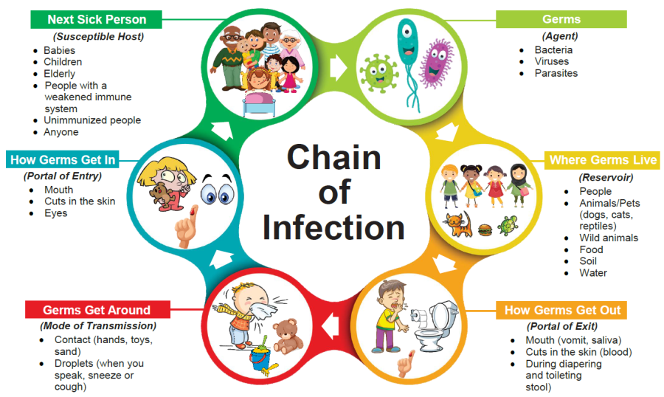
Research Background

Slide 6
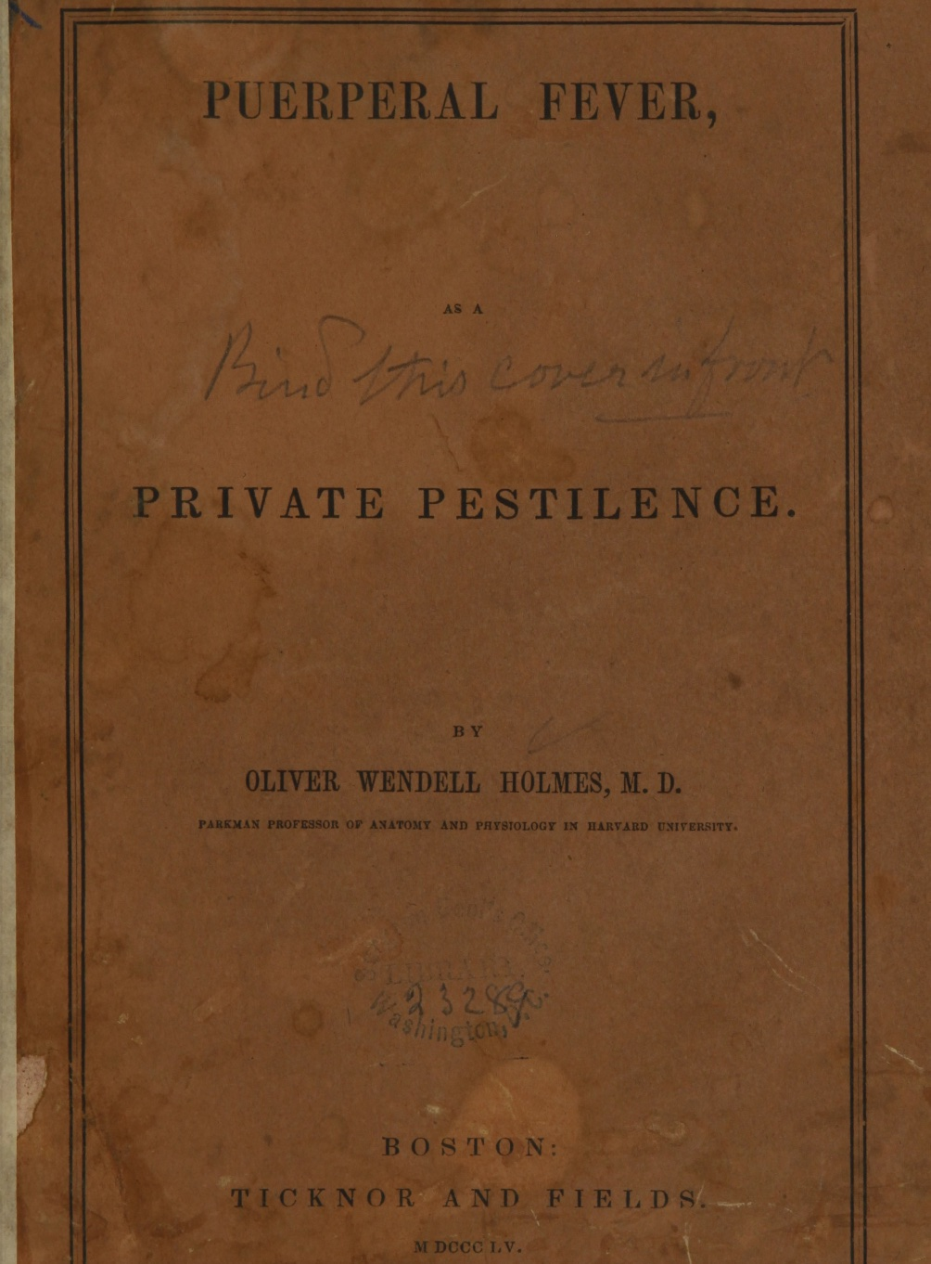
Research Background
Transmission of bacteria by hands
In 1855, Holmes published a book
Investigated a women who had died of puerperal fever after one week of her post-mortem exam
Physician’s unwashed hands were responsible for the transmitting puerperal fever
First of time, the role of hand in spreading bacteria was implicated

Slide 7
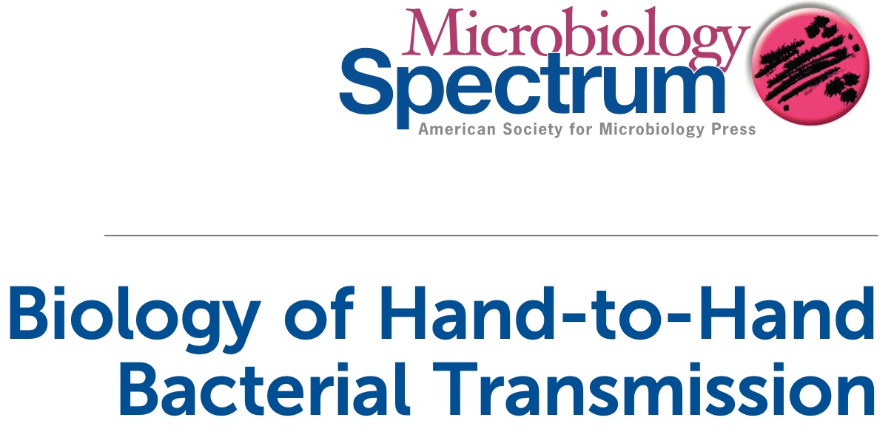
Research Background
Transmission of bacteria by hands
Numerous studies demonstrated that adequate hand hygiene is the best action to reduce bacterial transmission

Slide 8
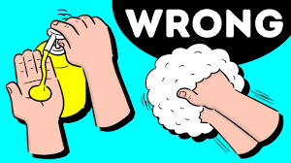
Research Background
Wash hand for at least 20s !!!
However, a quick wash (5s) has been
commonly observed

Slide 9
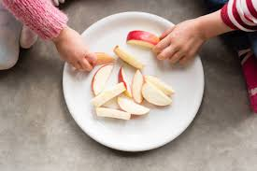
Research Background
“Hand to Apple Model”
The role of hand in spreading bacteria
How does different hand wash (5s, 20s) reducing bacteria transferred by hands

Slide 10
Variables
Manipulated Variables | Dependent Variables | Controlled Variables
Length of hand washing time 0s (dirty hands) 5s 20s | The number of bacteria colonies grown on agar plate | Type of liquid soap Temperature of water (tap water) Contact time of hand-to-apple Contact time of swab to hand A mount of soap

Slide 11
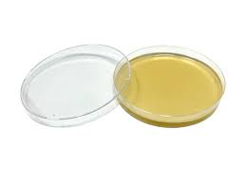
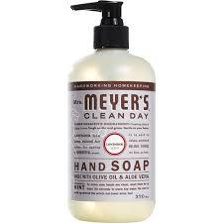
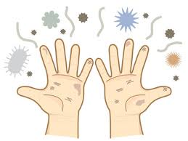
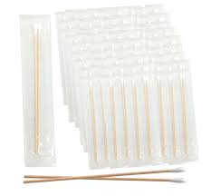
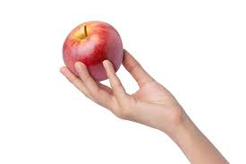
Materials
Agar Plate
Dirty Hands
Liquid Soap
Sterile Swab
Kleenex
Timer
Apple
Knife
Alcohol Swab
Electric blanket
*dirty hands: in this experiment, dirty hands will be after I shopped in two supermarkets around 4hours

Slide 12
Prepare Agar plates
Wash and clean apple skin/knife with alcohol swap. Cut into pieces.
Dirty hands
5s-hand wash
20s-hand wash
Use dirty hand to contact apple slice for 5s
Wash hand with liquid soap for 5s, dry with Kleenex, contact apple slice for 5s
Wash hand for another 15s to make total wash time 20s, dry with Kleenex, contact apple slice for 5s
Use a sterile cotton tip to swab the apple and transfer to Agar plate
Use a sterile cotton tip to swab the apple and transfer to Agar plate
Use a sterile cotton tip to swab the apple and transfer to Agar plate
Incubate with electric blanket around 32-37°C for 3 days. Count bacteria colonies
*An untreated Agar plate will be
used as a control
*Experiments will repeat 3 times

Slide 13
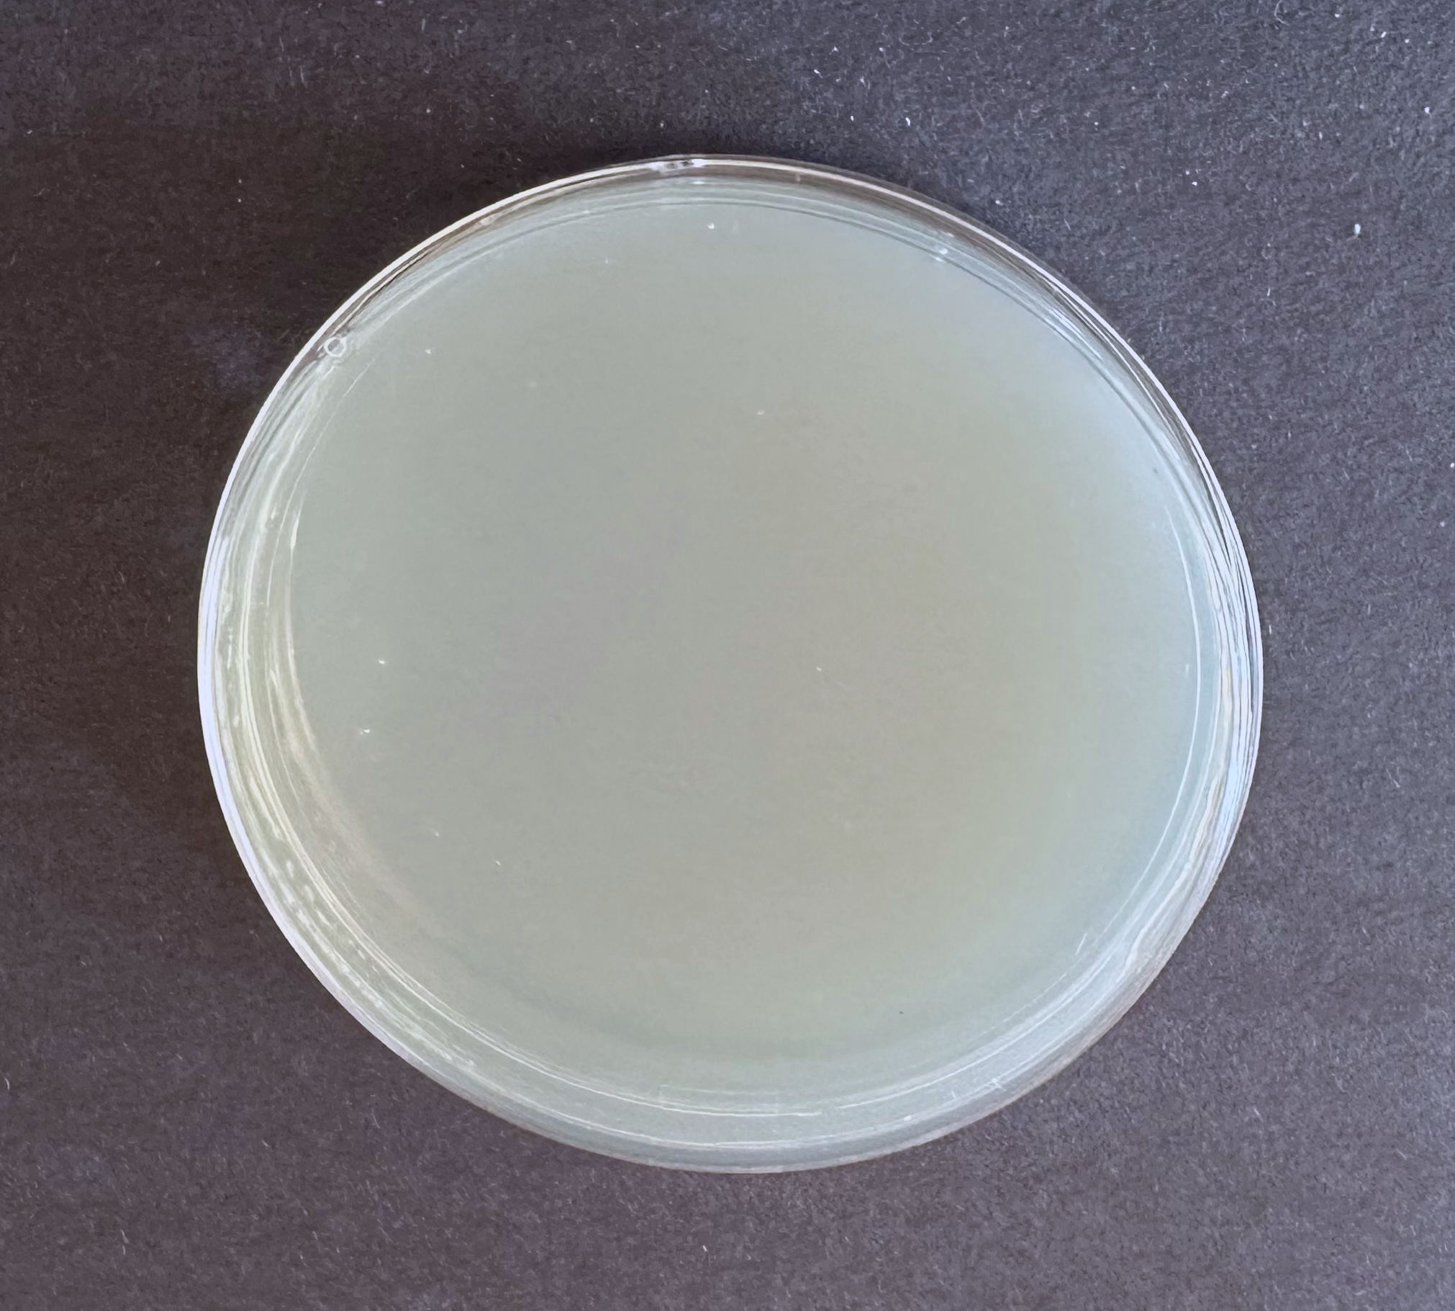
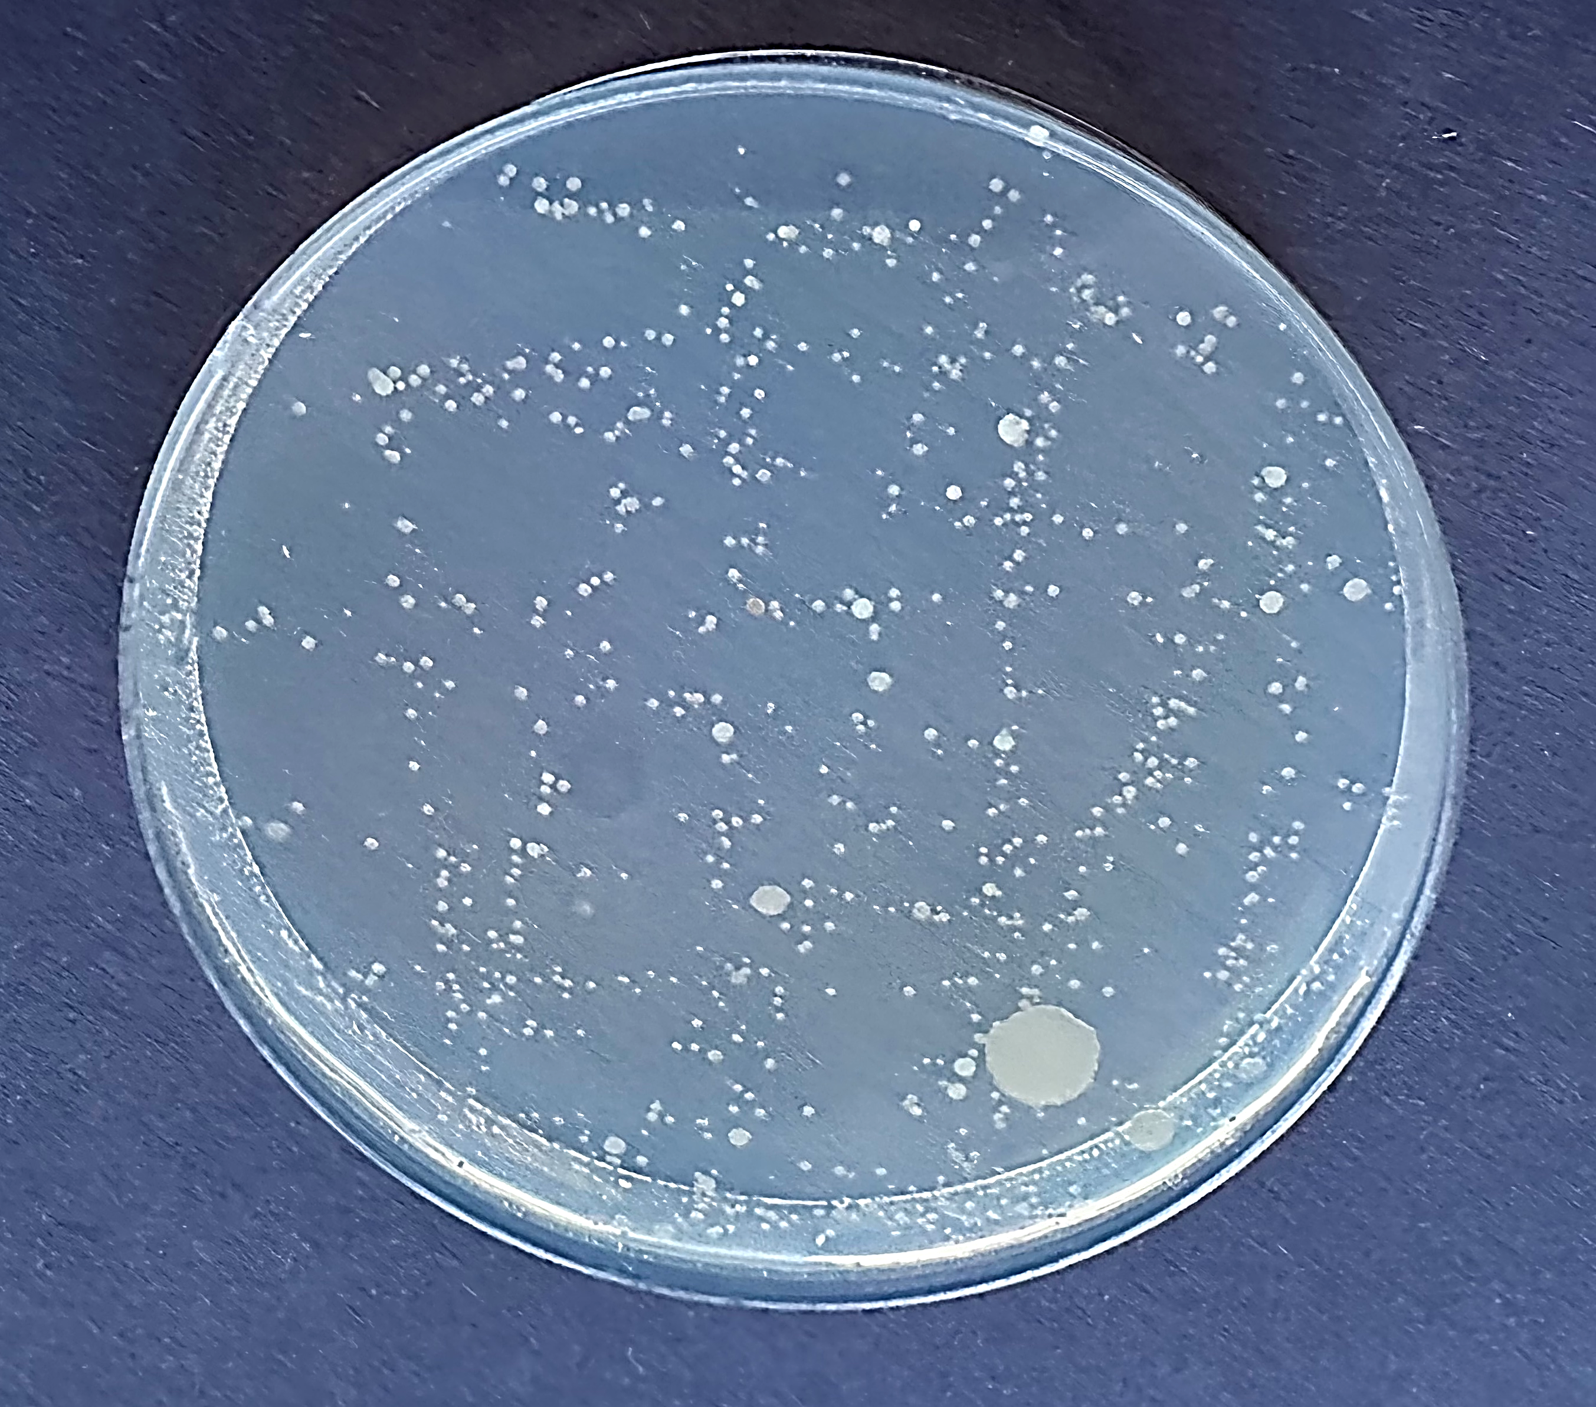
Results
Control Group Dirty Hands

Slide 14
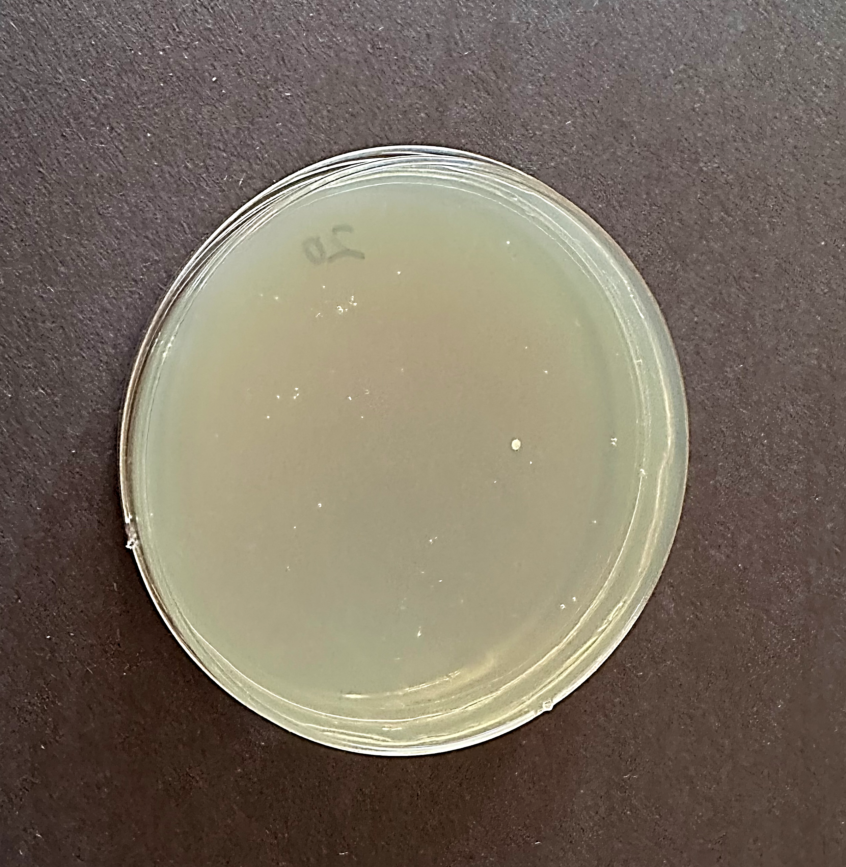
Results
5s-Hand Wash 20s-Hand Wash

Slide 15
Results
Replicates | Dirty hands | 5s-hand wash | 20s-hand wash
Experiment 1 | 518 | 271 | 24
Experiment 2 | 561 | 287 | 45
Experiment 3 | 466 | 339 | 55
Mean | 515 | 281 | 41
SD | 47.571 | 61.22 | 15.82

Slide 16
Analysis
Dirty hands - transmit lots of bacterial from our hands to apple.
20s-hand wash vs. 5s-hand wash - Significantly fewer bacteria were transferred to apple from 20s-hand wash compared with dirty hand and 5s-hand wash (p <0.05).
5s-hand wash vs. dirty hands: we found 5s-hand wash also reduce around 50% bacterial transmission (P <0.05).

Slide 17
Conclusion
Hand is spreading bacteria in our daily life.
A proper hand wash (20s) significantly reduced bacteria transmission - consisted with my hypothesis.
Surprisingly, a quick hand wash (5s) also can reduce bacteria transmission by around 50% and produced a statistically significant difference compared with no hand wash (dirty hands), which is opposite to my hypothesis. However, I cannot verify whether the number of bacteria left on hands from 5s-hand wash are enough to cause a disease.

Slide 18
Application
In this project, we visually observed the spreading of bacteria though the direct contact via hands by using hand-to-apple bacteria transfer model.
If a ready-to-eat food is contaminated with bacteria from hand and then eaten, it would have potential to cause illness.
Therefore, these project supports that there is a greater potential to reduce the transmission and acquisition of disease through proper hand wash. If everyone does proper hand hygiene, we are helping ourselves and others stay away from infection disease.

Slide 19
Possible Errors
Counting colonies
Only 3 repeats
Use different food
Use different liquid soap

Slide 20
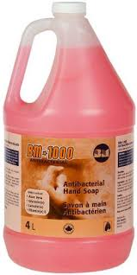
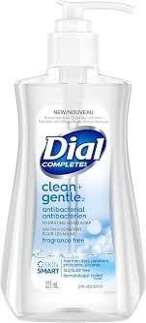
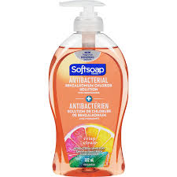
Further Study
Different brand of hand soap
Different water temperature for hand wash

Slide 21
References
Seager, L.M. 2010. Good Infection Prevention: Hand Hygiene. Dent Update. 2010 Sep;37(7):478-83.
CDC. About Handwashing. Feb 2024. https://www.cdc.gov/clean hands/about/index.html
GBD 2019 Antimicrobial Resistance Collaborators. 2022. Global Mortality Associated With 33 Bacterial Pathogens in 2019: A Systematic Analysis For The Global Burden of Disease Study 2019. Lancet. 2022;400:2221-48
The National Institute for Occupational Safety and Health (NIOSH). Chain of Infection Components. https://www.cdc.gov/niosh/learning/safetyculturehc/module-2/3.html
Ottawa Public Health. Chain of Infection. https://www.ottawapublichealth.ca/en/professionals-and-partners/chain-of-infection.aspx
Holmes OW. 1855. Puerperal Fever as a Private Pestilence. Ticknor and Fields, Boston, MA.
Campo, R.D., Martinez-Garcia, L, Sanchez-Diza, A.M., et al. 2019. Biology of Hand-to-Hand Bacterial Transissiom. Microbiology Spectrum 7(1):MTBP-0011-2016.
Vishwanath, R., Selvabal, A.P., Shanmugam, P. 2019. Detection of Bacterial Pathogens in the Hands of Rural School Children Across Different Age Groups and Emphasizing the Importance of Hand Wash. J PREV MED HYG 60:E103-E108.
World Health Organization. 2019. WHO Guidelines on Hand Hygiene in Health Care: First Global Patient Safety Challenge Clean Care Is Safer Care. Transmission of pathogens by hands.
Bischoff, W. E., T. M. Reynolds, C. N. Sessler, M. B. et al. 2000. Handwashing compliance by health care workers: the impact of introducing an accessible, alcohol-based hand antiseptic. Arch. Int. Med. 160:1017–1021
Green, L. R., V. Radke, R. Mason, L. Bushnell, D. W. Reimann, J. C. Mack, M. D. Motsinger, T. Stigger, and C. A. Selman. 2007. Factors related to food worker hand hygiene practices. J. Food Prot. 70:661–666.
Eyler, E., 2013. Chapter One – Pouring Agar Plates and Streaking or Spreading to Isolate Individual Colonies. Methods in enzymology. 533:3-14.
How to Grow Bacteria in a Petri Dish. https://www.wikihow.com/Grow-Bacteria-in-a-Petri-Dish
“How to Grow Bacteria: 5 Experiments to Grow & Test Bacteria.” Home Science Tools, 2025. https://learning-center.homesciencetools.com/article/bacteria-experiment-guide/
National Library of Medicine. Common Terms and Equations. https://www.nlm.nih.gov/oet/ed/stats/index.html
How to Calculate Mean, Standard Deviation (SD), Standard Error of the Mean and 95% Confidence Interval Using Excel. https://media.hhmi.org/biointeractive/vlabs/lizard2/pdfs/How_to_Calculate_Stats_in_Excel.pdf

Slide 22
Acknowledgement
Mr. Baillie – my science teacher
My family

