Slide 1
Blooming
Bacteria
By Lily Mitchell

Slide 2
Testable Question
What surface in the school contains the most bacteria?

Slide 3
Background Research pt1
Bacteria are microscopic single-celled organisms that serve a purpose in all organisms. Most bacteria are useful and serve a purpose within an organism, such as bifidobacteria, which help with digestion, infection prevention and the production of compounds such as B vitamins. Then there are harmful bacteria that can weaken the immune system with viruses, and are spread through contact with an infected surface. An example of harmful bacteria would be salmonella.

Slide 4
Background Research pt2
Bacteria thrive in moist, warm, and dark environments. This means that schools are great breeding grounds for thousands of different kinds of bacteria to reproduce. Bacteria reproduce asexually by mitosis or meiosis. Mitosis is when a cell duplicates itself completely and splits into 2 identical daughter cells. Meiosis is when a cell divides itself twice to produce 4 cells containing half the original amount of genetic information. Bacteria also reproduce using binary fission. Binary fission is nearly the same as mitosis, but mitosis is used for the growth of organisms, while binary fission is for reproduction. Binary fission is also simpler because it uses prokaryotic cells, instead of mitosis, which uses eukaryotic cells. This is because the cell structure of a prokaryotic cell is simpler than that of a eukaryotic cell. Prokaryotic cells are single celled organisms that don't have a nucleus in comparison to eukaryotic cells which do contain a nucleus.

Slide 5
Background Research pt3
For these cells to reproduce, they must have the right environment to do so. I am creating that environment for the bacteria with nutrient agar which provides a rich environment for bacteria to grow. Nutrient agar is a cushion of nutrients for bacteria to grow on while not being a material that mold can eat through. Nutrient agar contains moisture and nutrients that fungi absorb when they grow on it.
Bacteria are some of the fastest-reproducing organisms in the world. Some species of bacteria can double in 4 to 20 minutes! These bacteria can grow to visible quantities within hours. This is only some species of bacteria under the right nutrient-rich conditions.

Slide 6
Hypothesis
If I swab 10 different surfaces in the school, then I believe that the chromebook from the grade 8 cart will be the dirtiest because it is used the most and cleaned the least.

Slide 7
Materials
10 sterilized petri dishes
10 swabs for bacteria collection
10 clean swab holders
Enough Nutrient Agar for 10 petri dishes
Boiling Water
1 Sharpie
1 large pot
1 pair of tongs
1 large plastic bag
Small pot
Lightbox & smartphone for photographing the petri dishes

Slide 8
Variables
Constant Variables | Day swabbed Temp of petri dishes Amount of nutrient agar Type of swab Temp of agar when swabbed Agar
Manipulated Variable | Location/Item Swabbed
Responding Variable | Amount of bacteria grown

Slide 9
Procedure-Set Up
Fill a large pot about half way to full with water
Boil the water
Once boiled, turn off the heat
Dip tongs into boiling water for about 10 seconds
Place all petri dishes into the hot water
Let them sit in the water for about 30 seconds
Take them out with the sterilized tongs and transfer to a large ziplock bag
Leave the bag open somewhere safe so that they can dry

Slide 10
Procedure-Bacteria Collection
Get your 10 swabs
Label each tube with what you plan to swab
Collect sample by taking your swab and gliding it over a surface
DO NOT TOUCH THE SWAB
Place your swab into the tube and close the lid tightly
Repeat step five nine more times to collect all of your samples

Slide 11
Procedure-Agar Prep
Boil water in a small pot
Turn off stove
Mix boiling water with agar
Stir until dissolved
Pour agar into petri dishes (equal amount in each)
Let the agar cool in the petri dishes
Once cool and solidified, glide your sample swab over the surface of the
agar on the petri dish
Using tape and a sharpie write where the sample is from on the lid of the petri dish
Repeat step seven nine more times until all petri dishes have bacteria on them
Place lids on all petri dishes and place them somewhere dark
Daily, record how much has grown on each petri dish

Slide 12
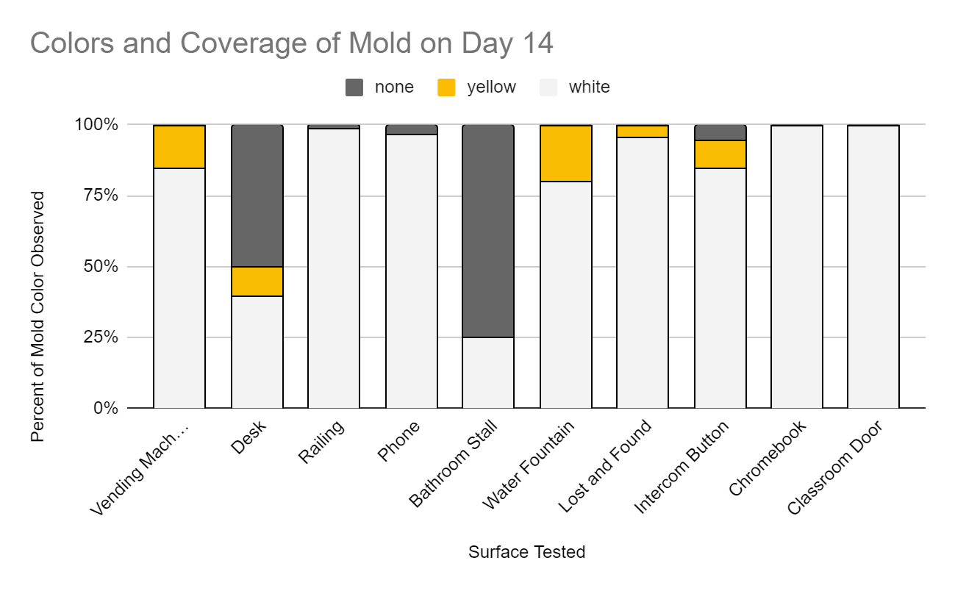
Observations

Slide 13
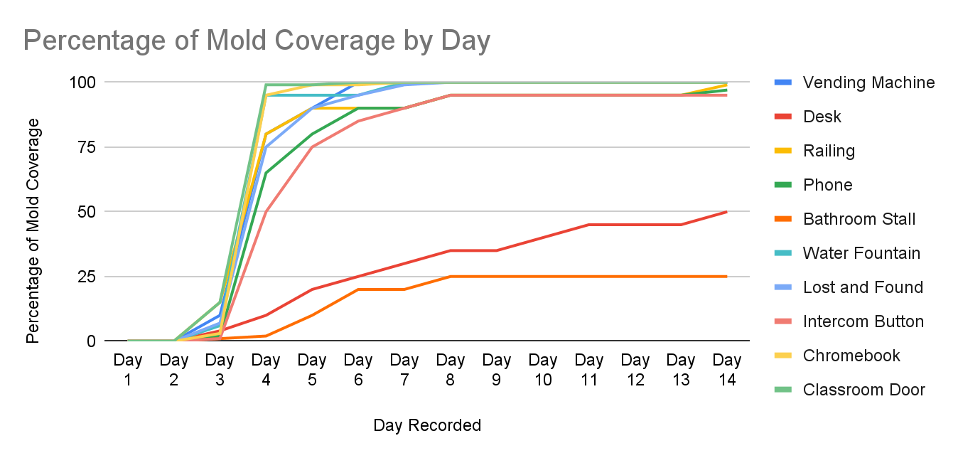

Slide 14
Conclusion
My hypothesis was incorrect because I predicted that the chromebook would grow the most mold, and while it did end up being 100% covered, so did many other samples.
The sample that reached 100% coverage the fastest was the room 18 door handle. I think the experiment resulted this way because the door handles are not cleaned regularly and are touched by many people every day.

Slide 15
Analysis of Results
In my experiment I swabbed 10 surfaces in my school and grew mold from them on agar petri dishes. I was shocked to find that the classroom door handle of room 18 was the dirtiest because i thought that they were cleaned regularly.
I was also surprised by how many different kinds of mold the desk sample grew. I was surprised because I know that the desks get cleaned every once in a while. I guess it just goes to show how much bacteria is on our hands.
I was not, however shocked to see how little the bathroom stall grew, because I know that our bathrooms are cleaned regularly by the custodial staff. I think this is also due to the fact that the upstairs plays host to less classes and so the bathroom I swabbed is used less than the ones on the main floor.

Slide 16
Sources of Error
My first source of error was the time between collecting the samples and actually swabbing them onto the agar plates. This may have caused the growth to be less than if the swabs were taken and then immediately placed onto the plates.
My second source of error is that I only tested each surface once, so I have no way of knowing if the results I received were an anomaly or if they were completely accurate.

Slide 17
Application
As of March 8th 2024, 4.2% of students at R.T Alderman school have been reported sick. My project shows areas of the school that need to be sanitized more often to get that number down in coming years. It also shows that no matter how old the students are, handwashing protocols and sanitising protocols must stay the same.
My next steps would be to swab the same items in different grade level classrooms to determine which grades need to be reminded about cleaning protocols and which classrooms are in more dire need of sanitizing.

Slide 18
Sources
https://medlineplus.gov/genetics/understanding/howgeneswork/cellsdivide/#:~:text=Mitosis%20is%20a%20 fundamental%20process,carefully%20 controlled%20by%20 certain%20 genes
https://www.biologyonline.com/dictionary/binary-fission#:~:text=Binary%20fission%20is%20 similar%20to,for%20 growth%20in%20 multicellular%20 organisms
https://openoregon.pressbooks.pub/mhccbiology112/chapter/binary-fission/#:~:text=The%20cell%20division%20process%20of,identical%20to%20the%20parent%20cell
https://microbeonline.com/nutrient-agar-composition-preparation-uses/
https://www.pnnl.gov/science/highlights/highlight.asp?id=879#:~:text=Why%20it%20 matters%3A%20 Bacteria%20are,every%204%20to%2020%20minutes.
https://sitn.hms.harvard.edu/flash/2020/how-microbes-grow/

Slide 19
Sources
https://www.medicalnewstoday.com/articles/157973#:~:text=Bacteria%20are%20microscopic%2C%20single%2Dcelled,in%20industrial%20and%20medicinal%20processes.
https://www.healthline.com/nutrition/why-bifidobacteria-are-good#:~:text=Bifidobacteria%20are%20healthy%20bacteria%20found,extremely%20important%20for%20your%20health.
https://en.wikipedia.org/wiki/Prokaryote
https://cbe.ab.ca/about-us/school-culture-and-environment/health-and-wellness-in-school/Pages/coronavirus.aspx

