Slide 1


PARKINSON’S TREMOR DETECTION DEVICE
RISHI GANAPATHY
GRADE 8 -LOUIS RIEL SCHOOL
CALGARY

Slide 2
PROBLEM
Around 10 million elderly patients are heavily affected by Parkinson’s Disease, and it is the second most prevalent neurodegenerative disease.
Many elderly patients who suffer from Parkinson’s Disease struggle with managing their disease (i.e. taking their medication). This leads to losing muscle control, which in turn can cause many injuries.

Slide 3

Current solutions to address this are time based, administering medication at fixed intervals.
The problem with this however, is that multiple factors such as physical exertion, diet, and disease progression can cause the medication to ebb at an unpredictable rate.

Slide 4
PROPOSED SOLUTIONS
How can we provide medication reminders based on real-time tremor (symptom) data?
Individualized wearable device
Tremor monitoring and analysis
Medication reminders based on tremor frequency

Slide 5
HYPOTHESIS
If a wearable accelerometer (tremor detector) is used to monitor tremors, then the user can be notified for medication reminders based on tremor frequency.

Slide 6
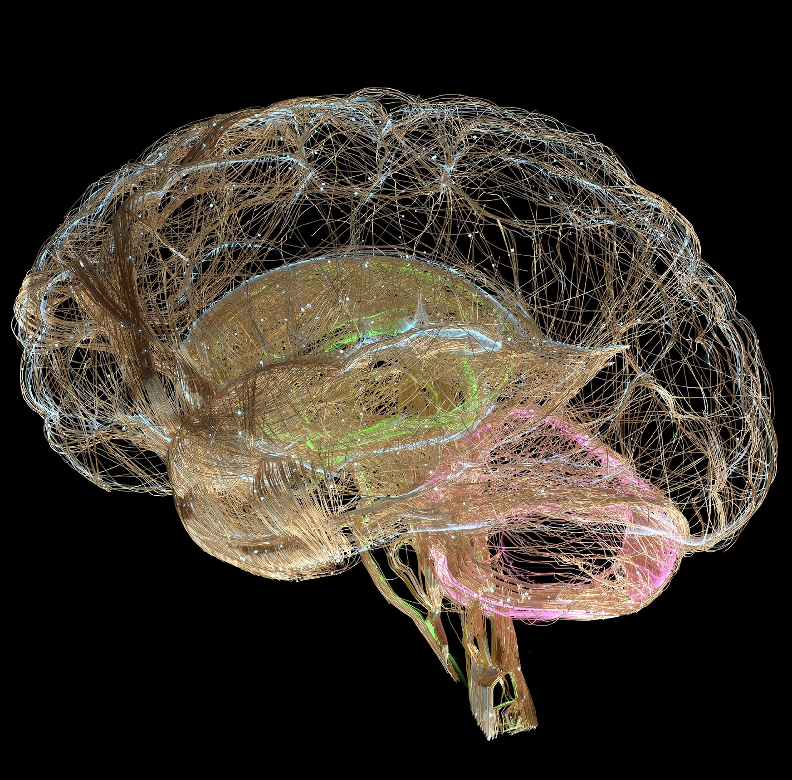
BACKGROUND RESEARCH - PD
Parkinson's disease (PD) is caused by progressive degeneration of dopamine producing cells specifically the Substantia Nigra in the brain.
This results in a critical shortage of dopamine, the chemical messenger responsible for signal transmission, which is essential for motor control
Symptoms include; gait issues, rest tremors, bradykinesia, loss of facial expression resolution
As a result of these symptoms, muscular control is sacrificed, leading to an increased possibility for accidents and injuries.

Slide 7



BACKGROUND RESEARCH - PD
PD patients suffer major falls upto 3 times more than healthy individuals
50% of PD patients experience recurrent falls
2-3 times more likely to suffer a hip fracture
Such injuries are much harder to recover from
Cognitive functions and awareness decline, especially with PD at an elderly age
https://www.parkinson.org/understanding-parkinsons/statistics
Notes:
increase detail(effect and bullet points)

Slide 8




BACKGROUND RESEARCH- LEVODOPA
Dopamine is vital for muscular control
Levodopa is the most common medication to treat PD
Levodopa is a dopamine replacement and assists in production of dopamine
Recommended levodopa dosage is determined from clinical examination using the Unified-Parkinson’s-Disease Rating- Scale(UPDRS)

Slide 9



BACKGROUND RESEARCH - ASSESSMENT
The specific rating on the scale (1-4) is based on visual diagnosis, physical examination based on a standardized questionnaire
Most patients go in for periodic re-assessments only every ~6 months
Disease can progress unpredictably within this period
https://pmc.ncbi.nlm.nih.gov/articles/PMC11233456/

Slide 10





BACKGROUND RESEARCH- TREMOR
One of the most common symptoms of Parkinson’s is a resting tremor in the extremities
Current clinical methods for detecting tremors are based on visual examinations
The prescribed dosage from the clinical examination can ebb from dietary changes, physical exertion, and disease progression
Accelerometers can be used to determine specific tremor severities, providing medication alerts

Slide 11
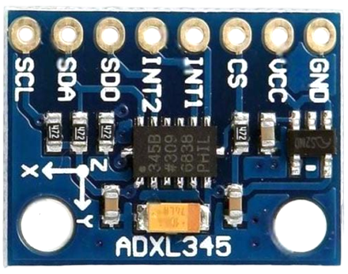
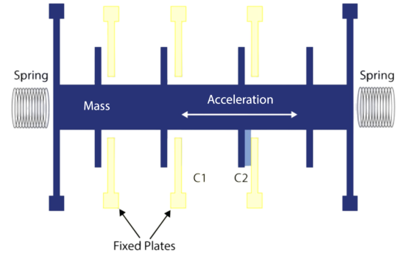
BACKGROUND RESEARCH- ACCELEROMETER
When the chip moves, the weight has inertia, causing the springs to compress
This causes capacitance to change resulting calculating acceleration
Accelerometer (ADXL345) contains a tiny weight (known as a proof mass) that is suspended by silicon springs

Slide 12
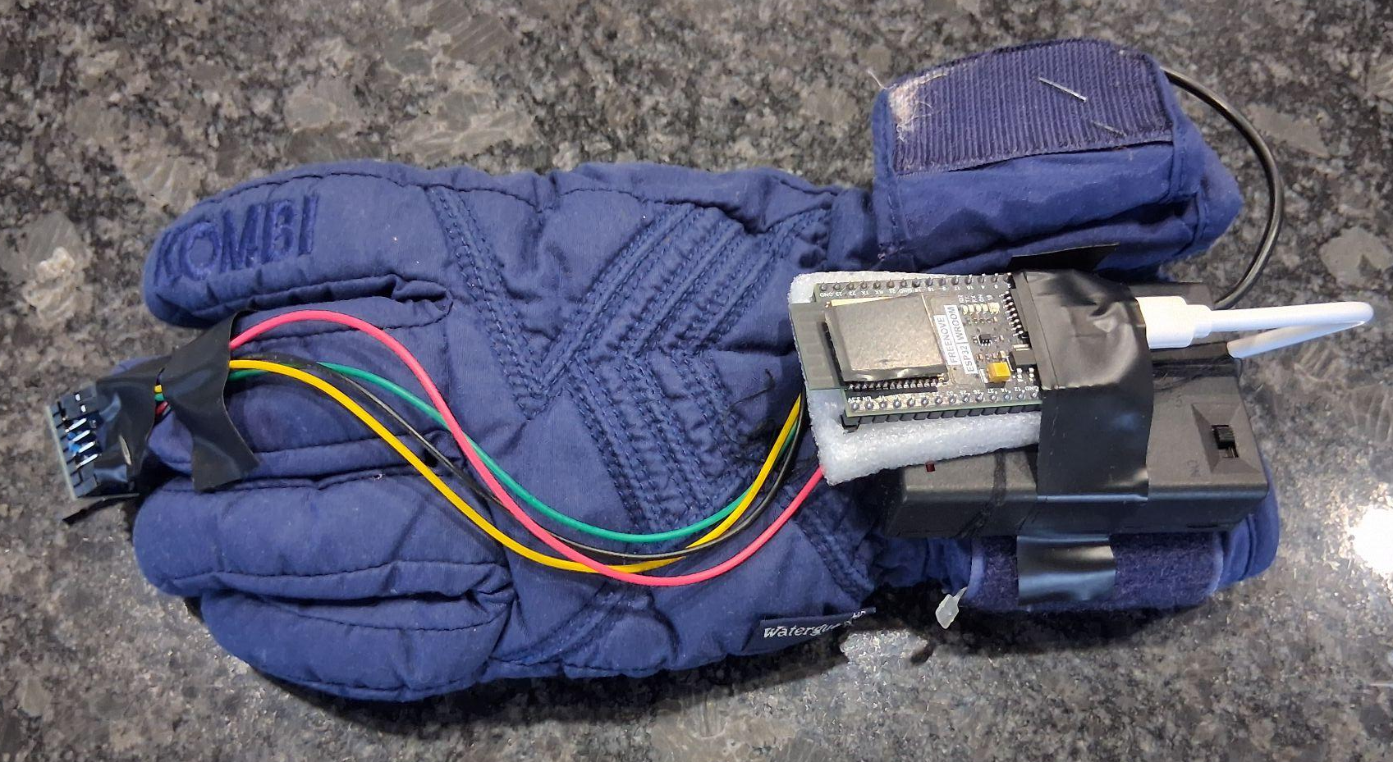
This device does not directly replace clinical diagnosis, but demonstrates correlation potential
Wearable Gloves for monitoring
Processing Board+ Battery Pack
Accelerometer

Slide 13
MATERIALS
ADXL345 accelerometer module (for tremor detection); 3-5v
ESP32 board- processes data and relays information to phone
Lithium Ion battery- powers device
Female to female jumper wires
TP4056 charging module- charges lithium ion battery safely and supplies constant power to ESP32
Phone- for notifications
USB-C data cable

Slide 14
PROCEDURE - SIMPLIFIED
Accelerometer reads tremor data
1
Using Fast Fourier Transformation (FFT), data is converted to specific frequencies
2
Data shown in the app on the phone and reminder provided to the patient to take medication
3

Slide 15
PROCEDURE -ALGORITHMIC LOGIC
App on patient’s phone sends notification to place hand on a stable surface every 30 minutes
Reads data for 30 seconds- app receives and stores data- processing happens during this time period
ADXL345 reads raw accelerometer data- 100 readings per second
Converts the raw value into G’s (utilizes past coding libraries)
Removes gravity offset- averages gravities presence(~1) and subtracts from all the values
Calculates the magnitude of values- combined x,y,z axis—-- sqrt(x^2+y^2+z^2)
Divide all values into 5 second windows
Calculate FFT’s(frequency) for each window, this tells us the frequency of the tremor, ”how fast is the hand shaking in between frames?”
See next
Notes:
insert text box (see next page)

Slide 16
PROCEDURE -ALGORITHMIC LOGIC - CONT’D
Assign severity score to frequency and threshold to determine medication timing- 70% of maximum tremor analyzed
If the tremor does not reach the threshold, repeat from step 1
Once the medication is taken, the user should activate a toggle switch in the app to avoid repeat alerts, waiting 45 minutes to send a alert, stopping potential overdose
The first day the algorithm will set a threshold from the maximum tremor analyzed, which will be re-calibrated every few days

Slide 17
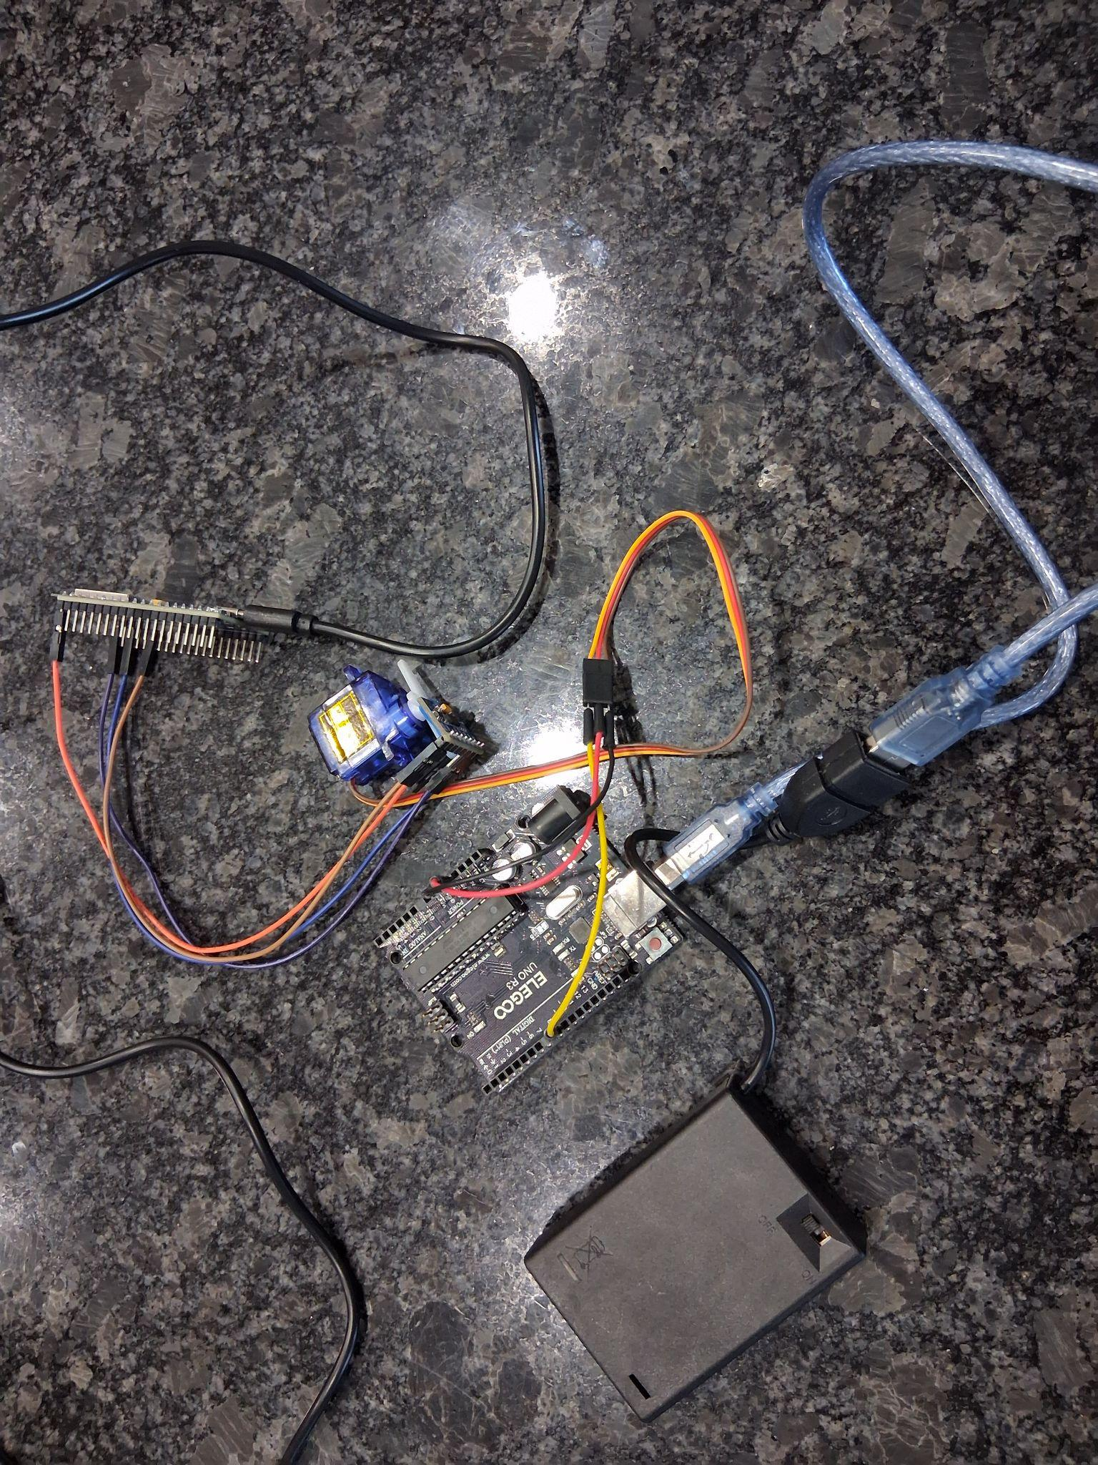
DESIGN TESTING - FREQUENCY
Arduino board combined with Motor was used to test the accuracy and precision of frequency shown in the accelerometer
BATTERY PACK
PROCESSING BOARD
https://youtu.be/k_1BmGY6xKU
SERVO MOTOR ATTACHED TO ACCELEROMETER

Slide 18

ACCURACY/PRECISION TESTING
Actual set frequency is compared against the measured frequency of the motor.
Actual (Hz) | Average Measured (Hz) | Standard Deviation | Accuracy Error (%) | Repeatability Limit (~99.7%)
0.5 | 0.504 | 0.007 | −0.80% | ±0.0210
0.67 | 0.683 | 0.0067 | −1.94% | ±0.0202
1 | 1.019 | 0.0145 | −1.90% | ±0.0435
1.25 | 1.272 | 0.0063 | −1.76% | ±0.0190
1.67 | 1.675 | 0.0619 | −0.30% | ±0.1856
2 | 2.035 | 0.0184 | −1.75% | ±0.0052
The measurements are highly accurate (close to the actual values) and highly consistent (precise)

Slide 19
OBSERVATIONS
Measurements up to 2 Hz showed low variability and low error, indicating high precision and accuracy.
Accuracy error remained under ~2%, demonstrating reliable frequency detection.
Higher‑frequency testing was limited by motor instability rather than sensor performance.

Slide 20
OBSERVATIONS
Gravity removal and FFT analysis significantly improved signal quality.
The system responded consistently and issued medication alerts shortly after tremor frequency exceeded the threshold.
Overall performance supports the feasibility of symptom‑based medication reminders.

Slide 21
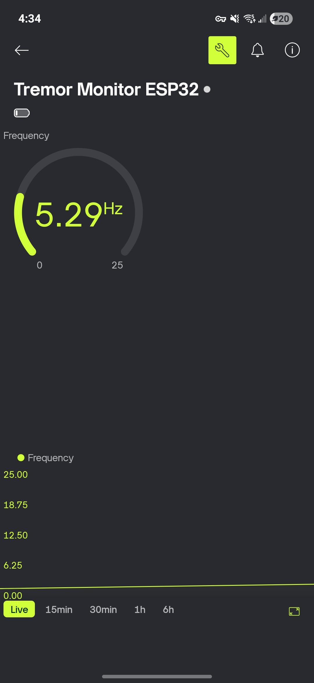
APP FOR MONITORING

Slide 22
CONCLUSION
Yes, the low cost accelerometer objectively measures the frequency and maps to a severity score of the tremors, helping to send reminders for the medication. This validates the hypothesis.
With consistent usage of the wearable device, patients will have much more precise and consistent medication timings, significantly lowering the risk of accidental falls.

Slide 23
EXTENSIONS
Currently the prototype is quite bulky and undynamic. Doing this on an industrial level would mean using a small chip with a PCB board that would be encased, mounted on a strap to the wrist, or in a ring.
Design in a way that this could be worn anywhere on the body with resting tremors, completely personalized.
A multitude of diseases also entails tremor as one of the more prominent indicators of a medication ebbing. These diseases include Hyperthyroidism, alcohol & substance abuse and motor neuron diseases such as Multiple Sclerosis.

Slide 24
SOURCES
https://www.parkinson.org/understanding-parkinsons/movement-symptoms/tremor
https://pmc.ncbi.nlm.nih.gov/articles/PMC9863142/
https://www.apdaparkinson.org/what-is-parkinsons/symptoms/tremor/
https://www.ninds.nih.gov/health-information/disorders/parkinsons-disease
https://www.ninds.nih.gov/health-information/disorders/parkinsons-disease
https://practicalneurology.com/diseases-diagnoses/movement-disorders/evaluation-of-patients-with-tremor/30247/
https://pmc.ncbi.nlm.nih.gov/articles/PMC6032646/
https://www.movementdisorders.org/MDS/MDS-Rating-Scales/MDS-Unified-Parkinsons-Disease-Rating-Scale-MDS-UPDRS.htm
https://www.radc.rush.edu/docs/var/detail.htm?category=Motor+and+Gait&subcategory=UPDRS&variable=tremsc
https://www.ncbi.nlm.nih.gov/books/NBK482140/
https://pmc.ncbi.nlm.nih.gov/articles/PMC9314669/
https://www.ninds.nih.gov/health-information/disorders/tremor
https://www.parkinson.org/library/fact-sheets/fall-prevention https://en.wikipedia.org/wiki/Accelerometer https://learn.sparkfun.com/tutorials/accelerometer-basics/all https://www.jameco.com/Jameco/workshop/Howitworks/how-servo-motors-work.html?srsltid=AfmBOor50Nm5vdY1poP3zcK3yUzR-WzMhzyMRwoYbcwI2MfQaru63oho

