Slide 1


Science Fair 2026 My Log Book
By: Shaurya Veer Karanwal

Slide 2

October 2025
School, and CYSF Science Fair Project

Slide 3

October 11
My science fair topic, which focuses on how addiction impacts brain function, was formally finalized today. I chose this subject because addiction is frequently misinterpreted as a moral failing rather than a neurological condition supported by science. I discovered from early reading that recurrent drug use results in quantifiable alterations in brain chemistry, especially in the dopaminergic system. Analyzing how these neurological alterations take place and elucidating their long-term impacts on behaviour and decision-making is my aim for this project.

Slide 4
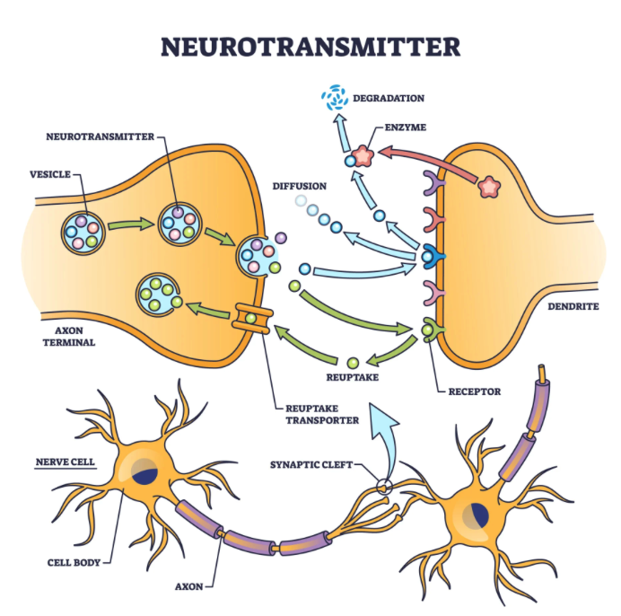
October 14
October 14
I started to develop basic understanding because I wanted to learn about normal brain operation. I studied neurons and synaptic transmission along with neurotransmitters while focusing primarily on dopamine and its function in motivation and reward systems. I discovered that dopamine gets released during pleasurable activities and activities necessary for survival which leads to people repeating those actions. The normal functioning of dopamine needs to be understood before researchers can study how addictive drugs interfere with this process.
Sources used:
• NIDA source from citation list
• Background neuroscience source from citation list

Slide 5
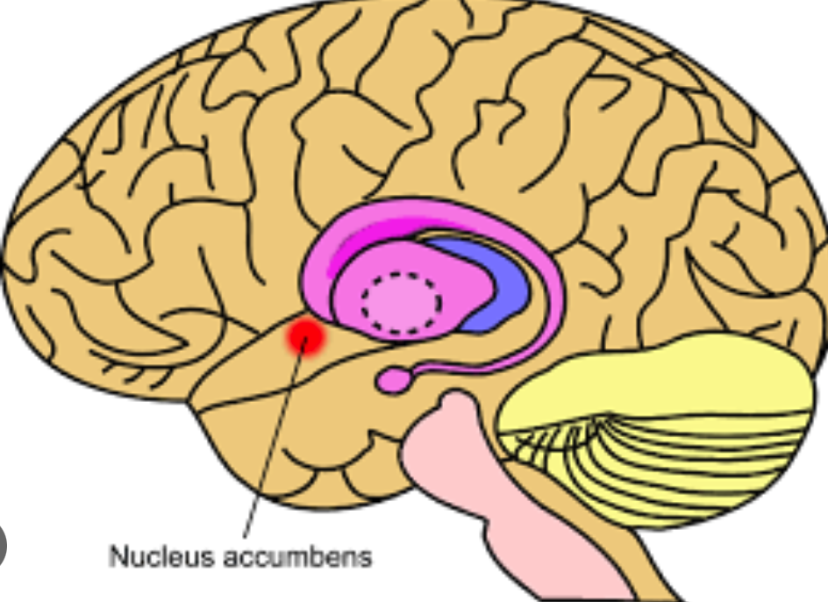
Oct 18
October 18
Today I studied the brain's reward system which includes three main areas of the brain: nucleus accumbens and ventral tegmental area and prefrontal cortex. I discovered that addictive substances create artificial stimulation of this brain pathway which results in excessive dopamine production that exceeds normal reward response. The brain receives excessive stimulation which causes progressive loss of ability to communicate between two brain areas that control decision-making and impulse regulation. The research results show that addiction becomes established through fundamental alterations in both brain structure and chemical composition.
Sources used:
• NIDA reward pathway article
• Journal article from citation list

Slide 6
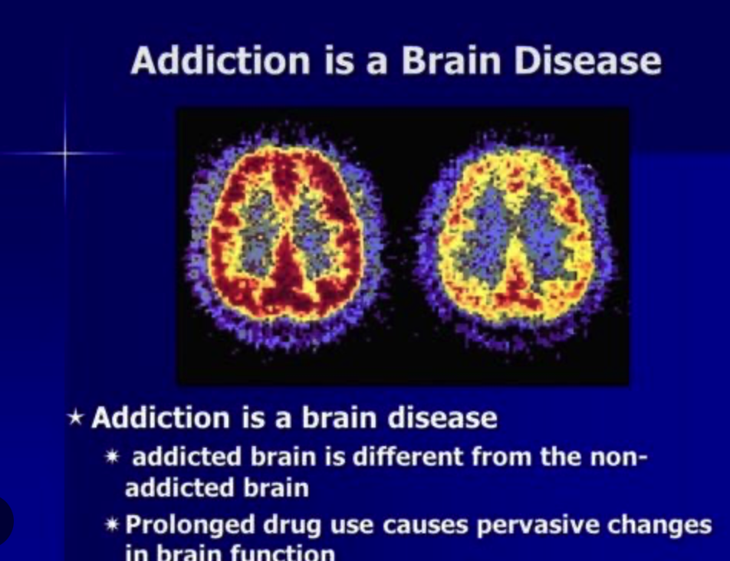
Oct 22
The date is October 22 I studied scientific research which explains the classification of addiction as a chronic brain disease. Brain imaging studies show long-term structural and functional changes in individuals with substance use disorders. The research results demonstrate that addiction changes brain circuits which control self-control and stress response mechanisms. The research proved addiction is a biologically measurable condition which changed my understanding of the condition.
Sources used: • NIDA disease model article • Additional peer-reviewed source from citation list

Slide 7
Oct 18
Today I studied the brain's reward pathway which includes nucleus accumbens and ventral Tegmental area and prefrontal cortex. I discovered that addictive substances produce a dopamine surge which exceeds the levels of natural rewards. The process of excessive stimulation leads to the breakdown of essential decision-making abilities together with impulse control functions.
Sources used:
• National Institute on Drug Abuse (NIDA)
• Volkow et al.(journal article from citation list)

Slide 8
October 22
October 22
I studied research explaining why addiction is classified as a chronic brain disease. Brain imaging studies show structural and functional changes in addicted individuals. This evidence shifted my understanding of addiction from a behavioural issue to a neurological disorder.
Sources used:
• National Institute on Drug Abuse (NIDA) • American Society of Addiction Medicine

Slide 9

October 24 2025
Today I have done some research on some addictions and listened some TED talks about addiction such as Johann Hari’s “Everything we know about addiction is wrong” and went over the Rat Park experiment by Bruce Alexander.
I also talked to some doctors in my family about addiction and a good project outcome.
I also watched a few Lastly I read videos on what an Article
addiction and On the Effects
dopamine is. Screen Addiction Affects Physical and Mental Health | Premier Health

Slide 10
Oct 27
October 27
I studied PET (Positron Emission Tomography) scans to understand how scientists use them to measure dopamine receptor activity. Researchers can use PET imaging to detect decreased dopamine receptors in the brains of people with addiction. This scientific evidence demonstrates brain changes through visible measurements.
Sources used: • Volkow et al. (PET imaging study from citation list) • NIDA brain imaging article

Slide 11

November 2025
School, and CYSF Science Fair Project

Slide 12
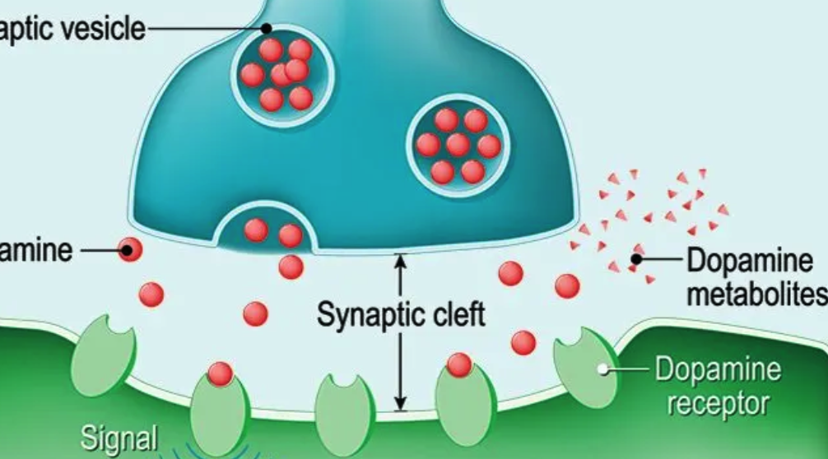
November 2
November 2
My research studied cocaine and alcohol effects on dopamine transmission. The cocaine drug prevents dopamine reuptake which leads to high dopamine levels in the synapse. Alcohol operates through an indirect mechanism to boost dopamine release which results in behaviour reinforcement.
Sources used:
• NIDA cocaine research report
• NIDA alcohol research article

Slide 13
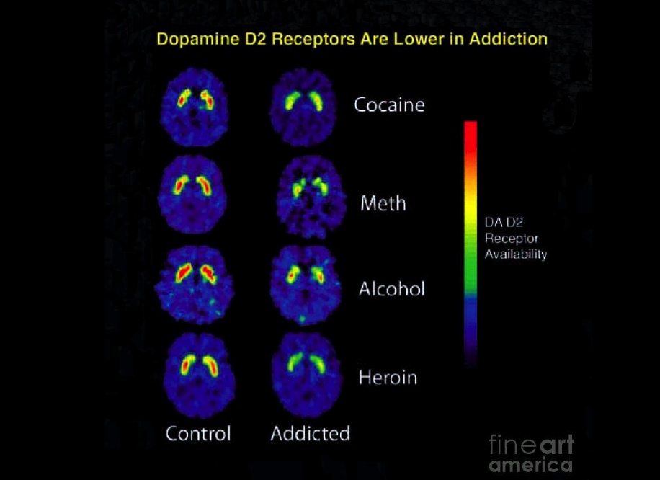
November 6
I examined Dr. Nora Volkow's research about dopamine receptor levels in addicted people. Her research with PET imaging showed that dopamine D2 receptors in the striatum were less available than normal. This reduction decreases sensitivity to everyday pleasurable activities, which leads to compulsive drug-seeking behavior. These findings strengthen the argument that addiction involves long-term neurochemical adaptation.
Sources used:
• Volkow et al. journal article from citation list

Slide 14

November 10
I refined my research question to improve clarity and scientific focus. I am not doing a experimental project but this week I hope to answer: How repeated drug use changes dopamine receptor function which creates specific long-term neurological impacts. The revision establishes a clear connection between brain chemistry and its effects on behavior. A precise research question will help maintain focus throughout my project development. The research question will guide my research work throughout my entire study. The research question will guide my research work throughout my entire study.

Slide 15
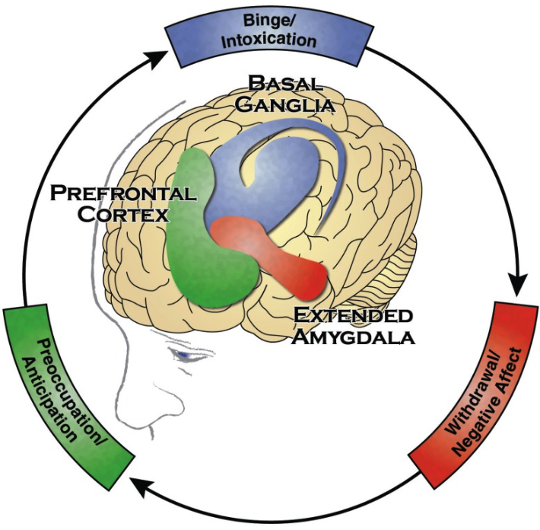
November 14
The three-stage model of addiction process studies three stages which include binge/intoxication and withdrawal/negative affect and preoccupation/anticipation. The three stages of the process show how different brain regions function abnormally through basal ganglia and extended amygdala and prefrontal cortex which compose the three stages. The model demonstrates how people begin to use drugs but ultimately reach a point where their drug use becomes an uncontrollable addiction. Researchers study this progression because it links specific behavioral patterns to changes that occur in the brain's neurological functions.
Sources used:
• NIDA three-stage model article

Slide 16
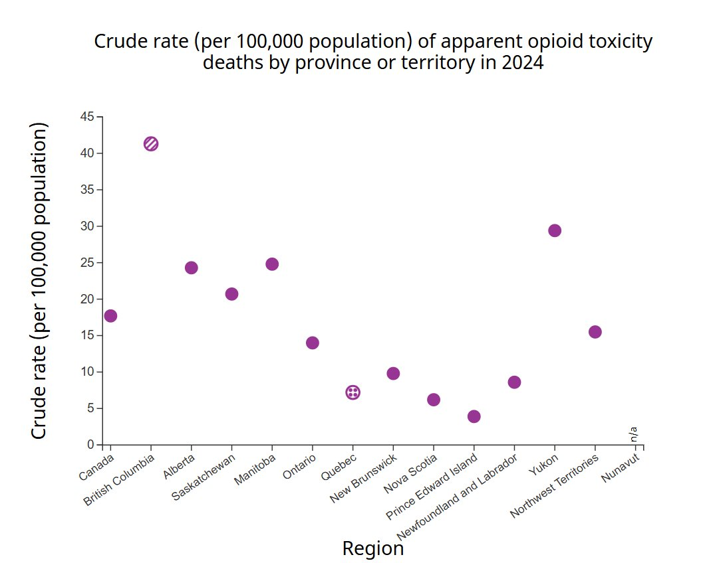
November 18
The Canadian government data which I cited contains my collected statistics about opioid usage. The data showed significant increases in opioid-related harms which affected specific provinces with British Columbia experiencing the most severe impacts. The statistical evidence proves that substance use disorders create a broad impact which affects multiple communities. My neuroscience research gains greater social importance through the inclusion of actual data from real-world situations.
Sources used:
• Government of Canada opioid report
• Provincial health data source from citation list

Slide 17
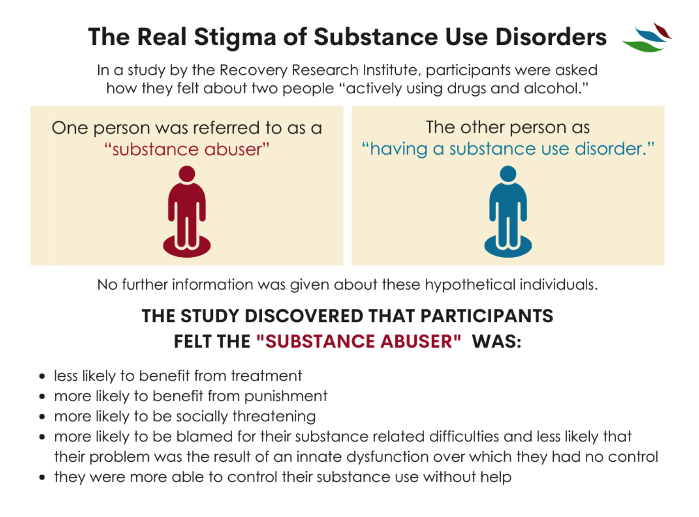
November 23
The research I conducted focused on addiction stigma because I wanted to understand its effects on recovery success. Research shows that negative perceptions held by society create barriers which stop people from accessing treatment services. Stigma creates two negative effects because it makes people feel alone while it creates shameful feelings that lead to worse mental health problems. I decided to include an awareness section explaining how education can reduce harmful misconceptions.
Sources used:
• CCSA report from citation list

Slide 18

November 28
I started creating structured interview questions which I developed for addiction professionals. My questions focused on neurological changes, withdrawal symptoms, treatment methods, and relapse prevention. The inclusion of interviews will bring in qualitative information which will support scientific research findings. Expert insight adds credibility and practical perspective to my project.

Slide 19

December 2025
School, and CYSF Science Fair Project

Slide 20
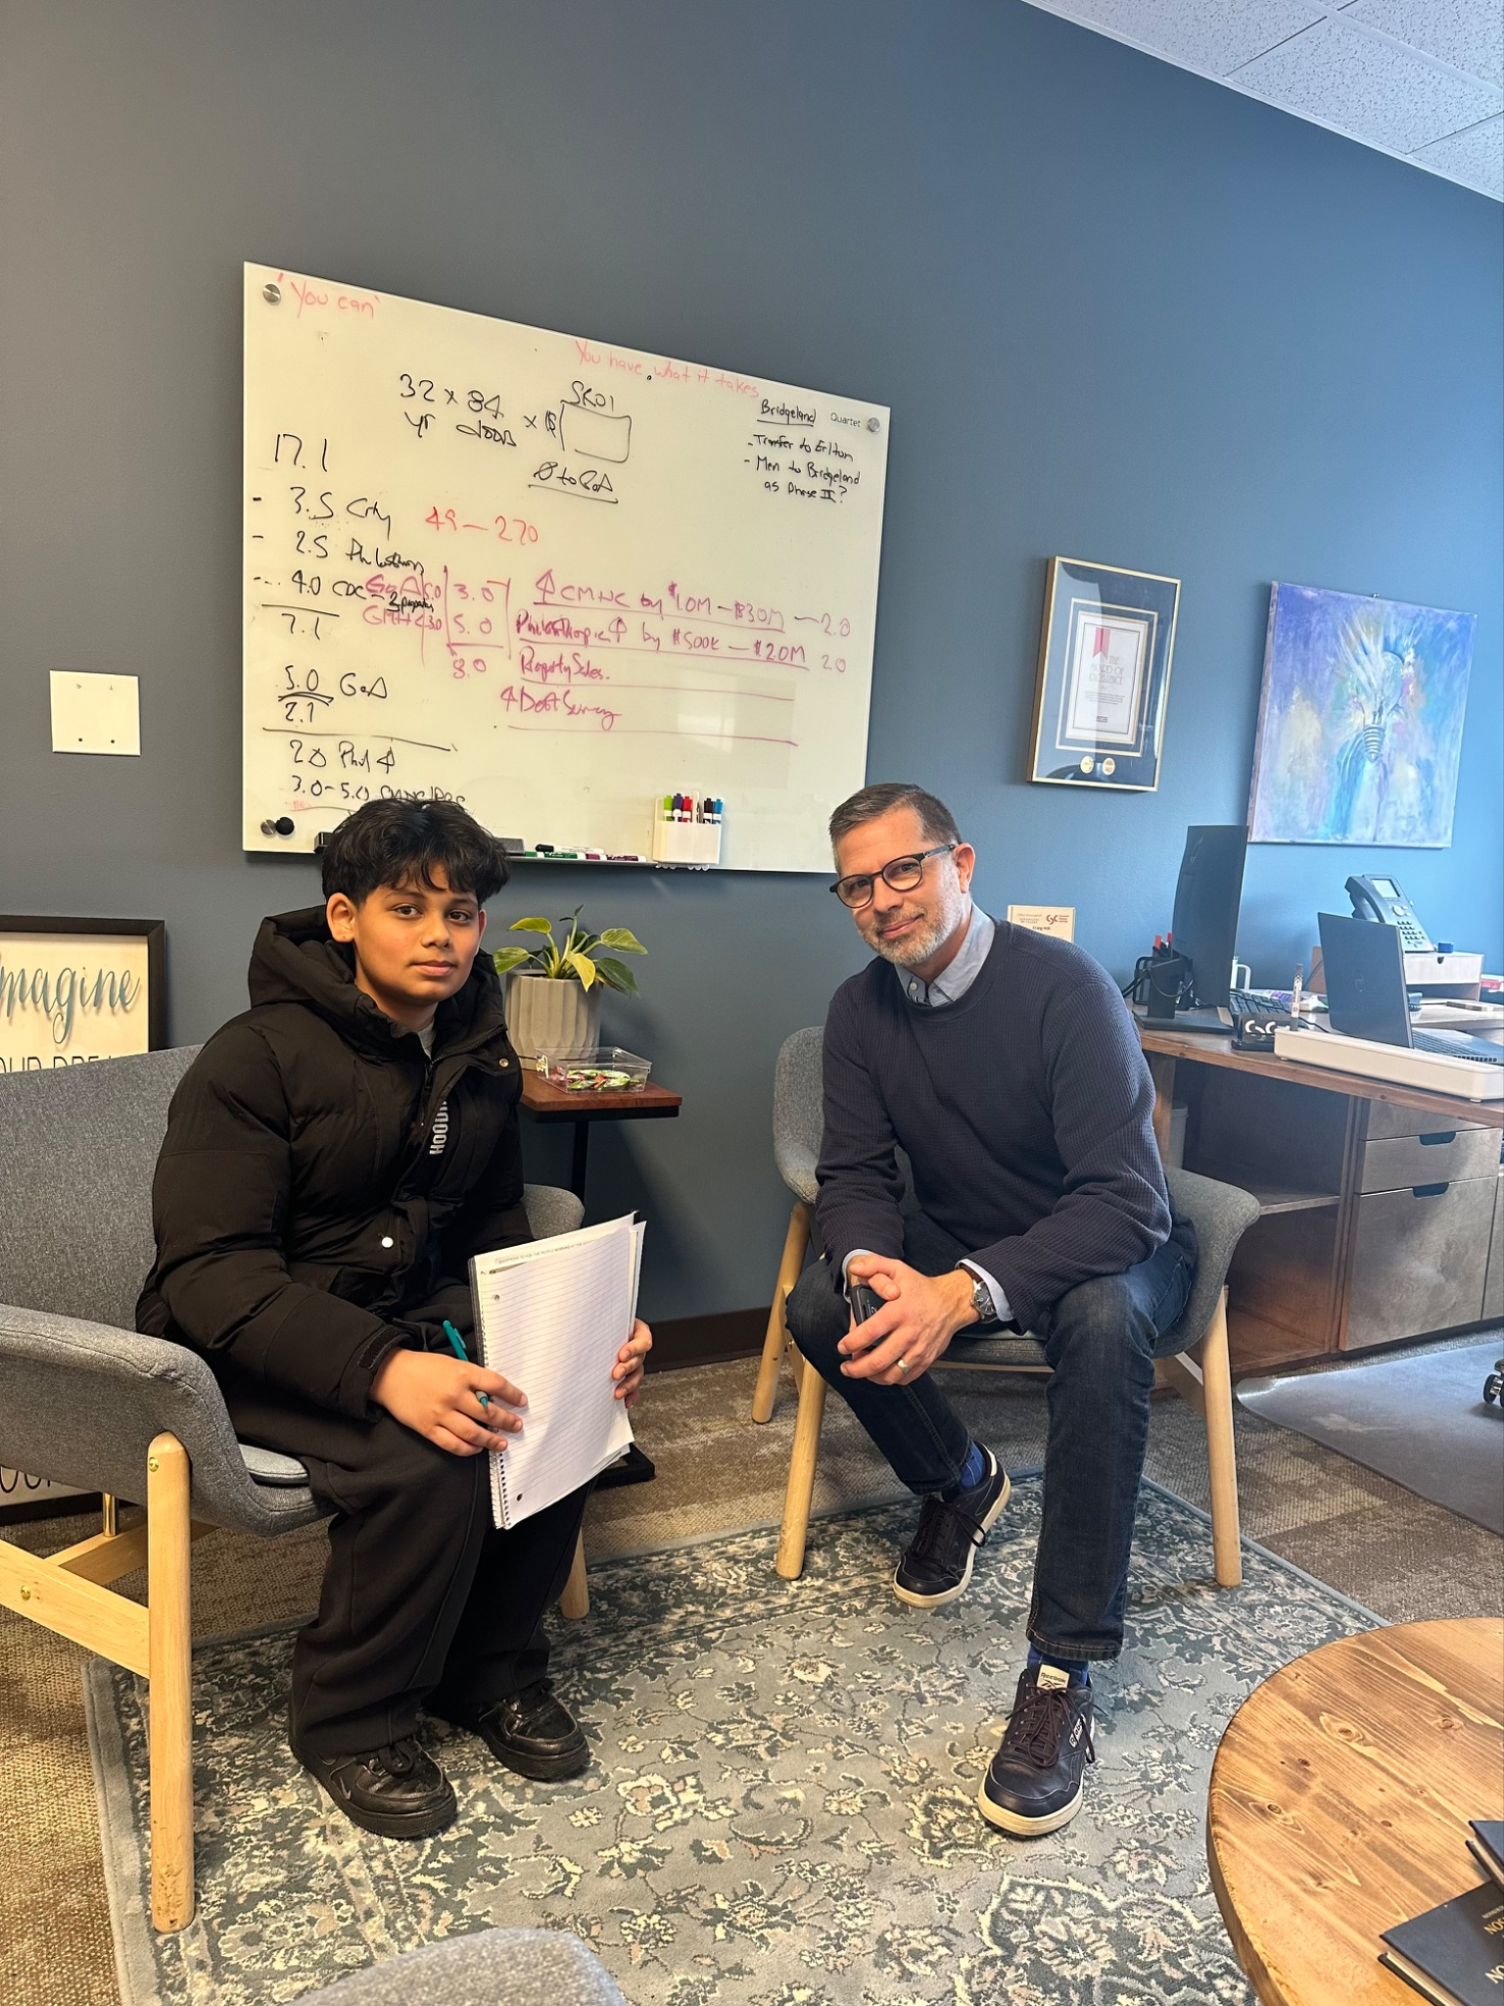
December 3
December 3
I conducted an interview with Craig Hill, an addiction counselor. He explained how addiction affects people's behaviour and their relationships with family members and their emotional peace. He emphasized that recovery requires both medical intervention and psychological support systems. His insights reinforced the idea that addiction is a complex condition which involves both biological and environmental elements.
Source used:
• Personal interview – Craig Hill

Slide 21

December 8
December 8
I conducted an interview with a nurse who works in addiction treatment programs. She described withdrawal symptoms which included anxiety and nausea and physical discomfort during the detox process. She explained that medical supervision protects patients from risks during their recovery process. The interview gave me important information about how substance dependence affects the body.
Source used:
• Personal interview – Addiction treatment nurse

Slide 22
December 10
December 10
The research work needed to be presented through five distinct sections that described dopamine function, PET imaging, opioid statistics, stigma and recovery models. The scientific research benefits from better logical organization which leads to improved comprehension.
All research sections need to prove their relevance through direct connection to the main research question. The final presentation achieves better understanding through its defined categories of content.

Slide 23
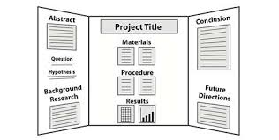
December 16
The date December 16 marks the beginning of my work on written material for my tri-fold board project. I made sure that all scientific information I presented was both correct and easy to understand for people without scientific training. The text will be supported by visual elements which include brain diagrams and graphs. The use of visual elements together with scientific explanations improves the effectiveness of communication.

Slide 24
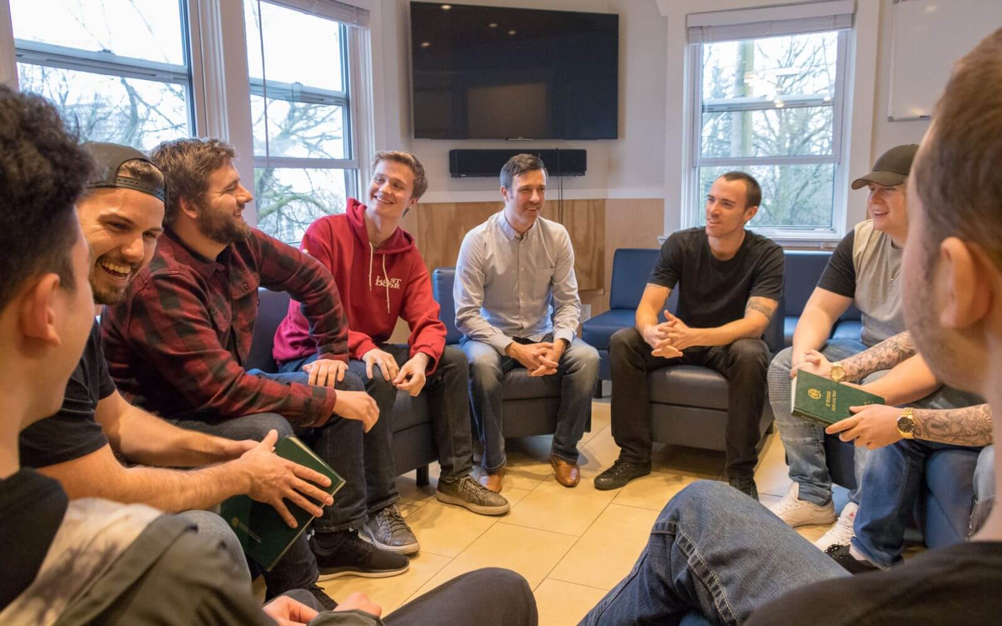
December 20
I studied two different recovery methods which are harm reduction approaches and abstinence-based recovery methods. The process of harm reduction research works to decrease health dangers while it acknowledges that recovery occurs through successive steps of improvement. I assessed these methods to establish a connection between neuroscience research and its impact on public health policy. The research for my project includes societal impact assessment as an additional element.
Sources used:
• Government health policy source from citation list
• CCSA research article

Slide 25

January 2026
School, and CYSF Science Fair Project

Slide 26
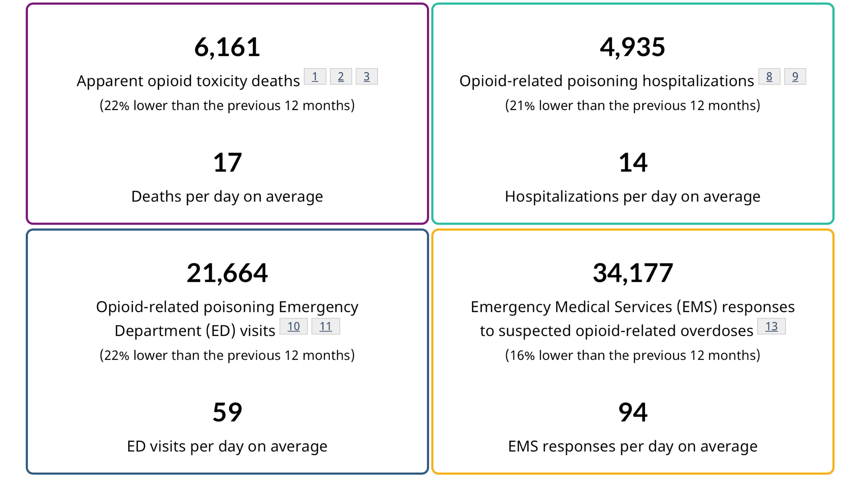
January 4
I started my graphing work when I obtained government-approved opioid statistics data. Visual representation of data helps simplify complex trends. I labeled axes with accurate information and created proper title content to achieve better understanding. The scientific credibility of my work increases through the use of valid graphical data.

Slide 27
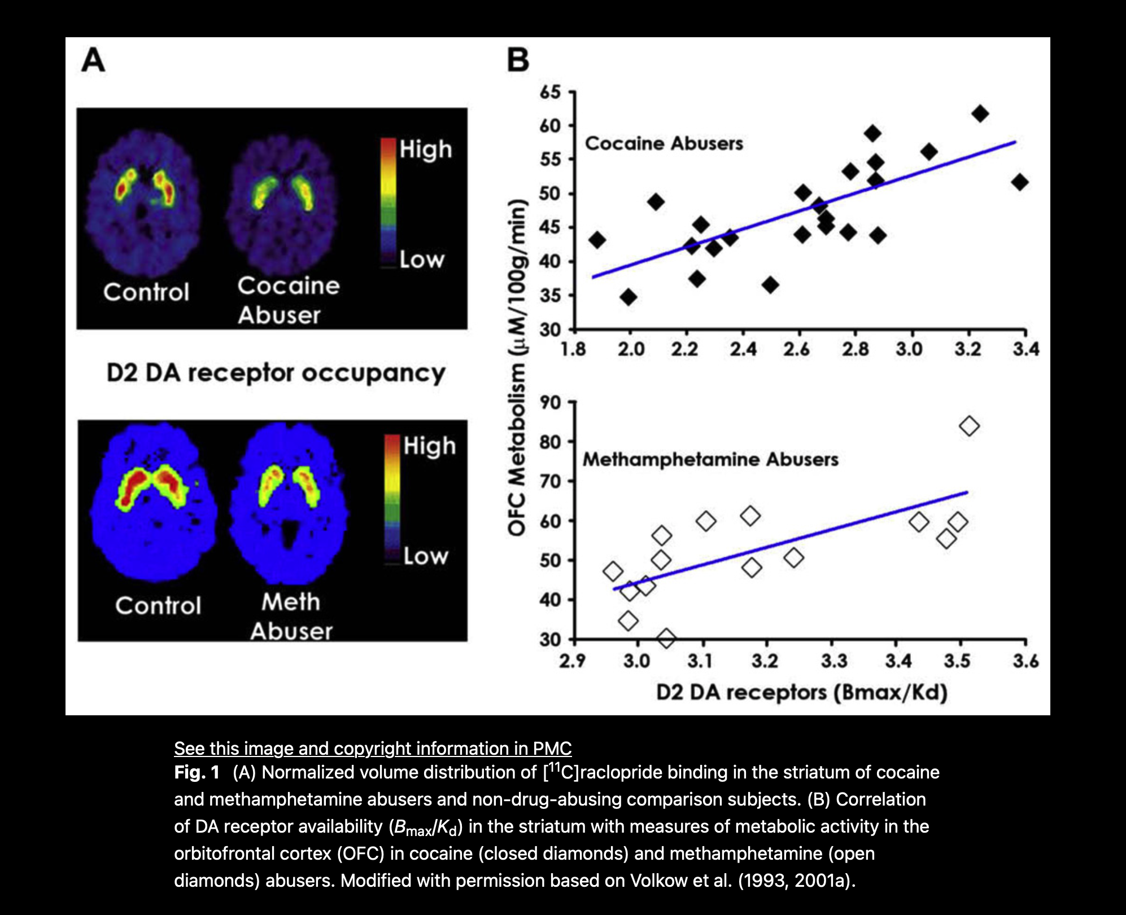
January 8
I studied PET scan images which were published in academic journals through peer-reviewed research process. The addicted brain images show reduced dopamine receptor activity compared to healthy controls. The visual differences between these two things provide scientists with measurable evidence which demonstrates how brain functions have changed. The project gains scientific strength through the inclusion of these images which serve as supportive evidence.
Sources used:
• Volkow PET imaging study

Slide 28
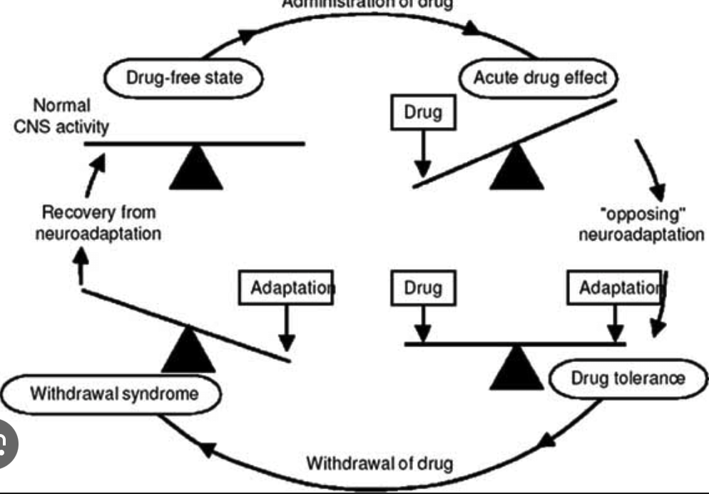
January 12
I wrote the "Addiction and the Brain" section of my board. My explanation included neurotransmission and receptor Downregulation and Neuroadaptation
which I described using exact scientific terms. I used my approved sources to support all of my explanations. The scientific accuracy of information needs to be maintained because it establishes credibility.

Slide 29
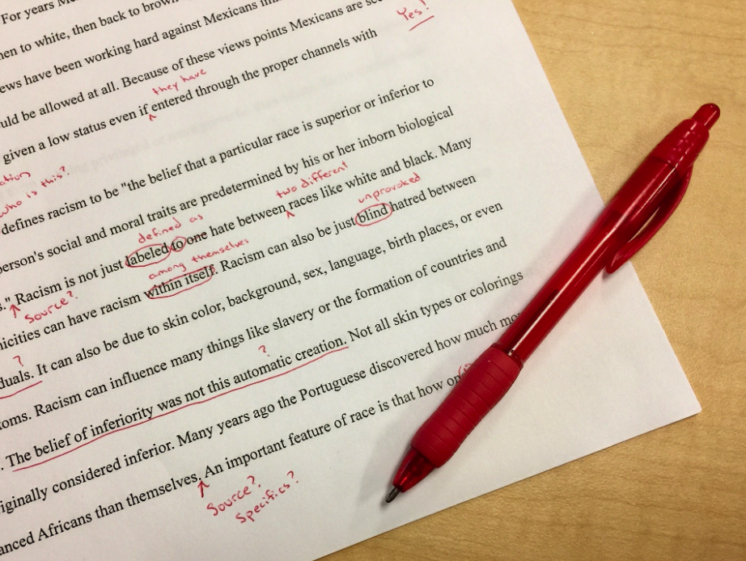
January 16
January 16
I revised my explanation of dopamine tolerance to improve clarity. The repeated overstimulation of the body leads to a decrease in receptor sensitivity which forces users to increase their drug intake until they reach the same effects as before. This process contributes to dependence and escalating use. The mechanism explanation functions as a foundation which establishes my complete argument.

Slide 30
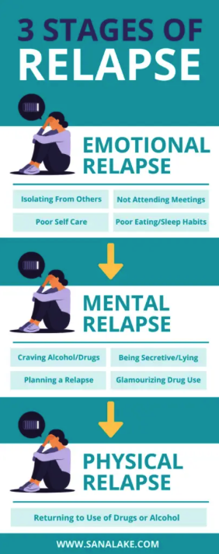
January 20
January 20
I added a section explaining why addiction is considered a chronic relapsing disorder. Research shows that altered neural pathways can persist even after long periods of abstinence. This explains why relapse rates are high. The information shows that neurological effects from the research study will last a long time.

Slide 31
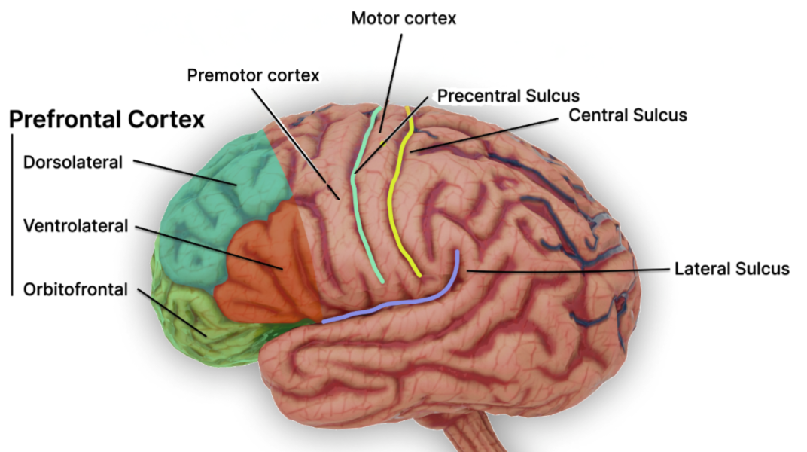
January 24
January 24
I completed my work which showed how dopamine dysfunction leads to reduced prefrontal cortex function. The brain region which controls prefrontal function determines a person's ability to control their impulses and make decisions. The brain disability leads to continuous drug-seeking behaviour. I confirmed all my statements through the sources I provided.

Slide 32
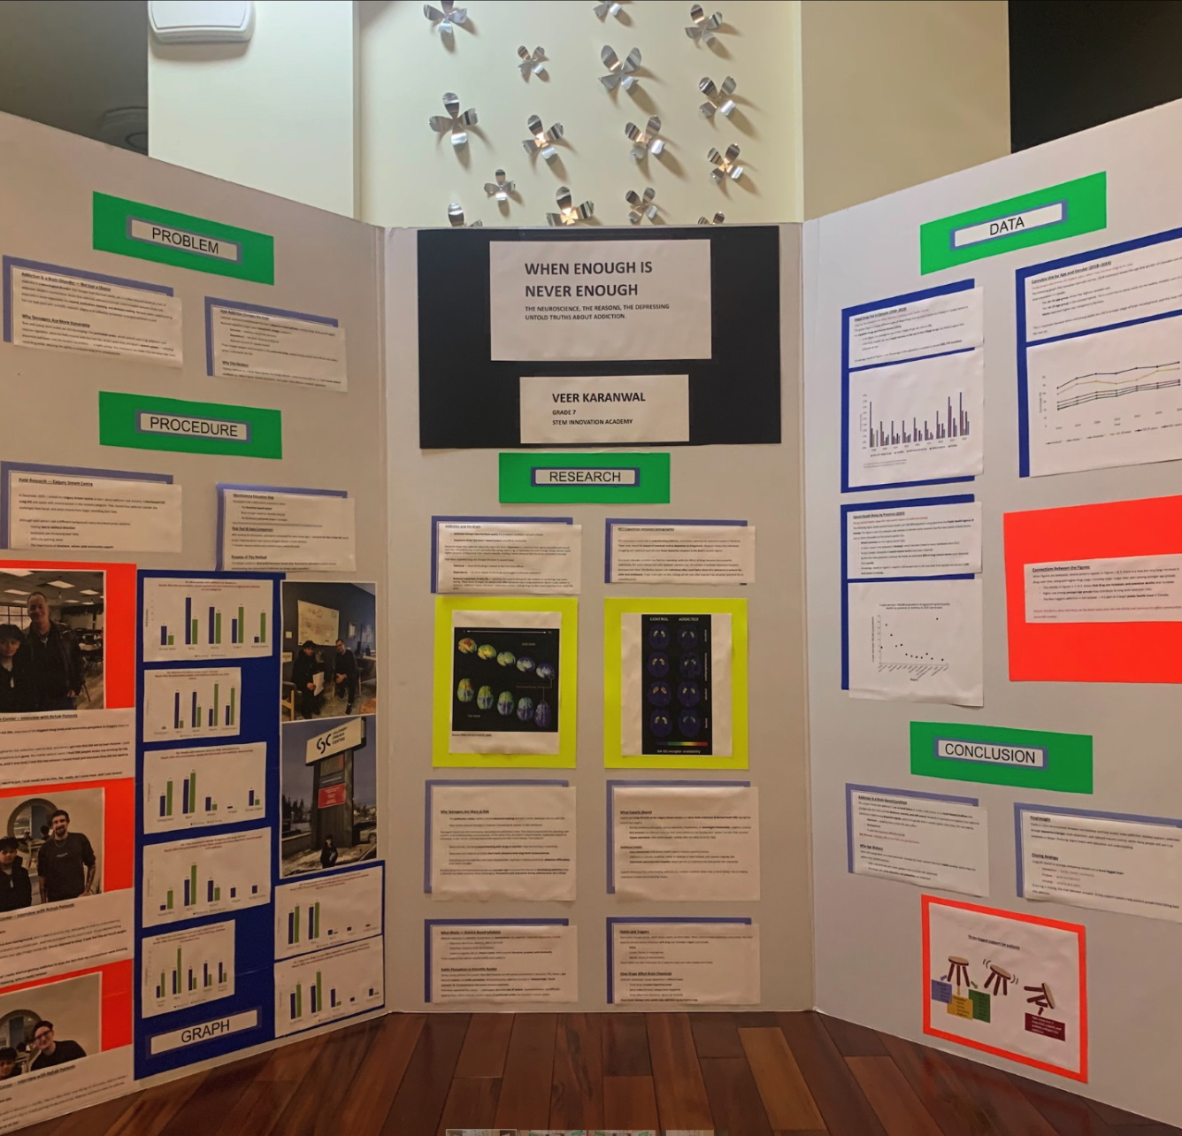
January 28
January 28
My process to build a tri-fold board layout started when I began creating my first design. I designed the sections to present information which connected brain science with its effects on society and its use in recovery. The design process began with visual balance and reading ease as the main focus. Scientific information becomes easier to understand when design elements function effectively.

Slide 33

February 2026
School, and CYSF Science Fair Project

Slide 34
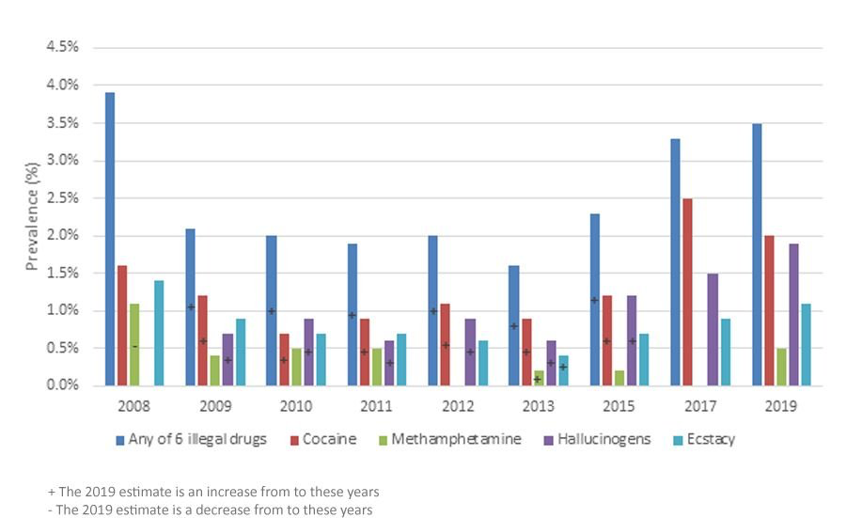
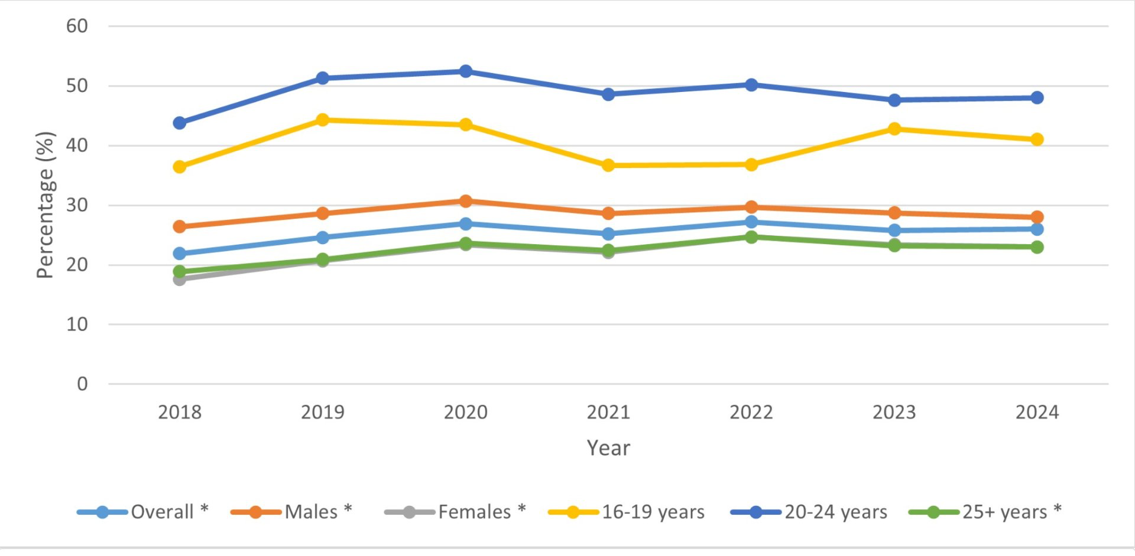

February 2
February 2
I printed graphs and visual materials for the board. I verified each statistic through my approved sources to confirm its correct value. The review process examined all aspects of citation placement throughout the document. Scientific integrity remains a top priority.

Slide 35
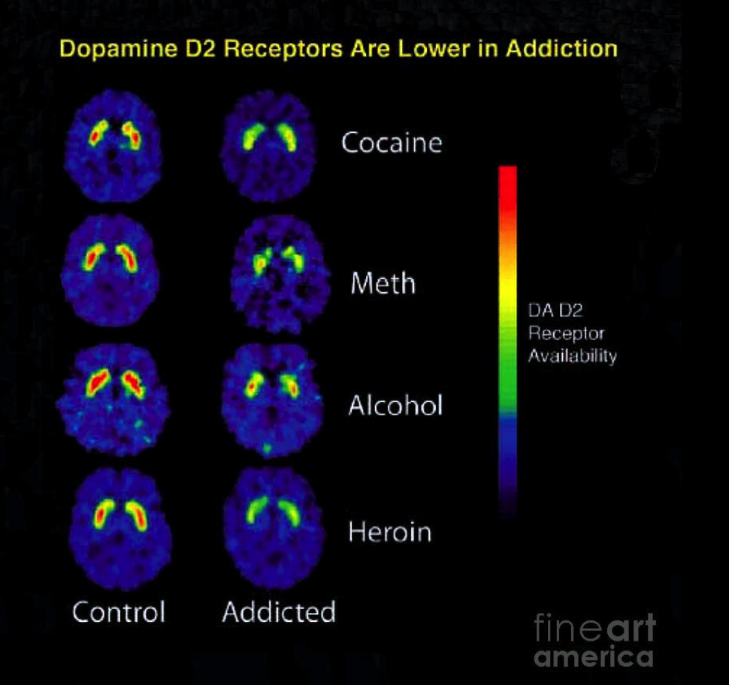
February 5
I refined my PET scan explanation for clarity. I clearly described how tracers bind to dopamine receptors to measure activity levels. The science becomes more accessible when researchers present complex processes in their simplest form. Clear communication is essential during judging.

Slide 36

February 8
February 8
I finished my conclusion. I showed that addiction results in observable changes to the brain because of dopamine receptor down regulation. I demonstrated that educational programs can decrease stigma while improving recovery results. My conclusion establishes a connection between brain science and social responsibility through its explanation of brain science.

Slide 37
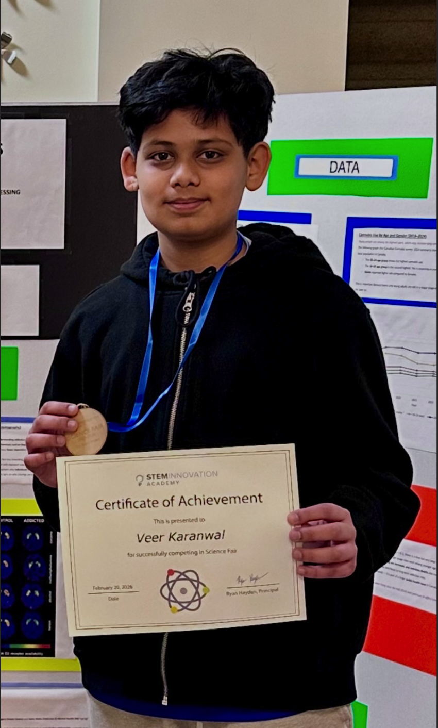
February 20
Today was my School Science fair, competing against grade 7-9, I won the top research project amongst them all, I will continue to practice my speech for CYSF

Slide 38

February 28
Today will be my last entry I have shortened my presentation and I am almost done my online section of the CYSF Portal
I am excited for the Day to come and am still changing minor errors

