Slide 1
Salt, Water, and Bean Plants
Ryan Kolosowski, 6C
Webber Academy

Slide 2
Scientific Question
Hypothesis
How does salt affect plant growth?
If more salt is present in the water used to water a bean plant, then that bean plant will grow less than the bean plant with less salt in the water.

Slide 3
Background Research
Increased salt in water and soil in dry and semi dry areas happens wherever irrigated agriculture is practiced.
This occurs because water has minerals and salt. As water evaporates, minerals and salt are left behind and accumulate
It seriously affects productivity on about 50 million acres (20 million hectares) of the worlds’ irrigated land.
In Mesopotamia, Sumerian irrigation practices caused a salt build-up in water and soils that inhibited food production and no doubt contributed to the decline of Sumerian culture.

Slide 4
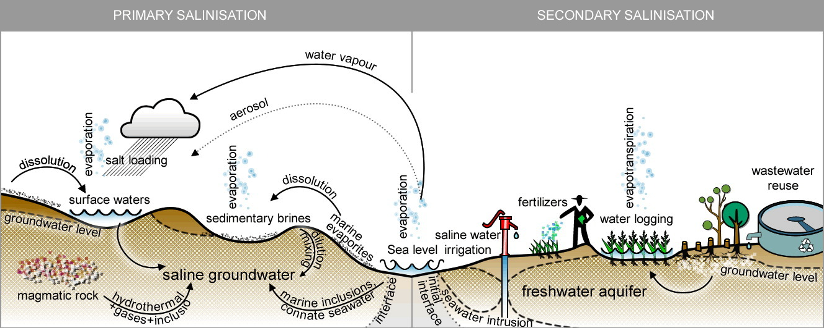
Soil Salinization https://ars.els-cdn.com/content/image/1-s2.0-S0048969716318794-fx1_lrg.jpg

Slide 5
Background Research
Salt in water and soil can lead to decline in world food production and can lead to hunger and starvation.
During winter many areas in Canada put lots of salt on the roads to try to melt the snow and ice.
In the spring, when it rains, the salt gets swept away and goes into the soil and onto the fields.
Sodium chloride (NaCl) and Calcium chloride (CaCl2) is used on roads.
Plants get affected and die because of the salt.

Slide 6
Variables
Manipulated Variables: Water; Different concentrations of NaCl salt in water (0.5%, 1%, 2%, 5%); Different concentrations of CaCl2 salt in water (0.5%, 1%, 2%, 5%)
Responding Variables: Presence of Sprouting; Height of Plants; Condition of plants
Controlled Variables: Amount of water; Amount of sunlight; Amount and type of soil; Temperature; Beans

Slide 7
Materials List
Beans: Blush Lane
Miracle Gro potting mix: Home Depot
Sifto Table Salt: Safeway; Diluted
Alaskan Premium Ice Melter: Home Depot; Diluted
Tap Water
Clear Cups: Amazon
Pyrex Liquid measuring cup: Bed, Bath and Beyond
Kitchen Scale

Slide 8
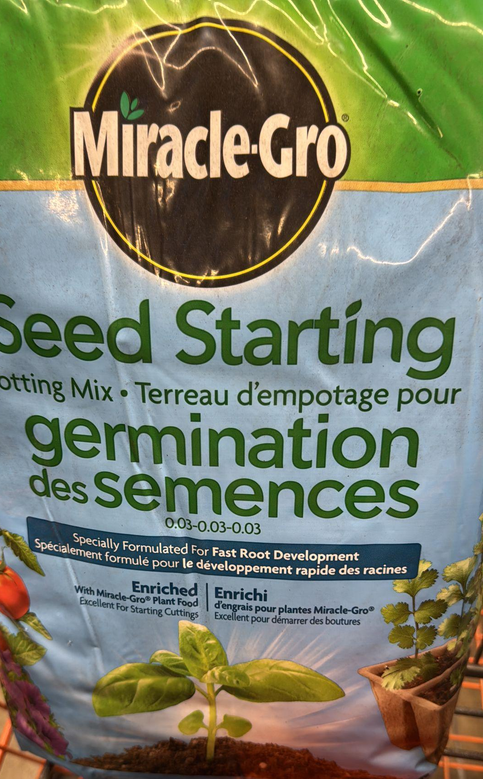
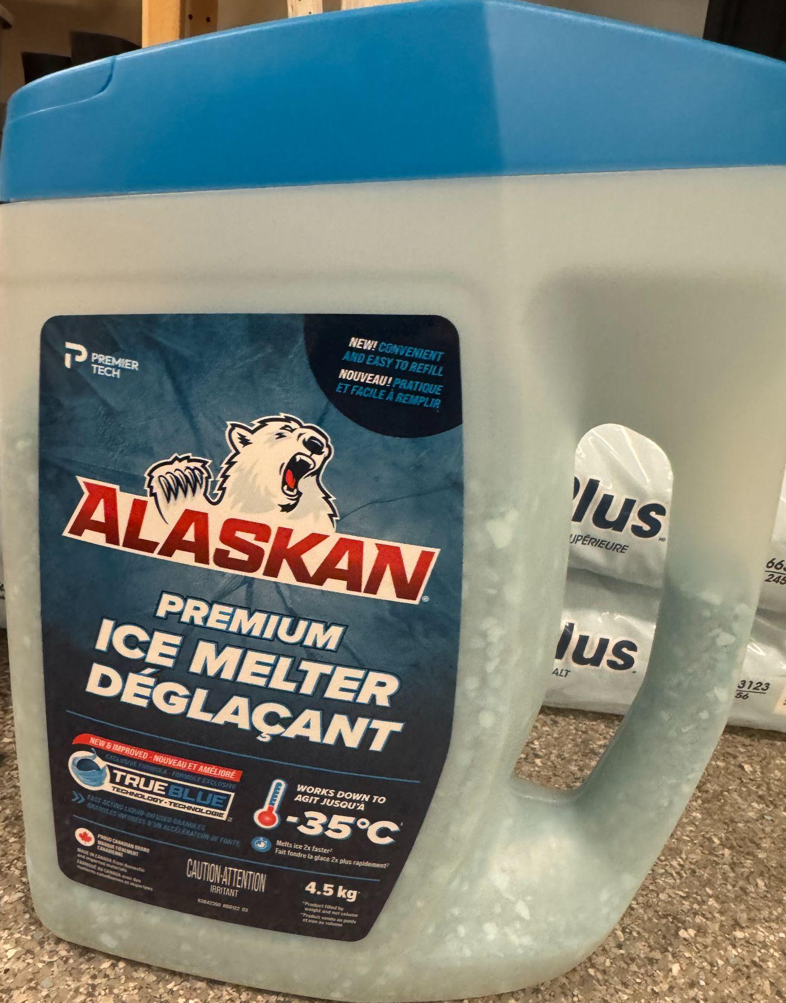
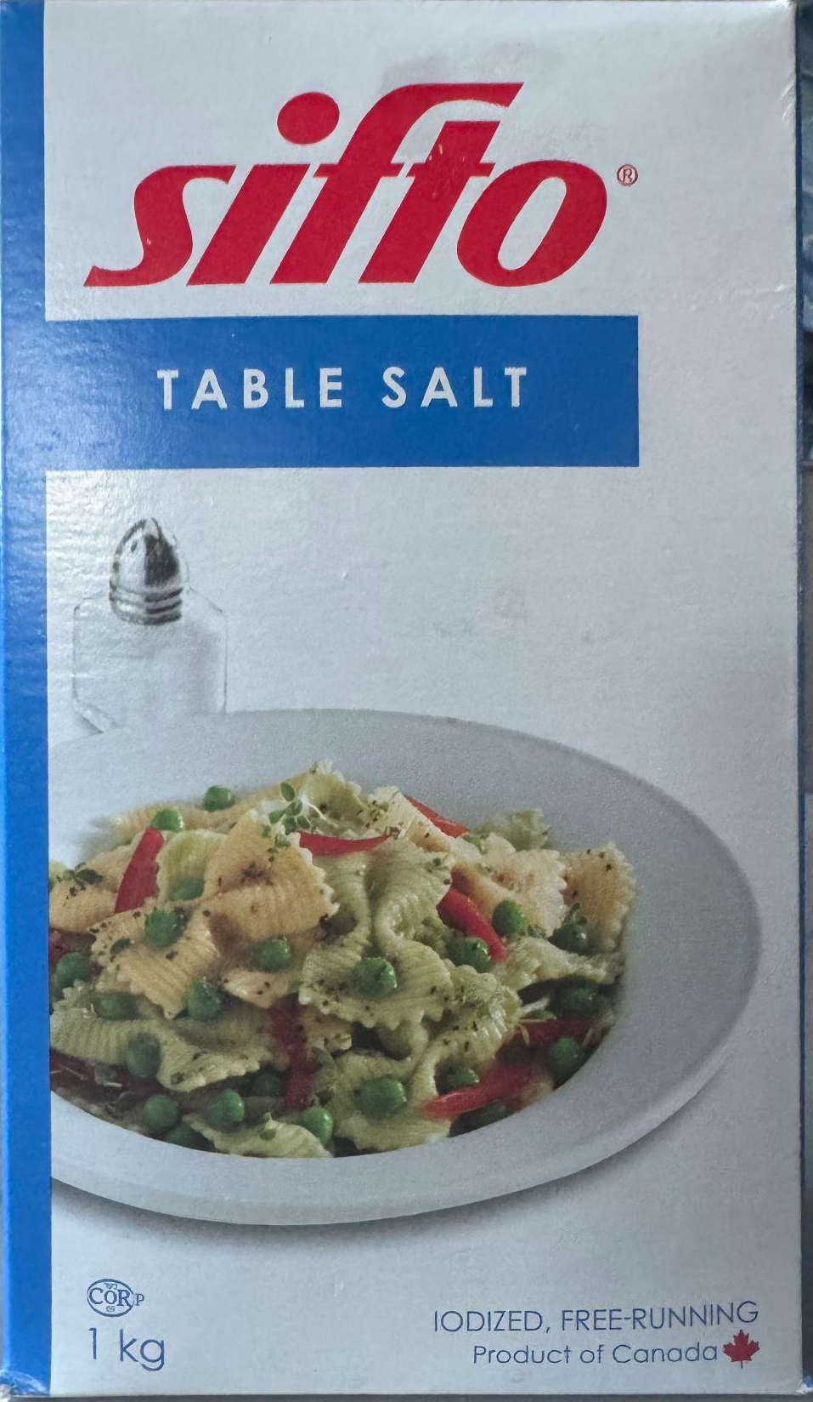
Beans
Cups
Potting Mix
Calcium Chloride, CaCl2
Table Salt, NaCl

Slide 9
Procedure
Fill 27 cups with the same amount of potting mix.
Place 2 beans inside the soil in each cup.
Prepare different concentrations of NaCl and CaCl2 salt in water in watering cups.
0.5% - 0.5g of salt in 99.5ml of water
1% - 1g of salt in 99ml of water
2% - 2g of salt in 98ml of water
5% - 5g of salt in 95ml of water
Place all bean cups in the same sunny area.
Mark each bean cup with the concentration of solution I will be using to water it.
3 cups each for water and each concentration of salt.
Water with the same amount water and salt solutions in each cup at the same time regularly.
Observe and record sprouting, plant height and condition of plant, ex. Is the plant wilted/withery?

Slide 10
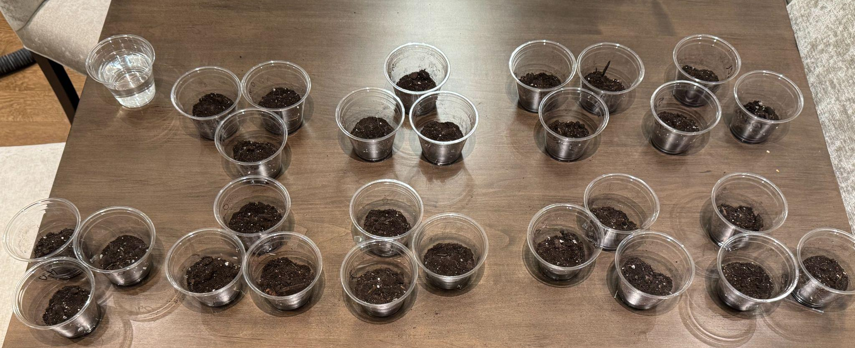
Set Up

Slide 11
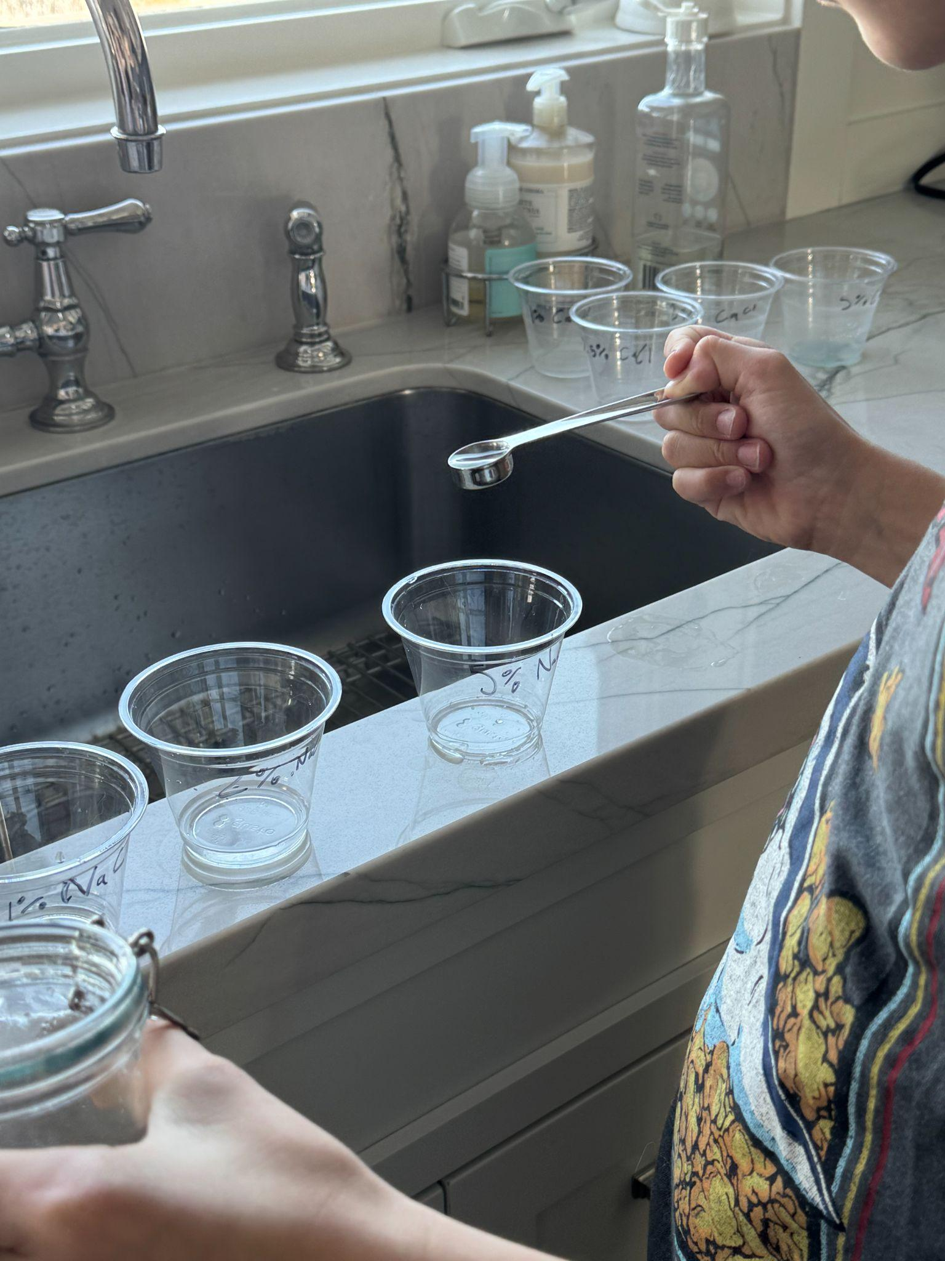
Preparation of Salt Solutions
Water, 0.5%NaCl, 1%NaCl, 2%NaCl, 5%NaCl, 0.5%CaCl2, 1%CaCl2, 2%CaCl2, 5%CaCl2.

Slide 12
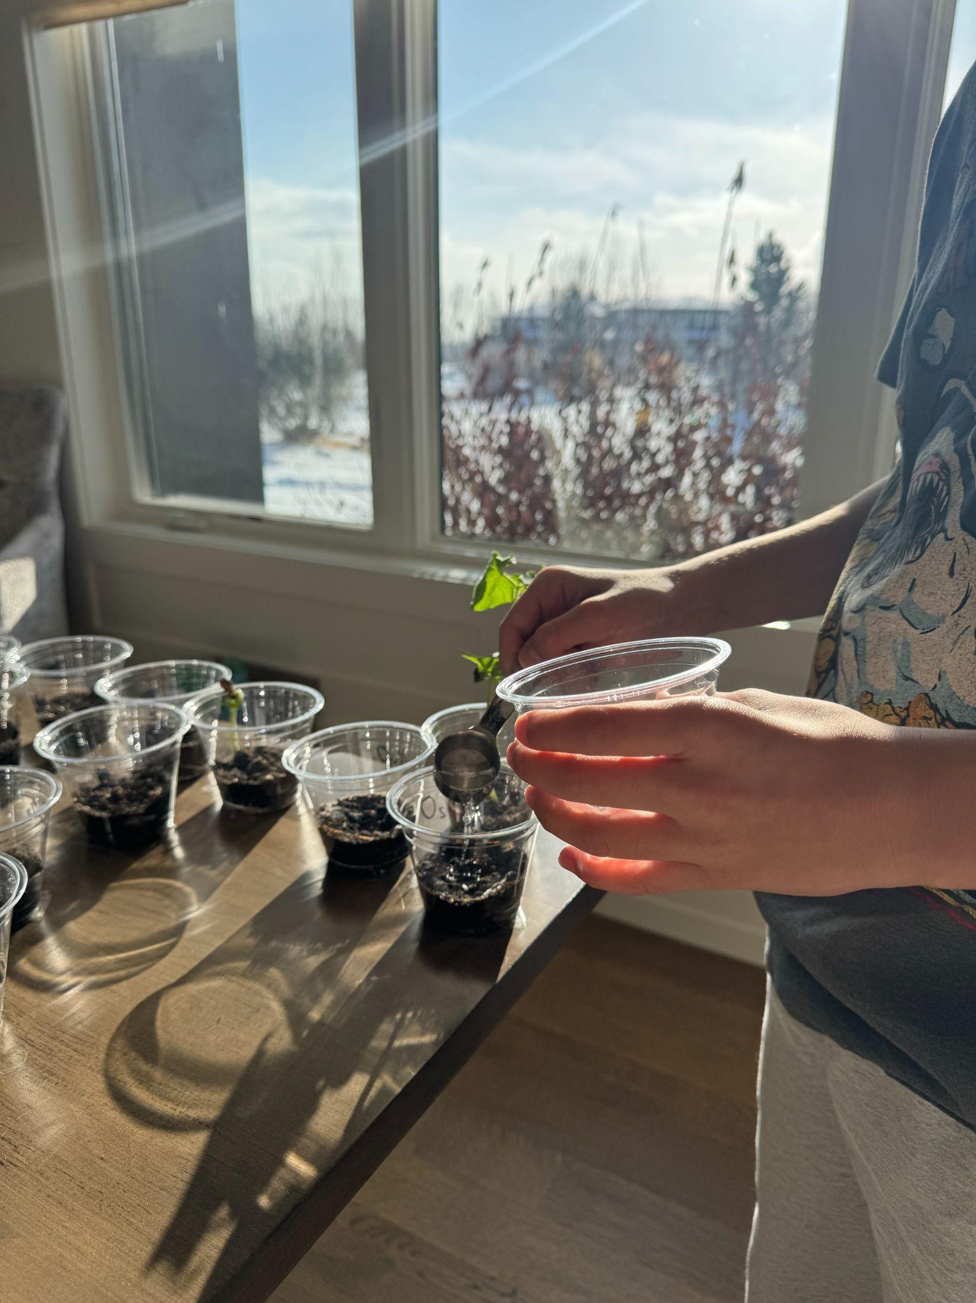
Watering the Plants

Slide 13
Summary of Results
Day | 3 | 7 | 10 | 13 | 15 | 16 | 20 | 23 | 26
H20 | 0 | 1cm | 6cm | 12cm | 12cm | 12cm | 15cm | 16cm | 19cm
H20 | 0 | 0 | 2cm | 7cm | 7cm | 7cm | 10cm | 12cm | 13cm
0.5% NaCl | 0 | 1cm | 3cm | 4cm | 4cm | 4cm | 4cm | 5cm | 5cm
0.5% NaCl | 0 | 0 | 0.5cm | 0.5cm | 0.5cm | 0.5cm | 0.7cm | 1cm | 1cm
0.5% CaCl2 | 0 | 0 | 0.3cm | 0.3cm | 0.3cm | 0.3cm | 0.3cm | 0.3cm | 0.3cm
1% NaCl | 0 | 0 | 0 | 0 | 0 | 0 | 0 | 0 | 0
1% CaCl2 | 0 | 0 | 0 | 0 | 0 | 0 | 0 | 0 | 0
2% NaCl | 0 | 0 | 0 | 0 | 0 | 0 | 0 | 0 | 0
2% CaCl2 | 0 | 0 | 0 | 0 | 0 | 0 | 0 | 0 | 0
5% NaCl | 0 | 0 | 0 | 0 | 0 | 0 | 0 | 0 | 0
5% CaCl2 | 0 | 0 | 0 | 0 | 0 | 0 | 0 | 0 | 0

Slide 14
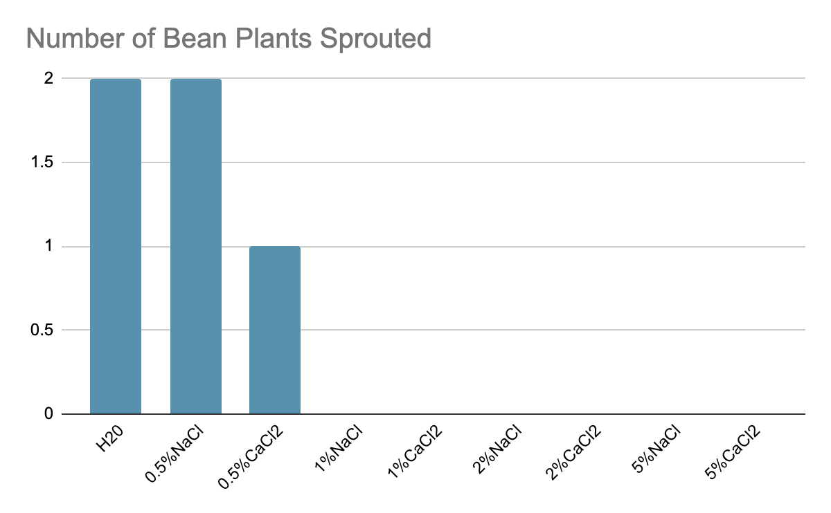

Slide 15
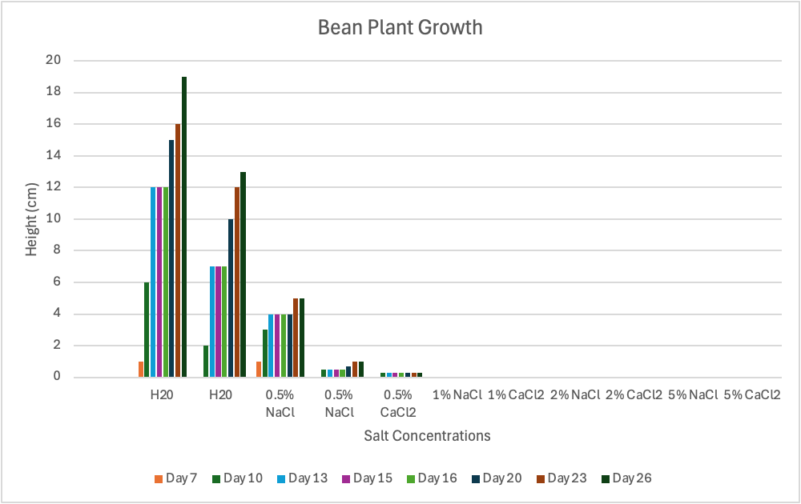

Slide 16
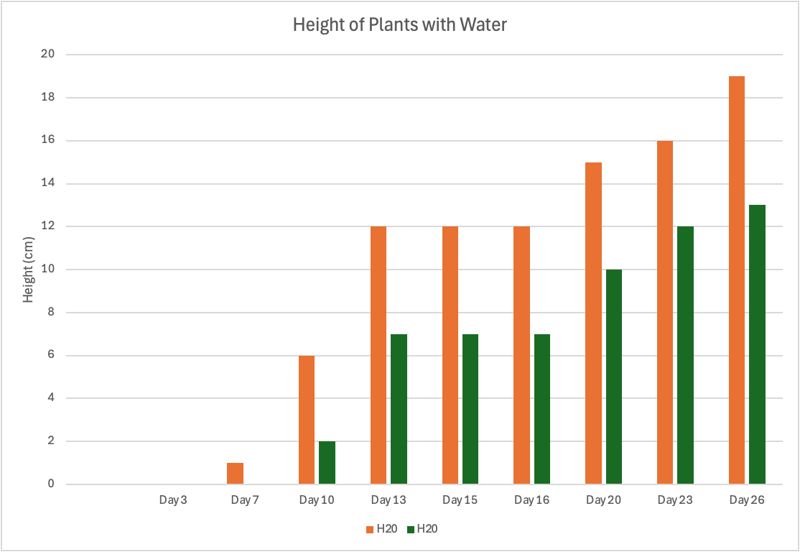

Slide 17
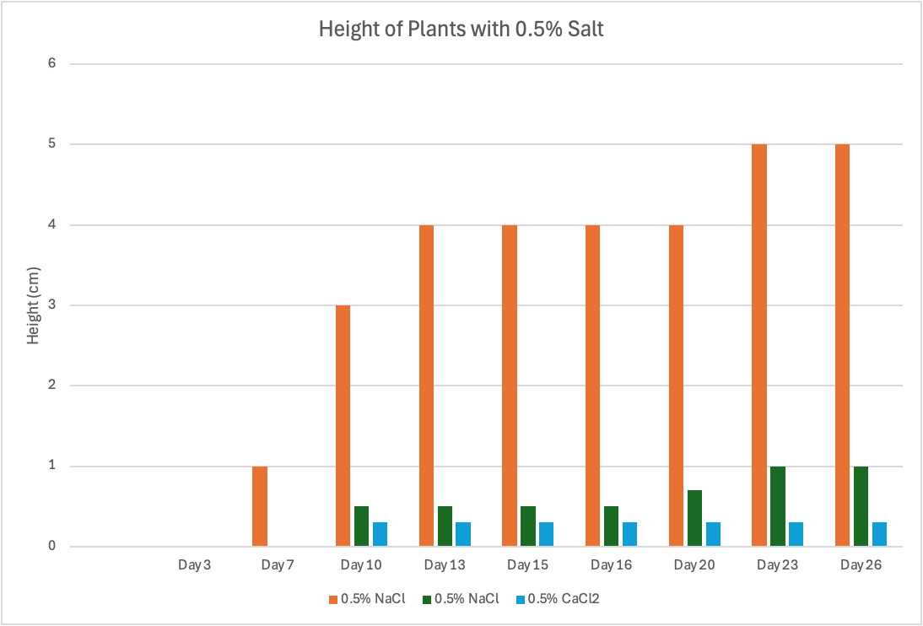

Slide 18
Observations
On Day 16 beans plants wilted slightly and these cups had soil that looked dry.
On Day 20 and forward salt residue was observed on all bean cups watered with 2%NaCl, 2%CaCl2, 5%NaCl, and 5%CaCl2.
Some beans even with water did not sprout.

Slide 19
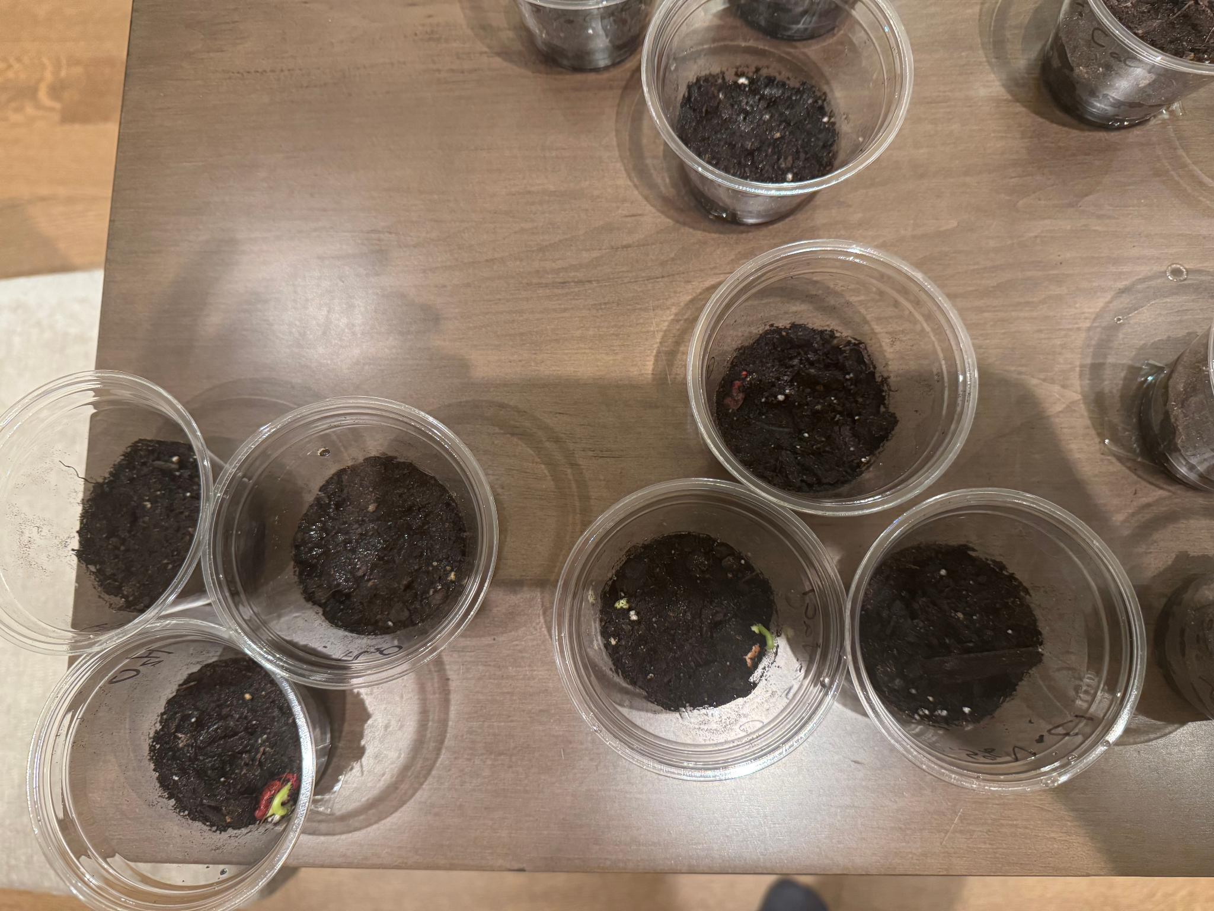
Day 7 Sprouting is Oberved in H20 and 0.5%NaCl

Slide 20
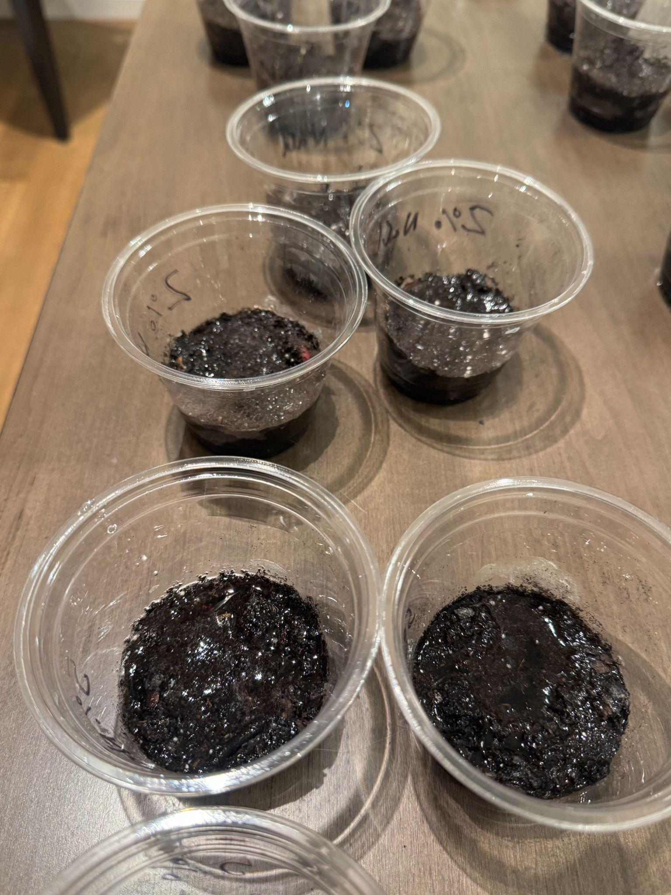
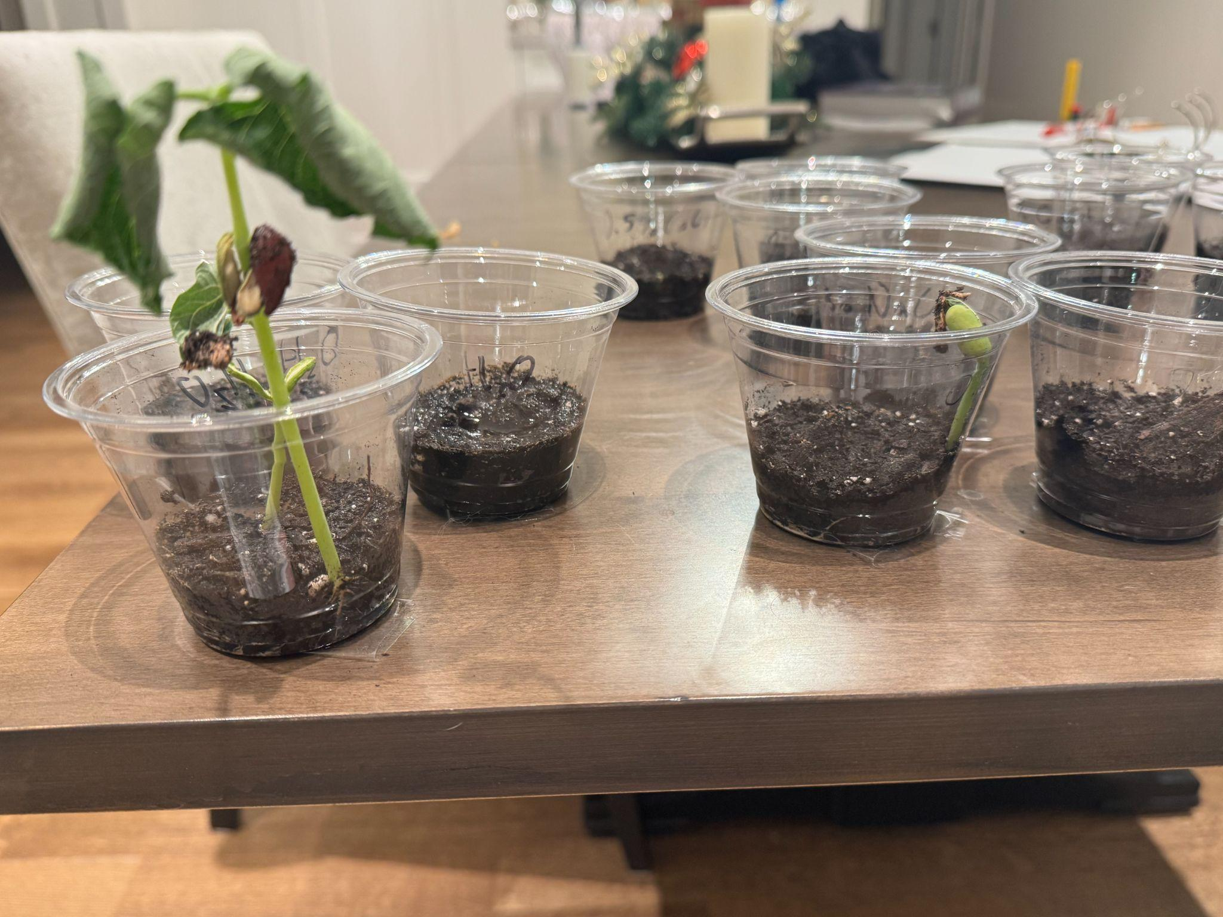
Day 20 Plants are Growing, Salt Residue in 2% and 5%.

Slide 21
Analysis
Plants with just water continued to grow throughout the experiment.
Plants with low concentrations of salt sprouted but grew little as the salt accumulated.
Beans with high salt concentrations never sprouted.
Plants wilted and soil looked dry because the plant used up all water.
Salt residue occurred because the water evaporated leaving the salt behind.
Even with water not all seeds sprouted.

Slide 22
Conclusion
Water allowed beans to sprout and grow continuously.
Small amount of salt in water allowed the sprouting but the plants stopped growing after a few days.
Large concentrations of salt in water prevented sprouting and growth.

Slide 23
Application
Governments can use this study to decrease the use of NaCl and CaCl2 on roads that are close to agricultural areas.
It is useful to know what concentration of salt in water causes problem with bean plants. There are agricultural areas in the world where a lot bean plants are grown. Those could be kidney beans, soy beans, or other types of beans. If the roads are salted close to the fields, this could lead to a lower harvest.
Also, if the fields are irrigated with water with even a small amount of salt, then over the months and years the soil will accumulate the salt causing the same problem again. The best water for growing plants is rainwater, because it does not contain any minerals or salt.

Slide 24
Application
When there is snow or ice on the roads, salt is used to melt it. If we can find a good substitute for the salt, then this will prevent the negative effects of salt on plants.
Some studies showed that CaCl2 was safer than NaCl for plants. My study shows that it is worse, so CaCl2 should not be used as a substitute.

Slide 25
Sources Of Error
It is possible that the temperature in my home is not right for the plants to sprout and grow. Maybe too little or too much water and solutions were used on the plants.
The cups with beans were put where the sun shone well and that might have been too sunny for the beans.
Also, my measurements of salts and water to prepare the solutions might have not been exact. I used a kitchen scale that may not be the best method of measuring small amounts.

Slide 26
Citations
https://www.iaea.org/newscenter/news/crp-success-story-landscape-salinity-and-water-management-for-improving-agricultural-water-productivity-d12013 (2025). Lee Heng, John Brittain, CRP Success Story: Landscape Salinity and Water Management for Improving Agricultural Water Productivity
https://www.sciencedirect.com/science/article/abs/pii/S0048969716318794 (2025). I.N. Daliakopoulos, The threat of soil salinity: A European scale review
https://www.noaa.gov/jetstream/ocean/sea-water (2025). Sea Water
https://openknowledge.worldbank.org/server/api/core/bitstreams/78b9fa85-83e6-549b-9c2c-d33099c0bc50/content (2025). Jason Russ, Salt of the Earth
https://www.scienceworld.ca/resource/bean-garden/ (2025). Bean Garden
https://www.sciencedirect.com/science/article/abs/pii/S0022169421004741 (2025). Lee Dong, Evaporation-induced salt crystallization and feedback on hydrological functions in porous media with different grain morphologies
https://www.degruyter.com/document/doi/10.1515/opag-2017-0064/html (2025). Eric B. Kouam, Genotypic variation in tolerance to salinity of common beans cultivated in Western Cameroon as assessed at germination and during early seedling growth
https://www.bluelinetrans.com/plant-tolerance-to-calcium-and-magnesium-chloride-concentrations (2025). Plant Tolerance to Calcium and Magnesium Chloride Concentrations
https://roam.macewan.ca/items/7893d495-802a-4d1e-badd-8ab4c2286277 (2025). Brittany Tonsi, Effects of NaCl and CaCl2 salinity stress on the germination, seedling and root morphology of Dalea candida
https://ars.els-cdn.com/content/image/1-s2.0-S0048969716318794-fx1_lrg.jpg (2025).

Slide 27
Acknowledgements
I would like to acknowledge my teacher, Mr. Baillie for helping me with the project and my mom and dad for giving me pointers after I presented in front of them.

