Slide 1
Blood Glucose Levels
By: Puneet Dhillon Grade 7A

Slide 2
Testable Question
When testing for how a mango, milk chocolate and coke would increase the blood glucose levels using a blood glucose monitoring watch then which food will increase the blood glucose levels the most?

Slide 3
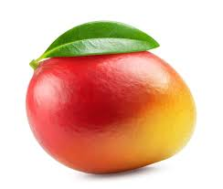
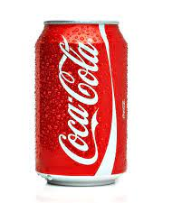
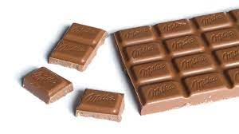
Hypothesis
If we test for the amount of glucose in a medium sized raw mango, 1 bar of milk chocolate (100 grams) and 1 can of coke using a glucose monitoring watch than, milk chocolate would raise the blood glucose levels the most. Milk chocolate has a whooping 52 grams of sugar (glucose and sucrose) where as a average sized raw mango has 8.98 grams and a 12 oz can of coke
has 39 grams of sugar. This is only estimate as many factors apply such as carbohydrates and fats.

Slide 4
Keywords and definitions
Glucose - A type of sugar which engenders fuel for the body through metabolism.
Blood glucose levels - The amount of glucose in the bloodstream.
Insulin - A milky white substance which is produced by the pancreas to lower down the blood glucose and allows it to be utilized by the cells.
Diabetes - A condition in which the pancreas doesn’t properly respond with the body; it either doesn’t make any insulin at all or injects insulin at wrong times.

Slide 5
Glucose and insulin Background Research
Glucose is engendered through the metabolism of the body, acting as the fuel of the body. A variety of foods that we consume contain glucose. Whether we consume sucrose (table sugar) or foods containing carbohydrates such as starches our body breaks these resources down to glucose. When the body breaks these foods down, insulin is produced by the pancreas. The pancreas plays a crucial role in the body by regulating the breakdown of carbohydrates, fats and proteins. Additionally it releases the enzymes into the small intestines to aid in the absorption of nutrients from victims. The pancreas releases insulin as it corresponds with the body.

Slide 6
What is diabetes? Background Research
The insulin let's glucose reach the bloodstream. It then lets the cells in the body to utilize the glucose. They may utilize the glucose as energy or store the glucose for other times. The body releases glucose when we consume it. For example the amount of glucose in the body is higher at lunch than in the middle of the night. The amount of glucose is referred to as the blood glucose level. When the glucose is utilized in cells the blood glucose level drops meaning the pancreas stops injecting insulin to the body. With diabetes, the basic definition for it is the pancreas doesn't respond with the body. The pancreas either doesn't inject insulin at all or injects insulin at the wrong times.

Slide 7
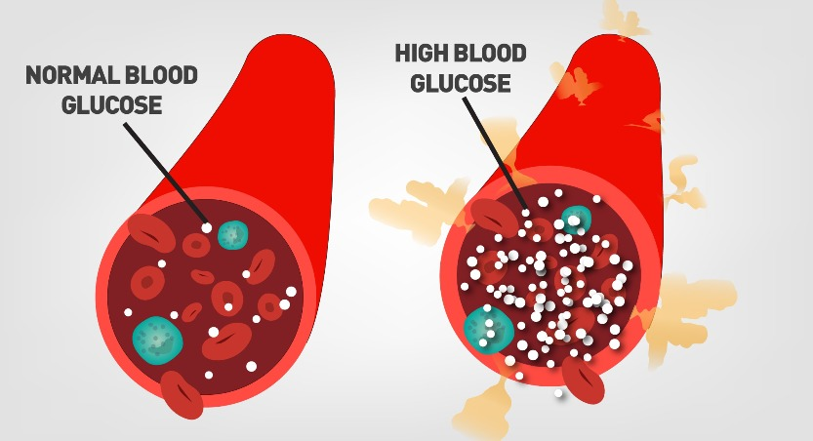
Symptoms of diabetes Background Research
Due to this the blood glucose level may ascend or decline to hazardous levels. Symptoms of diabetes may range from mild to severe. Some symptoms of diabetes include weakness, urinating more frequently, feeling very thirsty and hungry, feeling very
energetic and then followed by
tiredness (mood swings), and
losing large amounts of weight in
a short period of time.

Slide 8
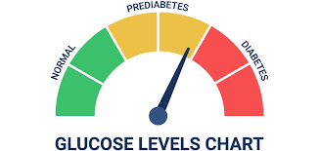
Types of Diabetes Background Research
Prediabetes - Diabetes doesn’t just appear in a few days. Diabetes gives an abundance of signals before they genuinely appear in a few days. These signals could take up to 10 years. During this period a person has prediabetes. Prediabetes is when you have a higher blood glucose level than a normal person but not as dangerously high to be relegated as
diabetes. A person with prediabetes
has a more preponderant chance of
developing a heart disease than a
average person.

Slide 9
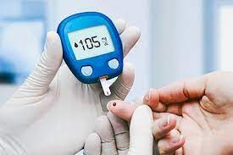
Types of Diabetes Background Research
Type 1 diabetes - In type 1 diabetes the pancreas either makes very little insulin or engenders no insulin at all. Insulin is very important as it allows glucose to be stored or utilized for energy by the cells. Unfortunately there is no cure for type 1 diabetes. 1.25 million people have to deal with
type 1 diabetes in United States
alone. Treatment of type 1
diabetes is a lifelong insulin
pump and a continuous glucose
monitor.

Slide 10
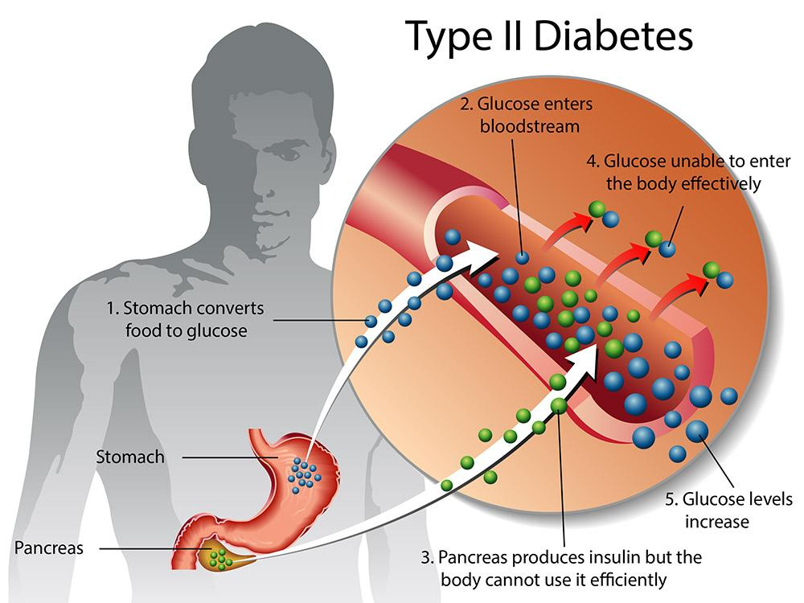
Types of Diabetes Background Research
Type 2 diabetes - During type 2 diabetes the pancreas doesn’t properly correspond with the body. This is when the body doesn’t make enough insulin or injects it at wrong time. In United States 38 million people have type 2
diabetes! However there is no
treatment of type two diabetes.
Diseases such as heart diseases,
strokes, foot problems, eye and
kidney disease have a increased
chance of happening.

Slide 11
The model Background Research
In this experiment we will be making a simulation of the human body. In a adult human body there is 1.2 - 1.5 gallons of blood, making a average of 1.3 gallons. Liters will be used here as it is a whole number. 1.3 gallons = 5 liters. The normal blood glucose levels are approximately 90 mg/dl the same as 5mm (mmol/l.) In 5 liters of blood there is about 3.3 - 7 grams of glucose (C₆H₁₂O₆) in a adult human body which is a average of 5.1 grams. This experiment will be done at a much smaller scale at 200 ml. Which means everything will be divided by 25. Scale 1:25. This means the amount of glucose in the experiment will be 0.204 grams.

Slide 12
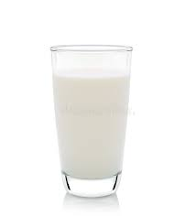
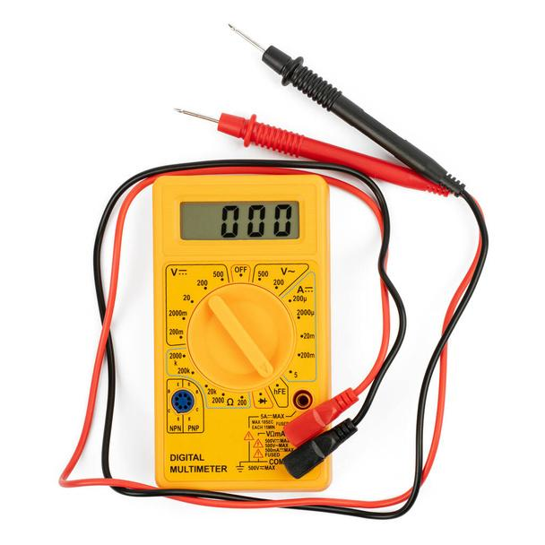
The model Background Research
The blood will be represented by milk as it is not a conductor of electricity unlike water. To the milk salt will be added as it is a conductor of electricity. The voltage of the milk is 0. In this model the average blood glucose level is 0.9 volts. 0.9 volts represent the average blood glucose level
which is about 4.75 mmol/l.

Slide 13
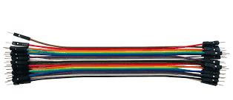
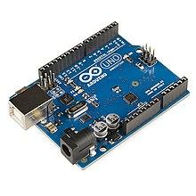
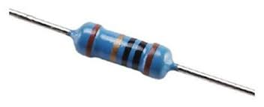
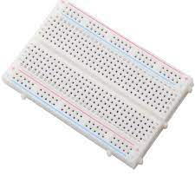
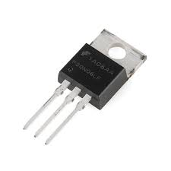
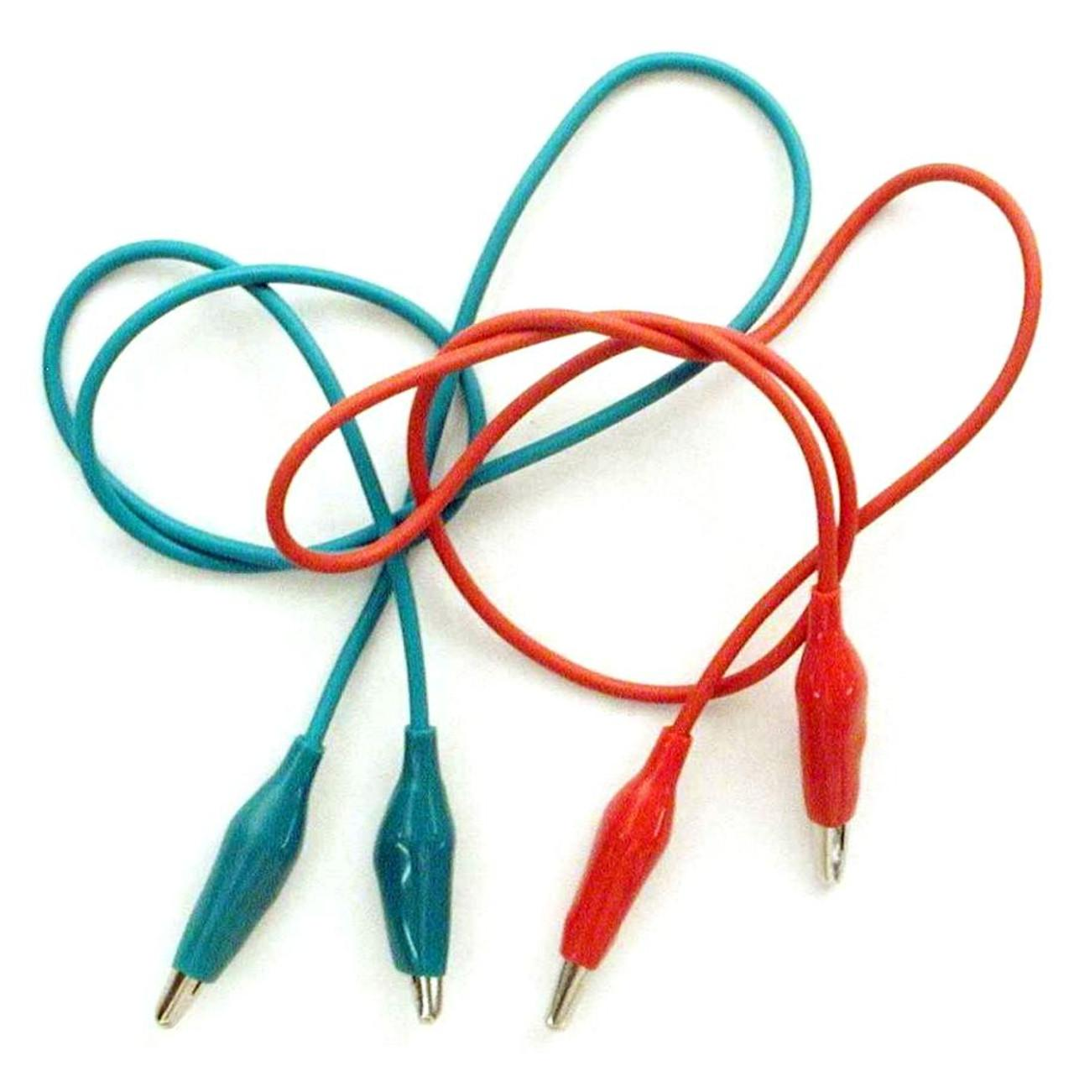
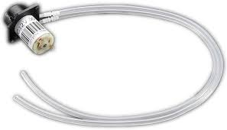
Materials
1 Arduino-compatible microcontroller board
1 USB cable
1 Small breadboard
Male to male jumper wires
1 5V peristaltic liquid pump
1 N-channel MOSFET
1 100 kΩ resistor
6 - 10 Alligator clips
1 Multimeter
7.4 battery supply
Aluminum wrap

Slide 14
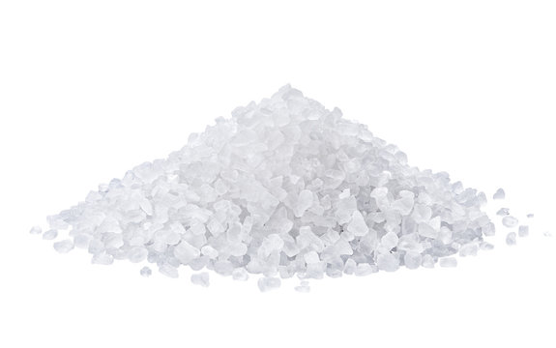
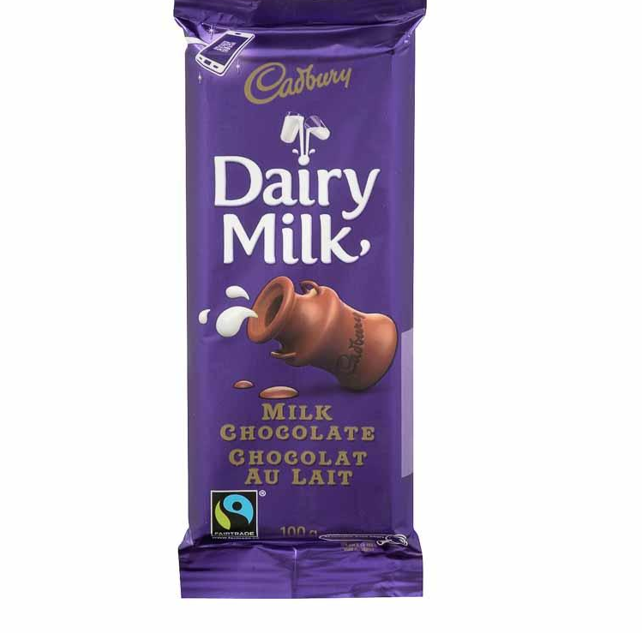
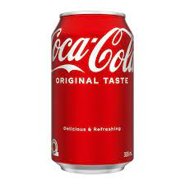
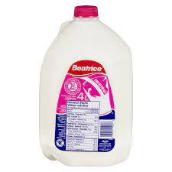
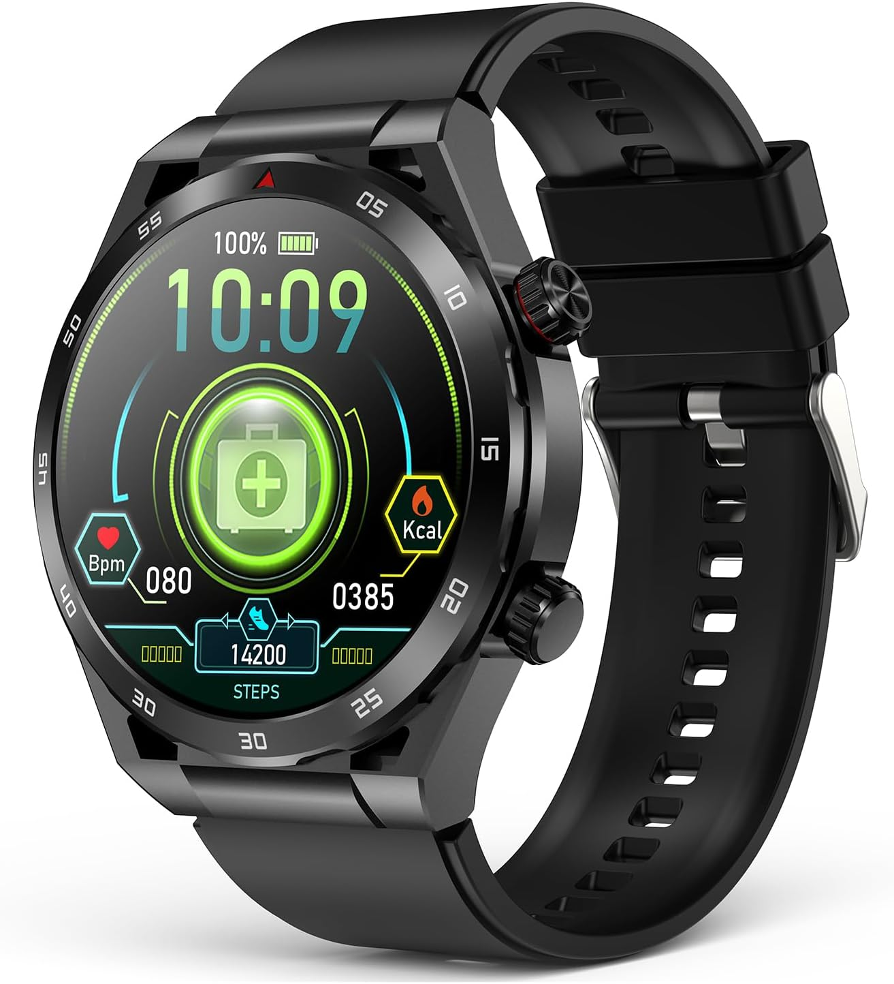
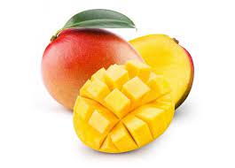
Materials
Tape
Scissors
About 1 liter Beatrice 2% milk
120 - 90 grams table salt
Measuring equipment
3 Average sized mangos
3 100 gram milk chocolates
3 Small cans of coke (222 ml)
1 Continuous glucose monitoring watch
3 participants

Slide 15
Variables Part A
Manipulated variable: My manipulated variable is the type of food being tested on a person. (Average sized mango, 100 grams of milk chocolate and 222 ml of coke)
Controlled variable: My controlled variable is the watch that is being used, the time the food is eaten at, how constantly the watch measures, and how long the experiment lasts.
Responding variable: Which food will increase the blood glucose levels the most.

Slide 16
Variables Part B
Manipulated variable: My second manipulated variable is the the way the simulator works to show the different types of diabetes after digesting food.
Controlled variable: My controlled variable is the way the simulator that is being used is built, the amount of milk, the size of the container, and the conductance sensor.
Responding variable: The blood glucose levels measured through the voltmeter for different foods.

Slide 17
Procedure (Glucose Monitoring) Part A
1. For participant number 1 a glucose monitoring watch is worn tight but comfortable.
2. Then at 4:45 AM in the morning they are given a mango, the watch starts recording every ten minutes.
3. The participant is then allowed to go to sleep.
4. The watch is kept on until 12:25 PM.
5. The data is recorded after every 10 minutes.
6. The next two day participant 1 eats milk chocolate and coke using the same procedure.
7. The other 3 participants eat the same 3 foods the following days.

Slide 18
Procedure (Diabetes Simulator) Part B
1. To start off, the 5 volt on the Arduino is connected to the positive ground bus on the breadboard using male to male jumper wires.
2. Using two jumper wires connect the (+) and (-) ground busses together.
3. Using male to male jumper wires the GND on the Arduino is connected to the negative bus on the breadboard.
4. Fourth connect the N-channel MOSFET with it facing upwards to the left. The first pin F5, the second in F6 and the last in F7.
5. Add a 100kΩ resistor from H16 to H20.
6. Connect the ∼11 on the Arduino board to G7 on the breadboard.
7. Connect A0 on arduino to F20 of the breadboard.

Slide 19
Procedure (Diabetes Simulator) Part B
8. Connect a wire from J5 to the left negative bus on the breadboard using the wires.
9. Connect a wire from J16 to the left positive bus on the breadboard.
10. On the breadboard we connect another wire from J25 to the negative bus.
11. The pump’s positive terminal will be connect to the left positive ground bus on the breadboard.
12. The negative will be connected to J6 on the breadboard.
13. Next make a conductance sensor. Cut 2 perfect pieces of aluminum foil measuring 30 cm and 1.5 cm.

Slide 20
Procedure (Diabetes Simulator) Part B
14. Than wrap them around a rectangular prism measuring 10 x 2 x 2 cm and weighing about 30 grams.
15. Connect both ends of the foil to alligator clips.
16. Attach a jumper wire from the positive end to J20.
17. For the negative side connect it to I25
18. Next we prepare a one molar NaCl solution (salt) by dissolving 11.7 grams of salt into about 200 ml of lukewarm water.
19. Next we connect the arduino to a computer using a cable.
20. Next we open up the arduino platform.
21. Then we download the calibration code and upload it our arduino. (which I got from science buddies)

Slide 21
Procedure (Diabetes Simulator) Part B
22. Then into 2 containers I added 200 ml of milk.
23. Next we put in our sensor in one container and open the serial monitor.
24. Next we add a little bit of salt to the same container until it reaches 0.9 volts. On the serial monitor it will read a number between 0 - 1023. You will have to convert it by dividing the number by 1023 and then multiplying it by 5.
25. Once it reaches 0.9 volts we add our pump one side into the milk with salt and the other one into the regular milk.
26. Than we add a 122 ml of the salt solution to represent a person with type 1 diabetes ate a mango.

Slide 22
Procedure (Diabetes Simulator) Part B
27. After 10 minutes the number was recorded.
28. Than for milk chocolate 132.1 ml of the salt solution was added and for coke 136.2 ml of the salt solution was added.
29. Than to represent type 2 diabetes a different code was updated which made the pump work and then stop and wasn’t very continuous.
30. The measurements were recorded.

Slide 23
Observations Mango
For person 1 the highest point in the blood glucose graph was 8.07 mmol/l or 145.3 mg/dl.
8.09 mmol/l or 145.6 mg/dl was the highest blood glucose levels for person 2 after consuming a mango.
Person 3’s highest blood glucose levels was 8.02 mmol/l or 144.4 mg/dl.
The average for all the participants was 8.06 mmol/l 145.1 mg/dl.

Slide 24
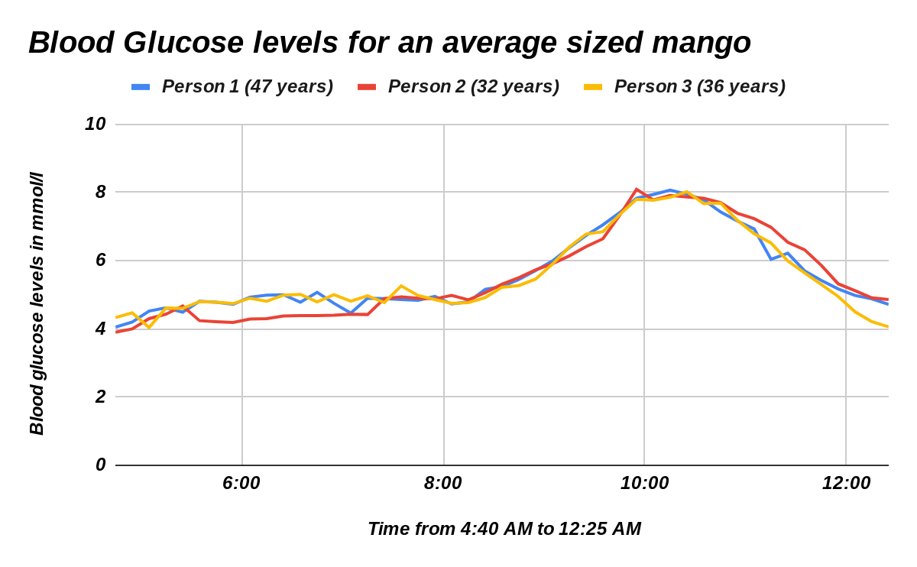

Slide 25
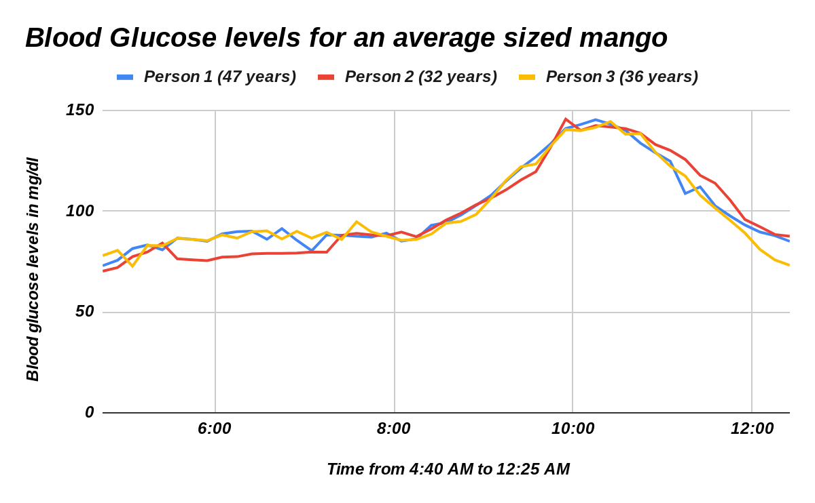

Slide 26
Observations Chocolate
8.3 mmol/l or 149.4 mg/dl was the highest blood glucose levels for person 1 after consuming milk chocolate.
For person 2 the highest point in the blood glucose graph was 8.02 mmol/l or 144.4 mg/dl.
Person 3’s highest blood glucose levels was 8.05 mmol/l or 144.9 mg/dl.
The average for all the participants was 8.12 mmol/l 146.2 mg/dl.

Slide 27
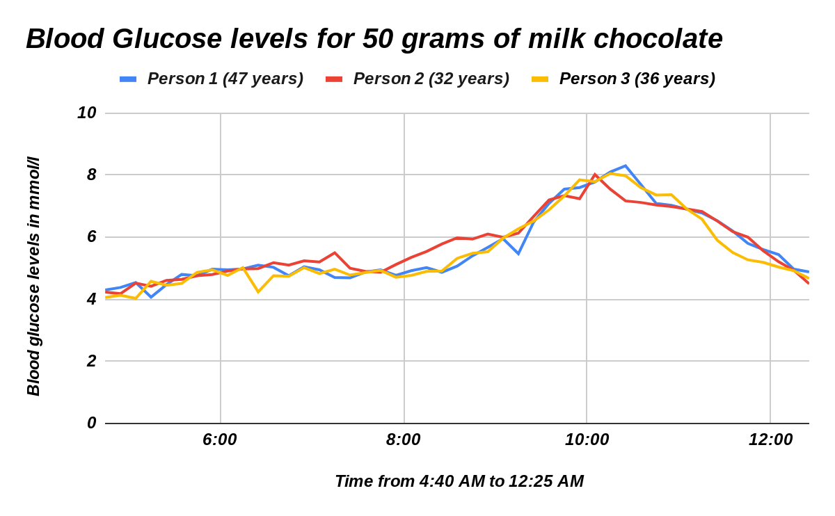

Slide 28
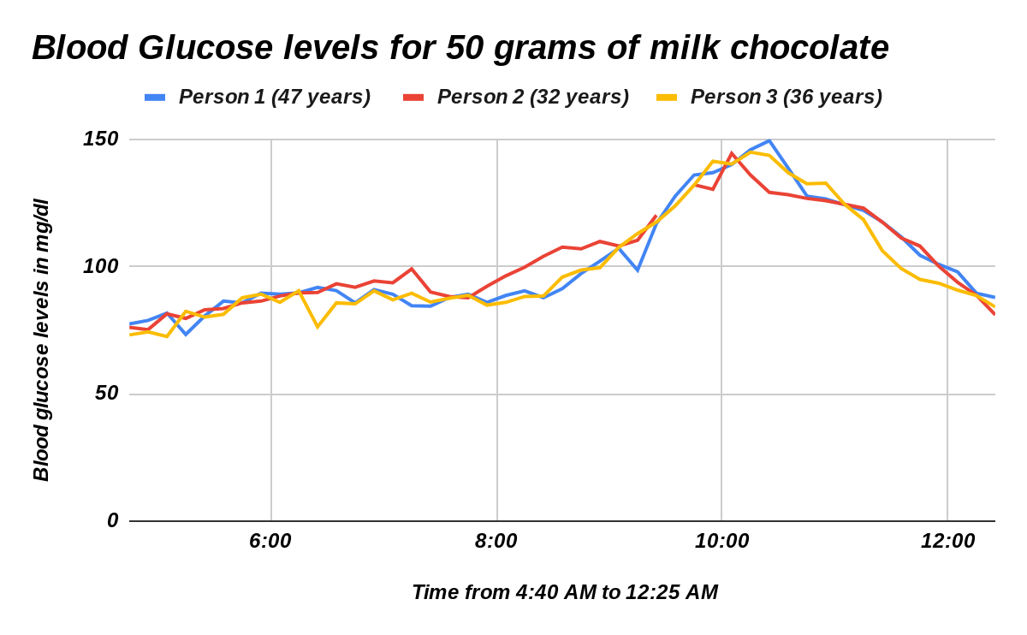

Slide 29
Observations Coke
Person 1’s highest blood glucose levels was 8.38 mmol/l or 150.8 mg/dl
For person 2 the highest point in the blood glucose graph was 8.09 mmol/l or 145.6 mg/dl.
8.22 mmol/l or 148 mg/dl was the highest blood glucose levels for person 3 after consuming milk chocolate.
The average for all the participants was 8.23 mmol/l 148.1 mg/dl.

Slide 30
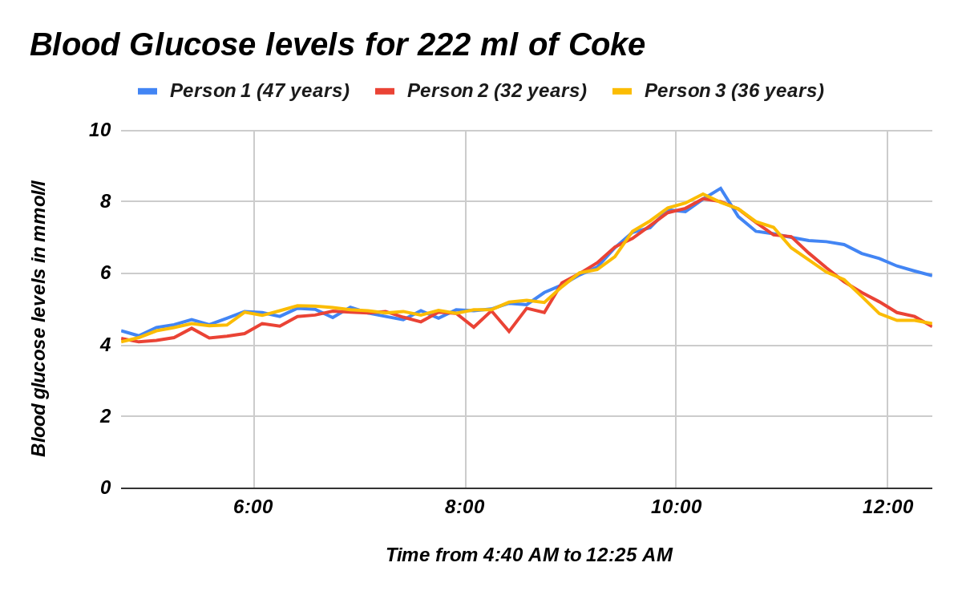

Slide 31
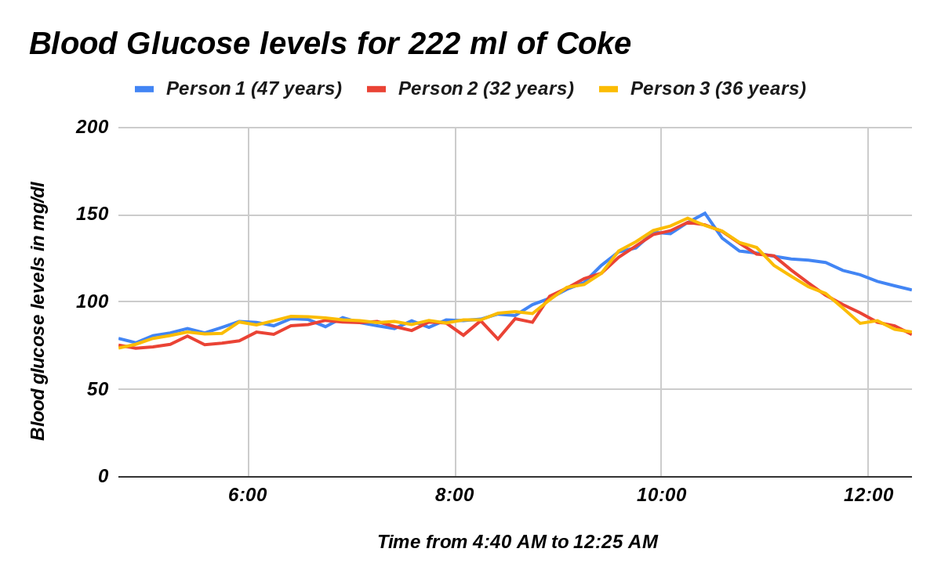

Slide 32
Observations Type 1 diabetes
For type 1 diabetes after 112 ml of a 1 molar NaCl solution was added to represent a mango, after 10 minutes the multimeter read 1.57 volts.
The multimeter read 1.89 volts ten minutes later after adding 132.1 ml of the 1 molar salt solution to represent milk chocolate.
Ten minutes after adding 136.2 ml of the 1 molar salt solution to represent coke the voltage on the multimeter read 1.95 volts.

Slide 33
Observations Type 2 diabetes
The multimeter read 1.43 volts ten minutes later after adding 122 ml of the 1 molar salt solution to represent a mango.
Ten minutes after adding 132.1 ml of the 1 molar salt solution to represent milk chocolate the voltage on the multimeter read 2.03 volts.
For type 1 diabetes after 136.2 ml of a 1 molar NaCl solution was added to represent coke, after 10 minutes the multimeter read 2.27 volts.

Slide 34
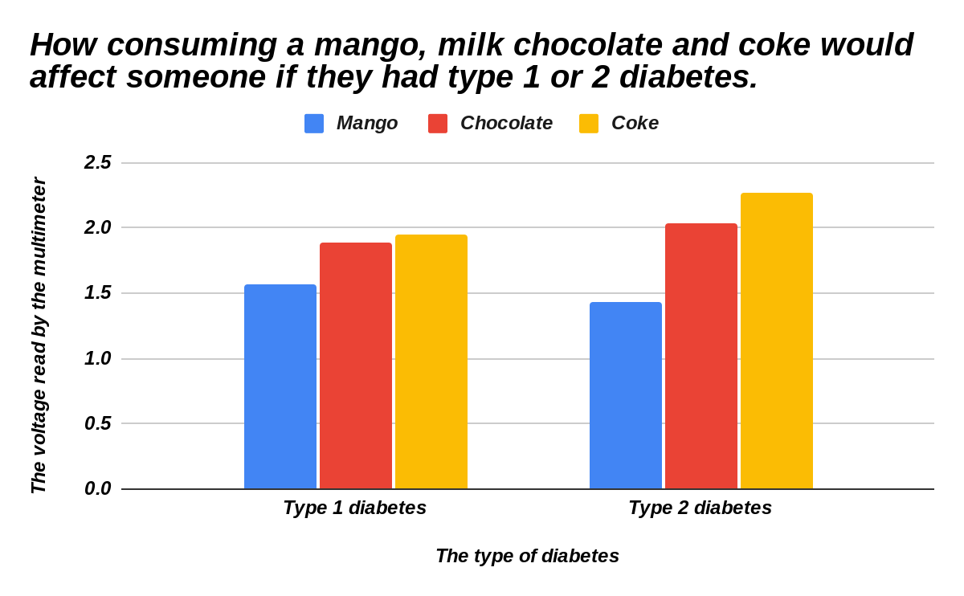

Slide 35
Conclusion
The focus of this experiment was to investigate how consuming a average sized mango, 100 grams of milk chocolate and 222 ml of coke would affect the blood glucose levels. It was hypothesized that the result of this experiment would be that consuming milk chocolate would raise the blood glucose levels the most. This was proved wrong because coke increased the blood glucose levels the most. The results of this experiment showed that the highest average point in the graph after consuming a mango was 8.06 mmol/l or 145.1 mg/dl, for milk chocolate it was 8.12 mmol/l or 146.2 mg/dl and lastly for coke it was 8.23 mmol/l or 148.1 mg/dl. This experiment can be supported by the following research.

Slide 36
Conclusion
Glucose is fuel for the body which is obtained from the foods we consume. Our body breaks them down to glucose. When we eat our blood glucose levels increase. To lower them back down a fluid is produced by the pancreas called insulin. The pancreas releases insulin as it corresponds with the body. This helps lower the blood glucose levels and allow the cells to use the glucose. When the insulin doesn’t properly respond with the body a medical condition known as diabetes is formed. There are different types of diabetes but there is no known cure. If a diabetic person consumes food containing high amounts of glucose it can increase there blood glucose levels to a dangerous level which can harm them.

Slide 37
Conclusion
From this experiment we can infer that a mango has the least amount of glucose, while milk chocolate has more and coke has the most amount of glucose.

Slide 38
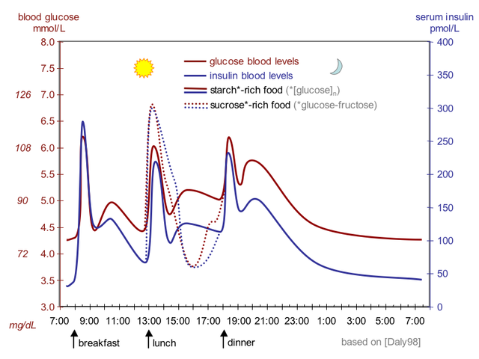
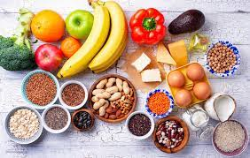
Applications
The results of this experiment can help many people out for a variety of reasons. First it can tell people who are diabetic how different foods will increase your blood glucose level. Second it can help people who are on a strict diet and don’t want to
consume a lot of glucose. Then, they can know which fruits and vegetables are good for them and which aren’t
and those foods would increase their blood glucose levels to a certain level.

Slide 39
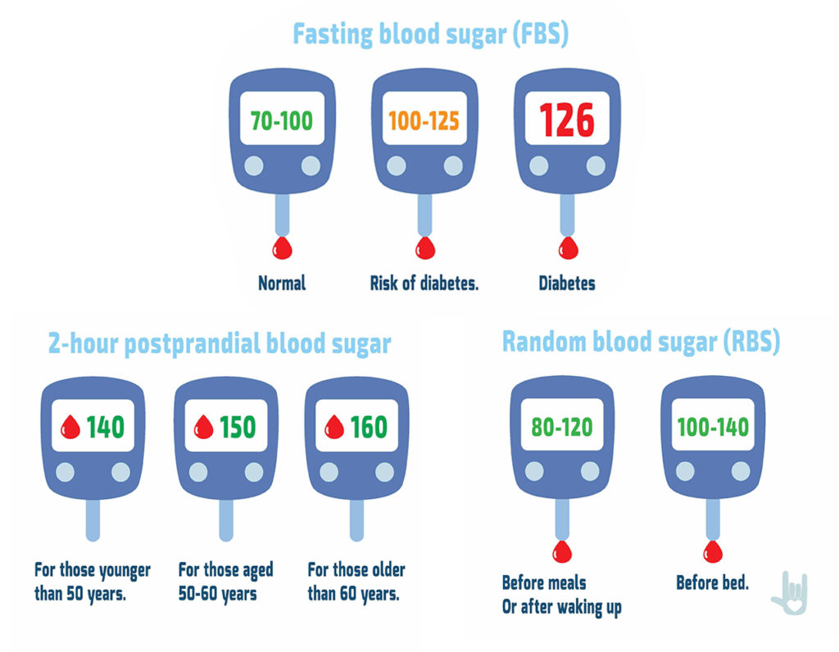
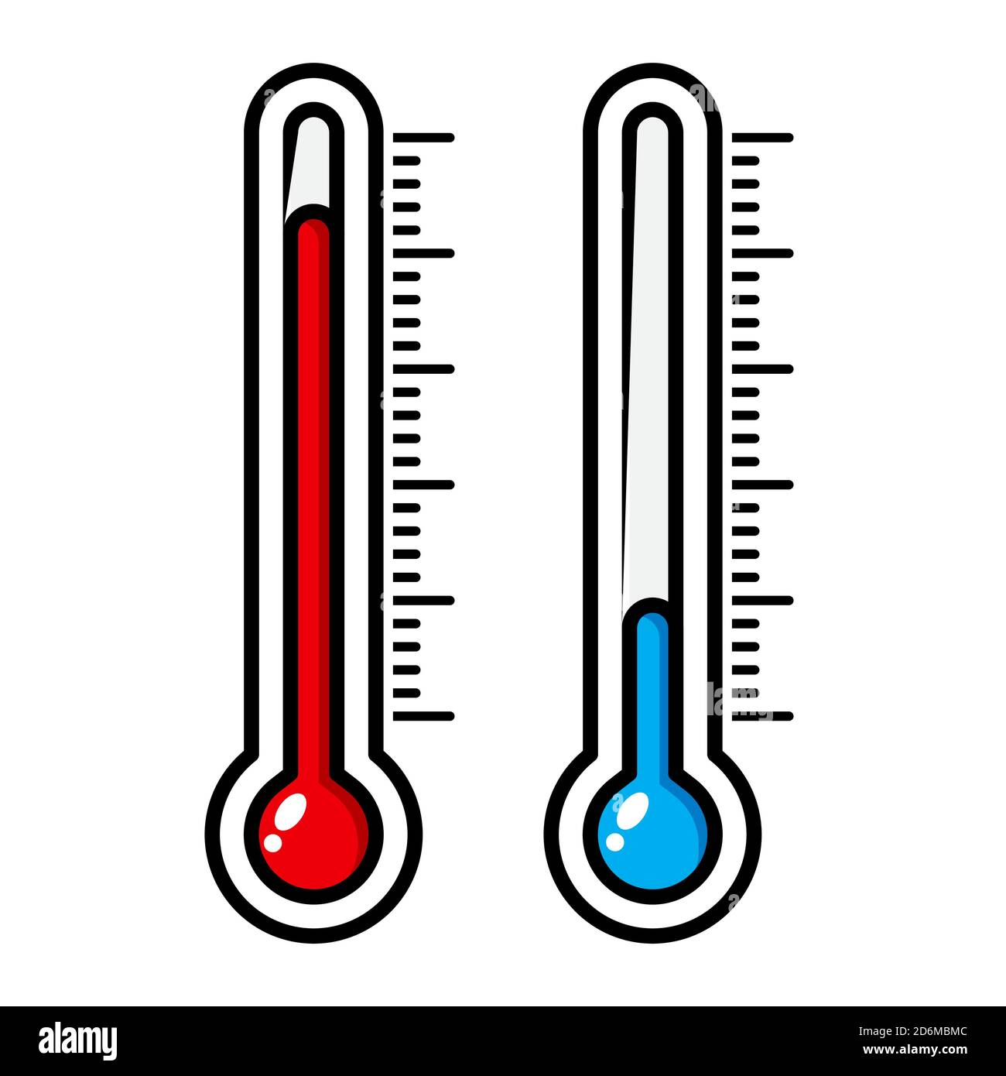
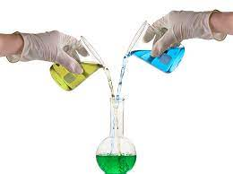
Next experiment
In order to further study the result of this experiment my next experiment can be, ‘do the blood glucose levels vary due to gender?’ It can also be, ‘do the blood glucose levels change due to the temperature the food is at?’ I also like, ‘does the time when the food is eaten at affect how quickly the blood glucose levels rise?’

Slide 40
Sources of error
My science fair experiment could have been improved because sometimes in the model the conductance sensor would move around not giving me the fully precise numbers. In the very first trial for Part A where the participant had to eat a mango, we forgot to connect the watch to the phone so we did not receive the data and had to do it again. Things like gender and age were not taken into consideration.

Slide 41
Credits
I would like to thank my parents and my sister for supporting me and helping me out during my science fair. I would also like to thank my teacher and my science fair coordinator. Last but not least I would also like to thank all the participants who chose to participate in my science fair.

Slide 42
References
Dealing with diabetes: The road to developing an artificial pancreas: Science project (no date) Science Buddies. Available at: https://www.sciencebuddies.org/science-fair-projects/project-ideas/HumBio_p040/human-biology-health/developing-an-artificial-pancreas (Accessed: 21 January 2024).
Type 1 diabetes (2023) Mayo Clinic. Available at: https://www.mayoclinic.org/diseases-conditions/type-1-diabetes/symptoms-causes/syc-20353011 (Accessed: 21 January 2024).
What is diabetes? (2023) Centers for Disease Control and Prevention. Available at: https://www.cdc.gov/diabetes/basics/diabetes.html#:~:text=With%20diabetes%2C%20your%20body%20doesn,vision%20loss%2C%20and%20kidney%20disease (Accessed: 21 January 2024).

Slide 43
References
What is diabetes? (no date) DiabetesCanadaWebsite. Available at: https://www.diabetes.ca/about-diabetes/what-is-diabetes (Accessed: 21 January 2024).
(No date) Diabetes - StatPearls - NCBI Bookshelf - National Center for ... Available at: https://www.ncbi.nlm.nih.gov/books/NBK551501/ (Accessed: 22 January 2024).
Canada, P.H.A. of (2023) Government of Canada, Canada.ca. Available at: https://www.canada.ca/en/public-health/services/chronic-diseases/diabetes.html (Accessed: 21 January 2024).
Family Medicine, diabetes and Cardiology Centre of Excellence (2023) Reflex Medical Centre. Available at: https://reflexmedical.net/cardiac-diagnostics/stop-diabetes-its-complications/ (Accessed: 21 January 2024).

Slide 44
References
Garg, P. (2023) Type 2 diabetes - symptoms and causes - redcliffe labs, MyHealth. Available at: https://redcliffelabs.com/myhealth/diabetes/type-2-diabetes-its-symptoms-and-causes/ (Accessed: 21 January 2024).
Bottaro, A. (no date) How are your body organs affected by diabetes?, Verywell Health. Available at: https://www.verywellhealth.com/organs-affected-by-diabetes-5118060 (Accessed: 21 January 2024).
#Publisher (2023) World-first trial finds arthritis drug may help treat type 1 diabetes, Sky News. Available at: https://news.sky.com/story/world-first-trial-finds-arthritis-drug-may-help-treat-type-1-diabetes-13024706 (Accessed: 21 January 2024).

Slide 45
References
Kuball, E. (2018) Managing type 2 diabetes. Hoboken, NJ: John Wiley & Sons, Inc.
Rubin, A.L. (2015) Diabetes for dummies. Hoboken, NJ: John Wiley & Sons, Inc.
Ford-Martin, P. and Baker, J. (2012) The Everything Guide to Managing Type 2 diabetes: From diagnosis to diet, all you need to live a healthy active life with type 2 diabetes. Avon, MA: Adams Media.
Bottaro, A. (no date) How are your body organs affected by diabetes?, Verywell Health. Available at: https://www.verywellhealth.com/organs-affected-by-diabetes-5118060 (Accessed: 21 January 2024).
Poole, S.B., Riolo, A. and Rubin, A.L. (2023) Diabetes. Hoboken, NJ: John Wiley & Sons, Inc.

