Slide 1
Pixels to Prediction
Machine Learning Phenotypic
Clustering of
Hypertrophic Cardiomyopathy
Ayush Chalishajar
Dr. E. P. Scarlett High School
Grade 12

Slide 2
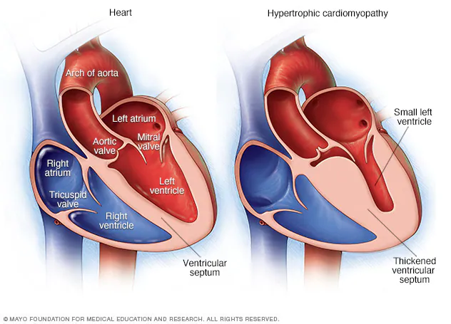
Background
Hypertrophic cardiomyopathy is a condition in which muscle tissues of the heart become thickened, primarily in the left ventricle.

Slide 3
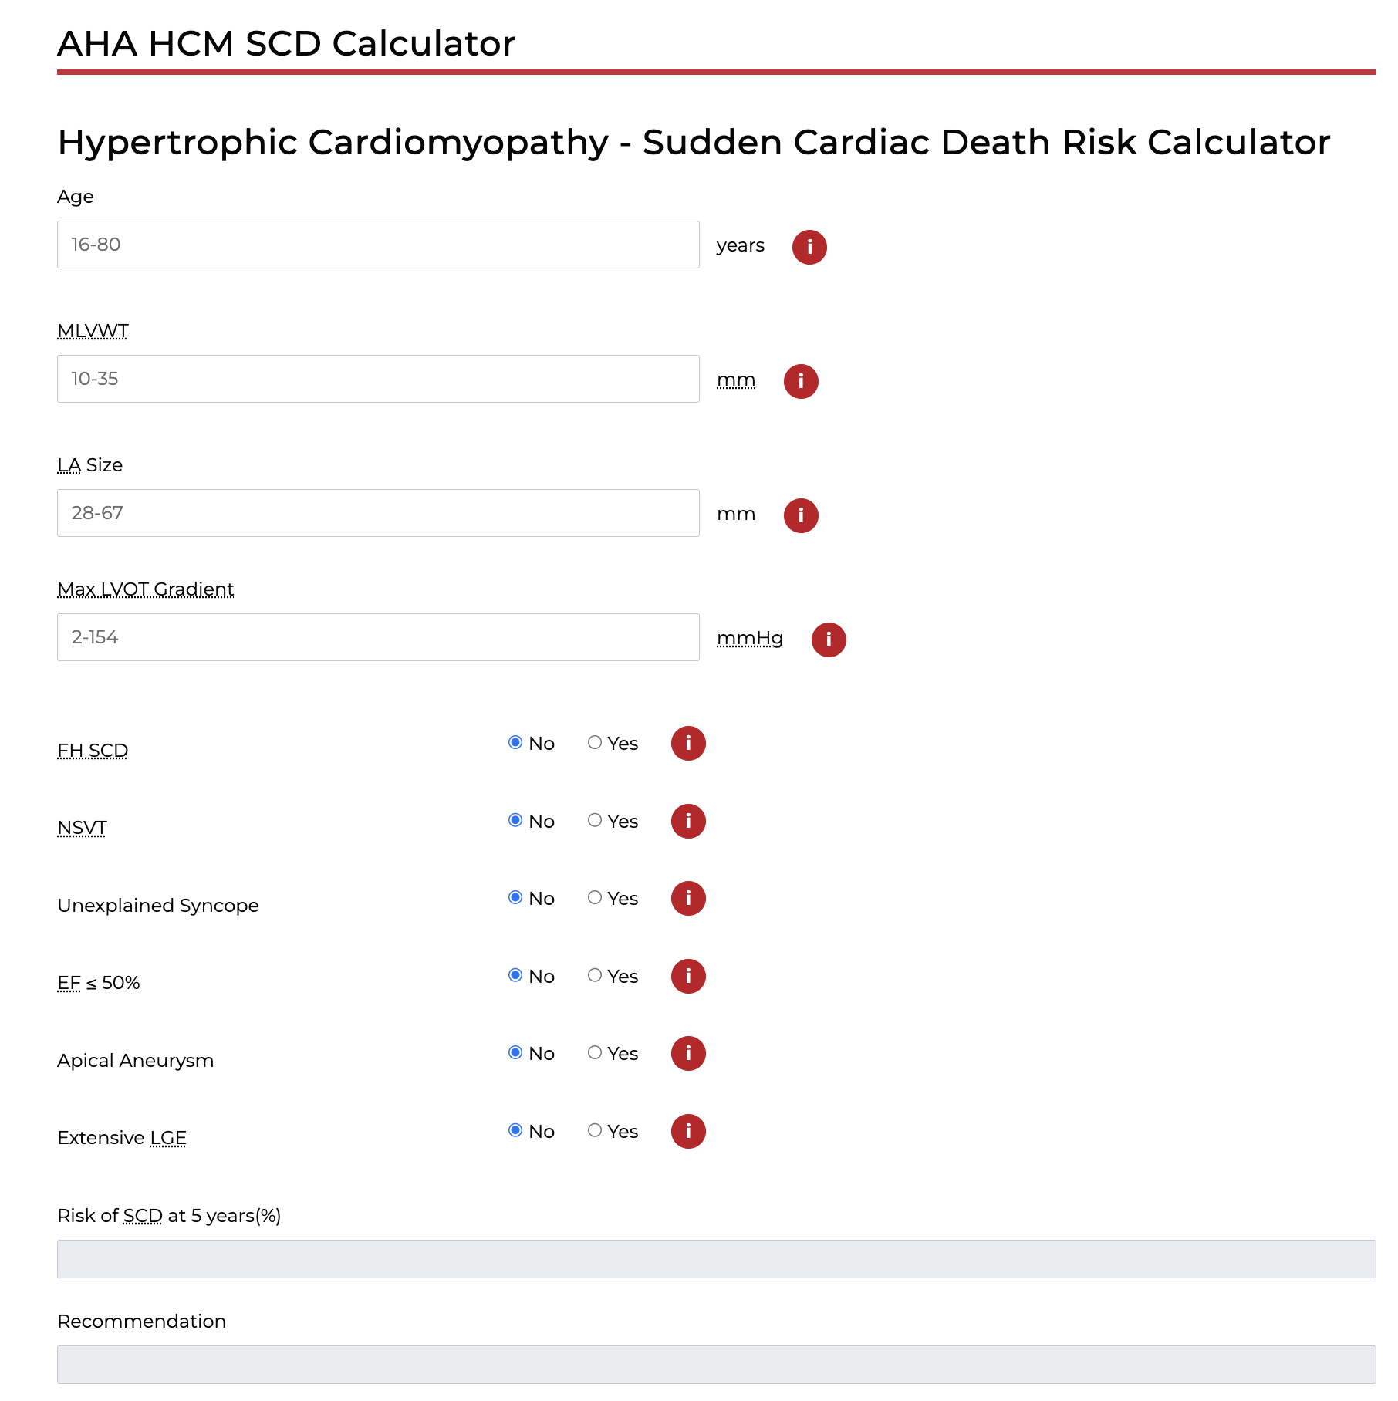
Background
Current risk scores for prediction of future adverse events in patients with hypertrophic cardiomyopathy incorporate the severity of myocardial hypertrophy
Described as a single measure of the max LV wall thickness
Massive LV hypertrophy is defined as wall thickness ≥30 mm in any segment by echo or CMR imaging
Consideration can be given to borderline values of ≥28 mm

Slide 4
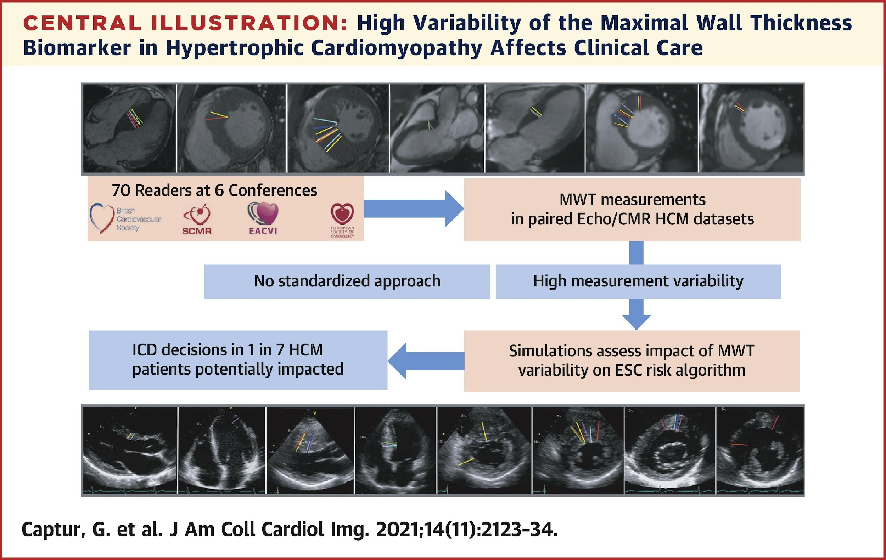
Background
Max LV wall thickness is probably an inaccurate, crude marker of disease expression and sub-optimal risk predictor

Slide 5
Objectives
Identify novel phenotypic clusters of HCM based on CMR-based 3D cardiac shape models presenting detailed assessments of regional wall thickness
Study the associations of these clusters with future adverse outcomes

Slide 6
Methods
405 patients with CMR-confirmed diagnosis of HCM
CIROC Registry
Baseline health questionnaires & CMR
Study cohort
CMR acquisition
Standardized protocol (Cine & LGE imaging)
All-cause mortality, heart failure admission, ventricular arrhythmia, appropriate ICD therapy, survived sudden cardiac arrest, new onset AF/flutter
Composite outcome

Slide 7
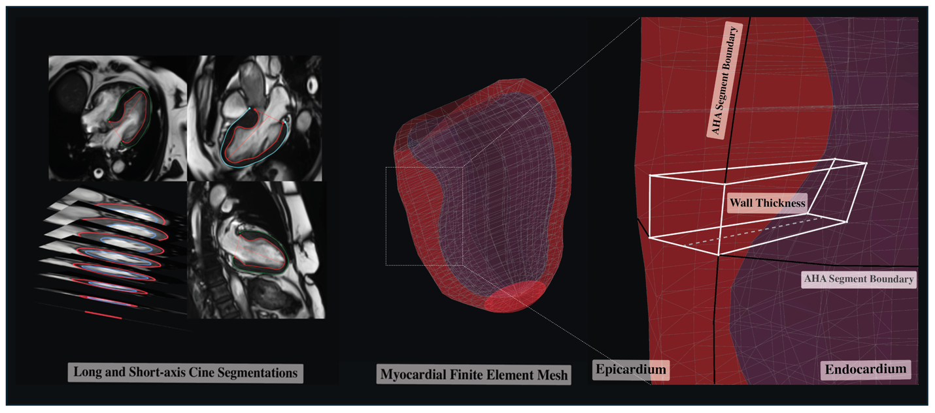
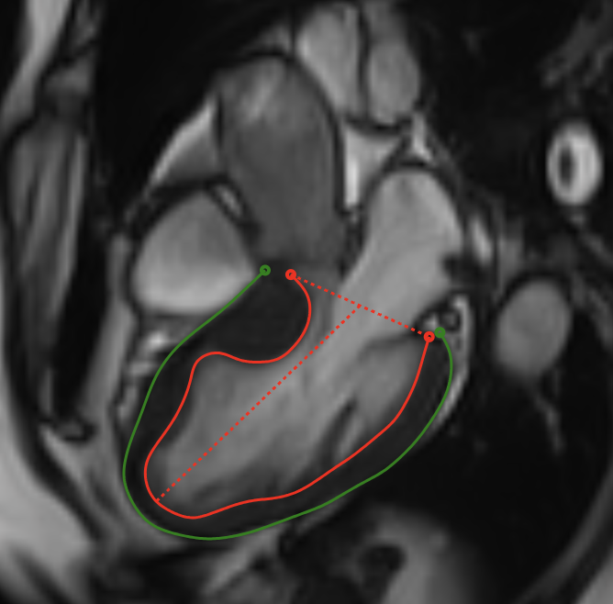
Methods – CMR Post-Processing
Cine images segmentation
3D mesh model

Slide 8
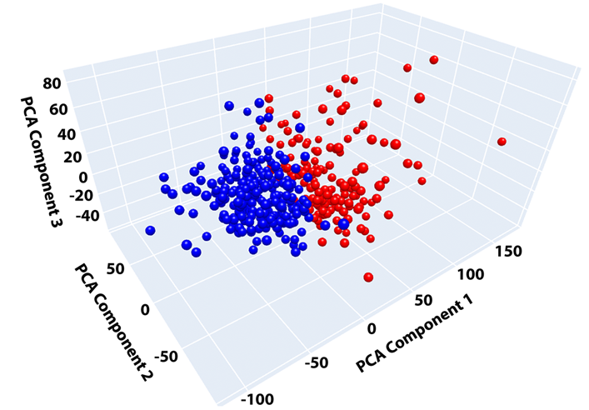
Methods - Clustering
Max thickness for 456 hexahedral elements
Principal component analysis (PCA) - Extraction of first 8 components (explain 80% of variance)
K-means clustering

Slide 9
Results
Baseline clinical characteristics
Characteristics | Overall N = 405 | Cluster 1 N = 252 (62%) | Cluster 2 N = 153 (38%) | p-value
Age, yrs | 56.8 ± 14.5 | 57.5 ± 14.8 | 55.5 ± 13.9 | 0.15
Male sex | 275 (68%) | 153 (61%) | 122 (80%) | <0.001
Smoking |  |  |  | 0.065
Never | 283 (70%) | 185 (73%) | 98 (64%)
Current | 73 (18%) | 37 (15%) | 36 (24%)
Former | 43 (11%) | 28 (11%) | 15 (10%)
HTN | 191 (47%) | 103 (41%) | 88 (58%) | 0.001
DM | 84 (21%) | 40 (16%) | 44 (29%) | 0.002
AF/flutter | 63 (16%) | 36 (14%) | 27 (18%) | 0.37

Slide 10
Results
Baseline CMR characteristics
Characteristics | Overall N = 405 | Cluster 1 N = 252 (62%) | Cluster 2 N = 153 (38%) | p-value
HCM morphology |  |  |  | 0.39
Septal | 269 (66%) | 162 (64%) | 107 (70%)
Apical | 100 (25%) | 68 (27%) | 32 (21%)
Mixed | 36 (9%) | 22 (9%) | 14 (9%)
BSA-indexed LV EDV, mL/m² | 73.1 (63.1, 84.5) | 71.2 (61.8, 81.1) | 76.9 (65.4, 87.8) | 0.002
BSA-indexed LV ESV, mL/m² | 24.6 (20.1, 30.1) | 23.5 (18.9, 28.5) | 26.4 (21.3, 32.1) | <0.001
BSA-indexed LV mass, g/m² | 75.1 (64.0, 92.1) | 68.1 (59.0, 78.7) | 93.5 (81.7, 111.1) | <0.001
LV EF, % | 66.3 (61.3, 70.5) | 67.5 (61.8, 70.8) | 64.0 (60.3, 69.7) | 0.005
BSA-indexed LA volume, mL/m² | 44.8 (35.0, 54.5) | 43.3 (34.6, 53.2) | 47.6 (36.5, 56.3) | 0.022
LGE % fibrosis/scar | 5.9 (1.5, 13.2) | 4.4 (0.0, 8.8) | 8.8 (2.9, 19.1) | <0.001

Slide 11
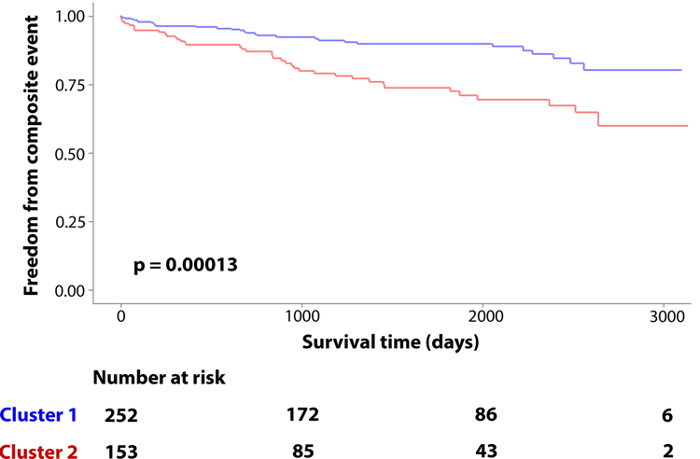
Results
Median follow-up: 4.5 yrs
67 patients developed the outcome (11% in Cluster 1 vs 25% in Cluster 2; p<0.001)

Slide 12
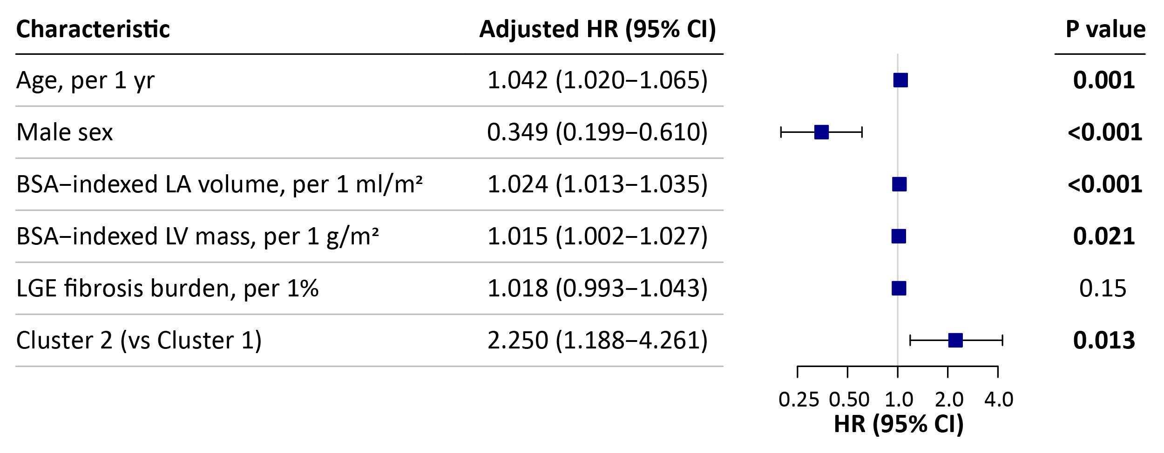
Results
Multivariable Cox model for associations with 1ry outcome

Slide 13
Conclusion
Using unsupervised machine learning applied to comprehensive regional LV wall thickness measurements generated from a 3D mesh model, we identified two unique phenotypic clusters of HCM
Cluster membership was independently associated with future adverse clinical outcomes
Future studies are warranted to confirm the value of this approach in refining currently existing scores for risk stratification of patients with HCM

