Slide 1
Piezoelectricity
(pee-ay-zo-elec-tri-city)
By Mika Kawai & Chloe Leung

Slide 2
Problem
Can we make a crystal that generates the same amount of electricity as a quartz using piezoelectricity?

Slide 3
Hypothesis
We don’t think we can generate more electricity than a quartz with synthetic crystals. This is because most electronics are powered by quartz and not synthetic crystals, and we think scientists have already found out why not to use synthetic crystals.
Both calories and electricity are forms of energy, so the crystal with the most calories would generate the most electricity. Out of the the synthetic crystals, that would be sugar.

Slide 4
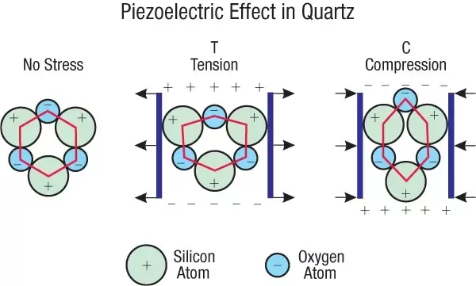
What is Piezoelectricity?
Piezoelectricity is an ability certain things have, causing it to generate electricity when we apply mechanical stress (pressing or squeezing it).

Slide 5
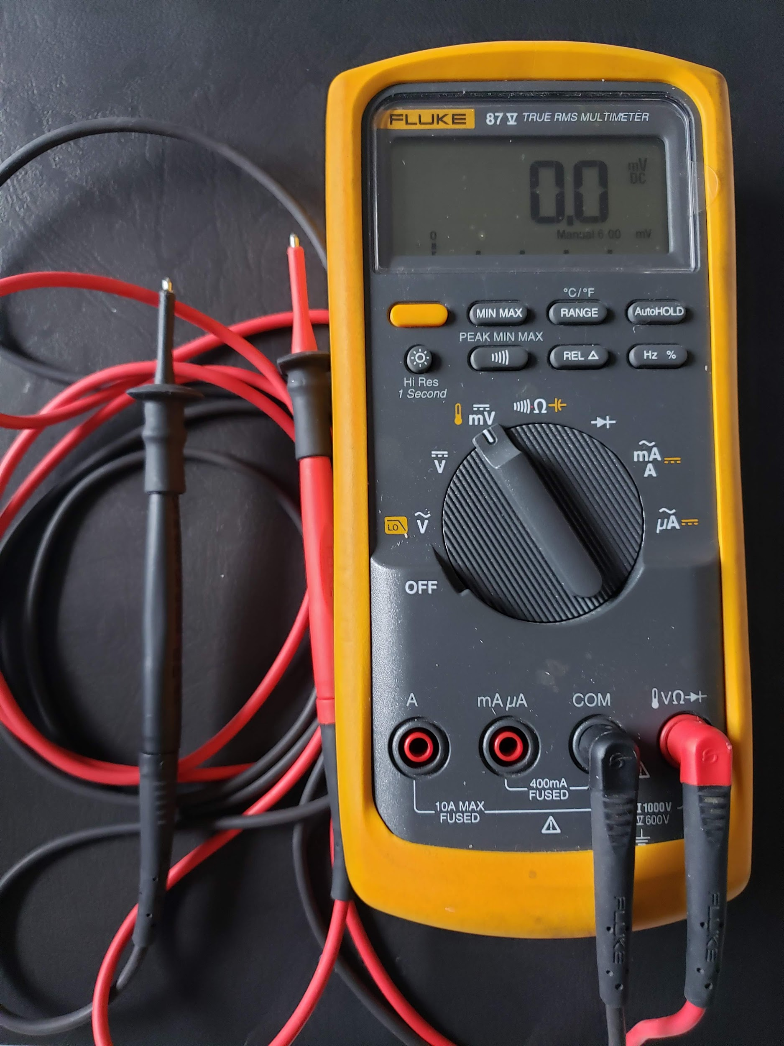
What is Electricity, Voltage, and a Voltmeter?
Electricity is energy made when electrons, which have negative charge, move.
Volts are a unit used to measure how strong an electric current is. For our experiment, we will use millivolts, 1,000 millivolts being 1 volt.
A voltmeter measures how many volts something is producing (their voltage).
This is our voltmeter.

Slide 6
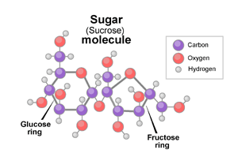
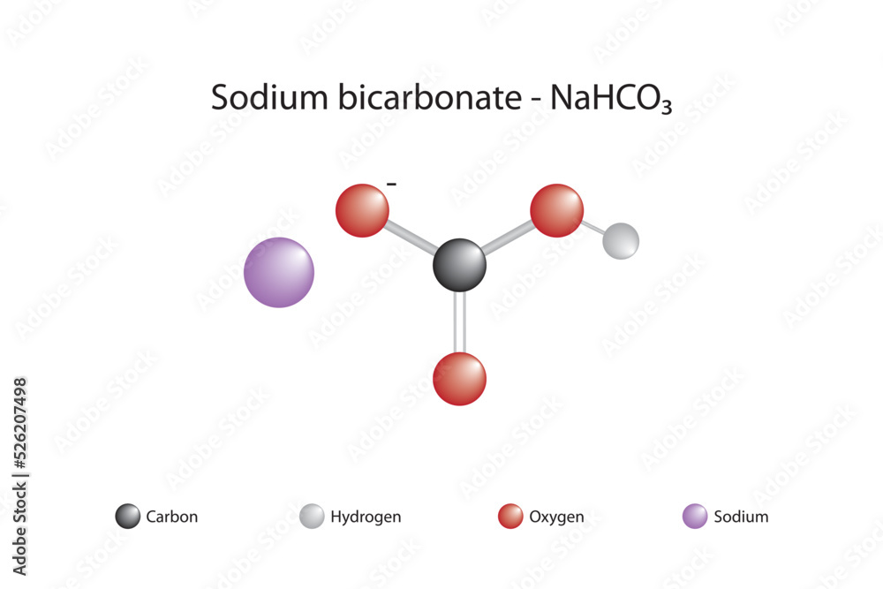
What is a Crystal?
A crystal is a solid which its atoms or molecules are put together in a specific pattern. They can be made by humans or nature in many different ways. For our experiment, we will be growing crystals from a supersaturated solution. In our supersaturated solution, the atoms or molecules of the solute are taken part and rearranged in a specific pattern and the crystals form.
Epsom Salt

Slide 7
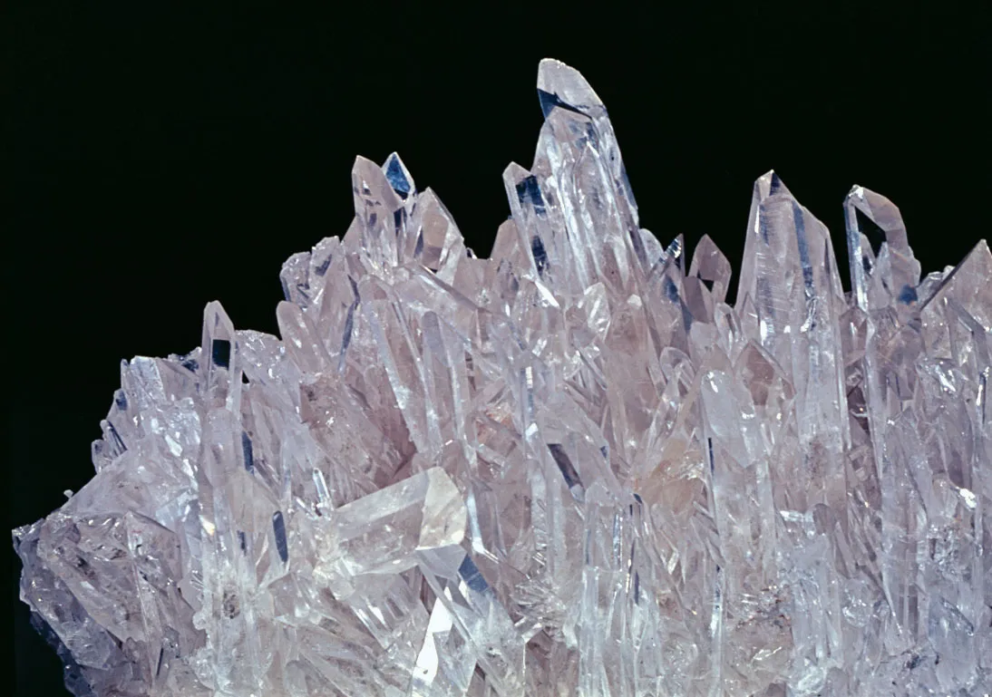
Calories and Chemical Formula of our Materials
Materials | Chemical Formula | Energy (Calories)
Baking Soda (100g) | NaHCO₃ | 0
Epsom Salt (100g) | MgSO₄ | 0
Quartz (100g) | SiO₂ | n/a
Salt (100g) | NaCl | 0
Sugar (100g) | C₁₂H₂₂O₁₁ | 387
Fun (or maybe not-so-fun) Fact: Epsom salt made our skin dry and itchy.
Fun Fact: Piezoelectricity comes from the Greek word piezein, meaning push or press.

Slide 8
Variables
Growing Crystals
Manipulated: Types of Solute
Responding: Type of Crystal that Grew
Controlled: Room Temperature, Air pressure, amount of solute, amount of solvent, time, type of cup, humidity
Measuring Voltage
Manipulated: Types of Crystal
Responding: Voltage generated
Controlled: Room Temperature, Air pressure, person applying force, Voltmeter used, time, humidity, number of trials, how force was applied
Control: Quartz

Slide 9
Materials
Growing Crystals
Testing Voltage
Cups
Sugar
Salt
Baking soda
Epsom salt
Pipe cleaner
Paper towel
Popsicle stick
Water
Clock
Camera
Kettle
Voltmeter
Wooden dowel
Quartz
Sugar crystals
Salt crystals
Baking soda crystals
Epsom salt crystals

Slide 10
Procedure
Make crystals
Heat 1 cup of sugar with 2/3 cup of water in a pan
Bring the water to a boil while stirring with a popsicle stick, until the solution become supersaturated
Suspend a pipe cleaner into a cup, making sure the pipe cleaner doesn’t touch the sides of the cup
Cover the top with a paper towel, and grow them for 8 days
Repeat the steps above with salt, epsom salt, and baking soda instead of sugar
Record observations in Table 1 and take pictures of the crystals
Measure voltage of crystals
Apply mechanical stress to the crystals with a wooden dowel (salt, sugar, baking soda, epsom salt, and quartz) using a similar force 4 times each
Record observations in Table 2 (low power) and Table 3 (high power)

Slide 11
Observations - Growth of the Crystals
Weight of Crystals | Weight of Crystals | Weight of Crystals | Weight of Crystals
3 g | 2 g | 78 g | 0 g

Slide 12
Factors that Affect Crystal Production
Solubility
We assumed all solutes have the same solubility. As it turns out, different substances have different solubilities. None of the were at the supersaturation point, but epsom salt was closest to the supersaturation point, so that is why it grew best.
 | What we Put | Solubility (g/ml) | What we Should have Put | Solubility (g/ml) | Analysis
Sugar | 200g/160 ml | 1.25 | 200g/100ml | 2.00 | Undersaturated
Baking Soda | 270g/160 ml | 1.69 | 10g/100ml | 0.10 | Oversaturated
Epsom Salt | 250g/160ml | 1.56 | 115g/100ml | 1.15 | Oversaturated
Salt | 300g/160 ml | 1.88 | 35g/100ml | 0.35 | Oversaturated

Slide 13
Contamination
As we know, burning plastic releases pollutants into our atmosphere. When we directly poured hot water into our plastic cup, it probably melted the plastic, which caused there to be pollutants and other chemicals to be released. These pollutants and chemicals might worsen crystal growth.
Ion Valence
If something has more ion valence, it will have better crystal production. For example, epsom salt has an ion valence strength 2 (Mg²⁺, SO₄²⁻), salt has an ion valence of 1 (Na⁺, Cl⁻). An ion valence strength of 2 is expected to make more crystals than something with an ion valence of 1.

Slide 14
Observations - Pictures of Crystals
No crystals formed
Baking Soda | Epsom Salt Smooth/Clear/Brittle | Salt Smooth/Cloudy/Brittle | Sugar Rough/Clear/Brittle
Quartz 1 Smooth/Cloudy/Strong | Quartz 2 Smooth/Clear/Strong | Quartz 3 Smooth/Semi-Cloudy/ Strong

Slide 15
Table 2 - Voltage Of Crystals (mV) - Low Power
Type of Crystal | Trial 1 | Trial 2 | Trial 3 | Trial 4 | Average
Baking Soda | n/a | n/a | n/a | n/a | n/a
Epsom Salt | 2.6 | 2.7 | 2.9 | 3.1 | 2.825
Quartz 1 | 3.3 | 4.2 | 3.6 | 3.9 | 3.750
Quartz 2 | 1.9 | 2.3 | 1.9 | 2.2 | 2.075
Quartz 3 | 2.0 | 2.1 | 2.4 | 2.0 | 2.125
Salt | 4.6 | 5.1 | 4.2 | 4.2 | 4.525
Sugar | 2.8 | 2.0 | 3.2 | 2.6 | 2.650

Slide 16
Table 3 - Voltage Of Crystals (mV) - High Power
Type of Crystal | Trial 1 | Trial 2 | Trial 3 | Trial 4 | Average
Baking Soda | n/a | n/a | n/a | n/a | n/a
Epsom Salt | n/a | n/a | n/a | n/a | n/a
Quartz 1 | 11.3 | 10.8 | 10.9 | 10.4 | 10.850
Quartz 2 | 7.8 | 7.4 | 6.7 | 9.6 | 7.875
Quartz 3 | 8.6 | 9.8 | 8.9 | 10.7 | 9.775
Salt | n/a | n/a | n/a | n/a | n/a
Sugar | n/a | n/a | n/a | n/a | n/a

Slide 17
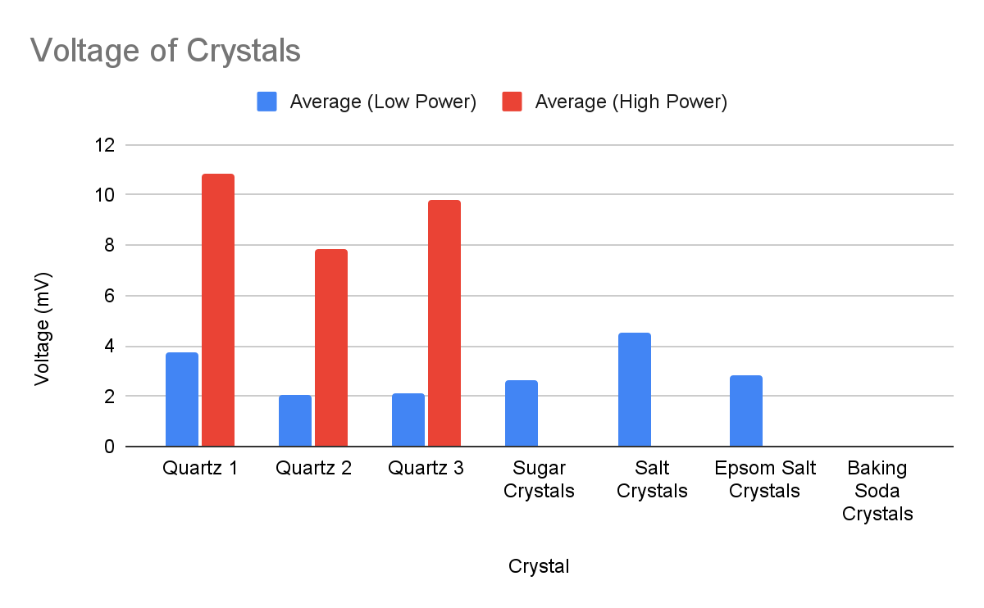
Graph

Slide 18
Factors affecting Piezoelectricity
Mechanical stress applied - More stress, more electricity
From graph one, high power has more electricity
Surface area - Less surface area, more electricity
Quartz 1 and Quartz 3 are about the same height, but Quartz 1 has a smaller surface area, and Quartz 1 produced more electricity. The salt crystal had a smaller surface area than the epsom salt crystal, but were about the same height, and the salt crystal produced more electricity (at low power).
Height - More height, more electricity
Quartz 1 and Quartz 2 have about the same surface area, but Quartz 1 is thicker, and Quartz 1 produced more electricity

Slide 19
Synthetic Crystals vs. Quartz
It is possible for synthetic crystals to generate more electricity than a quartz, and you can see this on the graph.
Both synthetic crystals and quartz did not seem to run out of electricity, and kept producing electricity after four tries.
The synthetic crystals shattered at high power, while the quartz did not, as you can also see on the graph. Since quartz were made under extreme heat (igneous rock), pressure (sedimentary rock), or both (metamorphic rock), it became a very hard rock. Our synthetic crystals, on the other hand, were made at room temperature and basically no pressure (air pressure), making them very brittle.
From our experiment, materials did not seem to matter, the amount of mechanical stress and shape of the crystals did. By changing these factors, we can generate more electricity than a quartz (as long as the synthetic crystals do not shatter).

Slide 20
Conclusion
Our hypothesis was incorrect, as we can generate more electricity than a quartz and the electricity produced does not seem to relate to the amount of calories something has, based on our experiment.
The electricity produced relates to how thick a crystal is, its surface area, and the amount of mechanical stress applied. A crystal can produce more electricity if it is thick, has a small surface area, and can withstand lots of mechanical stress. By changing these attributes, synthetic crystals can produce more electricity than a quartz, like seen in our low power experiment. Compared to our synthetic crystals, quartz produced more electricity at high power, as it could withstand more mechanical stress producing more electricity.

Slide 21
Our future
Using crystals for energy is environmentally friendly and renewable, as the crystals do not seem to run out of energy. If scientists were to research this topic more and gain a better understanding of it, we think it could be used as a main energy source in the future!

Slide 22
Errors
Solubility of materials, same ratio for all ingredients, some solutions were over the supersaturated (baking soda) some weren’t saturated enough (sugar)
1 cup of different solutes to be different in weight
Hot water poured straight into plastic cup, releases contaminates into solution
High power shattered our man-made crystals
Our fingers produced static electricity that was affected the readings (we solved this by using a wooden dowel)
Our mechanical stress will vary (did experiment 4 times to reduce problem)
Rock was not smooth, was hard to press

Slide 23
Citations
NANOMOTION. (2023, July 31). The piezoelectric effect - Piezoelectric motors & motion systems. https://www.nanomotion.com/nanomotion-technology/the-piezoelectric-effect/
Gallego-Juárez, J., Rodrı́Guez, G., Acosta-Aparicio, V., Riera, E., & Cardoni, A. (2015). Power ultrasonic transducers with vibrating plate radiators*. In Elsevier eBooks (pp. 159–193). https://doi.org/10.1016/b978-1-78242-028-6.00007-7
Grow your own Sugar Crystals Recipe | Chelsea Sugar. (n.d.). https://www.chelsea.co.nz/browse-recipes/grow-your-own-sugar-crystals/
electricity. (n.d.). Britannica Kids. https://kids.britannica.com/kids/article/electricity/353091
FoodData Central. (n.d.). https://fdc.nal.usda.gov/fdc-app.html#/food-details/169655/nutrients
Libretexts. (2021, July 6). Piezoelectricity. Engineering LibreTexts. https://eng.libretexts.org/Bookshelves/Materials_Science/Supplemental_Modules_(Materials_Science)/Electronic_Properties/Piezoelectricity
PiezoElectric Crystal | MADPCB PCB Manufacturing, Assembly & Design. Printed Circuit Board Manufacturing, PCB Assembly & PCB Design - MADPCB. https://madpcb.com/glossary/piezoelectric-crystal/
Why are noncentrosymmetric materials important in piezoelectricity? (n.d.). Quora. https://www.quora.com/Why-are-noncentrosymmetric-materials-important-in-piezoelectricity
McPherson A. A comparison of salts for the crystallization of macromolecules. Protein Sci. 2001 Feb;10(2):418-22. doi: 10.1110/ps.32001. PMID: 11266627; PMCID: PMC2373937 https://www.ncbi.nlm.nih.gov/pmc/articles/PMC2373937/
Hydrogen Pressure Sensors Must Withstand Extreme Pressures without Corrosion for Hydrogen-Powered Vehicles | Machine Design. (n.d.). https://web.archive.org/web/20100509075101/http://machinedesign.com/article/hydrogen-pressure-sensors-must-withstand-extreme-pressures-without-corrosion-for-hydrogen-po
Zamkovskaya, A., & Maksimova, E. (2016). Aspects of symmetry of Electromechanical Coupling Factors in Piezoelectric Single Crystals. Journal of Physics: Conference Series, 769, 012067. https://doi.org/10.1088/1742-6596/769/1/012067
Eltouby, P., Shyha, I., Li, C., & Khaliq, J. (2021). Factors affecting the piezoelectric performance of ceramic-polymer composites: A comprehensive review. Ceramics International, 47(13), 17813–17825. https://doi.org/10.1016/j.ceramint.2021.03.126

Slide 24
Crystal. (n.d.). Britannica Kids. https://kids.britannica.com/scholars/article/crystal/110297
Volt Definition & Meaning | Britannica Dictionary. (n.d.). https://www.britannica.com/dictionary/volt
What is a Crystal? (2019, July 19). Let’s Talk Science. https://letstalkscience.ca/educational-resources/stem-explained/what-a-crystal
What is sugar? | Exploratorium. (2023, March 7). Exploratorium. https://www.exploratorium.edu/explore/cooking/sugar
Molecular formula and chemical structure of sodium bicarbonate Stock Vector. (n.d.). Adobe Stock. https://stock.adobe.com/ca/images/molecular-formula-and-chemical-structure-of-sodium-bicarbonate/526207498?asset_id=526207498
Admin. (2023, May 9). Magnesium Sulfate (MGSO4) - Structure, Properties, Uses, FAQs of Magnesium Sulfate (MGSO4). BYJUS. https://byjus.com/chemistry/mgso4/
Gao, Z., Rohani, S., Gong, J., & Wang, J. (2017). Recent developments in the crystallization process: toward the pharmaceutical industry. Engineering, 3(3), 343–353. https://doi.org/10.1016/j.eng.2017.03.022
Buddies, S., & Lohner, S. (2024, February 20). Solubility Science: How much is too much? Scientific American. https://www.scientificamerican.com/article/solubility-science-how-much-is-too-much/
Libretexts. (2021b, July 6). Piezoelectricity. Engineering LibreTexts. https://eng.libretexts.org/Bookshelves/Materials_Science/Supplemental_Modules_(Materials_Science)/Electronic_Properties/Piezoelectricity
Quartz - Minerals Education Coalition. (2024, January 24). Minerals Education Coalition. https://mineralseducationcoalition.org/minerals-database/quartz/
De Jong, M., Chen, W., Geerlings, H., Asta, M., & Persson, K. A. (2015). A database to enable discovery and design of piezoelectric materials. Scientific Data, 2(1). https://doi.org/10.1038/sdata.2015.5

