Slide 1
This Presentation is dedicated to my Mother Institute CIS and all the Teachers
https://calgary.ctvnews.ca/mobile/school-fee-dispute-hits-calgary-islamic-school-1.5813268

Slide 2
Epilepsy and Advanced Research Techniques
Presented by:
Muhammad Usman Mirza
Grade. 7A

Slide 3
Outline
What is Epilepsy?
Types of Epilepsy
Causes
Neurodevelopmental Basis of Epilepsy
Treatments
Advanced Research Techniques
References

Slide 4
My Motivation! What motivated me to choose this topic?
One of my friend had a severe seizure attack while we were writing the PAT exam.
Students were very scared to see that situation, and everyone left the room except the teacher.
I had never seen this situation before. However, that critical condition made me interested in knowing about these Seizure attacks of Epilepsy, Advanced Research and Treatment Options at the present time.

Slide 5
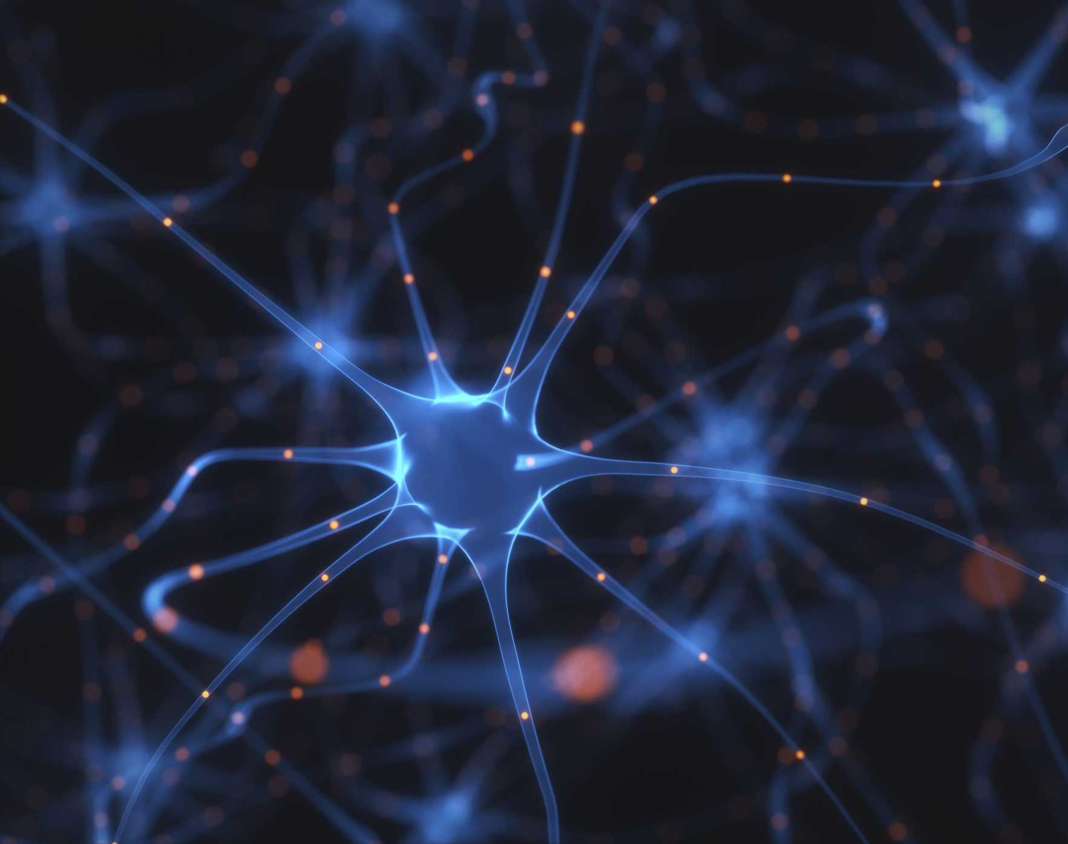
Epilepsy: What is it?
Epilepsy is a Brain-Based Disease and is also called Seizure Disorder.
The language of the Brain is Electrical Signals between Neurons (Brain Cells)
When there are Abnormal Changes in Electrical Activity and Nerve Cells don’t communicate, this may cause a Seizure attack.
Biologically, it is caused by a Chemical Imbalance in the Excitation and Inhibitory activity in the Brain, and this can cause Brain Damage or Death.

Slide 6
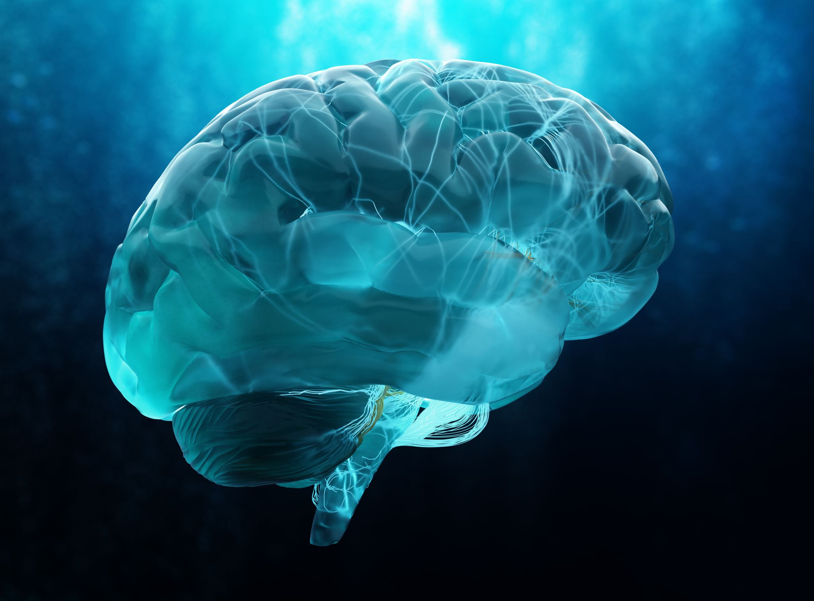
Epilepsy: What is it? Continued..
Difference between Epilepsy and Seizure Attacks:
Epilepsy: Epilepsy is a chronic Brain-based Disease, which is non-communicable (Non-Spreadable). It is not like Viral disease.
Seizure Attacks: A seizure is an Event.
It is the Primary Symptom of Epilepsy.
The Brain works by sending Electrical Signals through Nerve Cells.
Changes or Interruptions in Electrical Signals can cause a seizure.

Slide 7
Epilepsy: What is it? Continued.
Key Facts
Epilepsy may affect people of all ages regardless of gender or ethnicity.
Approximately 50 Million people all over the World live with Epilepsy.
Approximately 80% of people who have epilepsy are from low and middle-income countries.
Neuroscientists estimate that 70% of people can live without seizures if they are properly diagnosed and treated.
Some People with Epilepsy and their families suffer from Stigma (What other people will say) and discrimination.

Slide 8
Symptoms of Epilepsy
There are several symptoms of Epilepsy which could range from Mild to Severe.
The most Common Symptoms of epilepsy are the following:
Temporary Confusion.
A Staring Spell.
Jerking Movements of the Arms and Legs that can't be controlled.
Loss of Consciousness or Awareness.
Cognitive (Thoughts) or Emotional (Feelings) Changes.

Slide 9
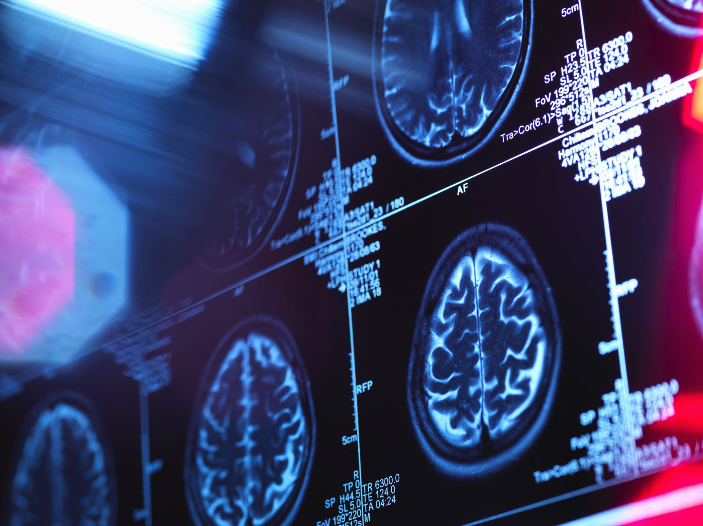
Causes of Epilepsy

Slide 10
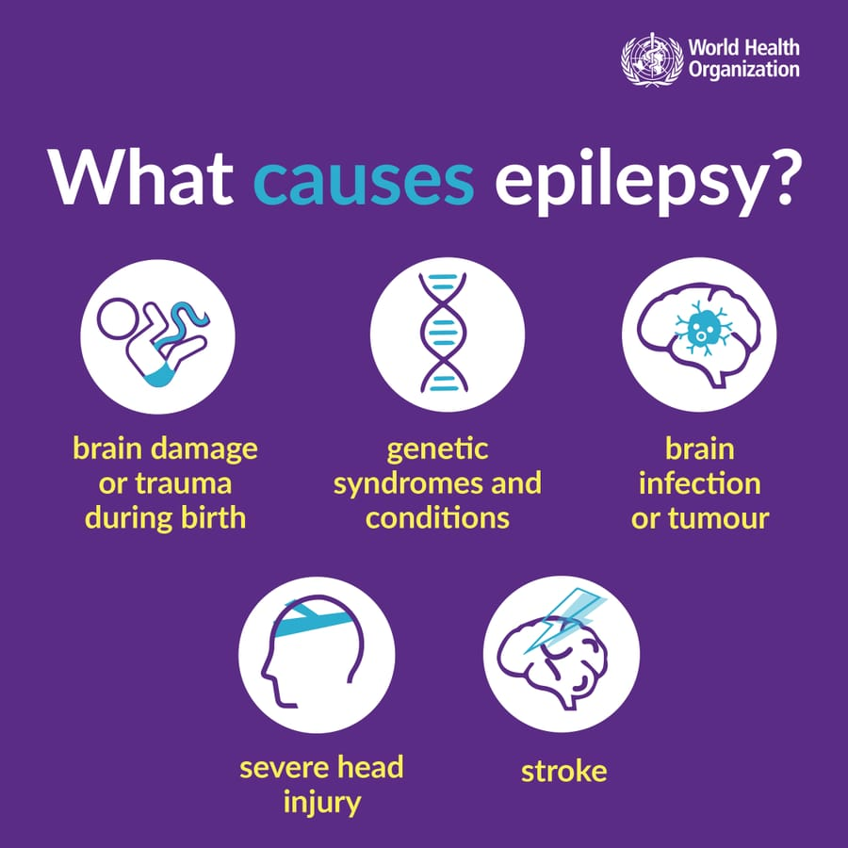
Causes of Epilepsy
There are many causes of Epilepsy.
Genetics: If Epilepsy is in the Family, there is a higher risk it can happen to the other family members.
Brain Tumors: It is a Cancerous mass which is due to the growth of abnormal cells in the brain that can cause Epilepsy.
Head Trauma: Head Injury can also cause Epilepsy.
Alcoholism & Withdrawal: Use of alcohol and bio-changes after stopping alcohol can cause Epilepsy.
Alzheimer's Disease: This may cause Epilepsy.
Strokes, Heart Attacks, and other conditions:
Loss of Oxygen in the brain may cause Epilepsy.
Buildup of Abnormal Blood vessels or Bleeding in the Brain: Bleeding between the brain tissue and the skull or inside the brain tissue can cause Epilepsy.
Swelling in the Brain: Due to damage to Neurons and lack of nutrients getting to the brain..
https://twitter.com/WHO/status/1493209225300000778

Slide 11
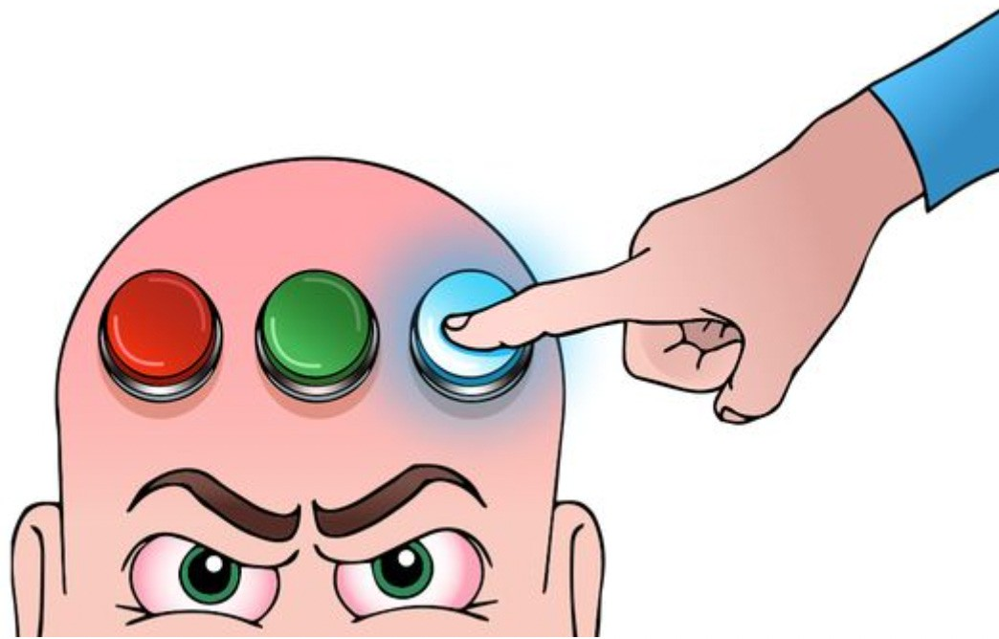
Seizure Triggers
Seizures and Epilepsy can affect Safety, Relationships, Work and Driving.
Stress (External Pressure in Brain) could be Exam Stress, Study Stress and Financial Stress etc.
Excessive Drinking Alcohol, or Alcohol withdrawal
Hormonal Changes in the body can stimulate Seizures.
Lack of Sleep is also a factor in seizures.
Visual Stimulation such as Flashing Lights or Moving Patterns stimulates seizures.

Slide 12
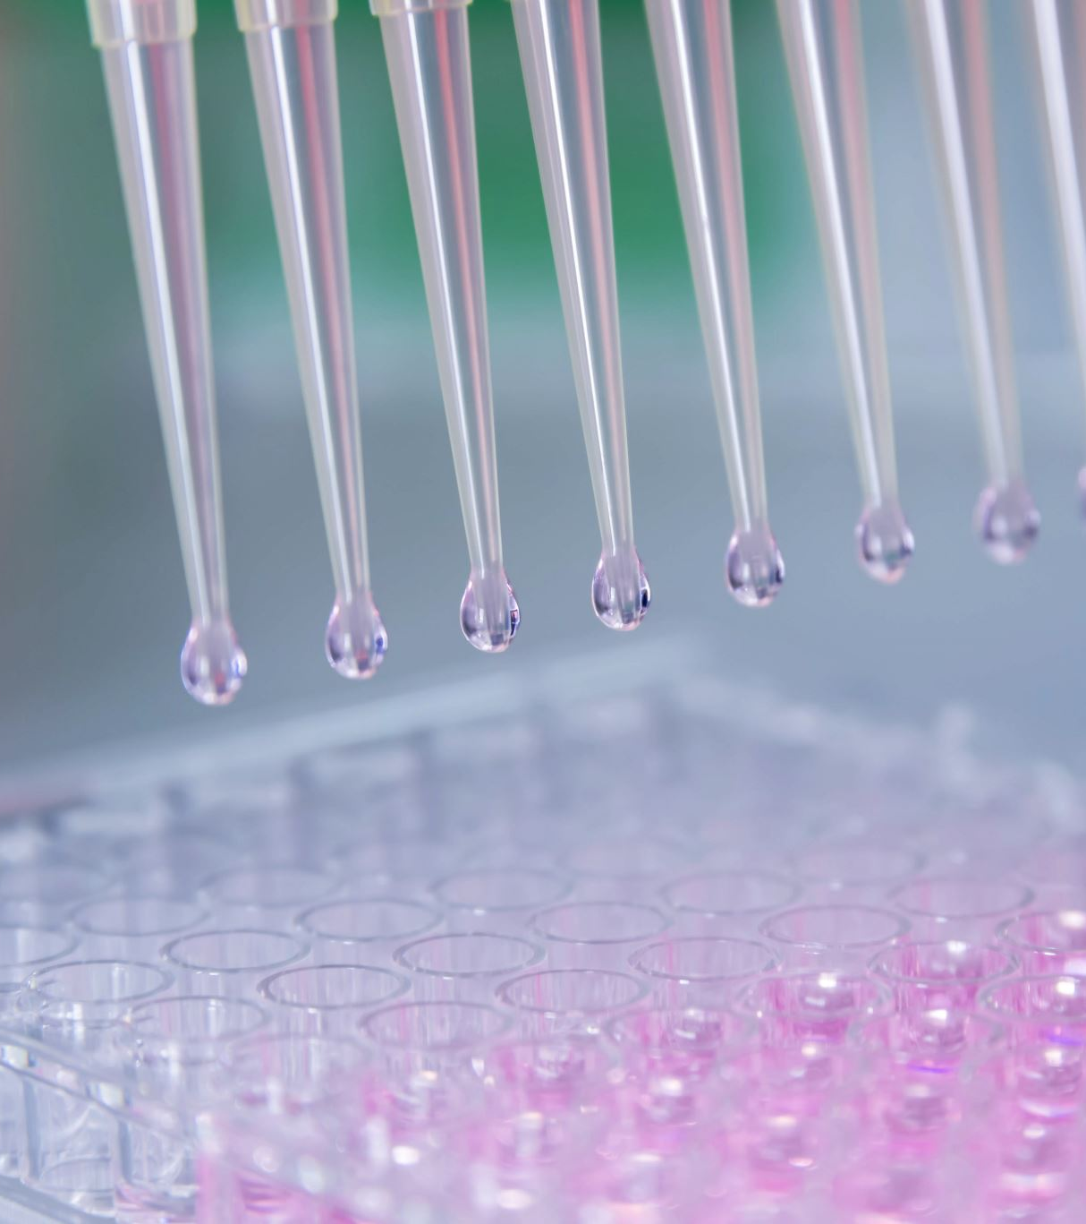
Types of Epilepsy
Epilepsy is divided into Four Types.
1. Generalized Epilepsy
2. Focal Epilepsy
3. Combined Generalized and Focal Epilepsy
4. Unknown Epilepsy

Slide 13
The Brain & Epilepsy Types Let’s take a look on Brain and its functions before we discuss the Epilepsy Types. https://anatomyinfo.com/parts-of-the-brain/

Slide 14
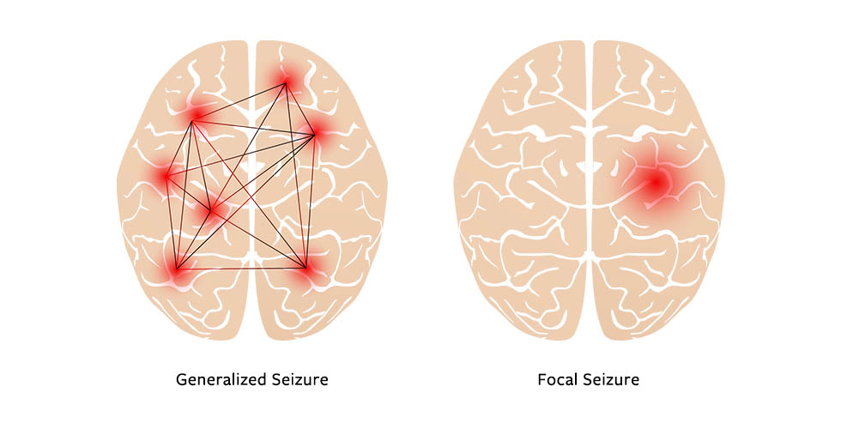
1: Generalized Epilepsy:
In this type, the left and right sides of the brain are affected.
These Seizures can be Motor or Non-Motor.
Motor Seizure:
It usually starts during childhood. However, it can also affect adults. Jerking movements, weakness or limp limbs, tense, stiffed muscles, trembling and full-body epileptic jerk.
Non-Motor Seizures: This is also called Absence Seizures.
It is for short periods and suddenly comes back to consciousness. This type is more common in children than adults.
This Seizure is for a Few Seconds, like, Jerking Arms or Rapidly Blinking Eyes. These
https://magazine.medlineplus.gov/article/understanding-different-kinds-of-seizures

Slide 15
2: Focal Epilepsy:
Focal Seizures affect one part of the brain which moves to another area of the brain. Patients can feel uncomfortable feelings in their stomach similar to the feelings of air turbulence or riding a rollercoaster.
Symptoms can be divided into Motor and No-Motor Symptoms.
Motor Symptoms:
Muscle Trembling, jerking, spasms, Repeated Movements, like Clapping or Chewing
b) Non-motor symptoms: Patients do not move. However, they may cause confusion or changes in emotions.
Waves of hot or cold
Goosebumps (Tiny muscles in our skin's hair pull upright)
Lack of movement
Changes in emotions or thoughts
https://magazine.medlineplus.gov/article/understanding-different-kinds-of-seizures

Slide 16
Difference of Generalized & Focal Epilepsy

Slide 17
Difference of Generalized & Focal Epilepsy
https://www.defeatingepilepsy.org/2021/01/03/

Slide 18
3: Combined Generalized and Focal Epilepsy:
In this type of epilepsy, patients have both generalized seizures and focal seizures.
They can experience a mixture of the symptoms as discussed in the previous slide.

Slide 19
4: Unknown Epilepsy:
When doctors do not know the Origin of Seizures, this is called Unknown Epilepsy.
Patients can have a combination of Motor and Non-Motor Symptoms.
Motor Symptoms: b) Non-Motor Symptoms
Seizure Duration is 1–3 Minutes. Emergency is required if it’s more than 5 Minutes.
Common Symptoms have been discussed in the previous slides.

Slide 20
Seizure Types & Recurrence https://www.cureepilepsy.org/for-patients/understanding/basics/seizure-classification/

Slide 21
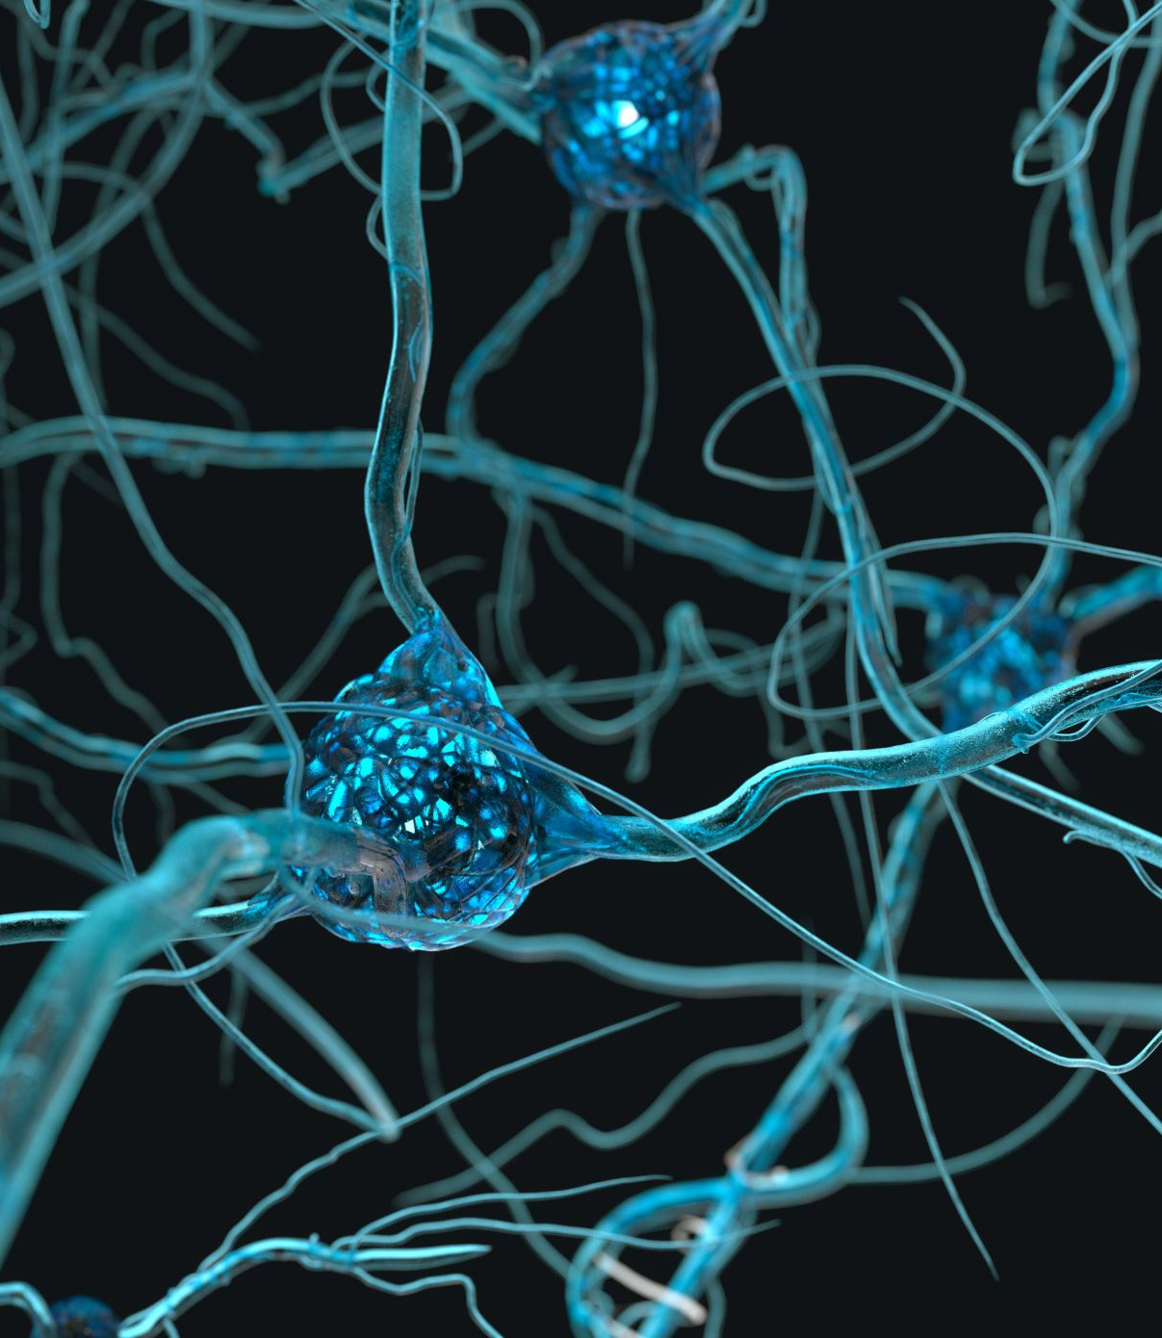
Neurodevelopmental Basis of Epilepsy.
A Synapse is a contact point.
There are Two Types: Inhibitory and Excitatory.
A seizure is caused by an imbalance between Inhibitory and Excitatory Synaptic transmission.
80% of patients can live without seizures if they take Antiepileptic Drugs.
Drugs can balance by increasing the Inhibitory or decreasing Excitatory Activity.

Slide 22
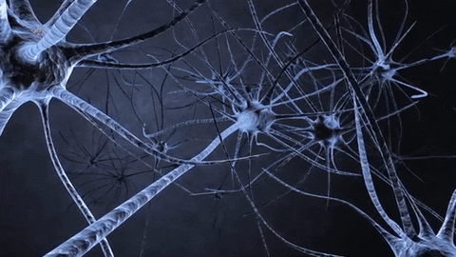
Neurodevelopmental Basis of Epilepsy.
https://mcgovern.mit.edu/2019/02/28/ask-the-brain-how-do-neurons-communicate/
https://giphy.com/explore/brain-neurons

Slide 23
Diagnosis of Epilepsy:
Epilepsy is diagnosed by the Physician.

Slide 24
Treatment

Slide 25
Treatments…
There are Several Clinical Treatment Options.
However, my centre of attention will be on Current Advanced Treatment and understanding the Mechanisms of Neurodevelopment, Degeneration, and Epilepsy Disease.
1: Antiepileptic Drugs. These drugs help to reduce some Seizures. There are around 30 approved drugs for the treatment of Epilepsy.
2: Ketogenic Diet. Another Treatment for Epilepsy which works on to Change in Diet.

Slide 26
Treatments…
3. Brain Surgery
The main Goal of Epilepsy Surgery is to decrease the number of Seizures, the Severity of Seizures or, ideally, to become Seizure-Free. There are several different types of Epilepsy Surgery.
Surgical Approaches to Manage Seizures
Removing the Part of Brain where the Seizures start.
Disconnecting Brain Nerve cell communication to stop the spread of seizures to other areas of the Brain.
Using a laser to heat and kill the Nerve Cells where the Seizures begin.

Slide 27
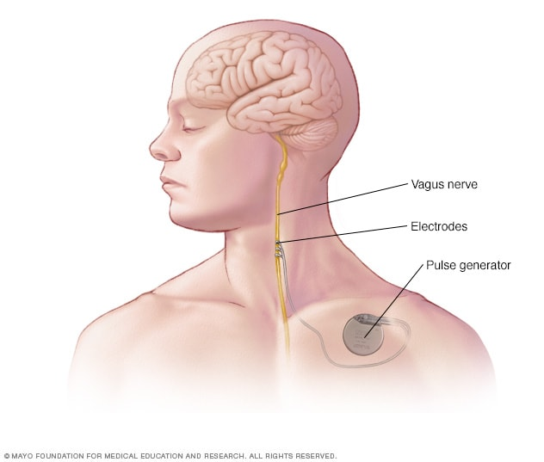
Treatments…
4: Vagus Nerve Stimulator
Let’s talk about Vagus Nerves first. There is one vagus nerve on each side of the body.
The vagus nerve runs from the lower part of the brain which goes to the neck to the chest and stomach.
It regulates our Heart Rate, Blood Pressure and Breathing by sending Signals between your Brain, Heart and Lungs.
It can also affect your Mood, Memory and Cognition by sending Electrical Signals between Brain and Limbic System.
(www.mayoclinic.orgvagus-nerve-stimulation/about/).1

Slide 28
Treatments…
4 : Vagus Nerve Stimulator
This is a successful Treatment for Epilepsy and Depression,
This Device Stimulates the Vagus Nerve with Electrical Impulses.
FDA-approved, it leads to Seizures and Mood Changes.
Side-effects:
Voice changes,
Throat Pain,
Cough,
Headaches,
Shortness of Breath,
Difficulty Swallowing,
and Skin itching.
(www.mayoclinic.org/vagus-nerve-stimulation)1

Slide 29
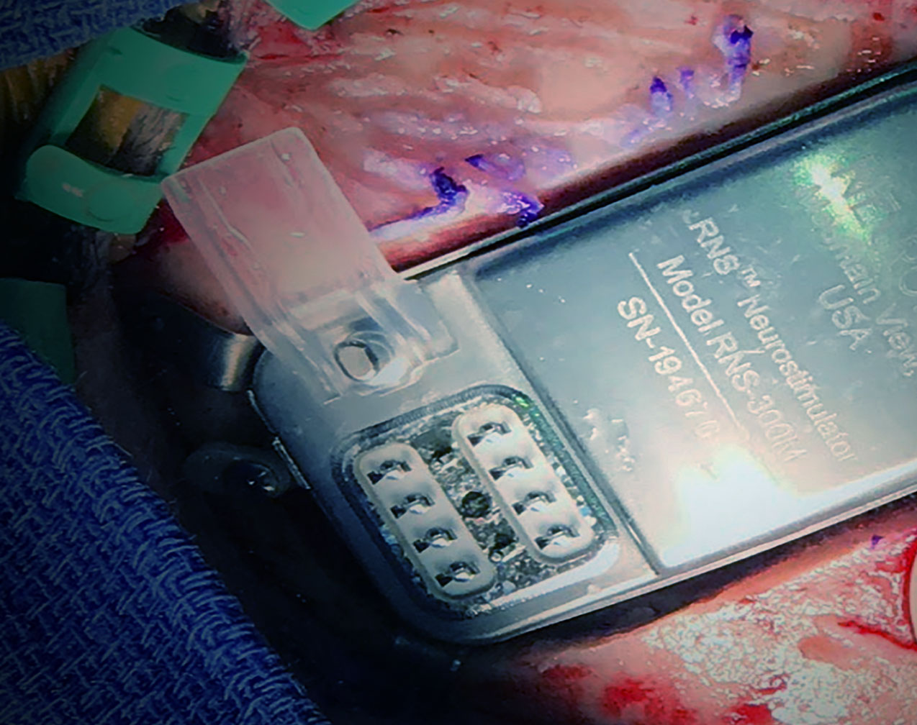
Treatments…
5 : Neurostimulation.
This is an emerging Treatment Option for some patients.
The implantable electrode records Brain Activity and identifies personalized activity characteristics that occur before a Seizure.
These implants then stimulate the seizure foci and prevent the Seizure from occurring.
This Treatment causes less Brain damage resulting from Brain Surgery since no resection is required.

Slide 30
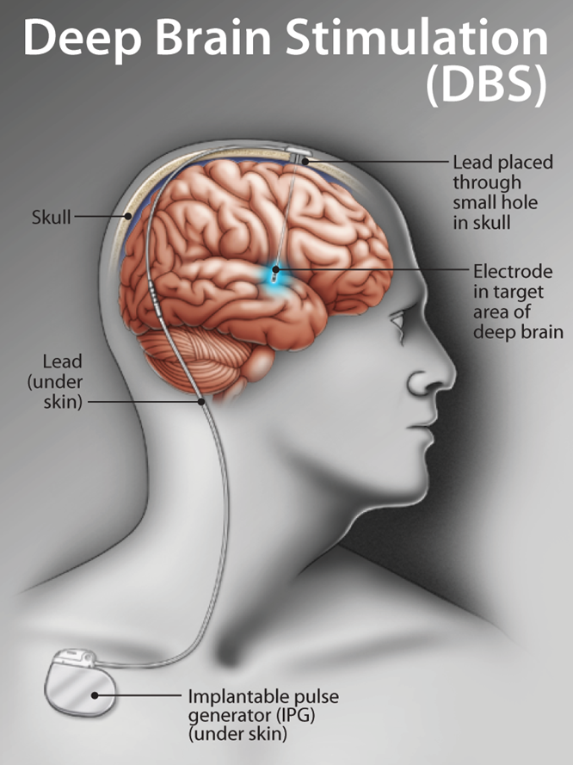
Treatments…
6: Deep Brain Stimulator.
It involves implanting Electrodes within areas of the Brain. The Electrodes Produce Electrical impulses that affect Brain activity to treat certain Medical conditions.
Annual Cost:
The Canadian Government is spending approximately Millions of Dollars annually on Epilepsy.
https://www.defeatingepilepsy.org/treatment-for-epilepsy/deep-brain-stimulation/

Slide 31
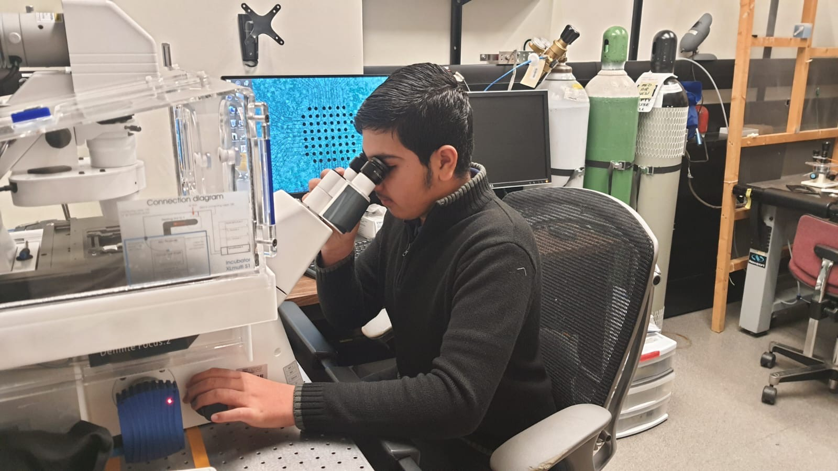
Advanced Research Techniques
Advanced Brain Imaging
This Technique helps to better locate the Seizure foci in the Brain.
Including High-Resolution Electrode Implants for recording Brain Activity
New machine-learning algorithms identify Morphological Signs of Seizure-induced Brain damage in MRI images.

Slide 32
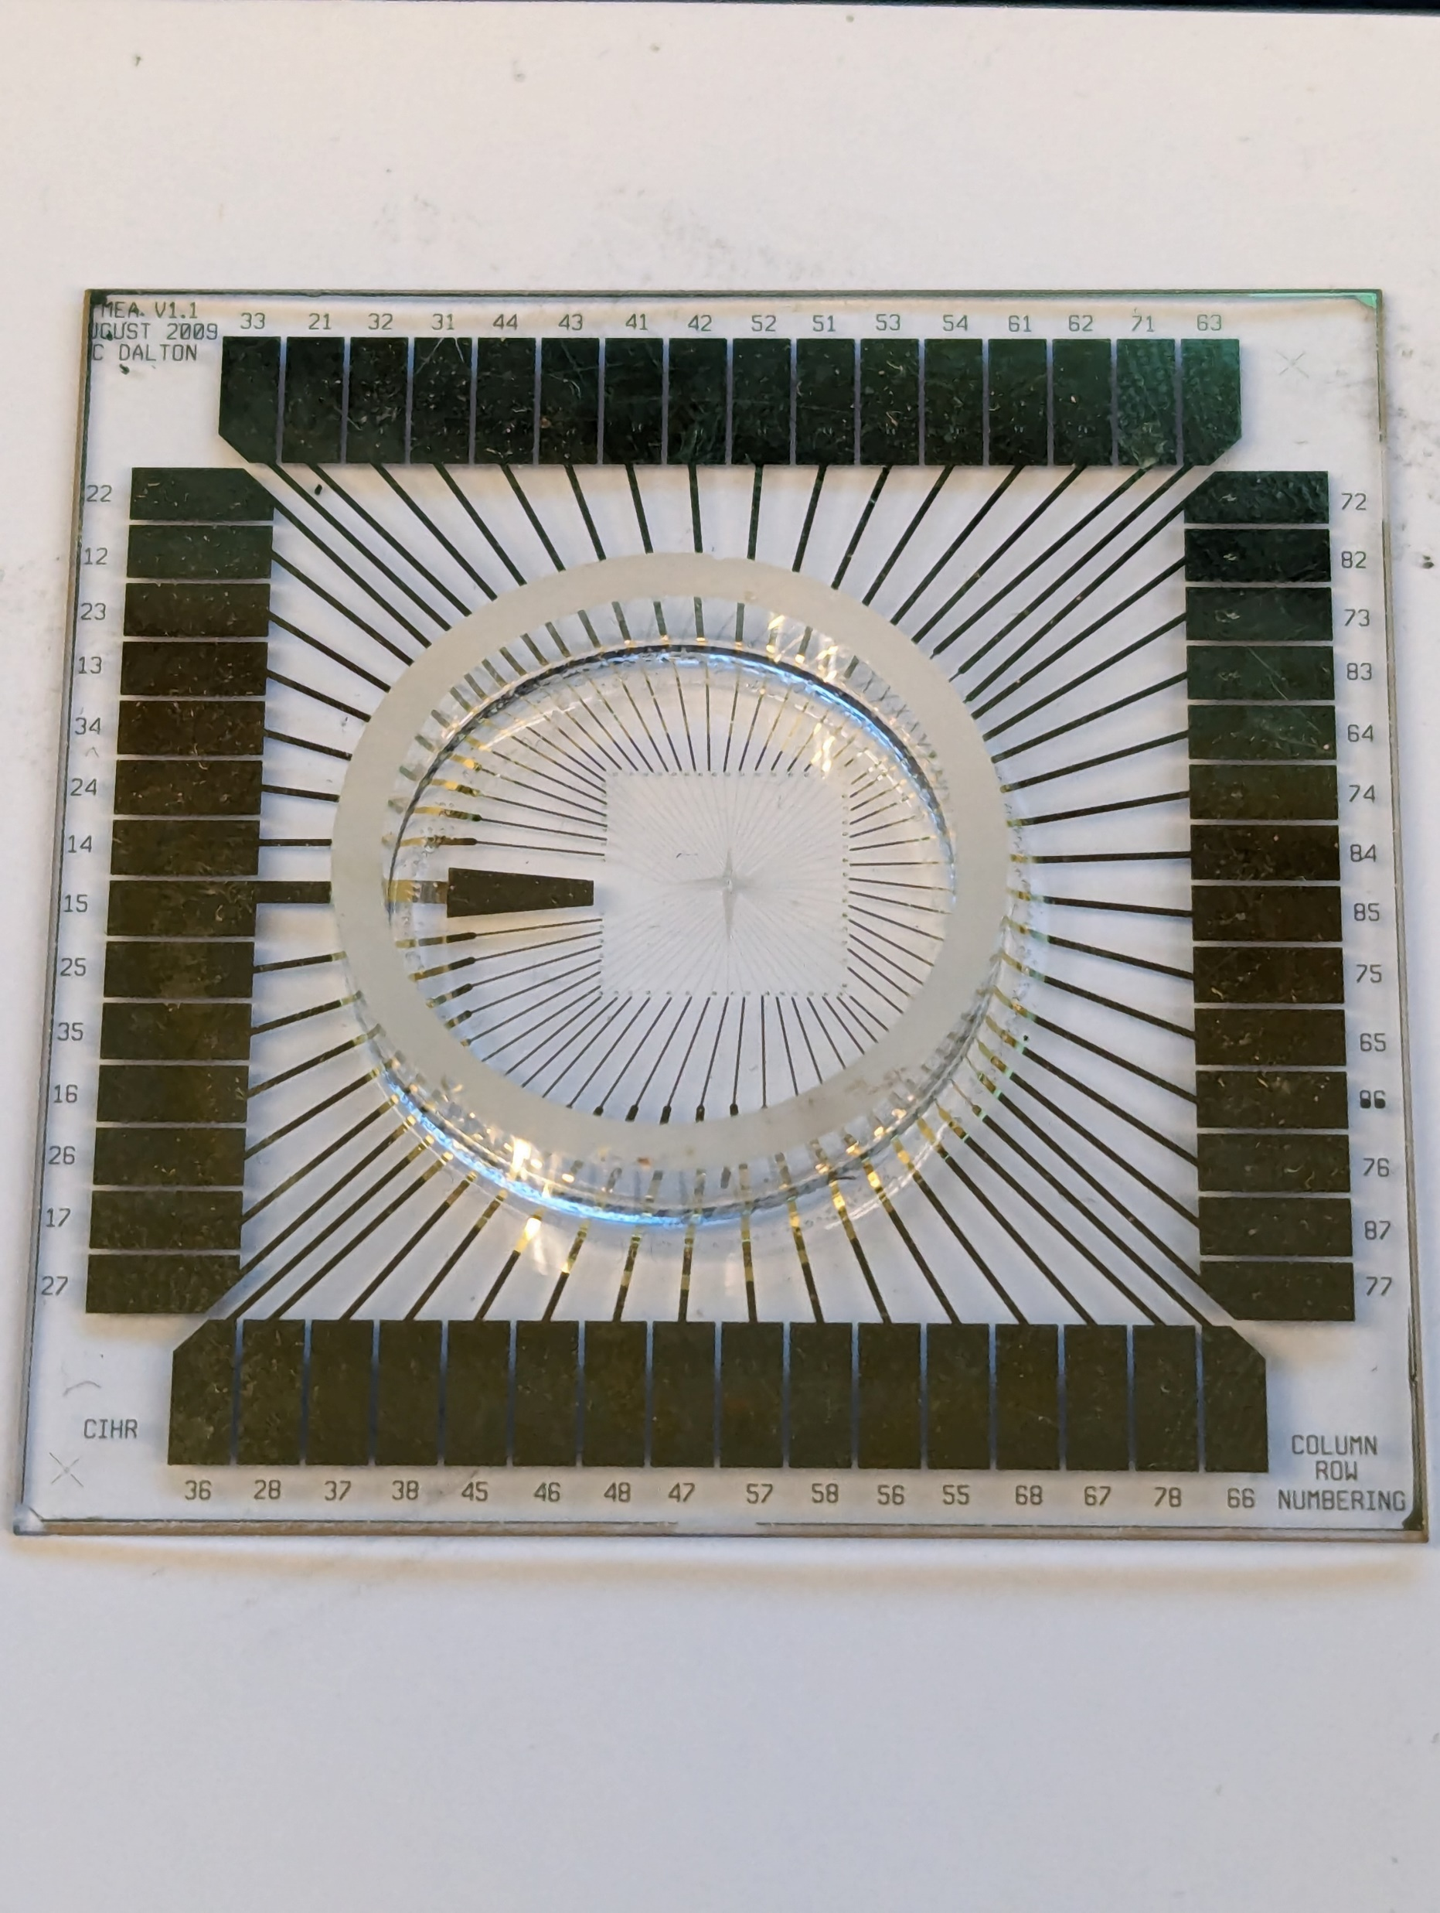
Introduction of the Neurochip

Slide 33
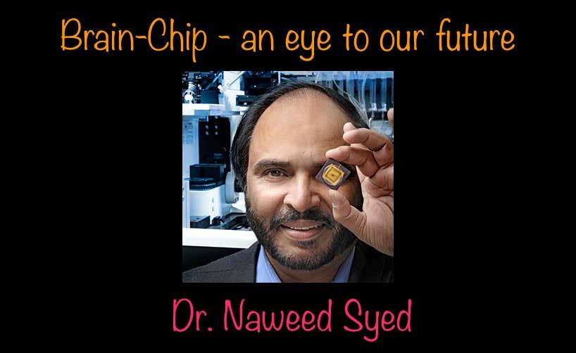
Introduction of Neurochip
Dr. Naweed Imam Syed is a Pakistani-born Canadian Neuroscientist.
He is the first scientist to connect Brain Cells to a Silicon Chip, creating the world's first Neurochip.
The Chip was developed by a team of Scientists from the University of Calgary, led by Dr. Naweed Imam Syed. Professor – Medicine.
Cumming School of Medicine, Full Member, Hotchkiss Brain Institute
Child Health & Wellness Researcher.
Alberta Children's Hospital Research Institute

Slide 34
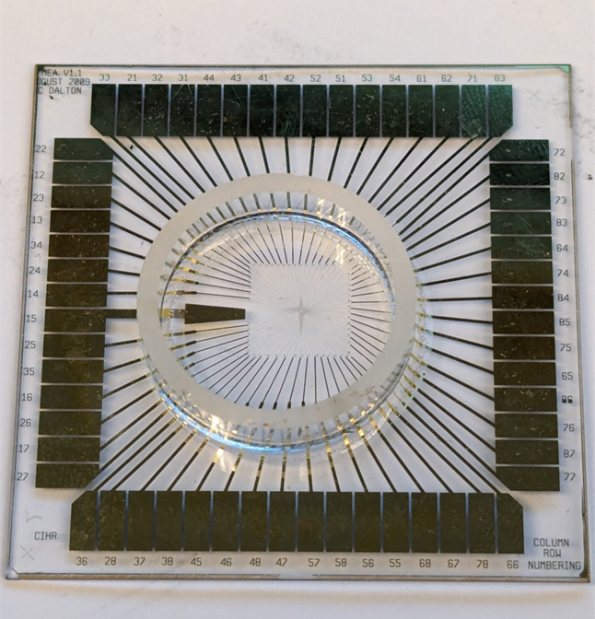
Introduction of Neurochip
The focus of the Research is to find
Safer and More Effective Medications for Epilepsy.
In Research, we record Electrical Activity from Neurons and see the impact of New Drugs on it.
This Process is scaled upon Animals and eventually tested in clinical trials with patients after FDA approval.
It allowed Two-way Communication between a Neuron and the Chip.
The chip allows researchers to Model Brain Circuits, Visualize Network Activity, and Test Potential Medications to STOP or PREVENT Seizures.
The Main Advantage:
Way of testing the Potential of Epilepsy Drugs more efficiently and could eventually help people with hard-to-treat Epilepsy get better care.

Slide 35
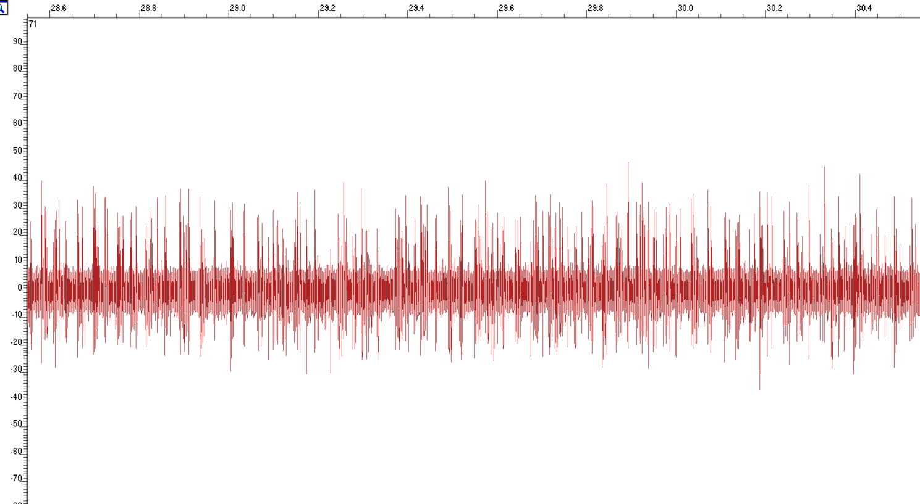
The Nuro Chip in action
30-Second Recording – x-axis
This is a 30Ssecond representative trace of seizure-like activity in a Neuron
Y Axis is the potential in uV Y-Axis
Every time you see a spike, that is an Action Potential. Note that the firing rate is very high and there is no break between bursts. This is an uncontrolled seizure-like activity from one Neuron on a Neuro-Chip.

Slide 36
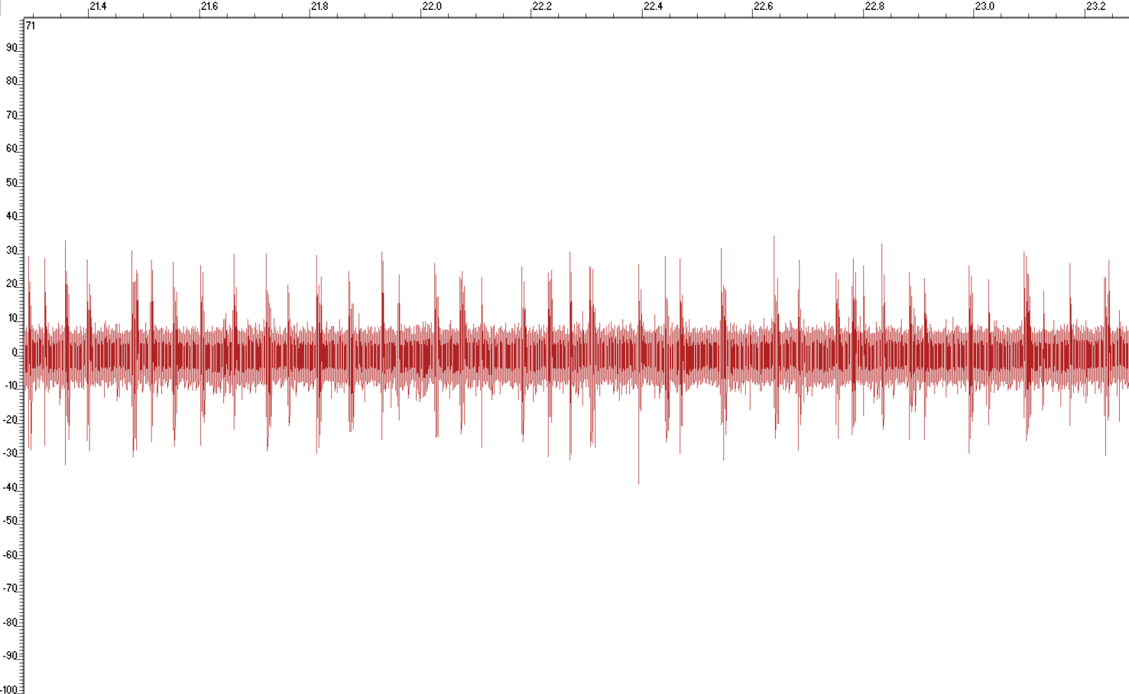
The Nuro Chip in Action
30 second recording – x-axis
This is a 30second representative trace of activity in a neuron in the presence of both a seizure + an antiepileptic drug
Y Axis is the potential in uV
Every time you see a spike, that is an Action Potential. Note that the firing rate is lower than before, and there are breaks between bursts. This is a controlled activity. It seems that the Antiepileptic Drug is rescuing the Neuron from seizure-like activity and bringing it back to baseline/healthy levels.

Slide 37
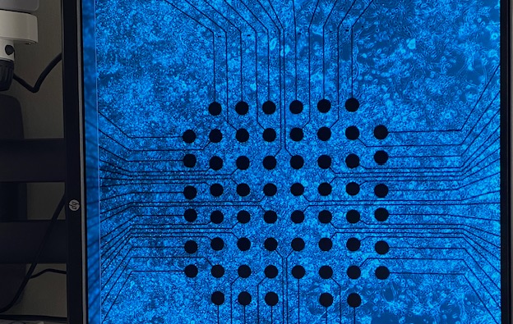
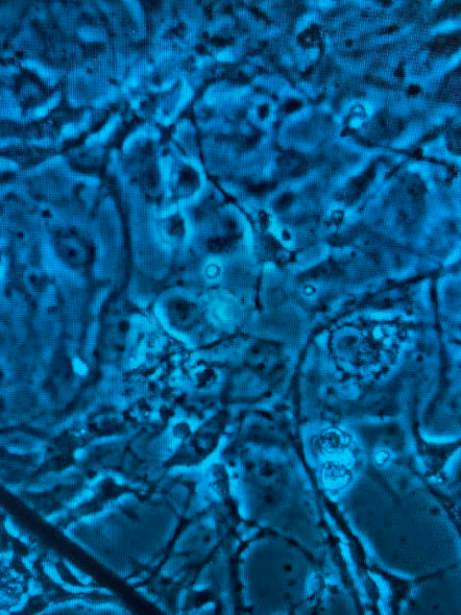
Nuro Chip in Action I had the opportunity to participate in cutting-edge experiments to discover new drug combinations for Epilepsy treatment.
Image about how Brain Cell is on a Neurochip
Image of Nuro cell and Glia Cells
Synopsis
Neuro Cells
Glia Cells

Slide 38
Observations/Analysis
I had the opportunity to go to the Neurosciences Research Centre at Cumming School of Medicine, at the University of Calgary and participated in cutting-edge experiments to discover new drug combinations for Epilepsy treatment. I spent in the lab 15-20hours in-person. I looked at AEDs and saw that they limit seizure-like activity in Neurons.
Antipoetic Drugs prevent Seizure activity in Neurons
Vagus Nerves Stimulator (VNS)
Neurostimulation
Lifestyle
https://educationalresearchtechniques.com/2015/09/30/observation-in-qualitative-research/

Slide 39
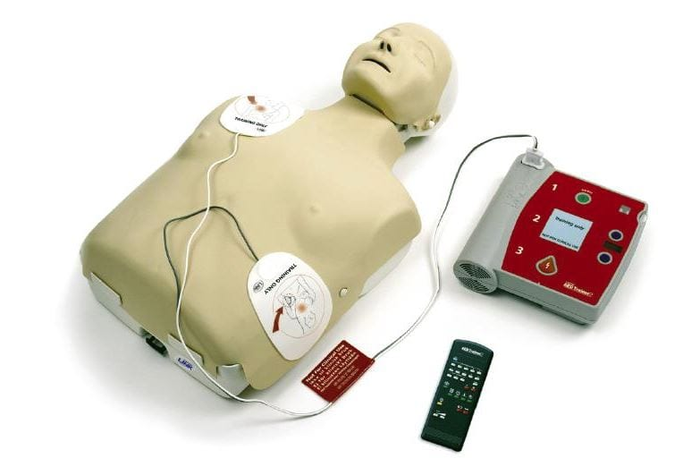
Conclusion
Epilepsy is a devastating and incurable disease.
But symptoms can be treated with several techniques
I observed that AEDs can immediately control seizure activity
using a Neurochip as a research device.
AED: A Medical device designed to analyze the Heart Rhythm and deliver
an Electric Shock to victims of Ventricular Fibrillation to restore the Heart Rhythm to normal. https://emsa.ca.gov/aed/

Slide 40
Future Directions/Areas of Improvement
When we devolve new devices and Implants in developing countries
We need to make new implantable devices that have less corrosion
We need more safer, reliable, and effective drugs
Build more accurate algorithms to model Seizure activity in the brain and develop.

Slide 41
My Experience
I had a great experience in the Neurosciences Lab at Cumming School of Medicine, the University of Calgary.
I observed Neuroscience Research, including Human Brain Cells, Snail Neurons, Gilia Cells, Synapsis, Neuro and Silicon Chips.
Interacting with Neuroscientists, Ph.D. and graduate students, I gained insights into the advanced research and treatment options against Epilepsy.
This experience was educational, and inspiring and motivated me to pursue my interest in neurosciences and to become a Neurosurgeon as a career in future.

Slide 42
Special Thanks!
Firstly, I would like to pay my Special Thanks to ALLAH whose Blessings made everything possible.
And to everyone who helped me to complete this Project on Epilepsy.
Special Thanks to Respectable Teachers Mrs. Sadak, Mrs. Jyoti and Dr. Naweed Imam Syed, Neuroscientist, Professor of Medicine and their Ph.D. students, Mr. Fahad Iqbal, Mrs. Zainab Khan and Mr. Mathew Yacoub (BHSc Student) from Cumming School of Medicine, University of Calgary.
Lastly, I would like to thank my father as well.

Slide 43
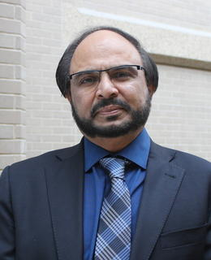
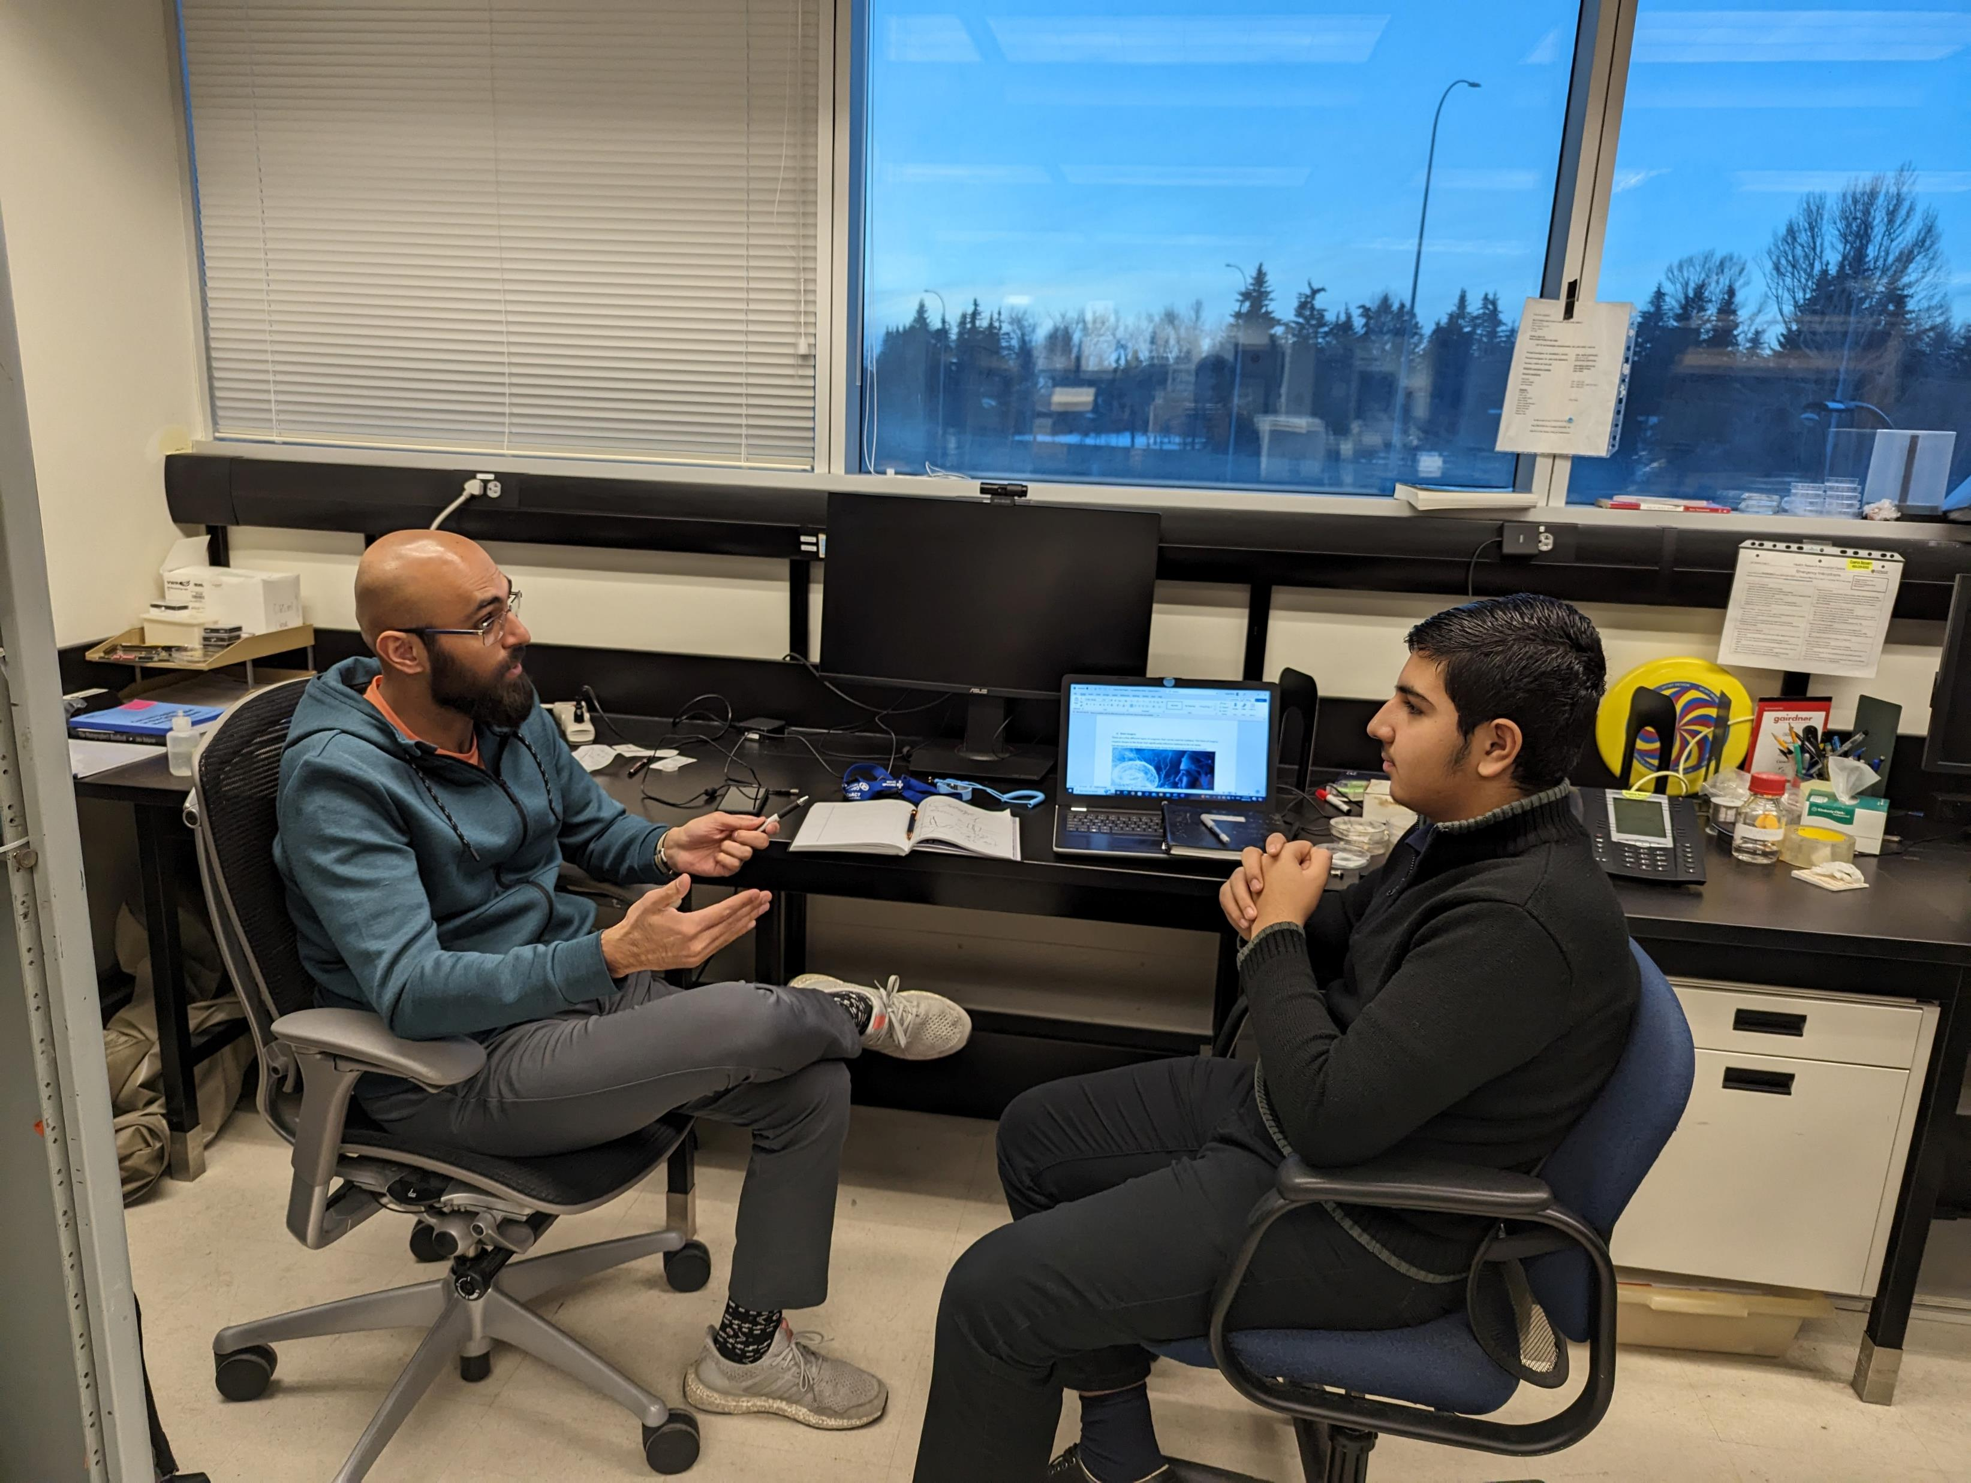
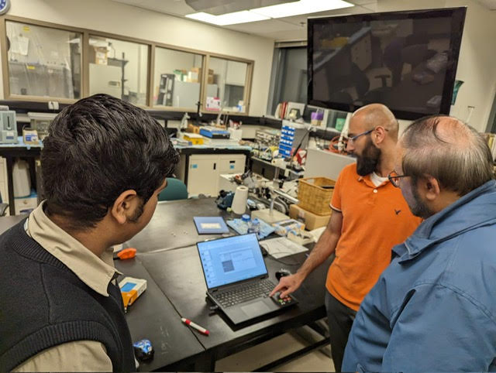
My Mentors…..

Slide 44
Ref:
https://www.empoweringepilepsy.org/all-about-epilepsy?gclid=EAIaIQobChMIh4mGotKmgwMVrMvCBB1XdgbXEAEYAiAAEgLuwPD_BwE
https://www.epilepsy.com/what-is-epilepsy
https://www.mayoclinic.org/diseases-conditions/seizure/symptoms-causes/syc-20365711
https://www.mayoclinic.org/diseases-conditions/petit-mal-seizure/symptoms-causes/syc-20359683
https://www.medicalnewstoday.com/articles/types-of-epilepsy#types
https://www.who.int/news-room/fact-sheets/detail/epilepsy
https://www.ninds.nih.gov/health-information/disorders/epilepsy-and-seizures
https://facty.com/conditions/epilepsy/10-treatments-of-epilepsy/2/
https://anatomyinfo.com/parts-of-the-brain/
https://www.google.com/search?q=what+is+the+role+of+limbis+system&rlz=1C1UEAD_enCA1080CA1088&oq=what+is+the+role+of+limbis+system&gs_lcrp=EgZjaHJvbWUyBggAEEUYOTIJCAEQABgNGIAEMggIAhAAGBYYHjIICAMQABgWGB4yCAgEEAAYFhgeMgoIBRAAGAoYFhgeMggIBhAAGBYYHjIICAcQABgWGB4yCAgIEAAYFhgeMggICRAAGBYYHtIBCjI0NTY2ajFqMTWoAgCwAgA&sourceid=chrome&ie=UTF-8
https://www.google.com/search?q=simple+Difference+between+Epilepsy+%26+Seizure+Attacks%3A&tbm=isch&ved=2ahUKEwiIm4GSpduDAxX_OUQIHU2MCKoQ2-cCegQIABAA&oq=simple+Difference+between+Epilepsy+%26+Seizure+Attacks%3A&gs_lcp=CgNpbWcQA1CZBliJFmDaGGgAcAB4AIABbYgBnQaSAQMzLjWYAQCgAQGqAQtnd3Mtd2l6LWltZ8ABAQ&sclient=img&ei=If6iZciGNf_zkPIPzZii0Ao&bih=712&biw=1511&rlz=1C1RXQR_enCA1059CA1059#imgrc=eCpi1v_Tz7UrmM
https://www.google.com/search?q=creative+pictures+of+Brain+and+seizures+attack&tbm=isch&rlz=1C1RXQR_enCA1059CA1059&hl=en&sa=X&ved=2ahUKEwjphY7qs9uDAxViJzQIHRJZB1oQBXoECAEQPg&biw=1492&bih=712#imgrc=ytq6aowmQq-_OM
https://www.cureepilepsy.org/for-patients/understanding/basics/seizure-classification/

