Slide 1

Science Fair Logbook
Name: Navreet
Notes:
Make a copy of this logbook (File - Make a Copy) and save in your Google Drive.
Share it with your Science Fair teachers: mmolfert@educbe.ca amduncan@educbe.ca kknanji@educbe.ca

Slide 2

Topic:
Write about the topic you chose. Why did you choose this topic? What do you hope to find out?
My topic is about vaping and the effect that it has on your lungs. I chose this topic because of how lots of youth/young people are vaping and its really bad for your lungs.
I chose a topic about vaping and the effect on human respiration rates. I chose this topic because of how many youth/young people are affected by vaping . I hope to find out how significant of an impact vaping has on human respiration rates.

Slide 3
Testable Question
How does vaping affect human respiration rates?
What is the effect of vaping on human respiration rates?
Which group of people is affected the most?
How does vaping affect individuals respiration rates with or without vaping?
Notes:
See D2L - Content - Getting Started - Planning Page 2

Slide 4
Method
Explain what you will research, how you will find out the answer to your question.
I will research how vaping affects individuals who vape and individuals who don’t and see the similarities and differences. How I will find the answer to my question is to find and see data that I will source from the internet and find
I will research how vaping affects individuals who vape and individuals who don’t and see the similarities and differences. How I will find the answer to my question is to find and analyze data that I will source from the internet. I looked at a study and their charts and results and methods and compared the different groups.
Notes:
See D2L - Content - Designing Your Experiment

Slide 5
Background Research
Research your topic and write about what you find out IN YOUR OWN WORDS. Add slides as necessary. Make sure to note your sources of information on the Sources page.
The average respiration rate for an adult at rest is 12 to 20 breaths per minute. If an adult’s respiration rate is under 12 or over 25 breaths per minute, that may be a sign of a health condition. How individuals check their respiration rate is by: finding a comfortable spot and sit or lying down. Then put a timer on for one minute then put your hand on your chest and breath and count how many breaths you take for 1 minute. What conditions can affect your respiration rate is: asthma, anxiety,pneumonia, heart disease, lung disease, and substance use disorder.

Slide 6
Background Research
What questions/information do you need to find out about your topic? What is some important vocabulary?
Normal respiration rate for each child age group
Age Category Age Range Normal Respiration Rate
Infant/Baby 0-12 30-60 breaths per minute
Toddler 1-3 24-40 breaths per minute
Preschooler 4-5 22-34 breaths per minute
School Age 6-12 18-30 breaths per minute
Adolescent 13-18 12-16 breaths per minute

Slide 7
Background Information
Research your topic and write about what you find out IN YOUR OWN WORDS. Add slides as necessary. Make sure to note your sources of information on the Sources page.
Vaping is when you use a small, handheld electronic device(like vapes, vape pens or mods) to inhale a mist of nicotine and flavor(e-liquid). It's similar to smoking but vaping warms up little particles out of a liquid instead of burning tobacco like cigarettes. An vape or other vaping devices heat up the liquid in the device to create an aerosol. Mist from vapes contains particles of nicotine, flavor and other substances suspended in the air. You breath these particles into your mouth from the mouthpiece, where they go down your throat into your lungs. What vaping does to your lungs is the particles you inhale from vaping can cause inflammation(swelling) irritation to your lungs. This can lead to lung damage like scarring and narrowing the tubes that make that bring air in and out of your lungs. Side effects of vaping are: coughing, shortness of breath, eye irritation, headaches, dry and irritated mouth and throat, and nausea. An e-cigarette is another word for a vape.

Slide 8
Background Research
One JUUL pod is equal to one box of cigarettes, Vaping is an addiction. Vapes were developed in China and came into the US market in 2007. It trended really fast. In 2015 the JUUL was created. That's when they saw an increase in teenage use. It was sleek and easy to hide and it had flavors that applied to the younger audience. They are so popular because they have so much nicotine in them that kids are getting high from it. 1 JUUL pod is equal to 1 pack of cigarettes. JUUL advertised young, fashionable models and hired influencers to promote their product. Nicotine can be really addictive to young people because their brain doesn’t fully develop until the age 25. There are 3 types of vape addiction: nicotine addiction, device addiction, and flavor addiction. Some symptoms of vaping are: coughing,shortness of breath and sometimes anxiety. The chemicals in vapes contain 99% nicotine and heavy metals like nickel,lead,tin and flavors. Vaping is more dangerous than smoking because of the high amounts of nicotine that is in it. The flavorings are causing affects and the nicotine is causing the addiction.

Slide 9
Hypothesis
Your prediction, or what you think will happen:
*use info from your research or background knowledge to help explain)
If individuals vape then their respiration rate will be higher because of the high amount of nicotine inside the vape.
(I do/change this…) (I think this will happen) (Why? )
If individuals vape then their respiration rate will be higher because of the high amount of nicotine inside the vape.---Some symptoms of vaping are coughing, and shortness of breath which can make your respiration rate higher and nicotine causes these symptoms.
If individuals don’t vape then their respiration rate will be lower because they do not consume nicotine that is inside the vape. — Nicotine is the thing that makes your respiration rate higher because of its symptoms so if individuals don’t vape then they don’t consume the type of nicotine in vapes so there is a high chance their respiration rate is lower than the average person who vapes daily.
Notes:
See D2L - Content - Hypothesis

Slide 10
Sources of Information
Note all sources used - websites, books, experts, etc. ( *Google is not a website, follow links to find the page information.) Add slides as needed.
Title | Author | Information (web link, publisher, etc) | Year
Vital Signs | Cleveland Clinic |  | 2025
 | ACLS Medical Training
What is the Normal Respiratory Rate for a 1 year old? |  |  | 2025
Vaping(e-cigarettes): What It Is, Side Effects & Dangers | Cleveland Clinic |  | 2026
Know Vape. Nic Sick: The Dangers of youth Vaping | Idaho Public Televison |  | 2023
Vital Signs
Cleveland Clinic
https://my.clevelandclinic.org › health › articles › 1088...
What is the Normal Respiratory Rate for 1 Year Old?
ACLS Medical Training
https://www.aclsmedicaltraining.com › normal-values-i...
Vaping (E-Cigarettes): What It Is, Side Effects & Dangers
Cleveland Clinic
https://my.clevelandclinic.org › health › 21162-vaping
Know Vape | Nic Sick: The Dangers of Youth Vaping
PBS
https://www.pbs.org · Mar 21, 2023
Notes:
See D2L - Content - Referencing Your Sources

Slide 11

Sources of Information
Note all sources used - websites, books, experts, etc. ( *Google is not a website, follow links to find the page information.) Add slides as needed.
Title | Author | Information (web link, publisher, etc) | Year
Smoking e-cigarettes and the effect on respiratory symptoms among a population sample of youth | Chaiton.M Pienkowski.M Musani.I Bondy.J.S Cohen.E.J Dubray.J Et al |  | 2023
Smoking, e-cigarettes and the effect on respiratory ...
Tobacco Induced Diseases
https://www.tobaccoinduceddiseases.org › Smoking-e-ci...
Notes:
See D2L - Content - Referencing Your Sources

Slide 12
Measures
The main thing the researchers measured was called”pack-equivalent years”. This is a strategy to find out how much a person has vaped over time. To calculate it, researchers asked:
Smoking Status - Alcohol or cannabis use in the past month
If the person ever had asthma
How many puffs a person takes each day when they vape
How many days they vaped in the past 30 days
How old they were when they first started vaping
They used this information to calculate how much vaping the person had done over the years. The main thing that was studied respiratory symptoms. Participants had to say whether they had any of these 5 symptoms in the last 4 months:
Regular coughing - Wheezing during exercising or walking up the stairs
Getting consistent colds that take a long time to go away
Coughing up mucus (phlegm)
Feeling out of breath doing simple chores

Slide 13
Measures
Researchers also asked to vapers about:
What type of vaping device was used
How long the person had been vaping
Personal information like: age, gender, education, race, and province
If they had asthma
This information helps researchers better understand the person’s health

Slide 14
Statistical Analysis
Researchers used a math method called “Poisson regression” to study how vaping affects breathing problems. This strategy helped researchers compare how often respiratory symptoms happened in different groups. They looked at:
How often people used vapes
How often they vaped
They also analyzed current vape users to see whether:
The type of vaping device
The flavor used
The number of years vaping
were linked to breathing problems

Slide 15
Results
About 60% of the people invited to join the study took part. Younger females with higher education, and those who never had vapes were more likely to participate. In total, 3082 young people completed the survey. The average age was about 20 years old, and they were between 16-25 years old. Most participants were White (about 74%) and most of them were female (about 81%). 396 people said they had asthma. When looking at vaping:
Half (50%) said they never vaped or not currently vaping
10% vaped less than once a month
5% vaped monthly
6% vaped weekly
28% vaped every day
Notes:
See D2L - Content - Designing Your Experiment

Slide 16
Results
Date:
Data: (measurements)
Group | Number of puffs per day | Number of days vaped per month | Number of years vaped
Never smokers | 3 | 6 | 2
Ever smokers | 6 | 13 | 2.4
Daily smokers | 8 | 14 | 2.2
Notes: What this means is that people who smoke also tend to vape more often and take more puffs each day. Never smokers who vape usually vape less often and take fewer puffs compared to people who smoke
Notes:
See D2L - Content - Designing Your Experiment

Slide 17
Breathing Symptoms
Date:
Data: (measurements)
Group | %Coughing up Phlegm
No smoking or vaping | 8.2%
Tried smoking or vaping | 13.4%
Vape daily | 26.3%
Smoke daily | 52.2%
Both daily | 45.2%
Group | Number of people
No smoking or vaping | 825
Tried smoking or vaping | 1303
Vape daily | 820
Smoke daily | 92
Both daily | 42
Notes:
See D2L - Content - Designing Your Experiment

Slide 18
Breathing Symptoms
Date:
Regular Coughing(Past 4 Months)
1.No symptoms at all
Group | % With no symptoms
No smoking or vaping | 65.8%
Tried smoking or vaping | 58.8%
Vape daily | 34.2%
Smoke daily | 13.3%
Both daily | 17.5%
Group | % Who Coughed
No smoking or vaping | 9.9%
Tried smoking or vaping | 16.4%
Vape daily | 40.1%
Smoke daily | 65.6%
Both daily | 57.1%
Notes:
See D2L - Content - Designing Your Experiment

Slide 19
Breathing Symptoms
Date:
Group | Shortness of breath while doing simple things
No smoking or vaping | 11.5%
Tried smoking or vaping | 18.3%
Vape daily | 30.9%
Smoke daily | 45.6%
Both daily | 51.2%
Group | Wheezing During Exercise
No smoking or vaping | 16.5%
Tried smoking or vaping | 20.1 %
Vape daily | 28.4%
Smoke daily | 47.8%
Both daily | 43.9%
Notes:
See D2L - Content - Designing Your Experiment

Slide 20
Breathing Symptoms
Over the past 4 months did you get any colds and your colds usually last longer than others?
Group | Number of people | Percentage
Total who said yes | 247 | 8.2%
Group 1 | 61 | 7.5%
Group 2 | 97 | 7.6%
Group 3 | 70 | 8.9%
Group 4 | 15 | 16.7%
Group 5 | 4 | 9.8%

Slide 21
Results
It shows that young people who both smoke and vape had the highest percentage of breathing symptoms. Those who only smoke or only vape also had more breathing challenges than those who did neither. People who did not smoke or vape had the lowest percentage of breathing symptoms. This means that smoking and vaping are both linked to more respiratory problems, especially when someone does both. People who did not smoke or vape had the least respiratory problems. People who vaped daily, smoked daily, or both daily had the most respiratory problems. The group that both smoked and vaped daily often had the highest percentage of coughing,wheezing, and shortness of breath. For example:
10% of non users reported regular coughing
40% of daily vapers reported regular coughing
66% of daily smokers reported regular coughing
Researchers also analyzed how long and how much somebody vaped(called pack-equivalent years).
For non smokers more vaping over time greatly increased respiratory problems. For people who had smoked before more vaping made respiratory problems higher. For daily smokers, vaping more did not clearly increase respiratory problems further. Vaping can be harmful for people who do not already smoke daily. Using a pod style device was linked to more respiratory problems. Using a cig-a-like device was not clearly linked to more symptoms.
Notes:
See D2L - Content - Designing Your Experiment

Slide 22
Conclusion
Vaping is linked to more respiratory problems in young people, especially for those who do not already smoke daily. Using a pod devices may increase the risk even more

Slide 23
Results: Analyze
Look at your data and observations. Look for patterns and trends. Explain what you found out:
I found out that non users had the least problems out of all the sections and even users was in between and the ones who smoke or vape daily or do both daily have the highest problems because vaping can cause more respiratory problems because of the amount of nicotine in it.
Notes:
See D2L - Content - Designing Your Experiment
See D2L - Content - Conclusion, Application, and Extensions

Slide 24
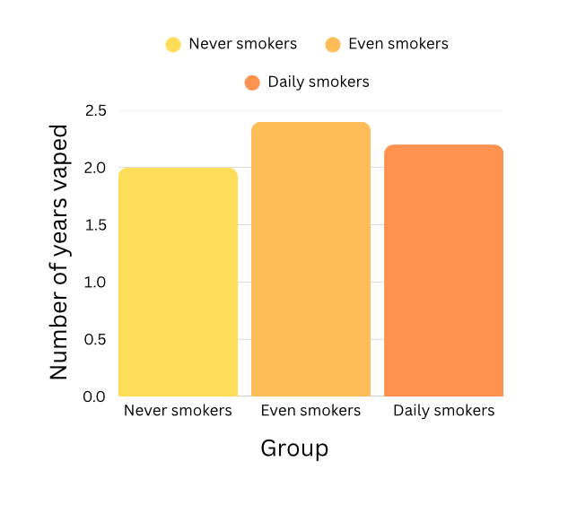
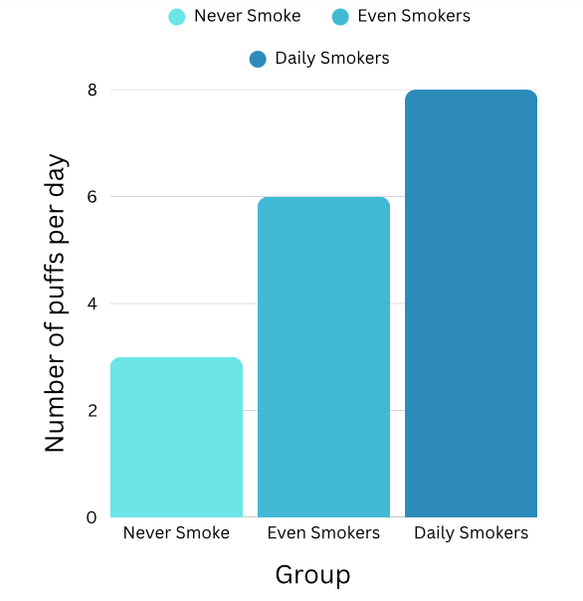
Results: Graph
Notes:
See D2L - Content - Designing Your Experiment
See D2L - Content - Conclusion, Application, and Extensions

Slide 25
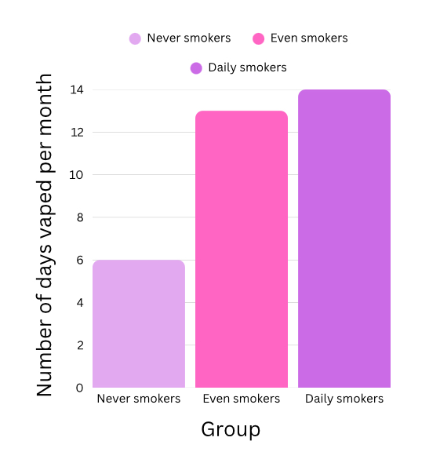
Results: Graph
Notes:
See D2L - Content - Designing Your Experiment
See D2L - Content - Conclusion, Application, and Extensions

Slide 26
Conclusion
My question was: How does vaping affect individuals respiration rates with or without vaping?
The answer to my question is: Vaping has more effect on respiration rates and makes more breathing problems
My hypothesis was correct because: When people vape their respiration rate was higher and it was because of the nicotine inside the vape
OR
My hypothesis was incorrect because:
Notes:
See D2L - Content - Conclusion, Application, and Extensions

Slide 27
Applications
In what ways are your findings useful?
Who could benefit from your results and how?
So people know how badly vaping can affect your breathing and respiratory symptoms so people who vape can quit and try to do thing to help their health.
Notes:
See D2L - Content - Conclusion, Application, and Extensions

Slide 28
Sources of Error
Do you think your results were reliable? Were there any other factors or conditions that could have affected the results of your experiment in unexpected ways?
What could have affected your results, that would need to be controlled differently if you were to repeat the experiment?
It was difficult to find a human study about respiration rates of people who vaped vs who don’t. So if I were to repeat this research again I would focus on lung capacity in stead on respiration rates.
Notes:
See D2L - Content - Conclusion, Application, and Extensions

Slide 29
Extensions
If you were to conduct this experiment again, what would you do differently?
I would focus on lung capacity instead of respiration rates because there are more studies that focus on that topic and easier to find. And it's more helpful research.
Notes:
See D2L - Content - Conclusion, Application, and Extensions

Slide 30
Extensions
Because of the results of this experiment, I wonder…
Describe further experiments that could be conducted to further investigate and understand your topic:
Maybe I could actually test people on their respiration rate for people who vape and don’t. And see how much times they can breath in a minute.
Notes:
See D2L - Content - Conclusion, Application, and Extensions

Slide 31

CONGRATULATIONS!!
You have completed your experiment!
Make sure that you enter information from this logbook into the CYSF Digital platform.
You are now ready to create your trifold display and practice your presentation.

