Slide 1
Designing a More Powerful Mini Magnetic Accelerator
Investigating how magnet stages and stack balls affect launch speed and distance.
This project focuses on improving a small magnetic device through engineering design.
Meer Gosain — Science Fair 2026

Slide 2
Challenge
Mini magnetic accelerators often launch steel balls weakly or sometimes not at all.
This means the stored magnetic energy is not being transferred efficiently into motion.
The challenge is to redesign the contraption, so the exit ball launches faster and travels farther.

Slide 3

Project Objective
The goal of this project is to improve the performance of a Mini Magnetic Accelerator.
Performance is measured by how fast and how far the exit ball travels after launch.
I tested design changes involving magnet stages and stack ball numbers to find the best setup.

Slide 4
Why This Is An Innovation Project
This project is about improving a working device instead of only observing a science experiment.
Each version of the accelerator was built, tested, and then modified to make it perform better.
This process follows the same engineering design cycle used in an innovation project.

Slide 5

Hypothesis
If I increase the number of magnet sets or add more stack balls, the exit ball will launch faster and farther.
More magnets should add more magnetic pulling force to accelerate the ball.
More stack balls should improve momentum transfer through the system.

Slide 6
Background Research — Energy
Physics is the study of motion and the forces that cause it.
Energy cannot be created or destroyed, only changed from one form to another or transferred between objects.
When something speeds up, it gains kinetic energy, which must come from a source such as a push, gravity, or magnetic force.

Slide 7

Background Research Magnetism
Magnets are interesting because they can affect objects without touching them.
They produce invisible areas around them called magnetic fields that pull on metals like steel.
As a steel ball moves closer to a magnet, it accelerates as magnetic energy turns into motion.

Slide 8
Background Research Momentum
Momentum is the quantity of motion an object has and depends on its mass and speed.
During a collision, momentum can be transferred from one object to another.
Steel balls transfer motion efficiently because their collisions are close to elastic.

Slide 9
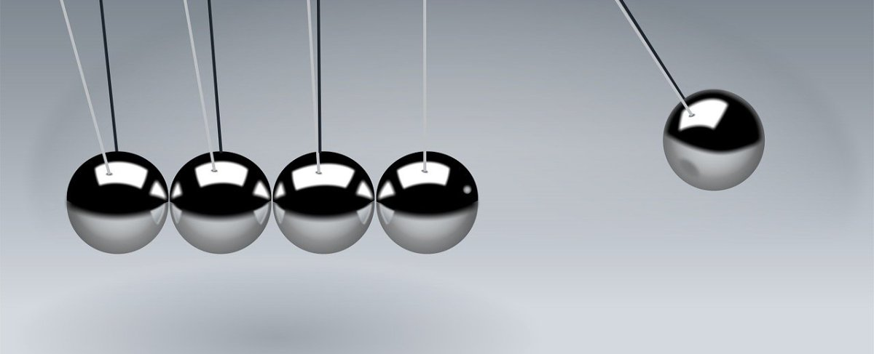
Energy Transfer Through Objects
Energy can move through a series of connected objects without all objects moving very much.
Newton’s Cradle is a good example, where the ball on one end swings out after a collision.
This happens because momentum and kinetic energy pass through the middle balls.
This Photo by Unknown Author is licensed under CC BY-NC

Slide 10
Magnetic Accelerators
Magnetic accelerators, also called Gauss rifles, combine magnetism and momentum transfer.
A magnet pulls a steel ball forward, increasing its speed before it collides with other balls.
The final ball launches forward with energy that came from the magnetic field.

Slide 11
Materials
The accelerator was built using strong neodymium magnets and steel balls.
A floorboard gap was used to guide the ball’s motion and reduce friction.
A foam stopper was placed at the end to safely stop the ball after launch.

Slide 12
Independent Variable
The independent variables were the number of magnet sets and the number of stack balls.
These were changed one at a time to see how each design change affected performance.
Testing multiple setups allowed comparison between different engineering designs.

Slide 13
Dependent Variable
The dependent variable was the speed that the exit ball traveled after leaving the accelerator.
Speed shows how much kinetic energy the ball had during the launch.
Greater Speed means a more powerful and efficient design.

Slide 14
Controlled Variables
Several factors were kept the same to make the test fair.
These included the same steel balls, same track, same starting distance, and same room conditions.
Keeping these variables controlled ensured that only the design changes affected the results

Slide 15
Design Criteria
A successful design needed to launch the ball consistently every time.
It also needed to increase speed and distance without becoming unsafe or unstable.
The best design would balance strong acceleration with smooth energy transfer.

Slide 16

Procedure Step 1
The track was set up on a flat indoor surface to keep conditions consistent.
A foam stopper was placed at the end to prevent the ball from rolling too far.
Magnets and stack balls were placed carefully in a straight line.

Slide 17
Procedure Step 2
A starting line was marked about 20–30 cm away from the magnet setup.
The shooter ball was always released from this same position.
This kept the starting energy the same for every trial.

Slide 18
Procedure Step 3
The shooter ball was released without pushing it, so only gravity caused it to roll.
It accelerated toward the magnet and collided with the stack balls.
The exit ball launched forward from the other end of the stack.

Slide 19

Procedure Step 4
The distance traveled by the exit ball was measured after each launch.
Three trials were done for each setup to improve reliability.
Results were recorded in a table for comparison.

Slide 20
Testing Method
Only one variable was changed at a time to keep the experiment controlled.
Comparing results helped identify which design changes improved performance.
Each new setup acted as a prototype in the design improvement process.

Slide 21
Observations — 1 Set, 1 Ball
With one magnet set and one stack ball, the exit ball did not move at all.
A loud sound was heard, but the energy did not transfer through the system.
This showed that the design was not effective.

Slide 22

Observations — 1 Set, 2 Balls
With two stack balls, the exit ball vibrated strongly but moved only a little.
Some energy transfer occurred, but it was still weak.
This made me think that more balls might improve momentum transfer.

Slide 23
Observations — 1 Set, 3 Balls
With three stack balls, the exit ball launched slowly but clearly moved forward.
Energy transfer through the line of balls improved.
However, the system still seemed limited by having only one magnet stage.

Slide 24

Observations — 2 Sets, 3 Balls
With two magnet sets and three stack balls, the exit ball launched the fastest.
The ball traveled the farthest distance compared to all other setups.
This showed that adding another magnetic stage increased acceleration.

Slide 25
Results Trend
As the number of magnet stages increased, acceleration also increased.
The combination of both produced the strongest launch.
As the number of stack balls increased, energy transfer improved.

Slide 26

Analysis
More stack balls allowed momentum to pass through the system more efficiently.
Extra magnet stages added more magnetic potential energy to the moving ball.
These two factors together explain why the final design worked best.

Slide 27
Conclusion
The hypothesis was supported by the test results.
Using more stack balls and adding another magnet stage increased speed and distance.
This project demonstrated how magnetism and momentum can improve a device.

Slide 28
Sources of Error & Limitations
Small misalignments between balls could change how energy transferred.
Friction on the track and air resistance may have reduced distance.
Magnets may not have been identical in strength, affecting consistency.

Slide 29

Applications & Future Improvements
Magnetic acceleration principles are used in particle accelerators and maglev trains.
Future improvements could include measuring speed with video analysis and using stronger magnets.
Reducing friction and improving alignment could make the system even more efficient.

Slide 30

Acknowledgements & References
I would like to thank my mom for supporting me and helping me stay focused.
I would also like to thank Ms. Bretner for guidance and goal setting.

Slide 31
Citations
1. Eisco Labs. (n.d.). Gauss gun – linear magnetic accelerator demonstration apparatus.
https://www.eiscolabs.com/products/gsdemo
2. Southern Manitoba University. (n.d.). Using magnetic balls to show conservation of energy.
https://www.demos.smu.ca/index.php/demos/e-n-m/48-magnetic-accelerator
3. Colorado State University Department of Physics. (n.d.). Gauss accelerator [Physics demonstration].
https://www.physics.colostate.edu/physics-demos/gauss-accelerator/
4. Flinn Scientific. (n.d.). Magnetic linear accelerator
https://www.flinnsci.ca/magnetic-linear-accelerator---demonstration-kit/ap6838/
5. Instructional Resources, University of Iowa. (n.d.). Magnetic linear accelerator – Gauss rifle [Demo notes].
https://physicsinstructional-resources.prod.drupal.uiowa.edu/5g1055-magnetic-linear-accelerator-gauss-rifle
6. KidsLoveKits. (n.d.). The Gauss rifle: A magnetic linear accelerator.
https://www.kidslovekits.com/projects/gauss_rifle/index.html
7. Flinn Scientific. (n.d.). Magnetic linear accelerator background information.
https://www.flinnsci.ca/magnetic-linear-accelerator_f0814952/dc11177ca/
8. Physics Outreach, Idaho State University. (n.d.). Magnetic linear accelerator demonstration.
https://www.isu.edu/physics/outreach/physics-class-demos/electricity-and-magnetism/magnetic-linear-accelerator/

