Slide 1
Microbial Fuel Cell Technology: A Pathway to Renewable in Remote Villages
By: Akhil and Prayush

Slide 2
Mission
Our goal is to use microbial fuel cell technology to create renewable energy in remote villages with limited amount of electricity
Question
How can we optimize microbial fuel cell technology to create renewable energy in remote villages?

Slide 3
What are Microbial Fuel Cells
A microbial fuel cell is a bio-electrical system that converts chemical energy into electrical energy. This is because the reactions catalyzed by microorganisms result in electrical energy.​
A microbial fuel cell contain an anode, and a cathode used to flow electricity throughout the machine
Bacteria thrive and multiply on the anode, generating a dense cell accumulation called biofilm that sticks to the anode of the microbial fuel cells​
Bacteria then use their microbial metabolism to transform organic substrate into CO2, electrons, and protons​
​

Slide 4
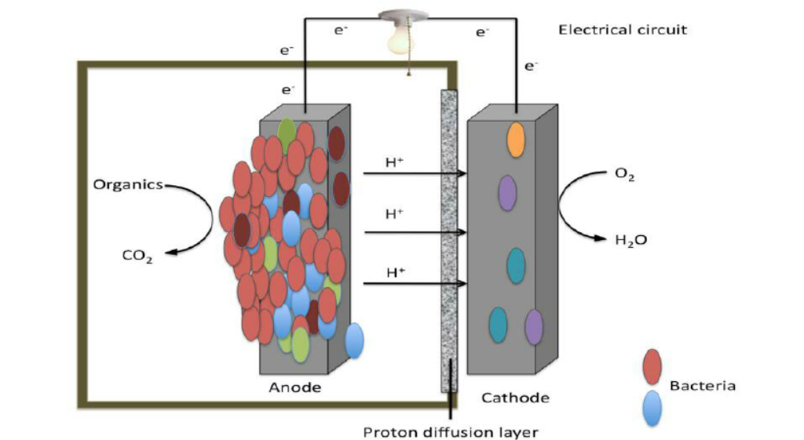

Slide 5
Parts of a Microbial Fuel Cell
Anode – Is the positively charged electrode where electricity moves into
Cathode – Is the negatively charged electrode where electricity leaves
PEM – (Proton Exchange membrane) Is designed to conduct protons while acting as an electronic insulator and generally made from ionomers which selectively transports protons from anode to cathode
Substrate – The substrate is the organic material that the microbes consume to generate energy. The microbes break the substrate down and release protons, electrons and CO₂
Microbes – Is the substance that breaks down the substrate, releasing electrons, protons, and CO₂
Electrolyte – Supports the growth of microbes by providing a liquid environment. Conducts ions between anode and cathode chambers to maintain a charge balance throughout the process of producing electricity
Aeration Device – Is used to supply the cathode with oxygen which improves the cathode reaction rate, enhancing the overall power output of the fuel cell.
External Circuit – Allows electrons to flow from the anode to the cathode, generating an electric current. Consists of conductive wire, resistor and a Multi-Meter

Slide 6
Why Microbial Fuel Cells
MFCs offer great promise for the future, as they can generate electricity while resolving environmental issues ​
Their versatility makes them very suitable for use in both urban and rural locations, especially those with limited electricity (Rural Villages) ​
Unlike fossil fuel-based traditional power generation system, MCFs emit a small amount of greenhouse gas
Check snap ok
Cause I already put this into the problem

Slide 7
History of Microbial Fuel Cells
Microbial Fuel Cells have been around since the early 20th century.
Initially, M.C. Potter designed the first microbial fuel cell in 1911, it wasn't refined and lacked attention, he ultimately scrapped the design.
The MFC regained attention in the 1970s, with studies and tests being held.
We want to make MFC's affordable and design MFCs that can be made in a bigger scale for remote villages.
Prayush check snap

Slide 8
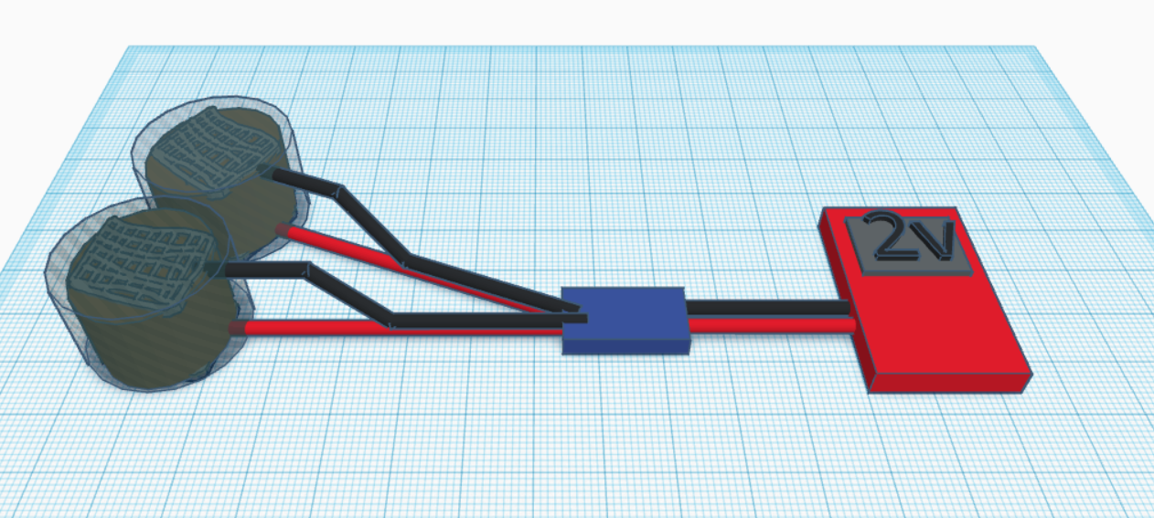
Cathode (Stainless steel mesh)
Multimeter
Anode (Stainless steel mesh)
Negative wire
Anode (Stainless steel mesh)
Cathode (Stainless steel mesh)
Positive wire

Slide 9
Materials
Two containers (anode and cathode chambers) - 2 tins​
Anode and Cathode Electrodes​ - Steel Mesh
Proton Exchange Membrane (PEM) - Diffusion
Conductive Wire – Copper Wire​
Microbial Culture (Bacteria) - Mud
Water
Activated Carbon Powder
Glue
Alligator Clips
Multimeter

Slide 10
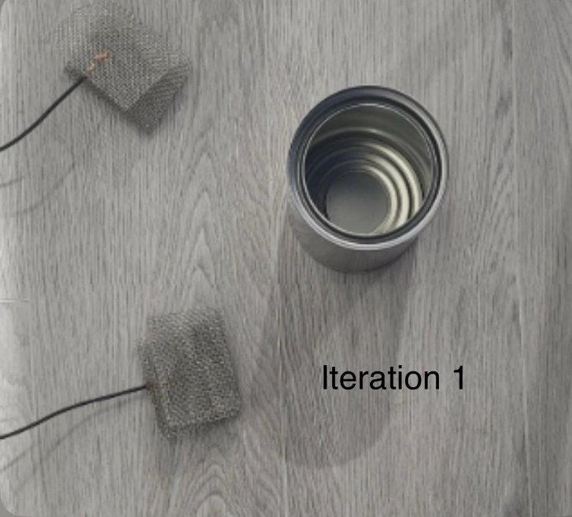
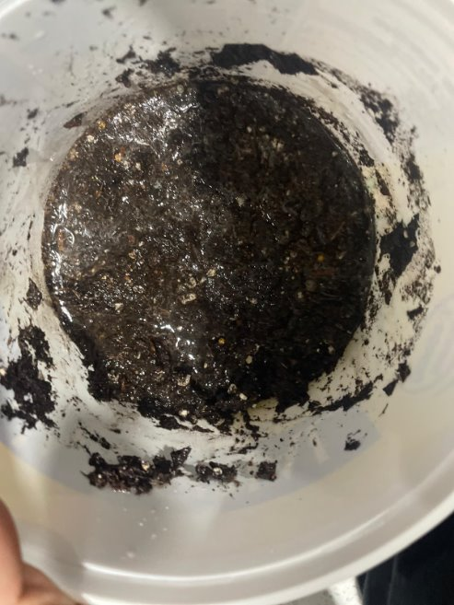
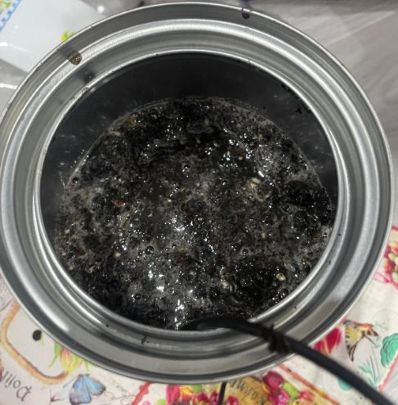
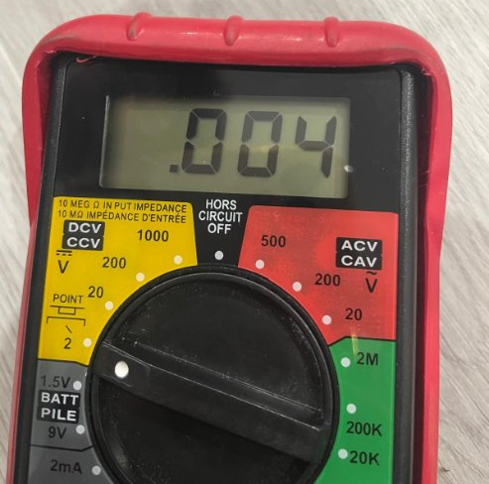
Iteration - 1
Includes -
Steel Mesh with no charcoal powder
Ratio of Water to soil = 80:20
Only 1 machine

Slide 11
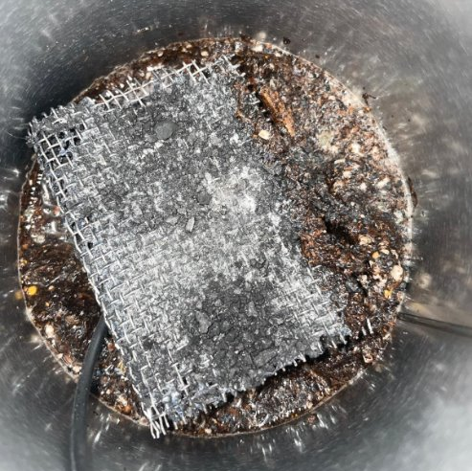
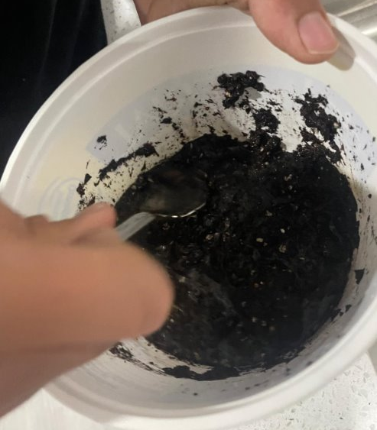
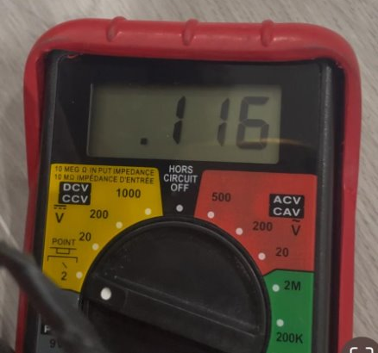
Iteration - 2
Includes
Steel Mesh with little charcoal powder
Ratio of Water to soil = 60:40
Only 1 machine
Cathode height increased for more contact with air

Slide 12
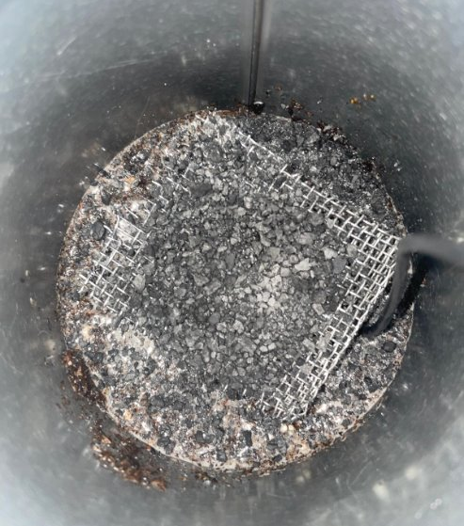
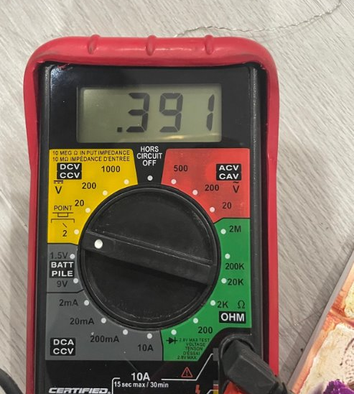
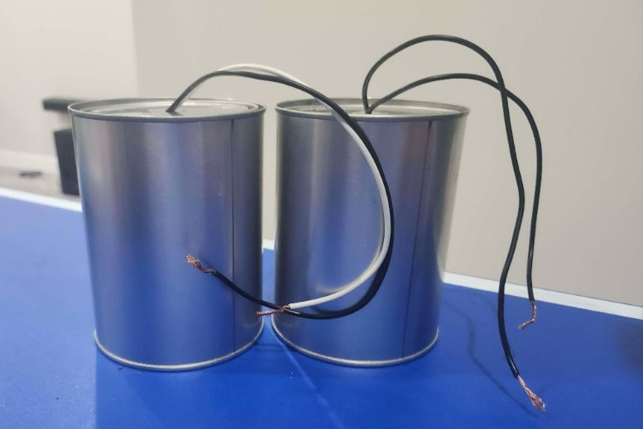
Iteration - 3
Includes
Steel Mesh with a lot of charcoal powder
Ratio of Water to soil = 60:40
2 machines
Cathode height increased for more contact with air

Slide 13
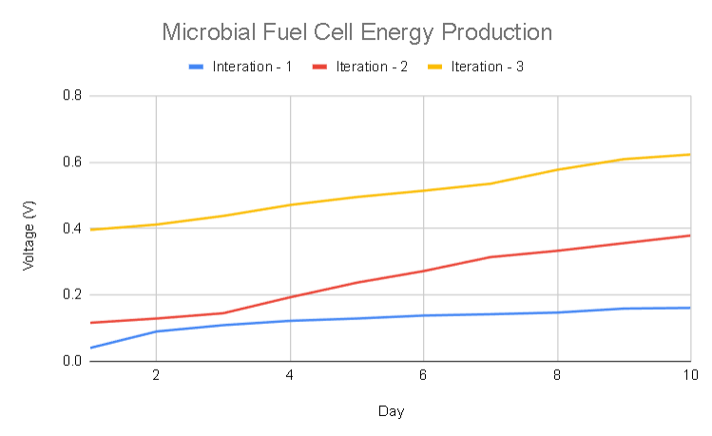

Slide 14
Complications
Although microbial fuel cells offer an eco-friendly, and simple way of generating electricity, multiple problems can arise. ​
One of which being the fact that microbial fuel cells don't have the ability to produce much electricity. This can be resolve by making them at a much larger scale, but this means that more maintenance is required with it being costlier.​
Another issue could be the low energy production due to less nutrients in the villages mud or food waste. Because of this the MCF cannot be fully utilized, providing less electricity to the village​

Slide 15
Implementing MFC's in our world
MFCs can change the face of renewable energy through converting organic wastes into electricity with the purpose of aiding communities where electricity is in short supply. ​
Most importantly, these devices will be useful in Sub-Saharan Africa, Southeast Asia, and South America, where production of organic wastes is high while infrastructure is not well advanced. ​
Because this technology transforms waste into energy, it increases recycling rates, decreases pollutants, and in the process, minimizes greenhouse gas emission. ​
MFCs can be integrated with other renewable energy sources such as solar and water aiming at the development of hybrid systems that are capable and reliable. As well as, performing other tasks such as water purification.​

Slide 16
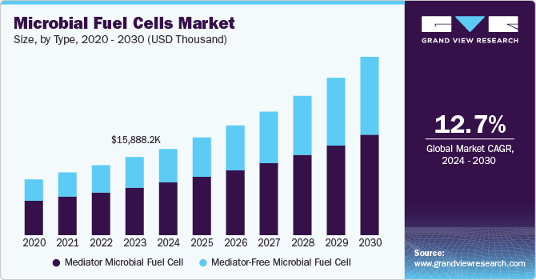

Slide 17
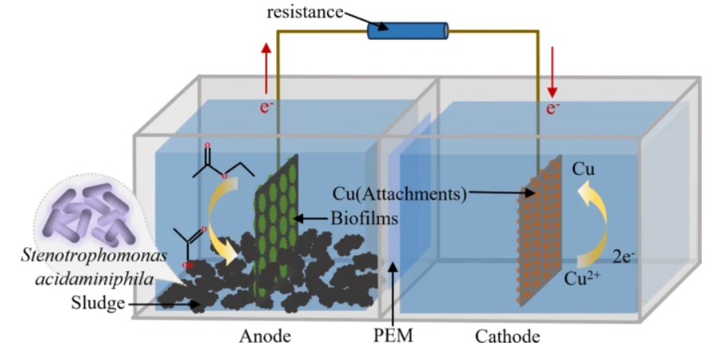

Slide 18
Increasing Energy Production
When using MFCs, it is important to pick an environment that has CO₂ available. ​
Using carbon capture methods like Post-Combustion Capture, Oxy-Fuel Combustion, and Direct Air Capture, we can collect CO₂ for the MFC, producing more energy.​
CO2 regulates the pH and microbial metabolism:​
pH regulation: A controlled pH can enhance proton availability and proton exchange across the membrane.​
Microbial Metabolism: Some bacteria can utilize CO₂ in metabolic ways, which might indirectly enhance their electron transfer efficiency. In systems with methanogenic bacteria, CO₂ can be used in methane production, which competes with electricity generation.​

Slide 19
Why is our technology better than existing solutions?
Our MFC:
Our MFC is fully built form low-cost materials, making them more accessible for third world countries.
The design we made uses carbon capture methods to boost the MFC, this reduces CO2 in the air and generates more energy.
This method is harnessing electricity is sustainable because it uses dirt that can be found anywhere.
Our MFCs have a big range when it comes to power generation, using just one fuel cell at a small scale can generate as little as 1V and using more can increase the electricity generated.
MFCs have a long lifespan, bacteria regenerates continuously meaning that MFCs don’t run out.
MFCs operate at room temperature, which makes it a better option as it doesn't require high temperatures like most fuel cells.
Other solutions:​
Other solutions often use toxic and hazardous materials. ​
Most have slow infrastructure growth and are not widely available.​
Other solutions have high carbon emissions with most requiring fossil fuels.​
​

Slide 20
Conclusion
With the information that we collected and the models we built, we can conclude that microbial fuels are steady and efficient way of energy production. Advancements in electrode materials, bacterial culture, and system designs will be crucial in enhancing efficiency and reliability. They hold a great promise for the future remote areas, producing just enough energy for small areas. With continued research and development, MFCs have a potential to completely change energy production, contributing to a more sustainable future and creating new opportunities.

Slide 21
Sources
https://pmc.ncbi.nlm.nih.gov/articles/PMC8088421/ ​
https://fabe.osu.edu/mfcfacts​
https://letstalkscience.ca/educational-resources/stem-explained/microbial-fuel-cells ​
https://www.energy.gov/energy-sources#:~:text=Primary%20energy%20sources%20take%20many,%2C%20solar%2C%20geothermal%20and%20hydropower. ​
https://afdc.energy.gov/fuels/electricity-production ​
https://www.sciencedirect.com/science/article/pii/S2588912523000279#:~:text=Microbial%20fuel%20cells%20generate%20bioelectricity,release%20of%20electrons%20and%20protons​
https://cosmosmagazine.com/science/biology/researchers-close-in-on-harnessing-electricity-from-bacteria/ ​
https://www.sciencedirect.com/topics/biochemistry-genetics-and-molecular-biology/microbial-fuel-cell
https://pmc.ncbi.nlm.nih.gov/articles/PMC8088421/
​

Slide 22
Sources cont.
https://www.nature.com/articles/s41598-024-74856-w
https://www.youtube.com/watch?v=bECIaInLmRw
https://www.youtube.com/watch?v=Nm_wkrIPW7E
https://www.youtube.com/watch?v=zmbCQei6P4Q
https://www.youtube.com/watch?v=su6PfYeMrsI
https://www.grandviewresearch.com/industry-analysis/microbial-fuel-cells-market-report
https://www.alliedmarketresearch.com/microbial-fuel-cell-market-A17181
https://www.rootsanalysis.com/microbial-fuel-cell-market
https://dianapham34.wixsite.com/microbialfuelcells/history
https://bioresourcesbioprocessing.springeropen.com/articles/10.1186/s40643-016-0116-6
https://illumin.usc.edu/microbial-fuel-cells-generating-power-from-waste/
​​

