Slide 1
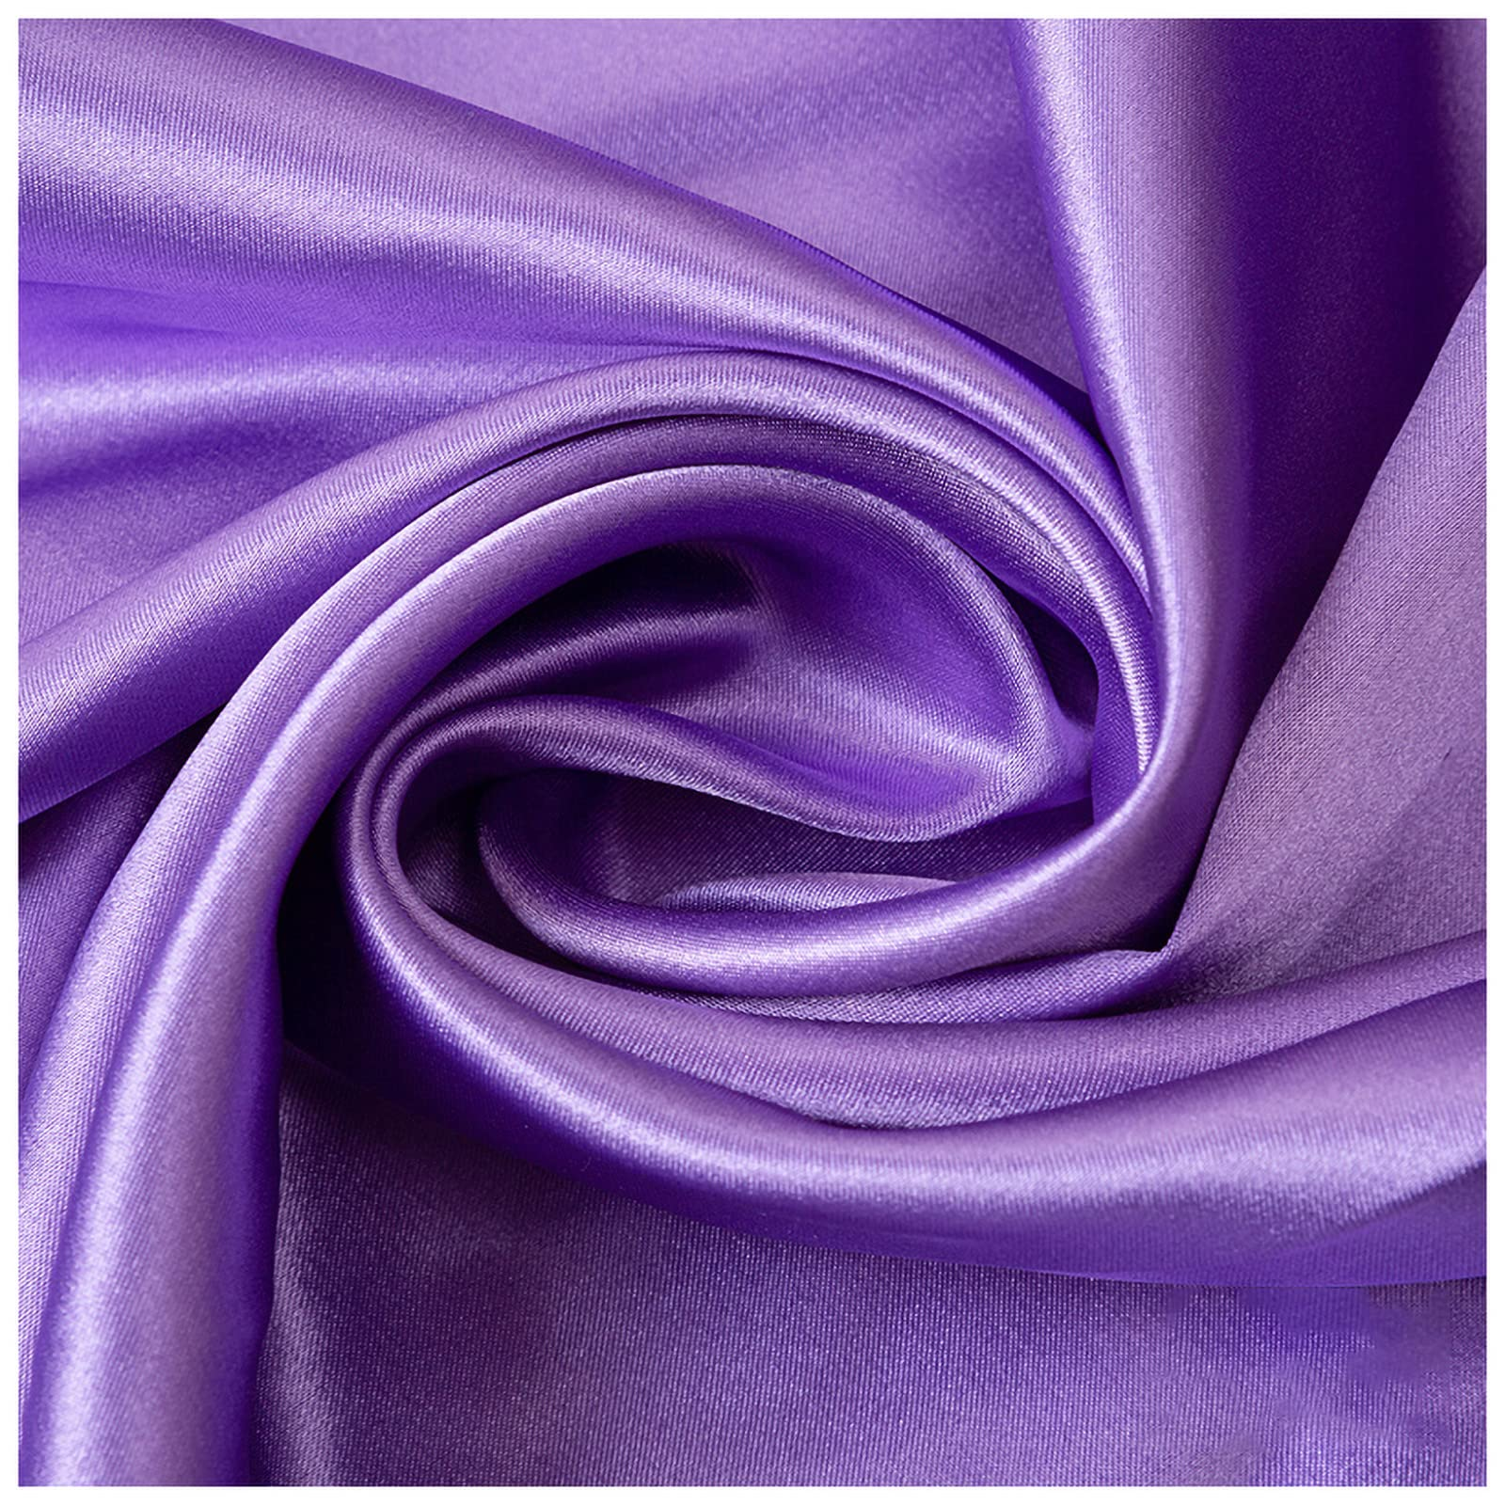
MATERIAL
MATTERS
Keera Thakrar

Slide 2
Testable Question
How does changing the material a jar is wrapped in impact the temperature of the water inside the jar?

Slide 3
Hypothesis
If a jar is wrapped in different materials, then wool will keep the jar the warmest, because wool sweaters and blankets are often used to keep people warm.

Slide 4
Introduction
Why is this an important experiment?
There are many reasons why doing this experiment could help the world. For example, have you ever been freezing in the winter, outside hiking, or out on a cold morning? Maybe you’re shoveling the snow, or your house heater doesn’t work. When I’ve been in these situations, I’ve noticed that people were most commonly wearing the following materials to keep warm: polyester, cotton, wool, flannel, and jeans. This led me to the question ‘What if I tested to see what material is the best insulator and would keep people the warmest?’ The second reason is we all have objects that we want to keep warm, so we need to know which material is the best insulator. And the last thing is, sometimes we want to keep cool. This experiment could show what material would keep you the coolest. These are reasons why we should look at my experiment and figure out accurate results.

Slide 5
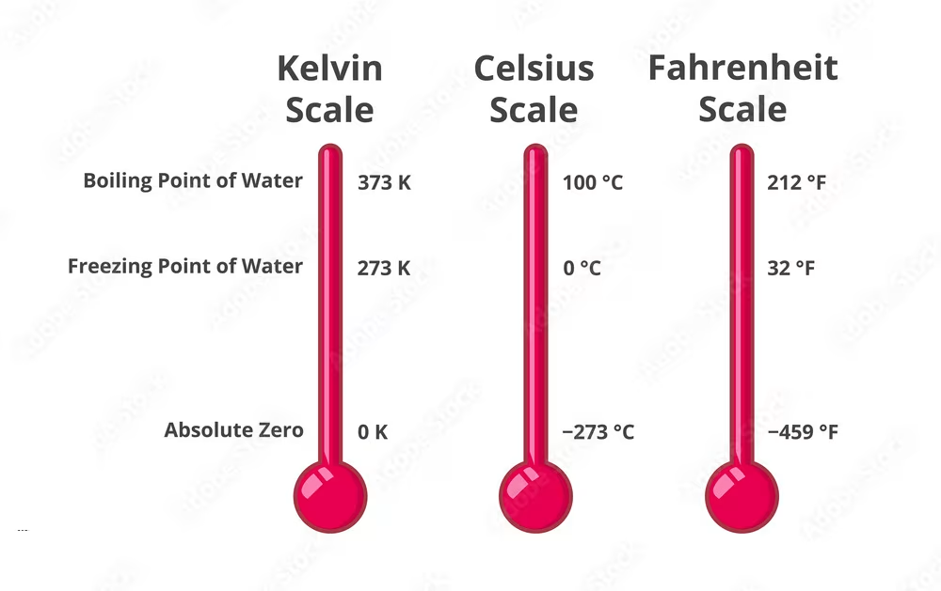
Temperature
Measuring Temperature:
We measure temperature in 3 different ways:
The first way is Celsius (ºC), which is the most common way of measuring temperature around the world, and the way this experiment is going to be done. Fahrenheit (ºF) is only used in the US, Bahamas, Cayman islands, and some small desolate islands. Celsius and Fahrenheit are different because they have different zero points and different increments. On the Celsius scale, 100 degrees separate freezing and boiling, but on the Fahrenheit scale, the difference is 180 degrees. Kelvin (K), the third temperature measurement, is a way of measuring really cold or really hot temperatures. Zero Kelvin degrees is -273.15ºC, and 0ºC is 273.15K. We do not typically use Kelvin to measure water temperature.
What Is Temperature?
Temperature is a measure of how hot or cold something is. It specifically measures kinetic energy (energy associated with motion) of particles in the object. We use temperature on ovens, before you go to school to know what to wear, if you have a fever, checking if the meat is safe to eat, measuring the temperature of the room, going out for blue days, keeping our fridge cool, and making food. In this experiment, we will be testing the temperature of water.
Water & Temperature:
Water freezes at 0ºC and 32ºF. Water is usually drunk around 10-22ºC . Water boils at 100ºC and evaporates at the same temperature.

Slide 6
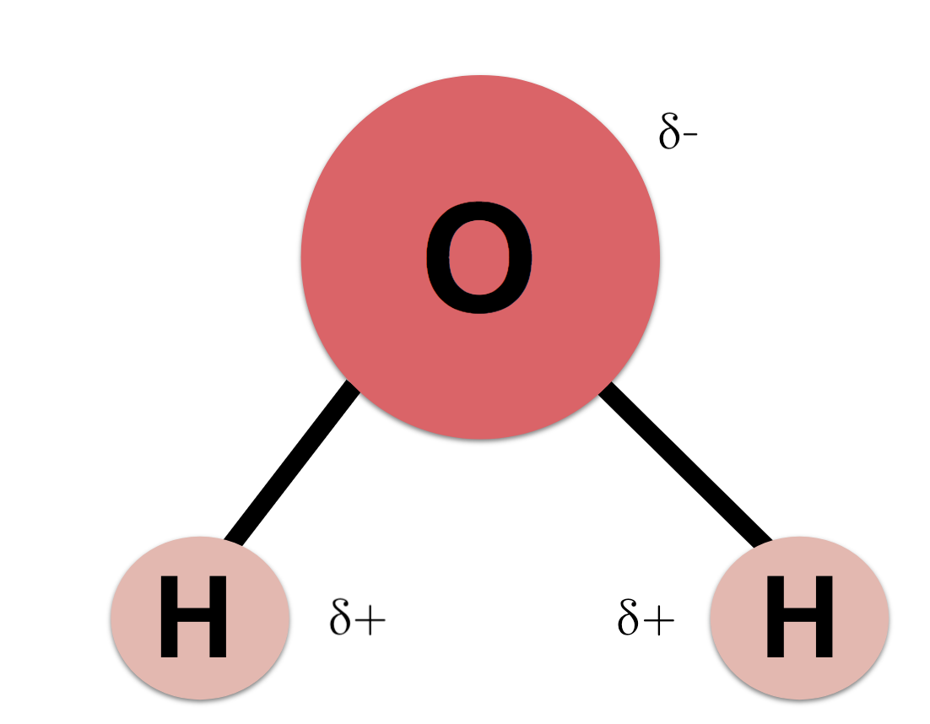
Water
Water’s Definition: The clear liquid that has no color, taste, or smell, that falls from clouds as rain or snow, and formes lakes, streams, rivers, ponds, and oceans. It is essential for life.
What Water Is Made Of: Water is made out of 2 Hydrogens and 1 Oxygen molecule. Water has the formula of H₂O. Water has a high polarity because water has two poles: a positive charge on hydrogen and a strong negative charge on oxygen. This allows water to have cohesive bonds (meaning that the same molecules stick to each other).
Water’s Importance to Life: Water brings nutrients to the body and plants. Water helps get rid of waste in animals and humans and helps produce urine. Water protects joints and organs, and maintains the temperature of organs.
Water and Temperature: When water freezes, the molecules of water expand, strengthen and make ice (a solid). Ice is less dense than water, which makes it float on water. Most liquids don’t do this, which makes water unique. When water heats up, the water molecules move faster and the cohesive bonds break. This allows water to change from a liquid to a gas.
ALL ABOUT WATER
Water is a liquid that keeps our body alive. Without water, we would be dead, and nothing on Earth could survive.
Water temperature changes a lot, making it a good thing to test things on. Water is essential to life and we all need it. We use it for our dishwasher, laundry, pumps, putting out fires, and even in some bedding.
But what is water? What is it made out of? What makes it so essential to life? What causes water to change temperature so easily?

Slide 7
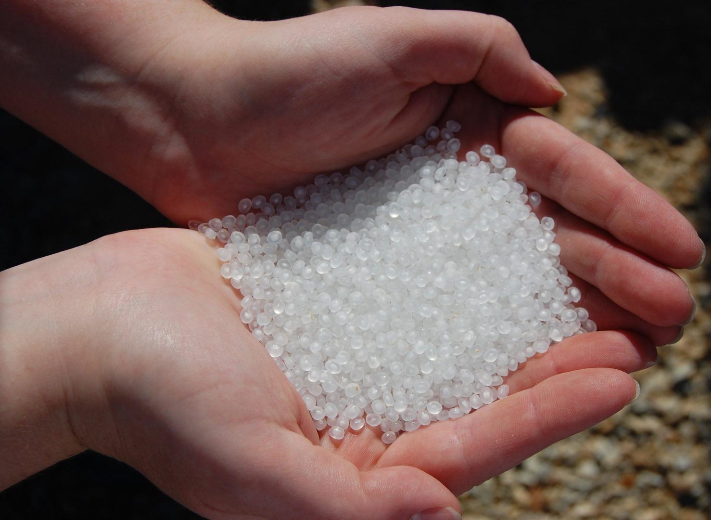
Polyester
Polyester is a synthetic material, meaning it is man-made and not found naturally in nature. Polyester fibres are made by melting plastic pellets through small holes to form long threads. These threads are then cooled to make a fiber. From there, the fiber goes to manufacturing companies to make clothing, tires, furniture, bottles and more.
Polyester is commonly used in clothing because it is cheap to produce, warm, durable and long lasting. Polyester is a really warm material because it traps the heat inside its fibers. Polyester is durable because the fibers are hard to pull apart, making it last a long time. Polyester is a great material to layer up with because it is a strong moisture wicking material, meaning it collects moisture away from your skin.
Another advantage of polyester is that it does not easily shrink or change shape. This keeps the clothing in new condition. It’s important to have a polyester clothing that is almost brand new condition because then there would be no missing threads, rips or tears, or heat loss as the polyester clothing gets old. Polyester can shrink if it is in really hot water for too long. This is why polyester clothing is washed in cold water and usually doesn’t go in the dryer, but hang drys instead. Polyester is less likely to shrink in comparison to wool or cotton because of the strong fibers.
So in the end, polyester is a great material to wear and use. Its cheap to make and lasts a long time. Polyester is found in may types of clothing, especially sweaters and jackets. This is because polyester is a warm light material. The only disadvantage of polyester is that it is not biodegradable making it hard on the environment and its not breathable because of how tightly the fibers are woven.
Polyester pellets

Slide 8
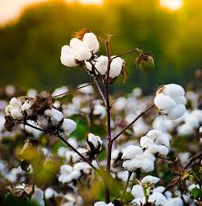
Cotton
Cotton is an organic material. Cotton comes from a plant, the Gossypium, or also called cotton plant. The Cotton come from the outer layer of the cotton plant’s seed. Before the cotton can be sent to manufacturing plants, it must be separated from the plant and then from the seeds. Machines assist in this process. Overall cotton is cheap to produce in comparison to other materials like wool.
There are two types of cotton, organic and regular cotton. Organic cotton is a lot better for your health because is grown without toxins or pesticides. The toxic pesticides in regular cotton not only hurt the environment, but can also harm your health in a few ways. Some of these ways are skin irritation, allergies, and even long-term health problems.
Cotton is also a very old material. It’s been used for over 7000 years! Cotton is not always used in clothes, it is also used to print money in the United States and is often used for towels, book bindings, bandages and even in coffee filters. India and China are the two countries that use the most cotton because cotton is cheap and affordable in these countries with the most amount of people.
Cotton, despite being a plant, is not great for the environment. Regular cotton uses lots of chemicals and fertilizers to grow, wasting the land. Cotton is a good insulator when its not wet as it can trap air in between its fibres. When wet, cotton becomes stronger and doesn’t stay warm. Cotton when wet becomes stronger because the hydrogen bonds in water make even stronger bonds with the cellulose in the cotton. When wet, cotton is not a good insulator because water gets trapped instead of air. Cotton can shrink, but it only shrinks once in its whole life. This happens because cotton fibres swell when wet, and then contract when dry, changing the size/ shape of the clothing.
However, cotton is a good material overall and cheap to produce. Cotton is comfortable, so they use it in hotels and hospitals for the bedding. Cotton can last decades but disintegrates after a week to 5 months once in the landfill.
Cotton Plant

Slide 9
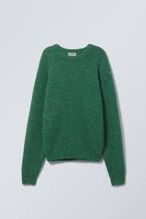
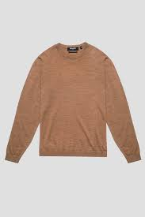
Wool
Wool
Merino Wool
Wool is a great natural material for keeping you warm. It is made from sheep's fur and therefore is an organic material. The shape of the wool fiber is like a coil that has natural bends and kinks. This shape helps trap air in to keep your body warm, making it a very good insulator. The sheep’s fur is made from keratin, the same material that makes up human hair, nails and the outer layer of our skin. Keratin is a strong protein and is the building block for wool, making the wool fiber strong.
Wool is a great material because it is fireproof and it is hard to burn. This is because wool is naturally high in nitrogen and water content requiring higher levels of oxygen in the surrounding air to burn. This makes it great for firefighters wear. The other people that should wear wool is babies. Babies have soft, sensitive skin and wool helps their skin stay soft.
Wool has many special properties like reducing body odor and can retain heat if damp. Many materials can’t retain heat when they are damp, but wool can. Wool is renewable and biodegradable making it great for the environment. Wool stays in its shape easily because the coil fibers can bend and return to its naturally shape. It is very durable and tightly woven. The main disadvantage to wool is cost to manufacture. It can be very expensive.
The most common wool is Merino wool and it is the wool that will be used for the experiment. Merino wool is is slightly different than regular wool because it's fibers are a bit softer and finer. That is why this is most commonly worn. It is also very breathable making it comfortable to wear in many different temperatures.

Slide 10
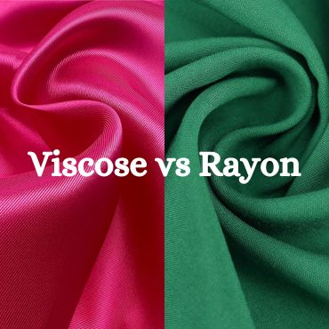
Flannel
Flannel is made out of cotton, but is different from cotton. It is more loosely woven than cotton so it can trap more air and is warmer and softer. It also goes through a process called napping. Napping is when the fabric is brushed on both sides, creating small fuzzy fibers. This makes it softer and thicker than cotton and these small fibers can trap in more air, making it warmer.
Flannel is more loosely woven so it allows moisture to escape making it a good moisture wicking material, meaning it collects moisture away from your skin. It also allows excessive heat to exit and this helps regulates body temperature more. This makes flannel is thick enough to be warm, but thin enough to be breathable, making it super comfy to wear. However, if you are wearing it, I highly recommend not putting it in the dryer; it shrinks. This happens because fibres swell when wet, and then contract when dry, changing the size/ shape of the clothing. Flannel is good for clothing though, and good for making blankets. Flannel doesn’t last as long as cotton because its not as strong because the fibers are loosely woven.
Just like regular cotton, Flannel is not a good insulator when wet. Flannel when wet becomes stronger because the hydrogen bonds in water make even stronger bonds with the cellulose in the cotton. When wet, flannel is not a good insulator because water gets trapped instead of air and this makes the material cold and wet.
Flannel often has some other material in it. In my case, it has rayon. Rayon is semi-synthetic. It is a man-made material and is almost always added to cotton or polyester. It is made from a wood pulp taken from pine trees and spun it to fibers, and then threads, but then is chemically processed. Rayon is also known as Viscose. Viscose is the same thing, but tends to look more shiny and silky. Rayon is popular because it flows, feels silky and comfortable to wear.

Slide 11
Jeans
Jeans are made from denim, which is a type of cotton. This makes it a natural material as cotton comes from a plant, the Gossypium, or also called cotton plant. What makes denim different from cotton is that it has a twill weave. A twill weave is when the fabric goes in a diagonal pattern, not up and down like cotton clothes. This requires more fibers and makes denim more dense, stronger and thicker because the weave is tighter together. This type of weave also hides stains well which people like. Because of the twill, it resist fraying and stretching, making it last a long time.
Jeans are a not good at regulating temperature. On a hot day, heat and sweat can get trapped in the small spaces in the twill. This does not make the material breathable. On a cold day, cold air can get inside of these spaces, making you cold. If denim gets wet, water gets trapped in these few spaces as well. The old water molecule could freeze if you are in a cold environment, making you cold.
Jeans often are not 100% denim. This is because we need something elastic around the waist, and sometimes on the ankles. This material is often spandex. Spandex is an elastic material that we use for the waistband of many pants, and we sometimes use it in elastic bands. This is because it is stretchy and that makes it a great material for using for these purposes.
The diagonal pattern is the twill weave

Slide 12
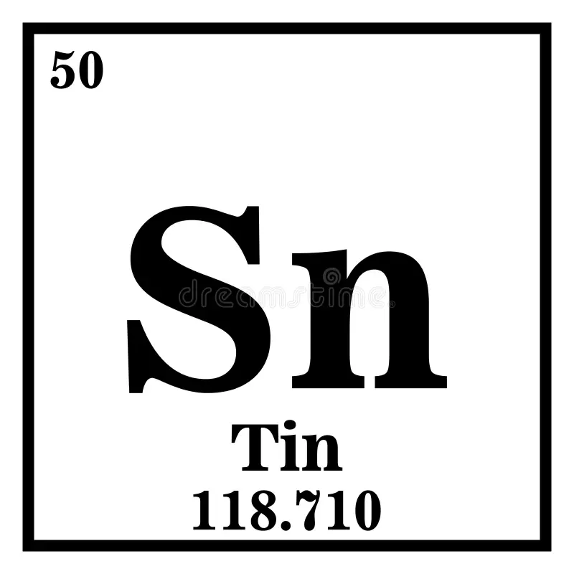
What Tin Is: Tin is an element found on the periodic table and it belongs to the carbon family. Tin is a very soft metal. Tin is often too soft to use on its own, and is often mixed with something else. Tin is a silvery-white color and unlike other metals is very easy to melt.
What Tin Is Made Of: Tin is made of stannic oxide and its chemical formula is SnO2. Stannic oxide is not used very much anymore because steel is stronger. Now it is mainly used for polishing marble, glass, and jewelry.
Tins Impact On The Environment: Tin is not biodegradable, making an major impact on the environment. They have to be melted down in certain factories. However, most people don’t get them to these facilities, and just throw them in the garbage. Then they go into the landfill, which harms the environment.
Tins Insulation: Thermal conductivity of a material is a way to measure its ability to transfer heat. Tin has a high thermal conductivity, meaning that heat travels through it very quickly, making it a terrible insulator.
PROS
CONS
Helps get less bacteria | Expensive
Light-weight | Not for hot temperatures
Durable | Can be bad for health
Good for making cans | Aluminum is better
Stannic Oxide
What is tin? What is it made out of? What is good and bad about tin? Is tin good for the environment?
And is tin a good insulator?

Slide 13
Variables
Manipulated Variable | The material the jar is wrapped in.
Controlled Variables | The amount and starting temperature of the water The glass jar The tin box the experiment is done in The temperature of the room itself Making sure the box is dry before starting the experiment Ensuring the same amount of material on all sides of the jar including below and above the jar Keeping the box is in the same place in the room Running the experiment for the same amount of time Using the same thermometer Using the same timer Using the same piece of clothing for each material Ensuring the material is dry and at room temperature before starting the experiment
Responding Variable | The change in temperature of the water in the glass jar.

Slide 14
Materials
1 polyester shirt
1 cotton shirt
1 wool shirt
1 flannel shirt
1 jeans shirt or pants
1 Thermometer that measures up to 100ºC
1 Electric Kettle
5000 mL of water
1 Tin box size: 16.5cm by 20cm, lid: 2cm, box, 10cm, total depth: 12cm
Paper or a notebook to record data
Pencil to write the data
Computer to upload the data
1 Small glass jar with a volume of 150 mL
A shady room to keep the box in
A phone or timer that rings and can set a timer for up to 2 hours
Another phone to take photos of your experiment

Slide 15
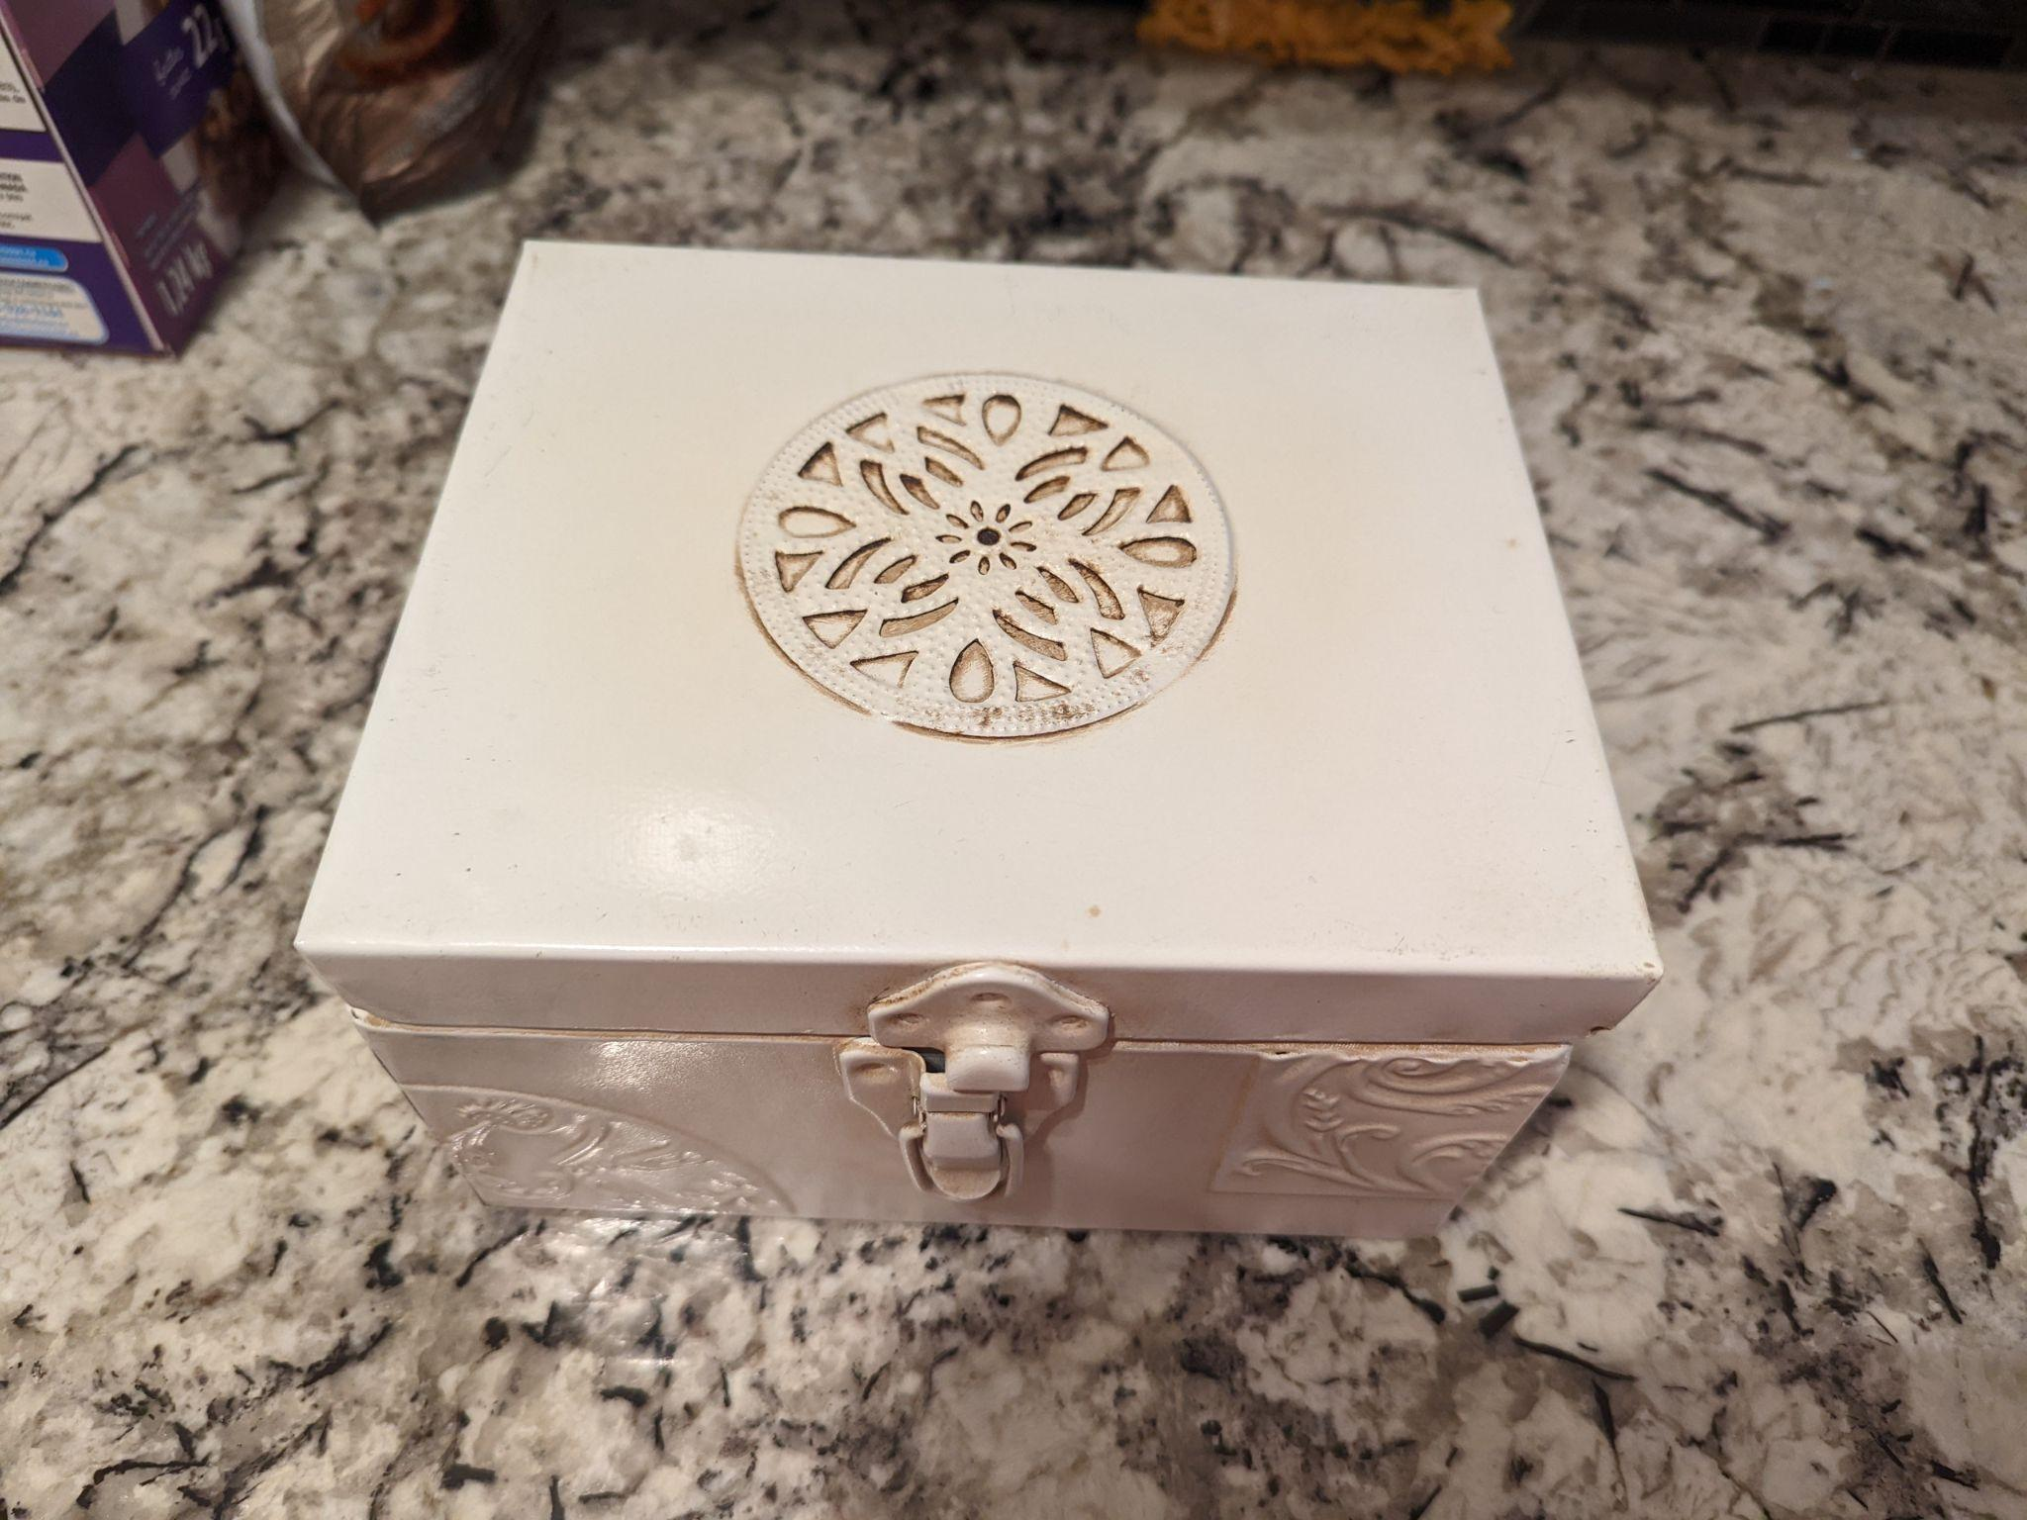
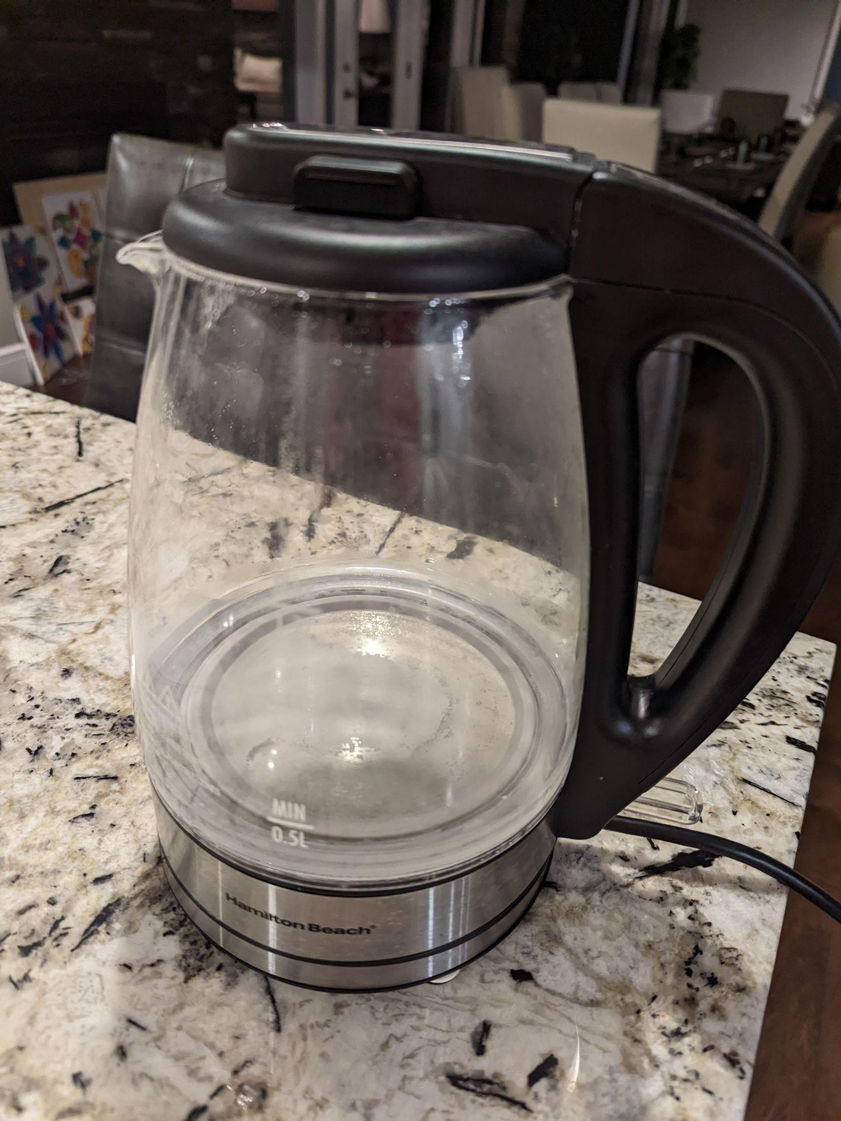
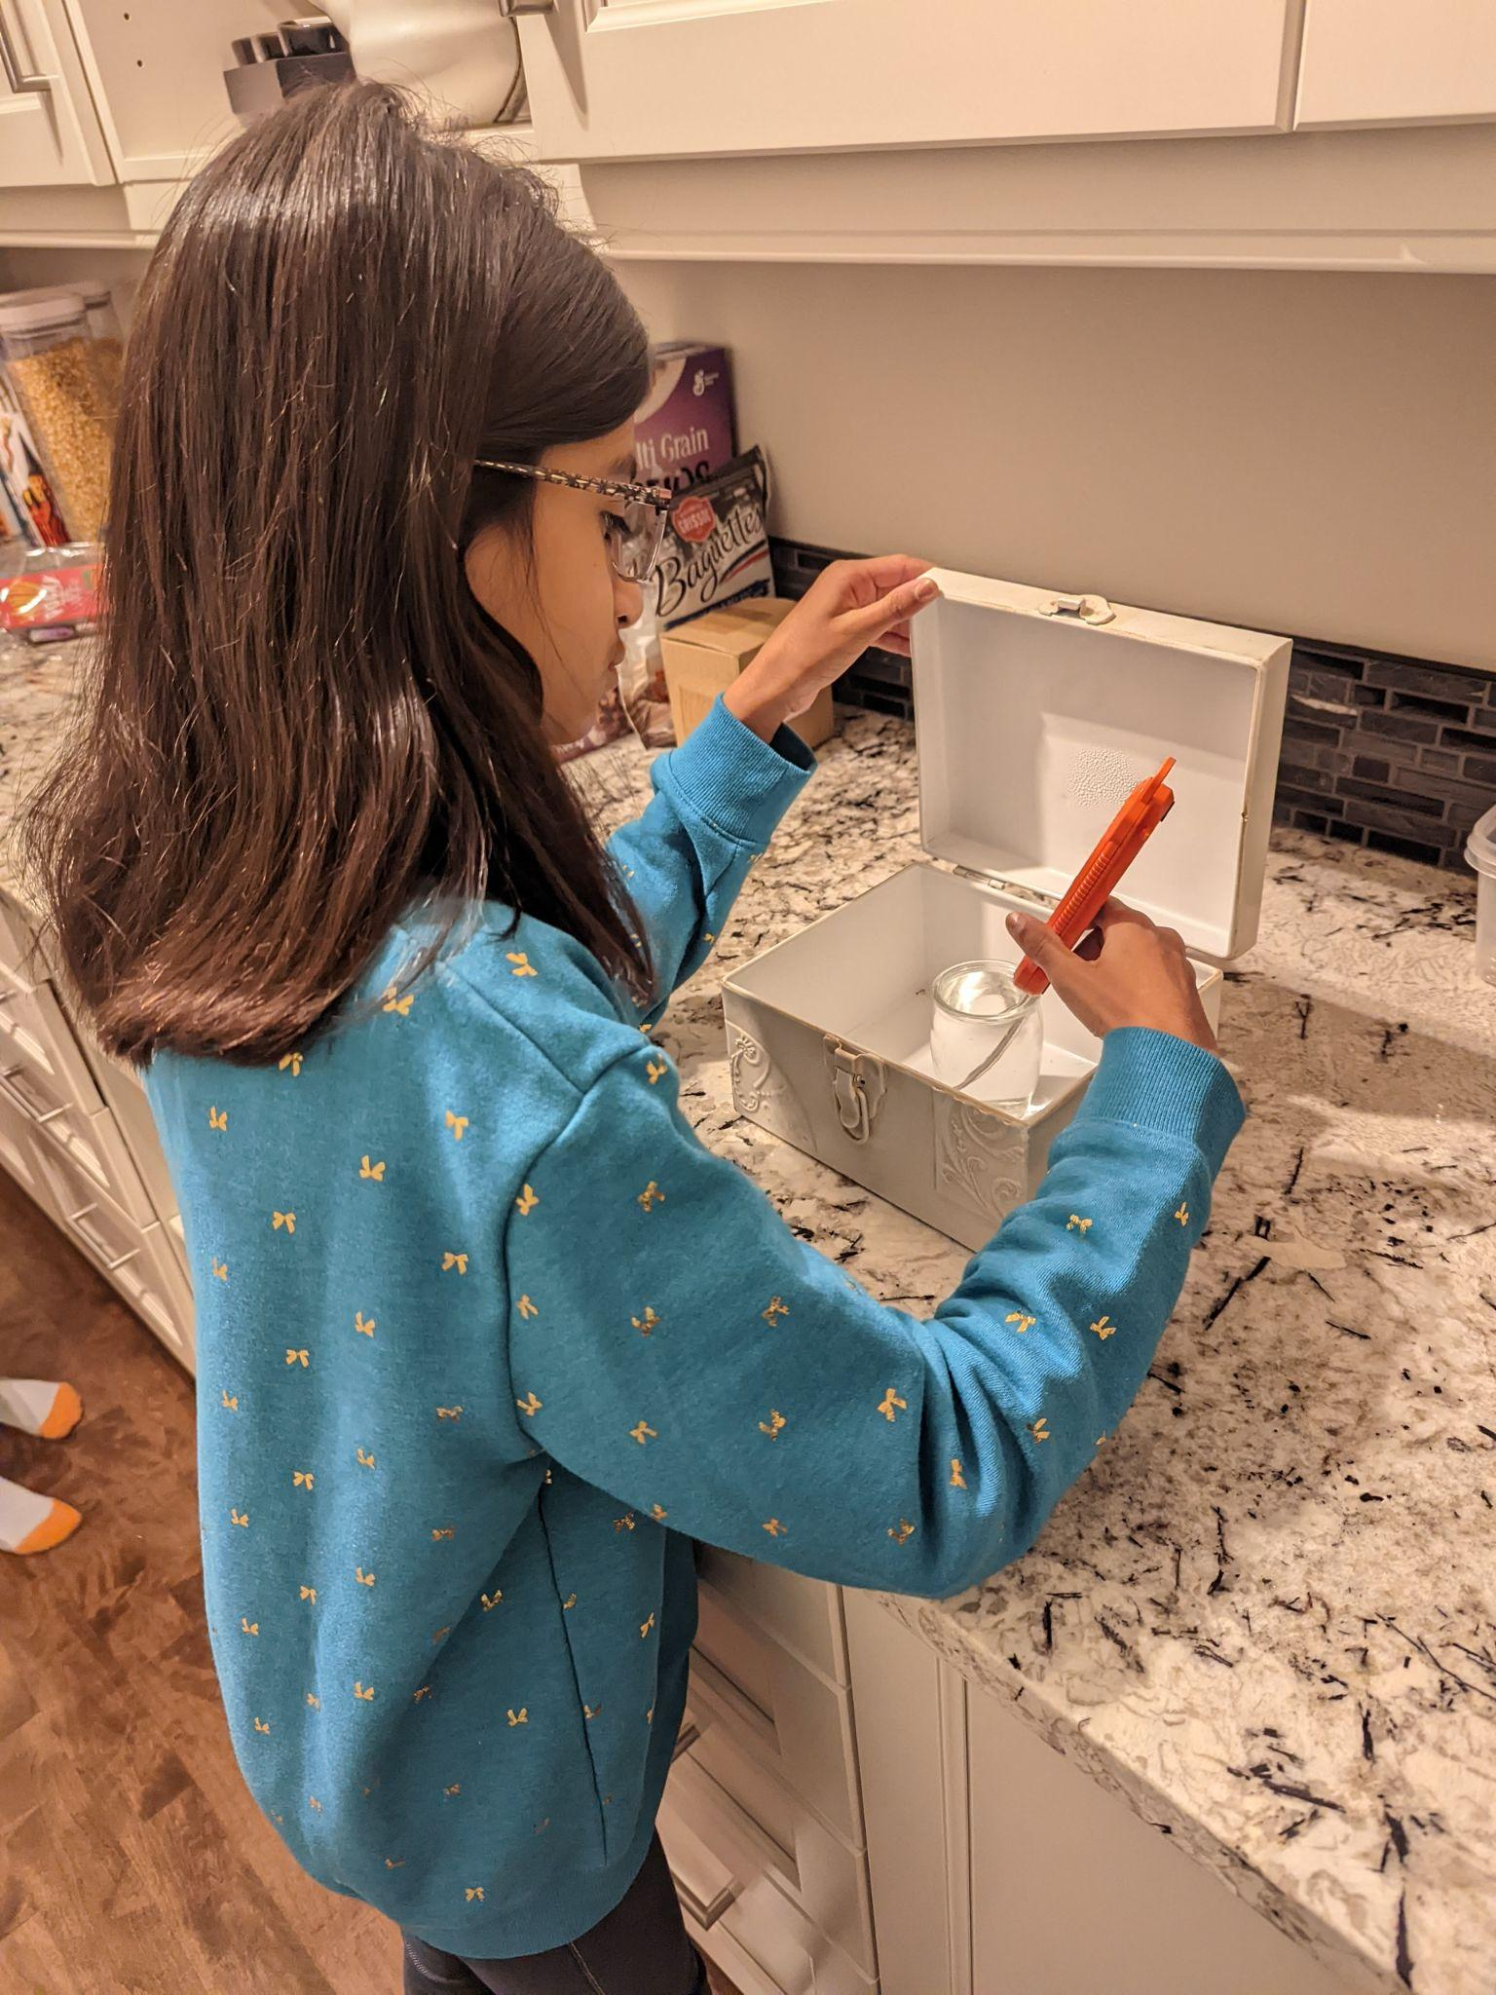
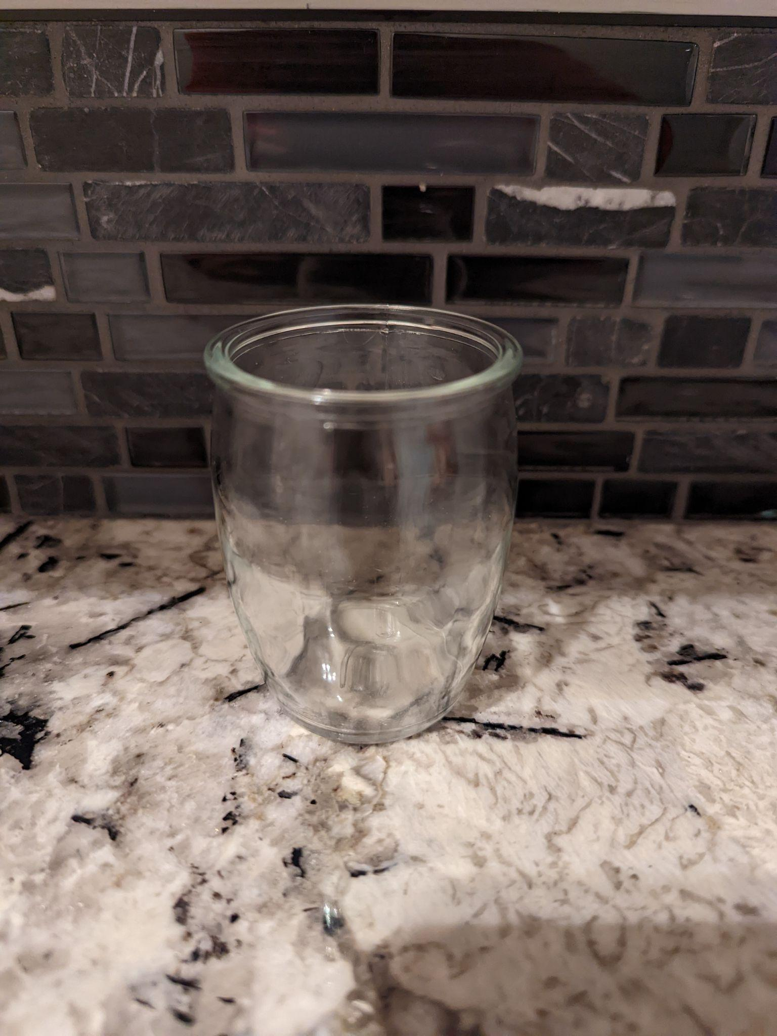
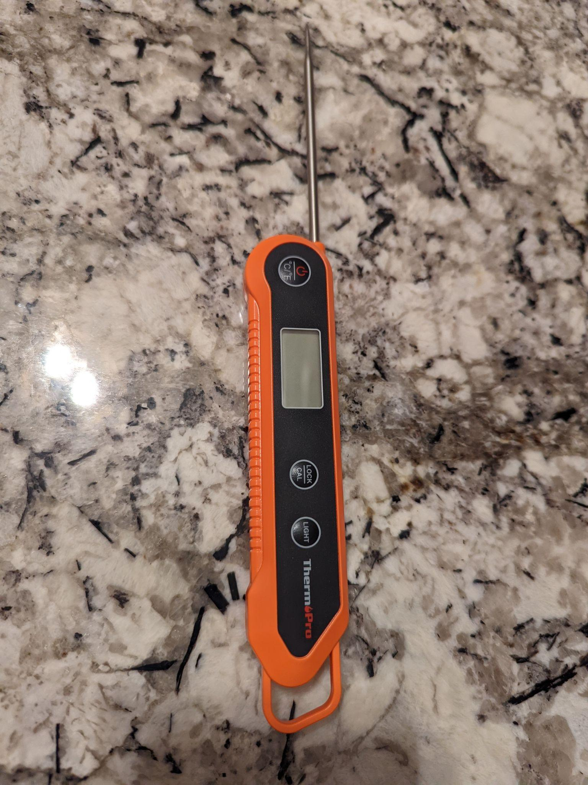
Material Photos
Tin Box
Kettle
Glass Jar
Thermometer

Slide 16
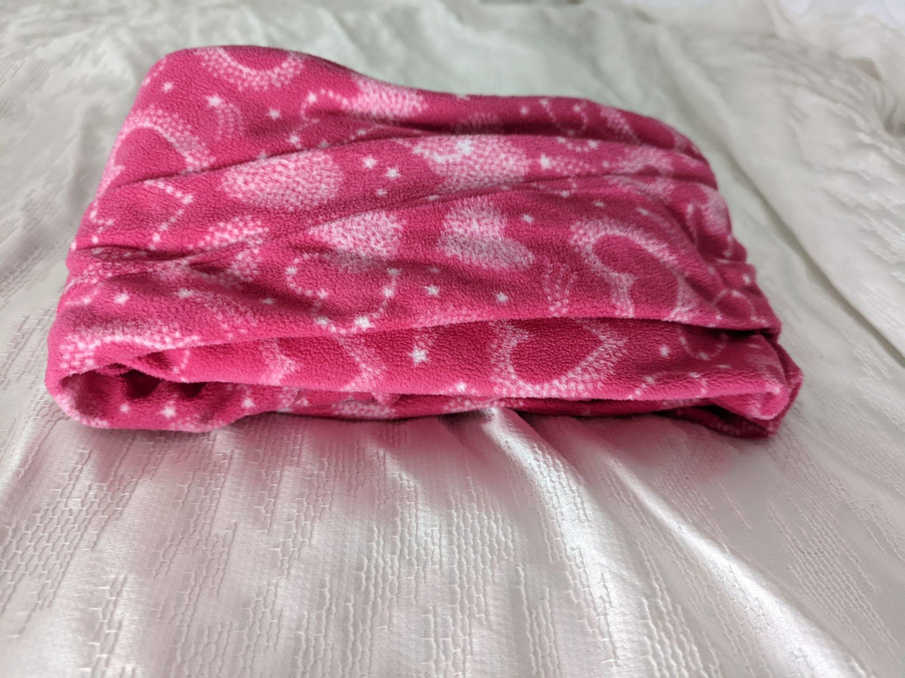
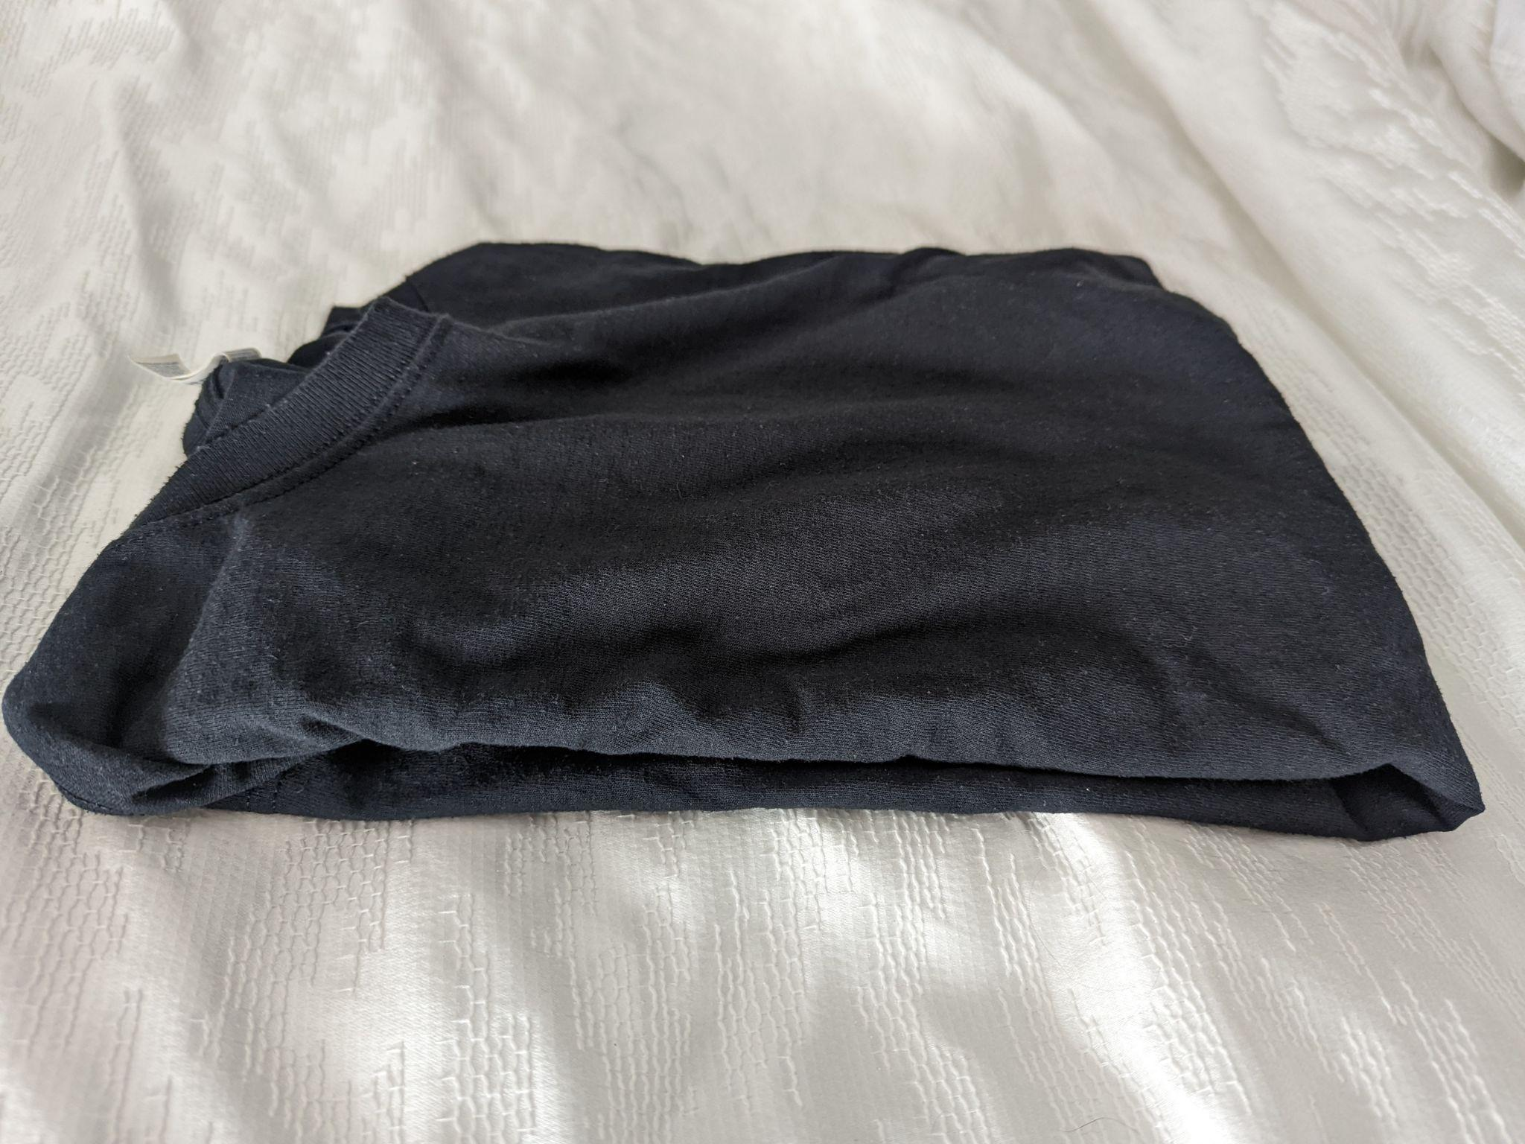
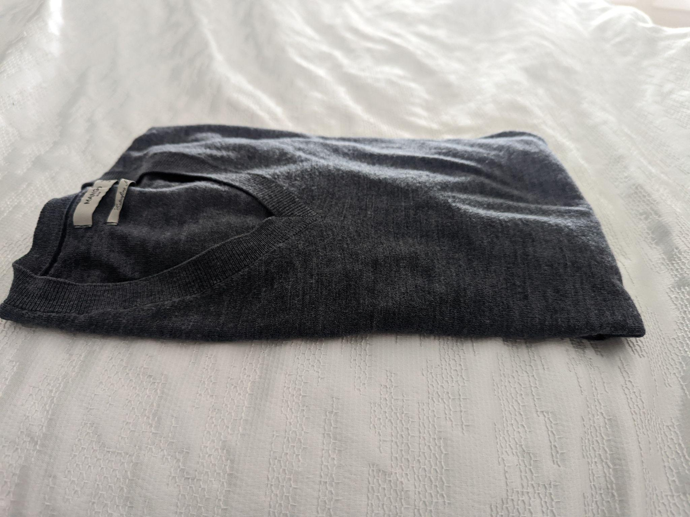
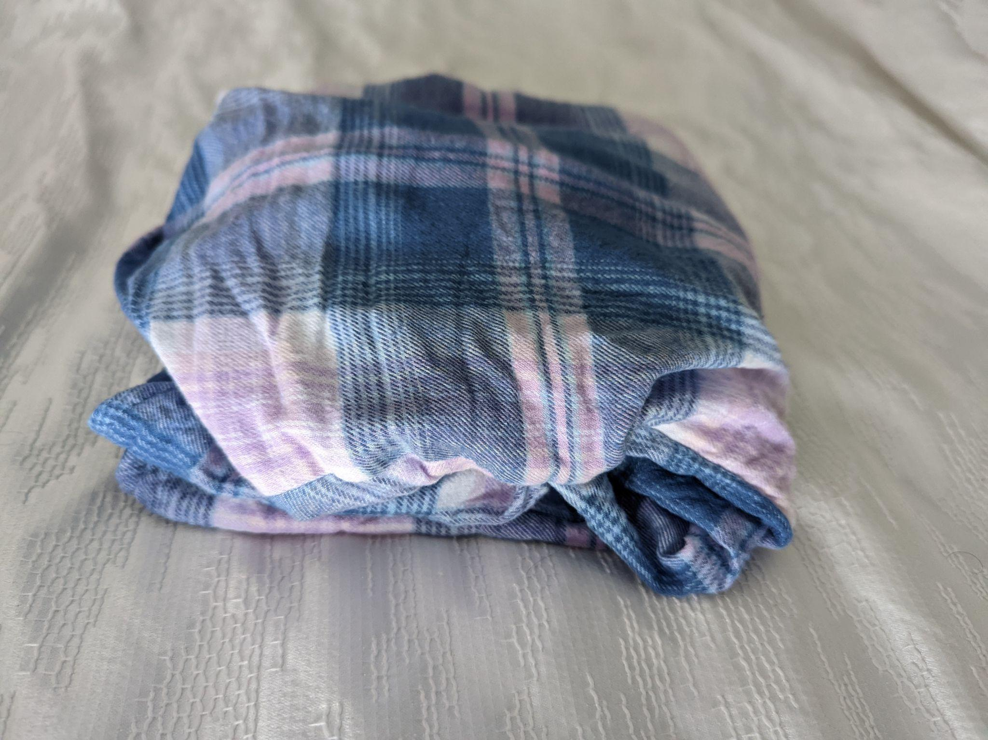
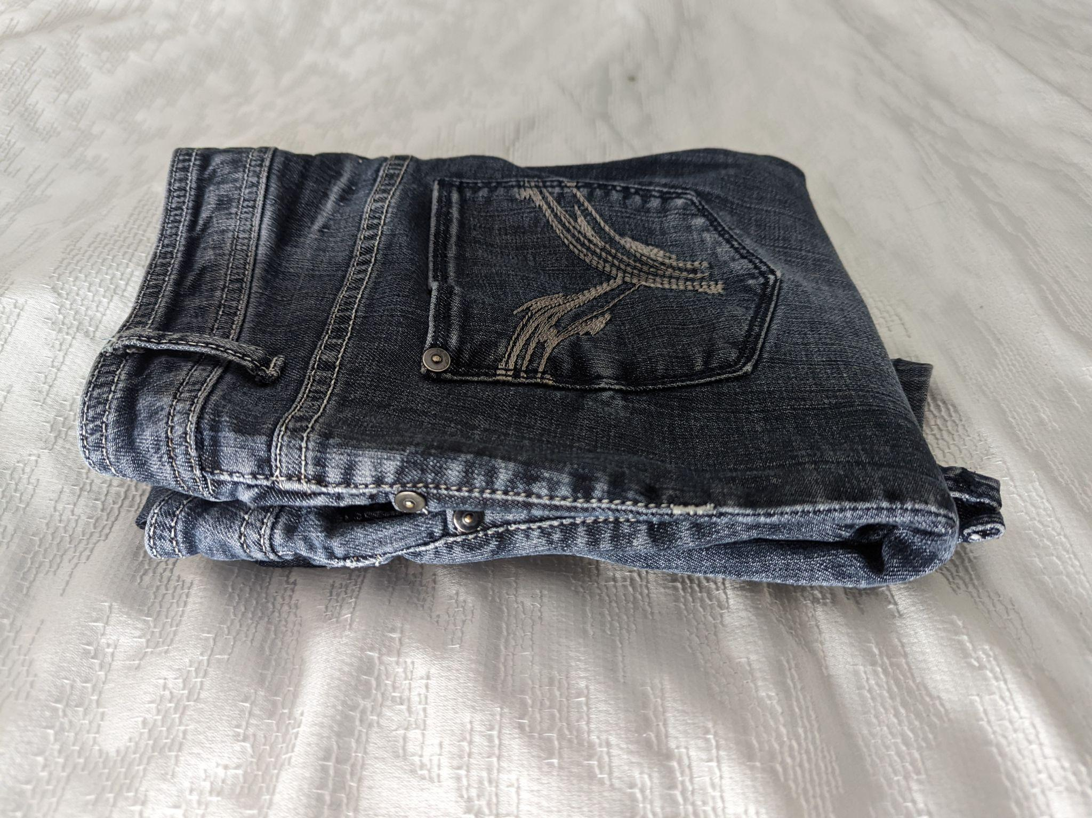
Material Photos
Polyester
Cotton
Wool
Flannel
Jeans

Slide 17
Procedure
Preparation Experiment
Gather the materials listed in the materials list.
Take the box and set the box open on a counter where the temperature of the room doesn’t change.
Put the glass jar in the center of the box.
Boil water in the kettle and wait for the kettle to turn itself off.
Take the kettle and pour the boiling water into the glass jar. Make sure that it fills to the brim of the jar.
Measure the water temperature with the thermometer and wait for it to cool down to 85°C.
As soon as it hits 85°C, close the lid of the box and start a timer for 15 minutes.
Just before the timer goes off, get to the box and get the thermometer on and ready to measure the temperature of the water inside the box. **Do not touch the box**
When the 15-minute timer goes off, open the box and measure the water temperature with the thermometer. Make sure that the temperature is measured the same way every time.
Record the temperature and the time that has passed. In this case it would be 15 minutes.
If the water temperature is above 45°C, start another timer for another 15 minutes and close the lid of the box.
Repeat steps 8-11 until the temperature of the water is 45°C or lower. The total time that has passed will be how long the actual experiment will run for. ( Mine was 30 minutes)

Slide 18
Procedure
Main Experiments:
Gather the materials.
Take the box and set the box open on a counter where the temperature of the room doesn’t change.
Place the jar in the center of the box.
Fill the space around the jar with wool. Pack it as tightly as you can but leave a little bit of the material to go over the top of the jar.
Boil enough water to fill the jar in the kettle. Wait for the kettle to turn itself off.
Take the kettle and pour the boiling water into the glass jar. Make sure that it fills to the brim of the jar.
Measure the water temperature with the thermometer and wait for it to cool down to 85°C
Place the extra material on the top of the jar so the jar is covered from all sides.
Close the lid of the box and start a timer for the time picked above in the Preparation Experiment.
Just before the timer goes off, get to the box and get the thermometer on and ready to measure the temperature of the water inside the box.
When the timer goes off, open the box and take off the material. Then measure the water temperature with the thermometer.
Record your data and any observations. These are called qualitative and quantitative data respectively.
Repeat steps 1-12, but with jeans instead of wool in step 3.
Repeat steps 1-12, but with polyester instead of wool in step 3.
Repeat steps 1-12, but with cotton instead of wool in step 3.
Repeat steps 1-12, but with flannel instead of wool in step 3.
Repeat steps 1-12, but with no material instead of wool in step 3
Repeat steps 1-17 4 more times to get 5 trials.

Slide 19
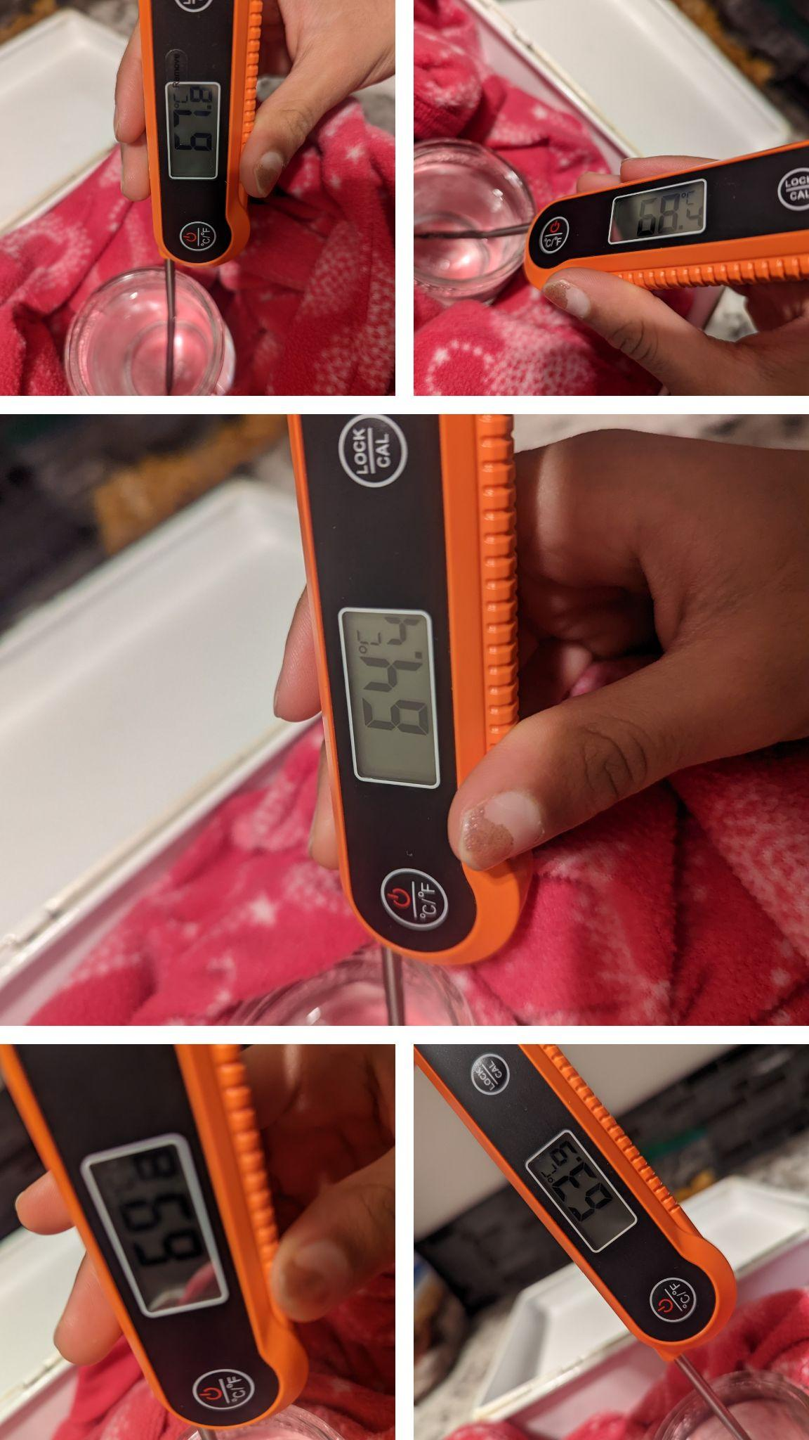
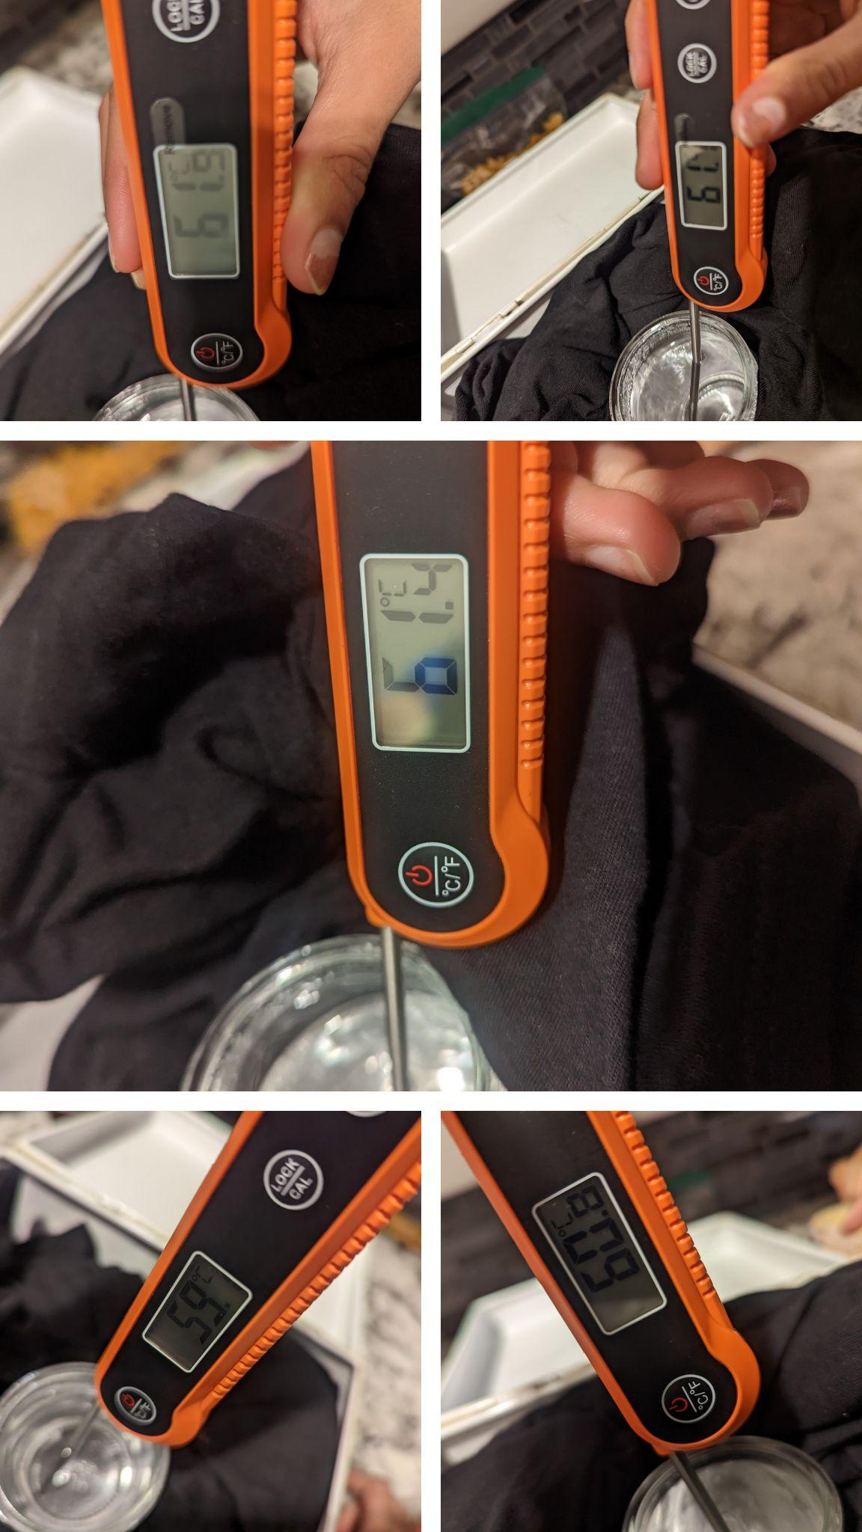
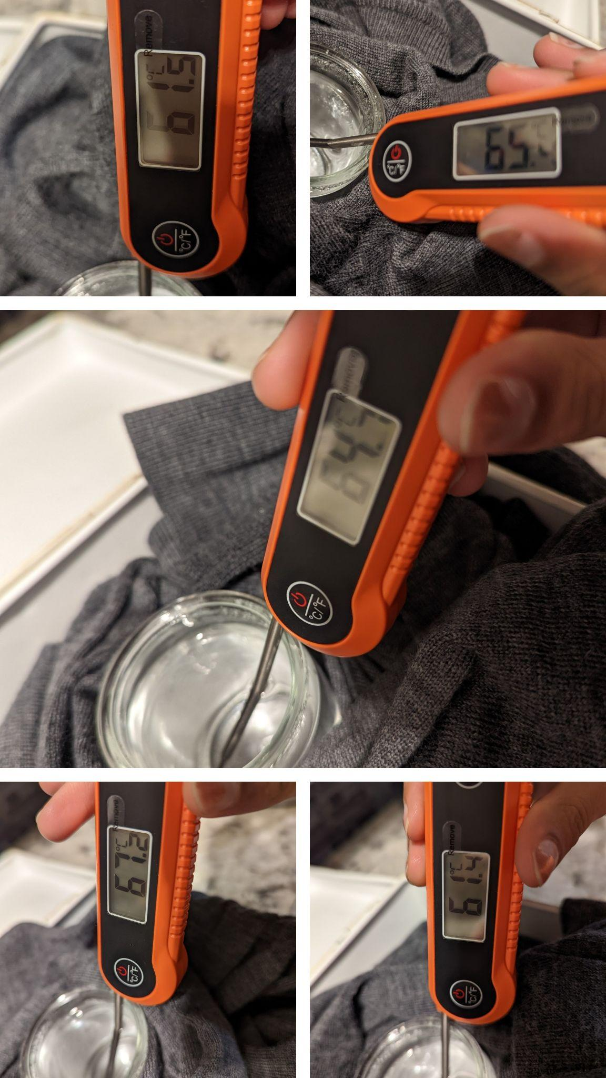
Experiment Photos
Polyester
Cotton
Wool

Slide 20
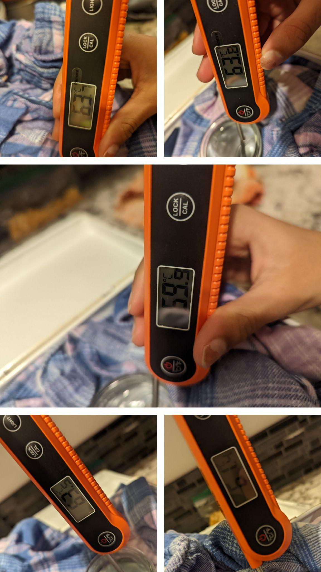
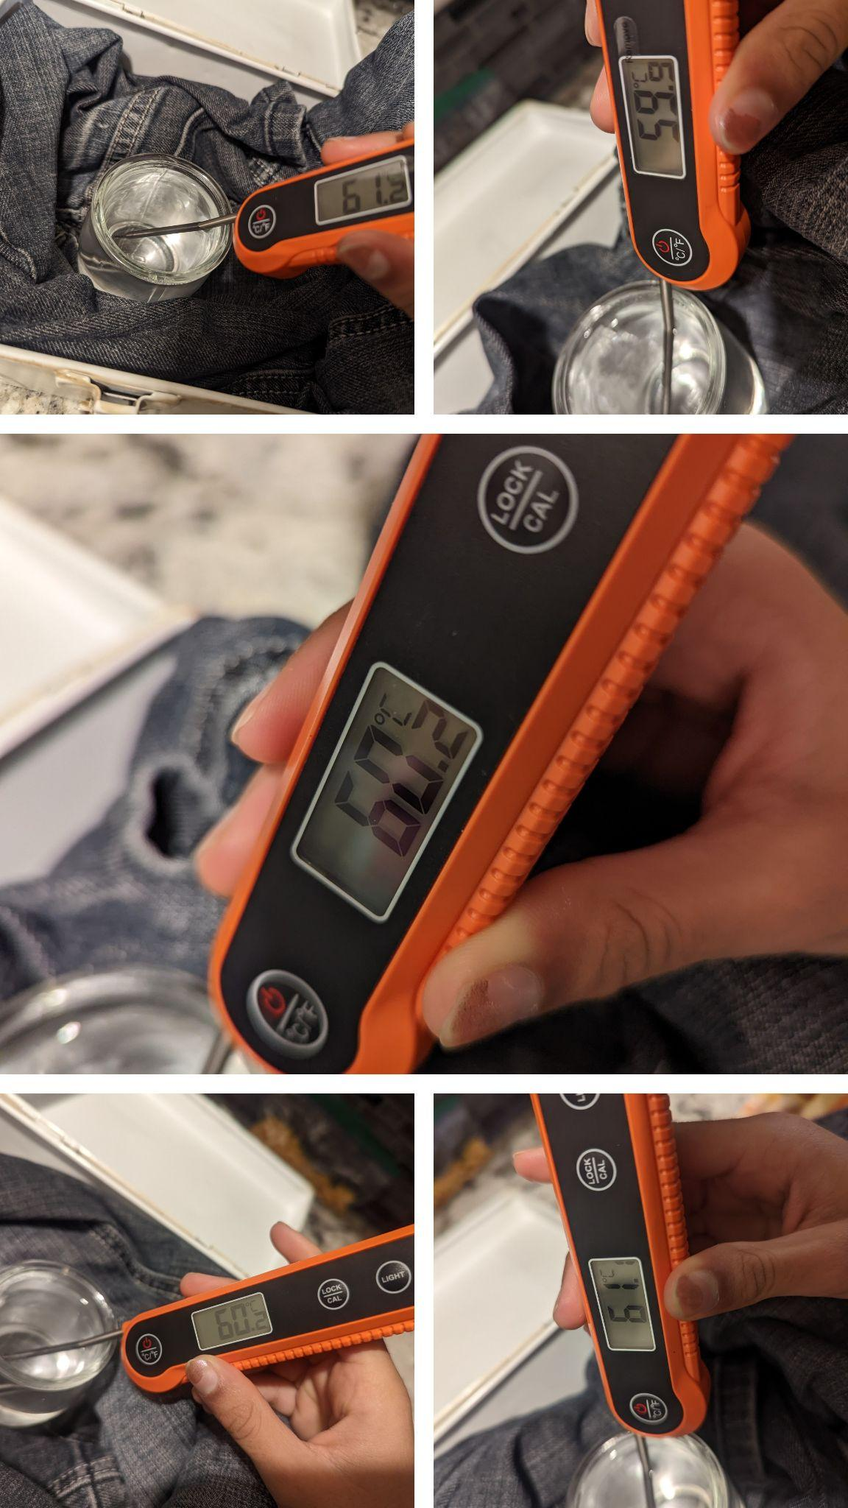
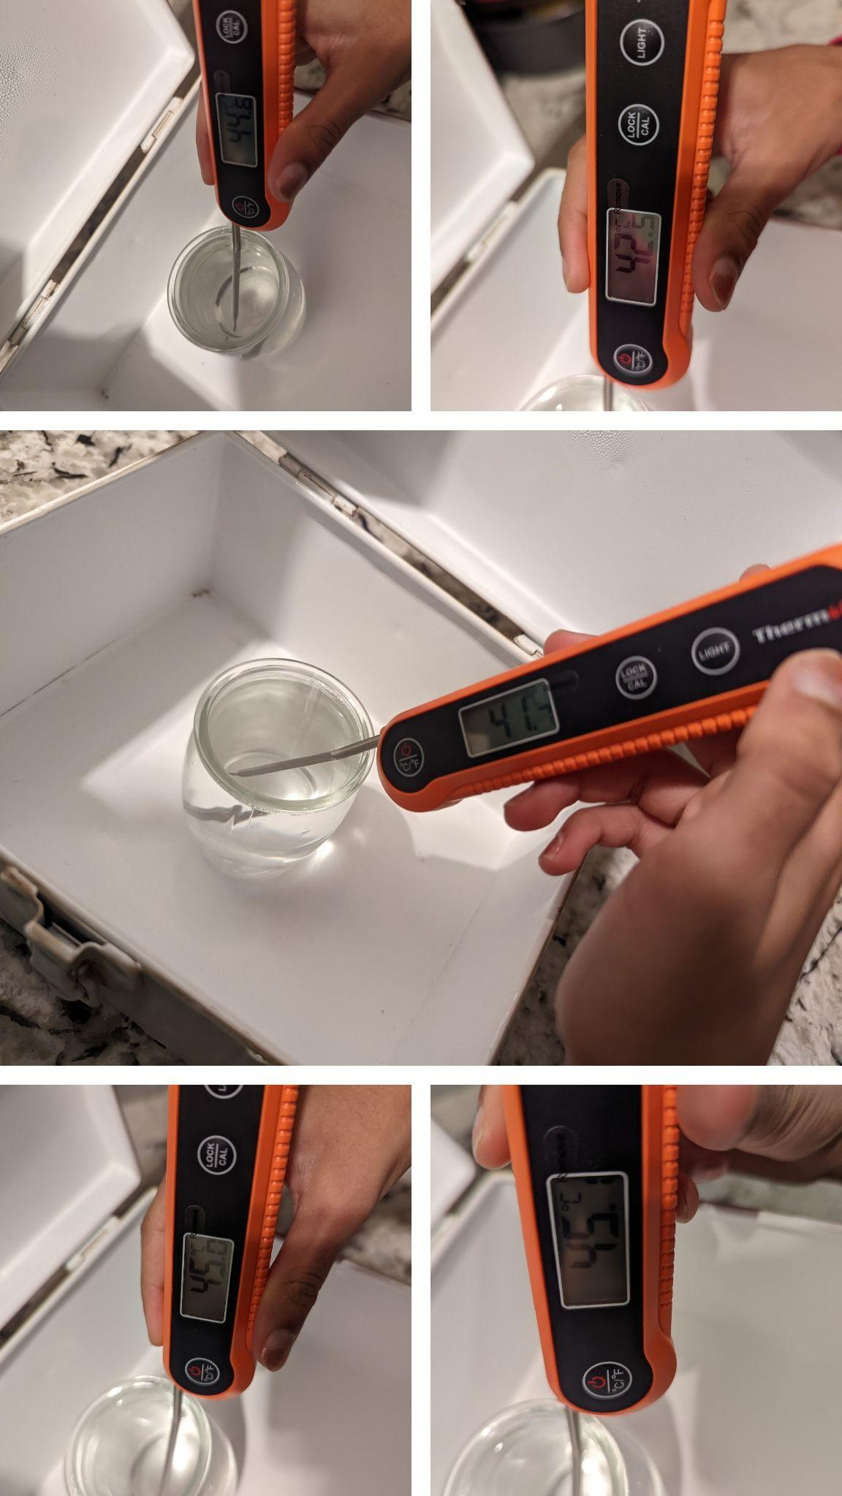
Experiment Photos
Flannel
Jeans
Nothing

Slide 21
Observations (Quantitative)
Material | Trial 1 Temperature of H₂O (ºC) | Trial 2 Temperature of H₂O (ºC) | Trial 3 Temperature of H₂O (ºC) | Trial 4 Temperature of H₂O (ºC) | Trial 5 Temperature of H₂O (ºC) | Average Temperature (ºC)
Polyester | 67.8 | 68.4 | 64.4 | 69.8 | 63.9 | 66.8
Cotton | 61.9 | 61.1 | 61.4 | 59.1 | 60.8 | 61.1
Wool | 61.4 | 61.5 | 65.4 | 64.7 | 67.2 | 64.0
Flannel | 63.7 | 63.8 | 59.9 | 63.5 | 61.4 | 62.4
Jeans | 61.2 | 59.9 | 60.2 | 60.2 | 61.1 | 60.5
Nothing | 44.6 | 45.1 | 42.5 | 41.7 | 45.0 | 43.8

Slide 22
Material | Trial 1 Description | Trial 2 Description | Trial 3 Description | Trial 4 Description | Trial 5 Description
Polyester | Condensation, water level lowered, material was wet, steam | Condensation, water level lowered, material was wet, steam | Condensation, water level lowered, material was wet | Condensation, water level lowered, material was wet, steam | Condensation, water level lowered, material was wet
Cotton | Condensation, water level lowered, material was wet | Condensation, water level lowered, material was wet | Condensation, water level lowered, material was wet | Condensation, water level lowered, material was wet | Condensation, water level lowered, material was wet
Wool | Condensation, water level lowered, material was wet | Condensation, water level lowered, material was wet | Condensation, water level lowered, material was wet | Condensation, water level lowered, material was wet | Condensation, water level lowered, material was wet
Flannel | Condensation, water level lowered, material was wet | Condensation, water level lowered, material was wet | Condensation, water level lowered, material was wet | Condensation, water level lowered, material was wet | Condensation, water level lowered, material was wet
Jeans | Condensation, water level lowered, material was wet | Condensation, water level lowered, material was wet | Condensation, water level lowered, material was wet | Condensation, water level lowered, material was wet | Condensation, water level lowered, material was wet
Nothing | Slight condensation | Slight condensation | Slight condensation | Slight condensation | Slight condensation
Observations (Qualitative)
Summary:
all qualitative observations were the same across all materials.

Slide 23
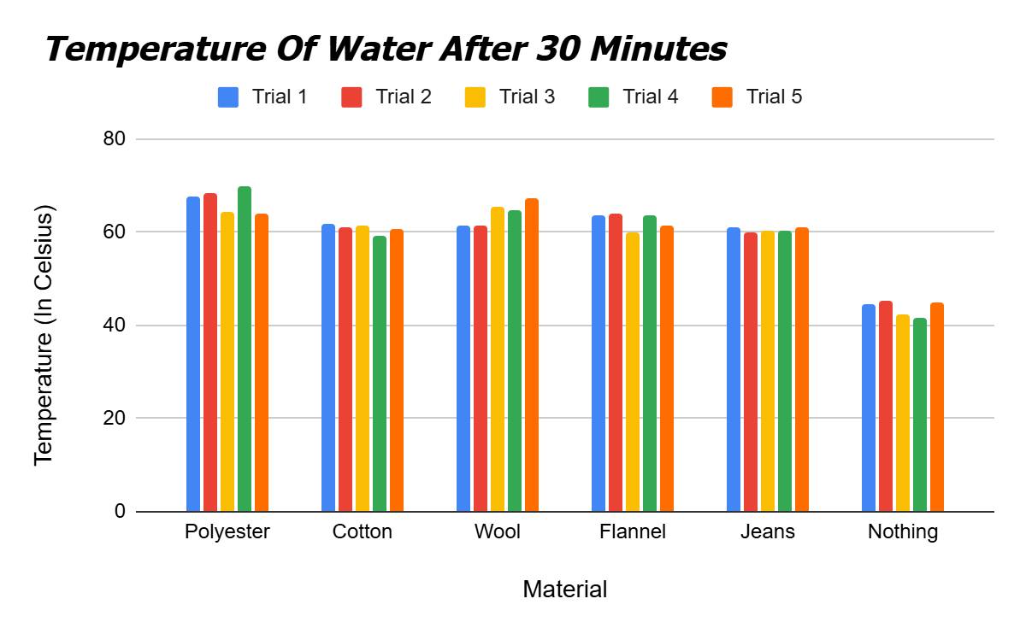
Data

Slide 24
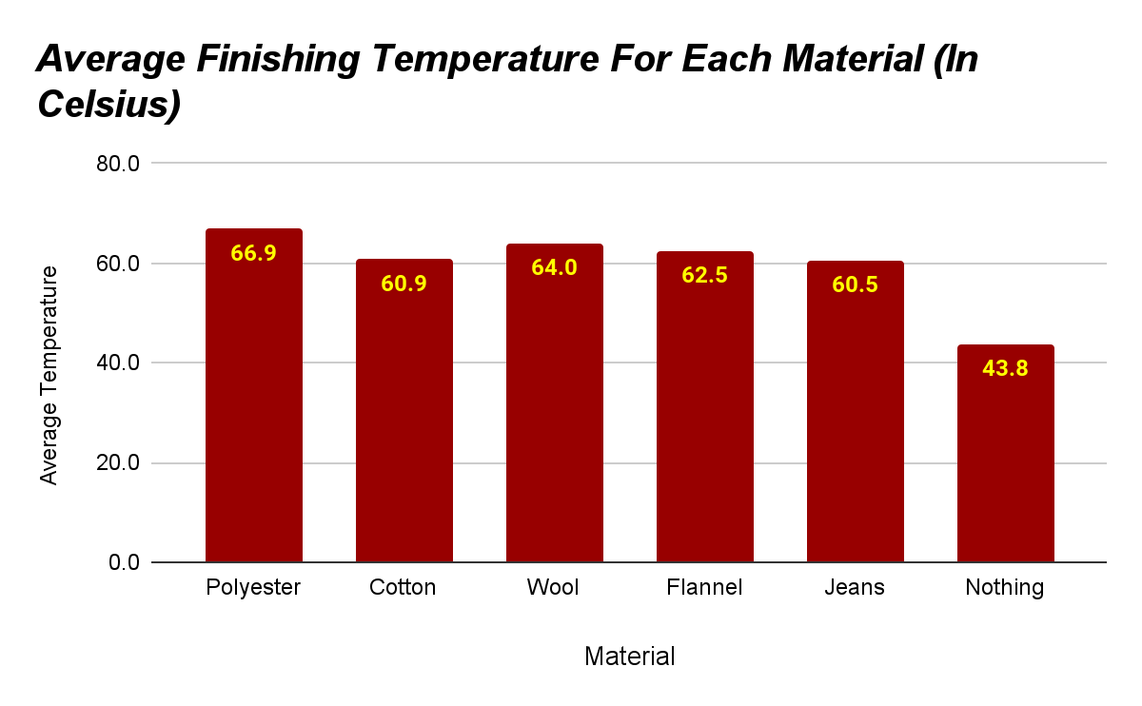
Data

Slide 25
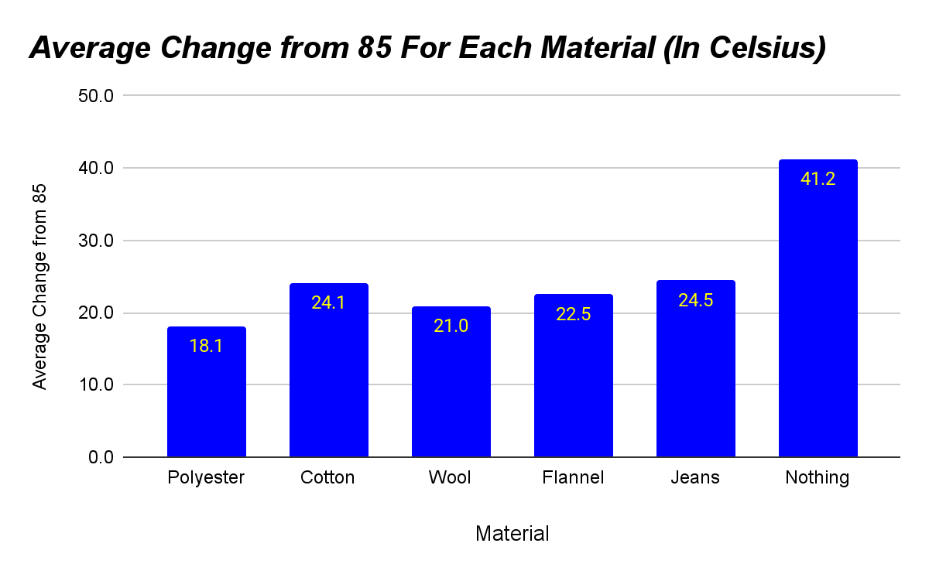
Data

Slide 26
Analysis
The temperature of polyester dropped very little compared to other materials, making it the best insulator. The polyester dropped by 18.1ºC whereas our control (no insulating material) dropped by 41.2ºC.
By looking at the data for this experiment, the first thing I can conclude is that polyester kept the water in the jar the warmest. The second thing I can understand was that having no insulating material around the jar made the water in the jar the coldest. This was an expected result, as it was called the negative control. This negative control was used as a baseline. Out of all the materials, polyester was found to be the best insulator, then wool, flannel, cotton, and then jeans. So these observations gave helpful information that answers the testable question: How does changing the material a jar is wrapped in impact the temperature of the water inside the jar?

Slide 27
Conclusion
The hypothesis was disproved. Polyester proved to be a better insulator than wool because polyester only dropped by 18.1ºC whereas wool dropped by 21.0ºC. This experiment shows that how polyester is woven and its plastic synthetic fibres was a better insulator than wools organic fibres.

Slide 28
Applications
Understanding the science behind what happened in what keeps water the warmest, is important to the real world in many different ways.
The first thing that we can use this information for is knowing how to stay warm in the winter. When the winters are harsh like they are here in Calgary, Canada, we have to stay warm. We need to know what materials to make jackets, boots, hats, mittens and scarves to stay warm. This will help people when they are doing simple things like shoveling the snow, or when they are doing hobbies like tobogganing, skiing, or snowshoeing.
We can potentially use this information to keep us cool in the summer time as well. This is important because in places like Mexico, or even the southern U.S.A, you need to stay cool. I would definitely not recommend wearing polyester in hot places, but I would also not recommend wearing jeans (even though it was the worst insulator in this experiment). This is because jeans is not a very breathable material, trapping heat and sweat. In order to find out what would keep us cool, I would have to set up a similar experiment with different materials.
Knowing what materials are a good insulator, could help in other situations. We could create plant sleeves out of warm materials to help crops grow year round. We could wrap good insulating materials around the plant roots and build small shelters to protect the leaves, stem and the other parts of the plant that come out of the ground. This way our plants could thrive all year long.
Finally, this information can help know what materials are good for insulating homes. We can also use the results of this experiment to help choose materials that are better for the environment. For example if two materials retain heat the same but one material is produced with less environmental impact, then we can use that material more in the future.

Slide 29
Next Steps
There are 3 major things that I would want to do differently.
The first thing that I would change is how long that the experiment would run. I think that the reason all the results were so close were because of how long the experiment went. If it went for an hour (or longer) instead of 30 minutes, I think that there would be a more of a difference between the materials and how they retained heat.
The second thing that I would want to change is how cold the room is. If the room was colder around 5ºC instead for 21ºC, then the materials might retain heat differently. This would make it more a winter scene and more real-life for when people actually want to stay warm.
The final thing that I would do is test out different materials to see how they perform against polyester and see if there is an even better insulating material out there.

Slide 30
Sources of Error
Sources of Error for Material Matters:
The thickness of the material could have been an impact although the amount of material in the box was the same. This could have made a major impact on the experiment.
Human measuring was also likely an error, as to hold the thermometer the exact same way 30x is not possible. This probably created a minor impact on the experiment.
The exact timing was not possible because of opening the lid, removing the material from the top, and putting the thermometer in. This probably made a minor impact.
On the first trial of flannel, we had to lock the box to make the box stay shut, just because of the way the material was. I have no clue how big of an impact this could have created but likely minimal as it was only 1 trial out of the 5.
The temperature at the start was always 85ºC, but not to the decimal. This could have created a very minor impact on the experiment.
The temperature of the room was not always at 21.0ºC, but was always very close. It was maybe a few decimal points off. This could have made a minor impact.

Slide 31
Citations
Adhav, L., & Saint-Elien, T. (2024, January 5). 18 types of jeans you absolutely need to live your best denim life.
Alffoto. (n.d.). 3,200+ Agriculture Cotton Plant Green stock photos, pictures & Royalty-Free Images - iStock. https://www.istockphoto.com/photos/agriculture-cotton-plant-green
Celsius vs Fahrenheit. (n.d.). Diffen. https://www.diffen.com/difference/Celsius_vs_Fahrenheit
CFDA. (n.d.). https://cfda.com/resources/materials/detail/polyester#:~:text=Polyester%20is%20resilient%2C%20has%20low,%2C%20and%20is%20pest%2Dresistant
Cotton, B. P. (2019, October 29). Uses of cotton | Barnhardt Purified cotton. Barnhardt Purified Cotton. https://barnhardtcotton.net/blog/uses-of-cotton/
Cosmopolitan. https://www.cosmopolitan.com/style-beauty/fashion/g26429319/types-of-jeans
Company, W. (2021, March 18). Wool as a sustainable fibre for textiles. Awi-woolmark2017-ui. https://www.woolmark.com/industry/sustainability/wool-is-a-sustainable-fibre/#:~:text=Wool%20does%20not%20contribute%20to,Hercosett%2C%20are%20also%20fully%20biodegradable

Slide 32
Citations
Gd-Admin. (2025, December 2). Nano Tin oxide Stannic oxide SNO2 nanopowder / nanoparticles. https://www.xingluchemical.com/. https://www.xingluchemical.com/nano-tin-oxide-stannic-oxide-sno2-nanopowder-nanoparticles-products/
Google. (n.d.). https://www.google.com/search
Is Polyester Bad For The Environment? Statistics, Trends, Facts & Quotes. (2023, November 16). GreenMatch.co.uk. https://www.greenmatch.co.uk/is-polyester-bad-for-the-environment
Khan Academy. (n.d.). https://www.khanacademy.org/science/ap-biology/chemistry-of-life/structure-of-water-and-hydrogen-bonding/a/hs-water-and-life-review
Limited, A. (n.d.). Tin Periodic Table of the Elements Vector illustration eps 10. Alamy Images. https://www.alamy.com/tin-periodic-table-of-the-elements-vector-illustration-eps-10-image331339004.html
Merino Wool Crew Neck Sweater - Camel. (n.d.). https://www.woolblankets.ca/merino-wool-crew-neck-sweater-camel.html
Professional, C. C. M. (2025, February 21). Keratin. Cleveland Clinic. https://my.clevelandclinic.org/health/body/23204-keratin
Robertson, L. (2024, February 12). Material Guide: What is Viscose and Is It Sustainable? - Good On You. Good on You. https://goodonyou.eco/material-guide-viscose-sustainability/

Slide 33
Citations
Schaper, M., & Schaper, M. (2023, February 24). Rayon vs Viscose: What’s the Difference? Mattress Clarity. https://www.mattressclarity.com/bedding/rayon-vs-viscose/#:~:text=The%20first%20thing%20to%20know,Keep%20reading%20to%20learn%20more
Sewport. (2021, June 21). What is Polyester Fabric: Properties, How its Made and Where. Sewport. https://sewport.com/fabrics-directory/polyester-fabric
Sewport. (2019, November 11). What is Flannel Fabric: Properties, How its Made and Where. Sewport. https://sewport.com/fabrics-directory/flannel-fabric#:~:text=Depending%20on%20the%20dyes%20and,materials%20when%20making%20their%20fabric
Uren, A. (2024, March 18). What is polyester? Material Guide, Ethics and Sustainability. Good on You. https://goodonyou.eco/how-sustainable-is-polyester/
What is Cotton. (n.d.). https://learn.genetics.utah.edu/content/cotton/what/
what twill weave plain weave sateen weave and difference? (n.d.). https://sixdragontextile.com/new/twill-weave-fabric.html
Wikipedia contributors. (2024, November 25). Tin. Wikipedia. https://en.wikipedia.org/wiki/Tin
Wikipedia contributors. (2025, February 21). Tin(IV) oxide. Wikipedia. https://en.wikipedia.org/wiki/Tin(IV)_oxide

