Slide 1
maNIPULATING
HYDROGEL
RELEASE
wITH ph AND cONCENTRATION

Slide 2
Question
How can I manipulate the rate at which hydrogels release their contained substances?

Slide 3
Part 1
Background Research

Slide 4
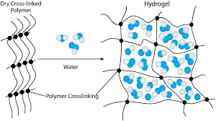
What is a hydrogel
Polymer - based spheres
Contain a substance, such as medicine
Can be manipulated to efficiently deliver long term treatment to specific body parts

Slide 5
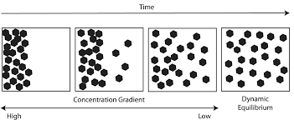

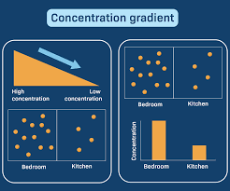
Diffusion theory
High to Low Concentration
Diffusivity = How easily a solute can travel through it’s solvent
Solute = Contained Substance
Solvent = Polymer Casing
Variables in the environment and the hydrogel itself can alter diffusivity

Slide 6
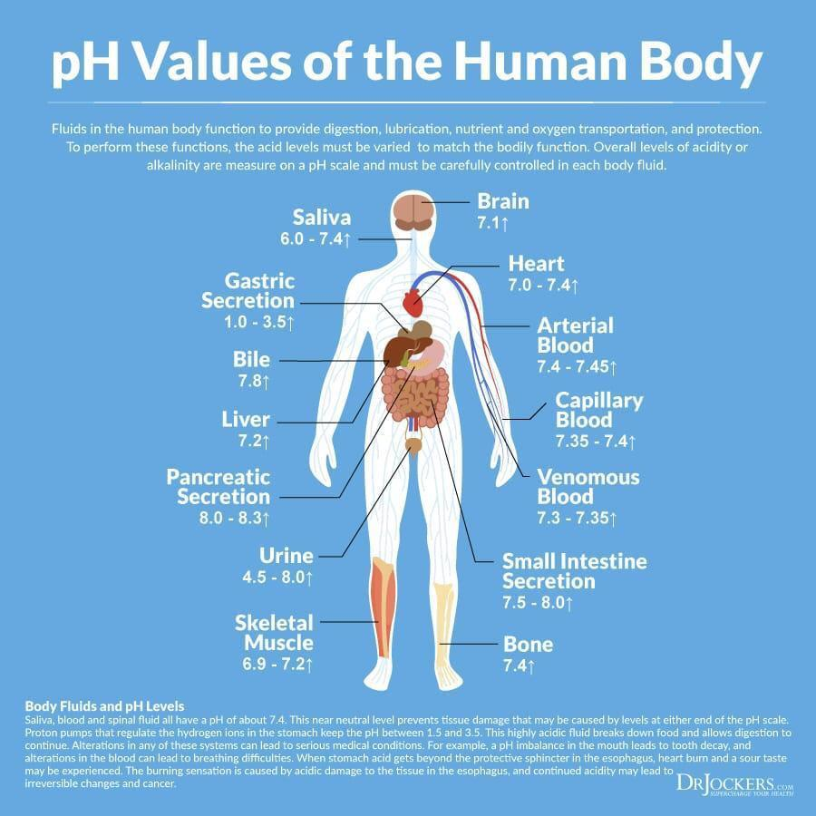
Why does pH Matter?
Different parts of our body have different pH levels
Different pH levels in environment leads to a change in diffusivity
Change in diffusivity leads to a change in the amount of substance released in a certain amount of time

Slide 7
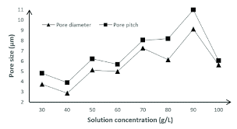
Why does concentration Matter?
A higher concentration of thickening agent decreases the diffusivity and the rate at which the contained substance will be released
It also decreases the amount of substance that can be contained, due to the hydrogel being more dense.

Slide 8
Part 2
pH

Slide 9
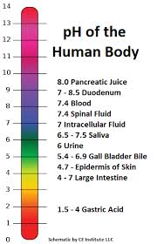
HYPOTHESIS 1
If I change the pH level of the environment in which a hydrogel is placed, then it will change the speed at which the contained substance within the hydrogel will diffuse. The Hydrogel will diffuse the contained substance because the acidity or basicness of the environment will diffuse change the rate of diffusion due to a difference in density between the environment and the substance in the hydrogel.

Slide 10
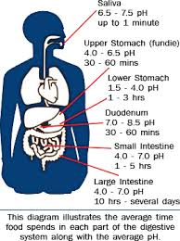
Variables 1
Independent:
pH level of the mixture the hydrogel is submerged in
Dependent:
Amount of dye that can be diffused in 1 hour
Controlled:
Concentration of gelatin in hydrogels (10%)
Amount of dye in each hydrogel (1mL)
Amount of mixture hydrogel is submerged in (200mL)

Slide 11
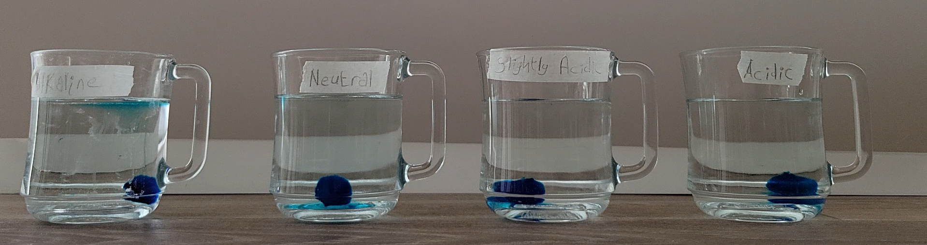
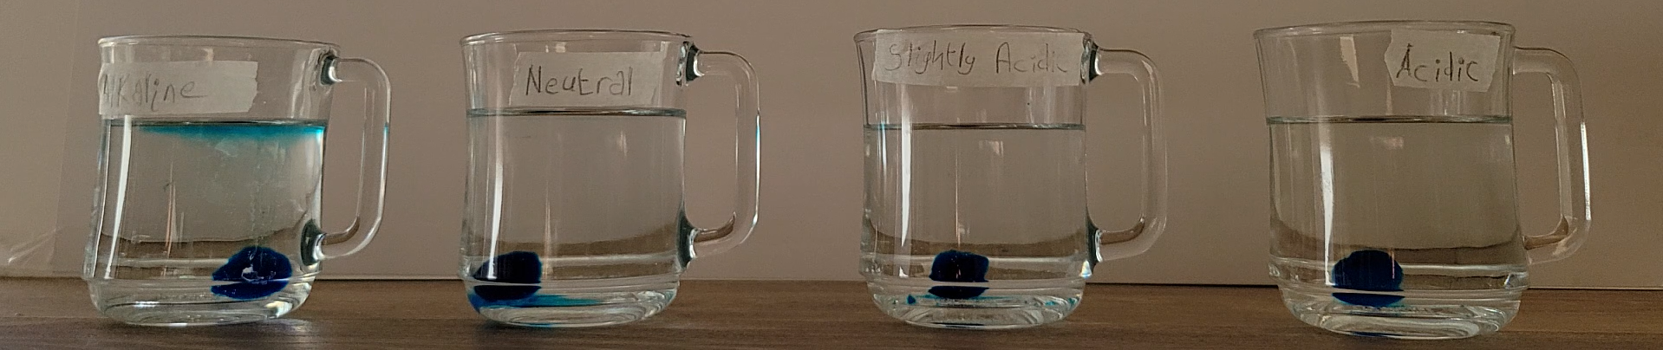
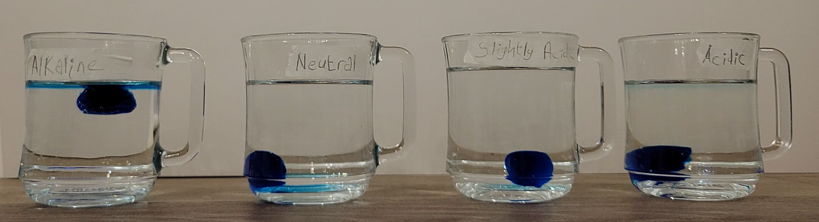
5 Minutes
Alkaline: Spread towards point of entry
Neutral and Slightly Acidic: Spread outwards and down from the physical hydrogel
Acidic: Stayed in the immediate vicinity of the hydrogel

Slide 12
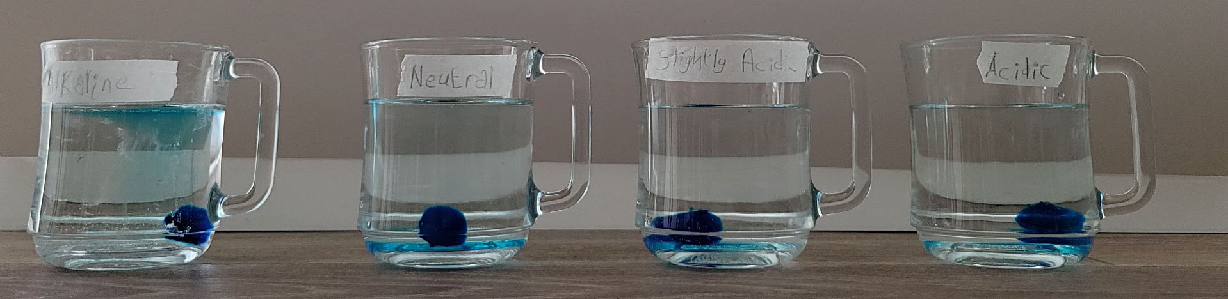
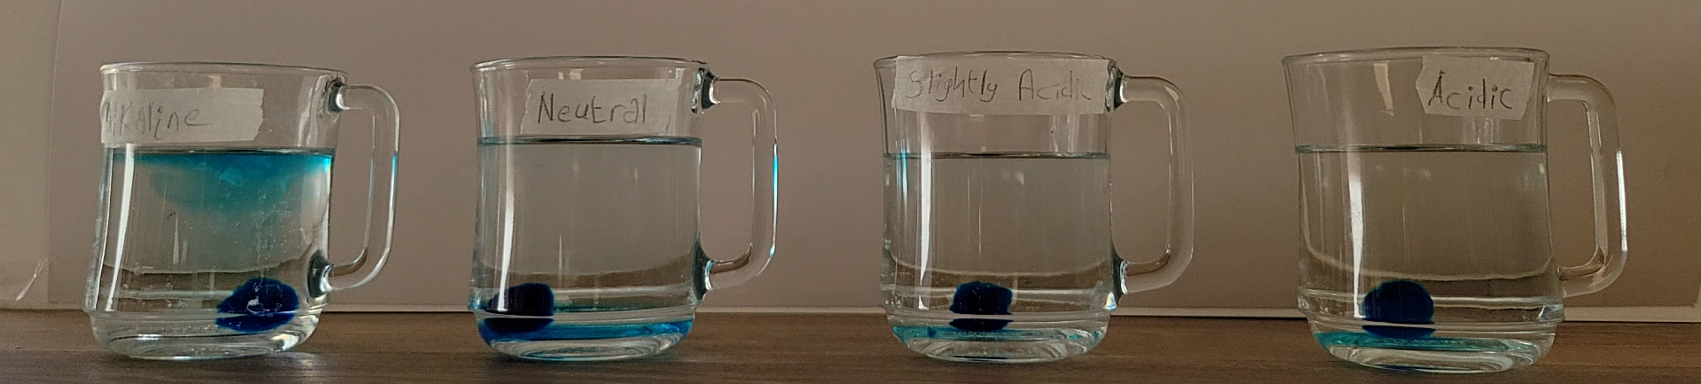
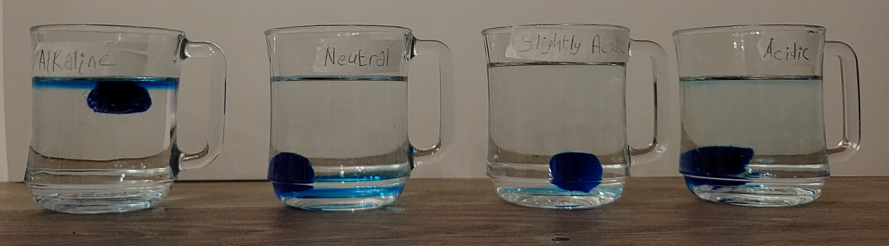
15 Minutes
Alkaline: Dye began to diffuse regularly, but dye from source is still going towards point of entry
Neutral and Slightly Acidic: The dye is beginning to diffuse evenly, but only a little bit
Acidic: Dye is still staying in immediate vicinity

Slide 13
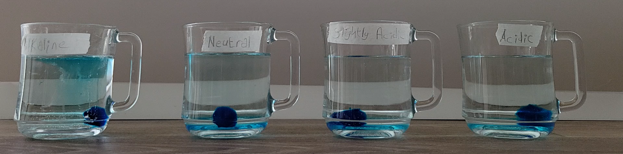
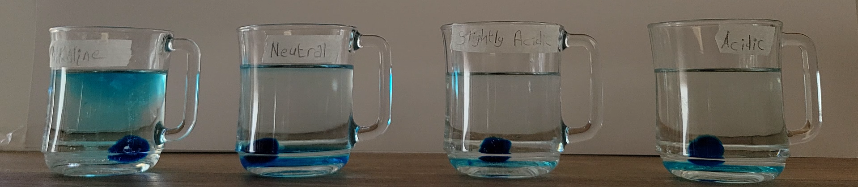

30 Minutes
Alkaline: Still naturally diffusing
Neutral and Slightly Acidic: Dye is beginning to diffuse more evenly then before
Acidic: Dye is beginning to release outwards and down

Slide 14
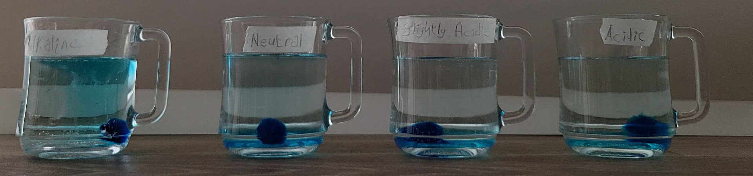
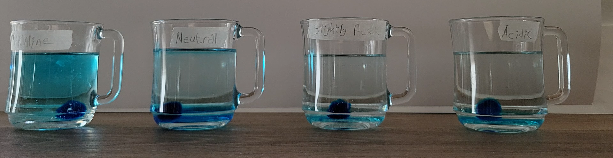
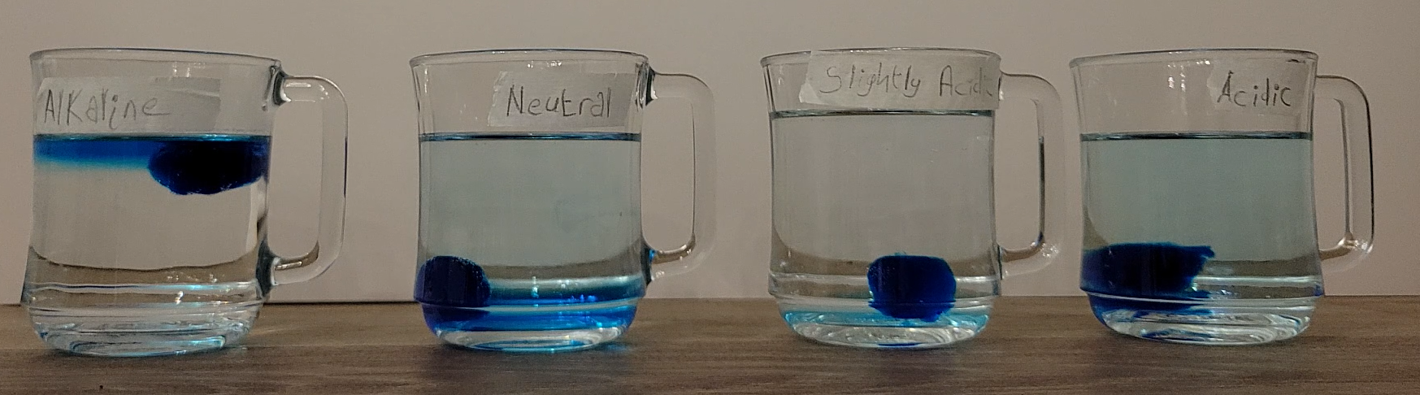
60 Minutes
Alkaline: Dye has spread all throughout the mixture
Neutral: Dye has spread to the entire mixture, though there is a higher concentration at the bottom
Slightly Acidic: Dye hasn’t diffused in the mixture at all
Acidic: Dye has diffused all throughout, but not evenly

Slide 15
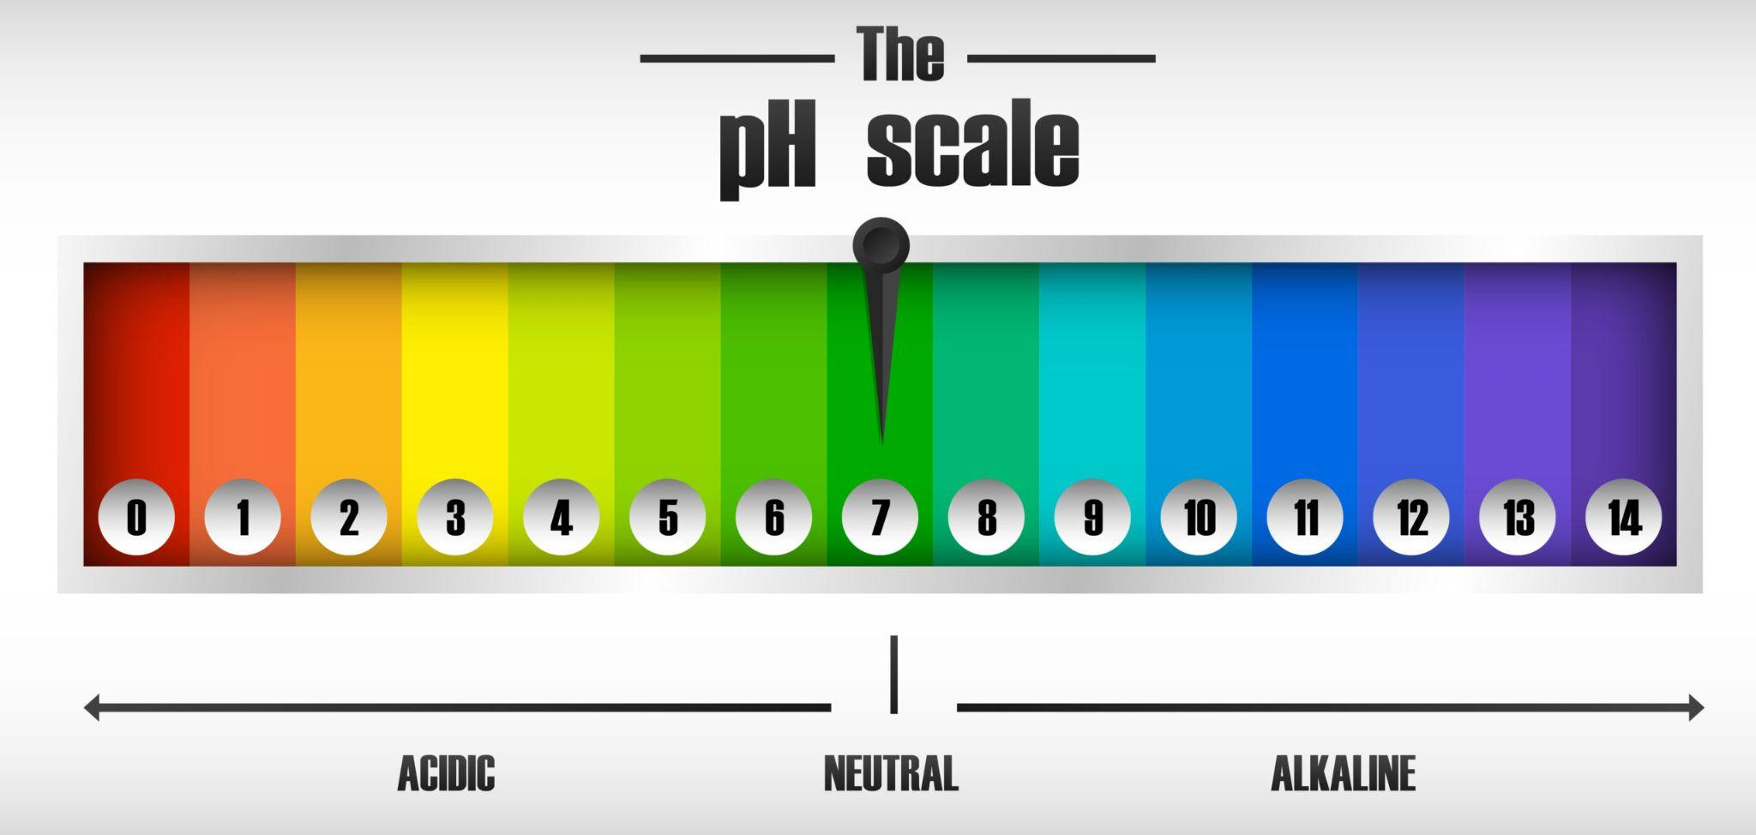
Conclusion 1
From these results, I can conclude that my hypothesis was correct. Changing the pH level of the environment in which I place my hydrogels can alter the rate at which the substance within the hydrogel will diffuse. I can tell this because as we can see both in my graph, and over time in the pictures, the different hydrogels had similar results over all 3 tests, leading me to make the conclusion that my results are accurate and fair.

Slide 16
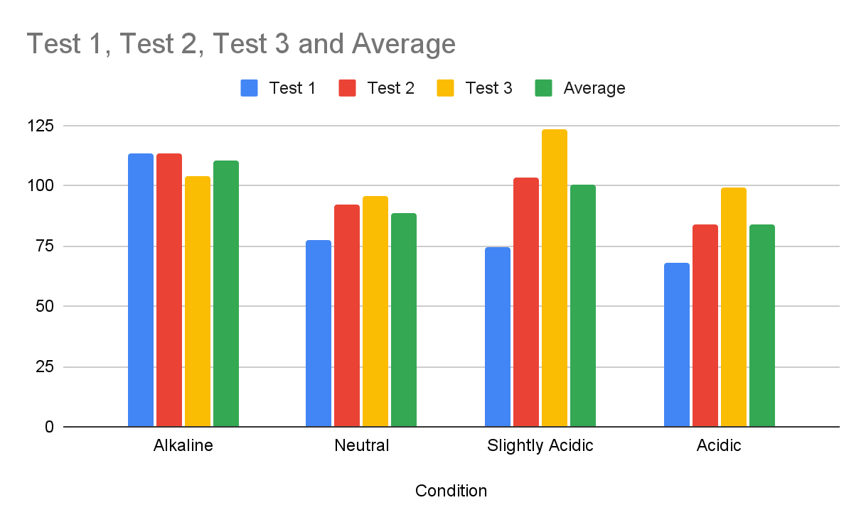
Conclusion 1
From these results, I can conclude that my hypothesis was correct. Changing the pH level of the environment in which I place my hydrogels can alter the rate at which the substance within the hydrogel will diffuse. I can tell this because as we can see both in my graph, and over time in the pictures, the different hydrogels had similar results over all 3 tests, leading me to make the conclusion that my results are accurate and fair.

Slide 17
Part 3
Concentration

Slide 18
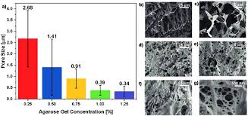
HYPOTHESIS 2
If I increase the concentration of gelatin present in the mixture I used to create my hydrogels, then there will be a lower amount of contained substance in the environment because the higher concentration of a binding component will result in a lower pore size, meaning that it will take longer to release the same amount of dye as a hydrogel with a bigger pore size.

Slide 19
Variables 2
Independent:
The concentration of gelatin in my hydrogels (10%,15%,20%)
Dependent:
Amount of dye that can be diffused in 1 hour
Controlled:
pH of environment/mixture (0)
Amount of dye in each hydrogel (1mL)
Amount of mixture hydrogel is submerged in (200mL)

Slide 20
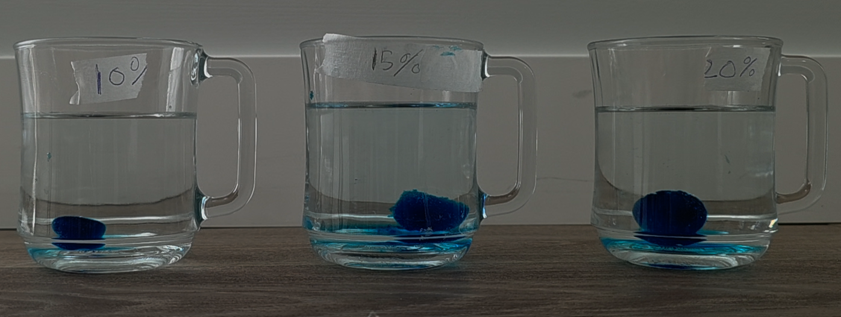
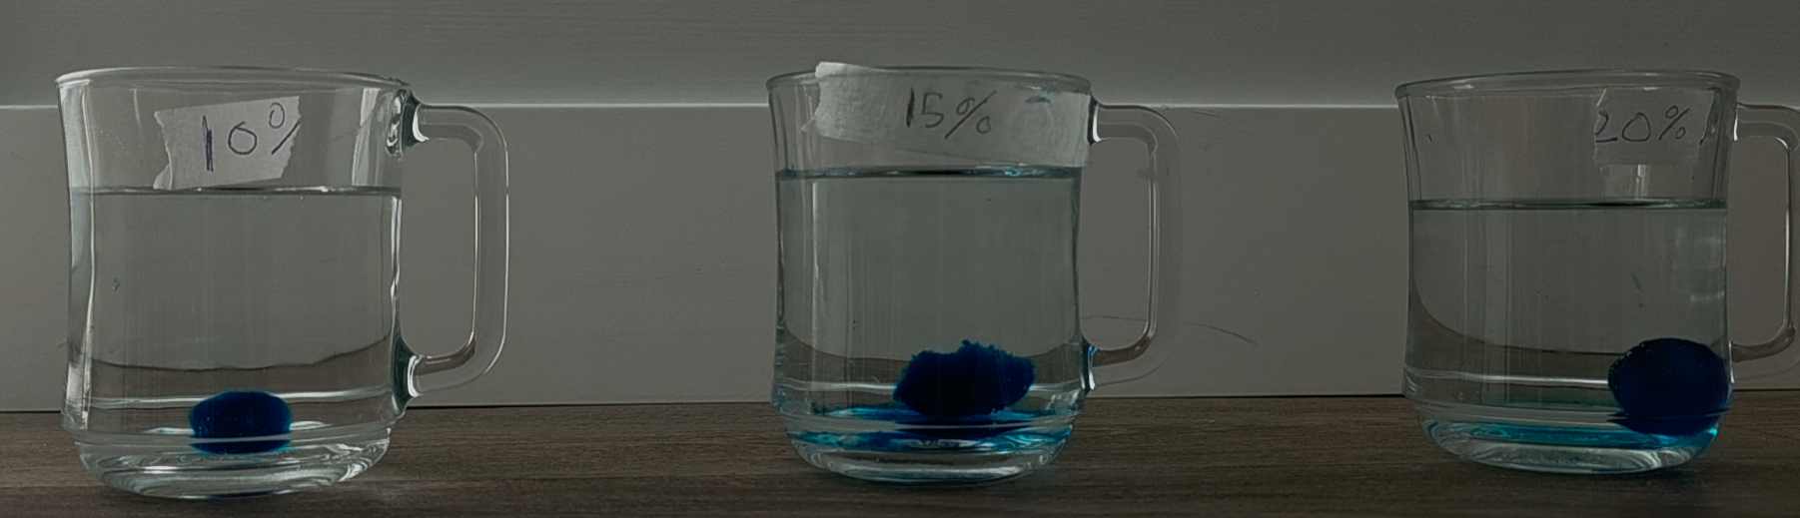
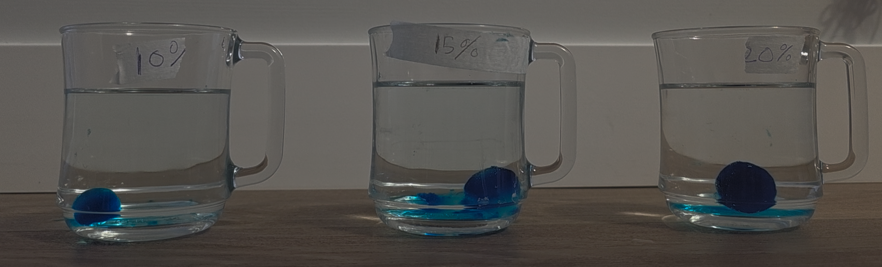
5 Minutes
10%: Not much diffusion
15% Not much Diffusion
20%: Not much diffusion

Slide 21
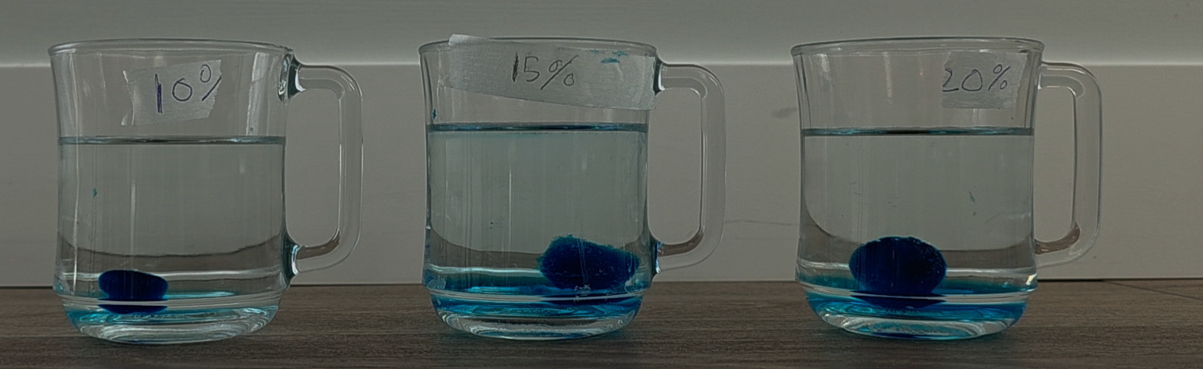
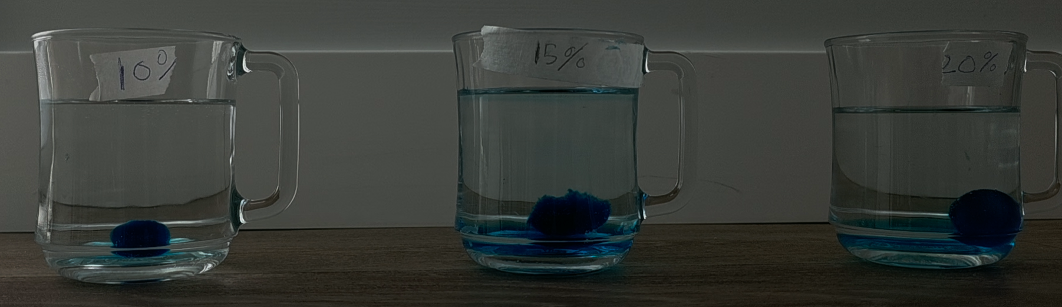
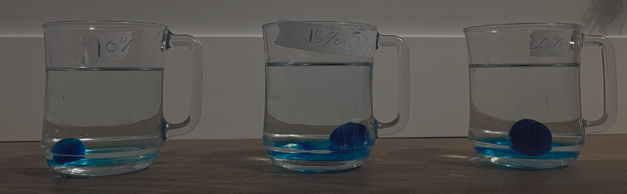
15 Minutes
10%: Light, even dispersion
15%: uneven dispersion, heavy near the bottom
20%: No dispersion, all dye settled at the bottom

Slide 22
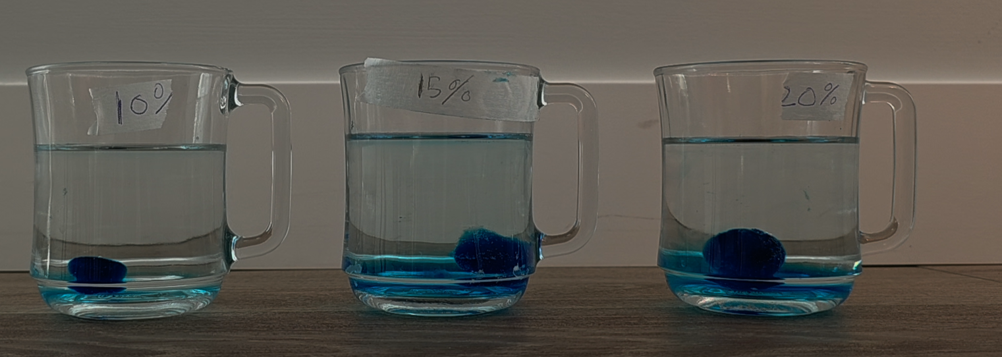
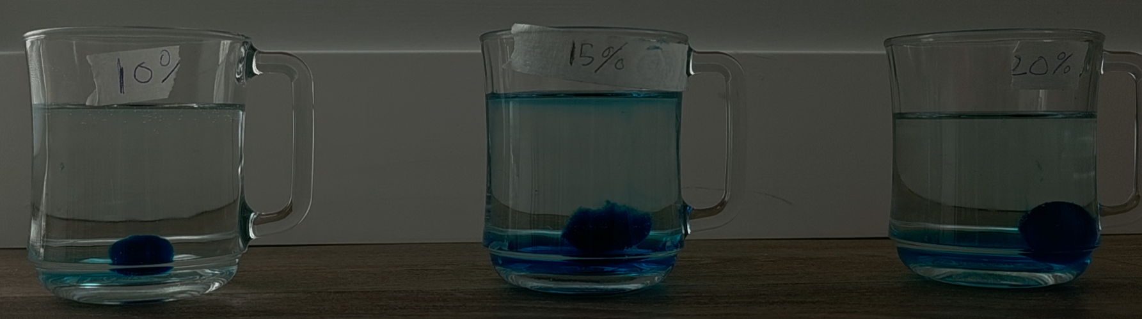
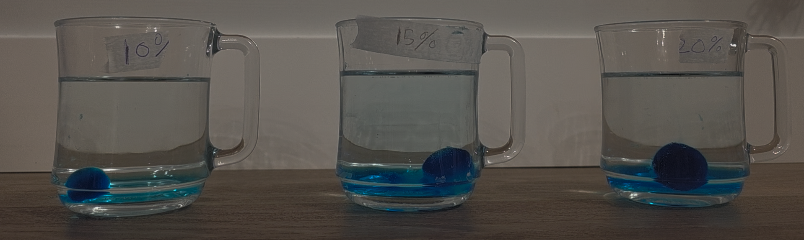
30 Minutes
10%: Even dispersion, dye is beginning to set near the bottom
15%: Uneven dispersion, dye is settling at the bottom still, but not as much as before
20%: Uneven dispersion, dye is still settling heavily near the bottom, but still dispersing a little bit throughout the mixture

Slide 23
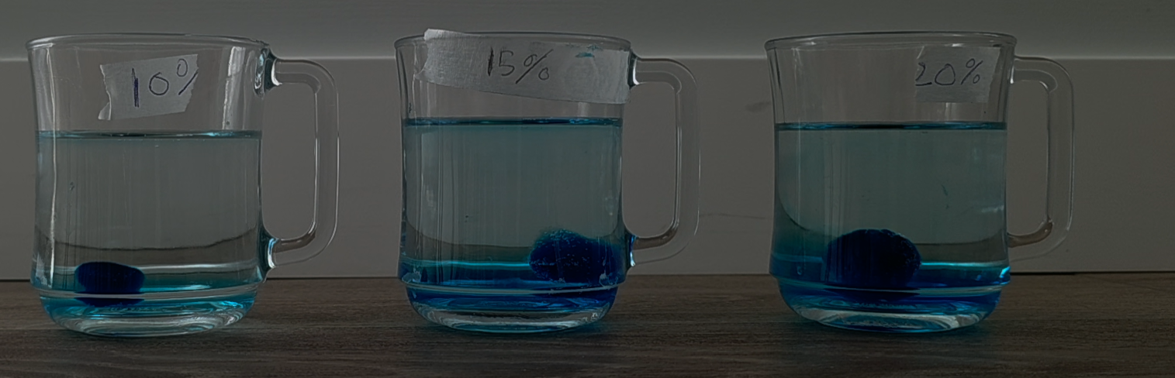
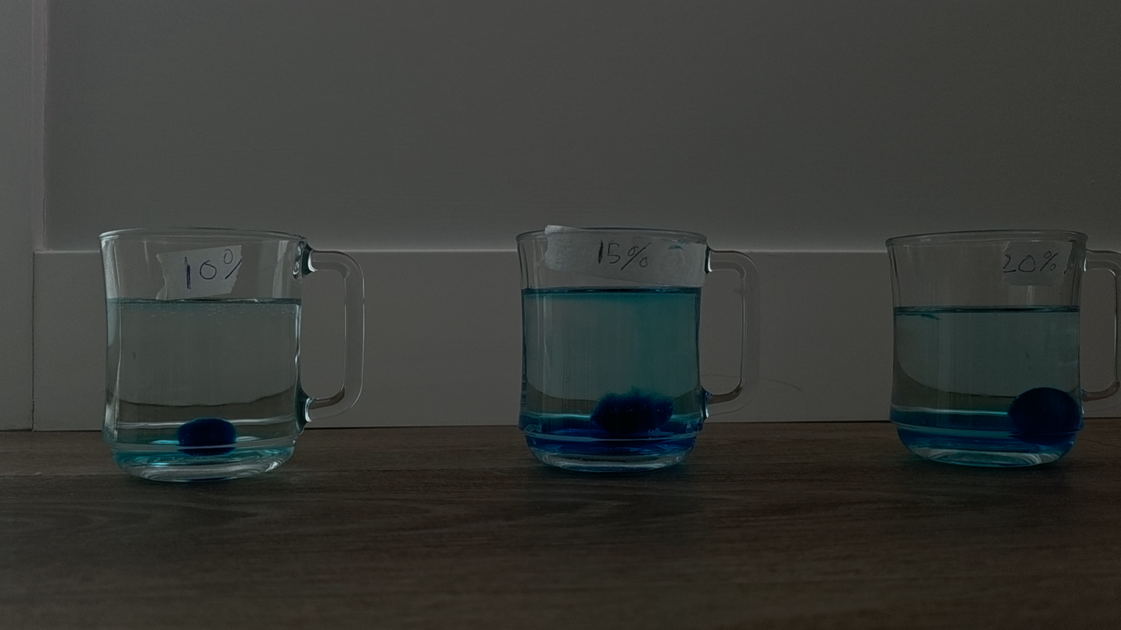
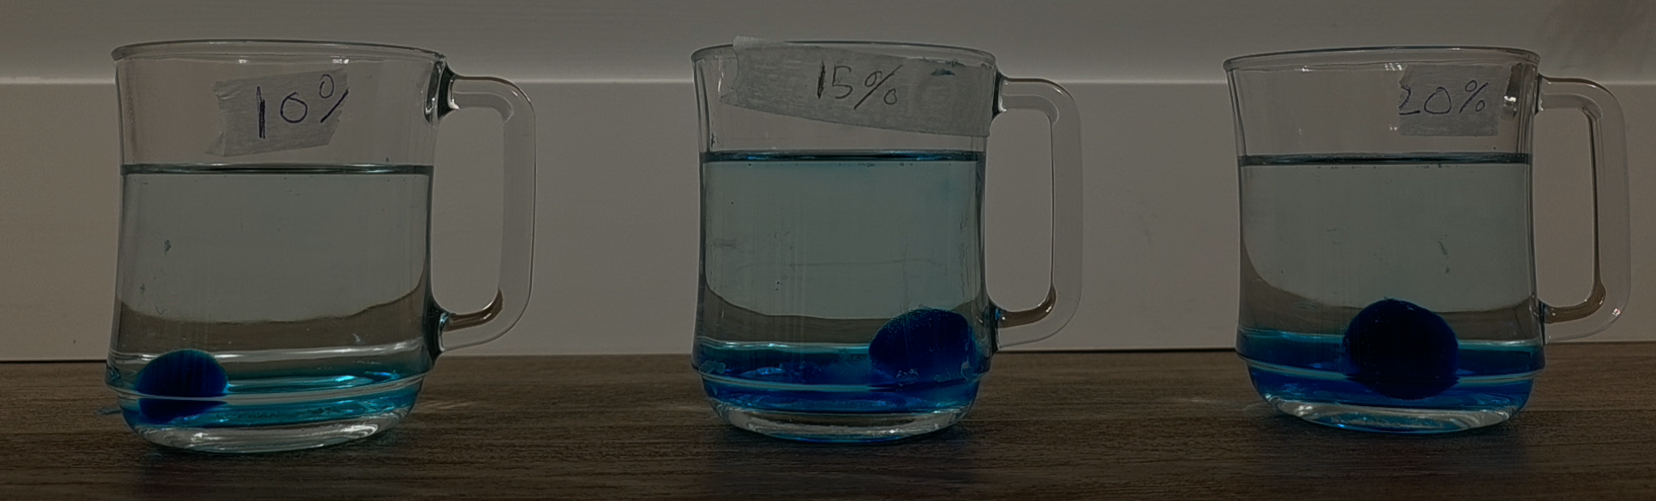
60 Minutes
10%: Dye has dispersed throughout the mixture, although some dye has begun to set at the bottom
15% Dye has dispersed throughout the mixture, still heavily settling at the bottom
20%: Dye is lightly dispersed throughout mixture, quite heavily settling at the bottom

Slide 24
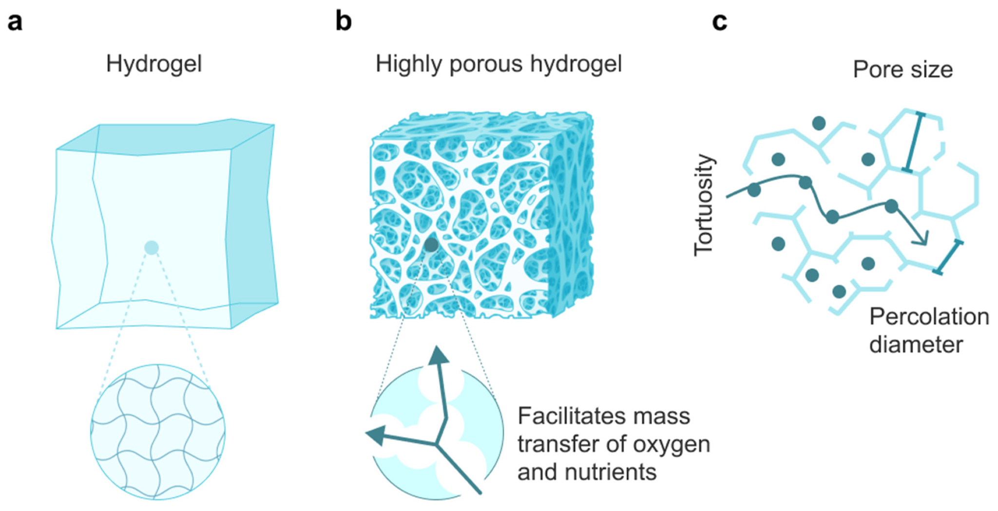
Conclusion 2
From my results, I can conclude that my hypothesis was correct. The higher the concentration of binding agent present in the mixture used to create hydrogels, the lower the amount of dye released in one hour will be. I can make this assumption based on the fact that in all 3 of my tests, all 3 different hydrogels had quite a bit of dye settling near the bottom, leading me to assume that the dye couldn’t dissolve fast enough and gravity pulled it to the bottom.

Slide 25
Part 4
Closing

Slide 26
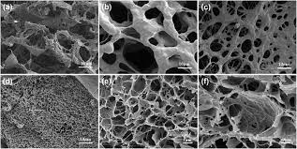
Sources of Error
Small inconsistencies in the shape and size of the hydrogel
Small inconsistencies in the measuring of the contained fluids
Small inconsistencies in the ratio of acidity or basicness in the environmental fluid

Slide 27
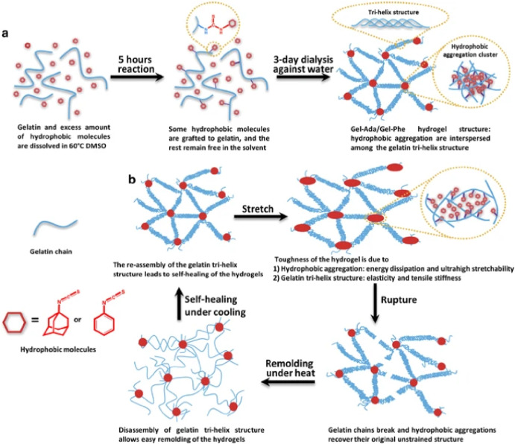
Real World Applications
Long term medicine
Covalent bonds
Terminal Illness

Slide 28
Thanks
Please consider me to move on the next stage
ameghladon@gmail.com
agastyam2@educbe.ca
Please keep this slide for attribution

