Slide 1
Log-book
Rockets and Exoplanets

Slide 2
February 17th
We started our project on this day! We chose this project because we wanted to unravel the mysteries that space hold.

Slide 3
February 18th
What are exoplanets?
exoplanet is any planet that is beyond our 8 planets ( 9 planets, if you count pluto)
Different kinds of exoplanets
closest planet to Earth is Proxima Centauri- b.
Kepler-186f
HD 209458 b
55 Cancri e
GJ 504 b
TrES- 2b
AU Microscopii b
Citations
https://en.wikipedia.org/wiki/Exoplanet
https://spaceplace.nasa.gov/all-about-exoplanets/en/#:~:text=Exoplanets%20are%20very%20hard%20to,on%20the%20stars%20they%20orbit.
https://en.wikipedia.org/wiki/Exoplanet
http://Exoplanet Exploration: Planets Beyond our Solar Systems://earthsky.org/astronomy-essentials/what-are-exoplanets
https://spaceplace.nasa.gov/all-about-exoplanets/en/#:~:text=Exoplanets%20are%20very%20hard%20to,on%20the%20stars%20they%20orbit.

Slide 4
February 18th
Why are exoplanets important to research about?
- exoplanets are important to research about because, one day our sun will explode and there will be no life/oxygen on Earth
- also we are polluting the air, water and land.

Slide 5
February 19th
How do we find exoplanets?
exoplanets are very hard to see directly with a telescope:
scientists have to use strong telescopes to see
they usually look for “wobbly stars”
What is radial velocity?
it means wobbly stars
Citations
https://spaceplace.nasa.gov/all-about-exoplanets/en/#:~:text=Exoplanets%20are%20very%20hard%20to,on%20the%20stars%20they%20orbit.

Slide 6
February 20th
Names of exoplanets that look like Earth
Proxima centauri -b
Kepler - 452b
TRAPPIST-1e
Coming up with our hypothesis
next 500 years humans will be multi- planetary
Citations
https://exoplanets.nasa.gov/alien-worlds/strange-new-worlds/

Slide 7
February 21st
What is the closest exoplanet to Earth that has the same characteristics?
Proxima Centauri- b
How far is this planet away in light years?
4 light years away
How far away is it in km?
3.784e+13

Slide 8
February 22
How long would it take a regular rocketship to get to Proxima Centauri B?
Our (scientist) prediction is 7000 years

Slide 9
February 22
How do rockets work?
They need gas and fuel to work
What are different rocket parts?
Nose Cone
Structure System
Fuel
Frame
Oxidizer
Pumps
Nozzle
Fin
Propulsion System
Payload System
Guidance System
Citations
https://www.youtube.com/watch?v=jI-HeXhsUIg&ab_channel=ScienceABC
https://www.nasa.gov/audience/forstudents/k-4/stories/nasa-knows/what-is-a-rocket-k4.html

Slide 10
February 22
What is an energy source of rockets right now?
fuel and gas
How can we improve rockets to make them go faster and further?
make your material lighter
get a new energy source
Citations
https://www.nasa.gov/audience/forstudents/k-4/stories/nasa-knows/what-is-a-rocket-k4.html

Slide 11
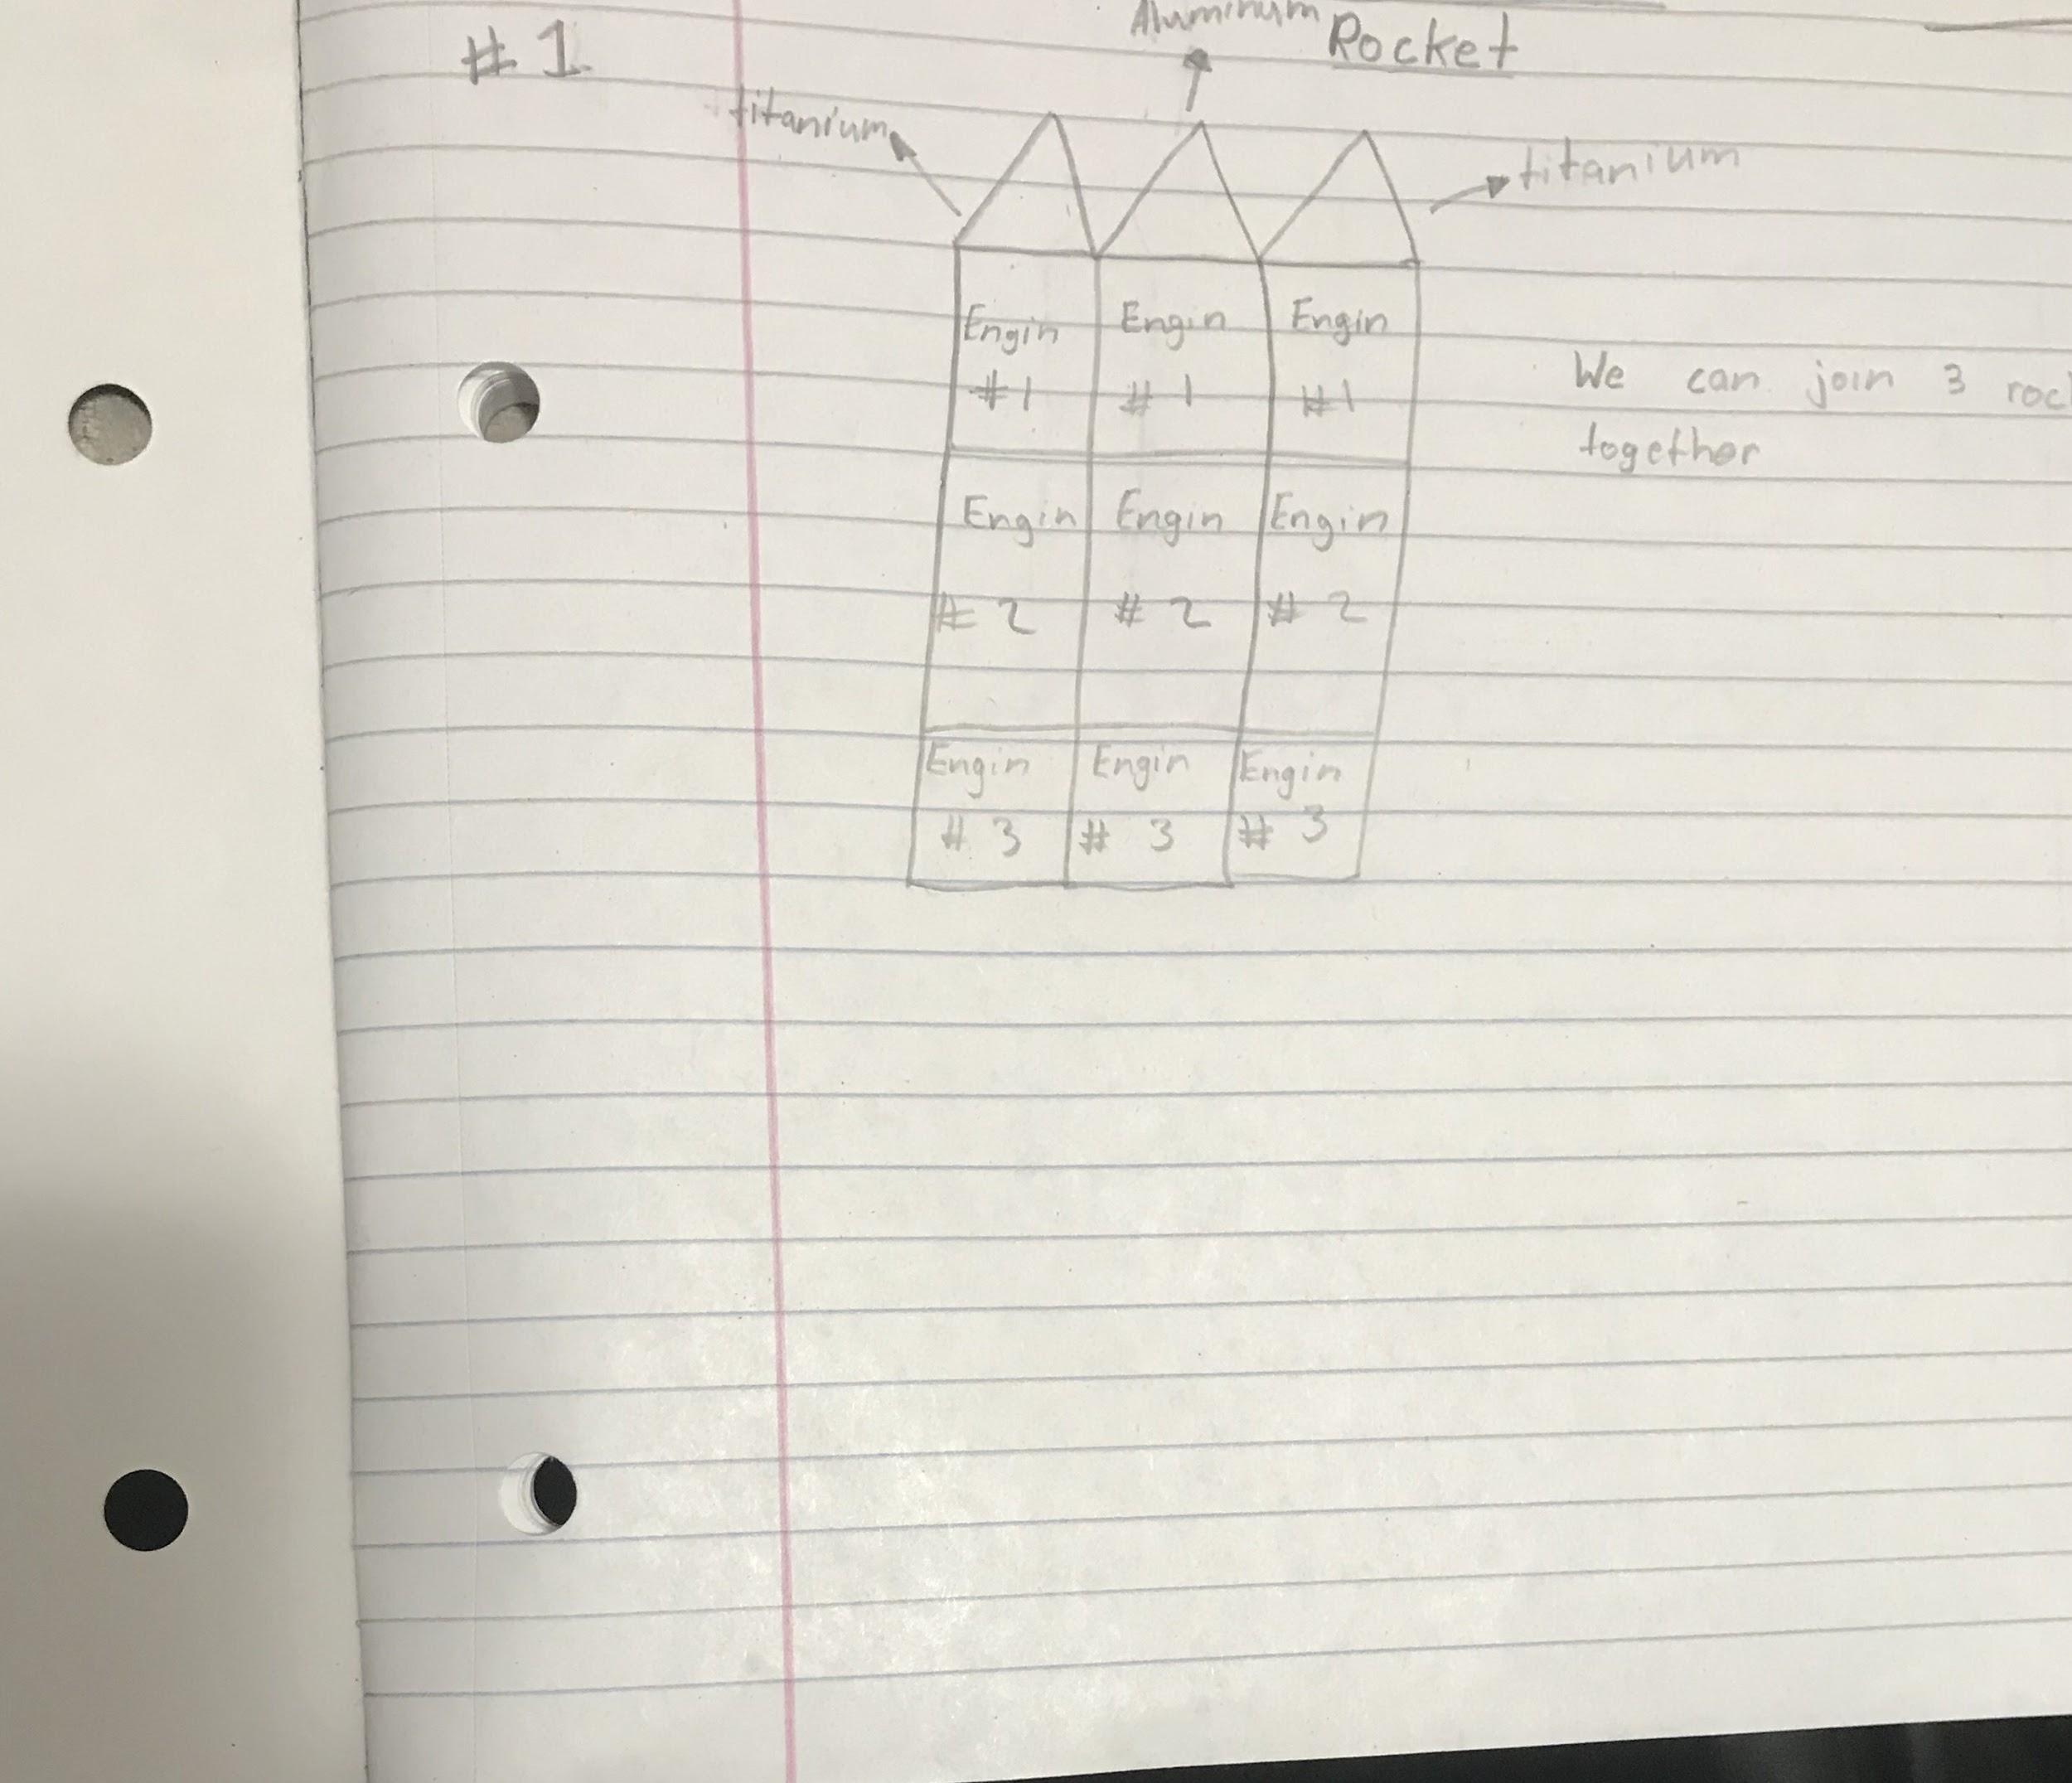
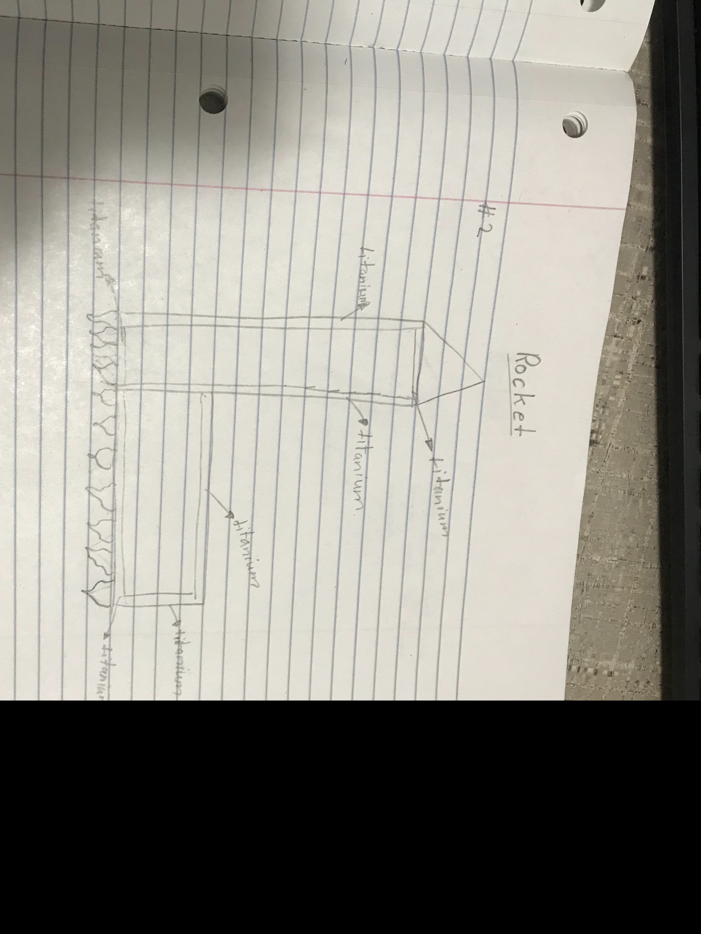
February 22
Add old pictures of your rockets:

Slide 12
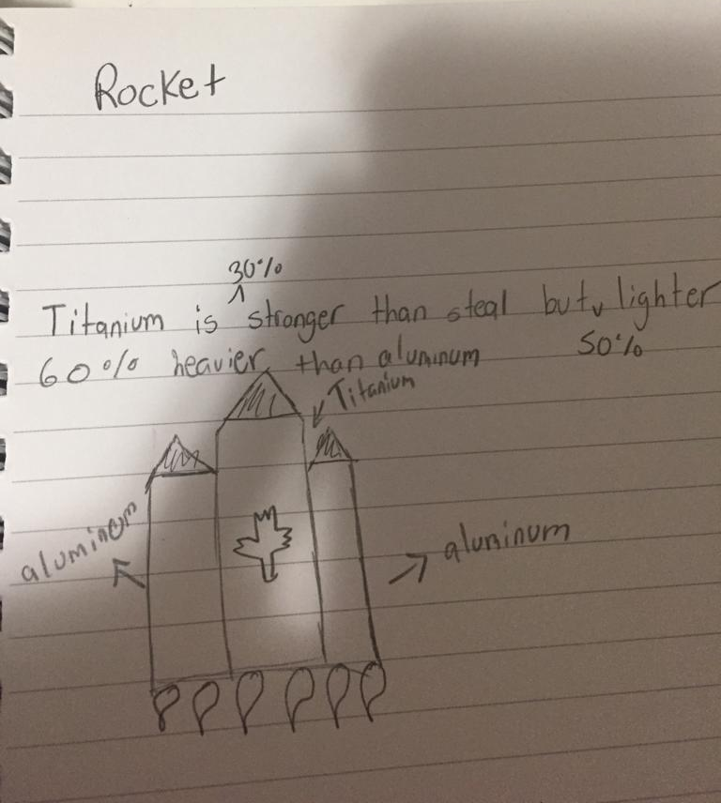
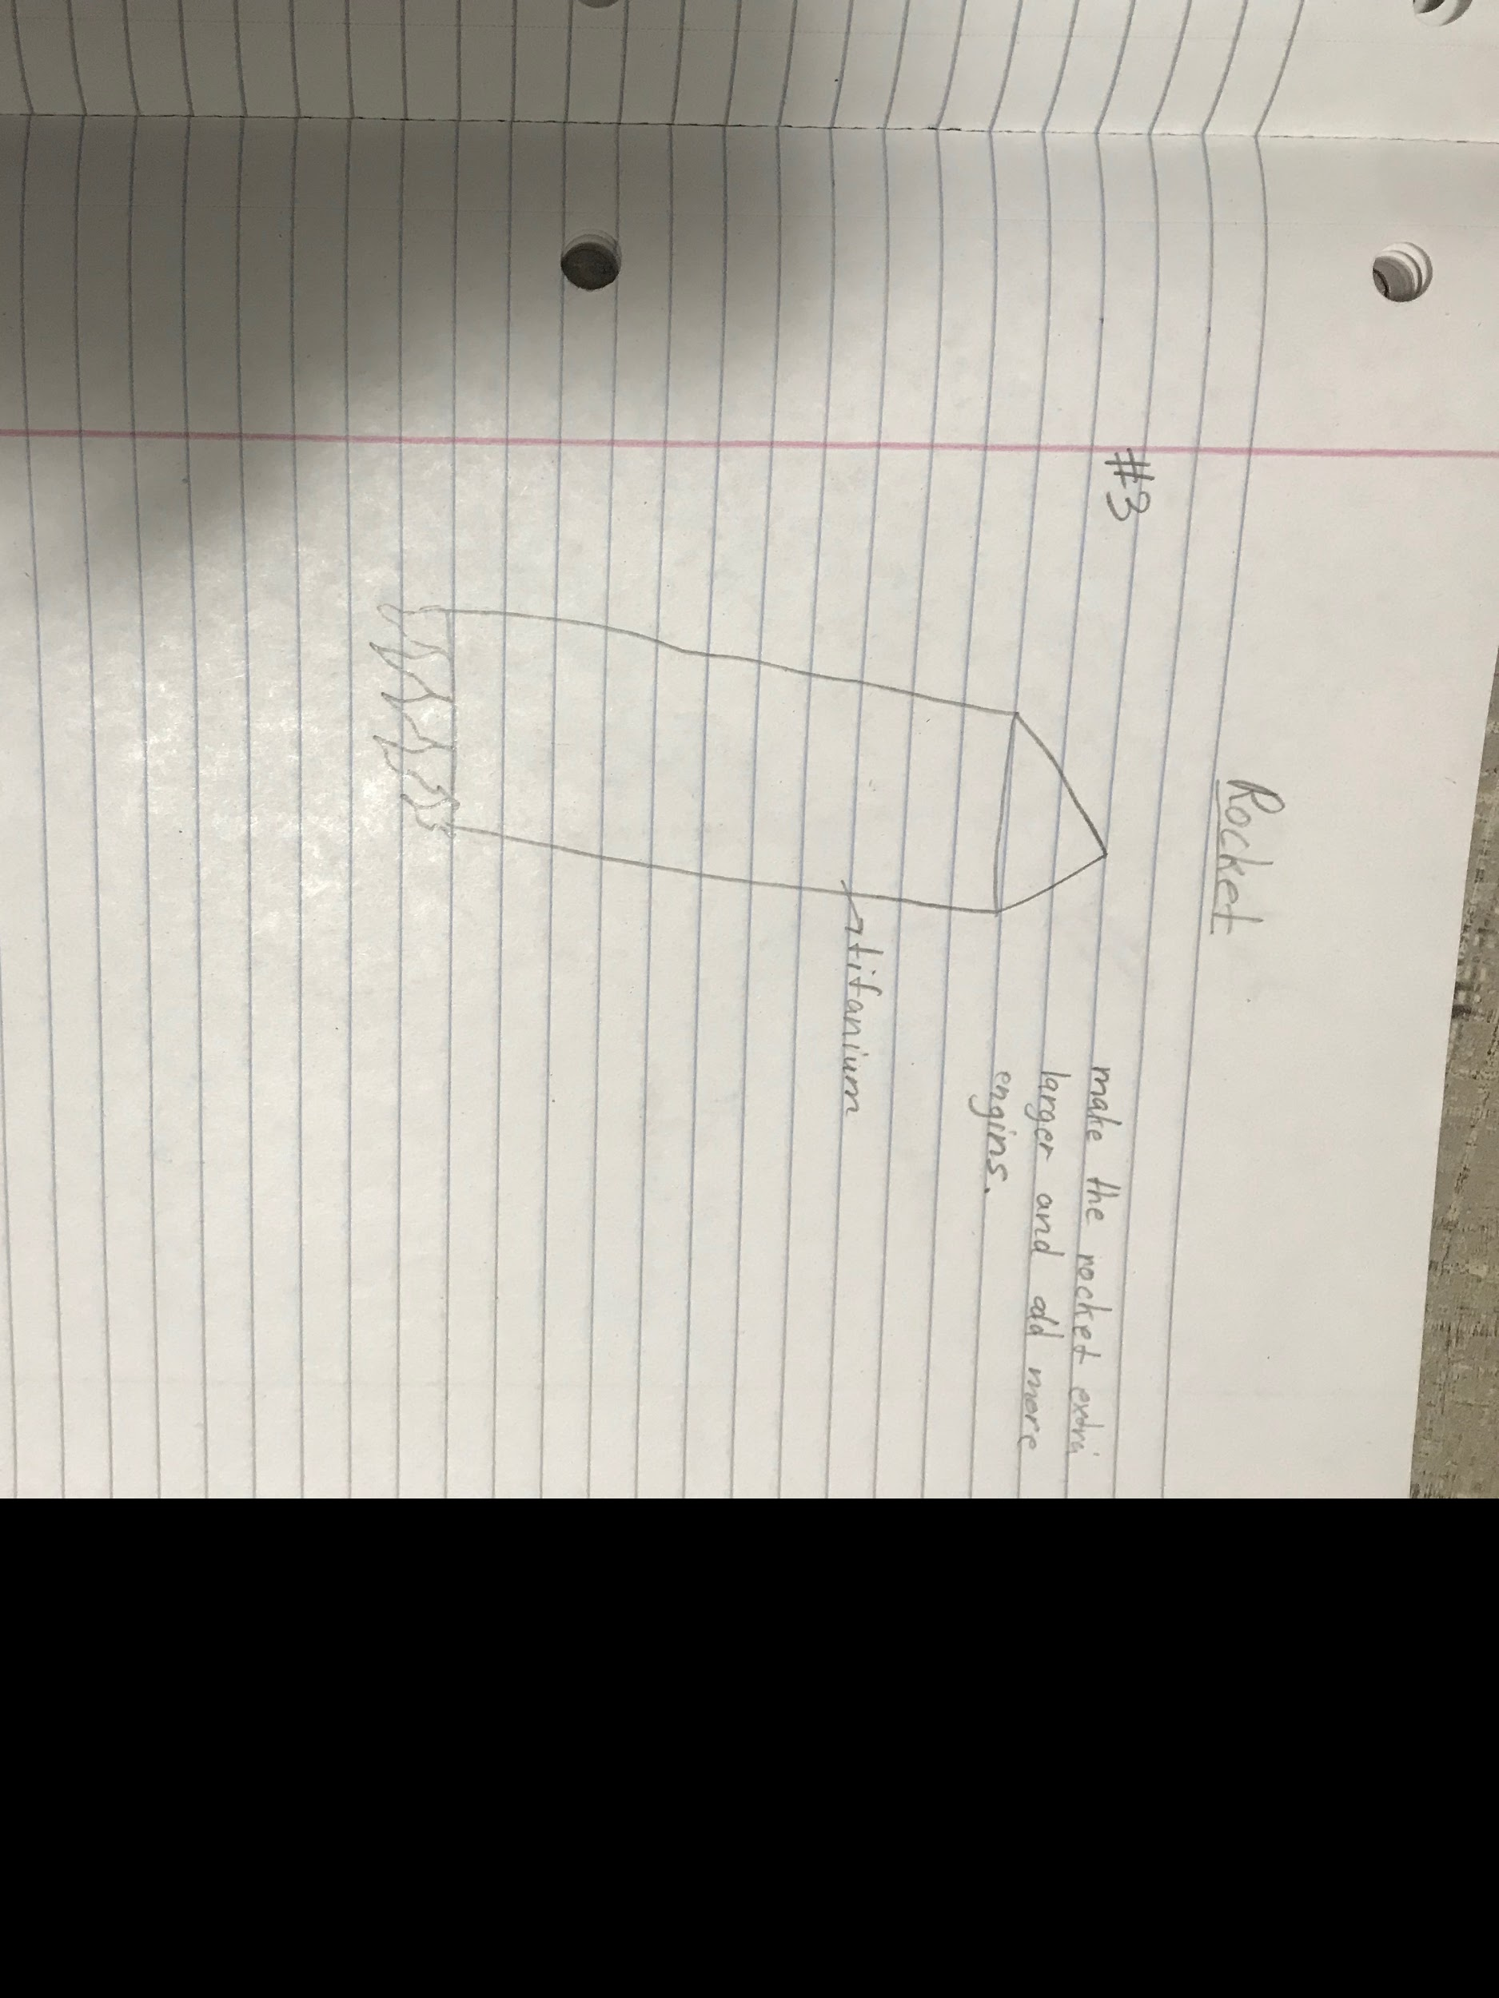

Slide 13
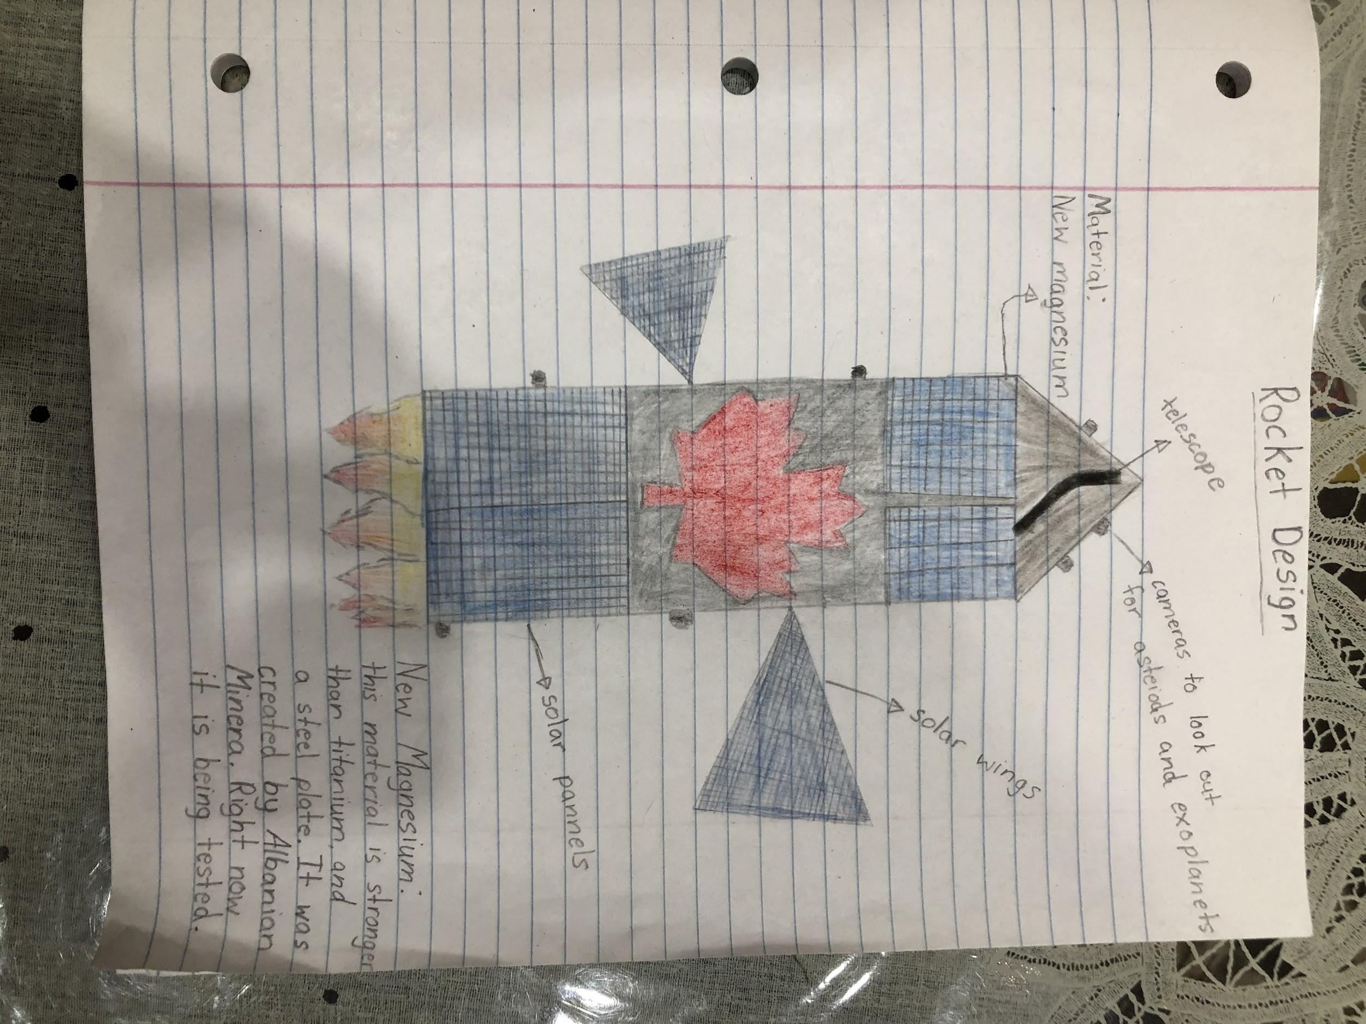
February 23
Final copy of the rocket

Slide 14
February 24
Explain the final design of the rocket
solar panels and solar wings to get energy from the Sun
made of New Magnezium because it is super light

Slide 15
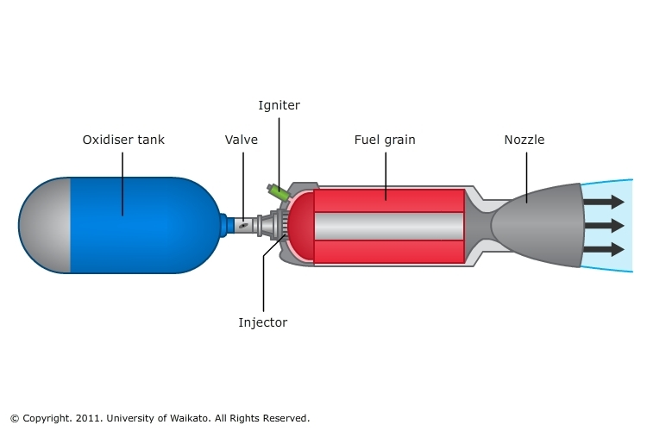
February 25
thousand times faster than normal engines
Draw and talk about the methane super engine.
Picture:

Slide 16
February 26th to March 16th
Work on presentation
added final touches to my presentation

Slide 17
March 17th
- We recorded the video
- Filled out the form

