Slide 1
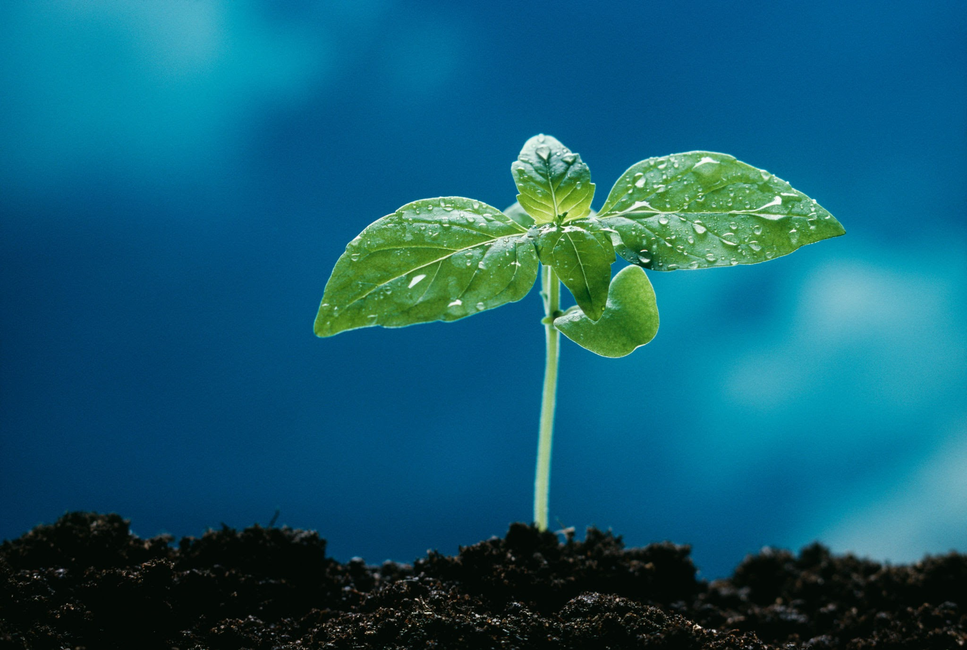
Science Fair Logbook
Name: Liakat and Navraj
Notes:
Make a copy of this logbook (File - Make a Copy) and save in your Google Drive.
Share it with your Science Fair teachers: mmolfert@educbe.ca amduncan@educbe.ca kknanji@educbe.ca

Slide 2
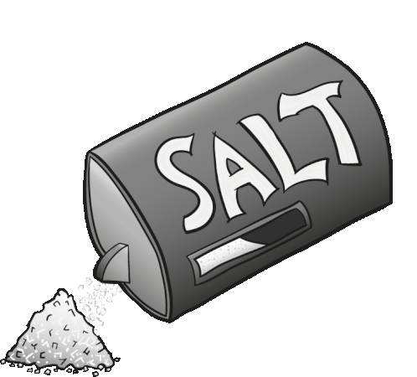
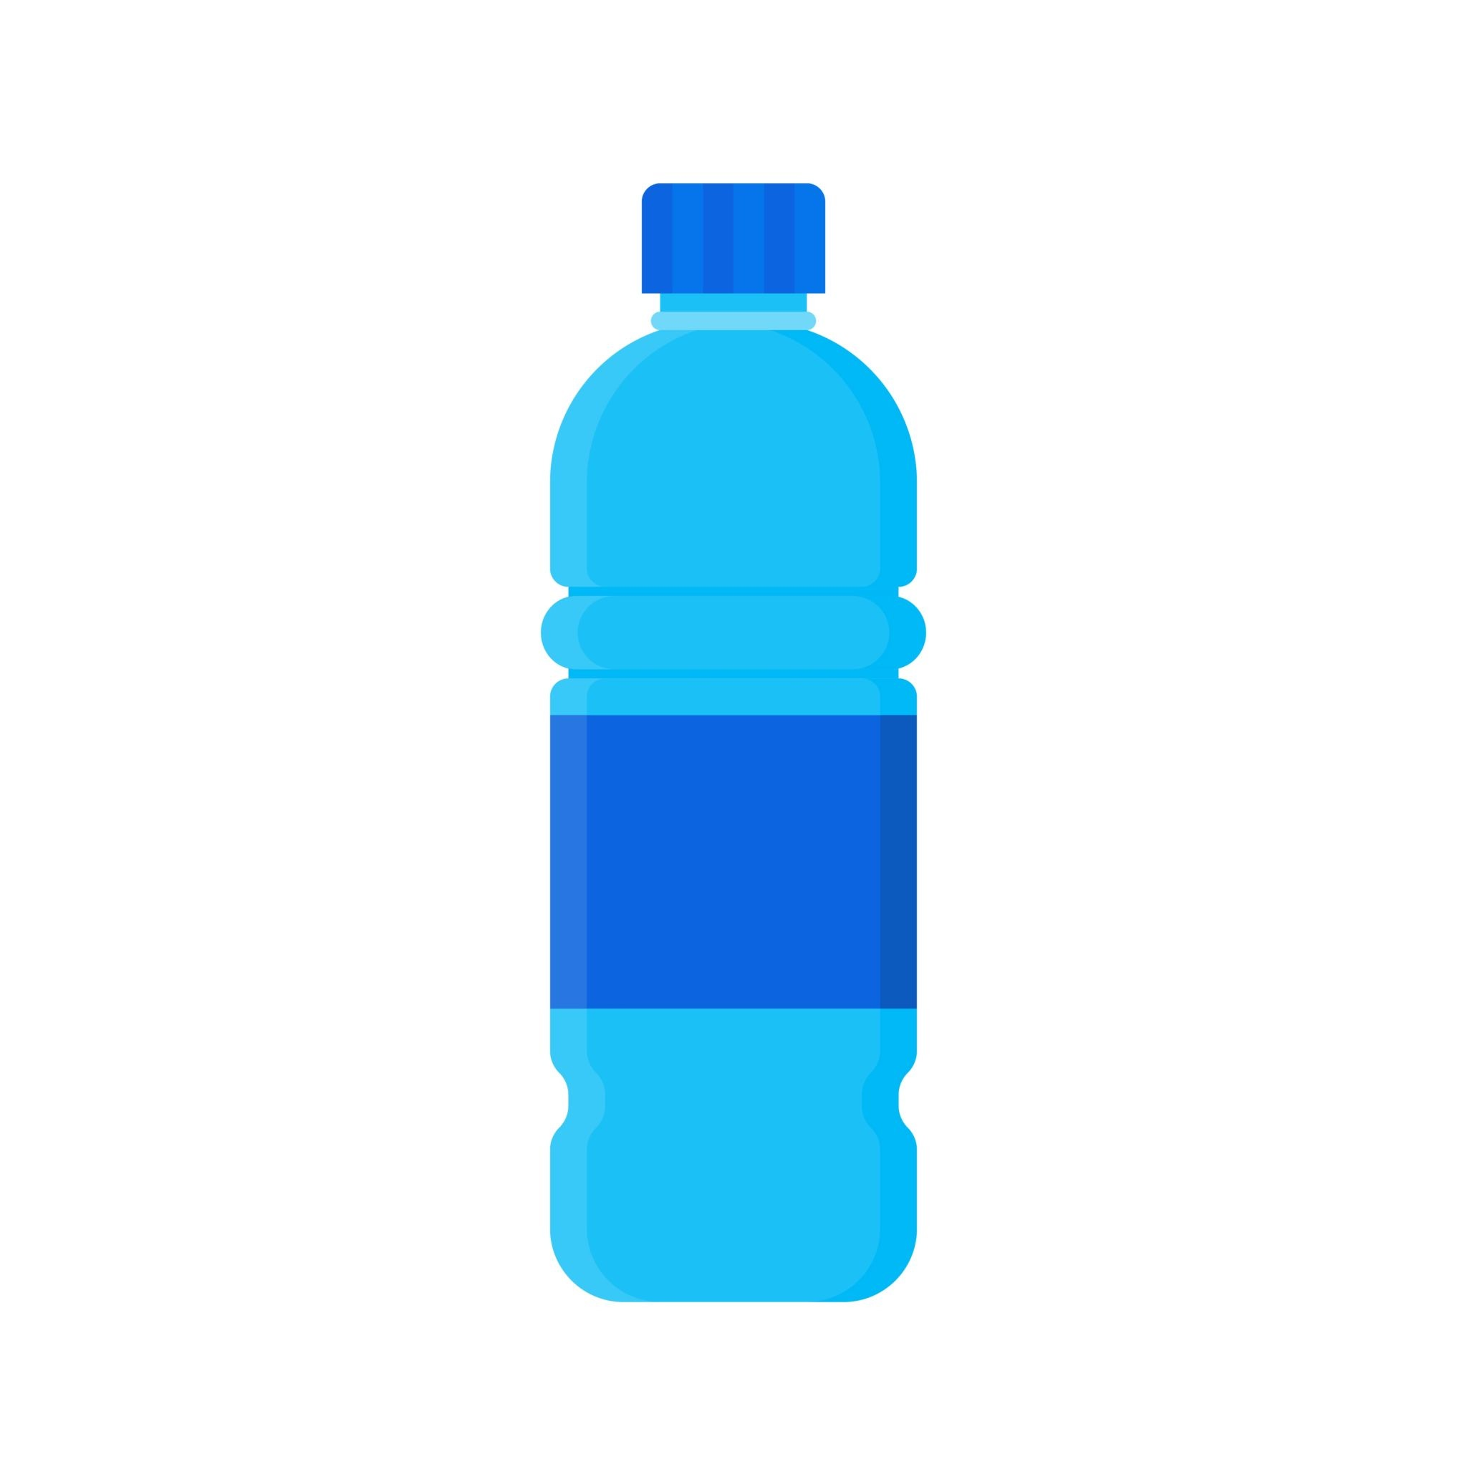
Topic:How does salt water affect plant
Growth .
Write about the topic you chose. Why did you choose this topic? What do you hope to find out?
We chose: How does salt water affect plant growth?We chose this topic because we want to find out if you can water a garden with not only fresh water,but also salt water.
Salt water

Slide 3
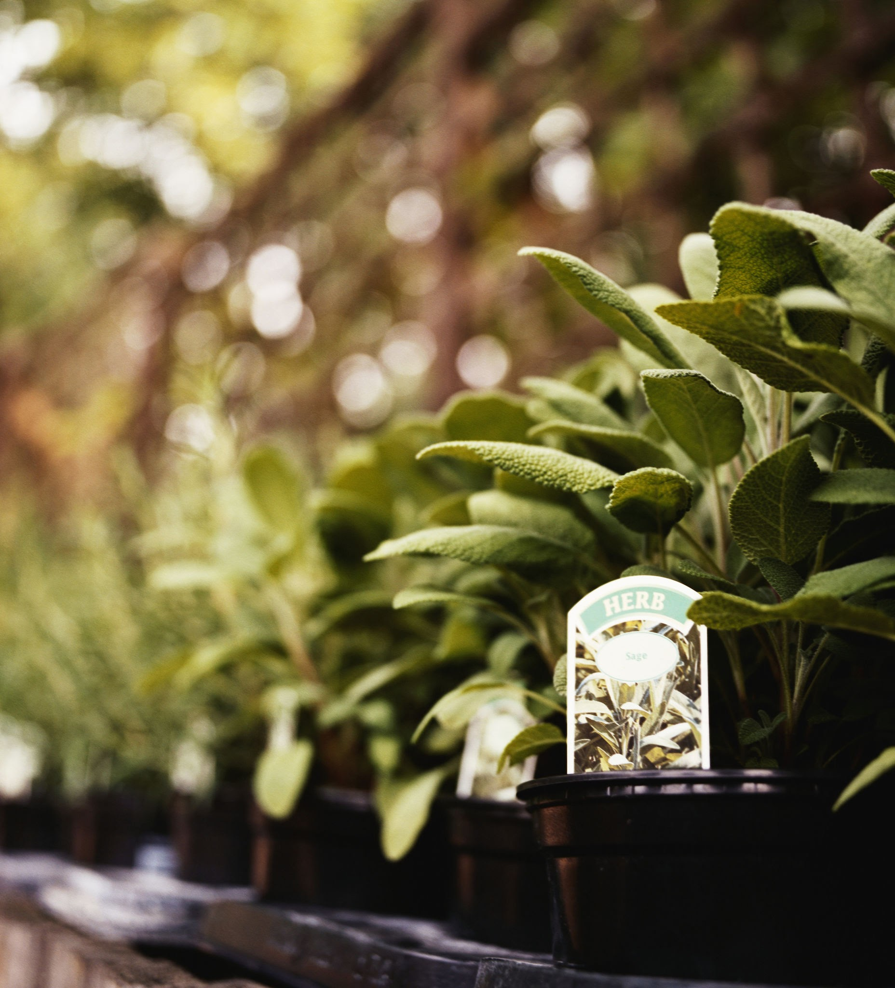

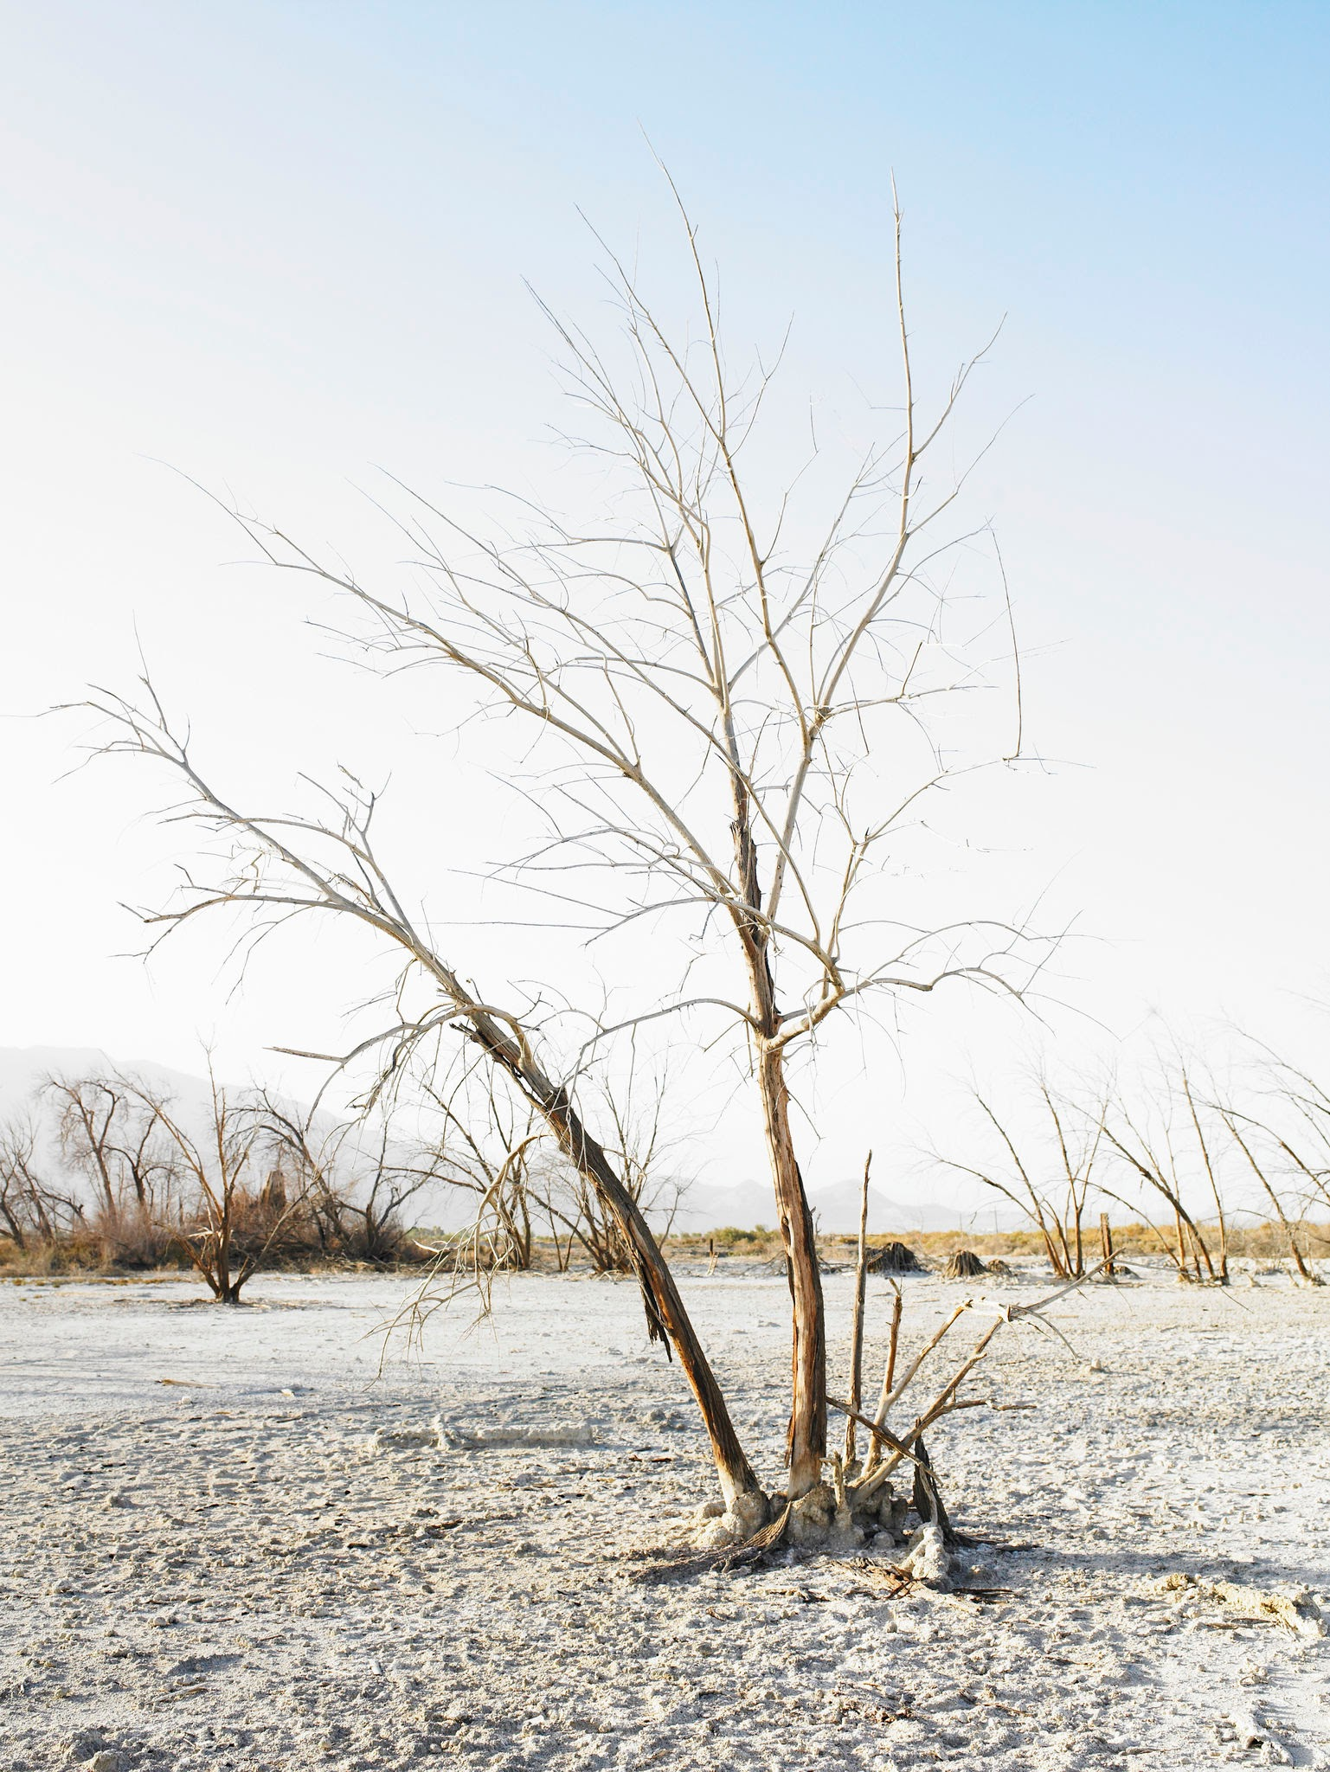
Testable Question
plant
How does salt water affect plant growth ?
What is the effect of salt water on plant growth?
Which water makes a healthy plant grow ?
NOT HELP!
Salt water can help plants become unstable and unhealthy,but we will try to see if that is true.
Wich
one
Notes:
See D2L - Content - Getting Started - Planning Page 2

Slide 4
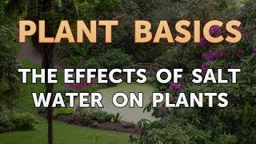
Background Information
What questions/information do you need to find out about your topic? What is some important vocabulary?
Plants don’t grow with with salt water.
Plant turns brown or yellow.
Salt water is from ocean.
Salt water effects the soil.
WATCH VIDEO

Slide 5
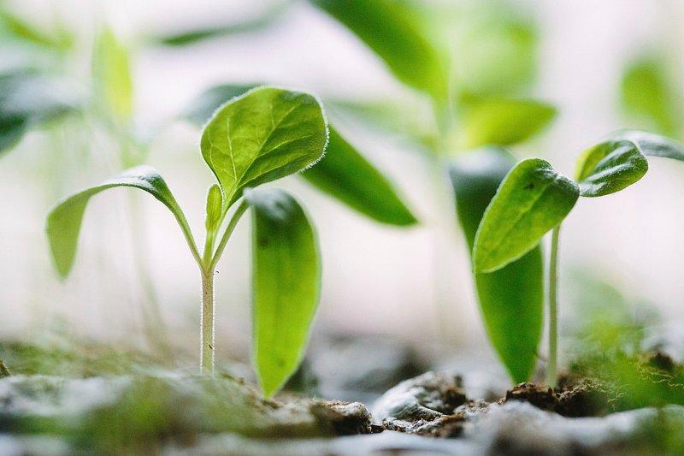
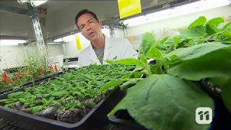
Background Information
Research your topic and write about what you find out IN YOUR OWN WORDS. Add slides as necessary. Make sure to note your sources of information on the Sources page.
Saltwater normally hurts most plants by causing dry nutrient imbalances, desiccated and toxicity, but
Certain salt-tolerant plants known as halophytes can survive or thrive in it.
Some sources that we used,well we only used one source but it is Google.
watch
video

Slide 6
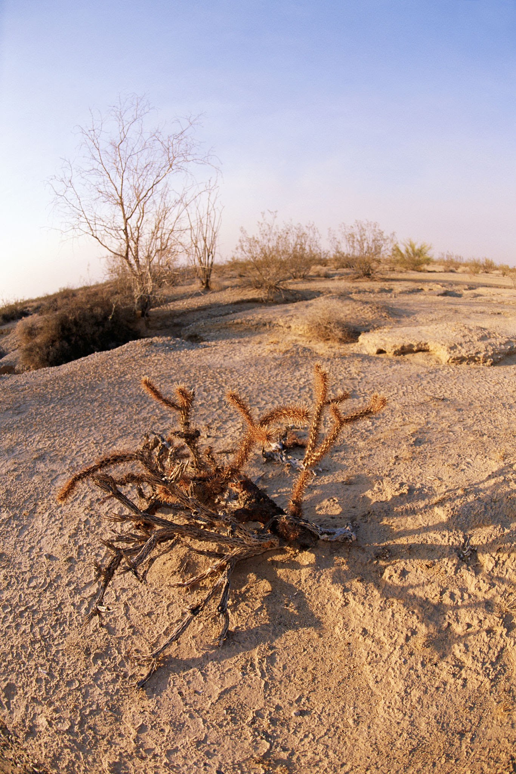
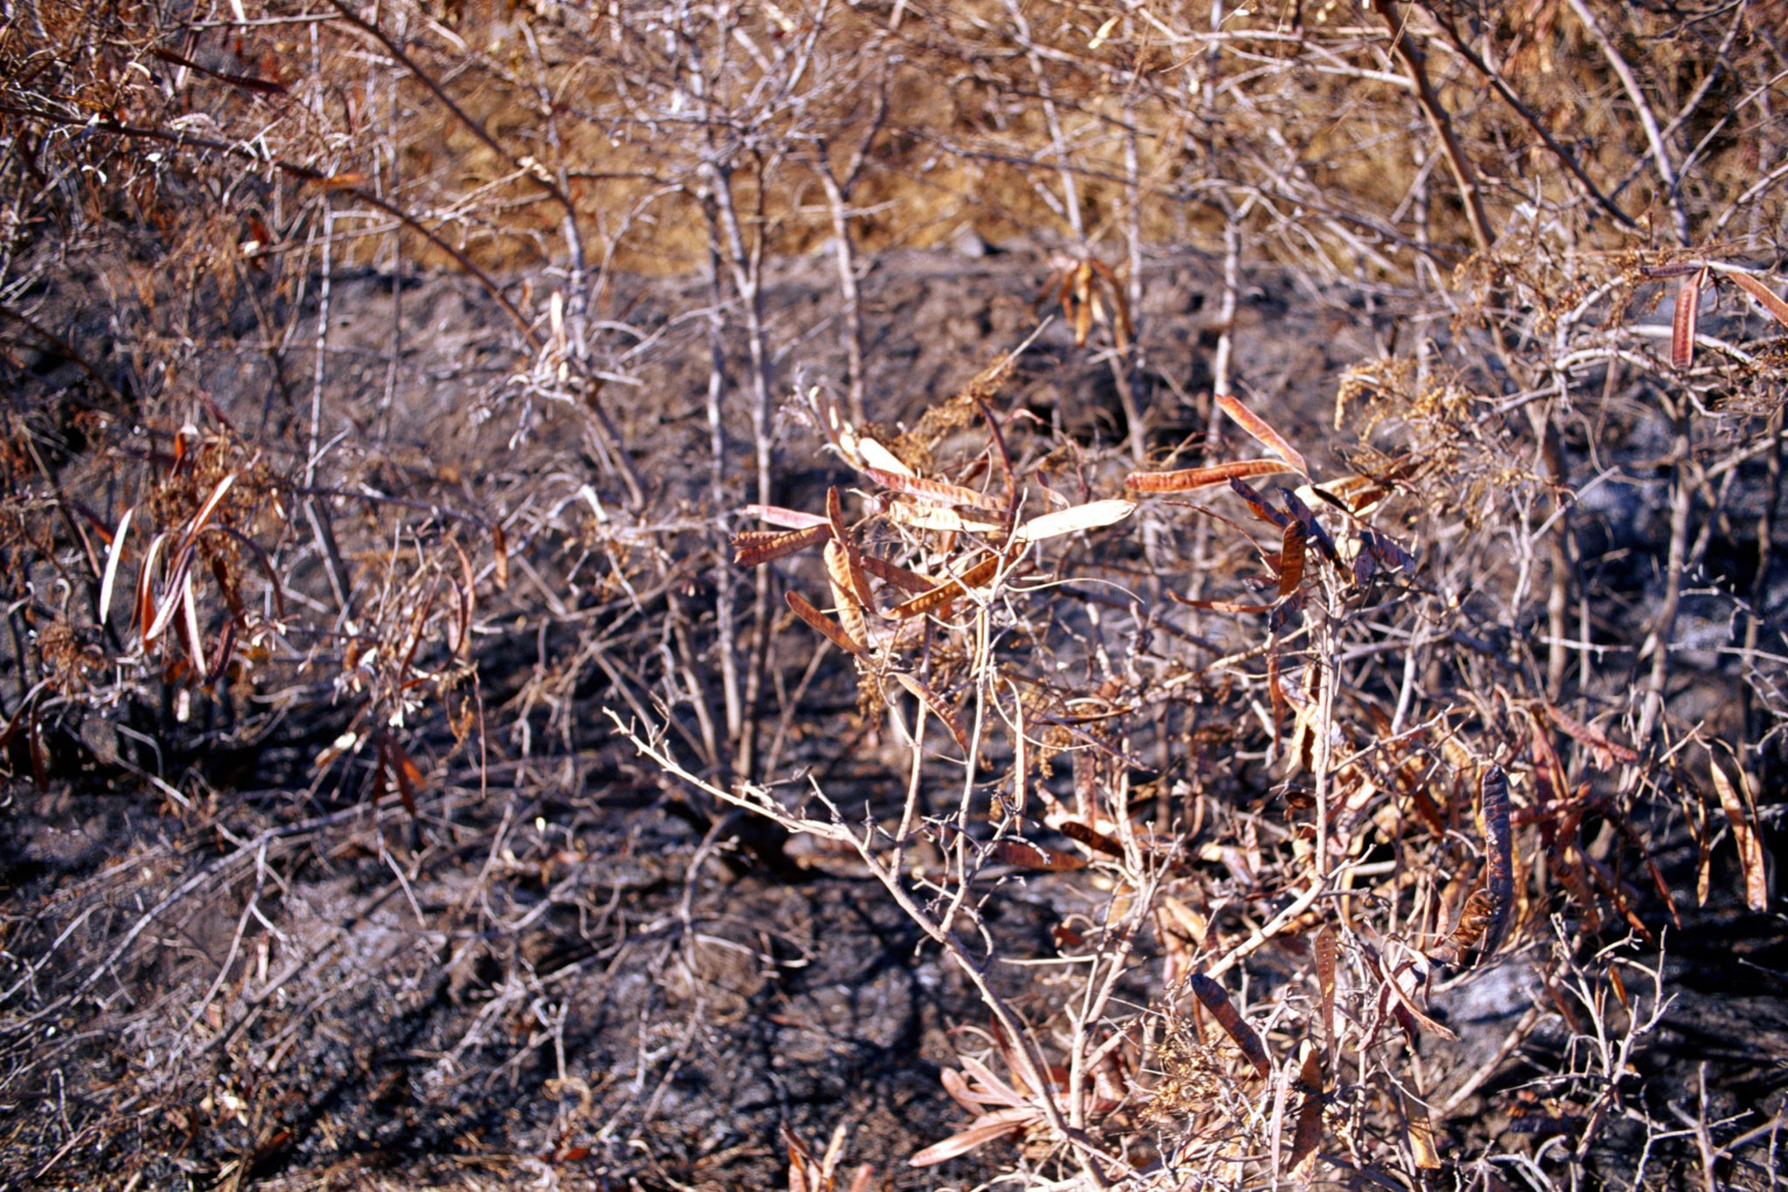
Background Information
Research your topic and write about what you find out IN YOUR OWN WORDS. Add slides as necessary. Make sure to note your sources of information on the Sources page.
Saltwater damages plants by causing severe osmotic stress.
Prevents roots from absorbing water.
Leading to dehydration and wilting even in moist soil.
Salt also causes direct toxic
Stunted growth.
Dry plants

Slide 7


Sources of Information
Note all sources used - websites, books, experts, etc. ( *Google is not a website, follow links to find the page information.) Add slides as needed.
Title | Author | Information (web link, publisher, etc) | Year
google | Larry page and Sergey brin | AI GOOGLE | 2026
google | Larry page and sergey brin | AI GOOGLE | 2026
google | Larry page Sergey brin | AI GOOGLE | 2026
google | Larry page and sergey brin | AI GOOGLE | 2026
google | Larry page and sergey brin | AI GOOGLE | 2026
google | Larry page and sergey page | AI GOOGLE | 2026
Notes:
See D2L - Content - Referencing Your Sources

Slide 8
Variables
Manipulated / Independent Variable
ONE thing that you will test/change:
TEST:SALT WATER EFFECT ON PLANT!
CHANGE:THE WATER THAT WE USE!
Responding / Dependent Variable
The thing I think will change or be affected: PLANT!
How will you measure it? :
MEASURING TAPE!
Notes:
See D2L - Content - Hypothesis - Variables and Hypothesis

Slide 9
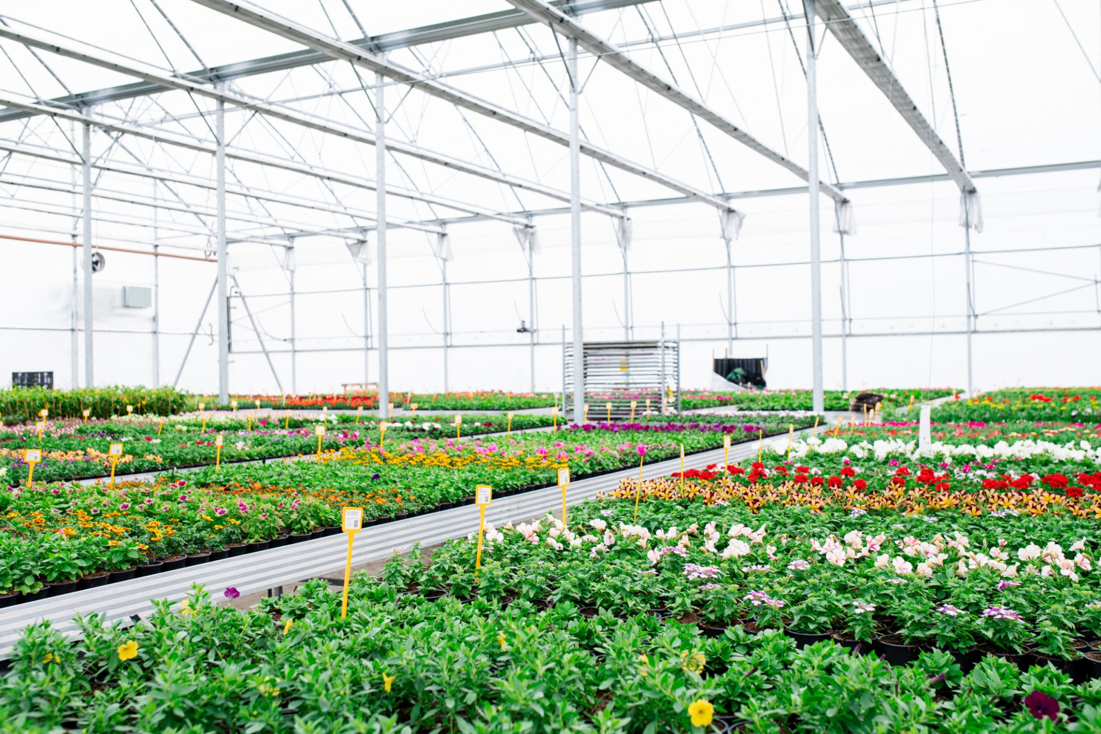
Variables
Controlled Variables
Things we have to be very careful to keep the same every time we test so that they do not affect the results/outcome of the experiment:
Make sure we don’t switch up the plants,because some plants are less immune to salt than others.
Notes:
See D2L - Content - Hypothesis - Variables and Hypothesis

Slide 10
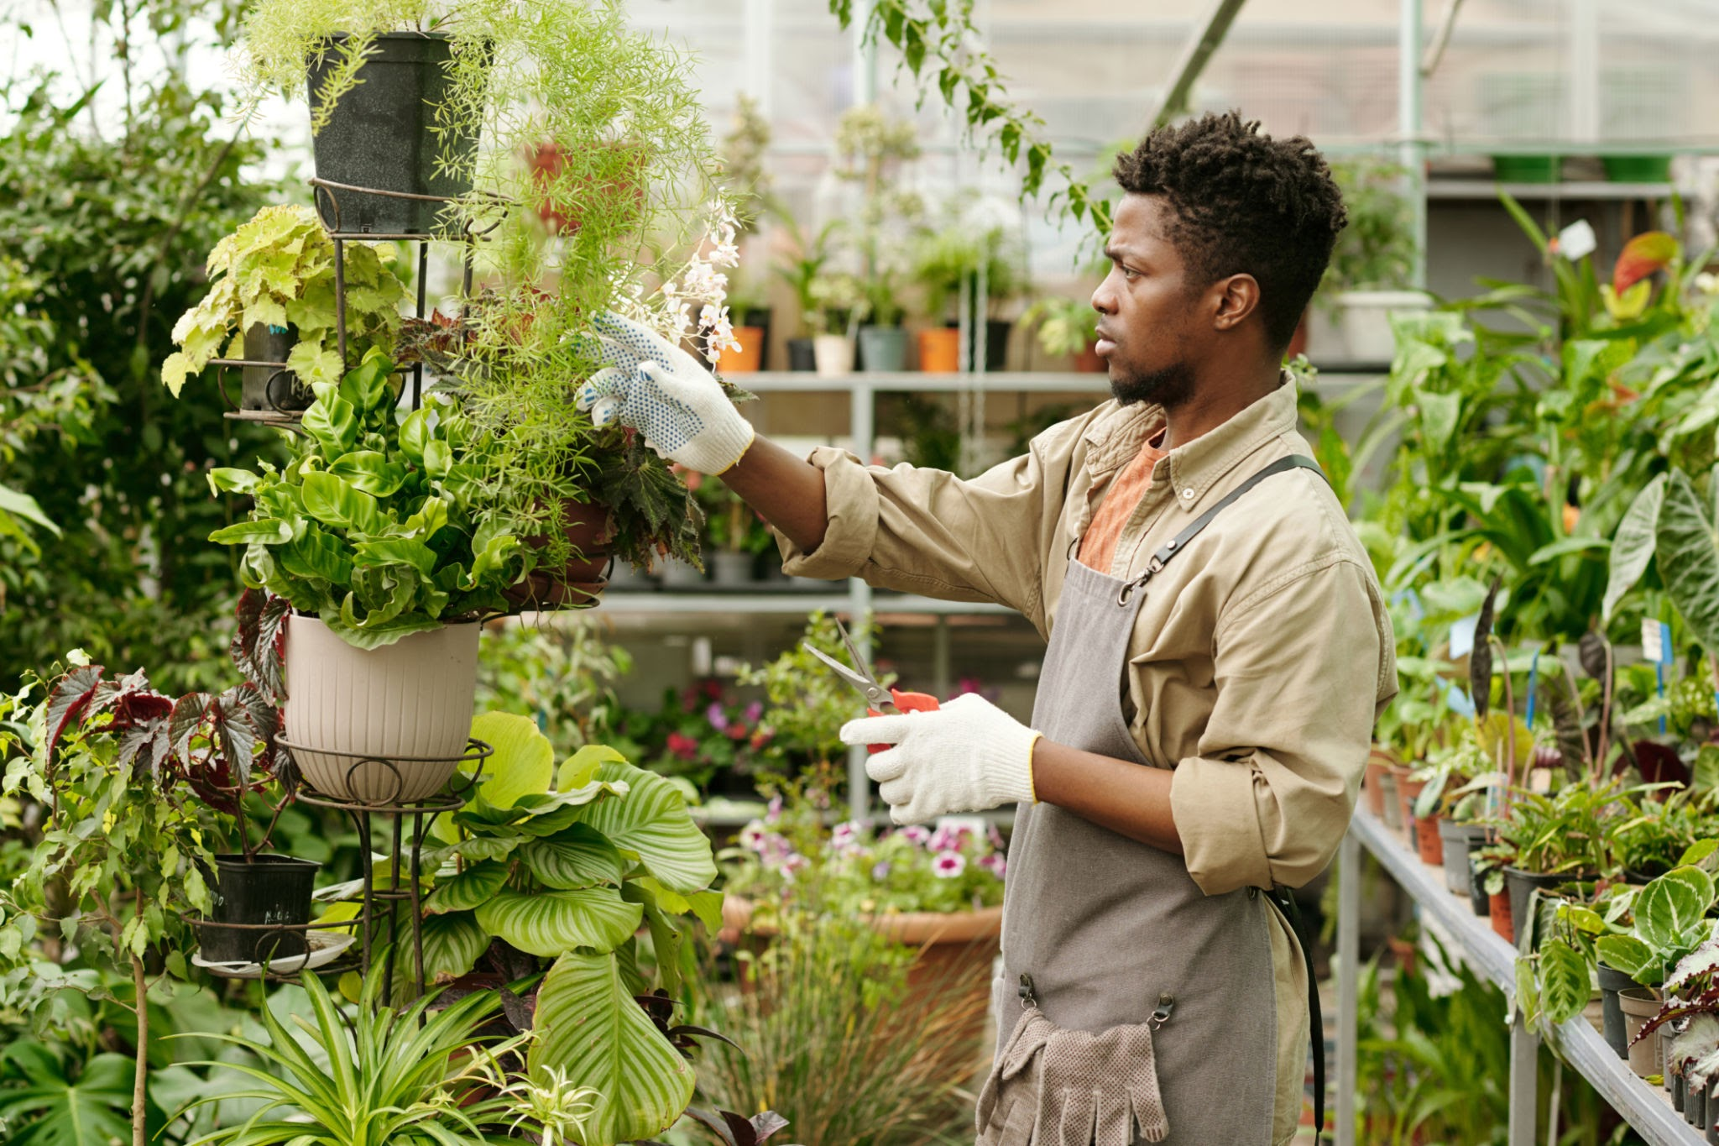
Hypothesis
Your prediction, or what you think will happen:
If saltwater affected on plants then will turn yellow,brown, or black because it causes trouble for roots and soil.
(I do/change this…) (I think this will happen) (Why? )
*use info from your research or background knowledge to help explain)
Our hypothesis is that fresh watered plant will grow faster than a plant due to imbalancing in nutrient systems,dehydration,ion toxicity,soil degradation,and trouble for roots and soi.
Notes:
See D2L - Content - Hypothesis

Slide 11
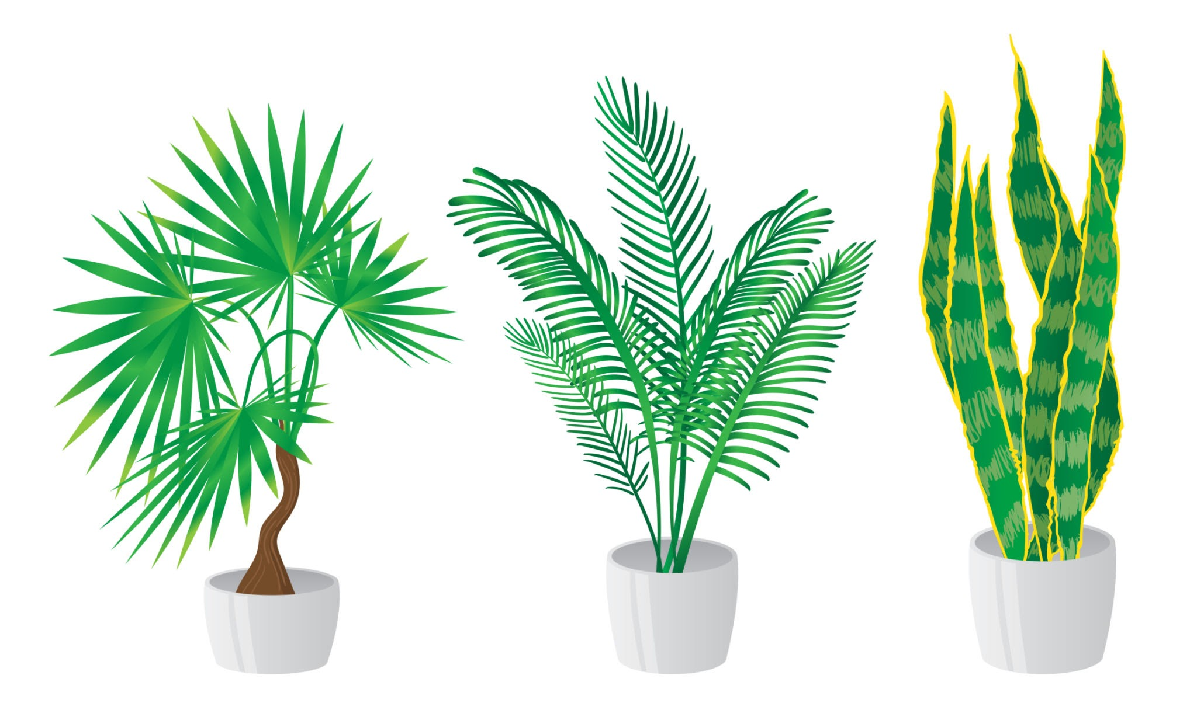
Materials
What materials will you use for your experiment? Be specific about amounts whenever possible.
Salt water.
6 of the same plants.
Fresh water.
Clear cups/pots.
Soil.
Sunlight.
Even amount of water for both” salt” and “fresh”.
Notes:
See D2L - Content - Designing Your Experiment

Slide 12
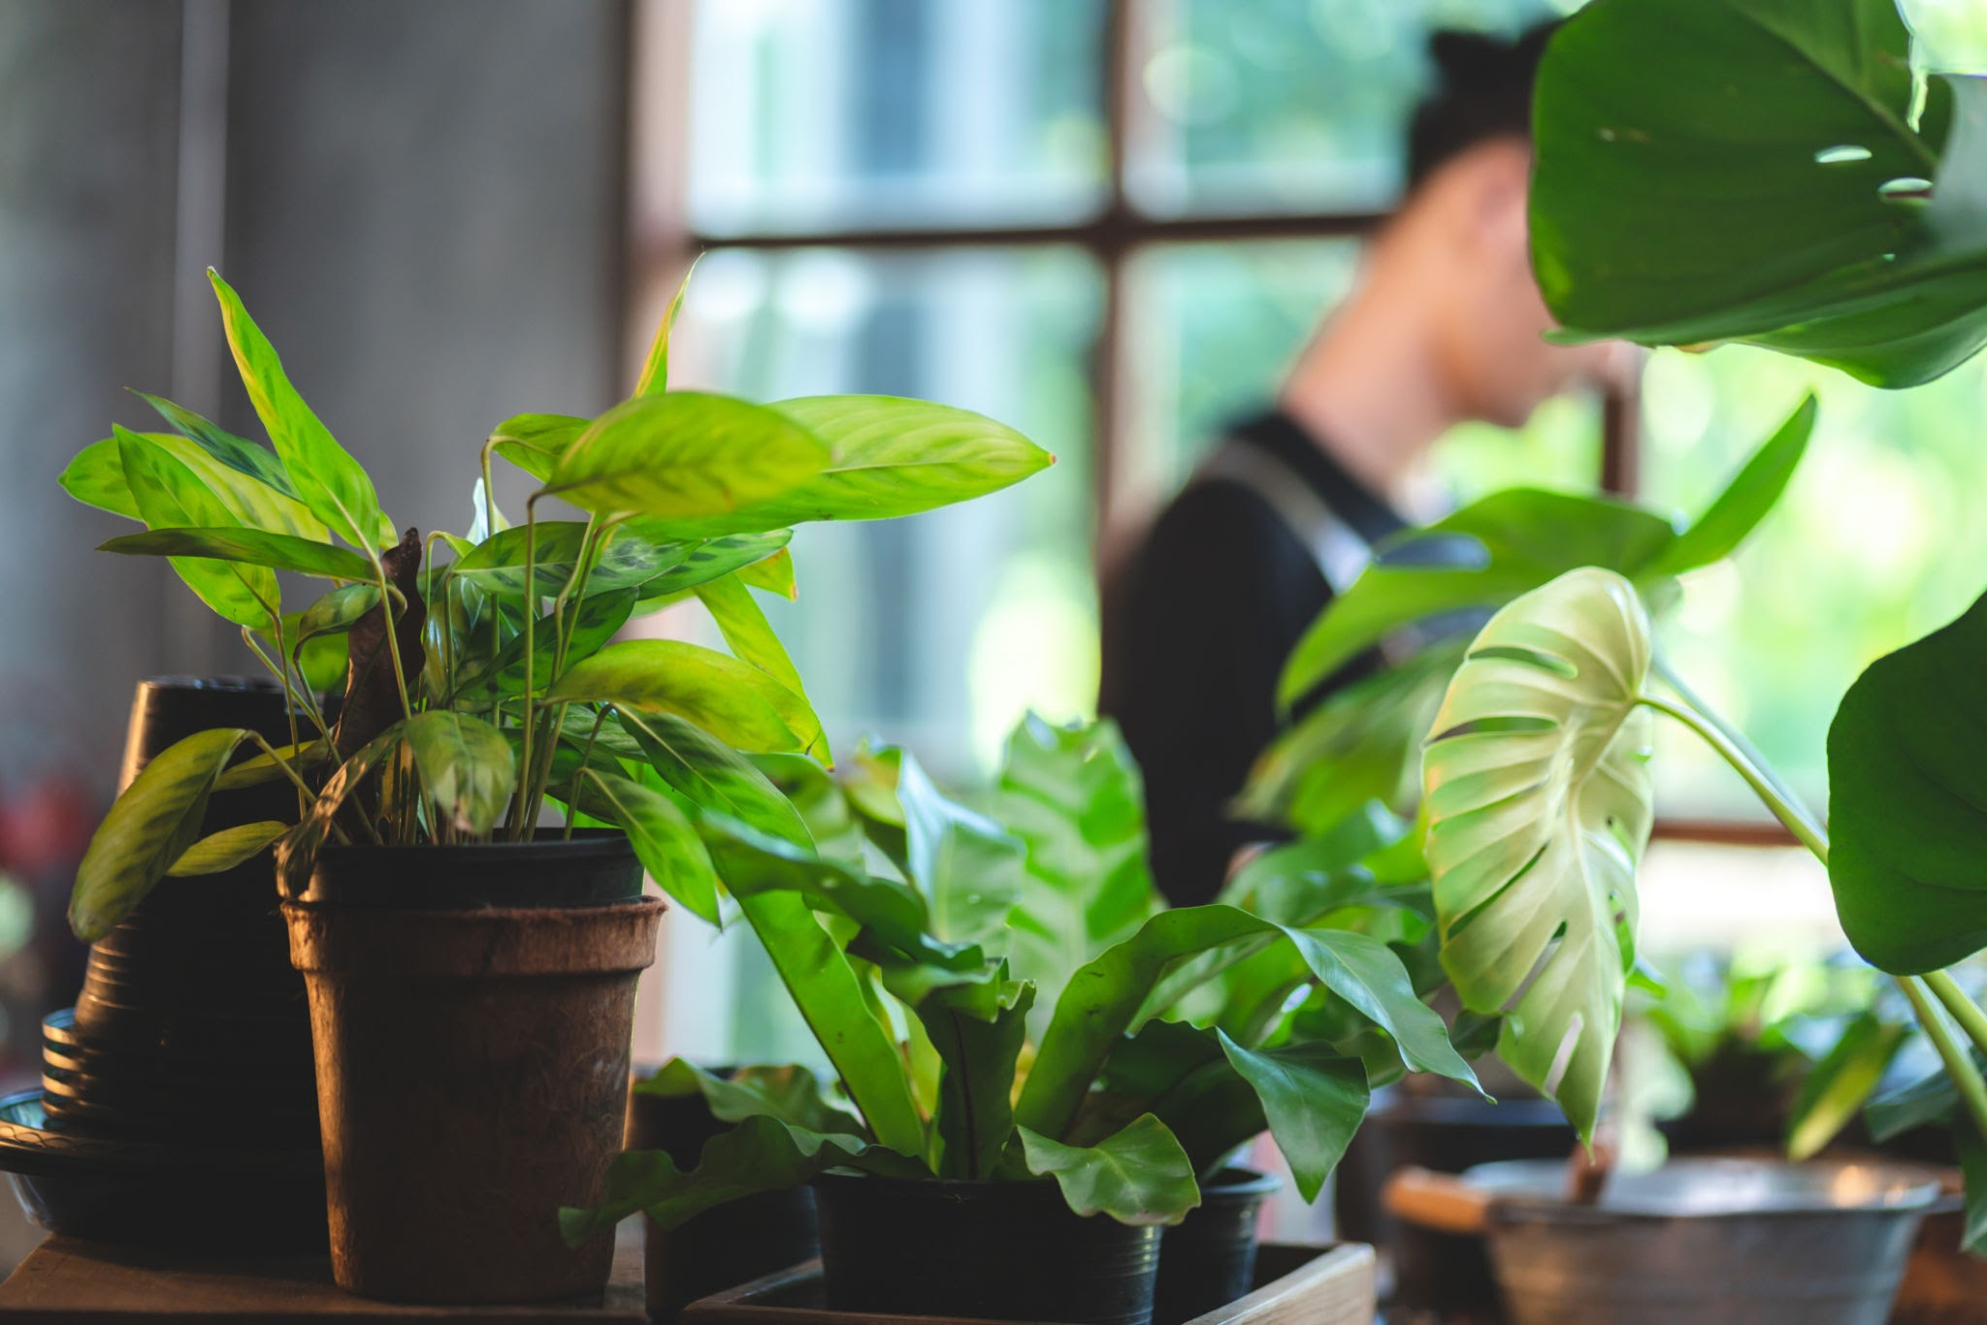
Procedure
List the step-by-step procedure you will follow to conduct your experiment. Be as specific as possible and include exact measurements, quantities, times, etc.
Here is are procedure step 1 to step 7.
Take 6 plants(2 plants for 3 trials).
Take 2 plants.
Label one fresh water,and other salt water.
Give both plants the water their supposed have amount.
Continue for 1 or 2 weeks.
see if results are correct .
Send to teacher.
Notes:
See D2L - Content - Designing Your Experiment

Slide 13
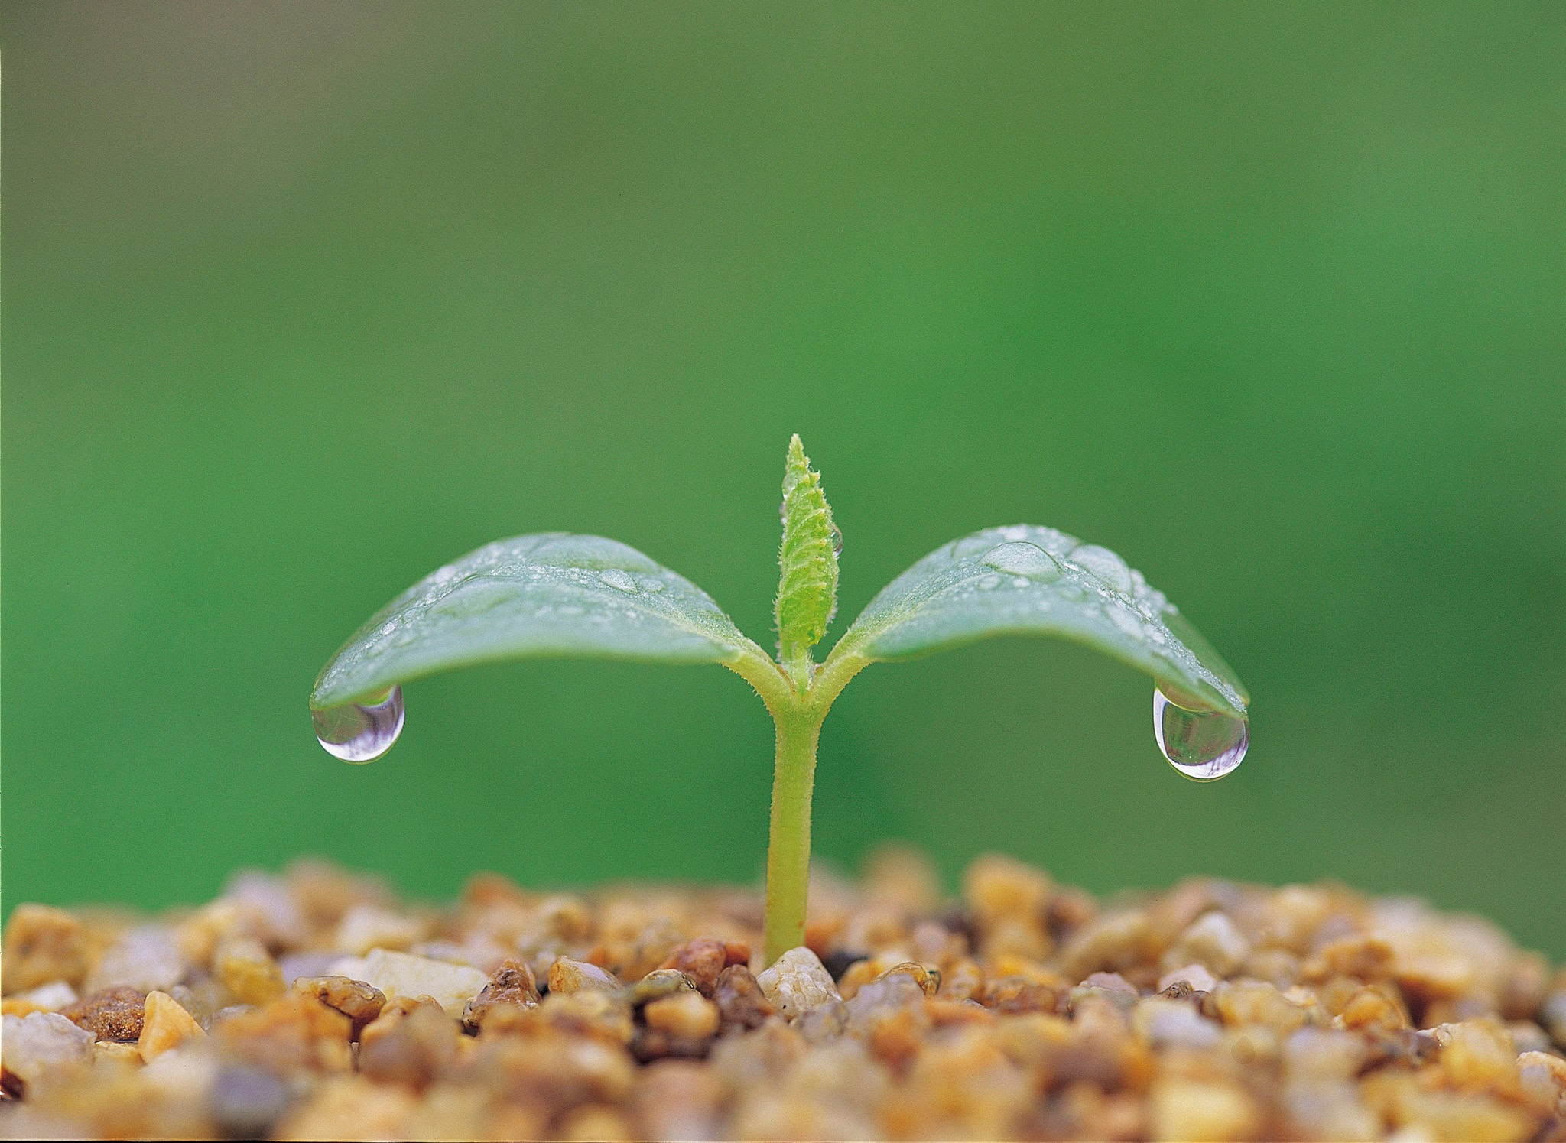
Experiment: Trial 1
Date:friday, feb, 27
Data: (measurements)
Observations:/Notes
We observe that the plants absolutely did not germinate.
But the water section looks like its about to pop out,for real!
Not germinate yet | Not germinate yet
Not germinate yet | Not germinate yet
Not germinate yet | Not germinate yet
Not germinate yet | Not germinate yet
Not germinate yet | Not germinate yet
Not germinate yet | Not germinate yet
Not germinate yet | Not germinate yet
Notes:
See D2L - Content - Designing Your Experiment

Slide 14
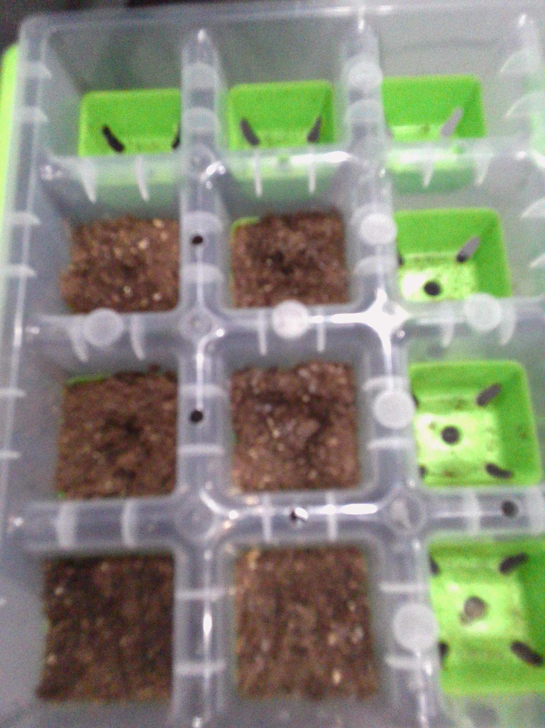
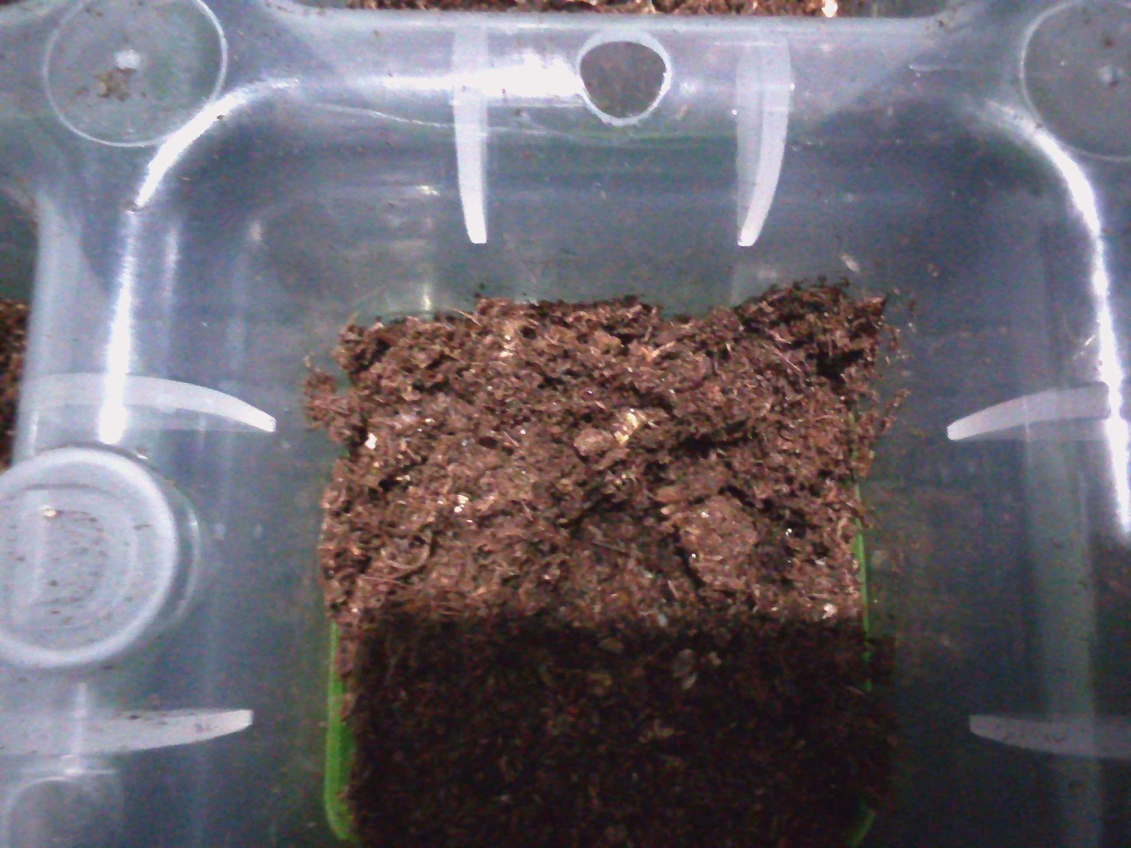
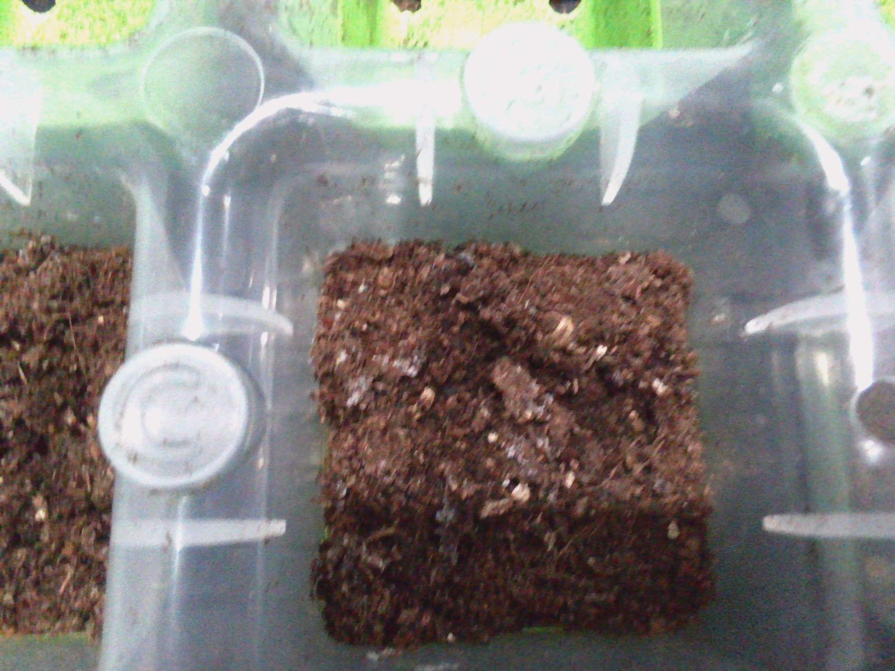
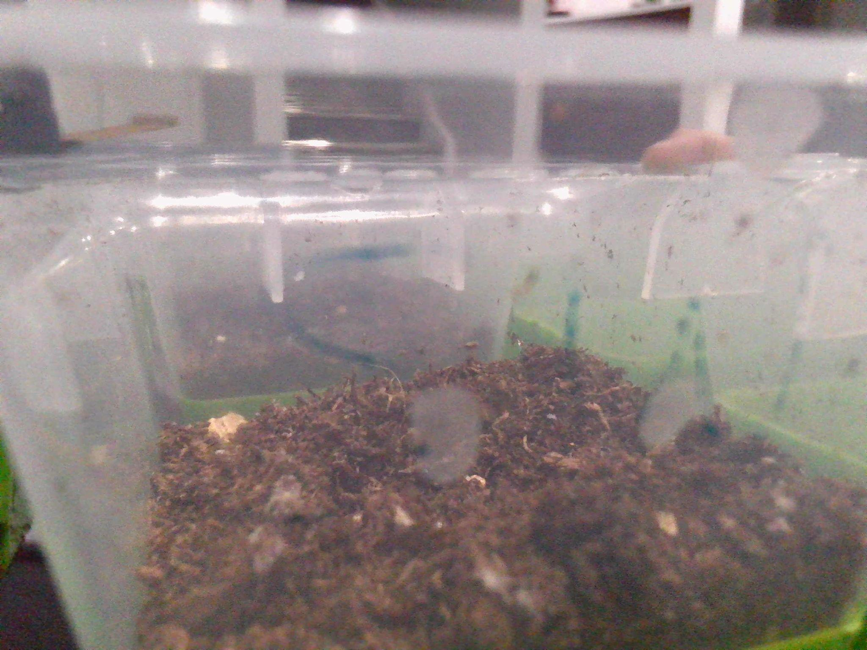
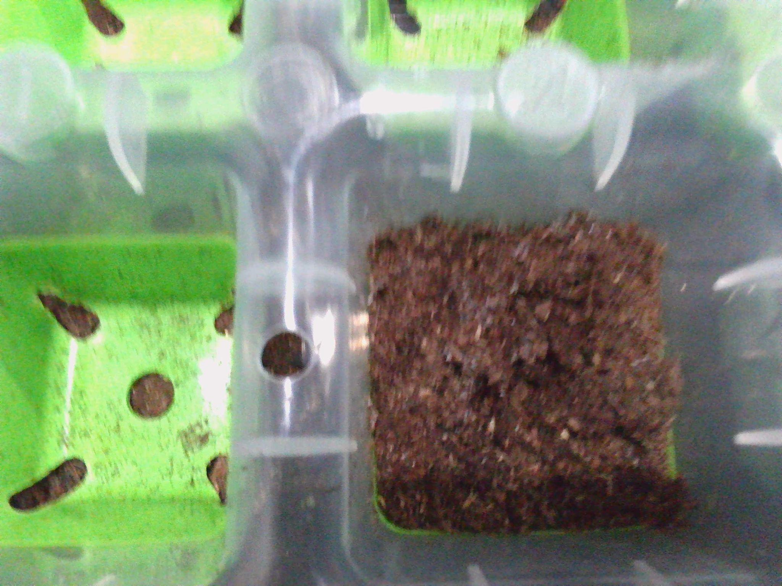
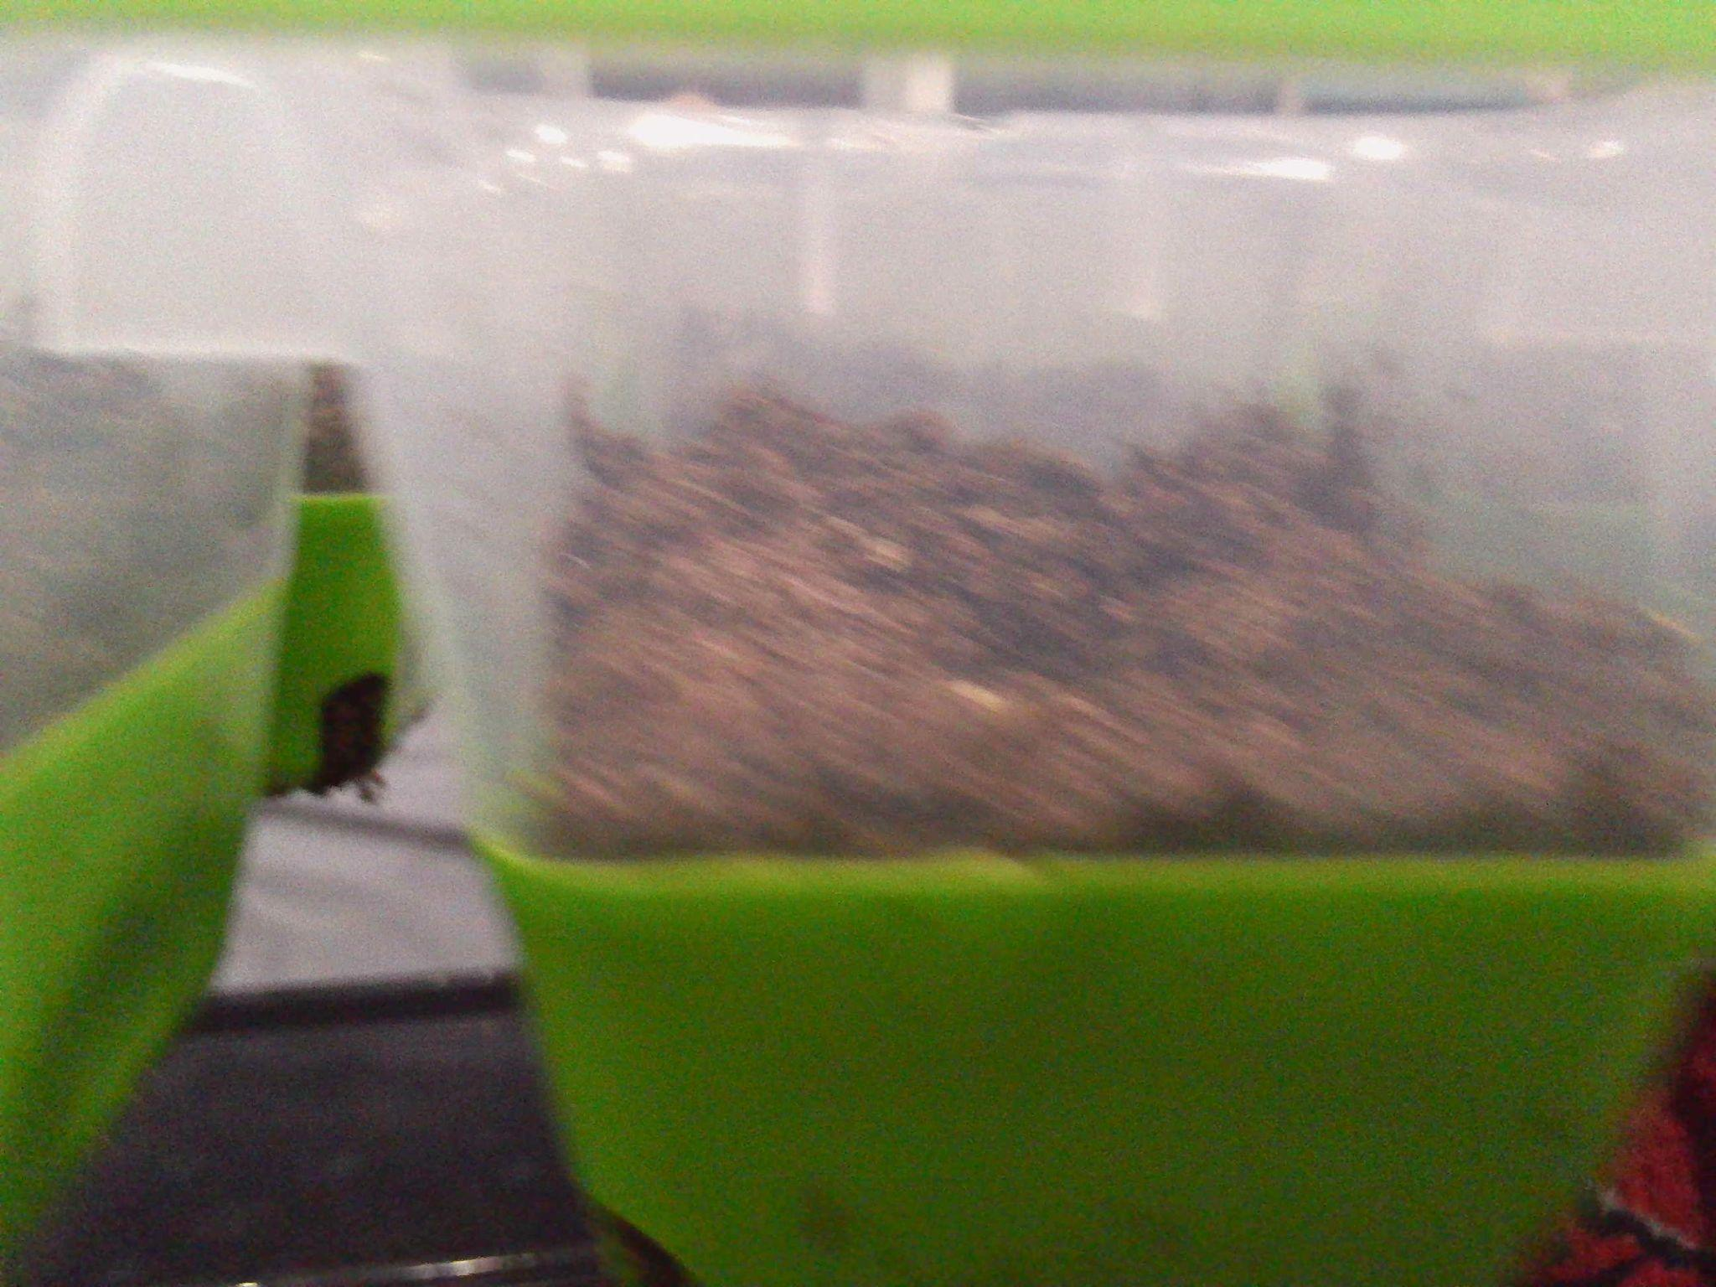
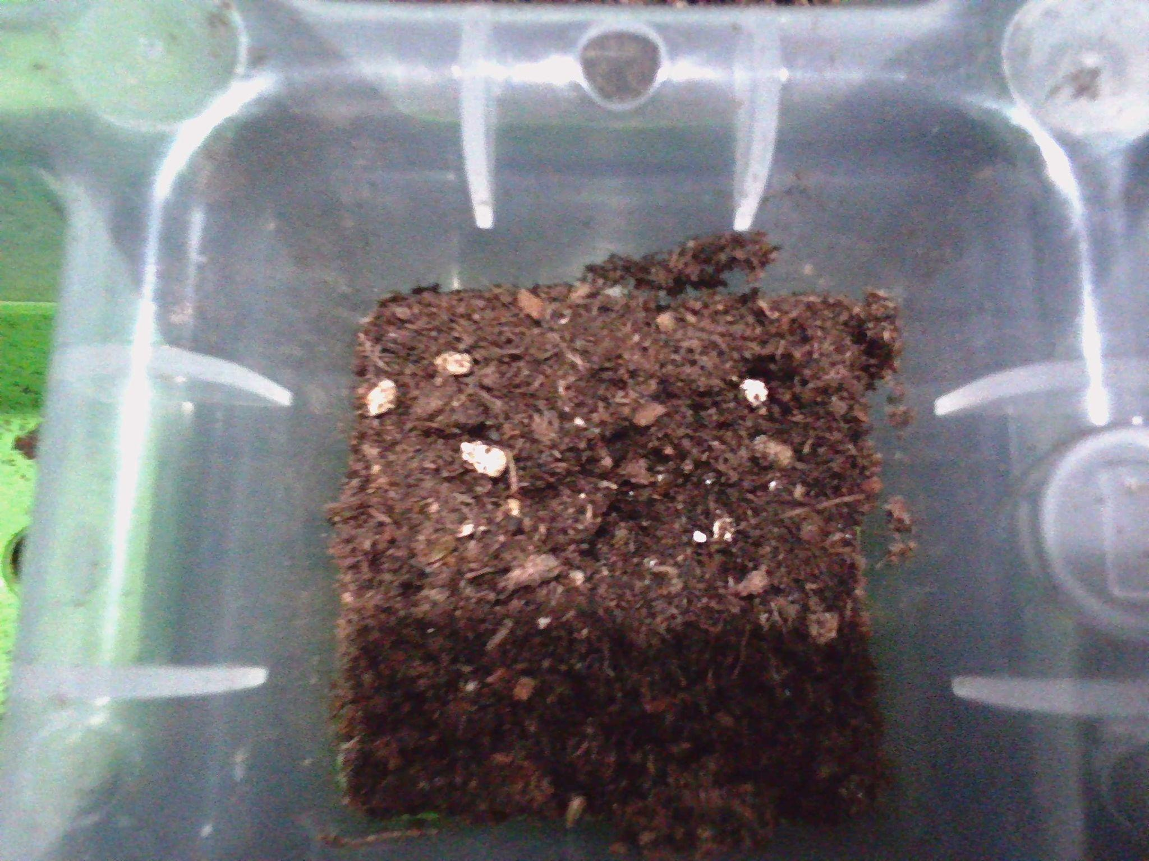
Experiment: Trial 1
Photos:
Notes:
See D2L - Content - Designing Your Experiment

Slide 15
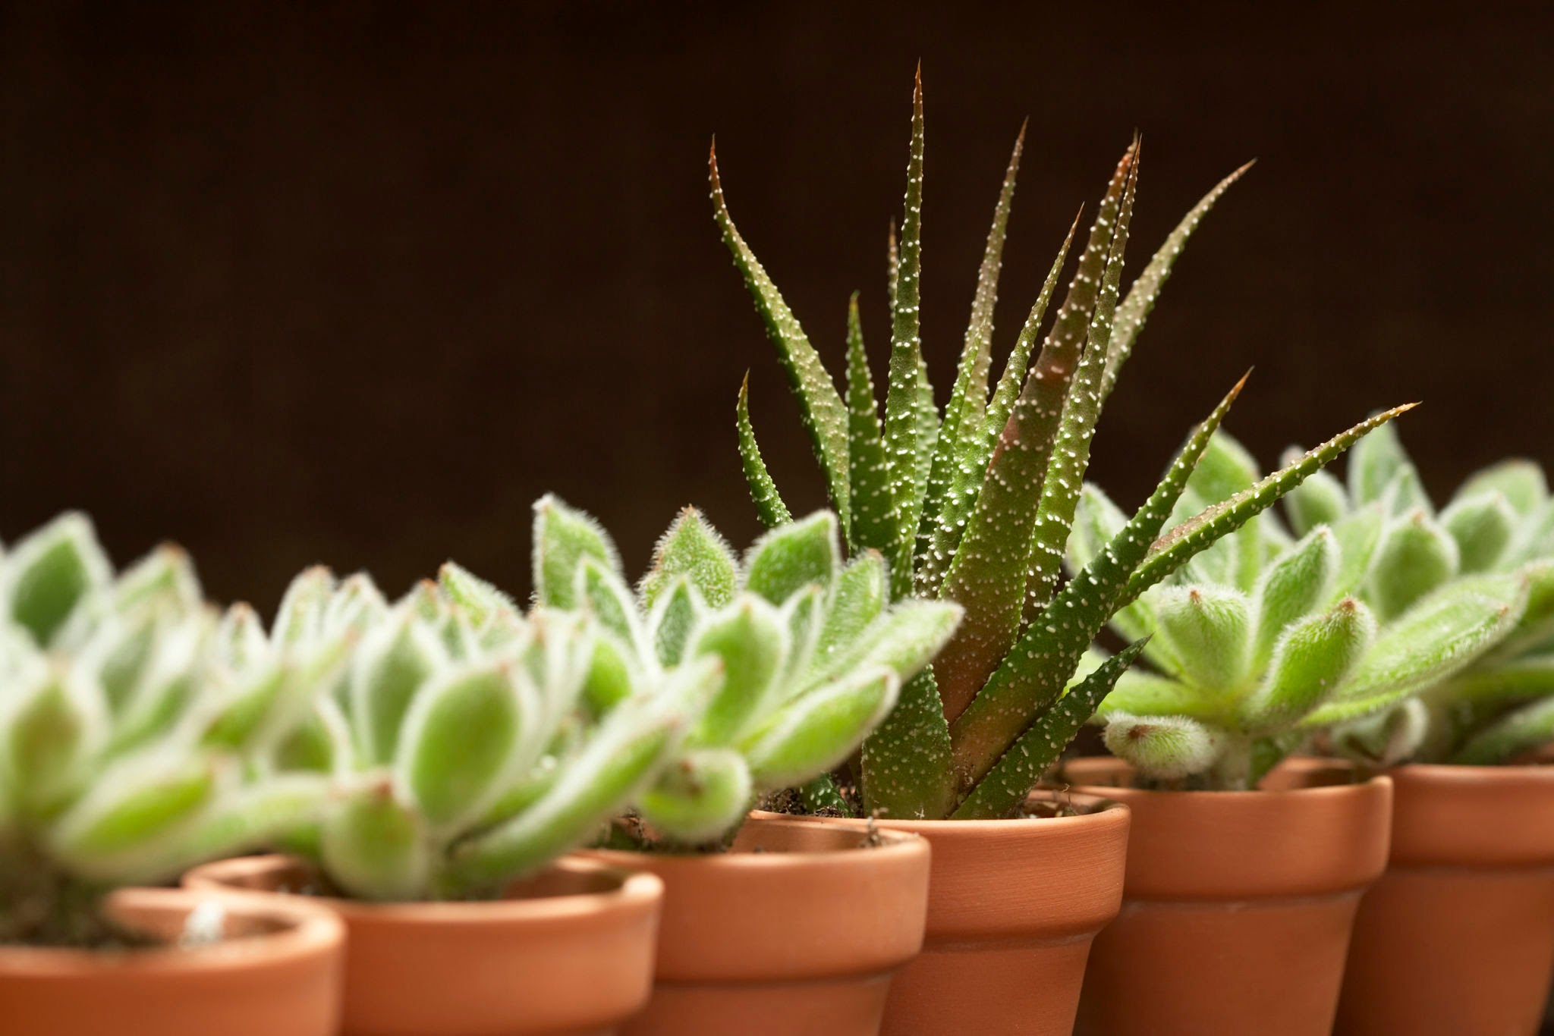
Experiment: Trial 2
Date:
Data: (measurements)
Observations/Notes
We observe that a few of the plants have cracks.
Not germinate yet:
Not germinate yet | Not germinate yet
Not germinate yet | Not germinate yet
Not germinate yet | Not germinate yet
Not germinate yet | Not germinate yet
Not germinate yet | Not germinate yet
Not germinate yet | Not germinate yet
Not germinate yet | Not germinate yet
Notes:
See D2L - Content - Designing Your Experiment

Slide 16
Experiment: Trial 2
Photos:
Notes:
See D2L - Content - Designing Your Experiment

Slide 17
Experiment: Trial 3
Date:
Data: (measurements)
Observations/Notes:
An observation that we made is that none of the plants have any part of their stem or petal that has shown itself.
Not germinate yet.
Not germinate yet | Not germinate yet
Not germinate yet | Not germinate yet
Not germinate yet | Not germinate yet
Not germinate yet | Not germinate yet
Not germinate yet | Not germinate yet
Not germinate yet | Not germinate yet
Not germinate yet | Not germinate yet
Notes:
See D2L - Content - Designing Your Experiment

Slide 18
Experiment: Trial 3
Photos:
Notes:
See D2L - Content - Designing Your Experiment

Slide 19
Results: Chart
Put your data together into a chart.
Example: (you can change the chart)
Trials | Week 1 Results | week 2 Results | Week 3 Results
Trial 1 | Didn't germinate | Cracks forming | More cracks forming
Trial 2 | Didn’t germinate | Cracks forming | More cracks forming
Trial 3 | Didn't germinate | Cracks forming | More cracks forming
Notes:
See D2L - Content - Designing Your Experiment
See D2L - Content - Conclusion, Application, and Extensions

Slide 20

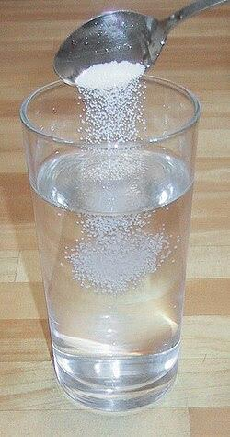
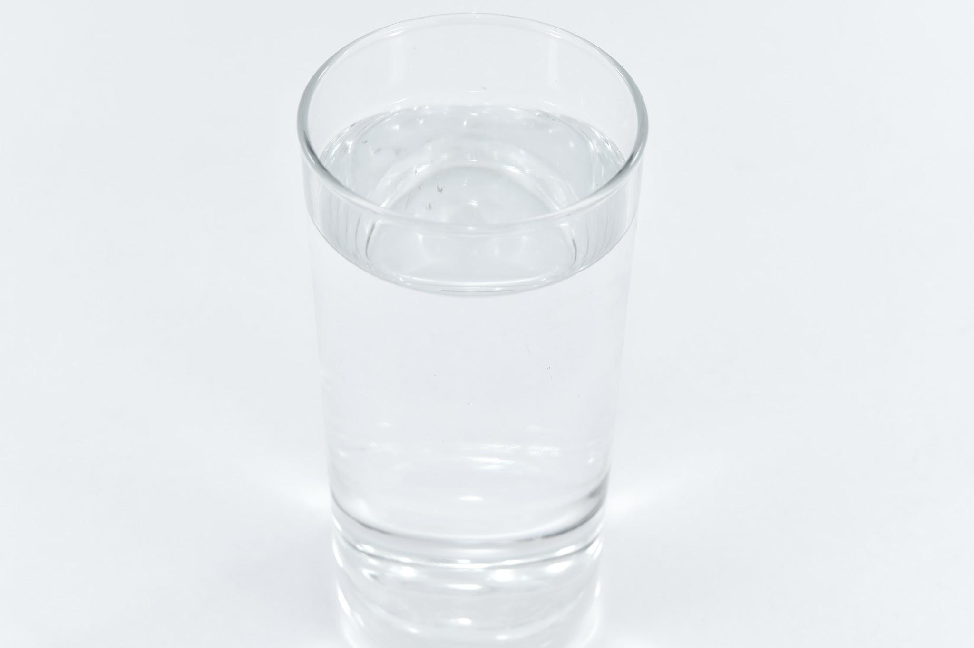
Results: Analyze
Look at your data and observations. Look for patterns and trends. Explain what happened in your experiment and what you found out:
We have analyzed that the plants are growing little cracks after we putted water daily for 4 times, morning afternoon,evening, and night time. We also let it fertilize in the sun every day.
Notes:
See D2L - Content - Designing Your Experiment
See D2L - Content - Conclusion, Application, and Extensions

Slide 21
Results: Graph
Graph your data for a visual display of your results.
Use Google Sheets or another website and copy the graph onto this slide, or draw by hand and upload a photo.
Ask your Science Fair teachers for help if you need it!
Notes:
See D2L - Content - Designing Your Experiment
See D2L - Content - Conclusion, Application, and Extensions

Slide 22
Conclusion
My question was:
How does the salt water affect plants?
The answer to my question is:
That fresh water was much better than salt water has a photosynthesis?
My hypothesis was correct because: The salt area did not grow because the salt water is not designed for plants and plants are not designed for salt water.
OR
My hypothesis was incorrect because: We were not incorrect.
Notes:
See D2L - Content - Conclusion, Application, and Extensions

Slide 23
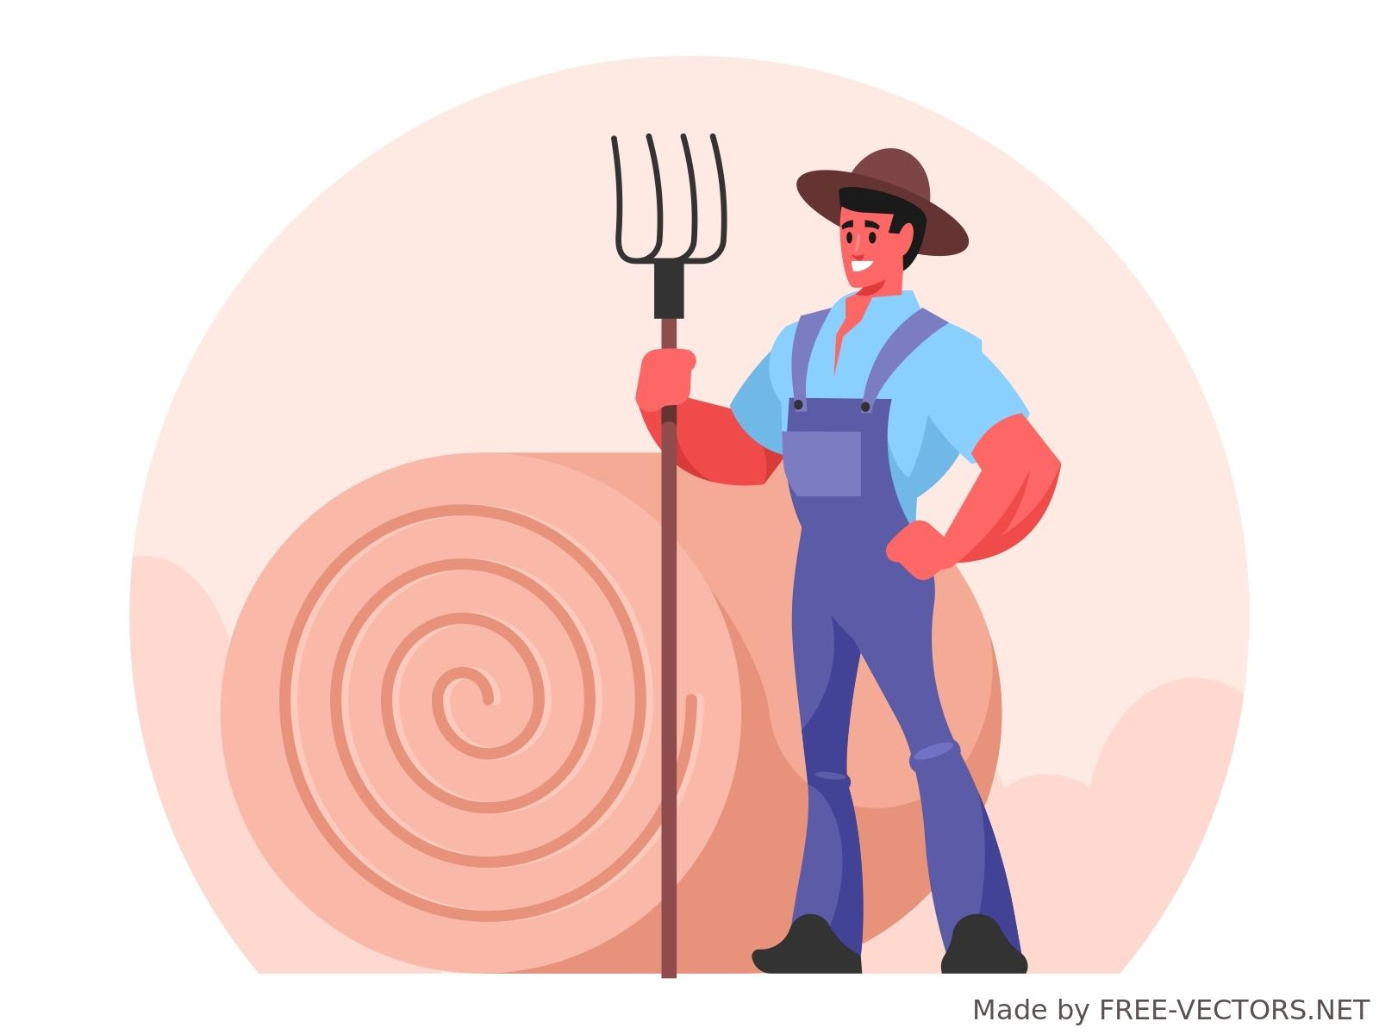
Applications
In what ways are your findings useful?
Who could benefit from your results and how?
It has been useful to farmers,people, and for a living things. So they can see what's better freshwater or saltwater for a fertilized photophysics for there plants. People like farmers and more can see your slides that we made and reflect on it.
Notes:
See D2L - Content - Conclusion, Application, and Extensions

Slide 24
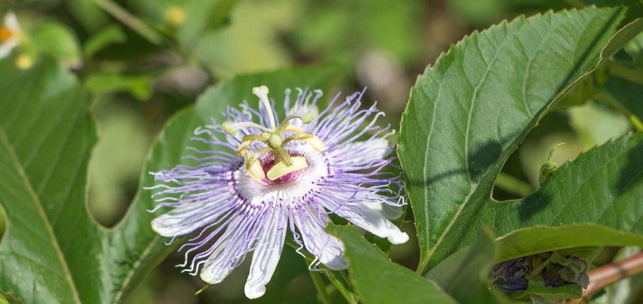
Sources of Error
Do you think your results were reliable? Were there any other factors or conditions that could have affected the results of your experiment in unexpected ways?
What could have affected your results, that would need to be controlled differently if you were to repeat the experiment?
First we got the wrong amount of plants. Then we got the correct amount of plants.we also watered the plants late to the due date.
Notes:
See D2L - Content - Conclusion, Application, and Extensions

Slide 25
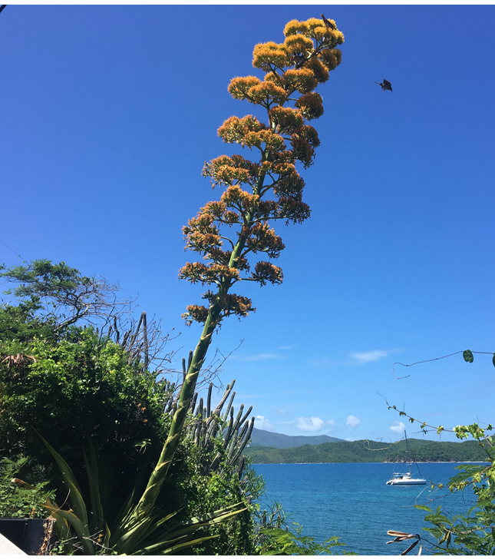
Extensions
If you were to conduct this experiment again, what would you do differently?
Maybe learn the plant earlier and not later closer to the deadline.
Notes:
See D2L - Content - Conclusion, Application, and Extensions

Slide 26
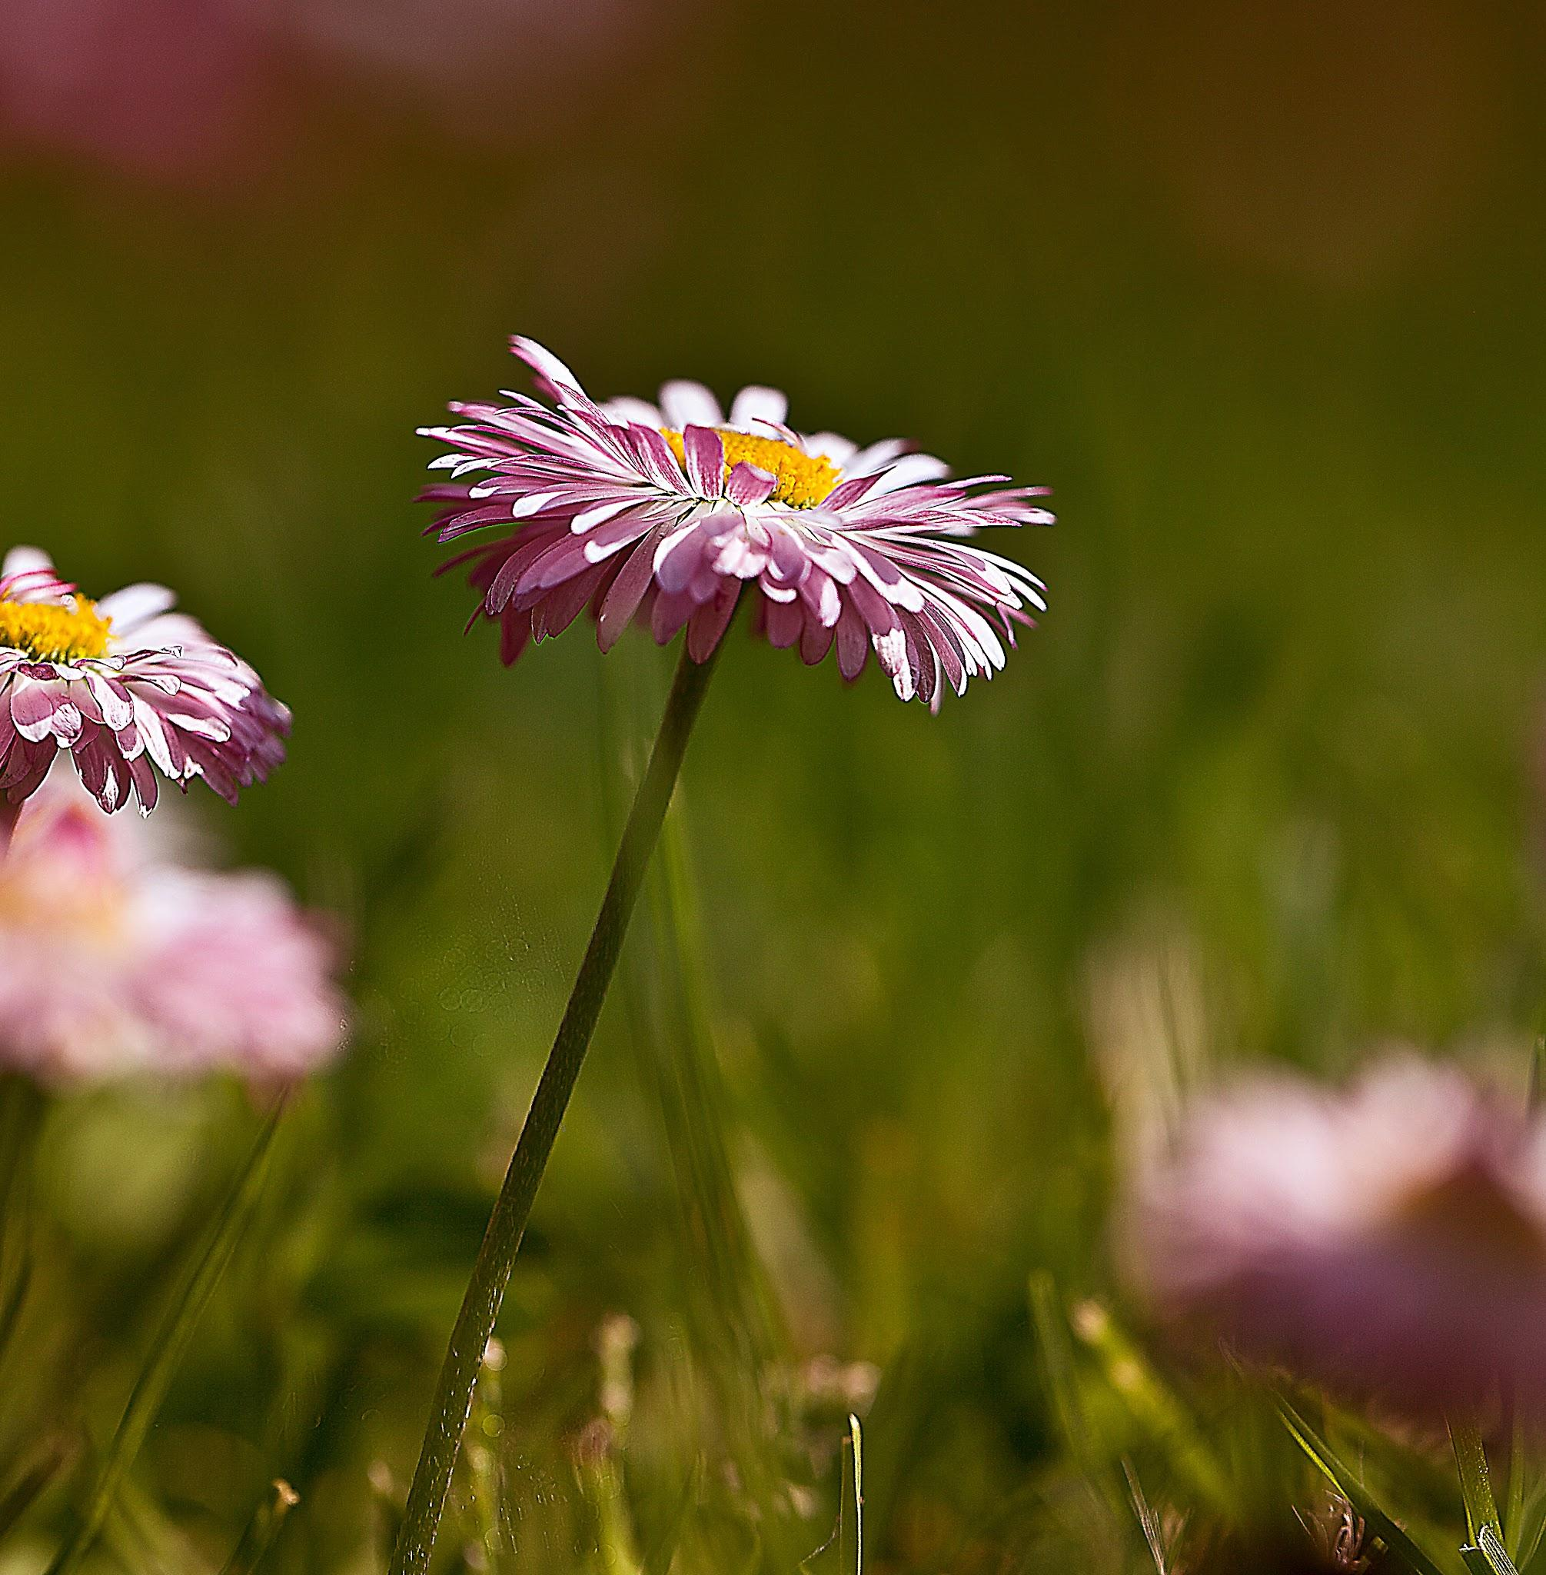
Extensions
Because of the results of this experiment, I wonder…
Describe further experiments that could be conducted to further investigate and understand your topic:
.is there another type of water that we can use for the future?
Notes:
See D2L - Content - Conclusion, Application, and Extensions

Slide 27



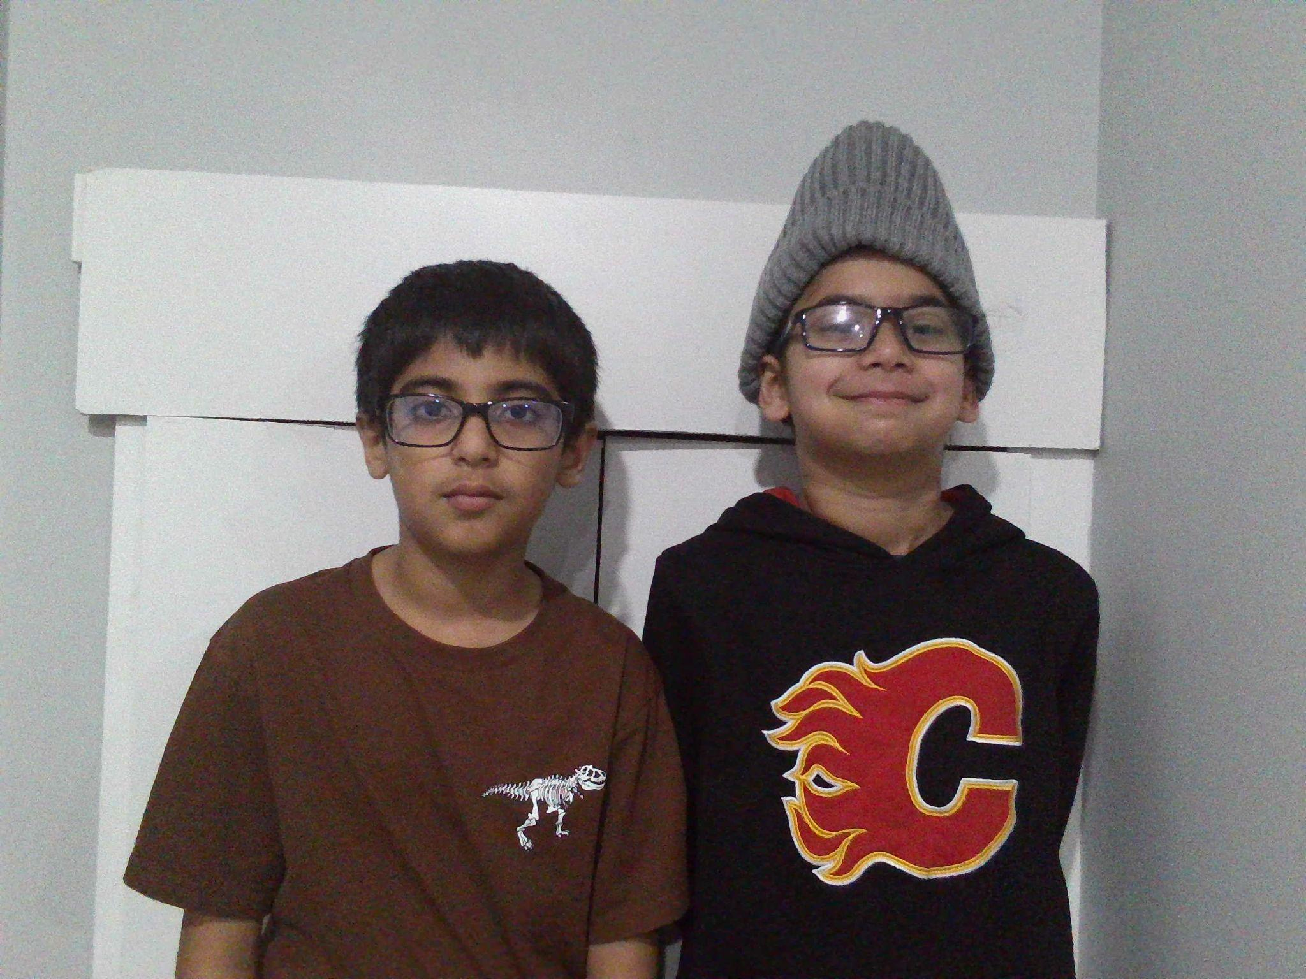
CONGRATULATIONS!!
You have completed your experiment!
Make sure that you enter information from this logbook into the CYSF Digital platform.
You are now ready to create your tri fold display and practice your presentation.

