Slide 1
PUMPED STORAGE HYDROPOWER

Slide 2
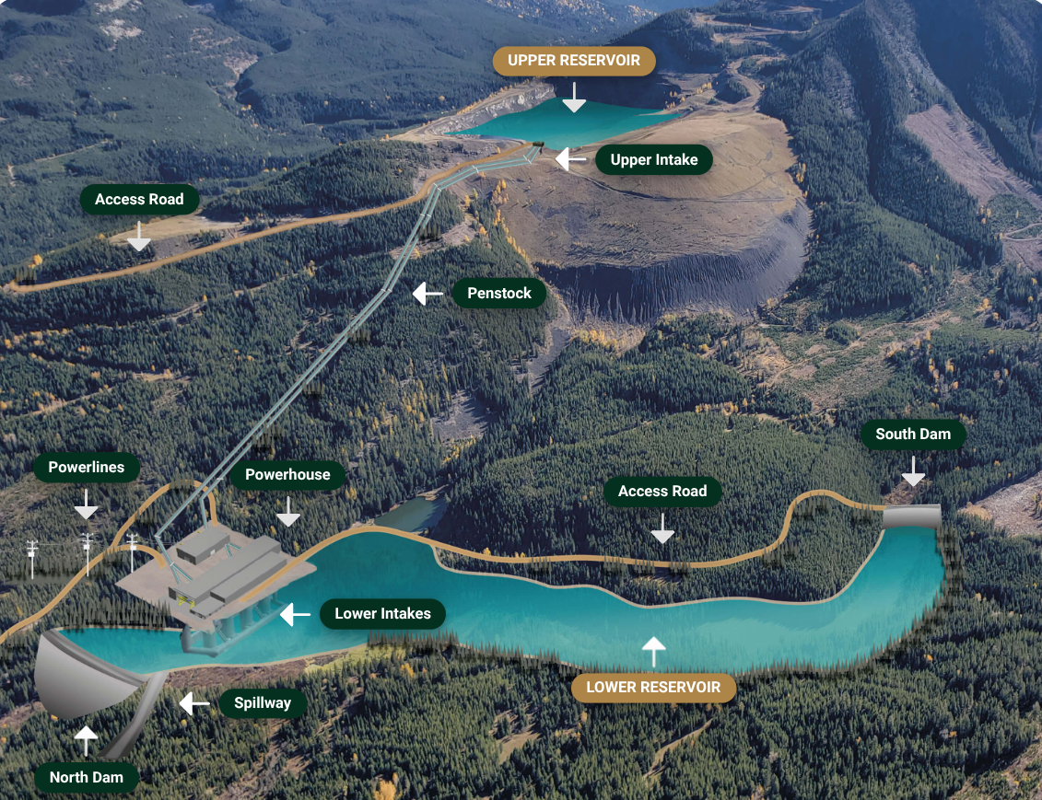
INTRODUCTION
My project aims to study and increase awareness about Pumped Storage Hydropower (PSH) as an energy storage method to increase the reliability of renewable energy.
This method provides a backup for solar and wind power when the wind isn’t blowing and the sun isn’t shining.
Fig 1. Planned PSH plant in Tent Mountain, AB

Slide 3
INDEX
Energy Demand
Renewable Energy Output
Energy Demand and Renewable Energy Supply
Pumped Storage Hydropower: Energy Storage Method
PSH: Animation Model
PSH: Advantages & Disadvantages
Global PSH Outlook
Canada’s PSH Capacity
Conclusion
References

Slide 4
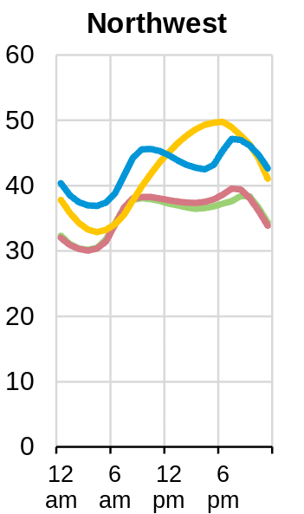
ENERGY DEMAND
Energy demand isn't constant throughout the day.
High during morning as people get to schools, offices and factories for the day.
Higher in evening as people need electricity for lighting, cooking other chores.
Low during night as everyone is sleeping with offices and factories closed.
GWh
Fig 2. Shows typical daily energy demand curve in North-West US with seasonal variation following the same trend except in summer where energy demand increases from morning to evening due to additional air conditioning requirements.

Slide 5
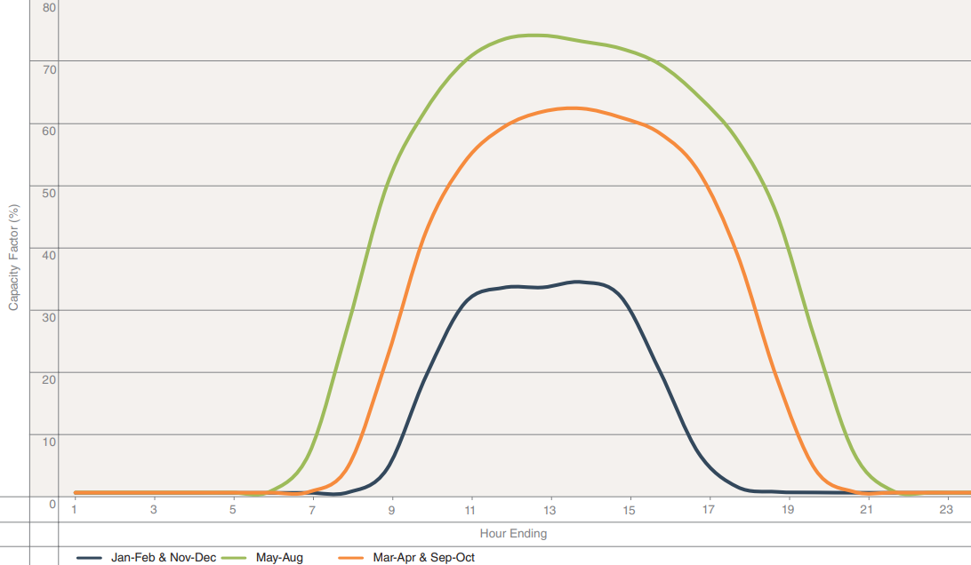
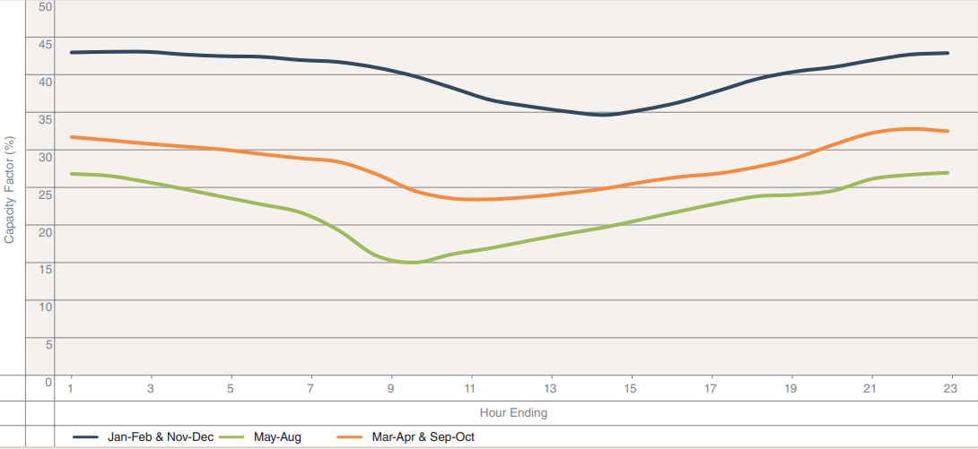
RENEWABLE ENERGY OUTPUT
SOLAR ENERGY
WIND ENERGY
Fig 3: The solar output curve changes through the day depending on sunlight hours (6am-10pm during summer & 8am- 6pm during winter) as shown above. The peak time is from 11am to 3pm.
Fig 4: The wind energy output changes through the day because the wind is blowing all day but the wind is stronger at some times of the day as shown above and at a certain time of day the winds are very weak.
It can be observed from the output curves for solar and wind that they complement each other. In winter when sunlight hours are less, wind energy output is highest. In summer when wind energy output is lowest, solar output is highest.

Slide 6
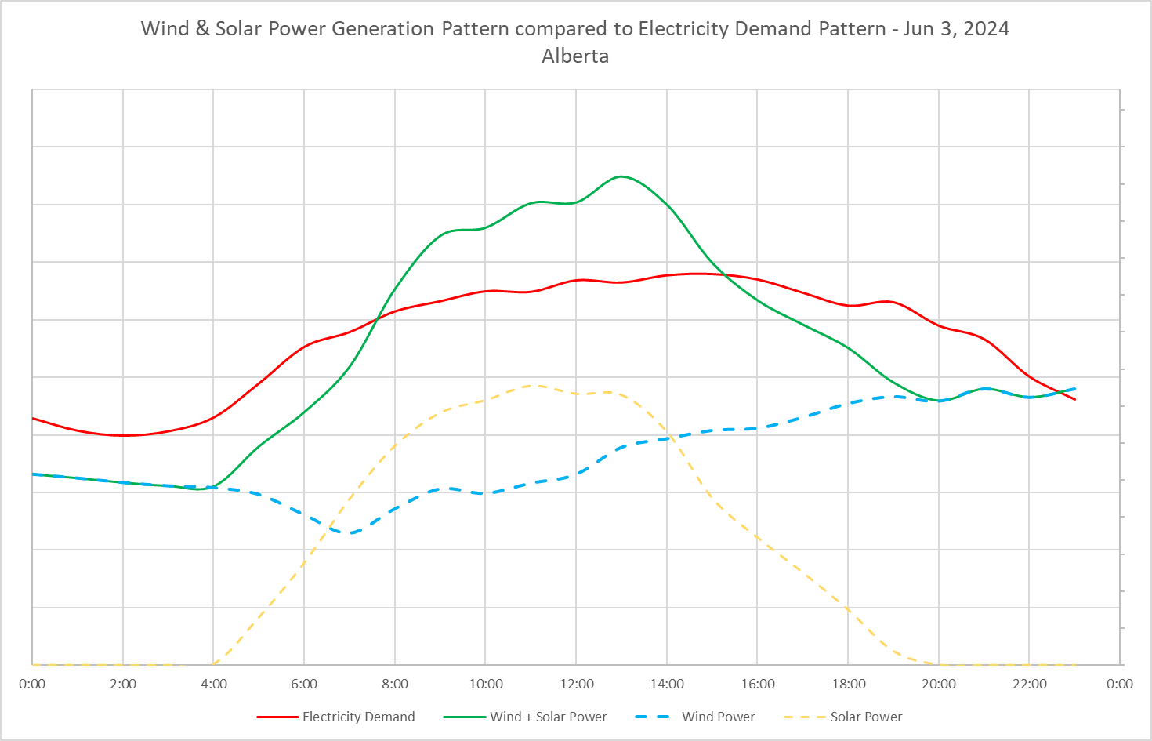
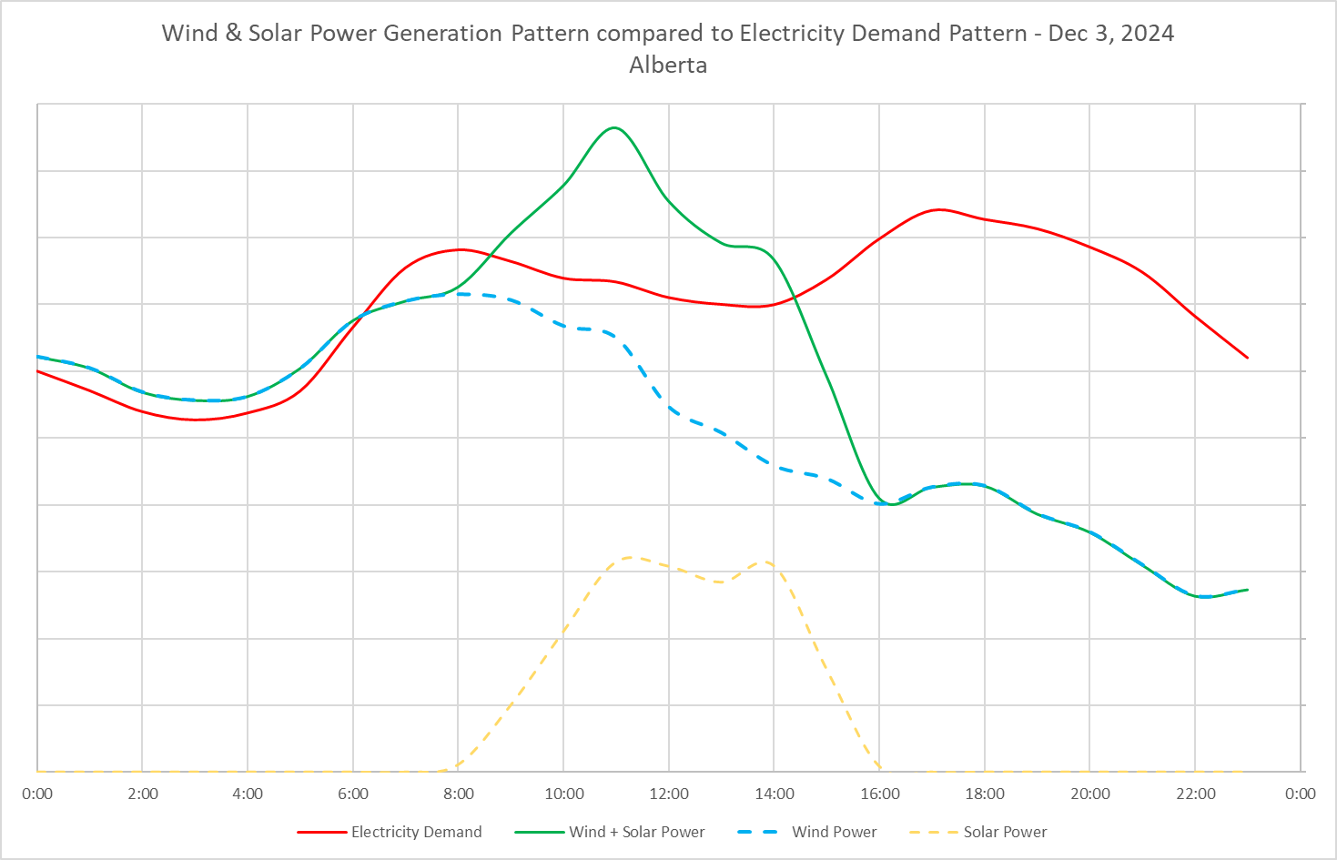
ENERGY DEMAND VS RENEWABLE ENERGY (WIND & SOLAR) SUPPLY
Fig 5. Shows electricity demand and solar+wind power pattern through a typical Summer day
Fig 6. Shows electricity demand and solar+wind power generation pattern through a typical Winter day
The graphs above show that energy demand isn't constant but keeps changing throughout the day. Total renewable energy output, like wind and solar also keeps changing throughout the day which creates times of excess energy and times of lack of energy. Therefore, in order to reliably meet electricity demand, an energy storage method is essential to store energy during times of excess energy and generate energy during times of lack of energy.

Slide 7
ENERGY STORAGE METHOD : PUMPED STORAGE HYDROPOWER (PSH)
Pumped Storage Hydropower is an energy storage method using gravity and water and works like a gigantic water battery.
This system consists of
Two reservoirs of water: one is at a higher elevation and one is at a lower elevation. The reservoirs can be of two types: Open loop where either an upper or lower reservoir that is connected to a naturally flowing water body like a river. Closed loop is an “off river” site that produces energy without it being connected with a natural inflow like a river.
Turbine : when water flowing from upper to lower reservoir spins the turbine it generates electricity. The size of the turbine depends on how much energy you can generate.
Pump: when water is pumped back up to upper reservoir from lower reservoir.

Slide 8
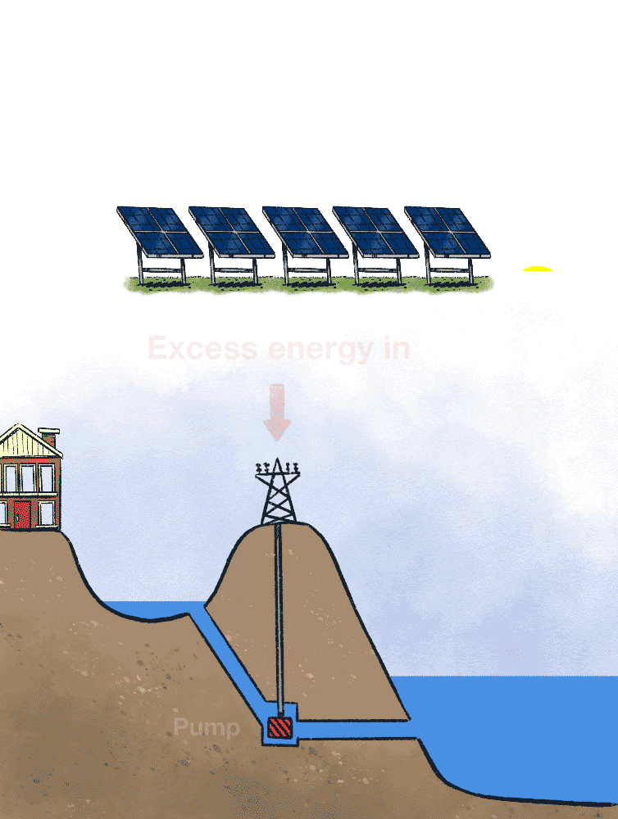
PSH ANIMATION MODEL
How is energy stored?
When less electricity is needed, such as at night OR when there is excess energy from wind or solar power plants, a pump moves water from the lower reservoir up to the higher one. This upward flow of water by the pump enables storage of the excess electricity, which can be re-generated by downward flow of the water when needed. The pump uses excess power from solar and wind to work the pump and transfer the water from the lower reservoir to the upper reservoir
How is energy generated?
When more electricity is needed OR when there is no wind or sunlight, water is allowed to flow from the upper reservoir down to the lower reservoir. This downward flow of water through a hydro-turbine generates electricity. Any extra power can be stored and can be re-generated when needed.

Slide 9
ADVANTAGES AND DISADVANTAGES OF PSH
ADVANTAGES
DISADVANTAGES
Low operating cost and long service life
Renewable and sustainable
Minimal environmental effects
Controllability
Recreational activities
Water supply and flood control
Very expensive startup cost
You don't get all the stored energy back
Affects aquatic life
Impact on water quality
Climate Dependant
Threat to habitats

Slide 10
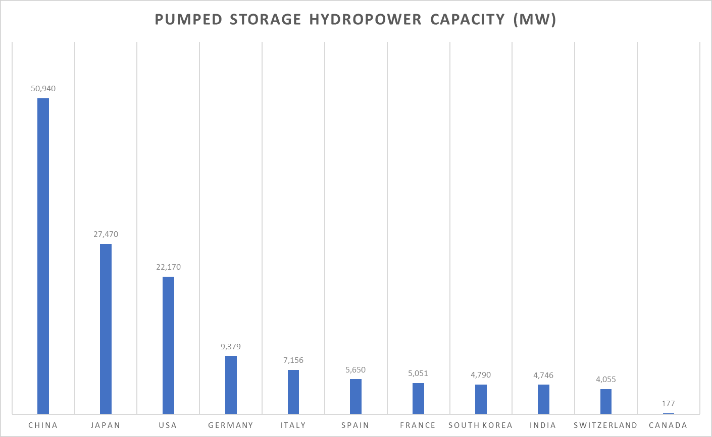
GLOBAL PSH OUTLOOK
Fig 7 Shows current pumped storage hydropower capacity in MW of the top ten countries that contribute about 80% of the world’s PSH capacity. Canada has 177 MW capacity of PSH.

Slide 11
CANADA’s PSH CAPACITY
PSH Project Name | Province | PSH Capacity (MW)
Canyon Creek PS | Alberta | 75
Meaford PS | Ontario | 1000
Marmora PS | Ontario | 400
Schreiber PS | Ontario | 333
Steep Rock PS | Ontario | 900
Tent Mountain PS | Alberta | 320
Hydro Battery PS | British Columbia | 4000
TOTAL |  | 7,028
Fig 8. Shows some PSH projects currently being developed in Canada.

Slide 12
CONCLUSION
The on-demand generation and storage of electricity increases the reliability of renewable energy sources (wind and solar).
PSH is by far the most popular and widely used energy storage method in the world, with some projects in operation for almost 100 years. In North America, it accounts for more than 95% of large-scale energy storage.
PSH can achieve 85% efficiency for energy storage.
Battery Energy Storage (BES) is the next popular energy storage method, where Lithium ion batteries are used in 90% of the projects. BES can achieve 95% efficiency for energy storage.
Amount of energy a PSH power plant can store depends on the size of the reservoirs and the height difference between the upper and lower reservoirs. For example, a facility with two reservoirs roughly the size of two Olympic swimming pools, and a 500 metre height difference between them, could provide a capacity of 3 megawatts (MW) and store up to 3.5 megawatt hours (MWh) of electricity. This can power 6 Alberta homes for 1 month.

Slide 13
REFERENCES
Fig 1: https://evolvepoer.ca/what-we-do/tent-mountain-pumped-hydro-energy-storage/
Fig 2: https://www.eia.gov/todayinenergy/detail.php?id=42915
Fig 3: https://www.aeso.ca/assets/Uploads/market-and-system-reporting/Annual-Market-Stats-2023_Final.pdf
Fig 4: https://www.aeso.ca/assets/Uploads/market-and-system-reporting/Annual-Market-Stats-2023_Final.pdf
Fig 5: https://www.aeso.ca/market/market-and-system-reporting/data-requests
Fig 6: https://www.aeso.ca/market/market-and-system-reporting/data-requests
Fig 7: https://www.hydropower.org/publications/2024-world-hydropower-outlook
Fig 8: https://waterpowercanada.ca/wp-content/uploads/2023/08/stantec_ps_final_en.pdf
https://waterpowercanada.ca/wp-content/uploads/2023/08/stantec_ps_final_en.pdf
https://www.hydropower.org/factsheets/pumped-storage
https://www.eia.gov/kids/energy-sources/hydropower/#:~:text=Pumped%2Dstorage%20hydropower%20facilities%20are,located%20 below%20the%20 upper%20 reservoir.I
https://www.energy.gov/eere/water/how-pumped-storage-hydropower-works
https://pumpedhydro.com.au/education/pumped-storage-hydropower-advantages-and-disadvantages/
https://www.energy.gov/eere/water/pumped-storage-hydropower-animation
https://theconversation.com/five-gifs-that-explain-how-pumped-hydro-actually-works-112610
https://www.eesi.org/papers/view/energy-storage-2019

