Slide 1
Jellyfish
Floating through time for over 500 million years
Mika Kawai & Chloe Leung

Slide 2
Problem
How do jellyfish function without organs that are essential for humans?

Slide 3
Hypothesis
We think jellyfish can function without organs because they have “smart” nerves that have replaced their organs. We also think their nerves interact with their environment, through reflexes and instincts. For example:
A baby will stop touching things that will burn them (reflex)
They will also run when something is scary (instinct)

Slide 4
Our Focus
To answer our problem, we will be looking at the following:
Nervous System
Respiratory System
Regeneration and Immortality
We think these systems have the biggest impact on humans, and so these are the ones we will be looking at.

Slide 5
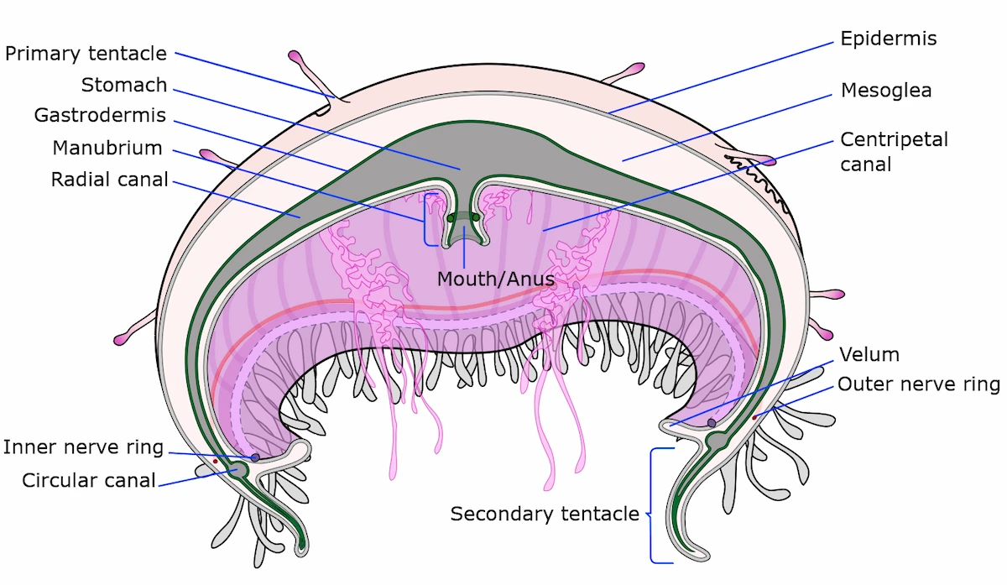
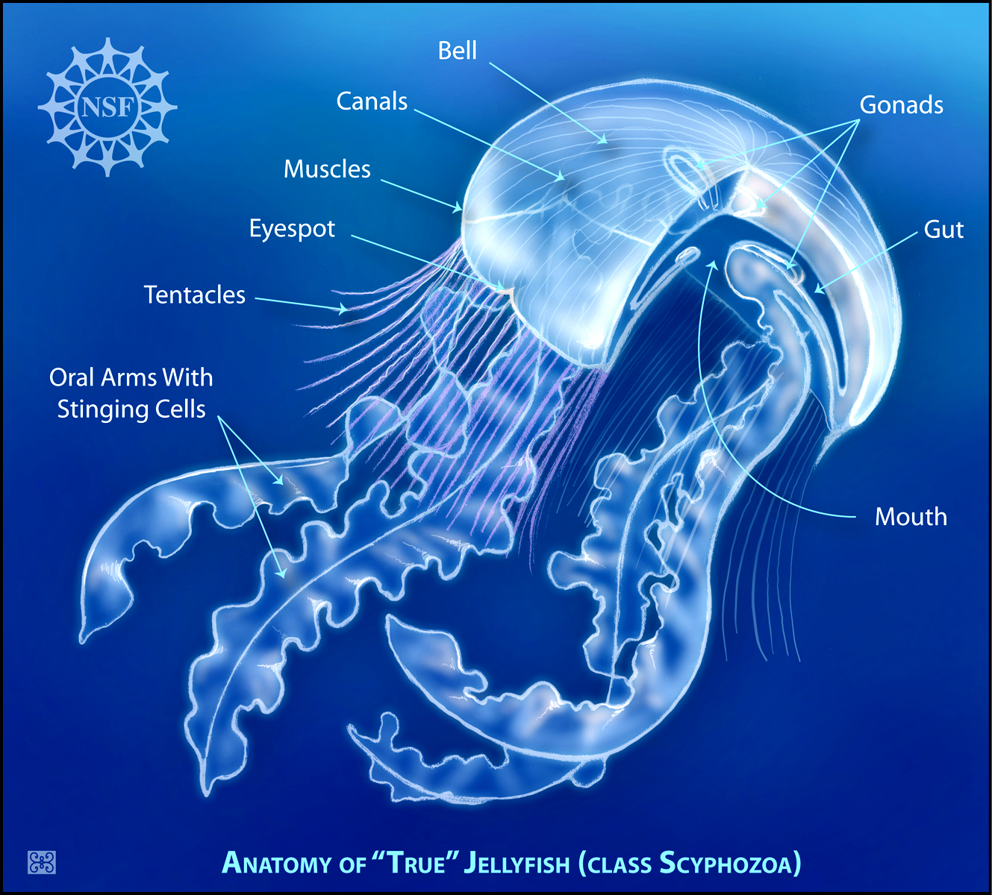
What Are Jellyfish Made Of?
A jellyfish has three layers of “skin”:
the epidermis, the thin outside layer
the mesoglea, the thick, squishy middle layer
the gastrodermis, the innermost layer
They also have:
A very basic nervous system, to react to stimuli
Digestive cavity, being both its stomach and intestine, with (only) one hole for the mouth and anus
Tentacles to move
Oral arms for protection
No brains, hearts, lungs, or blood
In fact, jellyfish are 95% made of water, meaning they don’t actually have a lot of solid material in them.

Slide 6
Background
Jellyfish…
Have been around for about 500-700 million years (Precambrian Era)
Survived five mass extinctions, one of which killed 70% of life on Earth
Survived three ice ages
Went through extreme changes in their environment caused by
Natural disasters
Asteroids
Urbanization and pollution
Come from the phylum Cnidaria
One of the oldest branches of the animal family tree
Includes anemones and corals
Most likely the first muscle-powered swimmers
Before jellyfish most organisms were moved by the environment and not of their choosing
So how did the jellyfish, such simple organisms, survive all this time?

Slide 7
How Jellyfish Survived
Scientists suggest…
Survival of the fittest
those with superior genes better fit for the environment will survive better than those who don’t. (In the fifth edition of “On the Origin of Species” by Charles Darwin(1869)
Evolution
We think they have evolved to have these superior genes that are fitted for the environment, over an extremely long period of time
In fact, we think jellyfish are still evolving today

Slide 8
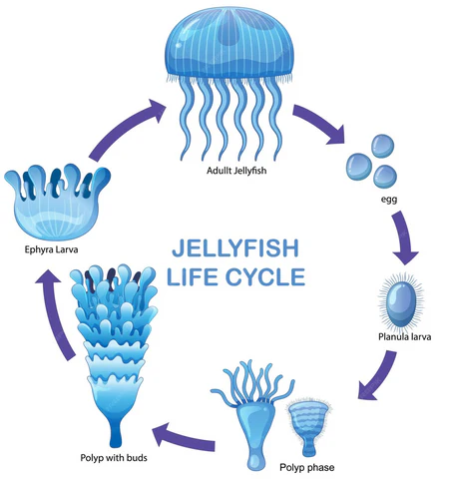
Evolution
Scientists studying the moon jellyfish (Aurelia aurita) hypothesize two possible evolutions for how the jellyfish developed the genes that have kept them alive and reproducing for so long.
Non-moving to moving
Most scientists believe they did not move at first, kind of like a coral, and at some point evolved to have a nervous system, muscles, and weaponry, which allowed them to move.
Moving to non-moving
Others believe that jellyfish and other species in the phylum Cnidaria were first muscle-powered carnivores, but over time some of the species like corals and anemones lost the ability to move (lost medusa life stage).

Slide 9
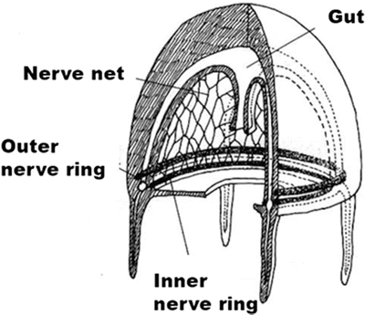
Nervous System
Jellyfish don’t have a brain, but they can still learn and remember
Jellyfish can remember past experiences and learn from them
Like if humans did something over and over, their muscles can remember, like how athletes remember posture or dancers remember choreography
Insead of a brain, jellyfish have a nerve net or nerve ring
These detect changes in their environment, like the temperature, gravity, water salinity, oxygen concentrations, and vibrations and currents
Then the nerves respond to these changes in the environment by controlling their muscles
Some jellyfish also have rhopalia
Which are clusters of nerve endings in their bells, that help them detect light and balance
This helps the jellyfish stay right-side up

Slide 10
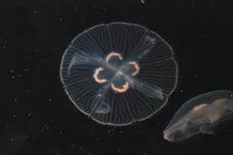
How Their Nervous System Affects Humans
Since jellyfish have a simpler nervous system than humans, they would be easier to study, and figure out the mystery of how neuron communication works. With this knowledge, we think researchers could eventually:
Find solutions to neuron disorders or damages
We could replace damaged parts with a nerve net
Generate neuron orders with AI, bypassing the brain or damaged parts
Help blind people
Use rhopalia to help them “see”
Help them detect light
Scientists, in October 2006, discovered a protein in jellyfish that might help us treat neurodegenerative diseases.

Slide 11
Respiratory System
Jellyfish use simple diffusion to meet their respiratory needs.
Diffusion: particles moving from high concentrations to low concentrations to meet equilibrium
Inhaling
Their extremely thin ectoderm, a layer in their epidermis, allows dissolved oxygen to simply pass right through into their body, without organs
Exhaling
Their waste leaves through surface cells without organs to meet equilibrium with the water
Oxygen storage
They can also store the oxygen in their mesoglea, and that allows them to withstand waters with low oxygen concentration, just like how we hold our breath
However, jellyfish will always be using the oxygen inside their body through cellular respiration, so they will basically never reach equilibrium with the water

Slide 12
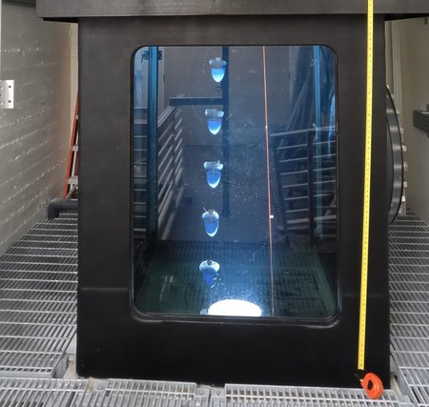
How Their Respiratory System Affects Humans
Jellyfish have a simple respiratory system that we think can help improve engineering, by redesigning airplanes, submarines, and climbing or diving equipment.
They can take in oxygen as they go higher into the atmosphere or deeper into the ocean, without the need to bring a giant tank of oxygen
An issue, though, is that reaching equilibrium in places with such low oxygen concentrations wouldn’t have enough oxygen for a human
If we overcame this, exploration would be easier than ever
Recently, in February 2024, scientists looked at the possibility of using a jellyfish as an exploration tool, after turning them into an “ocean-going cyborg”.

Slide 13
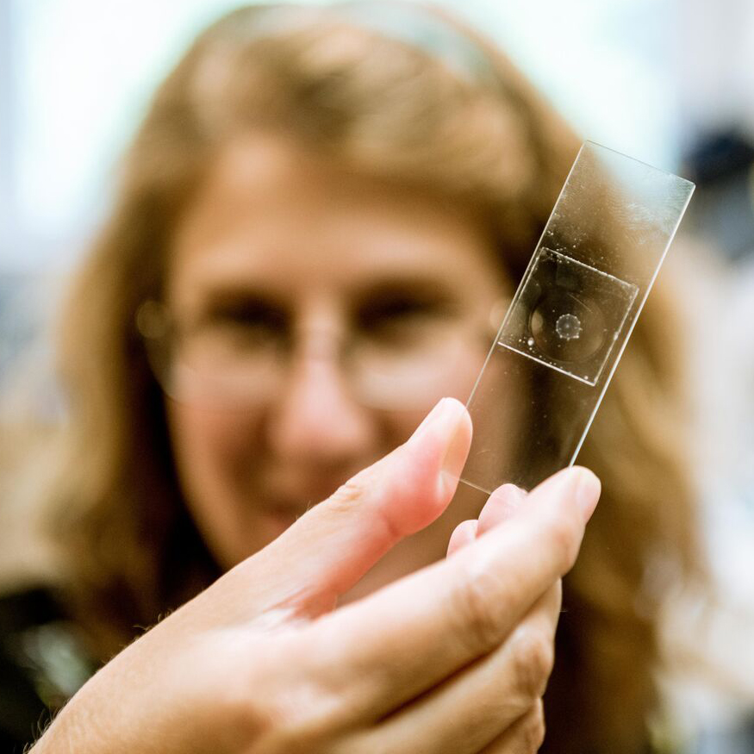
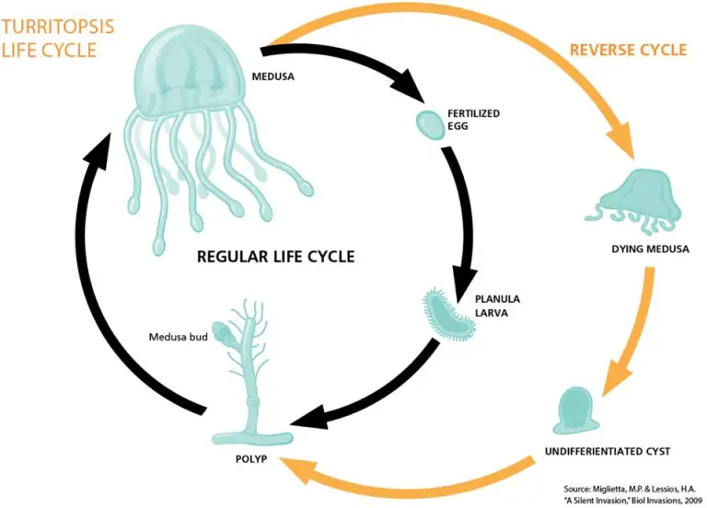
Regeneration and Immortality
Jellyfish can regrow, even with severe harm done to them
Jocelyn Malamy, from the University of Chicago, studied the Clytia hemispherica to understand jellyfish regeneration
Jellyfish regenerate by sending pre-existing cells to the site of injury, but the precise source is unclear
Jellyfish, like butterfly, undergo metamorphosis
Metamorphosis: A drastic change in the appearance or habits of an animal from childhood to adulthood
One species of jellyfish, the Turritopsis dohrnii, can revert back to its younger polyp form if its adult medusa body has been harmed
It would be like a butterfly turning back to a caterpillar, if it was harmed
If the Turritopsis dohrnii kept repeating this, they could theoretically never die, living up to their nickname the “immortal jellyfish”
Called transdifferentiation

Slide 14
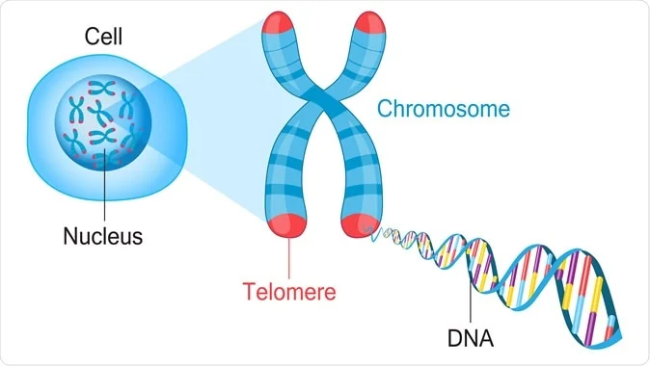
How Their Regeneration and Immortality Affects Humans
Humans could learn to regenerate
This can save lives, for example eliminating the need for organ transplants
Regenerating cells is much safer than using technology we have right now
We could not find anything for this kind of research, as most people were studying immortality, but we think this is as important, and may be easier to research, since it’s similar to healing
No one knows the exact reason humans age, but one theory suggests that it might be related to our DNA is getting damaged and shortened over time.
Immortal jellyfishes’ DNA don’t shorten over time
Scientists think immortal jellyfish have mutated/evolved to have long telomeres
Telomeres protect the end of DNA, to prevent it from shortening over time
The undamaged DNA appears to be why jellyfish can repeat the cycle of immortality
By learning from jellyfish, it seems like if humans had long telomeres, we should be able to stop aging
Unfortunately, the answer is not that simple
According to two researches in 2023, when humans have long telomeres, it seems to be linked to cancer
Based on these findings, it seems we have to control the uncontrollable cancer cells before we reach immortality in humans.

Slide 15
The Ethical Dilemma of Immortality
There is a controversy on whether scientists should continue this research.
Humans were not meant to live forever, so if we were to start changing our genes, we would live much longer than we naturally would, adding to issues like overpopulation and global warming.
The other side is that humans want to live, and choose when to die, not have it determined by nature.
Other thoughts are “if you replaced all your cells, would you still be you?” and “if you chopped yourself in half, and both halves regrew, which one is the original?”

Slide 16
Future Research and Continuation
Here are some topics we would like to research next time:
Can we control cancer cells?
Can we use active transport in airplanes, submarines, or diving equipment to breathe in low oxygen places?
Can we simplify humans, or at least some body parts, to make them more efficient?

Slide 17
Conclusion
Jellyfish can function without organs because they are so simple, and can meet their life needs using simple systems and processes such as nerve nets or nerve rings and diffusion. When they mess up, immortal jellyfish can undergo transdifferentiation to revert to a younger form without harm or injuries.
There are many areas that we can learn from jellyfish that can change our daily lives, from curing neural diseases to immortality. Though most of these researches are still going on and currently have more questions than answers, we believe our future looks promising. However, it is important that we consider the ethical and social issues in these researches.
Lastly, our hypothesis was generally correct, their nerves do a lot for them, but they didn’t work the way we thought they did. We didn’t even realize that, in theory, jellyfish could live forever.

Slide 18
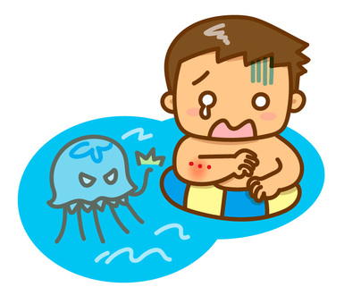
Why Did We Pick This Topic?
Mika got stung by a jellyfish over the summer in 2024
We thought jellyfish were very interesting, being so pretty and simple
After our research, one of the most common facts we found were that they lacked organs, and that was the topic we decided to focus on

Slide 19
Did You Know?
Their beautiful looks does not appear to help them better survive in the environment, based on our research
However, based on what we know about jellyfish, there is probably a reason they look the way they do, otherwise they wouldn't have evolved this way
When stung by jellyfish, urinating does not help. IT IS A MYTH
In 1991, scientists sent jellyfish to space, and they multiplied!
However, the space-born jellyfish did not know how to deal with gravity when the spaceship came back
A group of jellyfish is called a bloom, swarm, or smack

Slide 20
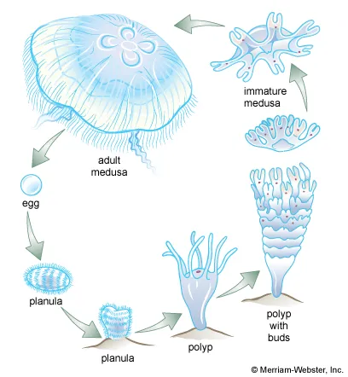
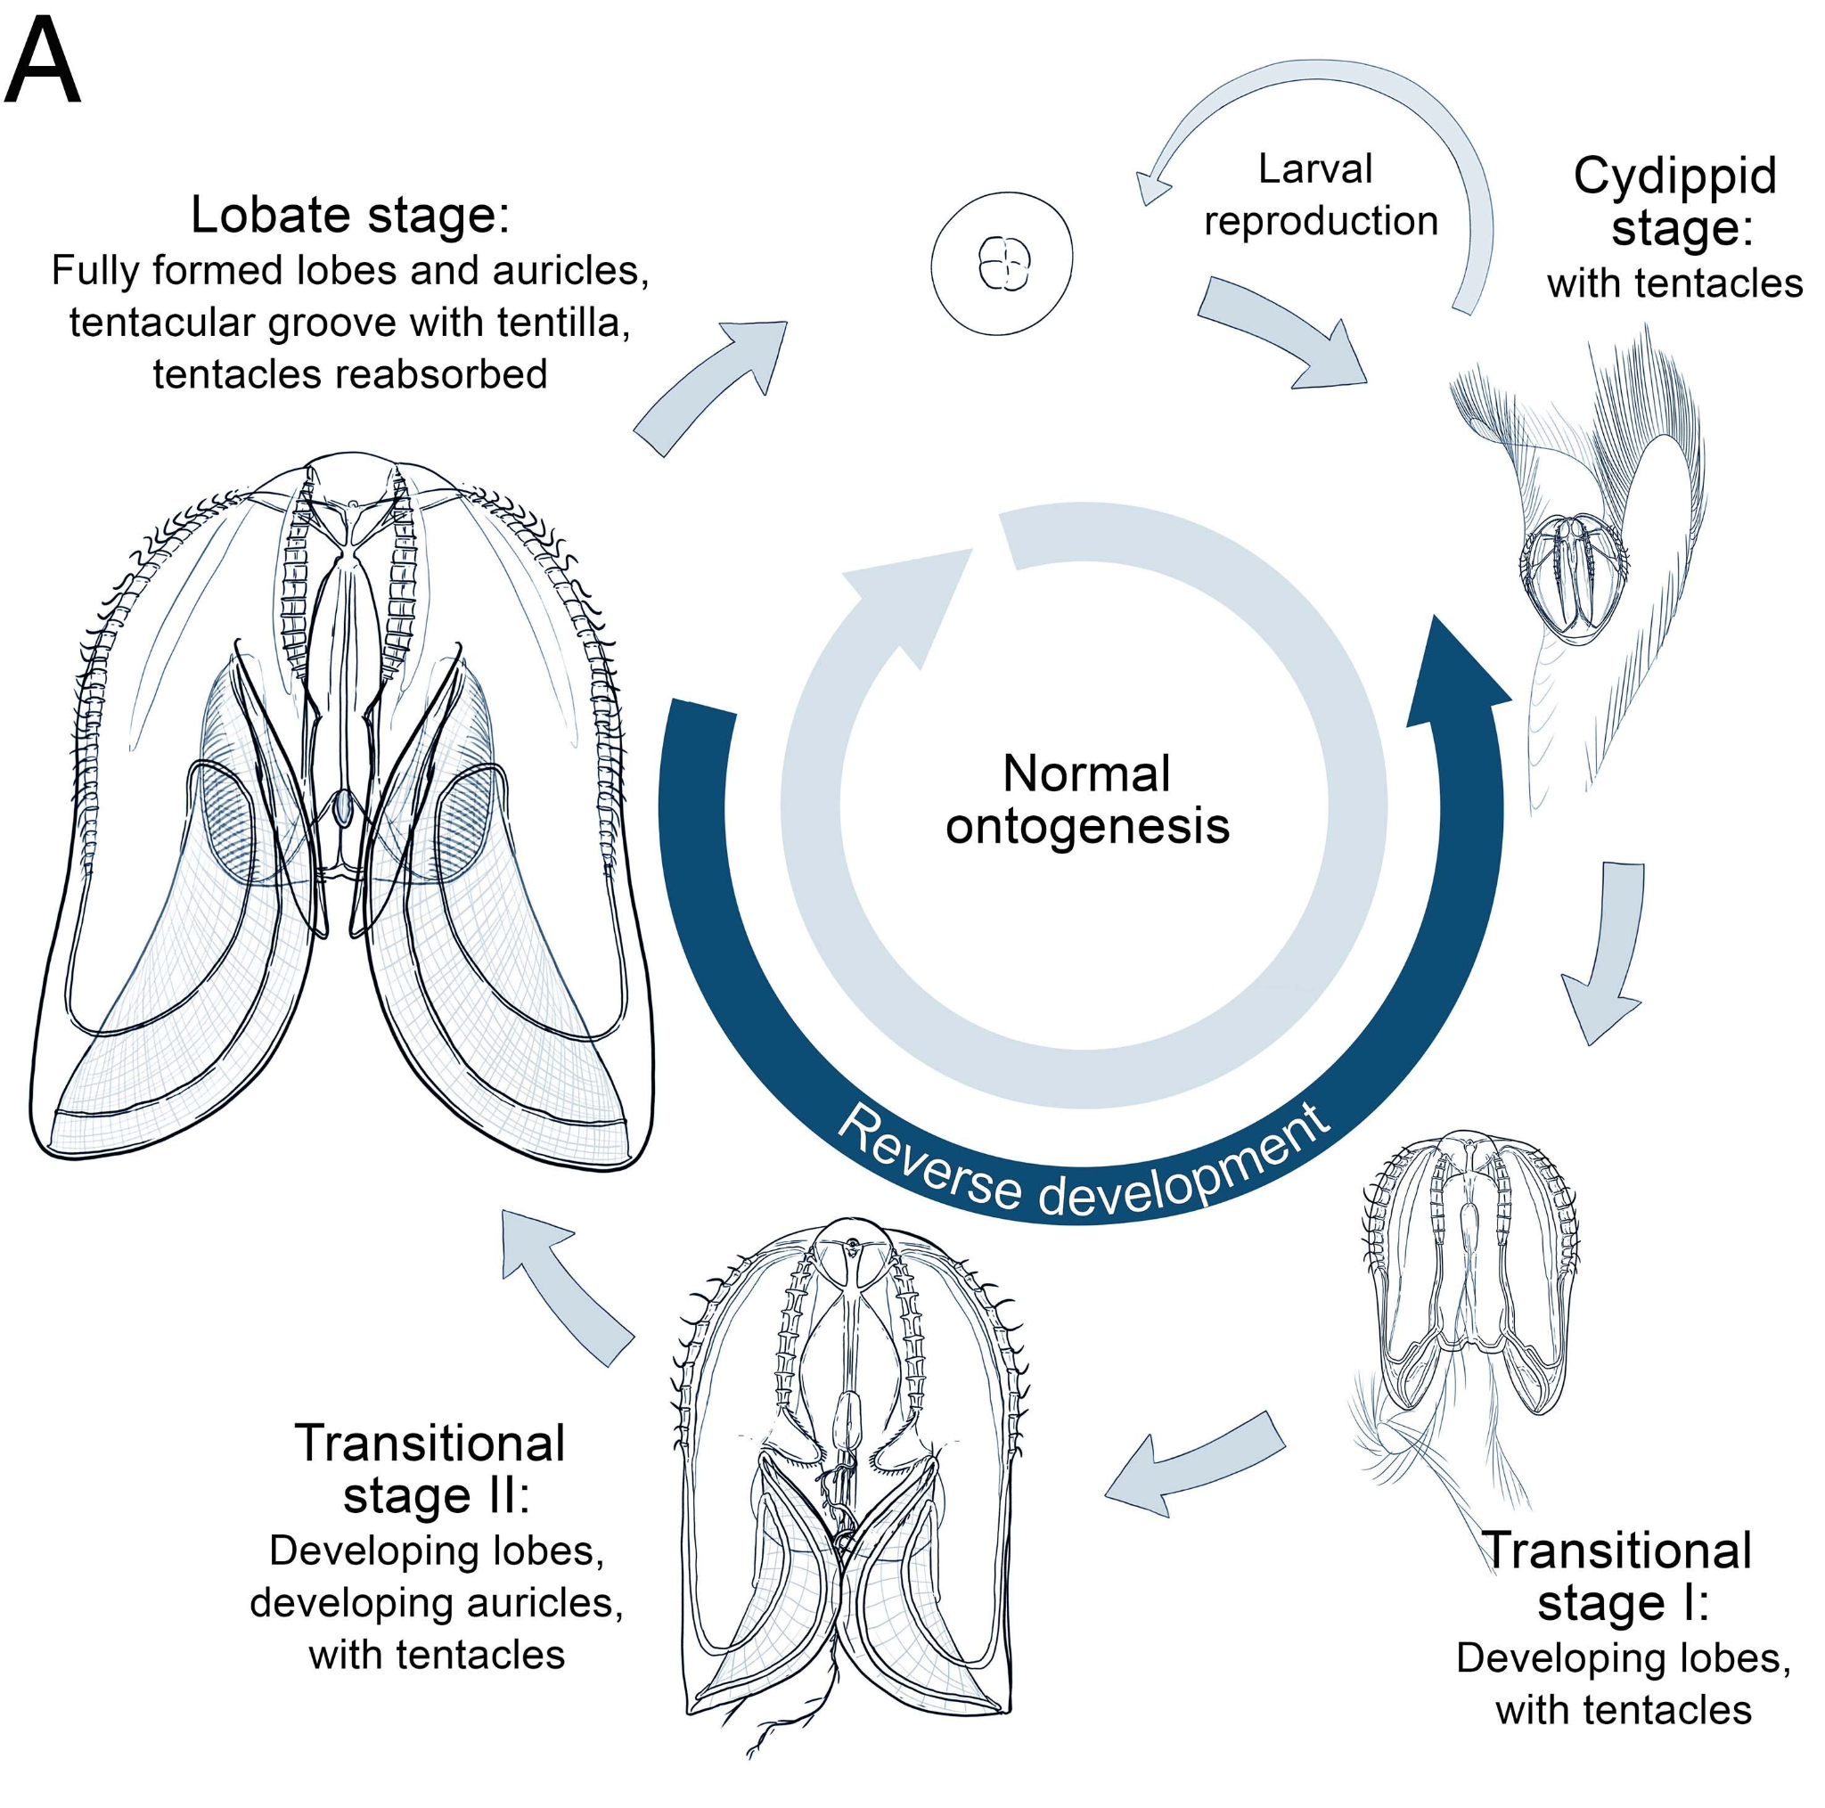
The difference is that comb jellies don’t have stinging cells.

Slide 21
Fun Fact - Life Stages of a Jellyfish
True Jellyfish
Egg - Eggs and sperm will be released into the ocean throughout late summer, and then the eggs will be fertilized
Planula - A fertilized egg will grow into a planula, which drift around the ocean until they hit a hard surface, which they latch onto
Polyp - After latching onto a hard surface, the planulae turn into polyps known as scyphistomae, which feed on small animals in the water they catch with their tentacles, and can reproduce by branching out and cloning itself
If the conditions are unfavorable, scyphistoma can shrink into a dome-shaped cyst, which is very durable, and can survive like that for years, until conditions get better, when they turn back into a polyp and continue growing
Polyp with Buds - When it is about 62 degrees fahrenheit in the spring, polyps will grow and elongate into a chain or stack of jellyfish clones called strobila, and periodically the strobila at the end of the chain will break of and swim away in a process known as strobilation
Immature Medusa - The free-swimming clone is called a ephyra, and it will feed on zooplankton until it grows into medusae
Adult Medusa - Adult medusa will release eggs and sperms, and the cycle repeats

Slide 22
Fun Fact - Life Stages of a Jellyfish Pt. 2
Comb Jellies
Egg - The sea walnut reproduces only sexually and are almost constantly doing it. Adults release both the egg and sperm into the water, and usually self-fertilize. The egg will grow for about a day, then it will turn into the larval comb jelly.
Larval Comb Jelly - The larval comb jelly have two long sticky tentacles that capture prey, until they grow to be about 5mm large. Then it begins to absorb the tentacles and start to grow lobes, that adults use to capture prey.
Adult - When the larval comb jelly is about 15mm long, it has absorbed its tentacles and is an adult.

Slide 23
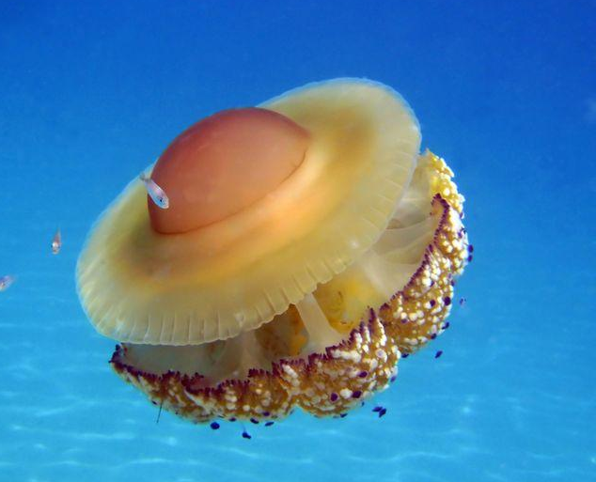
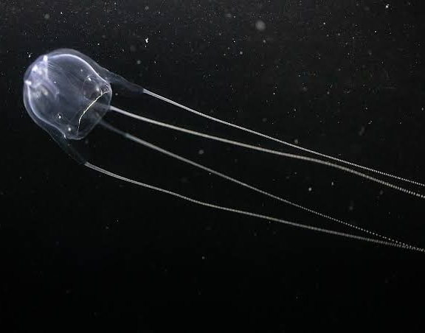
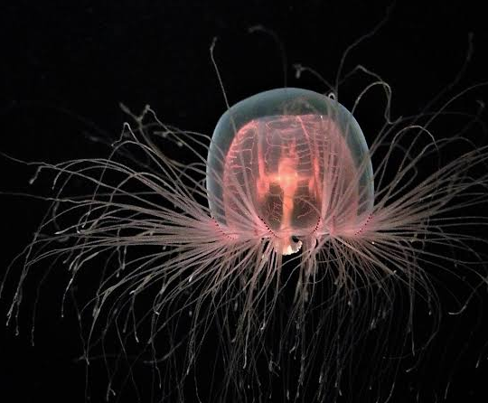
Extra Pictures of Jellyfish

