Slide 1
How do Animals Affect the Human brain
By Aidan and Isabella

Slide 2
Introduction
Im Aidan and this is my twin Isabella. where going to talk about how animals impact our brain. They might impact our lives but they definitely impact our brain, we will take a deeper dive into this topic.
1

Slide 3
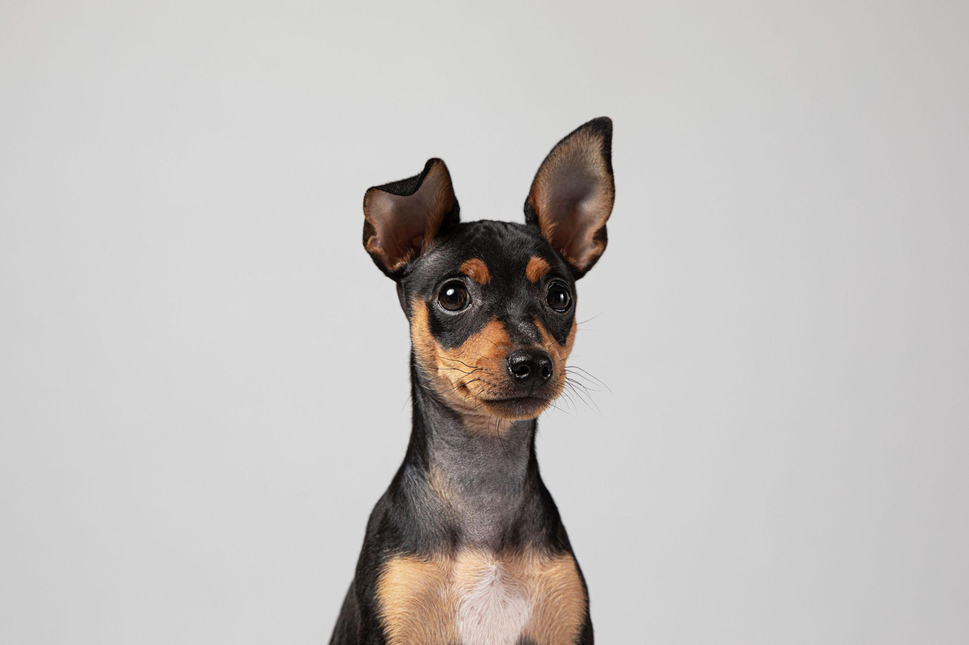
Is the impact a good thing or bad?
A lot of research has shown the positive benefits of interacting with pets, including how it can benefit an individual with their mental and physical health. Studies indicate that spending quality time with an animal can help continue reducing the individual’s stress levels and improving the overall health and wellbeing of an individual. An individual who has a pet, develops a strong emotional bond with that pet, and will rely on that pet to help manage emotional issues they may be experiencing because of how much support and companionship their pet provides.
2

Slide 4
Therapy dogs
Therapy dogs serve as a critical resource in a healthcare facility or community setting. A therapy dog is specifically trained to offer support and comfort to people who are experiencing stress, anxiety, and/or loneliness. Therapy dogs have found their home in locations such as hospitals, nursing facilities, schools, and rehabilitation centres. A therapy dog’s presence has been proven to assist in calming a patient, reducing the patient’s anxiety, and increasing the patient's overall emotional wellbeing. For many patients, interacting with therapy animals helps provide comfort as opposed to receiving comfort from traditional methods of treatment alone.
3

Slide 5
How do animals help us
Scientific studies have demonstrated that interacting with animals can trigger the release of endorphins, which are chemicals in the brain that help relieve pain and reduce stress. These chemical responses can improve mood and promote relaxation. Caring for a pet also promotes responsibility and provides individuals with a sense of purpose. For people experiencing depression or feelings of loneliness, pets can provide motivation and routine, as pet owners must ensure their animals are properly cared for each day. Pet ownership can also encourage social interaction and help individuals build stronger connections with others. For example, dog owners frequently meet new people while walking their dogs or visiting public spaces such as parks. Pets can act as conversation starters and help individuals form friendships. This increased social interaction can reduce feelings of isolation and contribute to improved mental health.
4

Slide 6
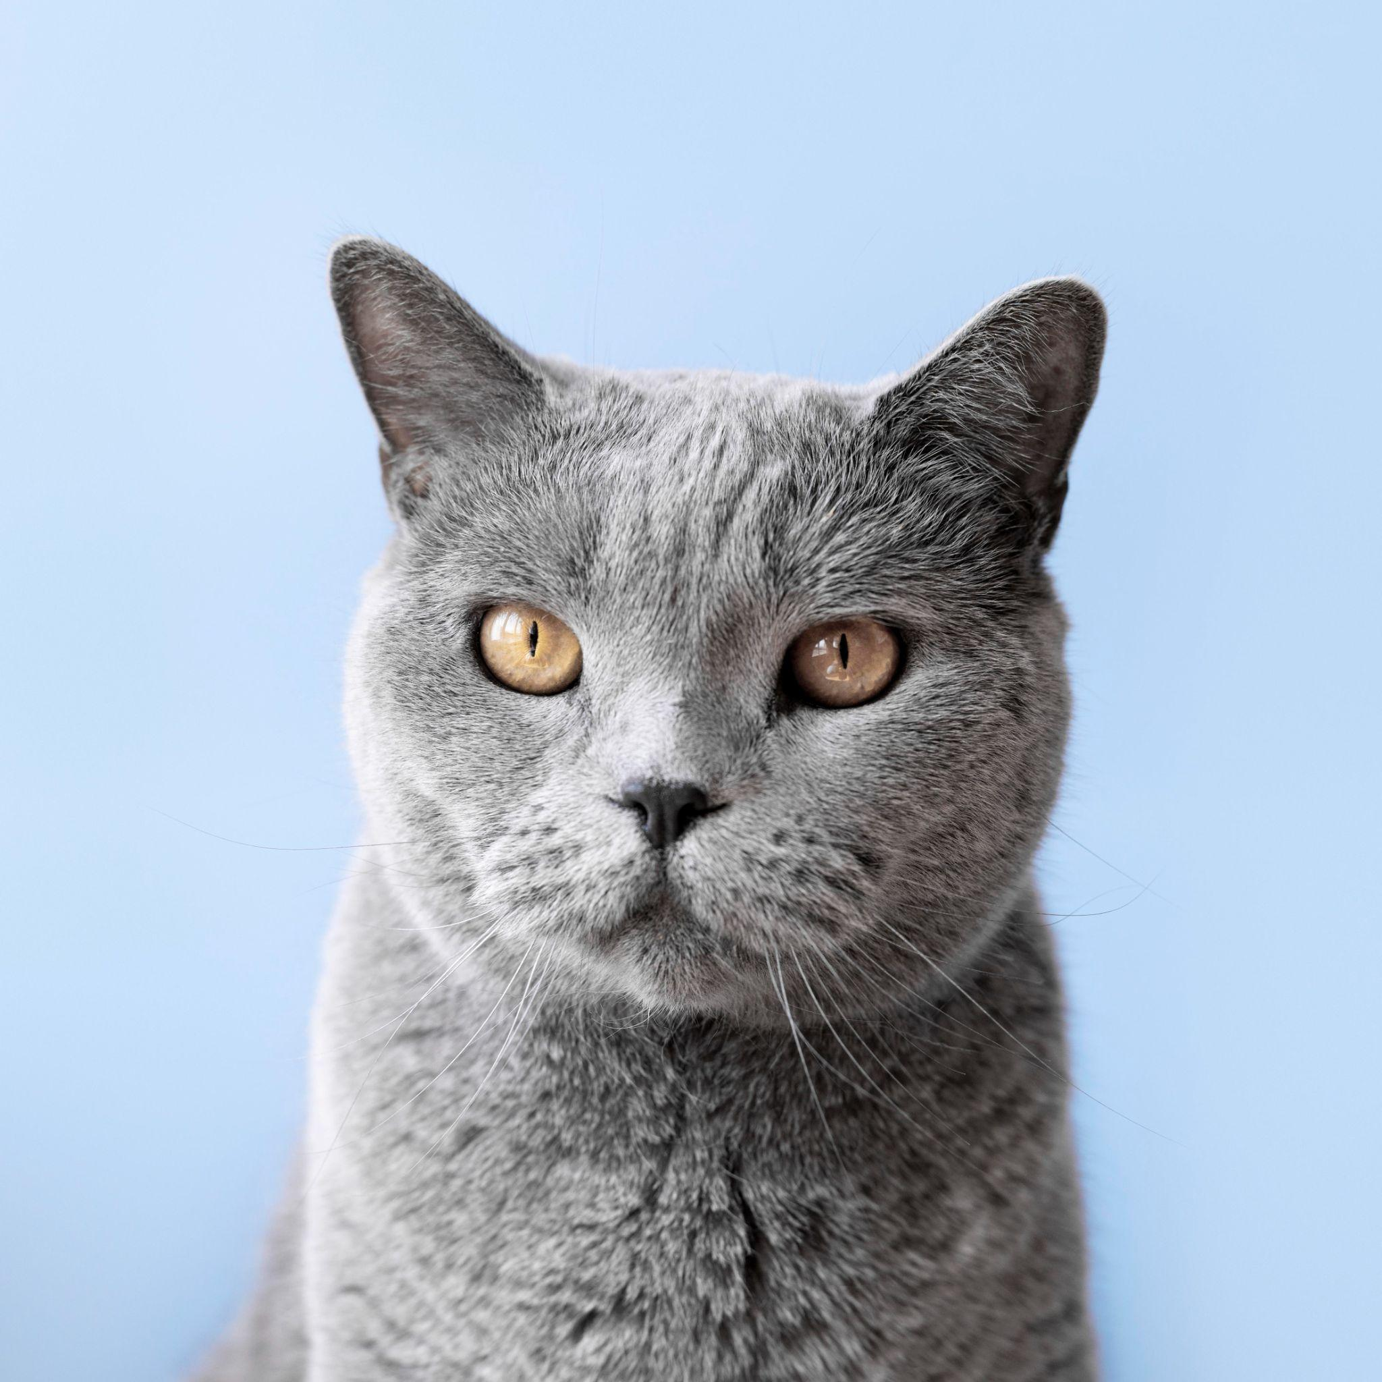
How do animals keep us fit
Pets not only provide mental health support, they can motivate us to be physically active. Research has found that dog owners tend to walk more and are more likely to spend time outdoors when compared to those who do not own dogs. Regular physical activity also helps with heart health, builds muscle, and improves overall physical fitness. Partaking in activities with pets can also help alleviate boredom and promote a lifestyle that is more active overall. All of this contributes to how much pets help to improve the mental and physical health of their owners. Pets help to improve the quality of life for an individual through companionship, emotional support, encouragement of physical activity, and the promotion of socializing with others. The ongoing research into human-animal interaction continues to demonstrate that pets are valuable sources of support for people in many different areas of their lives.
5

Slide 7
Brain scans
Here is a visual of a human brain, which indicates what happens to a human brain when it transitions from a stress response to being happy just by looking at a dog. The "before" scan shows that the Amygdala is focused on, and activated, as it acts as a "mini alarm" that alerts you to fear and anxiety when you are under stress. However, when the dog comes into view, that alarm shuts off and is replaced by the "Nucleus", a part of the brain where pleasure and reward are experienced. It is at this time that the brain begins to produce dopamine, or a "feel-good" chemical that is produced whenever you consume candy or unwrap a gift. In addition, the Prefrontal Cortex, or the thinking part of the brain, will help your brain shut down (relax) and "bond" with the dog. In essence, the dog acts as a "reset" for the human brain by shutting down their stress response and turning on their happy response.
6

Slide 8
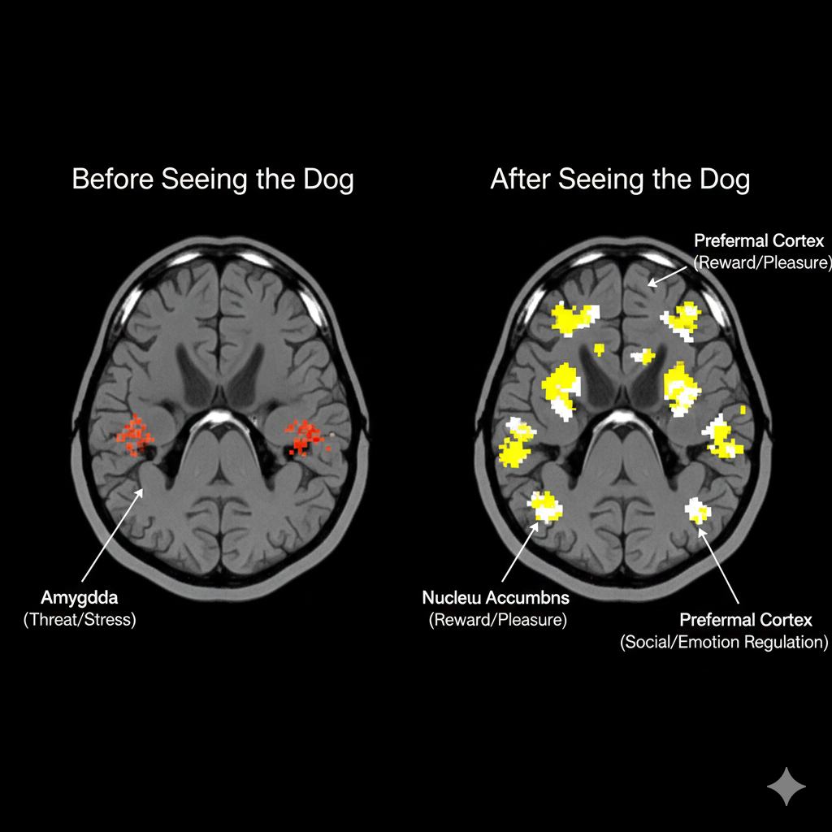
7

Slide 9
About our animals
The dog we have is a Staffordshire Labrador mix. He's a black dog with a bow tie! He's friendly and loves pets. And our hamster, Chow Mein he's a friendly little dude just there for the vibes. He's quiet and respectful the human hands that may come and pet him.
The watch that we are using is a Fitbit Charge 6 it can
Before the test we will ask the valinters if they're scared of dogs or hamsters, so we can tell if their heart beats spikes is it' stress or excitement.
8

Slide 10
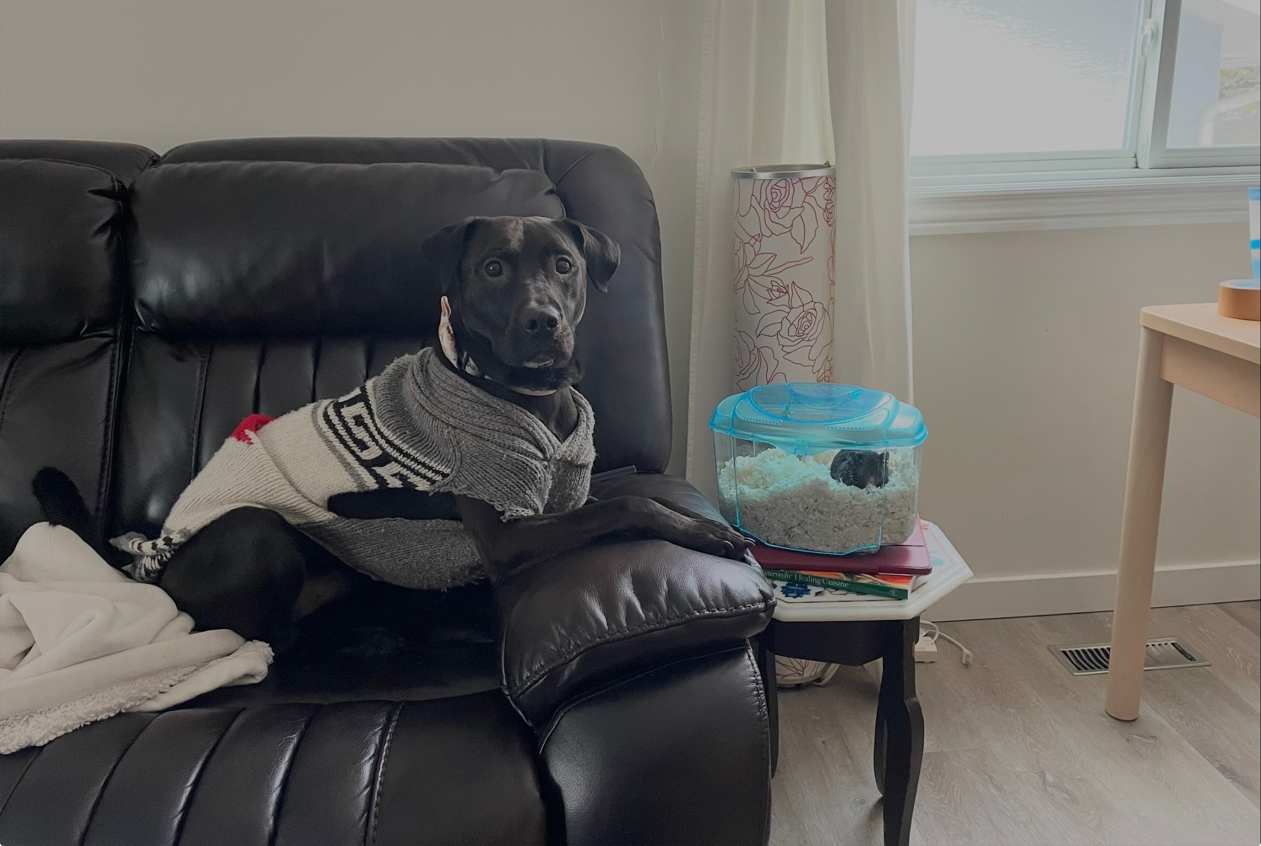
This is our Pets
Kisses
Chowmain

Slide 11
Procedures
First, measure the volunteer’s Bpm (beats per minute) without the dog. Then, show the volunteer the dog for the first time for 3 minutes and then take the dog away then we will record their Bpm to see the jump in Bpm typically high bpm to low, then we will get them to answer some short questions. Then we will show them there at the end.
9

Slide 12
Questions
We are going to ask them some questions after the test, such as.
1. Subjective Stress & Arousal.
On a scale of 1-10, how on edge do you feel right now?
Rate your current level of muscle tension.
2. Social Attachment
Do you consider your pet a member of the family?
Does being near an animal make you feel more connected to the world?
3. Attentional Focus
During the interaction, how often did your mind wander to stressful thoughts?
How easily were you able to focus on the animal's movements or breathing?
10

Slide 13
Hypothesis
Responding variable
When a person sees a dog for the first time, their brain may show an increase in their bpm (beats per minute)
Controlled variable
Muscle tension, and beats per minute.
Using the same dog, giving each person the same amount of time to see the dog, and measuring bpm in the same way each time.
11

Slide 14
Analysis
Our results showed that the average muscle tension score was 3.12. People who sat by themselves in a room had muscle tension levels that were a lot higher who were in a room with an animal. This tells us that having an animal in the room may help people feel more relaxed.
When we looked at types of animals we found some differences. Being in a room with a dog really lowered muscle tension by 5.26 points compared to animals. Dogs may have a calming effect on people. On the hand being in a room with a hamster actually increased muscle tension by 2.1 points. This means that hamsters do not have the relaxing effect as dogs.
Observation
With some of the volunteers we have seen their heart rate go down on the chart, and with others we have seen it go higher than others. With some of the volunteers they said that the time was faster with the animal there vs not there. In this first photo when the dog was not hear their heartbeat went down -8bpm but when the dog was there their heartbeat went up to 18 pmb at the end their heart rate went to 108 pmb.
12

Slide 15
Our conclusions
In conclusion, our experiment shows that animals can have a significant effect on human heart rate and emotions. When participants saw the dog, people with higher heart rates experienced a decrease, while those with lower heart rates experienced an increase. In contrast, when participants saw the hamster, everyone’s heart rate decreased. These results suggest that different animals can affect people in different ways. Some animals may help calm us and reduce stress, while others may increase excitement or happiness. Overall, our findings support the idea that animals can influence both our physical responses and our emotional well being.
13

Slide 16
Resources
Marti, Rahel et al. “Effects of contact with a dog on prefrontal brain activity: A controlled trial.” PloS onevol. 17,10 e0274833. 5 Oct. 2022, doi:10.1371/journal.pone.0274833/
Marti, R., Petignat, M., Marcar, V. L., Hattendorf, J., Wolf, M., Hund-Georgiadis, M., & Hediger, K. (2022). Effects of contact with a dog on prefrontal brain activity: A controlled trial. PLOS ONE, 17(10), e0274833. https://doi.org/10.1371/journal.pone.0274833
https://www.lovingcareanimalhospital.net/pets-that-can-help-improve-your-mental-health/
https://www.helpguide.org/wellness/pets/mood-boosting-power-of-dogs
https://pmc.ncbi.nlm.nih.gov/articles/PMC9630635/
https://pmc.ncbi.nlm.nih.gov/articles/PMC10751597/
https://littlebinsforlittlehands.com/heart-rate-experiment/
https://newsinhealth.nih.gov/2018/02/power-pets
https://youtu.be/-IXiH__dwyw?si=QG_yqadIX-F25P-6

Slide 17
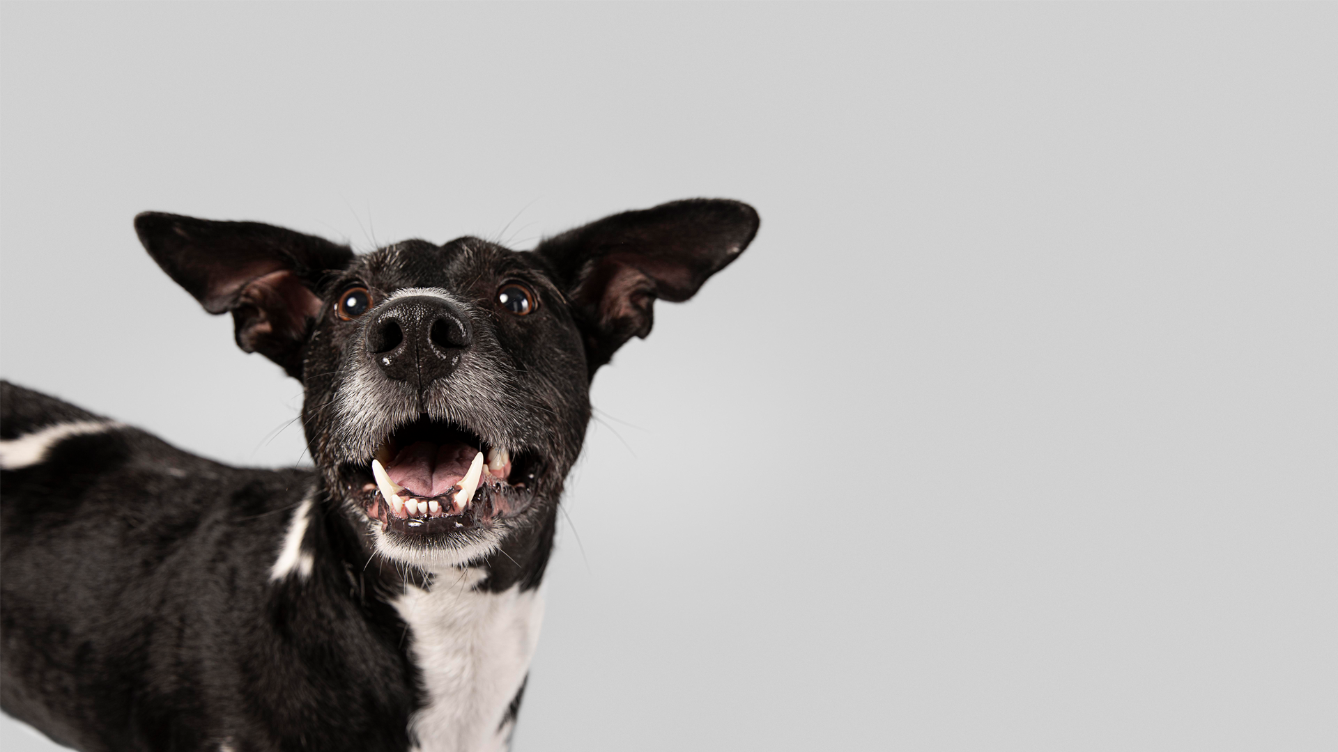
Credits
Linda Lindseth
Diego Nobrega U of C Research
H.D cartwright
Kisses
Chow Mein a.k.a Bear
Mark Lindseth
Dalhousie community

