Slide 1
Is It Better to Use Ethanol or Gasoline?
Mohammad Thraya
Calgary Islamic School 9B

Slide 2
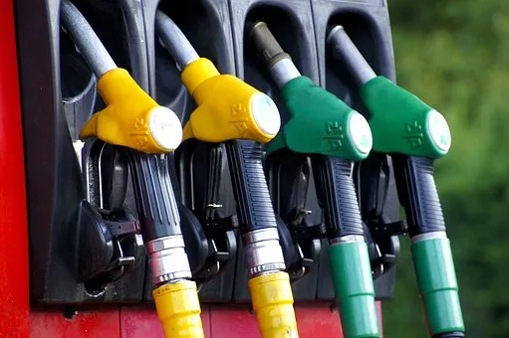
Scientific Question
How/where do we use ethanol and gasoline in our everyday lives? Can pure ethanol be used as an alternative to gasoline?

Slide 3
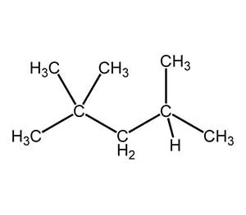
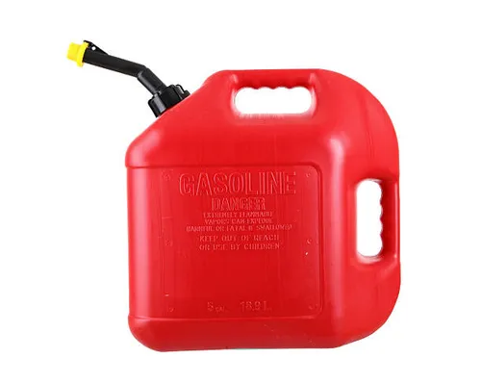
What Is Gasoline?
Gasoline is a chemical substance made up of carbon and hydrogen
Gasoline is used in our everyday lives. Its main purpose is to power motorized vehicles and machines, such as cars and trucks.
Gasoline’s chemical formula is C8H18

Slide 4
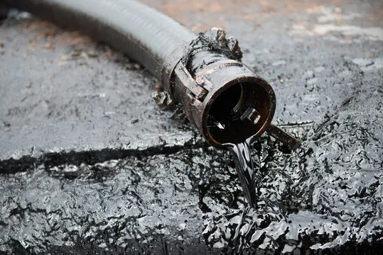
How Is Gasoline Extracted from Crude Oil/Fossil Fuels?
Gasoline is made from crude oil, a fossil fuel
Distillation is a procedure that converts crude oil into gasoline
During distillation, crude oil is heated and then separated into several components based on their boiling points. One of those components is gasoline.

Slide 5
Where Do We Use Fossil Fuels?
Fossil fuels are used to produce energy
We see fossil fuels used a lot for transportation such as cars, trucks, boats, airplanes, etc.
Fossil fuels are also used for producing huge amounts of electricity and heating our homes
In Alberta, fossil fuels run a big part of the economy and is Canada’s largest producer

Slide 6
What Are The Effects of Burning Fossil Fuels on the Environment?
One of the biggest effects of burning fossil fuels is the release of harmful gases, known as greenhouse gases, into the atmosphere
Greenhouse gases, such as carbon dioxide and other oxides, get trapped in the Earth’s atmosphere
This increases Earth’s temperature affecting climate change
These pollutants can also affect human health and wildlife

Slide 7
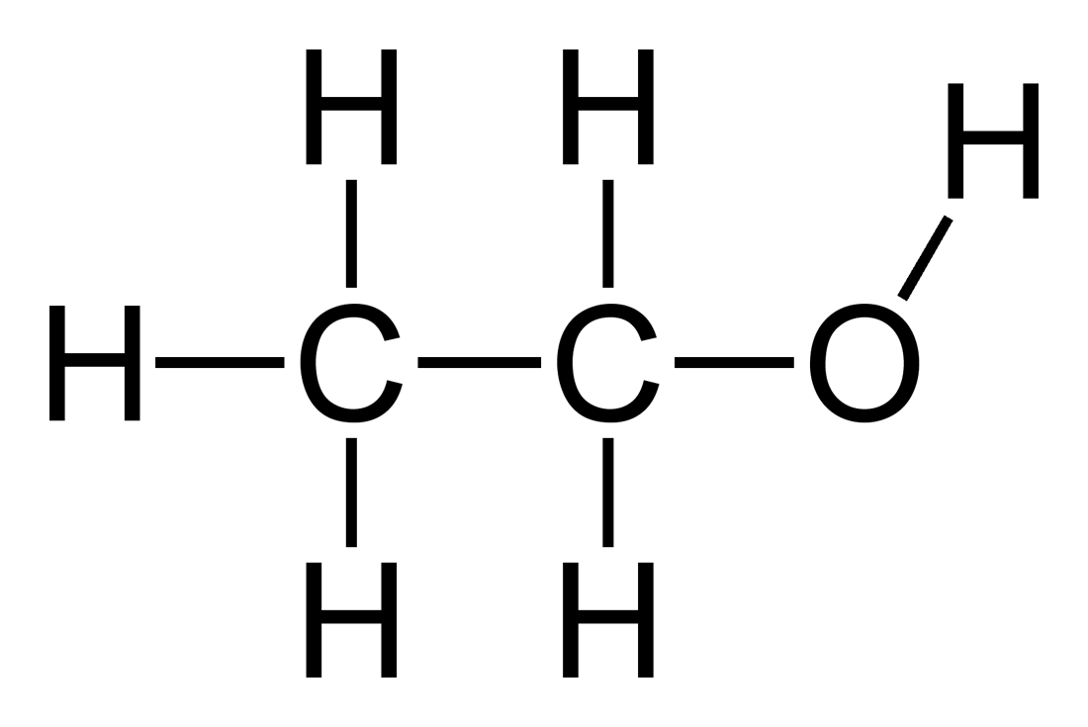
What Is Ethanol?
The chemical formula for ethanol is CH₃CH₂OH
Ethanol fuel is a mixture of ethanol with gasoline
It contains 10% ethanol and 90% gasoline. This is the most common amount (called E10). E100 is also available but is commonly used in labs.

Slide 8
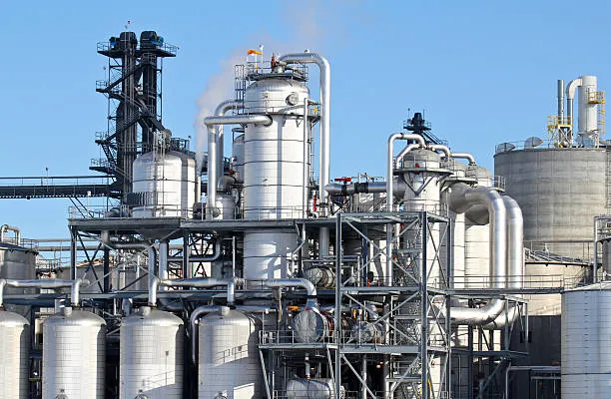
How Is Ethanol Made From Plants?
Ethanol is made from plants in a process called fermentation
The sugars from starch-based plants such as corn are then converted by yeast into ethanol
The US is the largest producer of ethanol

Slide 9
Where Do We Use Ethanol?
Used in cosmetics, solvents, and in foods/beverages
Ethanol fuel can be an alternative solution to pure gasoline such as for vehicles
100% ethanol is typically not used as car fuel because it does not burn as quickly as gasoline (higher octane) and is very expensive

Slide 10
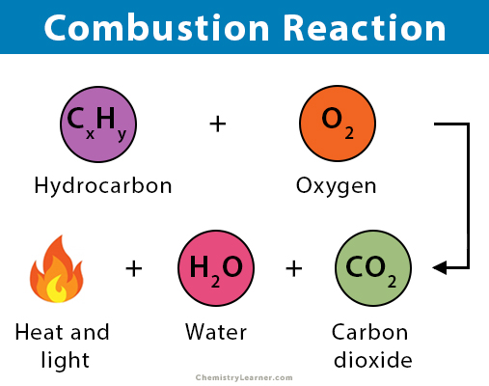
How Are Ethanol and Gasoline Used to Run Cars?
Fuel burns in a car engine through a process called combustion
Combustion is a process of controlled explosions
A combustion reaction typically involves a hydrocarbon (like gasoline) and oxygen to produce carbon dioxide, water and heat

Slide 11
Hypothesis
Ethanol may be a better source of fuel because it has less of an environmental impact than gasoline.
Gasoline may have better results then Ethanol performance-wise in the engine when the car is actually running.

Slide 12
Which Is a Better Fuel Source?
Ethanol produces 48%-52% less greenhouse gasses than gasoline. This means that all the greenhouse gasses that gasoline produce is 48%-52% more than ethanol fuel.
Gasoline has better performance than ethanol.

Slide 13
Conclusions
Ethanol is renewable - made from corn or sugar cane
Lower availability compared to gasoline
Higher octane rating - the number you find on gas pumps. The higher the number, the better it is at withstanding engine issues
Produces less greenhouse gasses
Expensive
Gasoline is non-renewable - obtained from crude oil
Longer lasting fuel per gallon compared to ethanol
Easier to get your hands on at gas stations
Lower octane rating than ethanol
Produces more greenhouse gases

Slide 14
Conclusions
Based on my findings, ethanol may be a better fuel source than gasoline for the environment but efficiency wise gasoline takes the win!

Slide 15
Future Applications: Why Research Fuel?
Global warming and climate change - alternatives to fossil fuels such as solar, wind and water
Environmental impacts - wildlife and agriculture
Electric cars - reduce carbon footprint?

Slide 16
References/Sources
https://afdc.energy.gov/fuels/ethanol_fuel_basics.html#:~:text=Ethanol%20has%20a%20higher%20octane,attain%20the%20standard%2087%20octane.
https://www.bellperformance.com/blog/the-major-differences-between-ethanol-and-gasoline

