Slide 1
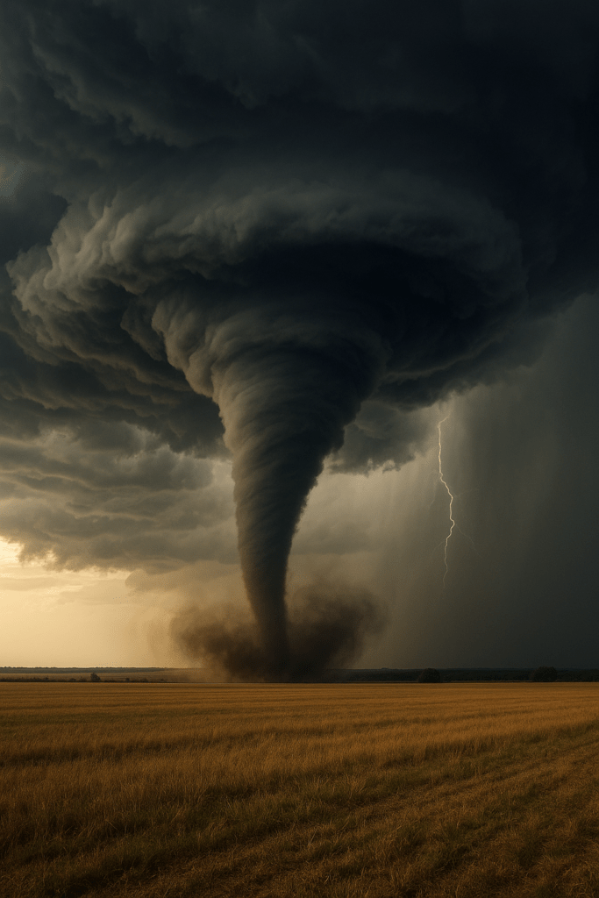
Tornado in Alberta?
What are the chances?
Research/Study Project
By: Ibrahim Khan

Slide 2

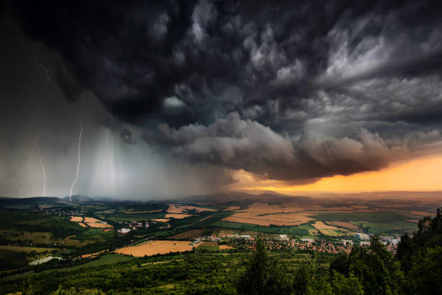
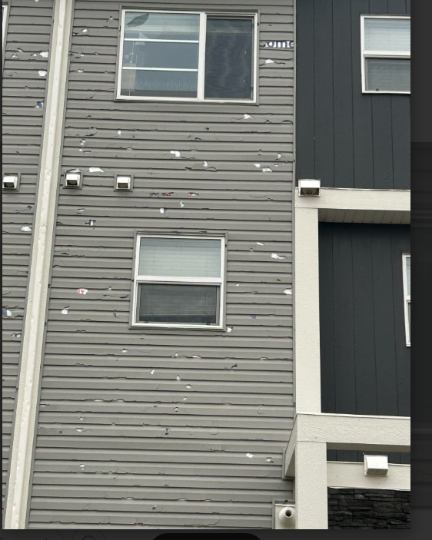

AUGUST 5th, 2024 AT 8:15 PM
Notes:
1st time experienced severe weather.

Slide 3
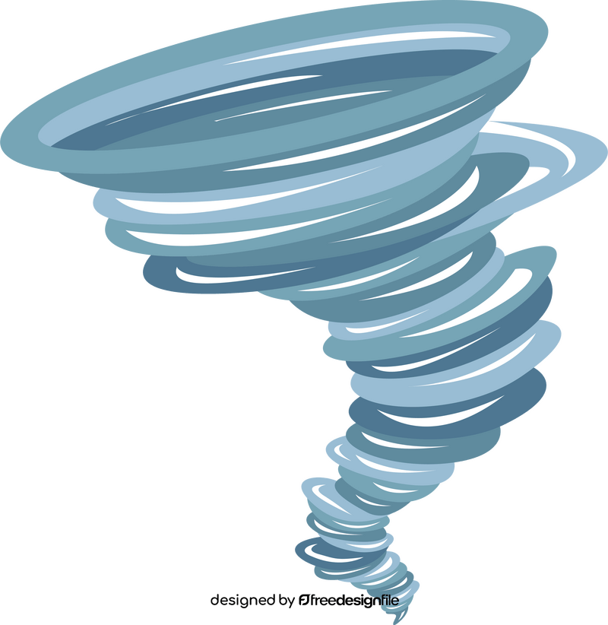
HYPOTHESIS
The chance of seeing a Tornado in Alberta is low because of the weather conditions needed to form a tornado are not good.
Hypothesis test questions:
1. What is a tornado?
2. What conditions are ideal for a tornado to be formed?
3. What is the risk level to experience a tornado in Alberta?
4. How does climate change impact tornadoes?
5. What is the Peak Season For Tornadoes in Alberta?

Slide 4
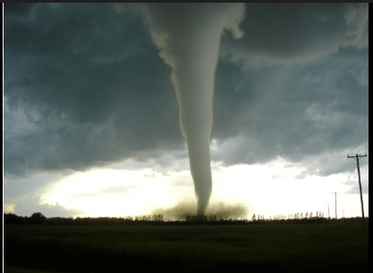
What is a Tornado?
A Tornado is a fast-spinning column of air, which touches the ground.
It usually comes from a strong thunderstorm.
Source: https://www.weather.gov
Notes:
A tornado forms when air starts spinning inside a strong thunderstorm and becomes powerful enough to touch the ground.

Slide 5
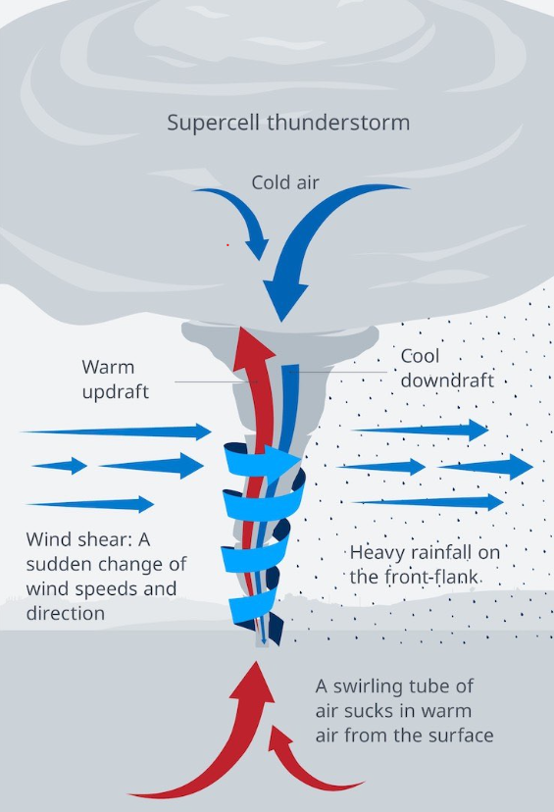
Ideal Conditions for a Tornado to be formed
Strong Thunderstorms: When cold dry air is pushed over warm humid air.
Warm, moist air near the ground: The warm air rises through the colder air, creating an updraft.
Air Movement: When the warm air rises through the colder air it can cause an updraft or a change in wind direction.
Wind Speed or Direction: When the wind in the thunderstorm becomes high in speed or direction, the updraft will begin to rotate.
Funnel Cloud: As the rotating updraft draws more warm air from the Thunderstorm, the rotation speed begins to increase, then the funnel cloud begins to form. As the Tornado gains strength, the funnel becomes longer.

Slide 6
How does climate change impact Tornadoes?
According to the Government of Alberta, air temperature data shows that Alberta is experiencing warmer temperatures over the years. Canada's average temperature has increased by about 1.7°C since 1948. Since Alberta is a part of Canada, it has also experienced warming.
What does that mean?
Warmer air can hold more moisture. More moisture can help create stronger thunderstorms. And, Tornadoes are formed inside strong thunderstorms.
Scientists are still studying if climate change is having an impact on the increase of tornadoes because tornado formation depends on many weather factors, not just temperature.
Notes:
Climate change can affect storms because warmer air holds more moisture. When moist air rises faster, storms can become stronger. Strong storms can increase the chance of severe weather, including tornadoes.

Slide 7
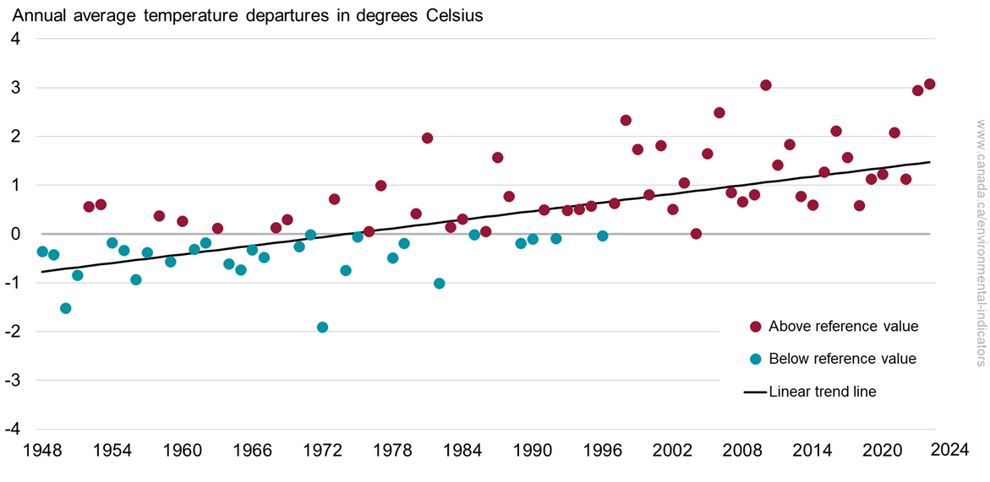
Annual average temperature departures from the 1961 to 1990 reference value, Canada, 1948 to 2024
Notes:
This graph shows how Canada’s temperature has changed from 1948 to 2024. The dots above the middle line show years that were warmer than the 1961–1990 average. The dots below the line show years that were cooler than the average.
In the earlier years, most dots are below the line, meaning temperatures were cooler. In more recent years, most dots are above the line, meaning temperatures are warmer. The black line shows the overall trend. It slopes upward, which means Canada’s temperature has increased over time.
This graph shows how Canada’s temperature has changed from 1948 to 2024. The dots above the middle line show years that were warmer than the 1961–1990 average. The dots below the line show years that were cooler than the average.
In the earlier years, most dots are below the line, meaning temperatures were cooler. In more recent years, most dots are above the line, meaning temperatures are warmer. The black line shows the overall trend. It slopes upward, which means Canada’s temperature has increased over time.

Slide 8
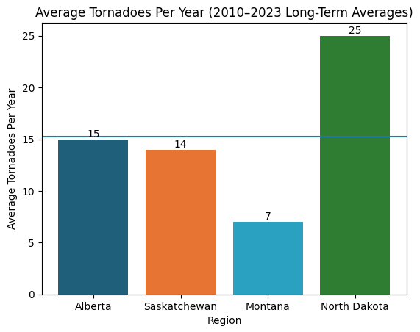
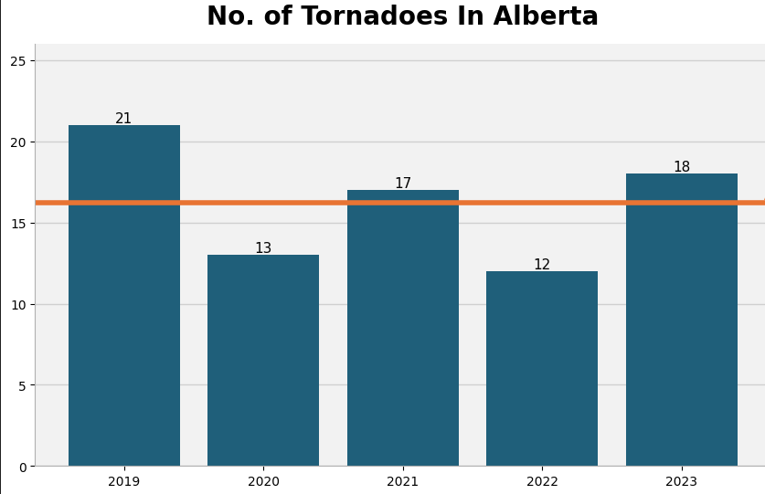
Comparison Analysis
Montana, Saskatchewan and North Dakota were chosen to do a comparison analysis because these regions are closer to Alberta in their location and similar climate. I found that these regions have similar average of tornadoes in the last 13 years.
Average: 15.25
Average: 16.2
Notes:
I used 2010–2023 because that includes all recent available data up to the current year. I wanted to include enough years to make the average more reliable.
For Alberta Questions: Why did you use the Tornado Average starting from 2019 to 2023? I used 2019–2023 because tornado tracking in Canada improved after 2017. Scientists started using better tools like satellites and drones. So the data is more accurate and I chose a recent 5-year period to calculate a average.

Slide 9
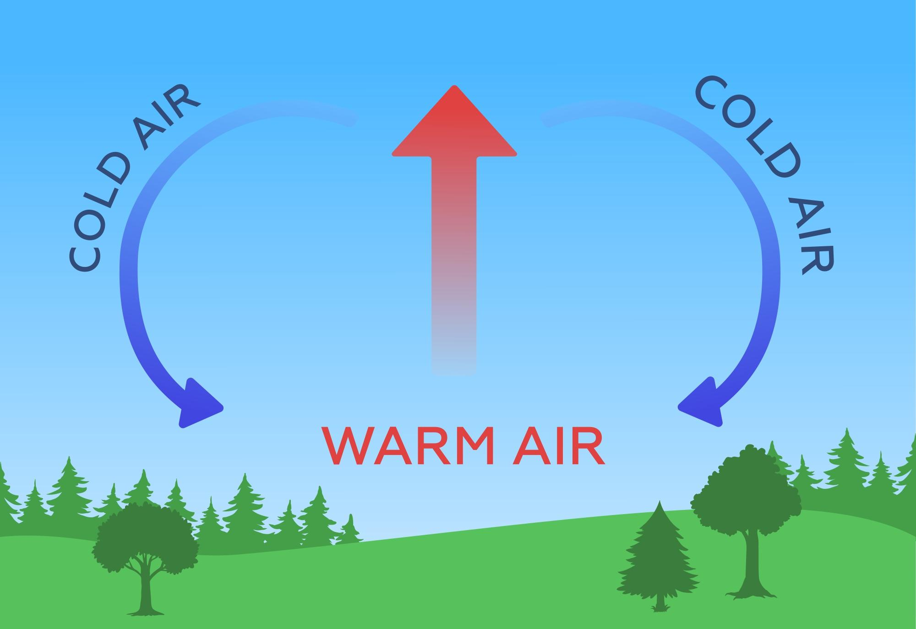
Peak Season for Tornadoes in Alberta
June is the peak month for tornadoes in Alberta. According to the Northern Tornadoes Project and Environment and Climate Change Canada, most tornadoes in Alberta occur between May and August. And June is typically has the highest number.
By June, the ground has warmed significantly from spring, creating warm air near the surface. At the same time, cooler air is often still present higher in the atmosphere. When warm, moist air rises into cooler air, it creates instability in the atmosphere. Tornadoes develop inside powerful thunderstorms, which is why June usually has the highest number of tornadoes in Alberta.

Slide 10
Conclusion
Based on my research, I found that my hypothesis was mostly correct. Alberta averages about 16 tornadoes per year. This shows that tornadoes do occur in Alberta, but they are not common.
Tornadoes only form under specific weather conditions, including warm, moist air, strong thunderstorms. These conditions are most common in early summer. Which is why June is the peak month for tornadoes to happen in Alberta.
Even though Canada’s temperature has increased by about 1.7°C since 1948, there is no clear evidence that tornado numbers in Alberta are increasing. Warmer air can hold more moisture and may influence storm intensity, but tornado formation depends on many atmospheric factors.
Overall, tornadoes in Alberta are possible, but the risk remains moderate. Studying tornado patterns helps us better understand severe weather and prepare for the future.

Slide 11
Fun Facts!
Did you know that the United States has an average of 1,200 tornadoes per year!
Did you know that tornadoes usually move from west to east.
Did you know that the Bridge Creek-Moore tornado is the fastest tornado in the world. It went up to 321 mph!
Notes:
Tornadoes usually move west to east because the big storm systems that create them move, in that direction.

Slide 12
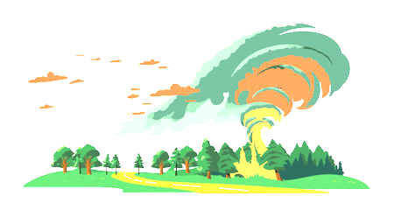
Thank you
Notes:
Questions: Why did you use the Tornado Average starting from 2019 to 2023? I used 2019–2023 because tornado tracking in Canada improved after 2017. Scientists started using better tools like satellites and drones, so the data is more accurate and I chose a recent 5-year period to calculate a reliable average.

Slide 13
Sources
https://www.nssl.noaa.gov/education/svrwx101/tornadoes
https://kids.nationalgeographic.com/science/article/tornado
https://climateinstitute.ca/news/fact-sheet-climate-change-and-storms
https://www.alberta.ca/climate-indicators-air-temperature
https://uwo.ca/ntp/https:
ntpopendata-westernu.opendata.arcgis.com
https://www.nssl.noaa.gov
https://naturecanada.ca/?gad_source

