Slide 1
How do fish survive lightning bolts?
By: Anastasia Korodimas and
Alexis Leung

Slide 2
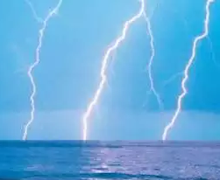
Question to research
How do fish survive when lightning strikes the ocean?

Slide 3
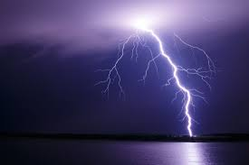
Hypothesis
We think that when lightning strikes the ocean, it will scatter at the surface. That way the fish under the surface of the water are safe.

Slide 4
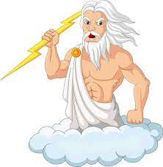
Ancient times
In the ancient times, the people thought that it was because of the gods from heaven. Benjamin Franklin knew that lightning produces electricity in the 1700s. To this day, it is unclear how he knew.

Slide 5
What causes Lightning
Today, scientists are still trying to figure out how, but one of the ways they think it happens is:
In the cloud, the small ice crystals gets pushed upward by wind and the bigger ice crystals fall downward by wind and gravity.
When the two crystals crash into each other, the smaller crystals become positively charged (loss of electrons) and the bigger ice crystals become negatively charged (gain of electrons).
Then the top of the cloud are positively charged and the base of the cloud are negatively charged. This is called an electric field.
The negative and the positive charged field wants to meet with each other, but it is very difficult to move within a cloud. So, then a big electric discharge, lightning, is formed for the two fields to meet or return to neutral

Slide 6
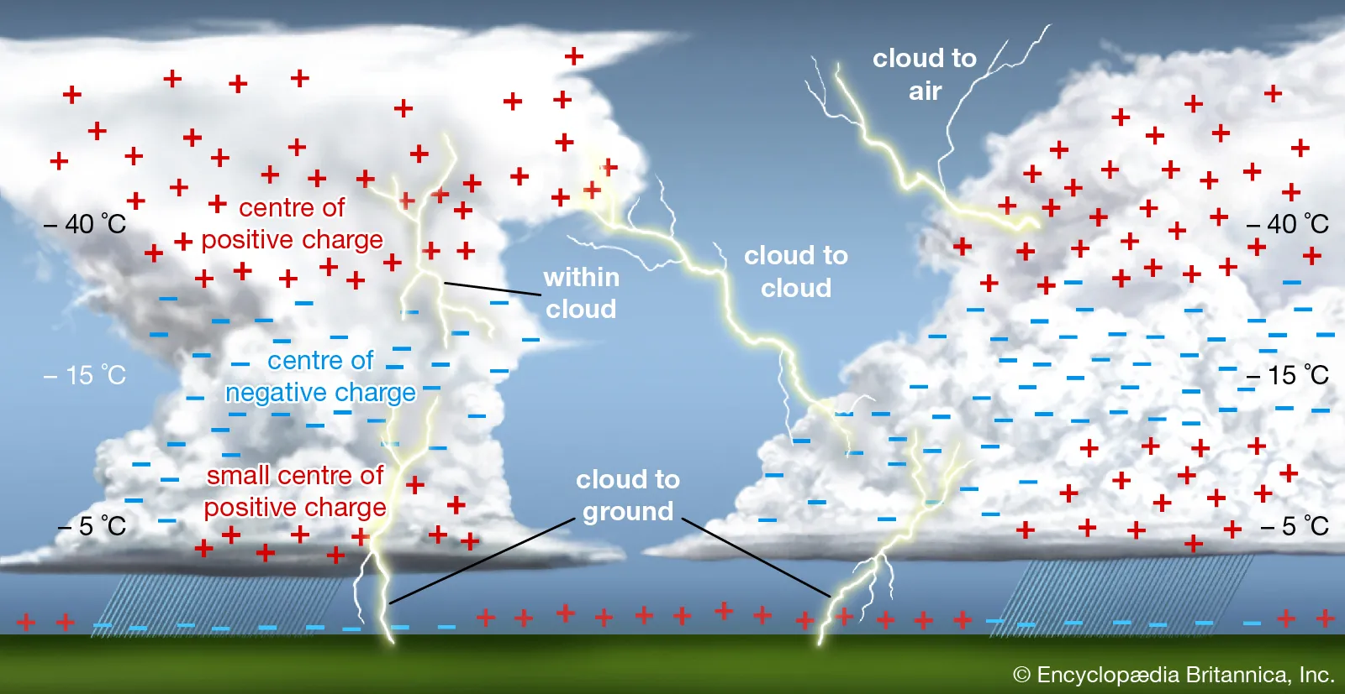

Slide 7
Three types of lightning
Intracloud
Inside the same cloud
Intercloud
Between two different clouds
Cloud to Cloud
Cloud to Air
Cloud to ground
Negative Lightning (90% to 95%)
Positive Lightning (5% to 10%)
10 times greater than negative lightning
Intracloud
Intercloud
Intracloud
Cloud to ground

Slide 8
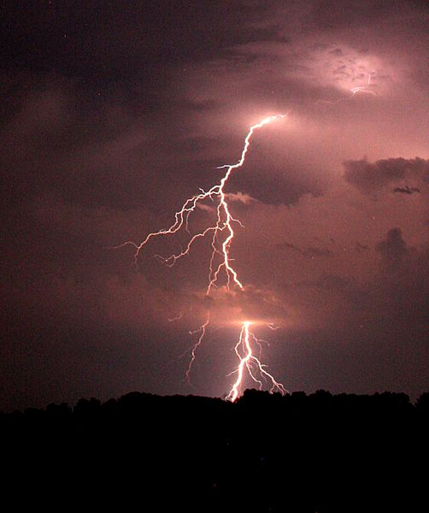
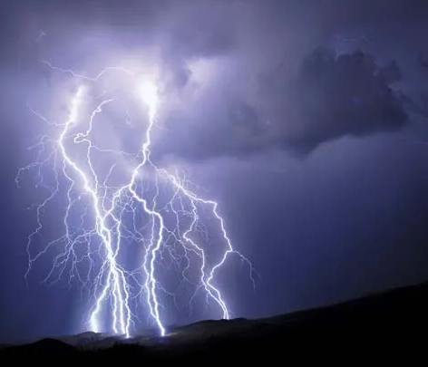
Properties of Lightning
Discharge of electricity
Can heat the surrounding air to over 30,000 degrees celsius, hotter than the surface of the sun
Can generate voltage of over 100 million volts
Typical Intracloud lightning can travel to about 365,000,000 km/h
Takes about 3 seconds to travel from Calgary to Toronto
Typical cloud to ground lightning can travel to about 300,000 km/h
Takes about 41 seconds to travel from Calgary to Toronto
Air acts like an insulator and slows down the speed of cloud to ground lightning

Slide 9
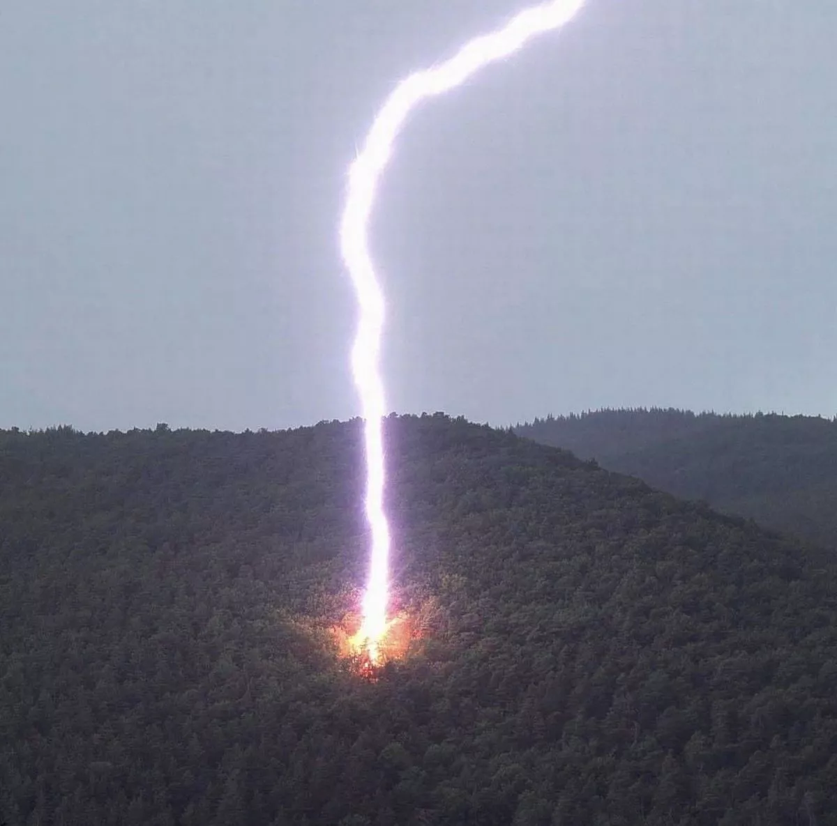
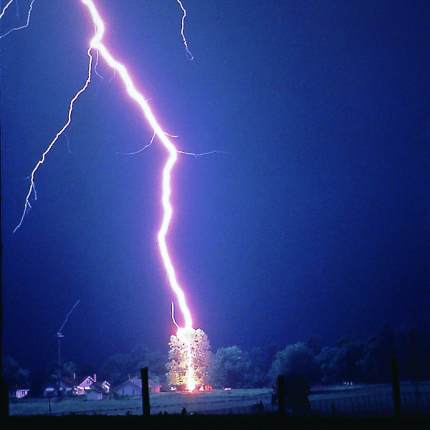
What happens when lightning strikes
A tree
It heats the water and sap inside, generating steam and causing the tree to explode
Humans/Mammals/Birds/Fish
Heart stop, Muscle injuries, Damage to brain and nervous system, Death
So we know lightning is fast, powerful and very destructive and we know a typical fish has no protection against lightning. So how do fish around the world survive lightning?

Slide 10
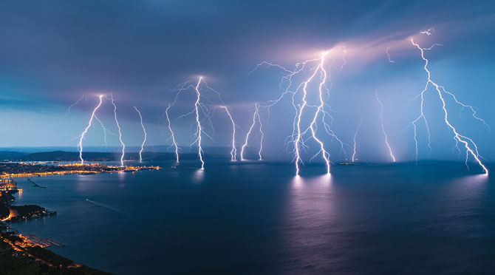
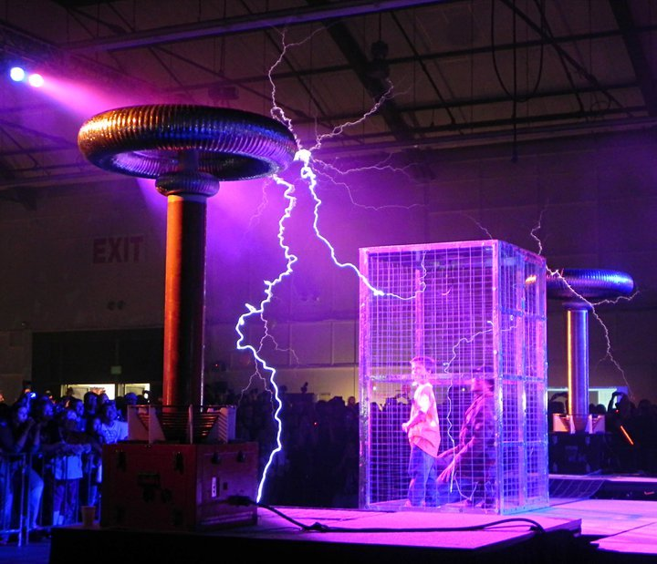
What happens when lightning strikes
The Ocean
Salt water is a great conductor, electricity can easily travels in it
When lightning strikes, the electricity will spread or dissipates over the surface of the water
This is because conductors keep electricity traveling at its surface
So the ocean acts similar to the Faraday Cage and protects the fish who lives underneath the surface
A River/Lake (Fresh water)
River/Lake also contains minerals and ions like the ocean
So, electricity is also spread over the surface of the water, protecting the fish that live underneath the surface
Pure Water
With no ions in the water, distilled water does not conduct electricity (insulator)
So, lightning will likely strike other places where electricity is better conducted
There are no natural bodies of pure water in the world discovered yet

Slide 11
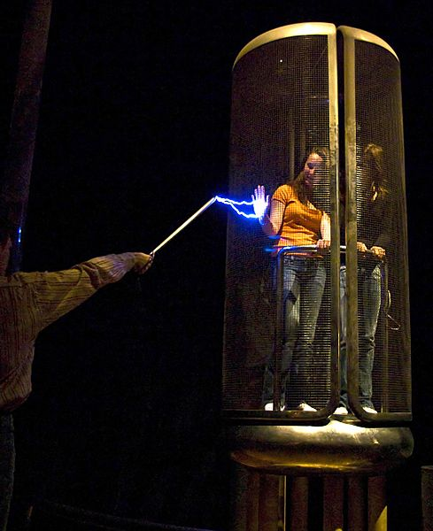
Faraday Cage
The Faraday Cage was invented in 1836 by Michael Faraday. The cage is made of conductive metal to keep you from getting electrocuted. The lightning will only travel along the edge of the cage, keeping objects inside safe from lightning. This concept is being used to build safer homes by using lightning rods.

Slide 12
What can we learn from the fish when lightning strikes
Do not stay on the surface of the water
Go very deep in water and don’t come to the surface until the storm is over
Scientists are not sure how deep lightning will travel
Surround yourself with an insulator, distilled water

Slide 13
But then, since…..
We are not fish so and cannot hold our breath for very long, you should always check the forecast before going out. This way, since our homes have lightning rods you can be protected because of the Faraday Cage concept.

Slide 14
Conclusion
When lightning strikes, the reason fish stay alive is because the ocean protects them. The fish themselves will die, but like we explained earlier the ocean has the same effect as the Faraday Cage. The ocean allows the lightning to travel along the surface of the water. The fish have to be deep underwater to not feel lightning. That means our hypothesis was correct.

Slide 15
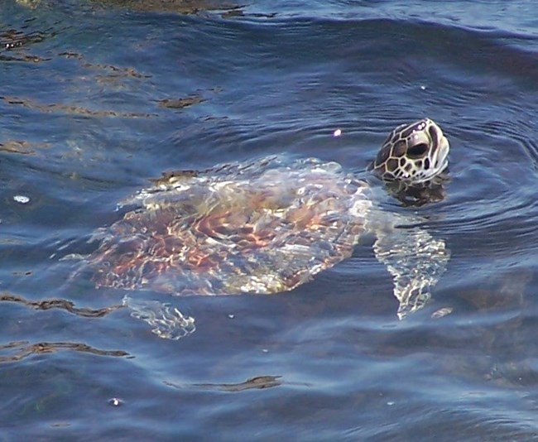
Extra Info About Lightning
Lightning is when an electrical discharge happens in the atmosphere very fast
When lightning strikes, most of the electrical discharge happens near the ocean's surface
Most fish swim below the surface and are unaffected
Some fish that are close to the surface get electrocuted
Never be in a boat or walking outside in a thunderstorm, stay in shelter if you are in a boat, go to the nearest shelter or stay low in the boat
Turtles can also be stunned

Slide 16
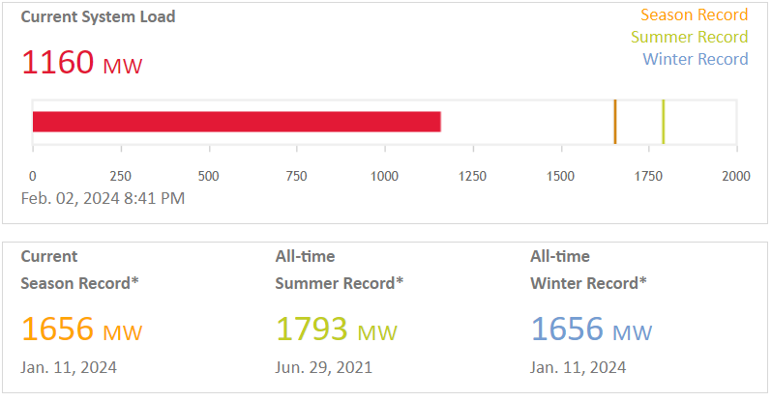
Future Research
According to the picture from Enmax, at peak times we can use up to 1,656 MW(mega watts) in winter. A lightning bolt can carry 100,000 MW( mega watts) in a vigorous storm. That means if we could somehow contain the lightning, then we could power many cities. Also, lightning is very hot and if we could contain the heat, we could heat up many homes. Lightning comes from clouds with circling ions and if we could imitate how lightning is made, then we could power and heat many cities.

Slide 17
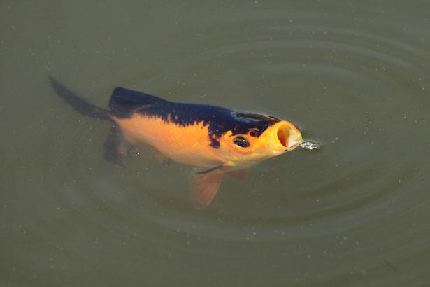
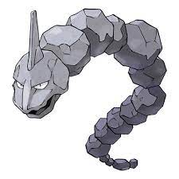
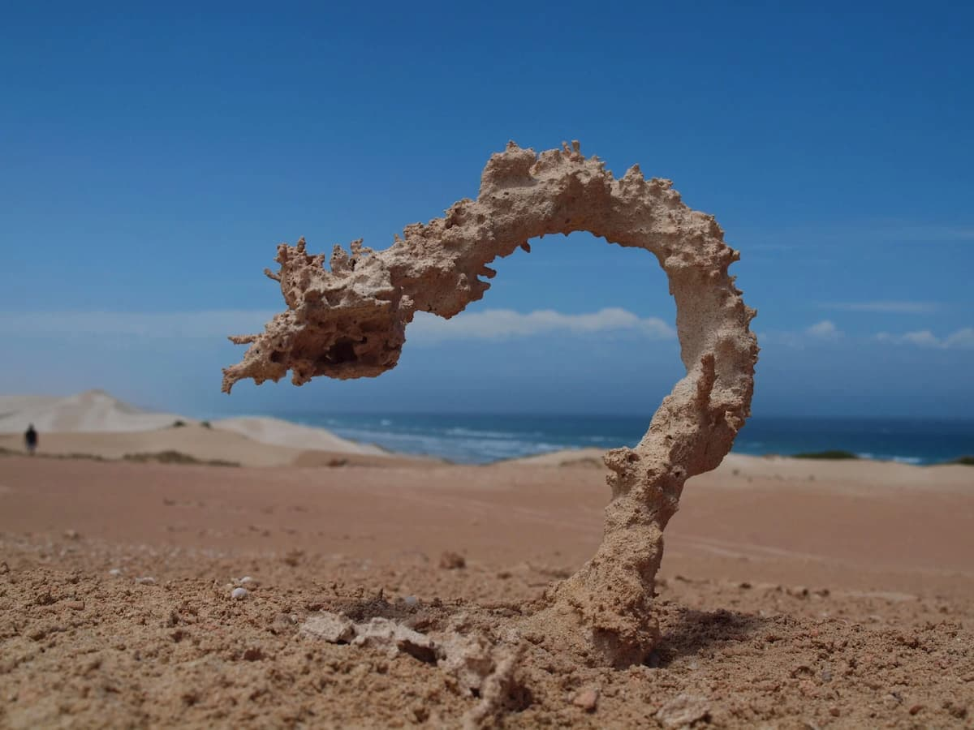
Fun Facts
When a fish is close enough to the surface while a thunderstorm it can be stunned and potentially be dead or lose conscious.
This is what it looks like when it is stunned.
When lightning strikes, will fish feel the shock?
If the fish are deep enough, they may feel a tingle or nothing at all, but scientists are not sure how deep they have to be
Did Benjamin Franklin really fly a kite into the storm while holding it?
No, he would have probably died. But, he likely did an experiment using kite and lightning
Is it true that lightning never strikes the same place twice?
Not true, the Empire state building is hit an average of 23 times a year
How often does lightning strikes
100 strikes per second to Earth’s surface
Chances of being struck by lightning
In the US, it is about 1 in 15, 300 people
When lightning strikes the dirt
It mixes the clay in the dirt and turns it into a rock called fulgurite.

Slide 18
Citations
123RF. “Greek Gods Ancient Religion Greece History Zeus Athena Poseidon Character Isolated Cartoon Mythology Goddess Vector Illustration. Greek Goddess Ancient Mythology and Religion in Greece.” 123RF, www.123rf.com/clipart-vector/cartoon_zeus.html.
Alabama Cooperative Extension System. “Caring for Lightning-Struck Trees - Alabama Cooperative Extension System.” Alabama Cooperative Extension System, 22 June 2023, www.aces.edu/blog/topics/forestry/caring-for-lightning-struck-trees
Balthazar, Deborah. “Lightning at Sea?” Science World, 16 Jan. 2023, https://scienceworld.scholastic.com/issues/2022-23/011623/lightning-at-sea.html?language=english
Britannica Kids. “Lightning”. Encyclopedia Britannica. https://kids.britannica.com/kids/article/lightning/390250
Buckley, Ollie. “Tree Explodes ‘into a Million Pieces’ as It’s Struck by Huge Lightning Bolt.” The Mirror, 14 Mar. 2021, www.mirror.co.uk/news/world-news/moment-huge-lightning-bolt-strikes-23714591
Environment and Climate Change Canada (ECCC). “How lightning works”. Government of Canada. https://www.canada.ca/en/environment-climate-change/services/lightning/science/how-lightning-works.html
Enmax. Real-Time System Demand.. www.enmax.com/generation-wires/real-time-system-demand.
Gabriel, Angeli. “What Happens When Someone Is Struck by Lightning.” FOX Weather, 7 Mar. 2022, www.foxweather.com/learn/what-happens-when-someone-is-struck-by-lightning

Slide 19
Citations
Kid Encyclopedia Facts. “Faraday cage facts for kids”. Kiddle encyclopedia. https://kids.kiddle.co/Faraday_cage
O’Callaghan, Jonathan. “What Is a Faraday Cage?” livescience.com, 3 Dec. 2021, www.livescience.com/what-is-a-faraday-cage.
National Aeronautics and Space Administration “A lightning Primer”. Lightning & Atmospheric Electricity Research. https://lightning.nsstc.nasa.gov/primer/
National Geographic. “Lightning”. Partners. https://www.nationalgeographic.com/environment/article/lightning
National Severe Storms Laboratory. “Severe Weather 101 – Lightning”. U.S. Department of Commerce – National Oceanic & Atmospheric Administration. https://www.nssl.noaa.gov/education/svrwx101/lightning/
National Severe Storms Laboratory. “Severe Weather 101 – Lightning FAQ”. U.S. Department of Commerce – National Oceanic & Atmospheric Administration. https://www.nssl.noaa.gov/education/svrwx101/lightning/faq/
National Severe Storms Laboratory. “Severe Weather 101 – Lightning Types”. U.S. Department of Commerce – National Oceanic & Atmospheric Administration. https://www.nssl.noaa.gov/education/svrwx101/lightning/types/
National Weather Service “Lightning and Cars”. U.S. Department of Commerce – National Oceanic & Atmospheric Administration. https://www.weather.gov/safety/lightning-cars
National Weather Service “Lightning and Fish”. U.S. Department of Commerce – National Oceanic & Atmospheric Administration. https://www.weather.gov/safety/lightning-fish

Slide 20
Citations
National Weather Service “Lightning Myths”. U.S. Department of Commerce – National Oceanic & Atmospheric Administration. https://www.weather.gov/safety/lightning-myths
Science Learning Hub. “Lightning explained”. New Zealand Government. https://www.sciencelearn.org.nz/resources/239-lightning-explained
Sottile, Zoe. “How to survive a lightning strike – or, better yet, avoid one”. CNN Travel. https://www.cnn.com/travel/article/lightning-strike-how-to-survive/index.html
The Economic Times. “Do fish die when lightning strikes the ocean?” India Times. https://economictimes.indiatimes.com/do-fish-die-when-lightning-strikes-the-ocean/articleshow/15700931.cms
Water Science School. Conductivity (Electrical Conductance) and Water | U.S. Geological Survey. 22 Oct. 2019, www.usgs.gov/special-topics/water-science-school/science/conductivity-electrical-conductance-and-water.
“What happens to the Human Body When it's Struck by Lightning?” Atrium Health. 26 June 2019, https://atriumhealth.org/dailydose/2019/06/26/what-happens-to-the-body-when-its-struck-by-lightning
“When Lightning Strikes”. Ocean Today. https://oceantoday.noaa.gov/lightning/
“When Thunder Roars, Go Indoors:” Lightning Safety Advice from NOAA. U.S. Department of Commerce. https://www.commerce.gov/news/blog/2022/08/when-thunder-roars-go-indoors-lightning-safety-advice-noaa

