Slide 1
How Does Dehydration Impact the Human Body?
By Usman Arain
A before after intervention experiment

Slide 2
Abstract
Introduction: Dehydration is the result of not drinking adequate water according to body needs. During exercises, adequate water is important to maximize endurance and performance. Usually it is recommended that exercises lasting less than 1 hour is not much affected by dehydration. However, in this study, I am testing if moderate amount of physical activity for as little as 20 mins can impact hydration status of the body.
Methods: I did a before and after experimental research study on 4 participants (including myself). The intervention was 20 mins, uninterrupted indoor brisk walk at room temperature. The measurements included heart rate, respiration rate, and skin hydration using a digital device to compare the changes in the hydration status before and after the intervention.

Slide 3
Abstract (cont’d)
Results: A total of 4 research participants included in this experimental research study. 75% were male, and 25% female. All 4 participants were healthy and had no medical conditions affecting physical activity or water intake. 2 participants were adult (18+yrs) and 2 participants were children under the age of 13 yrs. The average weight the average weight of the children participants was 33.0kg. The average weight of the adult participants was 69.5kg. The average height of the children participants 59 inches. The average height of the adults was 62.5 inches. The analysis for all participants showed significant increase in heart and respiratory rate and decrease in skin hydration after the intervention. Children group had more visible effect on heart rate and less on skin hydration while adult group had more visible change in skin hydration and less in heart rate. Analysis by gender did not show any variations.
Conclusion: This experimental study has demonstrated the impact of mild to moderate physical activity on the hydration status of skin and heart. The impact varies by age, weight and gender. Thus, it is recommended to appropriately hydrate with every physical activity to prevent negative impact on skin and heart.

Slide 4
Abstract (cont’d)
Conclusion: This experimental study has demonstrated the impact of mild to moderate physical activity on the hydration status of skin and heart. The impact varies by age, weight and gender. Thus, it is recommended to appropriately hydrate with every physical activity to prevent negative impact on skin and heart.

Slide 5
Introduction
Dehydration is the result of not drinking enough water according to body needs. Hydration is important for many different reasons. One reason is it allows body organs to function at optimum level. Several studies I reviewed stated that dehydration can lead to health problems such as heart related risks, brain related risks, skin dehydration and muscle weakness. One study I reviewed concluded that dehydration affects mostly the lower half of the body after conducting an experiment. Another study I reviewed (Eric Db Goulet, et al 2012) recommended drinking 5-10 mL/kg body weight 2 hours before exercise for endurance athletes. That study also stated that in exercises lasting less than 1-hour dehydration does not decrease endurance, but athletes are recommended to mouth rinse with sports drinks and in exercises lasting over an hour and which fluid is readily available, drinking according to thirst will maximize endurance and performance. However, I hypothesize that a moderate amount of as little as 20 minutes of physical may impact the hydration status of human body.

Slide 6
Daily Water Intake
The daily water intake varies by age and by activity level
These are just general recommendations:
Children
1-3 years: About 1.3 liters (5.5 cups)
4-8 years: About 1.7 liters (7 cups)
9-13 years: About 2.4 liters (10 cups) for boys, 2.1 liters (9 cups) for girls
14-18 years: About 3.3 liters (14 cups) for boys, 2.3 liters (10 cups) for girls
Adults
Men: About 3.7 liters (16 cups)
Women: About 2.7 liters (11 cups)
Activity Levels
Moderate Activity: Increase intake by about 0.5 to 1 liter.
High Activity: Increase intake by about 1.5 to 3 liters

Slide 7
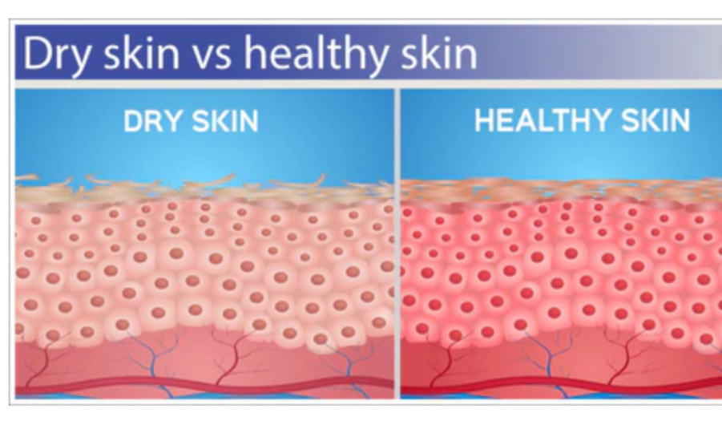
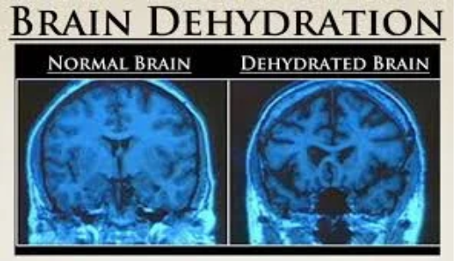

Slide 8
Research Question
How does short-term (<30 mins) physical activity impact hydration on the skin and heart?

Slide 9
Hypothesis
As little as 20 minutes physical activity significantly changes the amount of hydration in the skin and heart.

Slide 10
Methodology
This study was conducted in the Calgary region on 4 volunteer research participants in February of 2026. I conducted an experimental before and after experimental study on healthy human research participants to measure the hydration status before and after 20 mins physical activity. I included myself and three other family members to measure hydration status. I used brisk walk as the intervention of physical activity. The outcome was measured through skin hydration and body vitals including heart rate and respiration rate. I tested all four participants to determine if age and height had any impact on the measurements. To measure hydration level, I used a digital skin hydration tester, which provides accurate results and used by aesthetic professionals. It is a non-invasive testing device which is used on thin skin areas such as face and arms. The device was pilot tested 5 times to ensure accurate result before using it on the study participants.

Slide 11
Methodology (cont’d)
The normal heart rate for 10 – 13 years old = 70 – 100 beats per minute
The normal heart rate for adult (18+) = 60 – 100 beats per minute
The normal respirator rate for 10 – 13 years old = 12 – 22 per minute
The normal respirator rate for adult (18+) = 10 – 20 per minute

Slide 12
Methodology (cont’d)
Other measures included heart rate, respiratory rate, before and after the intervention (20 mins brisk walk).
The data provided an insight into how the hydration levels are impacted because of physical activities. The key variables in the analysis were age, gender, height and weight. The effect of confounding variables was determined to see any impact on the outcome.
The data were compared using mean readings before and after the intervention. The study participants provided informed consent and I provided information about the study procedures and the instruments for measurements. The involvement of their estimated time involved to participate in the study was also explained to the study participants.

Slide 13
The Intervention
20 mins uninterrupted moderate indoor physical activity (brisk walk) at room temperature over 3 days. No eating or drinking (such as water sips) was allowed during the period of intervention. The same intervention was used for all study participants.

Slide 14
Results
A total of 4 research participants is included in this experimental research study. 75% were male, and 25% female. All 4 participants were healthy and had no medical conditions affecting physical activity or water intake. 2 participants were adult, (18+) and 2 participants were children under the age of 13. The average weight the average weight of the children participants is 33.0kg. The average weight of the adult participants was 69.5kg. The average height of the children participants 59 inches. The average height of the adults was 62.5 inches

Slide 15
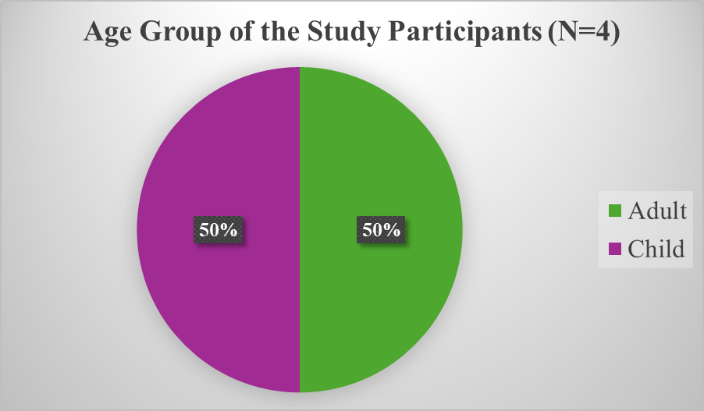
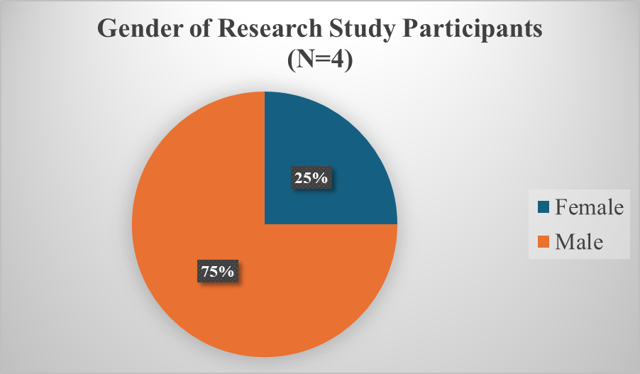
Results

Slide 16
Result (Cont’d)
The detailed analysis of before and after readings of all participants of three days are presented in these figures before. The first figure shows combined data from all participants which shows increase in heart rate and respirator rate after the intervention and decrease in skin hydration levels. Other figures show data for children only which had more impact on heart rate and less on skin hydration compared to adult group where the skin hydration changes were more impacted. The charts for male and female did not show much difference showing less or no variations due to gender.

Slide 22
Conclusion
This experimental study has demonstrated the impact of mild to moderate short-term (<30 mins) physical activity on the hydration status of different body organs. The impact on the hydration status of skin and heart varies by age groups but not by gender. Therefore, the requirement of water intake also varies by different age groups and sufficient water intake is required to maintain the health status of skin and healthy heart functioning.

Slide 23
Recommendations
We often recommend regular physical activity to maintain overall body health but, at the same time we often ignore to include hydration as a necessary part of physical activity which is also highly important.
Although hydration for almost all body is important, skin and heart are 2 of the organs which are immediately affected by the changes in hydration level.
Mild to moderate level of short-term (<30mins) physical activity may also need hydration to keep the body organs fully functional. This is particularly important for areas like Calgary where air humidity is less and dehydration often lead to health issues such as migraine.

Slide 24
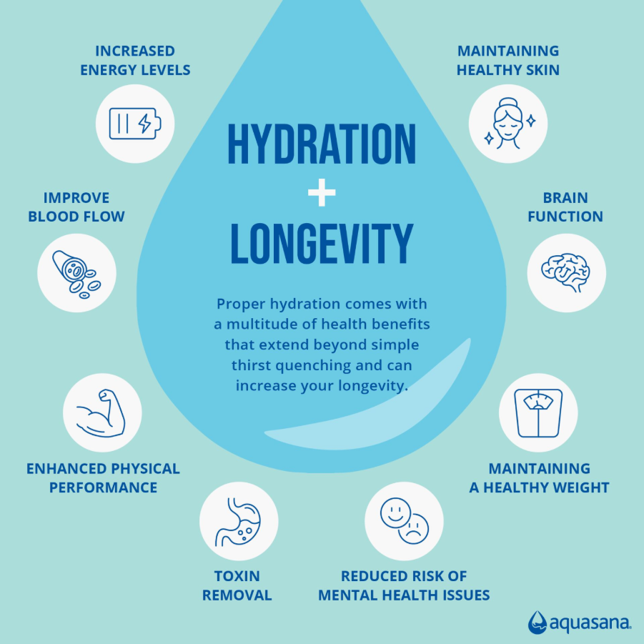

Slide 25
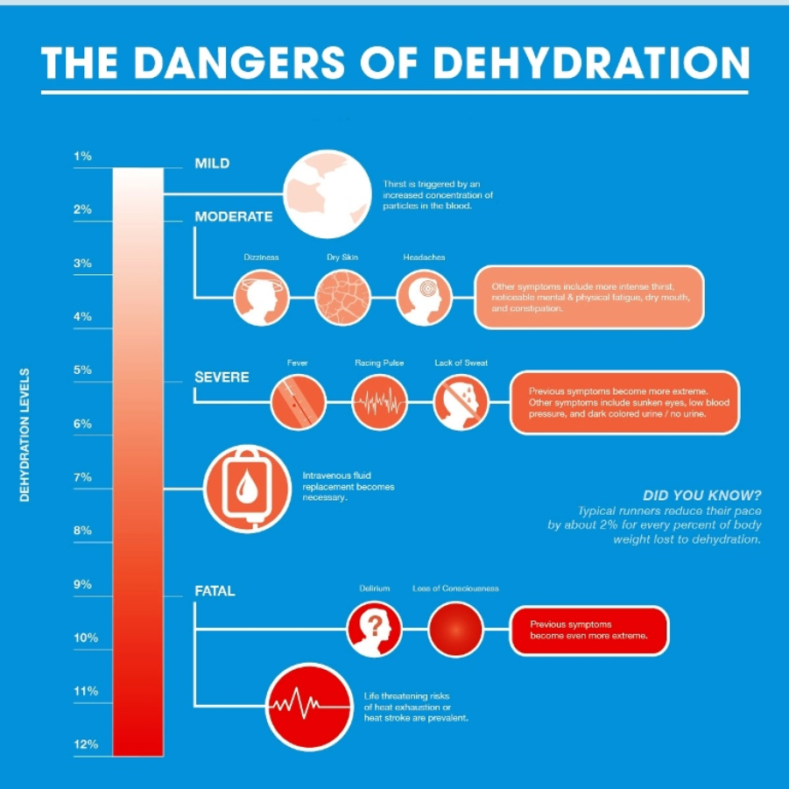

Slide 26
Limitations
The study was conducted on 4 people, so there could wider variation of people. So in the future the same study could be conducted on a larger number of participants.
The measurements used for the hydration status were all non-invasive to ensure the safety of the participants. However, more accurate findings could be obtained with higher levels of technology or by using blood samples or urine samples.
This study only measures the hydration status of organs like skin and heart, but almost every organ in the body may impact by the changes in hydration levels, but only some are measured in this study.

Slide 27
Challenges
Finding out the right measuring tools for the hydration status of things like the skin was challenging. I had to do literature searches to find out what are the possible ways to measure the current hydration status.
I included myself as a study participant which was hard to remain objective. However, using the standard processes and measuring tools ensure to keep my personal bias away from the results. It was challenging to not add my personal experience because I sometimes don't drink enough water.
The overall timeline was sightly challenging as I had to background literature searches, develop study processes/methodology, and conduct an experimental study during a short period of time.
The other challenge was to present the information from several articles in a concise summary for the introduction part. To develop an introduction, I did literature searches and found several articles, so it was challenging to present them in a concise summary.

Slide 28
References
Judelson, D.A., Maresh, C.M., Anderson, J.M. et al. Hydration and Muscular Performance. Sports Med 37, 907–921 (2007). https://doi.org/10.2165/00007256-200737100-00006
Sawka MN, Cheuvront SN, Kenefick RW. Hypohydration and Human Performance: Impact of Environment and Physiological Mechanisms. Sports Med. 2015 Nov;45 Suppl 1(Suppl 1):S51-60. doi: 10.1007/s40279-015-0395-7. PMID: 26553489; PMCID: PMC4672008.
Eric Db Goulet, Dehydration and endurance performance in competitive athletes, Nutrition Reviews, Volume 70, Issue suppl_2, 1 November 2012, Pages S132–S136
L. Kilpatrick-Liverman, J. Mattai, R. Tinsley, J. Wu. BookHandbook of Cosmetic Science and Technology. First Published2009. Edition3rd Edition. Pages16
Trangmar, S.J., González-Alonso, J. Heat, Hydration and the Human Brain, Heart and Skeletal Muscles. Sports Med 49 (Suppl 1), 69–85 (2019). https://doi.org/10.1007/s40279-018-1033-y
Maffulli N. Making weight: a case study of two elite wrestlers. Br J Sports Med. 1992 Jun;26(2):107-10. doi: 10.1136/bjsm.26.2.107. PMID: 1623355; PMCID: PMC1478935.
Maughan RJ, Shirreffs SM. Dehydration and rehydration in competative sport. Scand J Med Sci Sports. 2010 Oct;20 Suppl 3:40-7. doi: 10.1111/j.1600-0838.2010.01207.x. PMID: 21029189.

Slide 29
References (cont’d)
Edmonds CJ, Foglia E, Booth P, Fu CHY, Gardner M. Dehydration in older people: A systematic review of the effects of dehydration on health outcomes, healthcare costs and cognitive performance. Arch Gerontol Geriatr. 2021 Jul-Aug;95:104380. doi: 10.1016/j.archger.2021.104380. Epub 2021 Feb 17. PMID: 33636649.
Modelling the effect of hydration on skin conductivity. L. Davies, P. Chappell, T. Melvin,. Davies, L., Chappell, P. and Melvin, T . (2017), Modelling the effect of hydration on skin conductivity. Skin Res Technol, 23: 363-368. https://doi.org/10.1111/srt.12344
Martínez-Noguera FJ, Cabizosu A, Alcaraz PE, Marín-Pagán C. Effects of pre-exercise glycerol supplementation on dehydration, metabolic, kinematic, and thermographic variables in international race walkers. J Int Soc Sports Nutr. 2024 Dec;21(1):2346563. doi: 10.1080/15502783.2024.2346563. Epub 2024 Apr 27. PMID: 38676933; PMCID: PMC11057399.
Rodrigues R, Baroni BM, Pompermayer MG, de Oliveira Lupion R, Geremia JM, Meyer F et al Vaz MA. Effects of acute dehydration on neuromuscular responses of exercised and nonexercised muscles after exercise in the heat. J Strength Cond Res. 2014 Dec;28(12):3531-6. doi: 10.1519/JSC.0000000000000578. PMID: 24942173.
The IThe Importance of Hydration. March 1, 2019 by Safecare

