Slide 1
Gross Electricity
By: Parth Kale
Fairview Junior High School

Slide 2
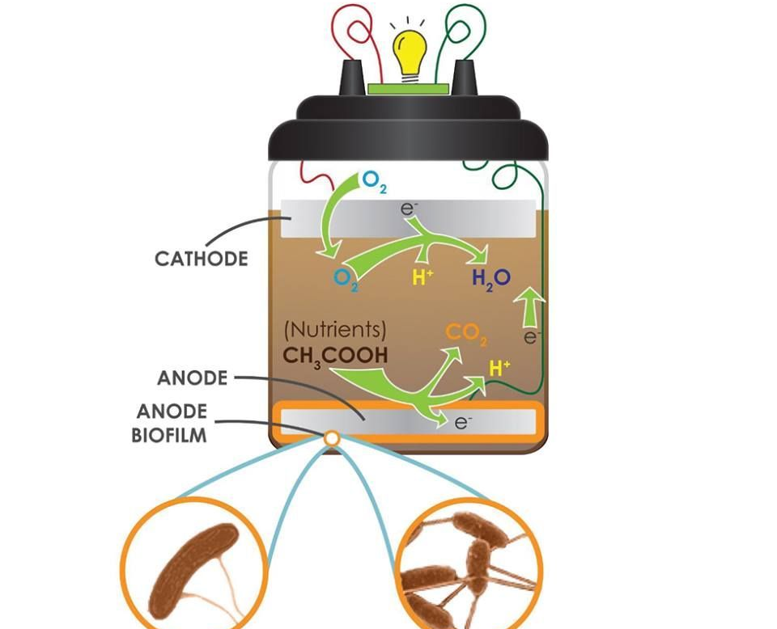
How does it work?
When electrogenic bacteria that are present in the soil eat, and break down organic or inorganic substrates in the soil, their digestive system generates electrons. These electrons are then returned back into the soil. This procedure occurs inside a container. The machine contains a cathode (positive), and an anode (negative). This in turn produces a complete circuit. The electrons move throughout the mud. Then an electrical chip harnesses this power in order to extract electricity from the mud, and there you have electricity.

Slide 3
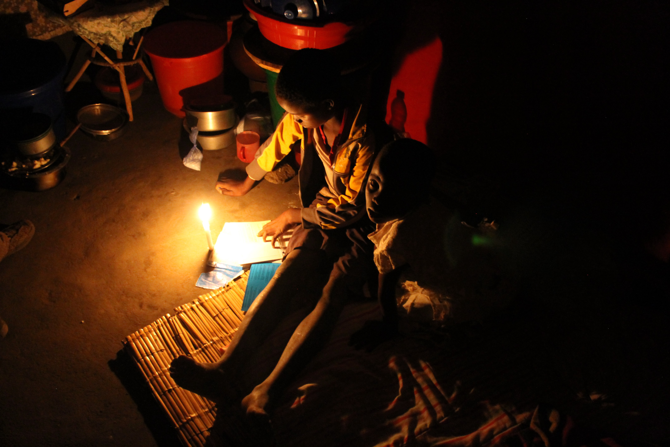
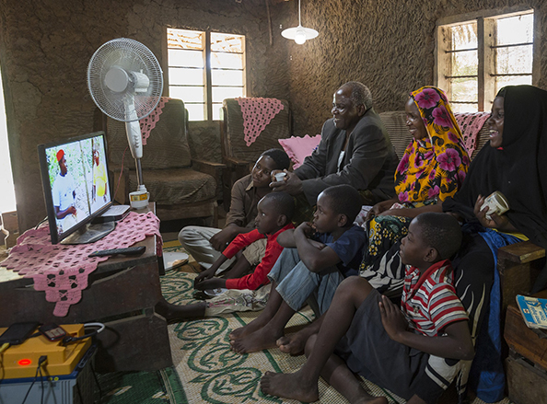
Where can it be used?
On our planet, there are many developing countries which are in need of electricity. They need electricity so that they can power a light bulb, and not eat in the dark, they need electricity so that hospitals can perform life saving operations. Not only that but in most developing country’s, even proper disposal of waste cannot be taken care of due to shortage of funds/money. This majority of this waste includes human excretes. Not only does human excretes contaminate drinking water, but also causes various deadly diseases like Cholera, Typhoid, Hepatitis, Polio, and many more.

Slide 4
The Future
In the future with the help of further development of infrastructure, we can integrate this technology into developing countries' societies. This way they can be provided with a better quality of life.

