Slide 1



Assessment of Solar Irradiance Patterns and Solar Power Potential in Calgary Using Data Analysis
Calgary Youth Science Fair (CYSF) Project 2026
Submitted by: Arushi Paul Grade 6 Fairview School Calgary, Alberta Canada
Study Location: Calgary, Alberta
Data Source: NASA Power, Statistics Canada
Notes:
Hello everyone, my name is Arushi Paul and I am in grade 6. Today, I am here to present my science fair project which is entitled as Assessment of Solar Irradiance Patterns and Solar Power Potential in Calgary Using Data Analysis. The sources I used for data is NASA power and statistics Canada and my study locations were Calgary and Alberta.

Slide 2
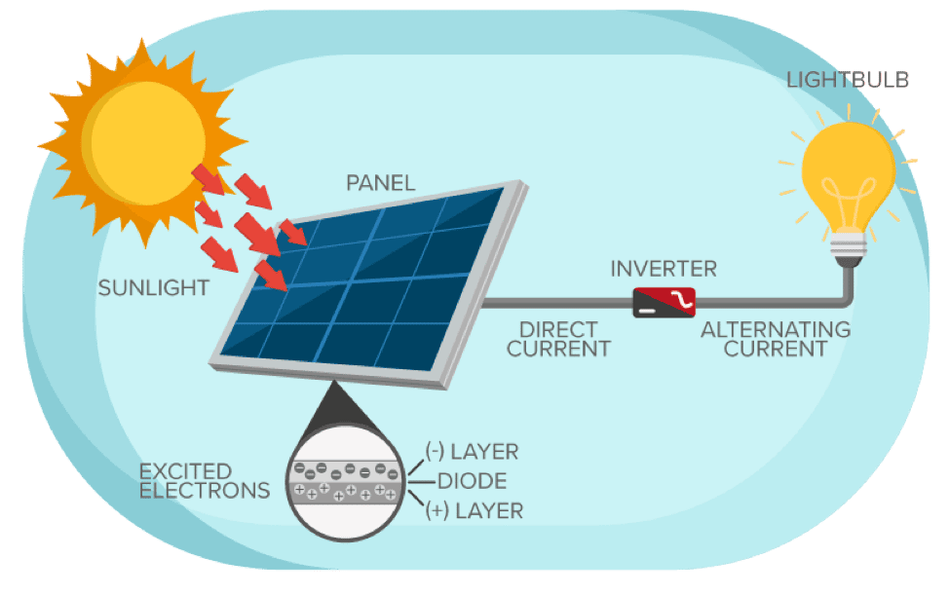
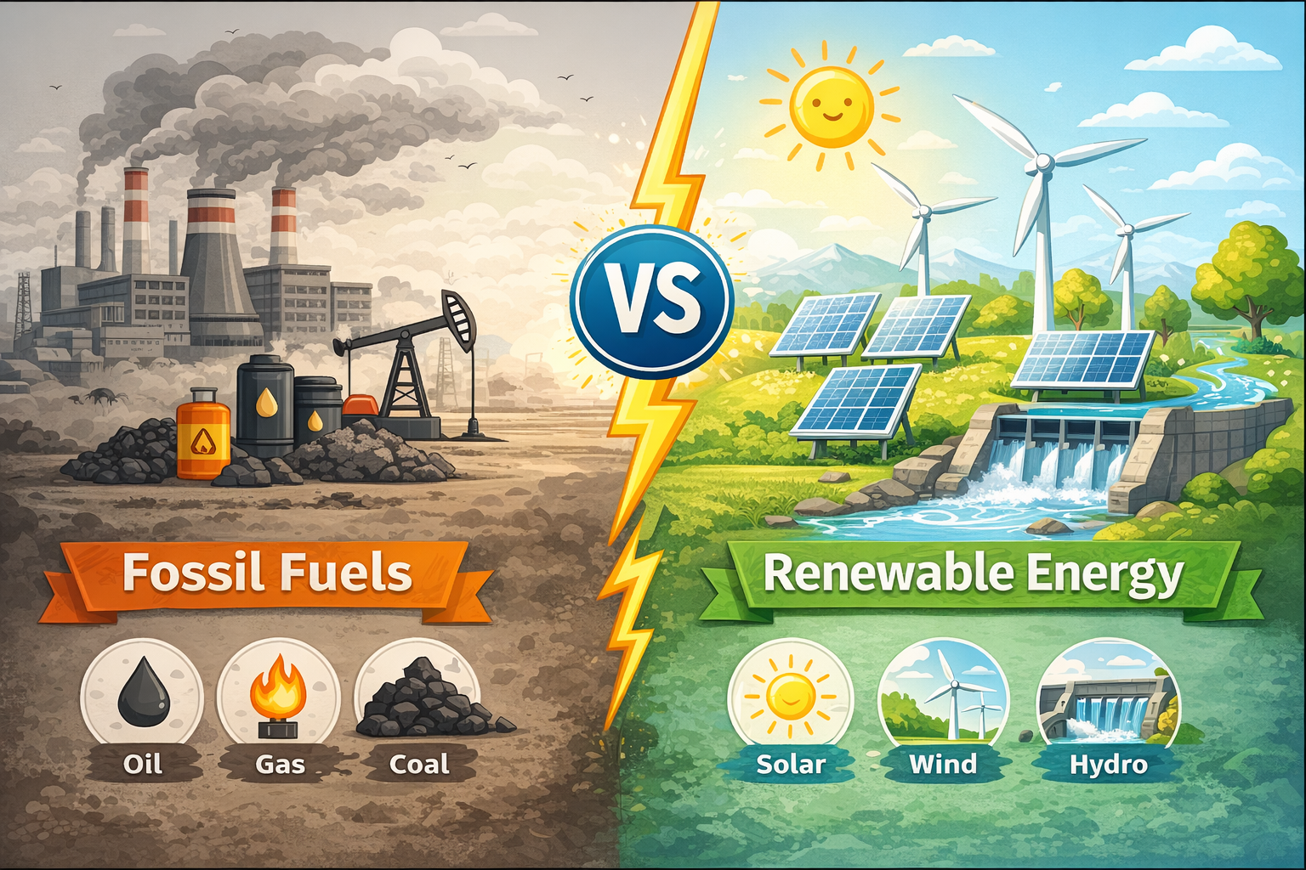
Why I Chose this Project
Motivations and Goals
To evaluate whether solar power is a practical energy solution n for Calgary using real scientific data.
To study how solar energy can reduce pollution and climate change.
To explore how photovoltaic (solar) energy can provide clean and renewable electricity.
To examine whether solar energy can work effectively in cold climates like Canada.
Why Solar Power?
Solar power uses energy from the sun
It does not produce pollution or greenhouse gases
Solar panels can be installed on rooftops
Solar energy helps reduce electricity bills and carbon emissions
Fig 01: Fossil Fuel Vs. Renewable Energy
Fig 02: Working Principle of Solar Power
The Sun sends solar energy to Earth
Solar Panels catch Sunlight and turn Sunlight into electricity
Electricity powers lights, fans, TV, and other devices
The inverter changes the electricity into a form that homes can use
Notes:
Before moving on to my main slides, I would like to talk about my motivations and goals. For this project, I wanted to understand whether solar power can really work in a city like Calgary by using real scientific data. We all know that climate change is becoming a serious problem, and one major reason is the use of fossil fuels, which release pollution and greenhouse gases into the air. That is why I was interested in renewable energy, especially solar energy, which is clean and sustainable. However, many people believe that solar power does not work well in cold and cloudy countries like Canada. Through this project, I wanted to test whether that assumption is true by analyzing real solar data from Calgary. From Figure 2 we can understand the working principle of solar power. This diagram shows how solar energy works: first, the Sun sends energy to Earth, and then solar panels capture the sunlight and convert it into electricity. After that we have to use an inverter to change the electricity into a form that homes can use. Finally, it can run lights, TVs, and other devices in our homes.

Slide 3


Data Sources
Table 01: Primary Data Source
NASA Power [1] | Statistics Canada [2]
Provided hourly solar irradiance and weather data | Provided electricity generation and installed capacity data
Variables used: Solar Irradiance Air Temperature Wind Speed | Used to study renewable vs. fossil fuel energy trends in Alberta
Used to analyze daily, monthly, and seasonal solar patterns in Calgary | Data Years analyzed: 2015-2024
These datasets were used to study solar energy potential and electricity trends in Calgary and Alberta.
Official Data Websites
NASA POWER : (https://power.larc.nasa.gov/)
Statics Canada : (https://www.statcan.gc.ca/ )
Notes:
Now here is the information regarding my data sources. From the left side of table 1 you can see I mentioned NASA power as my data source. NASA POWER provided hourly solar irradiance and weather data for Calgary. The main variable I used is the solar irradiance, which measures how much sunlight reaches the ground, including during cloudy conditions. I also used air temperature and wind speed data to better understand weather patterns. Basically, this data helped me to analyze how solar energy changes daily, monthly, and seasonally in Calgary. Secondly, I used data from Statistics Canada. This source provided information about electricity generation and installed power capacity in Alberta. I used this data to study how renewable energy compares with fossil fuel energy over time. Both datasets are publicly available.

Slide 4

Research Questions and Problem
What I wanted to find out
How Sunlight varies throughout the days and years?
Which seasons and months receive the most solar energy?
How many days are sunny, cloudy, or mixed?
Is solar power a good option for Calgary’s future?
Problem
Does Calgary receive enough sunlight throughout the year for solar panels to be our main source of energy.
Notes:
Now here are my Research questions and problems. In this part of my project, I focused on understanding how sunlight changes in Calgary over time and what that means for solar power. I wanted to find out how solar irradiance varies during the day and across different seasons, which months receive the most solar energy, and how many days are sunny, cloudy, or partly sunny. Most importantly, I wanted to answer one key question: Is solar power a good option for Calgary’s future? The main problem I investigated was whether Calgary receives enough sunlight throughout the year for solar panels to be a reliable and practical energy source.

Slide 5

Hypothesis
Hypothesis
Solar irradiance in Calgary varies by season, month, and time of day.
Summer (June–July) will have the highest solar irradiance and solar energy due to longer daylight hours and higher sun angle.
Solar irradiance will peak around midday (11 AM – 2 PM).
Winter (November–January) will have the lowest solar irradiance and energy due to shorter days and a lower sun angle.
Solar panels will produce much more electricity in summer than in winter.
Battery storage and grid support will be needed for a reliable winter electricity supply.
Notes:
Before I started my project, I made a hypothesis, which is my best scientific guess. I thought that the amount of sunlight in Calgary would change depending on the season, the month, and the time of day.
I predicted that summer, especially June and July, would have the most sunlight and solar energy because the days are longer, and the sun is higher in the sky. I also thought that the strongest sunlight would happen around noon.
I predicted that winter would have the least sunlight because the days are shorter, and the sun stays low.
Finally, I thought that solar panels would make much more electricity in summer than in winter, so batteries and help from the power grid would be needed in winter.

Slide 6
Methodology
Identify The Problem
Does Calgary receive enough sunlight to be a good place for solar power?
Select Study Area
Calgary, Alberta
Collect Data
1. NASA Power: Solar irradiance, air temperature, wind speed
2. Statistics Canada: Renewable Vs. Fossil electricity capacity
Organize and process Data
Grouped by: Hour of day, Month, Season
Classify Day Types
Using daily average solar irradiance: Sunny day, Moderate day, and Cloudy day
Data Analysis
Hourly solar pattern (sunrise to sunset), Monthly solar trend, Seasonal comparison, Solar vs. air temperature, Solar vs. wind potential, Alberta energy mix trend over time
Data Visualization
Result and Interpretation
Fig 03: Methodology flowchart illustrating data collection, processing, analysis, and interpretation used to assess solar energy potential in Calgary.
Notes:
This slide shows how I did my project step by step.
First, I identified the problem, which was to find out if Calgary receives enough sunlight to be a good place for solar power.
Next, I selected Calgary, Alberta as my study area in the website’s map for data collection.
Then, I collected data from two reliable sources: NASA Power and Statistics Canada
After that, I organized the data by hour of the day, month, and season.
I also classified each day as sunny, partly sunny, or cloudy using the daily average solar irradiance.
Then, I analyzed the data to study daily patterns, monthly changes, and seasonal differences.
Finally, I created graphs and charts to visualize the results and interpret what the data means for solar power in Calgary.

Slide 7
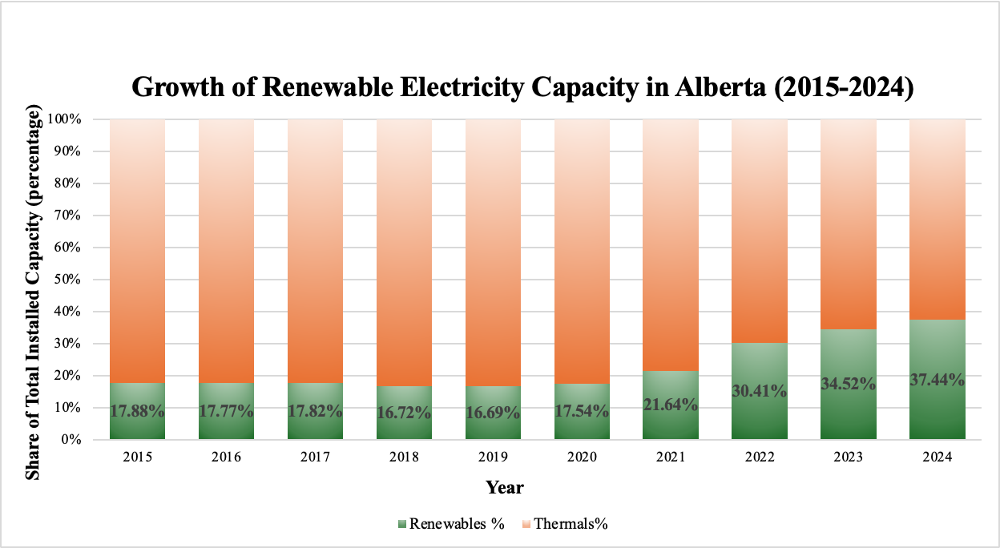
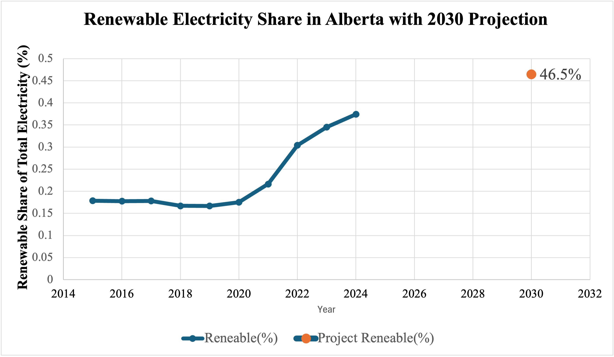
Energy Mix Transition in Alberta
2030 value was estimated using historical data (2015–2024) and a linear trend model.
Fig 03: Growth of Renewable Electricity Capacity In Alberta (2015-2024)
Fig 04: Renewable Electricity Share in Alberta with 2030 Projection
Renewable energy in Alberta has grown a lot from 2015 to 2024
Renewable energy share more than doubled from ~18% (2015) to ~37% (2024)
Most renewable growth happened after 2021
Thermal energy is still dominant but decreasing.
If the current trend continues, renewables could reach ~46% by 2030, almost half of Alberta’s electricity.
Notes:
This slide shows how Alberta’s electricity is changing from fossil fuels to renewable energy. On the left graph, the green part shows renewable energy like wind and solar, and the orange part shows fossil fuels like natural gas. We can see that renewable energy has grown a lot from 2015 to 2024. In 2015, renewables made about 18% of Alberta’s electricity. By 2024, it increased to about 37%, which means it has more than doubled. Most of this growth happened after 2021. The graph on the right shows a prediction for the year 2030. If this trend continues, renewable energy could reach about 46%, which is almost half of Alberta’s electricity. This is important because it shows Alberta is moving toward clean energy, and solar power in Calgary can help support this change and reduce pollution in the future.

Slide 8
Geography Factors
Latitude
Elevation
Sun Angle
Length of Daylight
Cloud Cover
Seasonal Changes
Latitude
~51N
Calgary is located at about 51° North latitude.
Elevation
1045m above sea level
Higher Elevation means a thinner atmosphere; less sunlight is absorbed.
More sunlight reaches the solar panel compared to lower-living cities
Other factors
Length of daylight, Seasonal sunlight variation, and Cloud cover are data-based factors. I will analyze historical data to find out its pattern.
This gives Calgary long daylight hours in summer.
Longer days mean more time for solar panels to produce electricity.
Fig 06: Geographical Factors that Affect Solar Power Potential
Notes:
Now, in this slide, I will explain how location affects solar power potential. Calgary is located at about 51 degrees north latitude, which means it has long daylight hours in summer. This gives solar panels more time to produce electricity. Calgary is also about 1,045 meters above sea level. At higher elevations, the air is thinner, so less sunlight is blocked, and more sunlight reaches the solar panels. These two factors stay the same and are good for Calgary’s solar potential. Other factors, such as the angle of the sun, seasons, day length, and cloud cover, change throughout the year and affect how much sunlight reaches the ground. In my project, I analyzed historical data to study these patterns and understand how good solar power is for Calgary’s future.

Slide 9
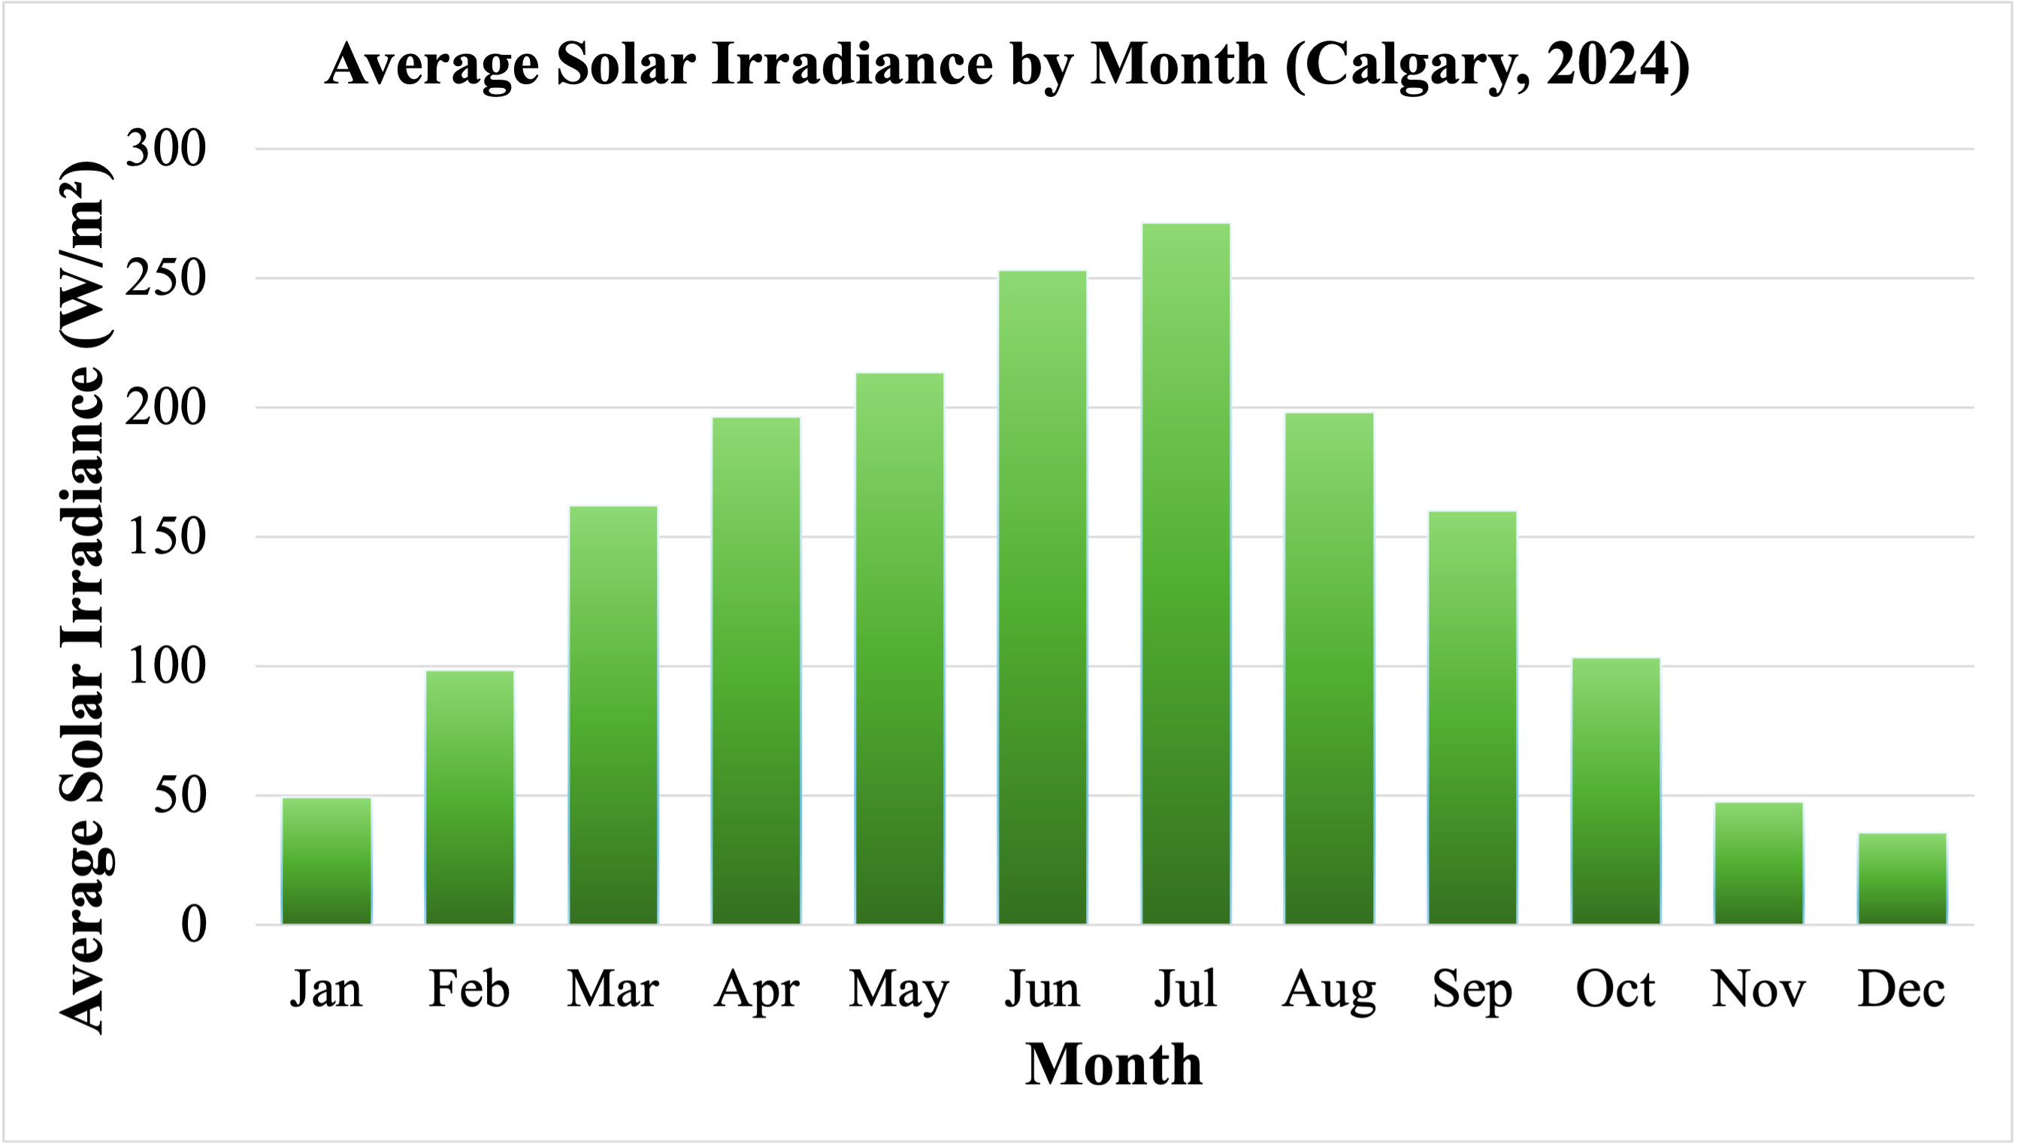
Monthly Solar Irradiance in Calgary
What is Solar Irradiance?
Solar irradiance = strength of sunlight (W/m²)
More sunlight → more electricity from solar panels
Table 02: Solar Irradiance Levels & Solar Potential [3]
Average Solar Irradiance (W/m²) | Solar Potential
< 75 W/m² | Poor
75 – 150 W/m² | Low–Moderate
150 – 250 W/m² | Good
> 250 W/m² | Excellent
Fig 05: Average Solar Irradiance by Month (Calgary, 2024)
Key Findings
Solar irradiance peaks in July (~270 W/m²)
The lowest values occur in December (~35 W/m²)
Summer solar energy in Calgary is approximately 5 times higher than in winter.
Solar power potential in Calgary is good to excellent from April to September, with peak performance in June and July.
Notes:
From this slide you can see the analysis part of my project. First, we need to know what solar irradiance is and why it is important. Solar irradiance means the strength of sunlight that reaches the ground. It is measured in watts per square meter. When sunlight is stronger, solar panels can make more electricity. When sunlight is weaker, solar panels make less electricity. The graph on the right shows the average solar irradiance for each month in 2024. We can see that the sunlight reaches its highest point in July, and then decreases again in the fall and winter. In July, the solar irradiance is about 270 watts per square meter, which is the highest of the year. In December, it is only about 35 watts per square meter, which is the lowest. Here you can also see table 2 which shows how different sunlight levels affect solar power potential. Using the graph and the table together, we can conclude that Calgary has good to excellent solar power potential from April to September, with the best performance in June and July. This helps explain why solar panels in Calgary produce much more electricity in summer than in winter.

Slide 10
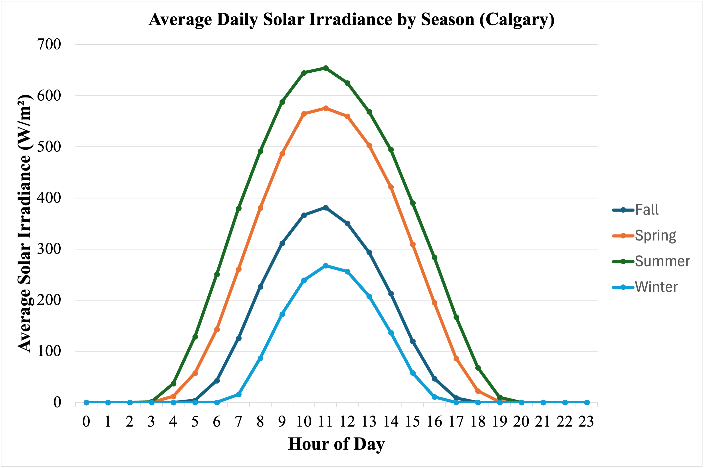
Seasonal Solar Irradiance in Calgary
Key Findings
Summer exhibits the highest solar irradiance, peaking at approximately 650 W/m² around noon (11:00–12:00 PM).
Spring has the second-highest irradiance, making it another strong season for solar power generation.
The summer curve is both taller and wider, indicating higher solar intensity and longer daylight duration, which together produce the greatest total daily solar energy.
Calgary’s solar resource is highly seasonal. Summer provides nearly four times more usable solar energy than winter.
Fig 06: Average Daily Solar Irradiance by Season (Calgary, 2024)
Recommendation from Seasonal Pattern
Battery storage (to save daytime solar energy) or grid support (to supply backup electricity) is necessary for reliable year-round solar power.
Notes:
Here, I have illustrated Calgary’s seasonal pattern. This graph shows how strong sunlight is during different seasons in Calgary throughout the day. The lines represent winter, spring, summer, and fall. We can see that summer has the tallest and widest curve. That means the sunlight is stronger and lasts longer during the day. Around noon, between 11 a.m. and 12 p.m., sunlight is the strongest, reaching about 650 watts per square meter. Spring is the second-best season for solar power, while winter has the weakest sunlight and the shortest days. Because of this, Calgary gets almost four times more usable solar energy in summer than in winter. This tells us that solar power works very well in summer, but in winter we may need battery storage to save energy or help from the power grid to make sure homes still have electricity.”

Slide 11
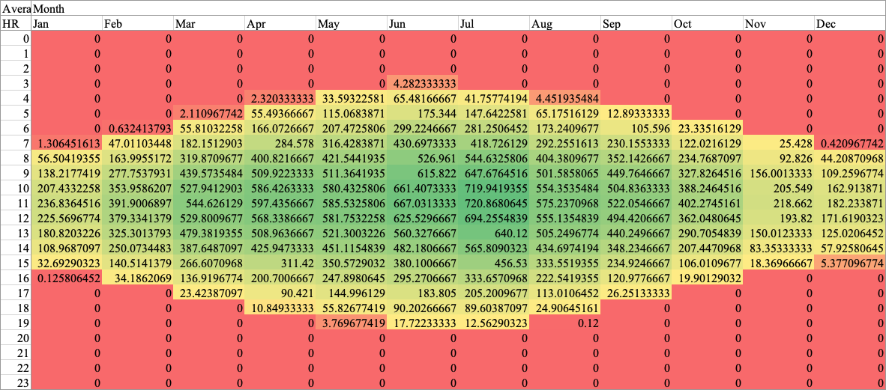
When and How Strong Is the Sun in Calgary
Solar Irradiance (W/m²) 🟥 Low 🟨 Medium 🟩 High
X-axis: Month (Jan–Dec)
Y-axis: Hour of Day (0–23)
Key Findings
Strongest sunlight: June–July (10 AM – 2 PM)
Weakest sunlight: Winter mornings & evenings
Best daily time for solar power: Midday
Best months for solar panels: April–September
Fig 07: Heat map showing how strong sunlight is by hour and month in Calgary (2024). Brighter colors mean stronger sunlight.
Why does this matter?
This helps to determine the best time of day and months to use solar panels efficiently in Calgary.
Notes:
Here I presented a heat map. This heat map shows how strong the sunlight is in Calgary during different hours and months. The brighter colors mean stronger sunlight. We can see that the strongest sunlight happens in June and July, especially around midday, from about 10 AM to 2 PM. Winter mornings and evenings have the weakest sunlight. This is important because it helps us know the best time of day and the best months to use solar panels efficiently in Calgary.

Slide 12
Cloud Analysis
Key Findings
30% of days are sunny, providing strong conditions for high solar electricity generation.
27% of days are partly sunny, offering moderate but usable solar potential.
Overall, 57% of days (sunny + partly sunny) are suitable for effective solar power generation.
Engineering Insight:
Fig 08: Percentage of Cloudy, Partly Sunny, and Sunny Days in Calgary (2024)
Days were classified as:
Cloudy: < 120 W/m²
Partly Sunny: 120–199 W/m²
Sunny: ≥200 W/m²
Although Calgary experiences a high number of cloudy days, more than half of the year offers usable solar conditions, confirming that solar power remains technically viable when combined with energy storage and grid integration.
Notes:
This slide shows how many days in Calgary are sunny, partly sunny, or cloudy. I used solar irradiance data to classify each day. If the sunlight was very strong, I would call it a sunny day. If it was medium, it would be partly sunny. If it was weak, it would be cloudy. From the pie chart, we can see that about 30% of days are sunny, about 27% are partly sunny, and about 43% are cloudy. That means more than half of the days, around 57%, still have enough sunlight for solar panels to make electricity. Even though Calgary has many cloudy days, this shows that solar power can still work well, especially when we use batteries to store energy and the power grid for backup.

Slide 13
Solar Energy Conversion
Step 1: Convert monthly average solar irradiance (W/m²) to Solar radiation, $H_{d}(\frac{kWh}{m^{2}}/day)$= $\frac{I_{avg}({W/m}^{2})x24}{1000}$
Step 2: Covert daily solar radiation to monthly solar radiation, $H_{m}=H_{d} × days in month$
Month | Monthly Average Solar Irradiance (W/m²) | Monthly Solar Radiation or Solar Energy (kWh/m²/month)
January | 49.52 | 36.84
February | 98.53 | 68.58
March | 162.33 | 120.77
April | 196.65 | 141.59
May | 213.69 | 158.99
June | 253.39 | 182.44
July | 271.68 | 202.13
August | 198.33 | 147.56
September | 160.10 | 115.27
October | 103.52 | 77.02
November | 47.67 | 34.32
December | 35.79 | 26.63
Calgary receives 1,312.14 kWh of solar energy per m² per year.
Table 03: Solar Energy by Season
Notes:
This slide shows how I changed sunlight data into solar energy. First, I started with solar irradiance, then I used a formula to convert it into solar energy, which is measured in kilowatt-hours per square meter. This tells us how much energy solar panels can actually collect. Table 3 shows how much solar energy Calgary receives each month. And then I added all the months together, I found that Calgary receives about 1,312 kilowatt-hours of solar energy per square meter each year. This shows that Calgary gets enough sunlight to support solar power, especially during spring and summer.

Slide 14


Energy Production
Solar Radiation to AC electricity for a PV system
$$E_{Annual}\left(kWh\right)=H_{annual}×P_{DC}(kW)×PR$$
Here, $P_{DC}$= System Size; PR = Performance Ratio (losses). Typical value 0.75-0.85
System Assumption
System size: 4kW (DC)
PR: 0.80 (accounts for inverter, wiring, temperature, snow, etc.)
Annual Energy from the solar resource
$$E_{annual}\left(kWh\right)=H_{annual}×P_{DC}\left(kW\right)×PR$$
Hence, $H_{annual}$= 1,312.14 kWh/year (from Table 3)
So, $E_{annual}\left(kWh\right)=4198.85 kWh$
Carbon Savings
CO₂ saved (kg/year) = $E_{Annual}(kWh)×EF$
Hence, EF= grid emission factor (kg CO₂ per kWh), for Alberta Providence EF=0.54 kg CO₂ per kWh
So, Annual CO₂ saving = 4198.85 $×$0.54 = 2267.38 kg/year = 2.5 tons/year
A 4 kW solar system can generate ~4,200 kWh/year and avoid ~2.5 tons of CO₂ annually
Notes:
This slide shows how sunlight can be turned into electricity. I assumed a 4-kilowatt home solar system and included real-world losses, like wiring, temperature, and snow. Using Calgary’s solar data, this system can make about 4,200 kilowatt- hours of electricity each year. That is enough to power many household appliances, and it can also reduce about 2.5 tons of carbon dioxide every year. So, solar panels not only make clean energy, but they also help protect our environment.”

Slide 15


Conclusion
Calgary receives enough sunlight to support solar power generation.
Solar energy is highest in summer (June–July) and lowest in winter.
More than 57% of days are sunny or partly sunny.
A 4 kW home solar system can produce about 4,200 kWh per year.
This can reduce about 2.5 tons of CO₂ each year.
Final Answer to My Research Question
Yes — solar power is a realistic, clean, and reliable energy solution for Calgary, especially from spring to fall when sunlight is strongest
Notes:
This slide shows my final conclusion. I found that Calgary gets enough sunlight for solar power, especially in summer. More than half of the days are sunny or partly sunny, and a 4-kilowatt home system can make about 4,200 kilowatt-hours of electricity each year. This can also reduce about 2.5 tons of carbon dioxide pollution. So, my final answer is yes — solar power is a clean, reliable, and realistic energy solution for Calgary, especially for spring and summer.

Slide 16
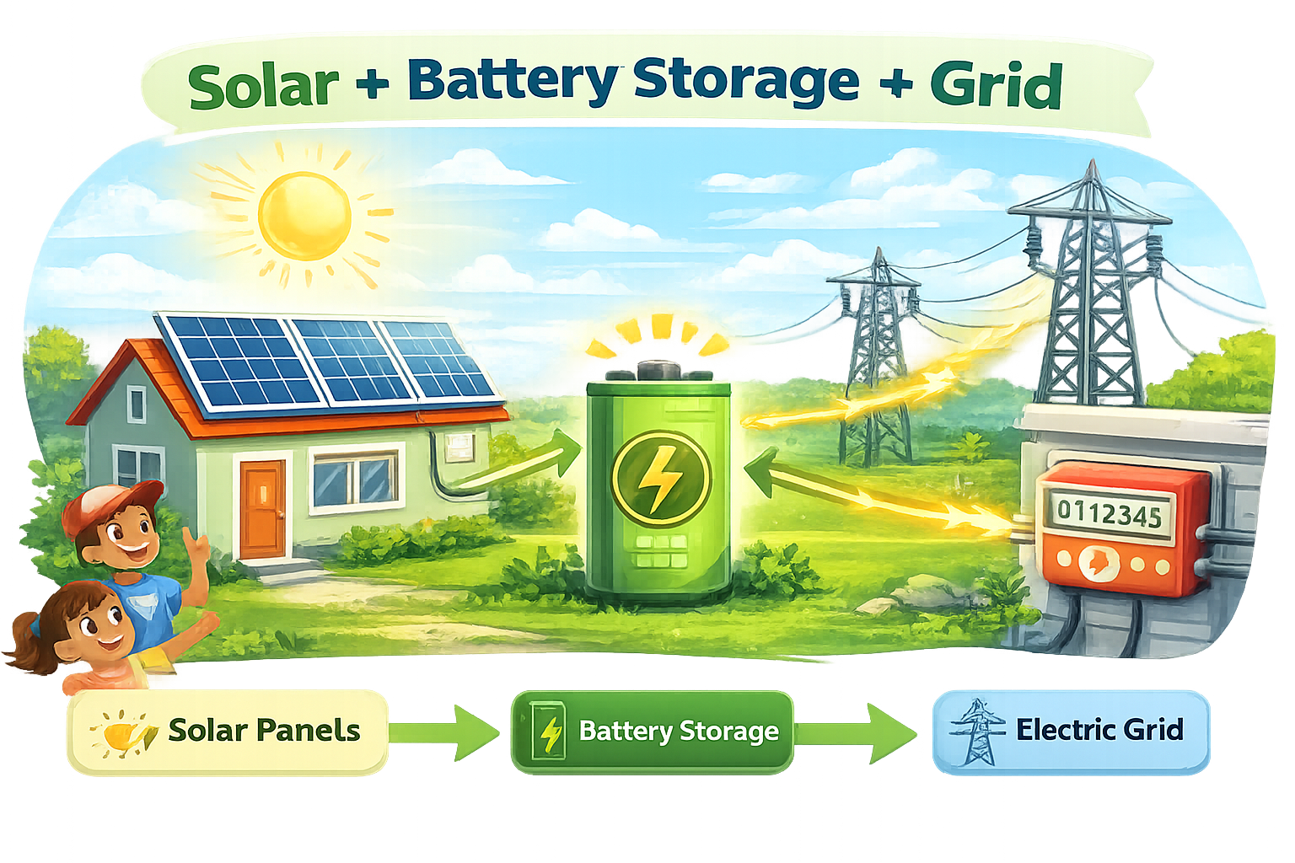

Recommendations
Install rooftop solar panels to use free sunlight.
Use battery storage to save extra summer energy.
Stay connected to the electric grid for winter backup.
Build more renewable energy projects in Calgary, Alberta.
Notes:
This slide shows my recommendations. I suggest using rooftop solar panels to collect free sunlight. Extra energy from summer can be saved using batteries, and homes should stay connected to the power grid for winter backup. I also recommend building more renewable energy projects in Calgary to reduce pollution and protect our environment. Together, solar panels, batteries, and the grid can give us clean and reliable energy.

Slide 17
References
[1] NASA Langley Research Center (LaRC) POWER Project. Surface meteorology and solar energy data for Calgary, Canada. https://power.larc.nasa.gov/
[2] Statistics Canada. Electricity generation and installed capacity by fuel type, Alberta. Government of Canada. https://www.statcan.gc.ca/
[3] Alternative Energy Tutorials. (n.d.). Solar irradiance and solar power basics. https://www.alternative-energy-tutorials.com/solar-power/solar-irradiance.html
https://www.cmisolar.ca/2024/07/18/how-solar-panels-can-help-reduce-high-electric bills/#:~:text=Offsetting%20Energy%20Use:%20Solar%20panels%20generate%20electricity,electricity%20bill%20and%20mitigating%20high%20electric%20bills.
https://www.aztechsolar.com.au/the-environmental-benefits-of-solar-energy-cleaner-air-and-water/
https://rayzonsolar.com/blog/solar-energy-reduces-air-pollution-sustainable-future#:~:text=Particulate%20matter%2C%20tiny%20particles%20suspended%20in%20the,air%20pollution%20and%20its%20associated%20health%20hazards.
https://www.sunrun.com/go-solar-center/solar-terms/definition/solar-module
https://www.hoymiles.com/solar-roi/is-solar-energy-a-nonrenewable-source.html#:~:text=How%20is%20solar%20energy%20renewable,than%20they%20will%20renew%20themselves.
https://energize-solar.co.uk/the-environmental-impact-of-solar-panels/#:~:text=The%20environmental%20impact%20of%20solar%20panels%20is%20significant%20in%20promoting,spaces%20helps%20conserve%20land%20resources.
https://everlightsolar.com/blog-solar-power-benefits/#:~:text=To%20start%2C%20solar%20is%20an,sustainability%20benefits%20of%20solar%20energy.
Notes:
Here in this slide, I have my references for my data and background research.

Slide 18
Appendix
Renewable Energy Trend
https://docs.google.com/spreadsheets/d/1OOOtXWa-lbEyuwhmcTf3FoFWV9SXIk8h/edit?usp=drive_link&ouid=115957587452182875144&rtpof=true&sd=true
Solar Irradience
https://docs.google.com/spreadsheets/d/1edhmrs8bvCrA9_BSTMfujxm_iJcLwuDK/edit?usp=drive_link&ouid=115957587452182875144&rtpof=true&sd=true

Slide 19

References
Notes:
Anyway, thank you for taking your time to listen and I hope you enjoyed my presentations. Thanks again.

