Slide 1
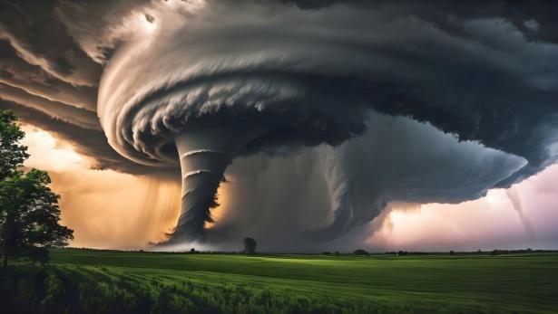
Exploring Tornadoes - Can they be stopped?
By : Shaurya Pandey

Slide 2
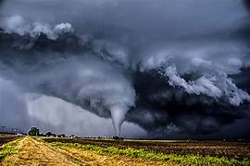
What are Tornadoes ?
Tornadoes are one of many types of severe storms. They are classified by a funnel-shaped cloud descending toward the earth. A tornado's life cycle typically consists of three stages. It starts when a funnel-shaped projection – called a tuba – develops beneath a rotating section of a thunderstorm. The tuba elongates downward from the cloud and is enveloped by a rotating sleeve – called the annulus – that develops upward from the ground. The full merging of the two creates a mature tornado vortex. This stage is followed by the third or degenerating phase, when the tuba rises back towards the cloud base and disappears. Cases where the tuba alone develops are called "funnels aloft" and are not tornadoes. The rotation of tornadoes is almost always cyclonic (clockwise in the northern hemisphere, counter-clockwise in the southern hemisphere, when the circling clouds are viewed from below).

Slide 3
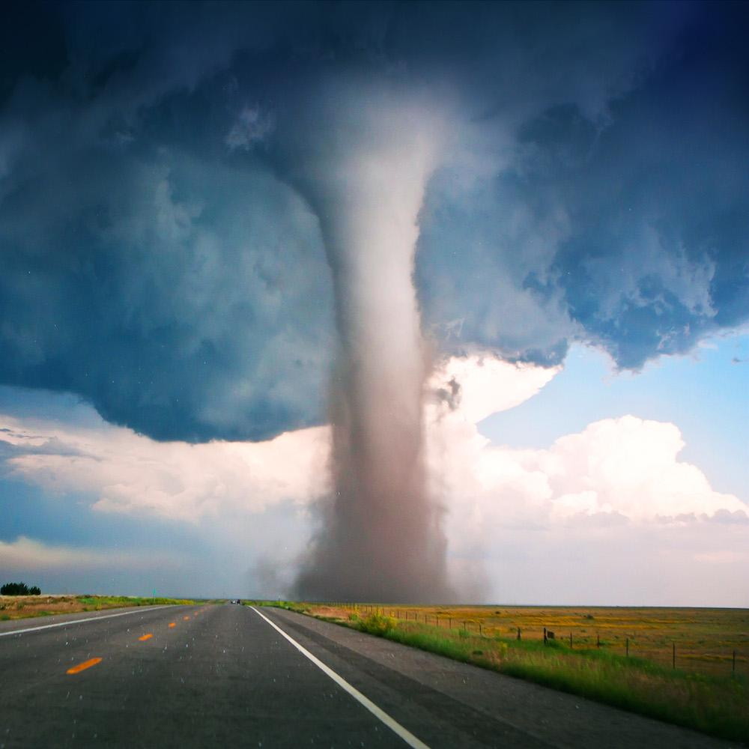
Definition Of Tornado
A tornado is a rotating column of air that extends from a thunderstorm cloud to the ground, characterized by high wind speeds and destructive power. Tornadoes form within thunderstorms, developing from cumulonimbus clouds. Wind speeds in tornadoes reach up to 300 mph (480 km/h), causing destruction. Funnel clouds extend from the thunderstorm base to the ground, though rare invisible tornadoes exist. Meteorologists classify tornadoes on the Enhanced Fujita scale, rating intensity from EF0 to EF5 based on potential damage being caused.

Slide 4
What Causes A Tornado To Occur ?
A tornado occurs when atmospheric conditions combine to produce rotating air columns that touch the ground, involving warm moist air, cooler dry air, and wind shear. Thunderstorms produce tornadoes when specific atmospheric conditions align. Warm moist air rises, creating low-pressure areas near the ground. Wind shear causes rotating updrafts called mesocyclones to form within developing storms. Large temperature and humidity gradients create areas with tornado potential in the central United States during springtime. Atmospheric instability and wind shear support the development of tornadoes. Air temperature and moisture dynamics play a role in tornado formation. Warm air rises and creates low-pressure areas near the ground. Cool air falls and creates high-pressure areas near the ground. Warm moist air collides with cold dry air to create instability and a dry line boundary. Thunderstorm development follows these atmospheric conditions. Atmospheric instability occurs when temperature differences cause air to become unstable.

Slide 5
What Causes A Tornado To Occur ? ( Continued)
Air temperature and moisture dynamics play a role in tornado formation. Warm air rises and creates low-pressure areas near the ground. Cool air falls and creates high-pressure areas near the ground. Warm moist air collides with cold dry air to create instability and a dry line boundary. Thunderstorm development follows these atmospheric conditions. Atmospheric instability occurs when temperature differences cause air to become unstable. Thunderstorms form as warm air rises, expands, and cools. Rotating thunderstorms develop as wind speed and direction change with height.
Wind patterns and vortex formation are essential components of tornado genesis. Wind shear exists when wind speed changes from 20-40 knots (23-46 mph) in the lowest 1 km (0.62 miles) of atmosphere. Wind direction changes contribute to the formation of a rotating updraft called a mesocyclone within the thunderstorm. Updraft creates inflow as air flows into the tornado base at speeds of 10-20 m/s (22.4-44.7 mph). Vortex swells as the mesocyclone touches the ground and interacts with surrounding air. Funnel cloud forms as a sign of the rotating air column extending from the thunderstorm base to the ground. Tornadoes occur when all these conditions combine, in regions like Tornado Alley. Tornado formation risk increases when atmospheric instability reaches a lifted index of -2 to -6 and downdraft speeds reach 5-10 m/s ( 16.4-32.8 ft/s.

Slide 6
Largest Tornado Recorded In History
The most "extreme" tornado in recorded history was the Tri-State tornado, which spread through parts of Missouri, Illinois, and Indiana on March 18, 1925. It is considered an F5 on the Fujita Scale, holds records for longest path length at 219 miles (352 km) and longest duration at about 3⁄ hours.

Slide 7
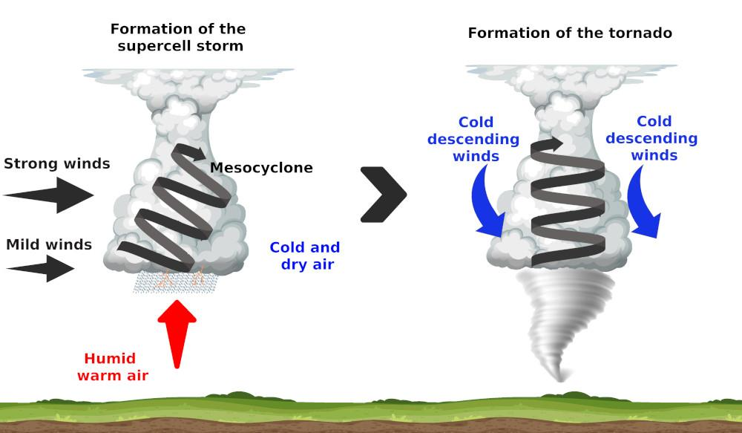
How Tornadoes Form
Two stellar cells meet and join together to create a supercell, the supercell brings hail, thunder, lightning , and winds that reach up to 220 mph, These winds start swirling in a clockwise direction creating a funnel of wind called a cyclone because of the low pressure. Then, the cyclone starts shaping it self into a cone shaped funnel of wind which has a pointy sharp tip that increases the velocity 330 mph, the cyclone then expands touching the surface of the land creating a tornado.

Slide 8
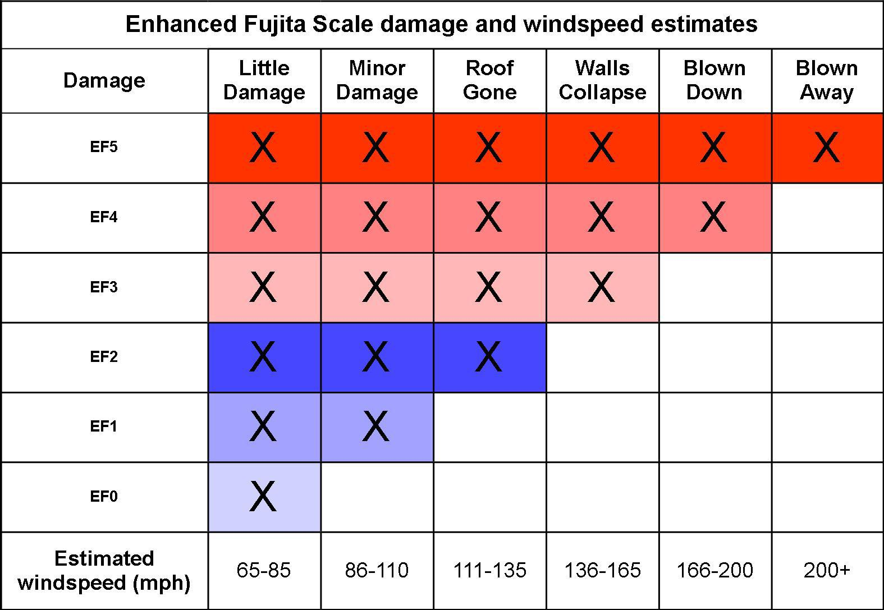
What Is A Way Of Measuring Tornadoes Today ?
Tornadoes range in intensity from very weak (winds from 64 km/h) to devastating (winds up to 509 km/h), on a scale of 0–5 devised by Japanese-American meteorologist T. T. Fujita. More than 90 per cent of Canadian tornadoes can be categorized as weak, or EF0 to EF1 on the Enhanced Fujita scale. Tornadoes ranked EF0 are called light and are characterized by winds of 64–116 km/h. They can cause damage to roofs and trees. Those ranked EF1 are classified as moderate, with winds of 117–180 km/h, and can cause damage such as overturned cars and uprooted trees.

Slide 9
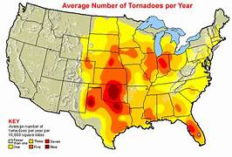
Where Do Tornadoes Usually Occur In Canada
Tornadoes have been recorded in every province and territory in Canada. However, tornadoes occur most frequently in two areas - from southern Alberta across southern Saskatchewan and southern Manitoba to northwestern Ontario, and from southern Ontario across southern Quebec to New Brunswick.

Slide 10
What Temperature Does A Tornado Form At ?
Tornadoes form at temperatures ranging between 60°F (15°C) and 80°F (27°C), with conditions occurring between 65°F (18°C) and 75°F (24°C), according to tornado researcher Dr. Harold Brooks. Dr. Harold Brooks indicates dew points for tornado formation are in the 50s to 60s Fahrenheit (10°C to 15°C). Temperature ranges for tornado formation vary depending on location and time of year. Tornadoes occur at temperatures outside the common range.
Tornadoes form at temperatures between 65°F (18°C) and 84°F (29°C). Warm air within this range rises, creating the necessary instability for tornado development. The minimum typical temperature for tornado formation is 50°F (10°C). 50°F (10°C) is required for thunderstorm development, which is a precursor to tornadoes.
Tornadoes occur in cool temperature conditions in some cases. Some instances of tornadoes have been reported at temperatures as low as 32°F (0°C), though these events are uncommon. Tornadoes form in warm conditions with temperatures high 90°F (32°C) in tropical or subtropical regions. Tornadoes occur in weather with temperatures as low as 40°F (4°C), associated with strong cold fronts or weather patterns.

Slide 11
Can Tornadoes Form hurricanes?
Tornadoes form from hurricanes, occurring in the outer rainbands and spawning when hurricanes make landfall due to the interaction between hurricane winds and land friction. Hurricanes produce thunderstorms capable of spawning tornadoes. Tornadoes form in the outer rainbands of hurricanes where wind speeds are highest. The National Hurricane Center documented that 22% of all U.S. tornadoes from 1995-2010 originated from tropical cyclones. Hurricane-spawned tornadoes have wind speeds ranging from 65-135 mph (105-217 km/h). The Gulf Coast and Southeastern United States face the highest risk of hurricane-induced tornadoes, especially during the 12-24 hours after landfall.

Slide 12
How Are Tornadoes Predicted ? ( Continued)
-Visual and ground-level observations complement technological methods. Storm spotters identify thunderstorm structures indicative of potential tornado formation. Forecasters recognize cues that signal imminent tornado development. Witness accounts confirm tornado sightings and provide on-the-ground information during severe weather events.
-Forecasting organizations coordinate efforts to predict and warn of tornado activity. The Storm Prediction Center issues nationwide forecasts for severe thunderstorm and tornado risks. Weather offices predict tornado risks for areas, alerting county regions when conditions are favorable. Post-event analysis contributes to prediction improvements. The Fujita scale assesses tornado damage and estimates wind speeds based on observed destruction patterns. Analysis of tornado observations helps identify patterns and trends, enhancing forecasting capabilities.

Slide 13
How Are Tornadoes Predicted ?
-Tornadoes are predicted by forecasters analyzing atmospheric patterns, using radar to detect rotating signatures, and recognizing cues like wall clouds within thunderstorm structures. Forecasters analyze wind shear, instability, and moisture patterns to determine tornado likelihood. Doppler radar detects rotating updraft signatures called mesocyclones within thunderstorms, extending from storm bases to miles high. Spotters recognize tornado cues like rotating wall clouds and funnel clouds. Computer models like the Weather Research and Forecasting (WRF) model simulate atmospheric behavior and predict thunderstorm and tornado development. Tornado prediction accuracy and lead time have increased due to radar technology improvements, computer modeling advancements, and observation network expansions.
-Prediction techniques enhance tornado forecasting accuracy. Meteorologists analyze vertical wind shear and wind structures to assess tornado potential. High CAPE (Convective Available Potential Energy) values indicate increased thunderstorm energy and tornado risk. Forecasters identify regions for tornado formation by combining multiple data sources. Severe thunderstorms are monitored, with particular attention to wind shear.
Technological tools play a crucial role in tornado prediction. Doppler radar detects rotating signatures within storms, providing location and speed data. Computer models forecast conditions conducive to tornado development using numerical simulations and machine learning algorithms. Satellite data analysis reveals cloud temperatures and wind patterns associated with severe weather. Lightning mapping studies and prediction techniques offer promising avenues for forecasting.

Slide 14
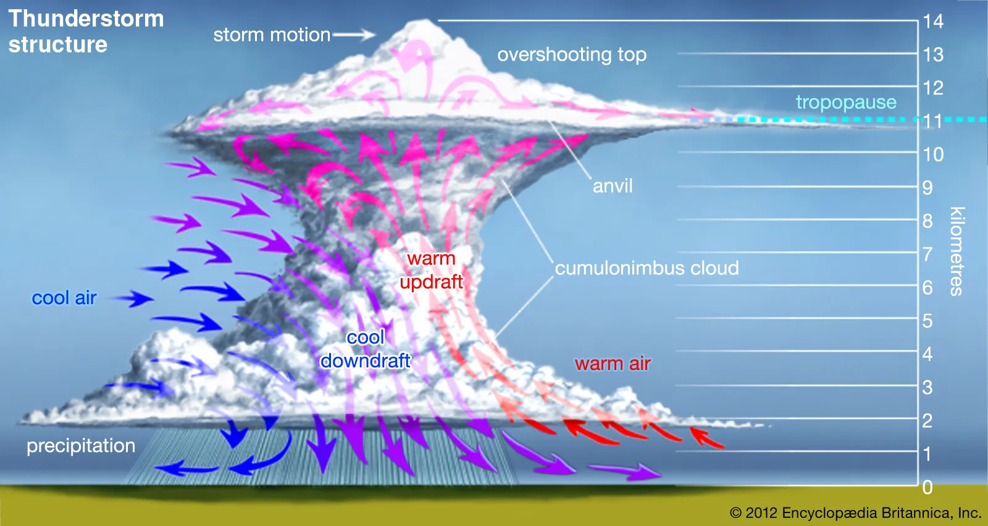
What Clouds Form Tornadoes ?
Cumulonimbus clouds form tornadoes, which are rotating columns of air extending from thunderstorm bases to the ground. Cumulonimbus clouds are large, dense structures reaching heights over 10,000 meters (33,000 feet). Thunderstorms are associated with these massive cloud formations. Supercells, characterized by rotating updrafts, are a type of cumulonimbus cloud. Rotating updrafts within supercells create funnel clouds, which are rotating columns of air. Funnel clouds touching the ground transform into tornadoes, completing the formation process.
Cumulus clouds precede tornado formation. These clouds develop into towering cumulonimbus clouds under the right atmospheric conditions. Cumulonimbus clouds reach heights over 10,000 meters (32,808.4 feet) and generate thunderstorms. Thunderstorms create the necessary environment for tornado development. Updrafts and wind shear within thunderstorms produce rotating clouds.
Wall clouds form at the base of rotating thunderstorms. These low-hanging clouds appear 0.62-1.86 miles (1-3 kilometers) above the ground. Supercells are conducive to wall cloud formation. Intense rotating updrafts called mesocyclones characterize supercells. Mesocyclones extend several kilometers into the sky and create the conditions for funnel cloud production.
Funnel clouds descend from wall clouds when atmospheric conditions are favorable. Rotating columns of air become visible as funnel clouds extend downward. Funnel clouds touching the ground transform into tornadoes. Ground contact initiates the rotation associated with tornadoes. Tornadoes can reach wind speeds up to 320 kilometers per hour (199.5 miles per hour) and diameters of 1.6 kilometers (0.99 miles.

Slide 15
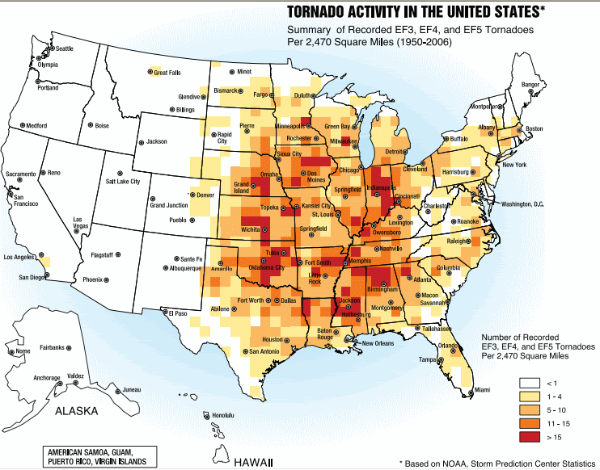
What is a tornado alley?
Tornado Alley is a nickname for the central United States area that experiences a high frequency of tornadoes due to its geography and climate. Tornado Alley encompasses states including Texas, Oklahoma, Kansas, Nebraska, and South Dakota. The region experiences over 50 tornadoes per year in some areas. Meteorologist Dan Kottlowski defines Tornado Alley as an area covering a portion of the Great Plains. The term “Tornado Alley” was coined in the 1950s to describe the region’s high tornado frequency. Weather conditions, including warm, moist air from the Gulf of Mexico colliding with cool, dry air from Canada, create an environment for tornado formation.

Slide 16
Ways To Stop Tornadoes
- Liquid Nitrogen
-Use tornadoes to power winds in opposite direction
- Superabsorbent polymers
- Solar Panels on Satellites
- Nuclear Bomb

Slide 17
Liquid Nitrogen
- Liquid Nitrogen is one of the resource we can use to stop a tornado because all storms are just electrical charges in the electrical field and liquid nitrogen takes away that electrical charge ,so if we figure out a way to get the liquid nitrogen into the eye of the storm then we will be able to stop the tornado.
-Using liquid nitrogen to stop tornadoes is another idea to stop tornadoes because it distorts the tornadoes because all storms are electrical charges in the electrical fields and liquid nitrogen distorts the electrical charge eventually distorting the tornado.This idea will not work because we don’t have the resources and technology to get the liquid nitrogen into the tornado and if we could we still wouldn't have enough liquid nitrogen to actually stop a tornado.

Slide 18
Use Cyclone to power winds in opposite directions
-Another way is using the energy from the from the tornado to create another tornado that is moving in the counterclockwise direction eventually using up all the tornado’s energy getting rid of the storm. The tornado that was spinning in the counterclockwise direction will stop the moment the other tornado stops because it is using the other tornado’s power, but in the time that we are making the system it can be destroyed by a storm before it is done getting built.

Slide 19
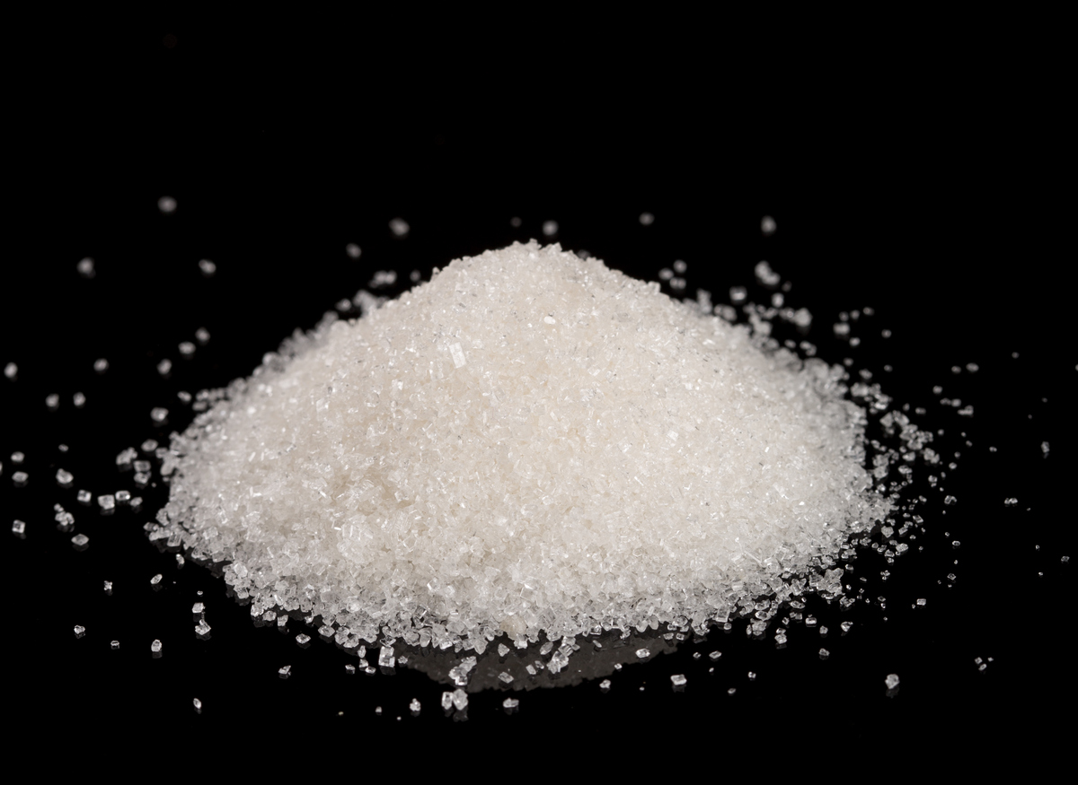
Superabsorbent Polymers
Superabsorbent polymers are materials that can absorb extremely large amounts of a moisture that are 30-60x their own size. We can build walls around areas that tornadoes usually occur and add superabsorbent materials that can suck the moistness out of the tornado stopping it because tornadoes are are made out of a lot of moisture and without it the tornado would be nothing. This idea would not work because when the tornado forms it will immediately destroy the wall because the wall is in in its range the wall and the superabsorbent materials will be destroyed causing no harm to the tornado and the wall will take a long time to make also costing millions of dollars making the government in a seriously bad condition.

Slide 20
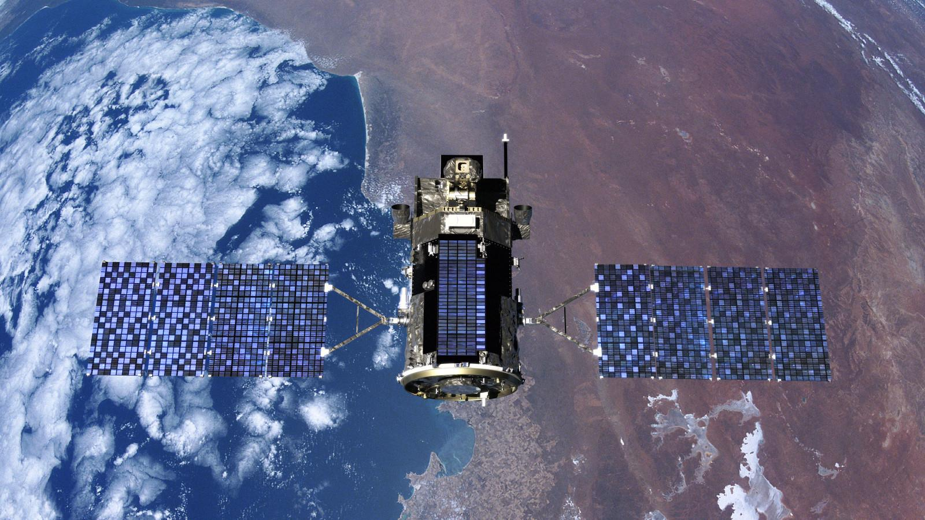
Solar Panels on Satellites
We can use satellites as a way to stop tornadoes by adding solar panels on a satellites which, convert the sun's heat and radiation to generate microwaves that can be shot into specific areas that tornadoes are forming in. Those microwaves now heat up the cold air that combines with the warm air that makes the tornado stop forming or can start to make the tornado get weaker and smaller eventually stopping the tornado, but it also would cost billions of dollars to create the satellite.

Slide 21
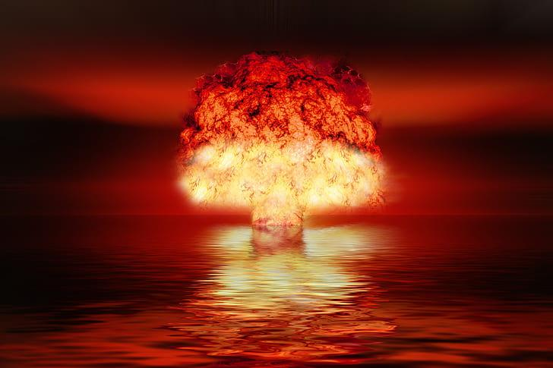
Nuclear Bomb
The idea dropping nuclear bombs into tornadoes was created in the 1880s the theory is that the explosive reaction of the nuclear bomb will distort the tornado. This theory is incorrect because after the bomb explodes inside the tornado the tornado just reforms and after the bomb explodes it gives off radiation that pollutes the land and gives the animals and humans radiation poisoning.

Slide 22
Why Using Satellites Will Not Work
This idea of shooting microwaves from a satellite will not work because when entering the atmosphere those microwaves releases radiation which harms the environment and gives animals and humans radiation poisoning. The microwaves also harm the land not letting specific kinds of vegetation from growing which results in harming the whole environment. The microwaves also enhances climate change and the climate changes effects create even more tornadoes resulting in even more destruction than before using the satellite. Therefore using these microwaves actually increase the amount of tornadoes.

Slide 23
Conclusion
Using all the information provided in the slides the conclusion is : Therefore the conclusion is that in our time and with our technology and resources we will not be able to stop tornadoes, but in the future with advanced technology we might be able to create potential ways to stop tornadoes .

Slide 24
Acknowledgements/ Sources
Pictures: Google Information:https://www.theweathernetwork.com/en/news/weather/forecasts/july-is-canada's-most-active-tornado-month-what-can-we-expect done
https://www.thecanadianencyclopedia.ca/en/article/tornado, done
https://en.wikipedia.org/wiki/Fujita_scale, done
https://en.wikipedia.org/wiki/Tornado_records done
https://kids.nationalgeographic.com/science/article/tornado done
Information:https://science.howstuffworks.com/nature/climate-weather/storms/tornado-alley.htm done
https://www.britannica.com/science/tornado done
https://www.smithsonianmag.com/science-nature/ten-amazing-facts-about-tornadoes-explained-180984051/ done
https://www.natgeokids.com/uk/discover/geography/physical-geography/tornado-facts/

Slide 25
Acknowledgements/ Sources ( Continued )
https://pubmed.ncbi.nlm.nih.gov/34395377/#:~:text=Superabsorbent%20polymer%20%28SAP%29%20is%20a%20kind%20of%20functional,especially%20in%20the%20areas%20of%20hygiene%20and%20agriculture.
https://pmc.ncbi.nlm.nih.gov/articles/PMC6918447/
https://gelok.com/super-absorbent-polymer-overview/
https://www.sciencing.com/type-clouds-make-tornadoes-5159/

